Slide 1
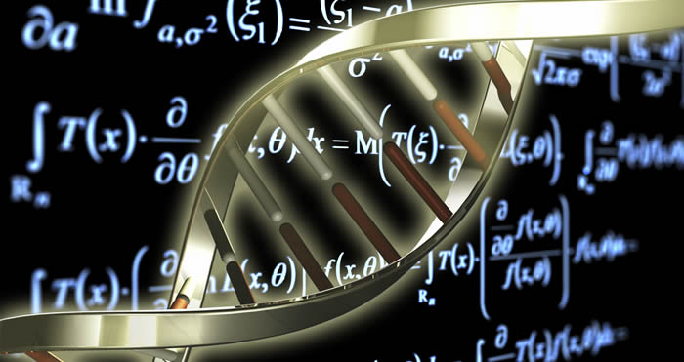
När biologi möter matematik
Marija Cvijovic
cvijoviclab.org
@CvijovicLab

Slide 2
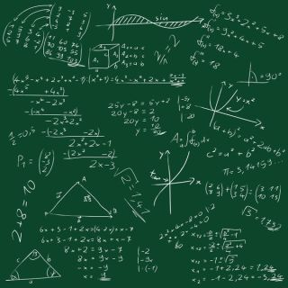
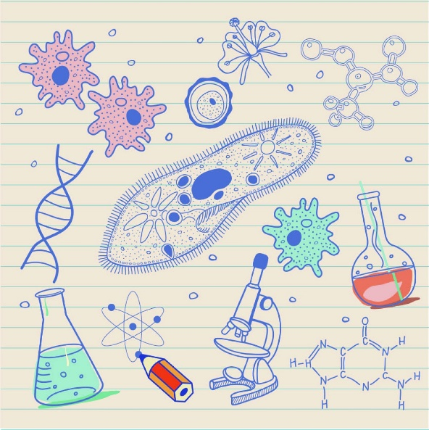
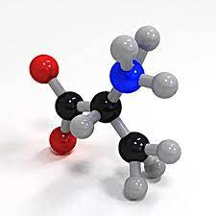
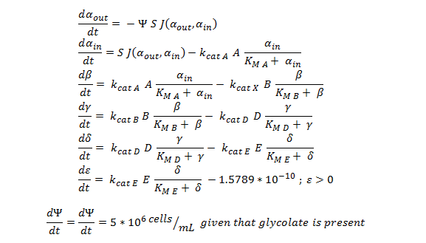
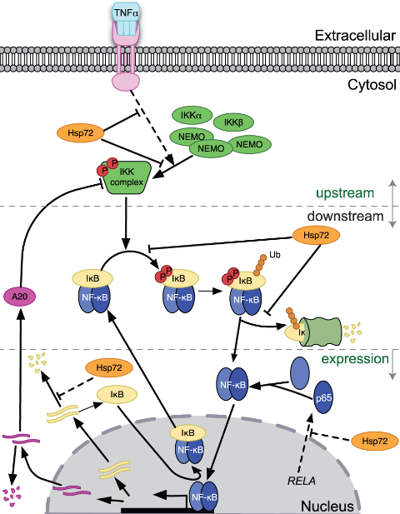
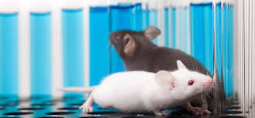
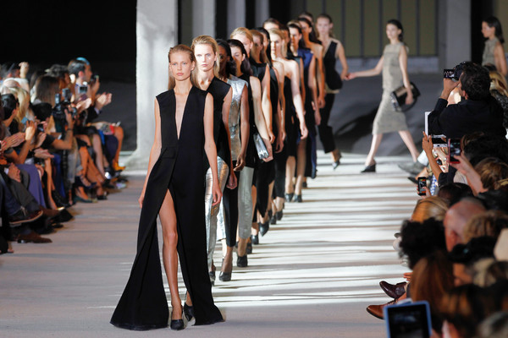
Vad tänker du?
Om jag säger matematik…..
Om jag säger biologi…..
Om jag säger modell…..

Slide 3

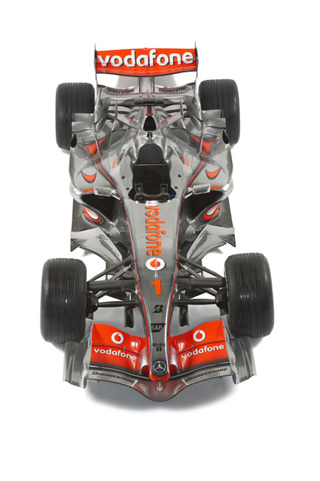
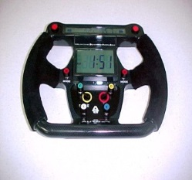
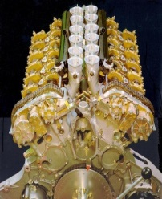
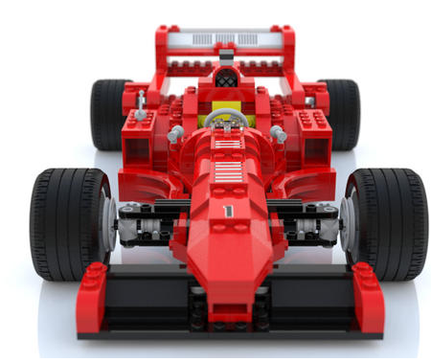

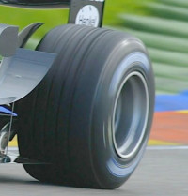
Vad är beräkningsbiologi?
Värkliga system
Komponenter
Modell
Simulering

Slide 4
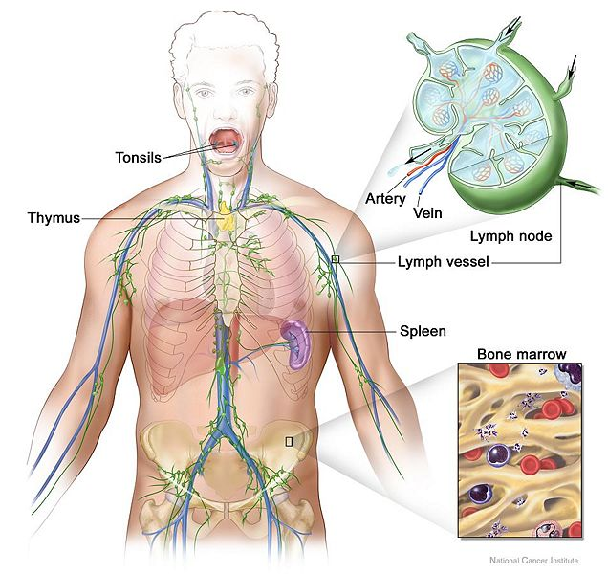
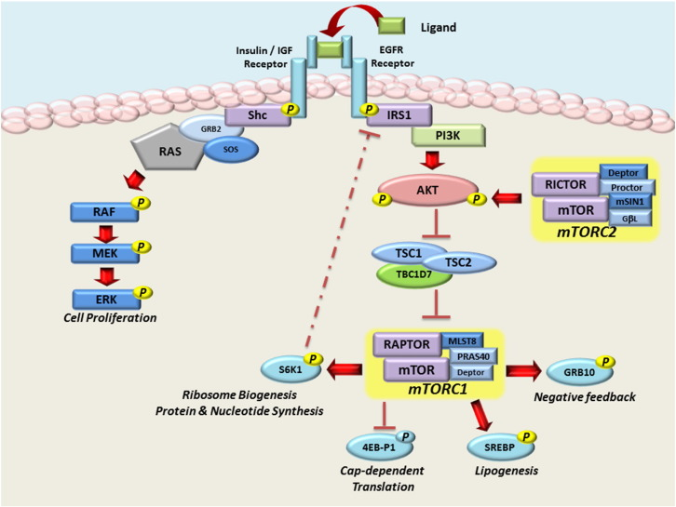
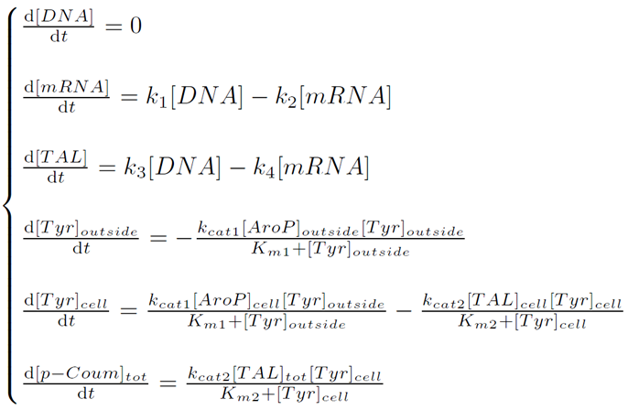
Vad är beräkningsbiologi?
Värkliga system
Komponenter
Modell
Simulering
Images taken from: http://creationwiki.org/Lymphatic_system

Slide 5
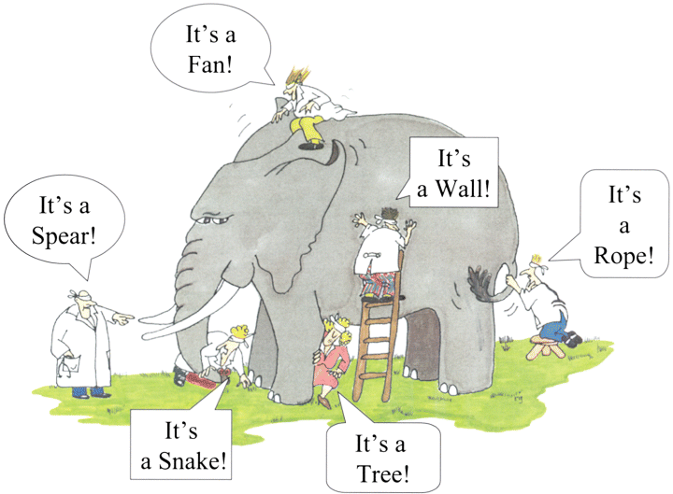
Grundtanken
“Helheten är större än summan av delarna.”
Aristotel
www.foodinfo.org.nz
Att analysera hela det biologiska systemet
Att tänka (och beräkna) vilka komponenter och interaktioner som är viktiga i ett komplext system
Att upptäcka nya strategier

Slide 6
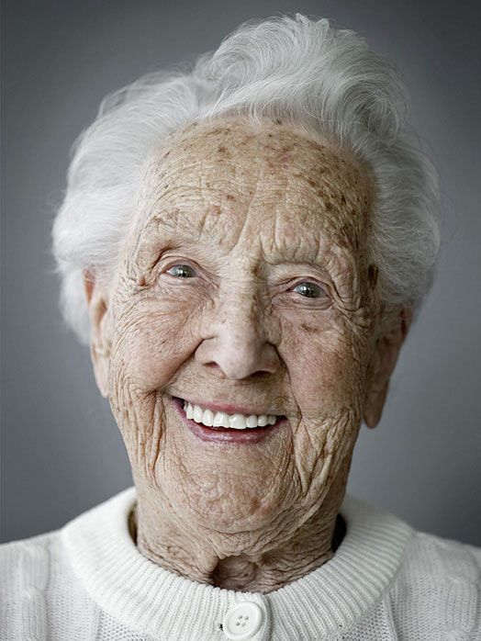

ÅLDRANDE

Slide 7
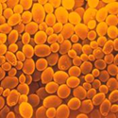
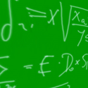
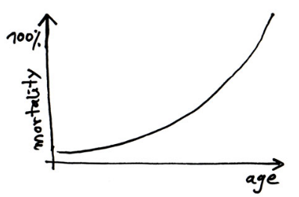
Du vet att du bli gammal när tårtljusen kostar mer än tårtan. Bob Hope
Vad är åldrande?
Biologer:
Processen att bli äldre; Åldrandet är helt enkelt åldern - tidsberoende förändringar som sker till biologiska enheter.
Matematiker:
Sannolikheten för döden av individer inom en population ökar exponentiellt med åldern.

Slide 8
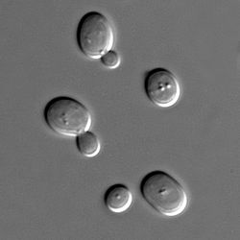
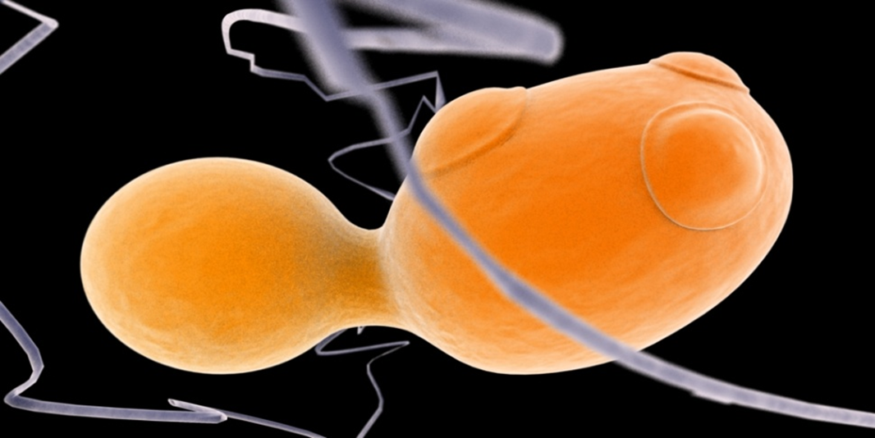

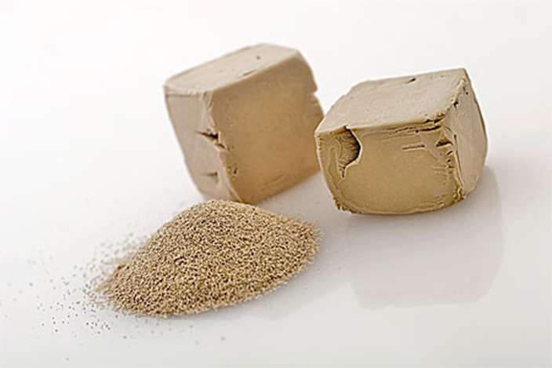
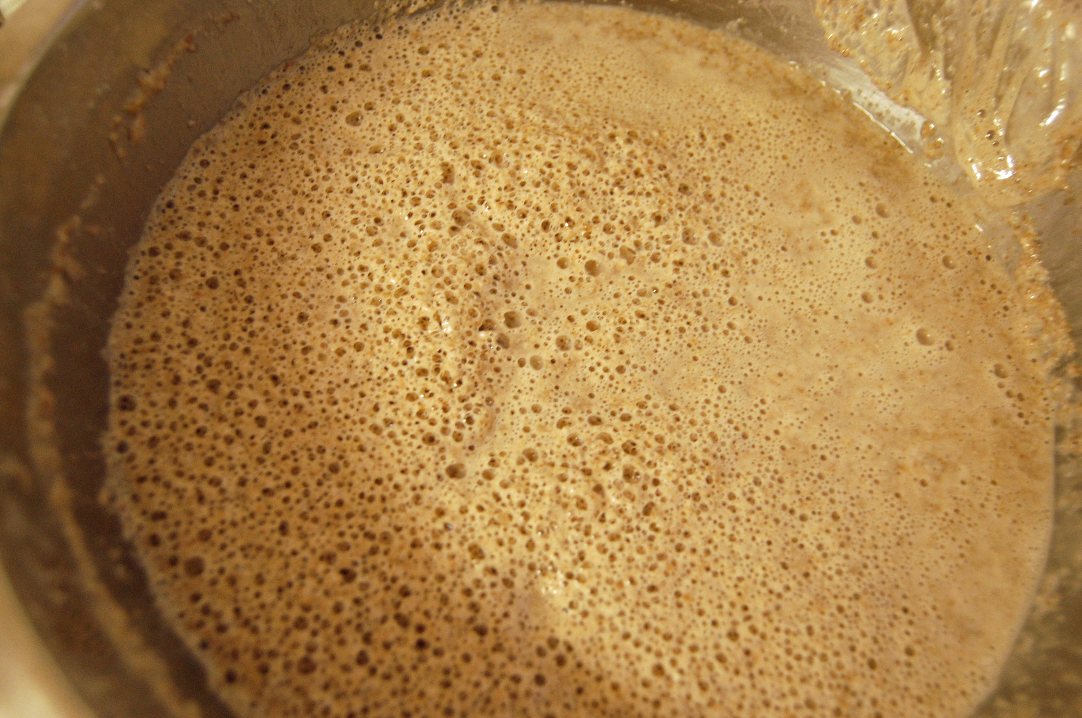

Slide 9


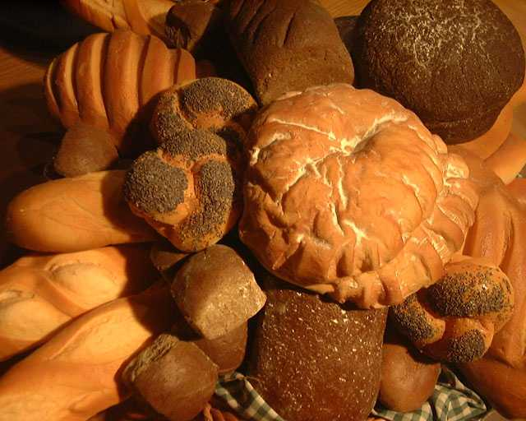

Jäst: the Almighty
(a.k.a. knoppjäst, bryggjäst, Saccharomyces cerevisiae)
Saccharomyces cerevisiae är den vanligaste arten av jästsvamp och har använts sedan urminnes tider, både till bakning och bryggning. Den är encellig, äggformad och 5-10 mikrometer lång. Den förökar sig genom knoppning.
moder
knopp
dotter

Slide 10
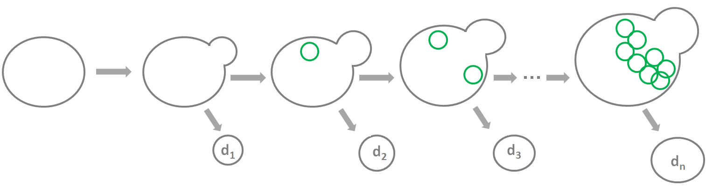

Åldrande teori: ackumuleringen av skadat material
Skadade proteiner ackumuleras med åldern
Födelseärr (knopp)
Bra (intakta) proteiner
Dåliga (skadade) proteiner

Slide 11
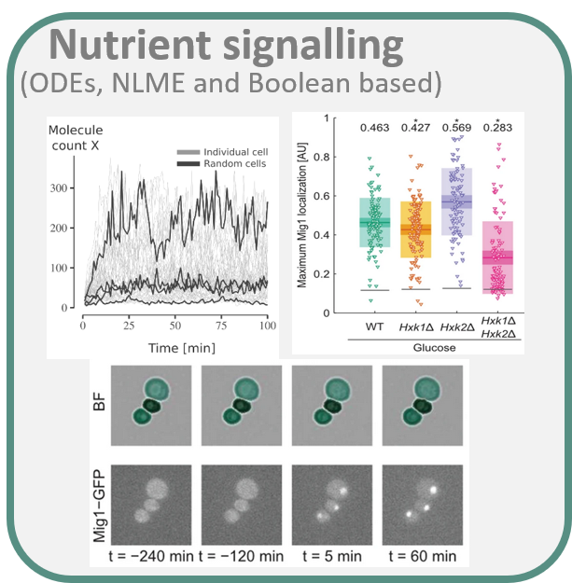
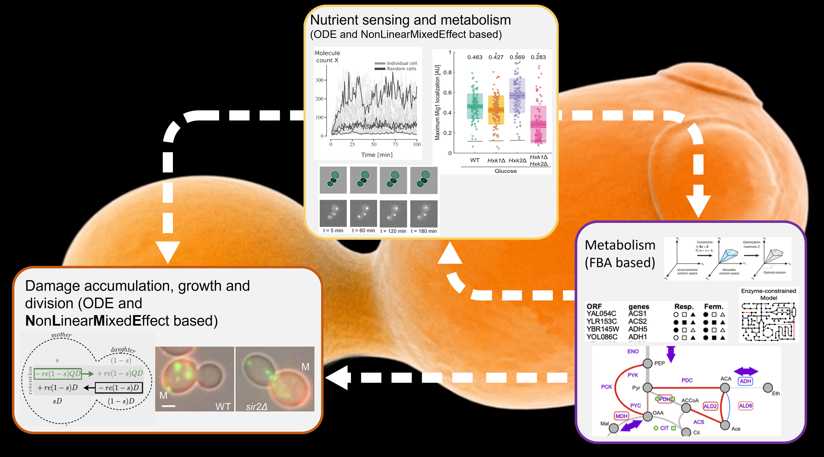
Hur och varför åldras vi?
Microfluidics + optical tweezers + yeast genetics + math

Slide 12
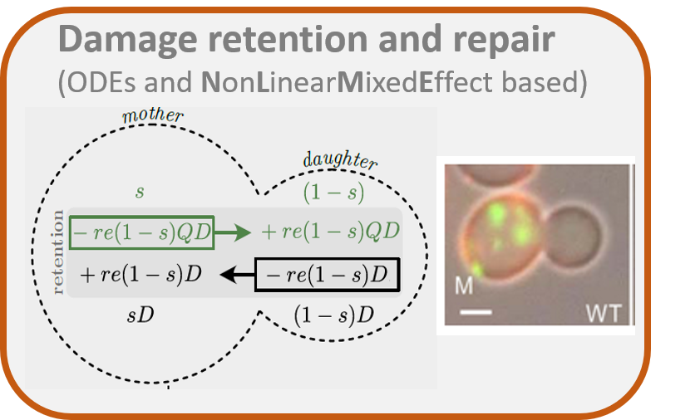
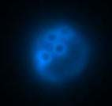
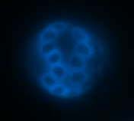
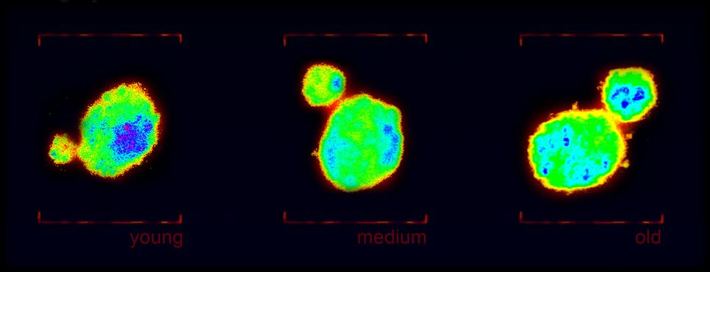
Åldrande drivs av skador
Notes:
the aggregate stoichiometries S generally increase and the diffusion coefficients D decrease when exposed to stress
Tsa1 is a hydrogen peroxide scavenger, that recruits heat shock proteins which together act as chaperones to aid the clearance of damaged proteins and protein aggregates. Tsa1 overexpression leads to fewer but larger and slower aggregates in oxidative stress

Slide 13
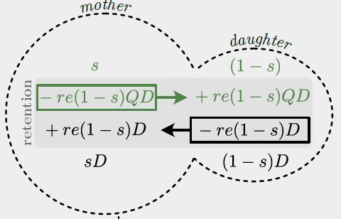
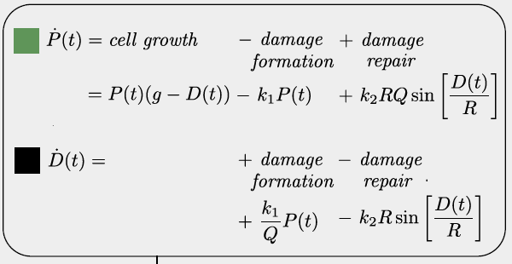
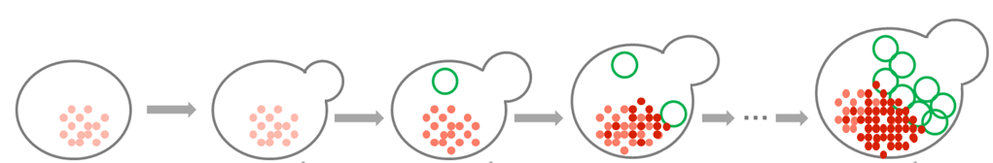
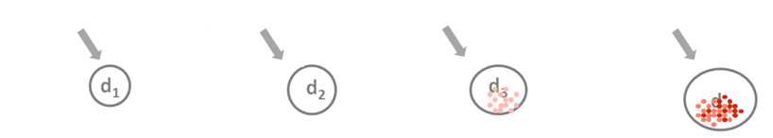
Från encellig till en hel populationsmodell av skadeackumulering

Slide 14
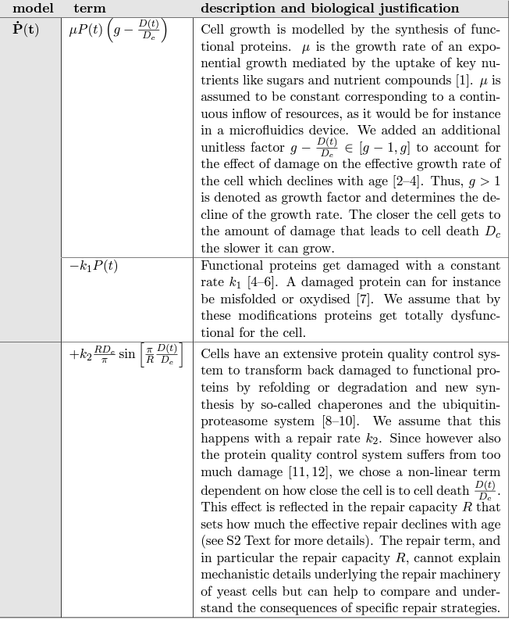
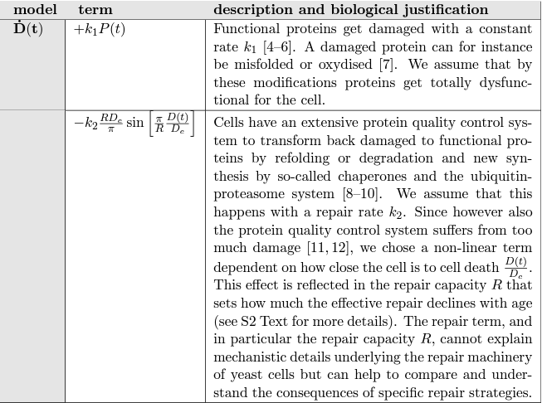

Slide 15
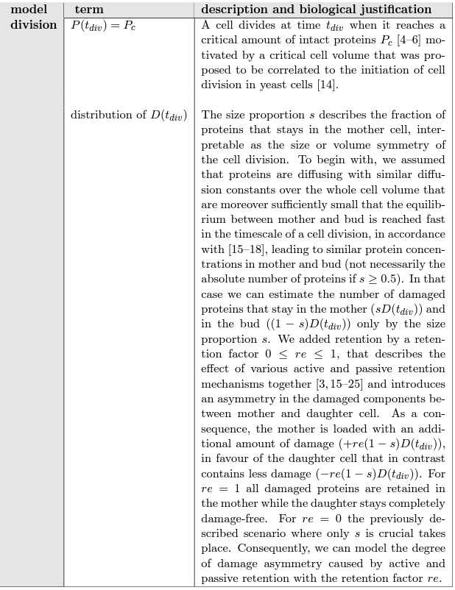
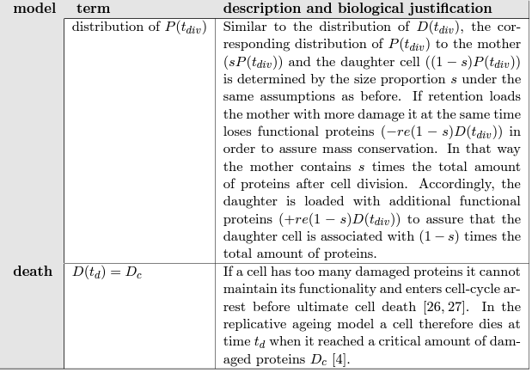
Två diskreta händelser: celldelning och celldöd

Slide 16
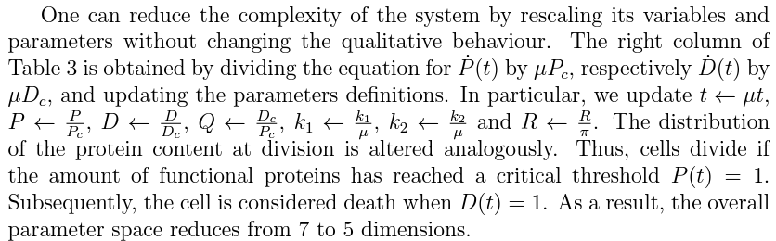
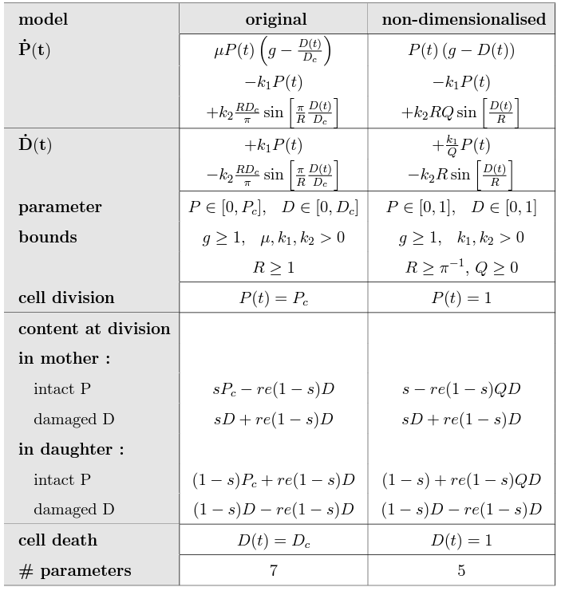
Non-dimensionalisation

Slide 17
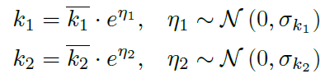
Från encellig till en hel populationsmodell av skadeackumulering
Individuality of cells in the population by introducing non-linear mixed effects
The individuality is reflected in the cell growth, damage formation k₁ and damage repair k₂
Fixed effects
constant for each population
Mixed effects
Vary between individuals within each population

Slide 18
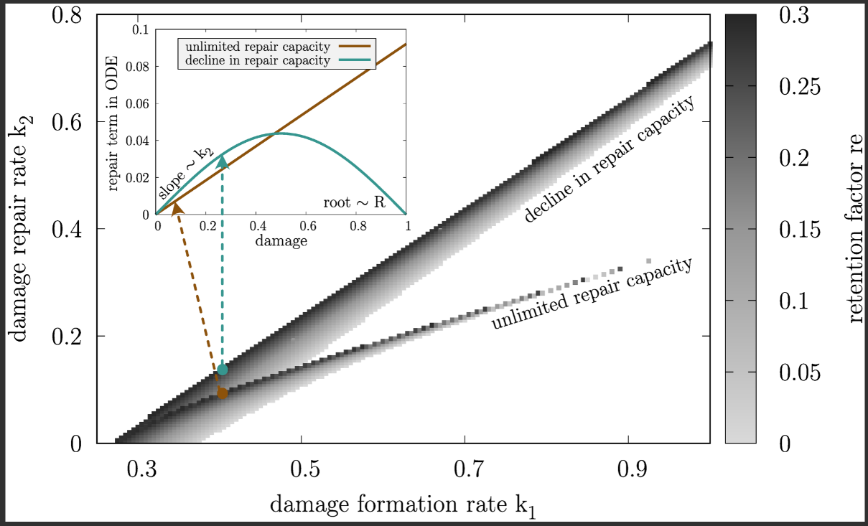
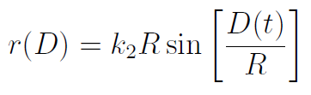
Discretised parameter combinations of damage formation rate (k₁), damage repair rate (k₂) and retention rate (re) leading to a constant replicative lifespan of 24 of initially damage-free cells for two distinct cases of repair capacity (R): unlimited repair capacity (R → ∞) and decline in repair capacity (R = π⁻¹). The parameter space is divided into a grid with Δk₁ = Δk₂ = 0.005 and re is adapted accordingly. The sub-panel shows exemplary repair terms r(D) for constant k₁ = 0.4, re = 0.2957 and k₂ = 0.092 for unlimited repair capacity and k₂ = 0.138 for decline in repair capacity.

Slide 19
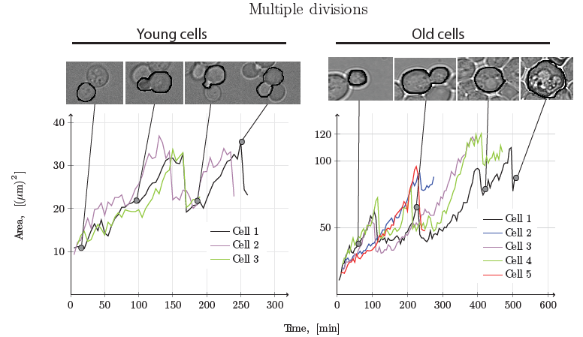
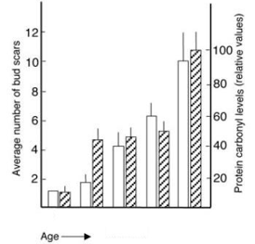
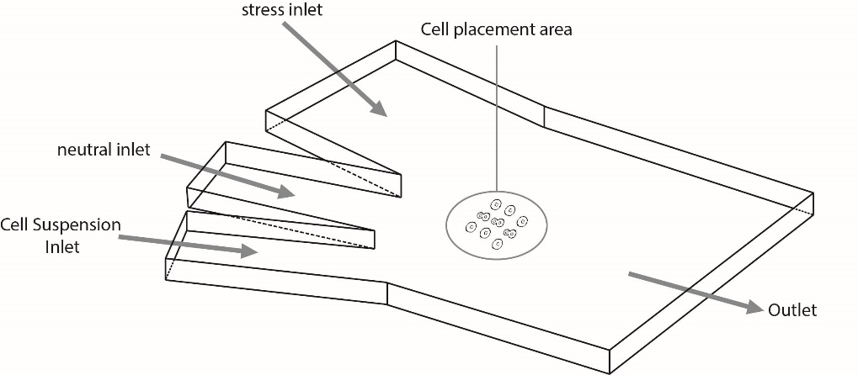
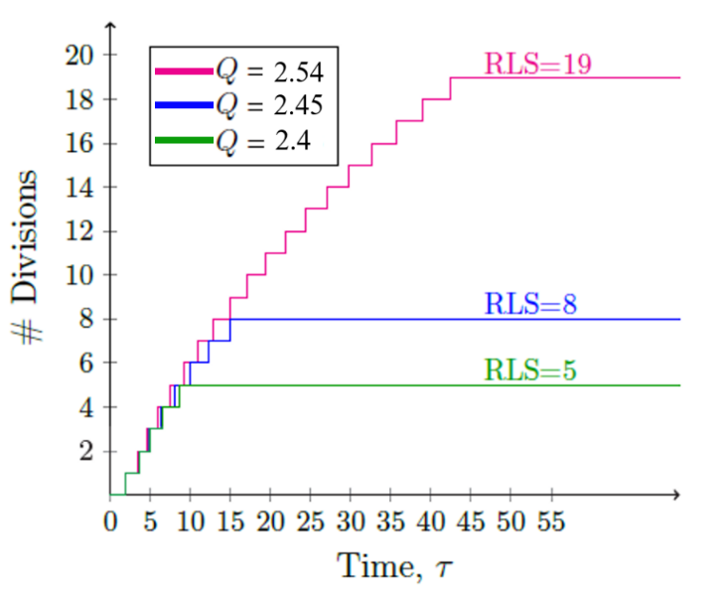


Replicative lifespan: Number of divisions before cell death.
Measure of age of a single yeast cell.
Experimentell data och modeller
Cell size (s): Yeast divides asymmetrically where mother is approx. 3
times larger than its daughter
Damage retention (re): active mechanism; age-related damage retained
within the mother cell at each division
Resilience to damage (Q): Capacity of the cell to cope with damage

Slide 20


Interplay between Retention, Resilience, Damage and Celle size
Assumption:
Minimal amount of intact proteins that a cell is required to have after cell division
retention
size
damage
resilience
(1) How much damage can a mother cell retain?
(2) How does the capacity to retain change with age?
(3) What factors limit the amount of damage a mother cell can retain at cell division?
(4) How does the degree of asymmetry in the cell division affect the capacity to retain damage?

Slide 21






Asymmetric division allows for retention of damage which comes at the price of a lower resilience to damage
(1) The capacity to retain damage decreases as the amount of damage increases
(2) Investing resources in the capacity to retain damage comes at the cost of a lower degree of resilience to damage
for the individual cell
a) Retention is a by-product of asymmetric division
b) The maximum degree of retention is proportional
to the degree of asymmetry
c) Maximal degree of asymmetry at which a cell can divide
,

Slide 22




Egenskaper av
populationen

Slide 23






Retention av skadad material främjar måttlig föryngring i alla grenar
För varje cell x i populationen definierar vi:
Rejuvenation index:
där föryngrad cell har ett positivt föryngringsindex

Slide 24


Nedgång i reparationskapacitet förlänger hälsoperioden
Att ha en lång health-span innebär:
‣ låga skadenivåer så länge som möjligt
‣ många divisioner när skadenivåerna är låga

Slide 25




Åldrande drivs av näringssignaler

Slide 26


Slide 27


Åldrande drivs av näringssignaler
The Boolean rules that determine the values of each component’s state vector at each
discrete time step were formulated as if-statements. These conditions consist of more then
one state requirement which are connected via the logical operators AND or OR. Thus, the state
vector of the respective component is only changed, if all requirements are fulfilled.

Slide 28


Åldrande drivs av näringssignaler

Slide 29


Åldrande drivs av näringssignaler
Activity transitions over discrete time steps.
Green – activation; Red - deactivation
Knockouts of the main components.
Green – activation; Red - deactivation

Slide 30


Åldrande drivs av metabola förändringar

Slide 31




Åldrande drivs av metabola förändringar

Slide 32


Slide 33
Åldrande drivs av flera sammankopplade processer:
flerskalig modell av jäst replikativt åldrande

Slide 34







Intact protein pool P_{tot} reduces as damage accumulates
Cell growth, division and protein damage accumulation
Central carbon metabolism
Nutrient and stress signalling
SNF1, TOR, PKA, YAP1 and SLN1
Optimal fluxes v and enzymes usages e in the metabolic network S
Cascade of events alter the state of signalling proteins
Nutrient uptakes and ROS production stimulate response
Time-delayed regulation of enzymes by constraining e_{max} and e_{min}
Active logical steady states of transduction factors induce gene ex-(re-)presssion of enzymes
Damage forms as a by-product of the metabolism vi ROS and RNS
Damage formation k_{1m} (t) and growth g(t) determined by metabolism

Slide 35


Slide 36


Slide 37













It takes a village to raise a child…
Svenja Braam
Sebastian Persson
Patrick Reith
Damiano Ognissanti
Linnea Österberg
Barbara Schnitzer
Julia Larsson
Isidora Kristófersdóttir
@CvijovicLab
VR-SSF Arena
Lasse Ray
George
Collaborators:
Sviatlana Shashkova, Dept. of Physics, University of Gothenburg
Umberto Picchini, Dept. of Mathematics, University of Gothenurg
Niek Welkenhuysen, FluiCell Microfluidic Technologies for Life Sciences, Gothenburg
Kurt Schmoller, Helmholtz Munich
Igor Kukhtevich, Helmholtz Munich
Mark Leake, University of York
Fabian Fröhich, The Francis Crick Institute
Jan Haseunauer, University of Bonn
https://github.com/cvijoviclab

Slide 38


