Slide 1

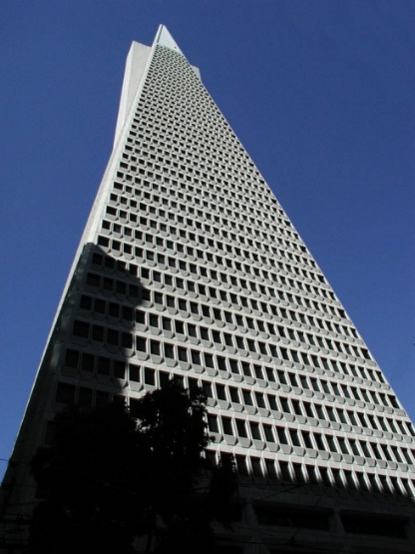
Software Architecture
DIT344
Michel R.V. Chaudron chaudron@chalmers.se
Software Engineering Division
Chalmers | GU

Slide 2

Software Architecting
Michel R.V. Chaudron chaudron@chalmers.se
Software Engineering Division
Chalmers | GU

Slide 3
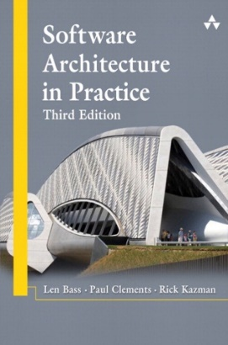
Reading material for this lecture
Ch 1 & 2
from Bass, Clements & Kazman: SW ARCH in Practice (3rd)

Slide 4
Presentation Change History
Date Aut Description
3 jan 2002 MC Added: Evaluation Book; SA def. by Sikkema
Jan 2013 MC adapted slides for Adv SW Arch course at Chalmers | GU
Aug 2017 MC adapt for BSC SW ARCH Chalmers|GU
Sept 2019 MC update for BSC SW ARCH Chalmers & GU
To do: Security, e.g. Christopher M. King, Ertem Osmanoglu (Editor),
Curtis Dalton, "Security Architecture: Design, Deployment and
Operations. McGraw-Hill Osborne Media; 1st Edition (July 30, 2001).

Slide 5
About Michel Chaudron
Research:
  Professor of the Software Engineering Group, Gothenburg
  Research Interests:
  Software Architecture-, Design & Modeling, UML,
  Empirical studies in SE
    How can we predict properties of the systems we design ?
    Can we quantify the effects of ‘doing architecture’
      In industrial SE projects or via experiments
Coordinates:
chaudron@chalmers.se
    Room 472, floor 4, Jupiter building, Campus Lindholmen
    Phone +46 31 772 11 65

Slide 6
Teaching Assistants
Mohammad | Zreik | guszremo@student.gu.se
Majed | Dalain | gusdalaima@student.gu.se
M Nazeeh | Alhosary | gusalhmn@student.gu.se
Majd | Al Haltoum | gusmajdal@student.gu.se

Slide 7
Goals of this course
Knowledge:
  concepts & terminology
  engineering standards & pragmatics
  modelling notations & analysis techniques
  ‘standard’ solutions
  ‘soft skills’ are important
  introduction of some research topics
Skills:
  design & documentation of architectures
  assessment of architectures

Slide 8
Your Hopes and Expectations
Who are you?
What do you expect / want to learn?

Slide 9
My rules
2 x 45-50 mins
Questions are very welcome
  during & after class
No laptops during lectures in class
Read the book
Hidden slides are uploaded on Canvas because they are informative, but not exam topics.

Slide 10
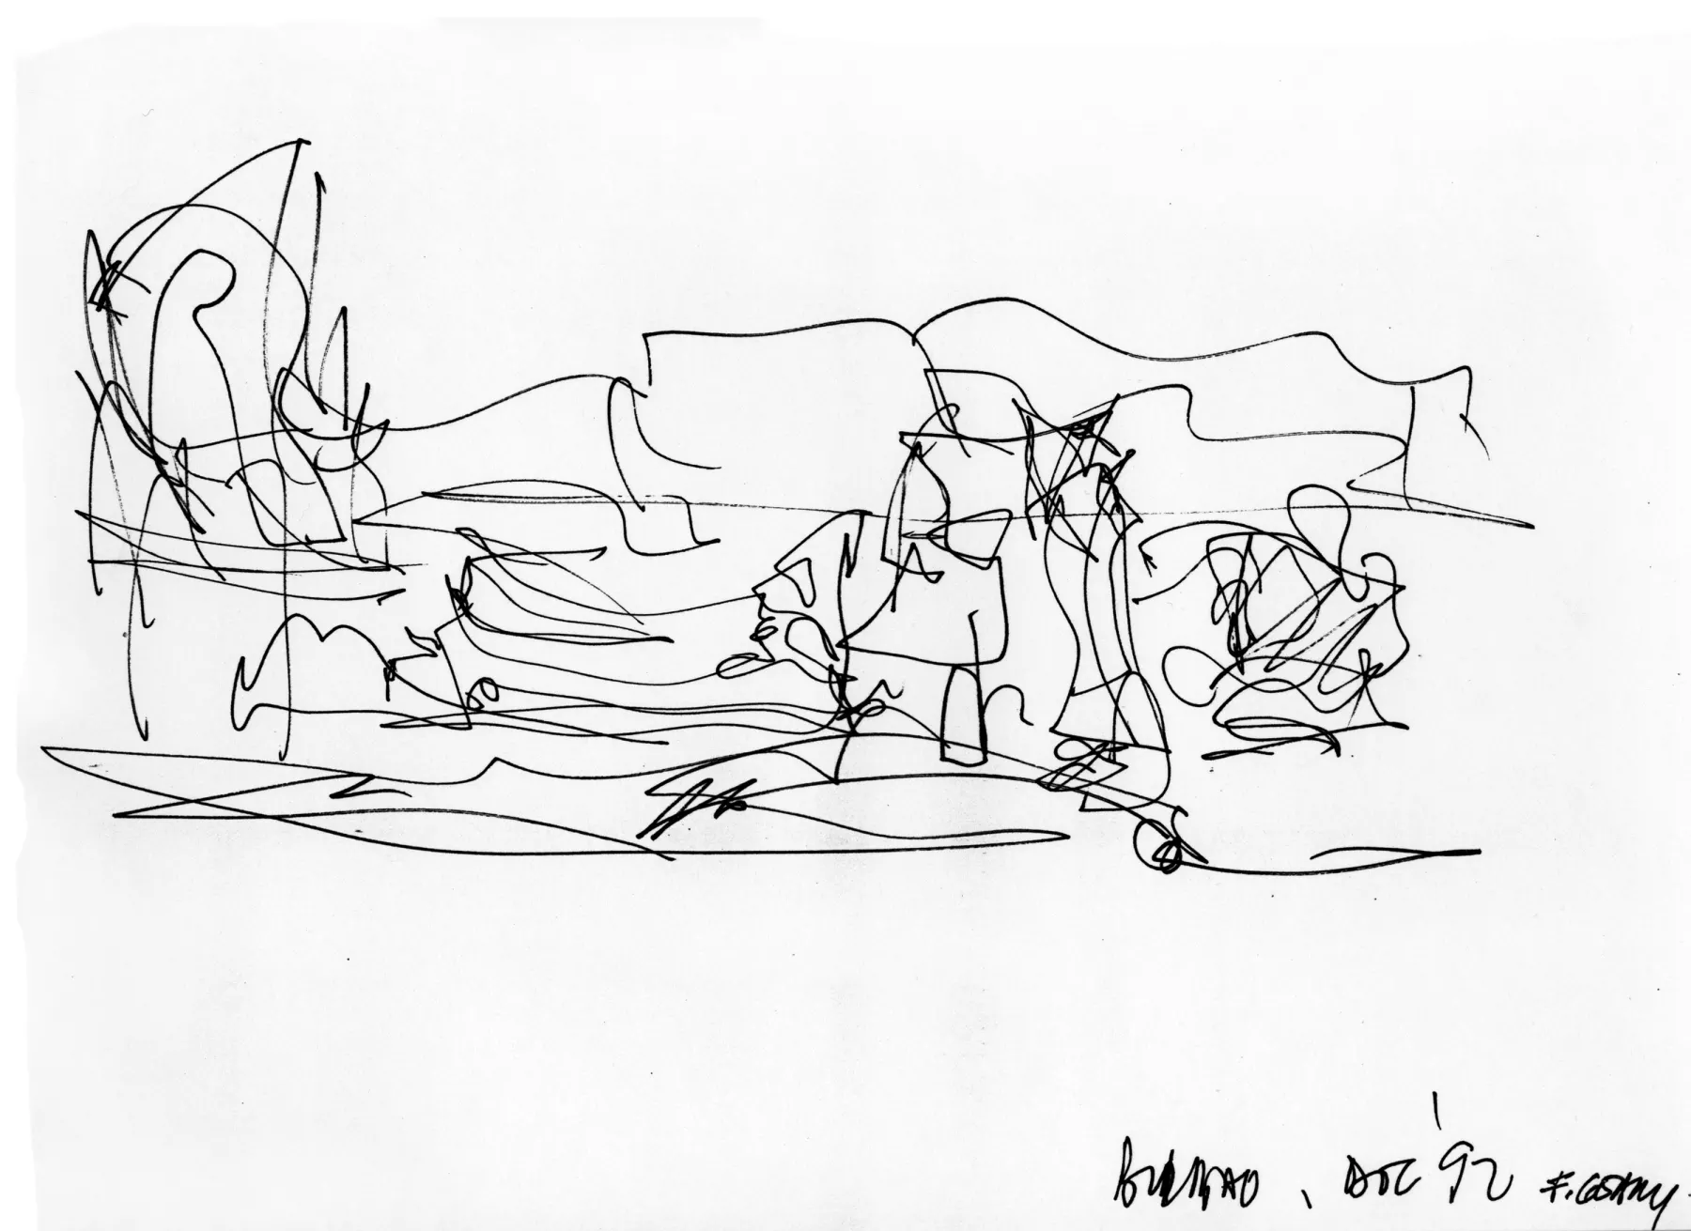
What is this? What is it for?

Slide 11
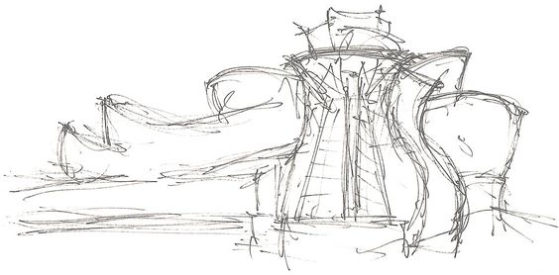

Slide 12
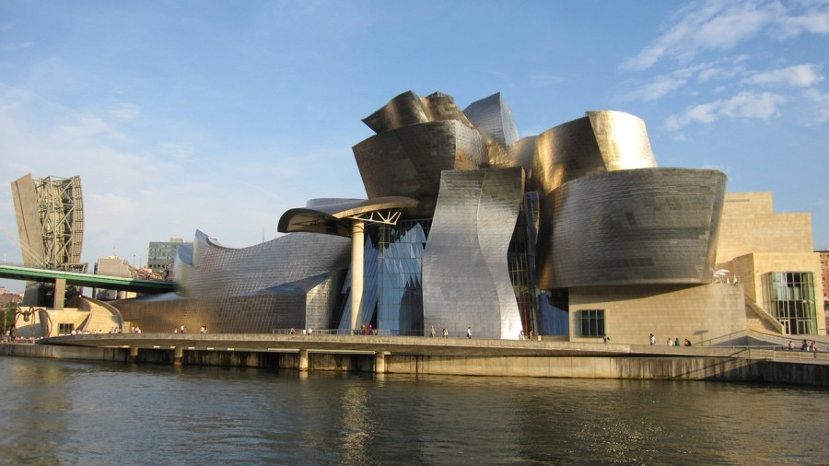
Form & Function

Slide 13
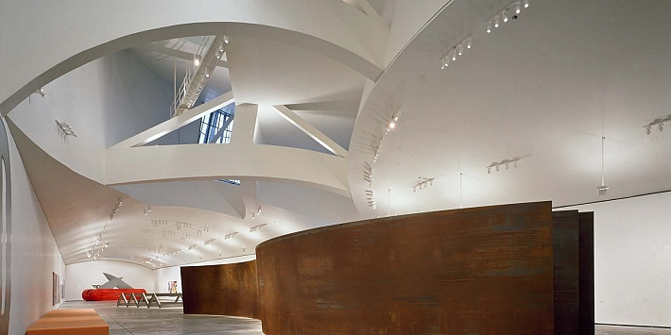
Space, Light

Slide 14
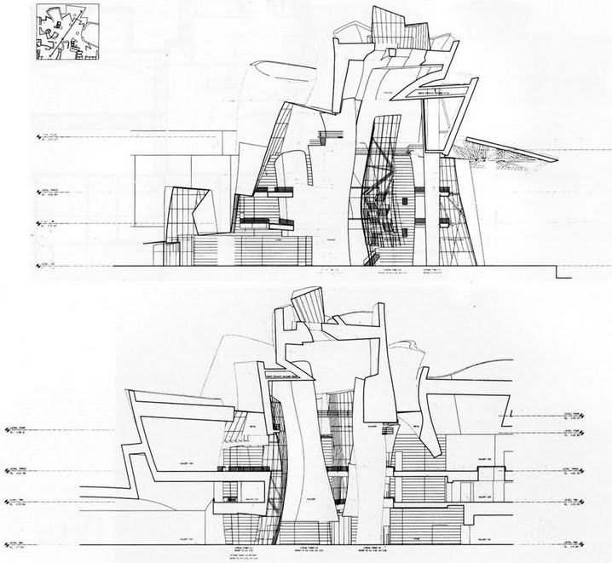

Slide 15
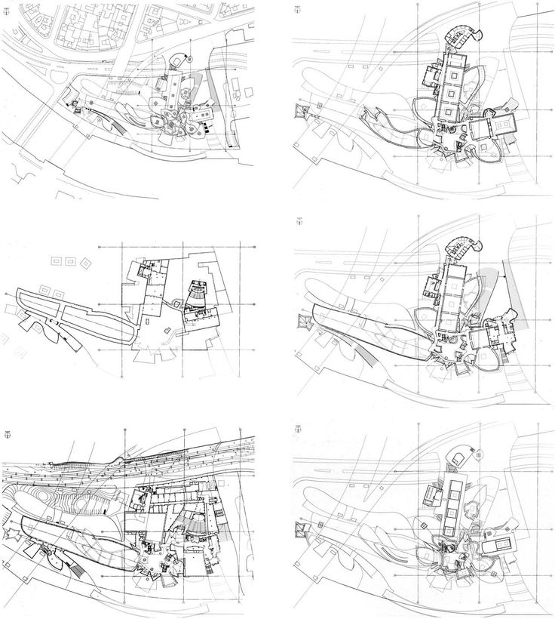
Building in its
environment

Slide 16
Outline
Organization of the lectures
Importance and use of architecture
What is Software Architecture?
Concluding Remarks & References

Slide 17
Schedule
Week |  | Date | Time | Lecture | Reading | Note
36 | L1 | 4 sept | 13:00 – 15:00 | Introduction & Organization
37 | L2 | 11 sept | 13:00 – 14:30 | Architecting Process & Views | Ch 1 & 2
37 | S1 | 12 sept | 10:15 – 12:00 | << Supervision/Assignment>>
38 | L3 | 18 sept | 13:00 - 15:00 | Requirements & Quality Attributes | Ch 3 & 4
38 | S2 | 19 sept | 13:00 – 15:00 | << Supervision/Assignment>>
38 | L4 | 20 sept | 13:15 – 15:00 | Architectural Styles 1 | Ch 13
39 | L5 | 25 sept | 13:15 – 15:00 | Architectural Styles 2 | Ch 15 & 16
39 | S3 | 26 sept | 10:15 – 12:00 | << Supervision/Assignment>>
39 | L6 | 27 sept | 13:15 – 15:00 | Roles and Responsibilities | Check Canvas
40 | L7 | 2 Oct | 13:15 – 15:00 | To be determined |  | UG
40 | S4 | 3 Oct | 10:15 – 12:00 | << Supervision/Assignment>> |  | UG
41 |  | 4 Oct | 13:00 – 15:00 | To be determined |  | UG
42 | L8 | 9 Oct | 13:15 – 15:00 | Technical Debt (t.b.confirmed) |  | PhD defence
41 | S5 | 10 Oct | 10:15 – 12:00 | << Supervision/Assignment>>
42 | L9 | 16 Oct | 13:15 – 15:00 | Design Principles | Ch 21
42 | S6 | 17 Oct | 10:15 – 12:00 | << Supervision/Assignment>> |  | check!
43 | L10 | 18 Oct | 13:15 – 15:00 | Architecture Evaluation | tbd
43 | L11 | 23 Oct | 13:15 – 15:00 | Reverse Engineering & Correspondence
43 | L12 | 24 Oct | 13:15 – 15:00 | To be determined (slack) | Ch 20
43 | L13 | 25 Oct | 13:00 – 15:00 | To be determined (exam practice?)

Slide 18
Teaching Philosophy
Tools
Directions
If you have a hammer, then this doesn’t mean all problems are a nail!

Slide 19
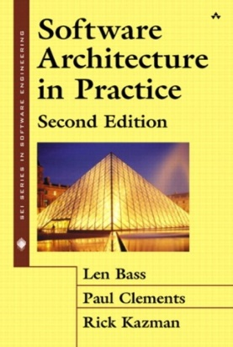
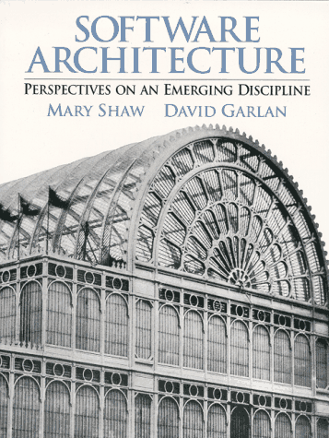
Software Architecture Books
Software Architecture in Practice, 3rd Edition,
L. Bass, P. Clements, R. Kazman,
SEI Series in Software Engineering,
Addison-Wesley, 2003
Software Architecture: Perspectives on an
Emerging Discipline, Mary Shaw, David Garlan,
242 pages, 1996, Prentice Hall
ISO/IEC/IEEE Standard
  1471-2000 - Recommended Practice for Architectural Description
  42010-2011 - Systems and software engineering — Architecture description

Slide 20
UML book
UML Distilled
4th or 3rd edition

Slide 21
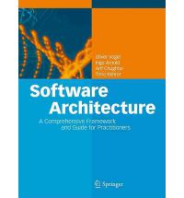
Software Architecture Books
Software Architecture
A Comprehensive Framework
and Guide for Practitioners
By Oliver Vogel, Ingo Arnold,
Arif Chughtai, Timo Kehrer

Slide 22
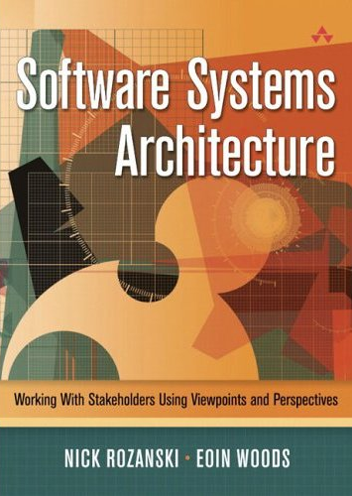
Software Architecture Books
Software Systems Architecture – With Stakeholders Using Views and Perspectives
by Nick Rozanski and Eoin Woods,
Addison-Wesley, 2005

Slide 23
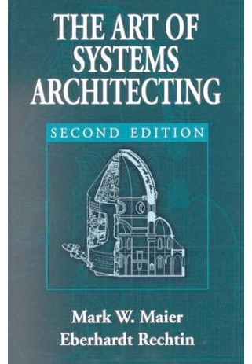
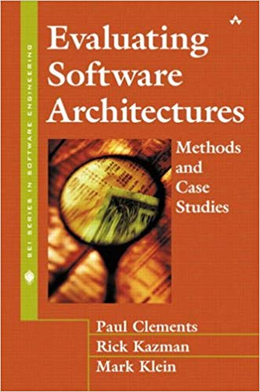
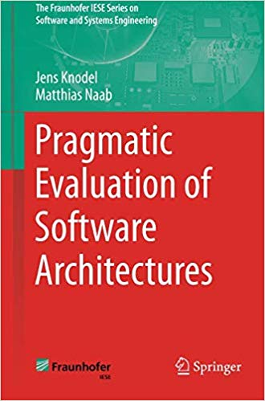
Software Architecture Books
The Art of Systems Architecting,
Second Edition (Hardcover)
by Mark W. Maier, Eberhardt Rechtin
Publisher: CRC Press, 2000
Evaluating Software Architecture
Paul Clements, Rick Kazman, Marc Klein,
2002, Addison-Wesley, ISBN 020170482X
Pragmatic Evaluation of Software Architectures, Jens Knodel, Matthias Naab, Springer, 2016

Slide 24
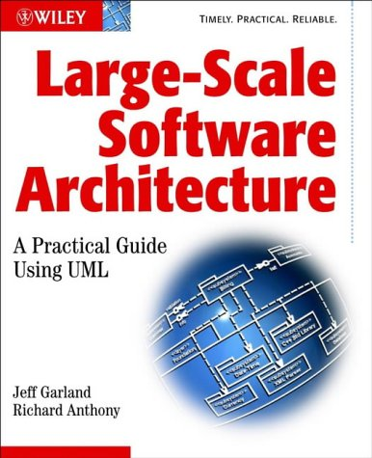
Software Architecture Books
Large Scale Software Architecture
A Practical Guide Using UML
by Jeff Garland & Richard Anthony,
Wiley, 2002.

Slide 25

Video Lectures
Scalable Learning
  Online platform
  You can create an account and register for our course
  You can watch lectures online – when & where you want
  You ask questions online
https://www.scalable-learning.com/#/courses/1111/modules/3525/courseware/lectures/14201
Let me know how you prefer to use the video’s:
  Watch before hand
    then I can find from ScalableLearning what you find difficult and pay more attention to this in class
  Watch after my lecture
NOT A REPLACEMENT FOR ATTENDING CLASS LECTURES(YET!)

Slide 26
Assignment
To be announced
Start of term
  UML
Examination:
  Assignment
  Written exam

Slide 27
Supervision session
Group formation
  Hand in ‘pairs of names’
  We will randomly allocate 2 pairs into a team of 4 students
Peer-evaluation for assessing individual contribution to assignments
Assignment follows typical steps:
  Understand requirements (apply knowledge from RE course)
  Identify stakeholders
  Identify architectural drivers
  Iterate:
    Identify components & behaviours
    Use patterns and tactics to achieve quality properties
  Hand in: RE doc & SW ARCH DESIGN doc

Slide 28
Structure of the Course (1)
Introduction:
  why, what, when, whom, …
  course ‘logistics’
  bit on requirements
Requirements, Architecture Modelling & Documentation
  bit more about requirements
  using UML for modelling
  documentation guidelines

Slide 29
Structure of the Course (2)
Architecture Modelling
  view paradigms (IEEE1471, 4+1, SHN, Zachmann)
  ADL’s (AADL, UniCon, Splice, Darwin/Koala)
Architectural Styles
  pipe-and-filter, blackboard, pub/sub, (P2P)
  strenghts and weaknessess of styles
Client/Server & Middleware
  2-tier, thick- thin C/S
Reverse EngineeringCORBA

Slide 30
Structure of the Course (3)
Architecture Evaluation
  Qualitative:
    Scenario-based: ATAM
  Quantitative Techniques for Analysing Architectures
    Reliability Block Diagrams, Rate Monotonic Analysis
    Queuing Networks
    Risk, Cost, Feasability
Roles & Responsibilities
Technical Debt
Guest lecture(s): to be confirmed

Slide 31
Tests
assignment parallel to course
final written test
I will try to test that
  You know a few things (concepts, facts, UML, …)
  You can do a few things
    THINK – analyze, structure, reason logically
There are a few things from this course that are very important
  I will emphasize them and expect you notice

Slide 32
Relation to Other CS subjects
Software Engineering
Distributed Systems
Databases &
Information Systems
Performance Modelling
Complexity Theory
Software Architecting
Central question:
How to design, document and assess software architectures.

Slide 33
Preview / Recap:
What is Software Architecture?
A definition:
Software Architecture is the global organization of a software system, including
the division of software into subsystems/components,
policies according to which these subsystems interact,
the definition of their interfaces.
(free after) Object Oriented Software Engineering
T. C. Lethbridge & R. Laganière
McGraw Hill, 2001

Slide 34
Outline
Organization of the lectures
Importance and use of architecture
What is Software Architecture?
Concluding Remarks & References

Slide 35
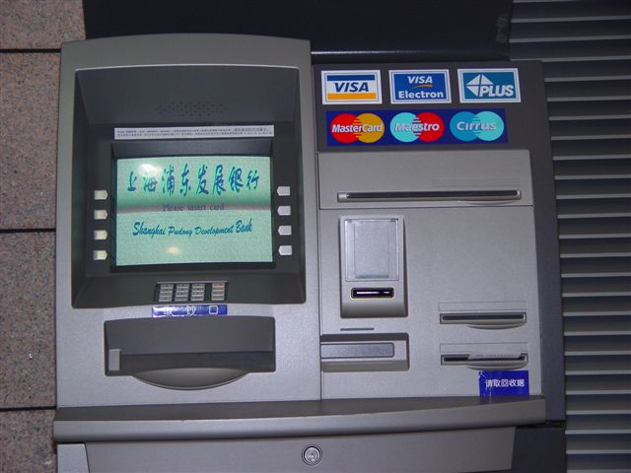
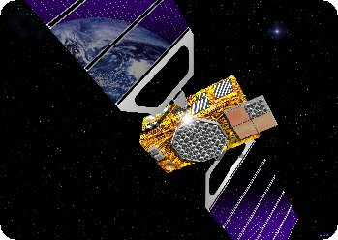
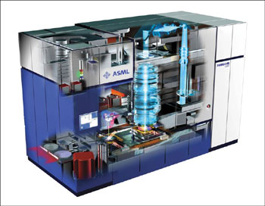

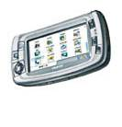
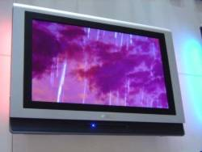
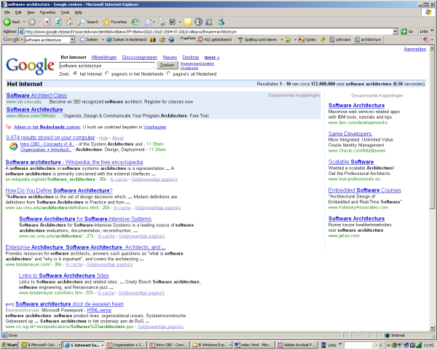


Slide 36
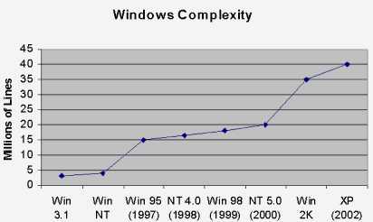
Increasing amount of software in systems
Nb: logarithmic scale
The amount of software
increases 10 fold every 10 years

Slide 37
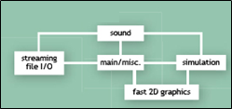
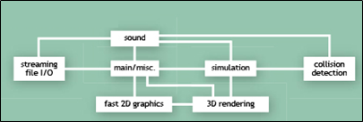
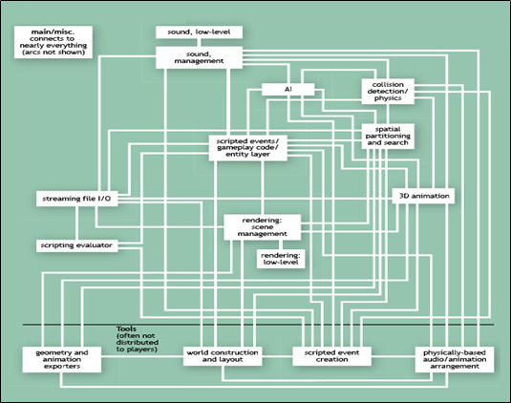
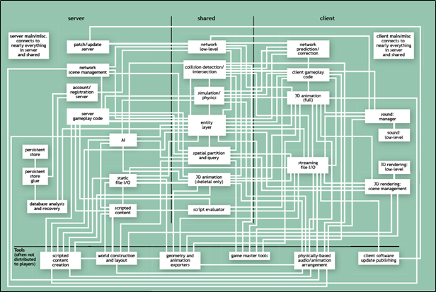
Increasing Complexity of Software
Blow, J. "Game Development: Harder Than You Think." ACM Queue

Slide 38
The Importance of Architecture
“A correct architecture has the largest single impact
on cost and quality of the product.”
Maranzano, ATT, 1995

Slide 39
The Importance of Architecture
10% of the lifecycle determines
90% of the costs and risks
≥ 100x
Requirements & Architecting
Design
Implementation
Testing
Deployment
Operation
SW fault repair costs
1x
Notes:
The costs of repairing a fault increases exponentially with the delay of its detection

Slide 40
Class Representatives
Drop by or send me an e-mail

Slide 41
Business Objectives of Sw. Arch.
Reduce time-to-market
  Through enabling reuse and gradual evolution
Reduce development cost
Through improved communication between developers
and earlier assessment of design alternatives and
assessment of system risks
Reduce maintenance cost
  Through incorporation of foreseeable changes
Improve product quality
Increase fitness for use through stakeholder involvement;
reduce errors through enforcement of conceptual integrity

Slide 42
Multiple Purposes of Architecture
Understanding + Analyzing
+ Communicating + Constructing
Understanding
Describing
Guiding
Why
What
How
Why is the system needed? What constraints apply?
Understanding the requirements
What are the important design decisions
What functions does the system provide?
What properties does the design have?
How can the system be built?
Figure from Gerrit Muller, How to Create a Manageable Platform Architecture

Slide 43
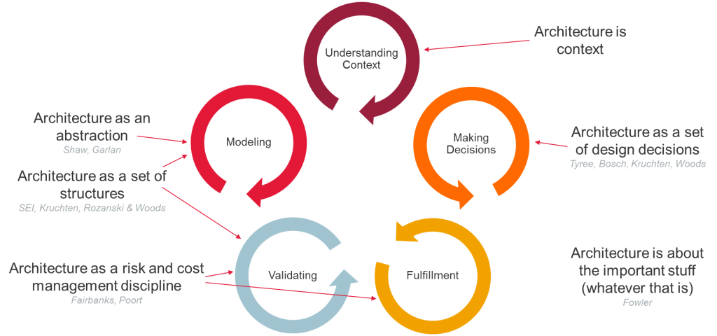
Multiple Purposes of Architecture
Picture from Eltjo Poort’s Architecture Blog - https://eltjopoort.nl/

Slide 44
Multiple Purposes of Architecture
analyse domain
define &
communicate design
analyse system
guide design
monitor implementation
guide implementation
monitor progress, cost, risk
Picture from Eltjo Poort’s Architecture Blog (2019) - https://eltjopoort.nl/

Slide 45
Monitor the Implementation

Slide 46
Outline
Organization of the lectures
Importance and use of architecture
What is Software Architecture?
Concluding Remarks & References

Slide 47
Let’s Look at some Examples

Slide 48
eCommerce Architecture Blueprint
VK
Par.
Trw
RD
AD
NRC
DtRG
Ad.g.
Ad.k.
Graf.
Meul.
DocA
DocR
MRe
Losv
Distr
Ab.A
Ab.R
Extranet
Internet
Intranet
Journ.
Auteurs
Nieuws-
dnsten
Advert.
(PR-bur)
Losse
verk.pt.
Vervoer-
ders
Distrib.,
bezorg.
Busin.
partners
Bedrijv.
Instell.
Advert.
(part.)
Abon-
nees
Bezoe-
kers
PCM
medewr.
Integration Platform (Message Broker)
Multi-channel Platform
Tel/CC
Brief/fax
Email
Website
Mobiel
ITV
...
Commerce Platform
Merkgebonden producten en diensten
Content
mgmt.
Content
publish.
Relatie
Onderh.
Advert.
aanbod
Advert.
Activ.
Merk
regels
Understanding
Describing
Guiding
Why
Gemeenschappelijke services
Search
&config.
Relatie
Profiles
Product
prijzen
What
How
PCM
regels
Work
flow
Security
ePaym’t
Content
DB
Relation
profile
DB
Bedrijfs
Regels
DB
Beveili-
gings
DB
Legacy Platform
ATEX
MedS
CCI
SII
Quark
VIP
Nova
Oman
Meul.
Lovr
Opls
ADS
TDS
NPD
Ami1
Ami2

Slide 49
From: CMU/SEI-2005-TN-027
From: Using the SEI Architecture Tradeoff Analysis Method to Evaluate WIN-T: A Case Study
Technical Note CMU/SEI-2005-TN-027
Notes:
Using the SEI Architecture Tradeoff Analysis Method to Evaluate WIN-T: A Case Study
Paul Clements, Software Engineering Institute
John Bergey, Software Engineering Institute
Dave Mason, U.S. Army’s Communications and Electronics Command (CECOM)
September 2005
Technical Note CMU/SEI-2005-TN-027

Slide 50
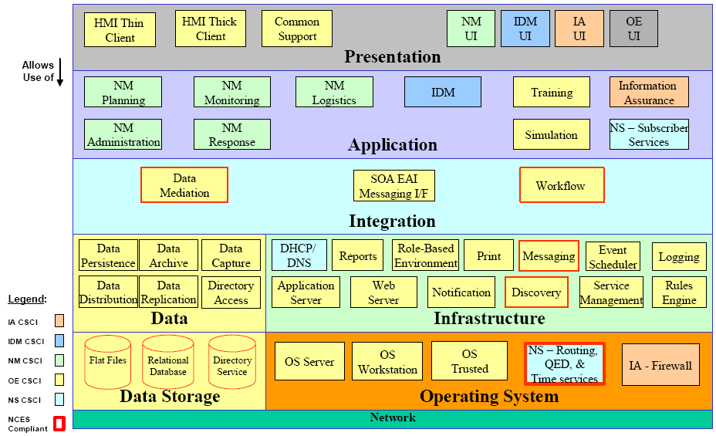
Refinement of previous slide
From: Using the SEI Architecture Tradeoff Analysis Method to Evaluate WIN-T: A Case Study
Technical Note CMU/SEI-2005-TN-027

Slide 51
Complementary view of previous
From: Using the SEI Architecture Tradeoff Analysis Method to Evaluate WIN-T: A Case Study
Technical Note CMU/SEI-2005-TN-027

Slide 52
Software Architecture of
K9 e-mail app (on Android )

Slide 53
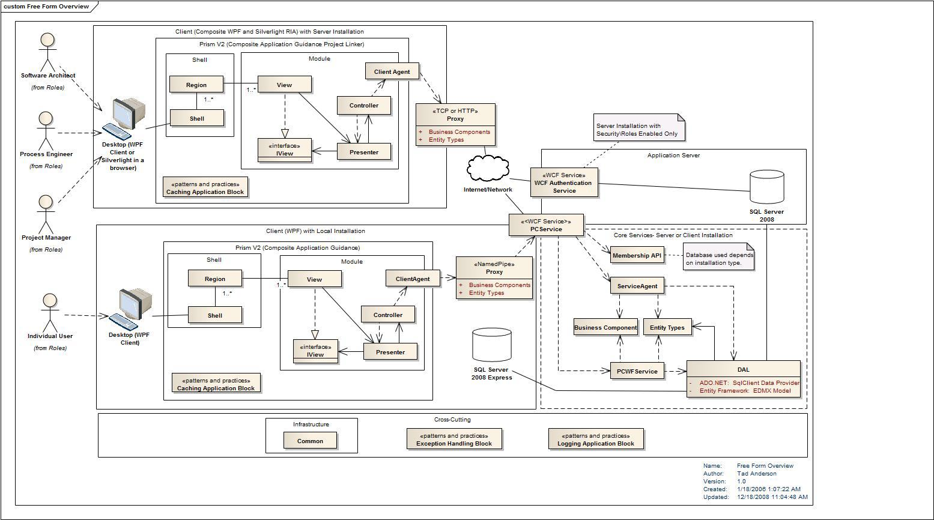

Slide 54
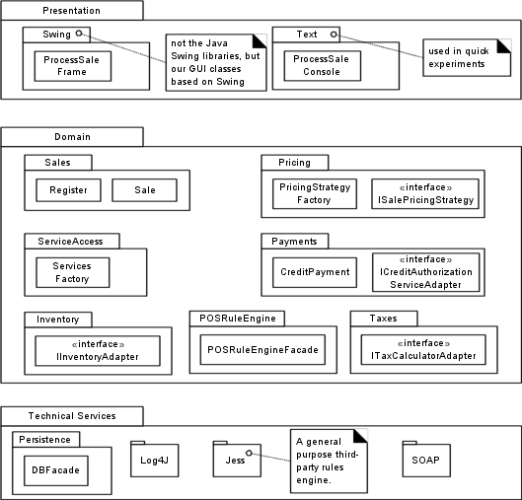

Slide 55
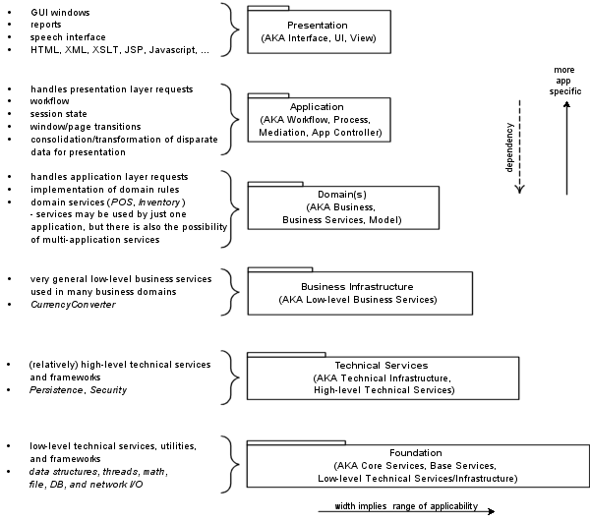

Slide 56
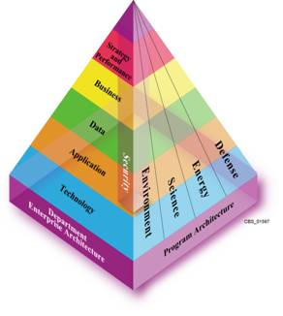
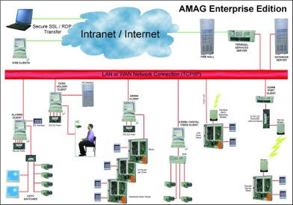
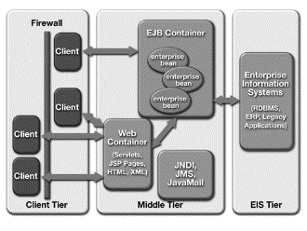
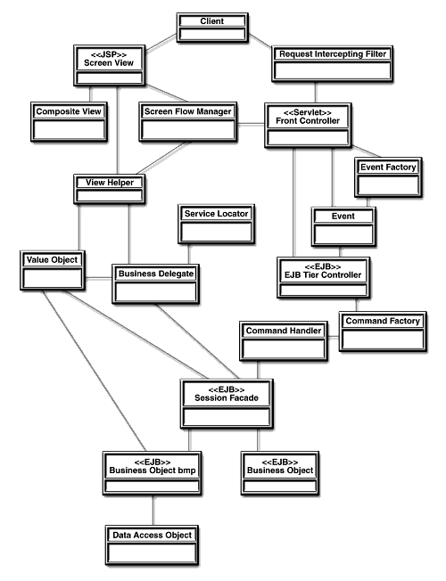
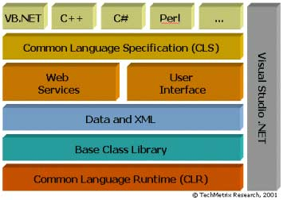
Levels of architecture*
Enterprise architecture
System architecture
Subsystem
Application architecture
Application
Macro-architecture
Frameworks
Micro-architecture
Subject
Observer
attach(Observer)
detach(Observer)
notify()
forall o in observers
o.update()
update()
Design patterns
ConcreteSubject
ConcreteObserver
* Mowbray and Malveau
getState()
update()
Notes:
Thomas J. Mowbray and Raphael C. Malveau. CORBA Design Patterns. John Wiley & Sons, 1997

Slide 57
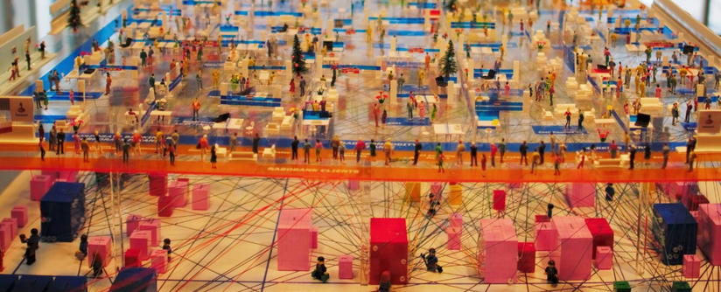
Banking Architecture
(Physical 3D model)
Rabobank's 3D model (Image source: Hans Tesselaar, BIAN)

Slide 58
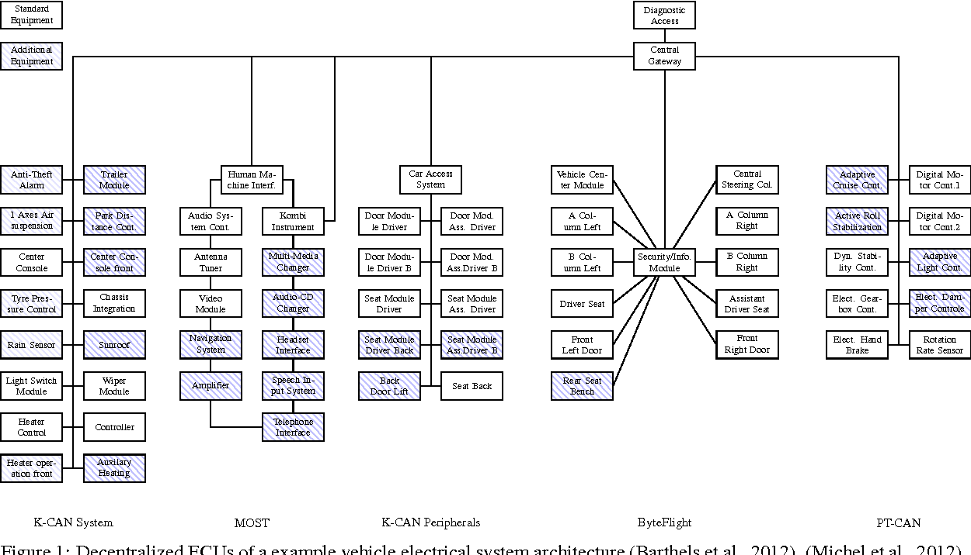

Slide 59
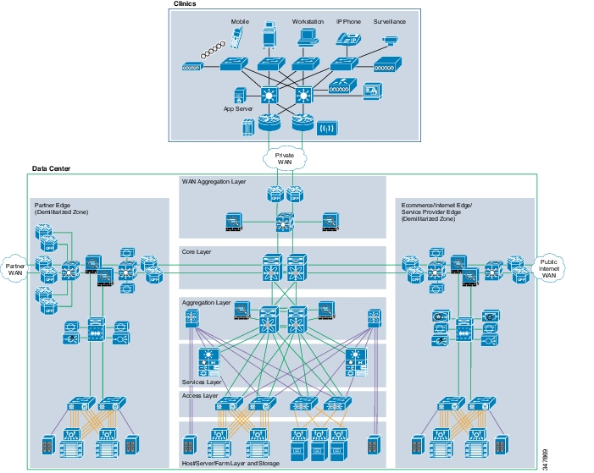
= Network
topology

Slide 60
What is Software Architecture?
Classic Definitions 1
An architecture is the set of significant decisions about
the organization of a software system,
the selection of the structural elements and their interfaces by which
the system is composed, together with their behaviour as specified in
the collaborations among those elements,
the composition of these structural and behavioural elements into
progressively larger subsystems,
the architectural style that guides this organization
The UML Modeling Language User Guide, Addison-Wesley, 1999
Booch, Rumbaugh, and Jacobson

Slide 61
What is Software Architecture?
Definition 2
The fundamental organization of a system embodied by its components, their relationships to each other and to the environment and the principles guiding its design and evolution
IEEE Standard P1471 Recommended Practice for
Architectural Description of Software-Intensive Systems

Slide 62
What is Software Architecture?
Definition 3
IT-Architecture is the collection of principles, guidelines and modelling standards that are used to guide the development, maintenance and use of IT-resources
within the entire organization.
M. Sikkema (banking industry)
Translation by M.R.V. Chaudron
Ontwikkelen Onder Architectuur, Informatie, juni 2000
Oriented towards enterprise systems.

Slide 63

Software Project Management
The Deadline
by Tom DeMarco
easy & fun reading
lots of lessons from practical experience
Also very though provoking:
Peopleware
by DeMarco & Lister,
  Dorset House Publ., 2nd ed, 1999

Slide 64
Software Architecture & Quality
The notion of quality is central in software architecting:
a software architecture is devised to gain insight in the qualities of a system at the earliest possible stage.
Some qualities are observable via execution: performance, security, availability, functionality, usability
And some are not observable via execution, but in the development process: modifiability, portability, reusability, integrability, testability

Slide 65
Architecting = Balancing Objectives
Functional dimensions
Structure
Functionality
Component interfaces
Component configurations
Local/Global Behavior
Control modes
Activities/Transactions
C&S protocols
Dependability
Performance
Timeliness
Reliability
Availability
Safety
Security
Robustness
General
Scalability
Flexibility
Maintainability
Reusability
Openness
User-Friendliness
Costprize
•••
Composability
Interoperability
Reusability
Extra-Functional dimensions
Notes:
All relevant system dimensions must be described by an architecture

Slide 66
Outline
Organization of the lectures
Importance and use of architecture
What is Software Architecture?
Concluding Remarks & References

Slide 67
Concluding Remarks 1
Experience is the hardest kind of teacher.
It gives the test first and the lesson afterward.
Susan Ruth, 1993
Software Architecture is a critical aspect in the design and development of software
We discussed definitions and objectives of Sw.Arch.
Understanding of basic principles of architecture design, analysis, documentation, and process are necessary, but experience is hard to beat.
Notes:
Additional problems:
Common definitions and terminology
What architectural descriptions need the various stakeholders?
What are suitable orthogonal design dimension?
Derivation of these descriptions from a common framework?
Criteria for the assessment of the quality and performance of IT-Architectures?
To what extent are object-orientation and formal methods useful?
When does a project requires a major architecting effort
and what is a suitable architecting process?
How to deal with the product-process interdependence?
How to manage the architecting function in an organization?

