Slide 1
Software Architecture
DIT344
Requirements, Quality Attributes
and a glimpse of Tactics
Prof. Dr. Michel R.V. Chaudron
Chalmers | University of Gothenburg

Slide 2
Schedule
Week |  | Date | Time | Lecture | Reading | Note
36 | L1 | 4 sept | 13:00 – 15:00 | Introduction & Organization
37 | L2 | 11 sept | 13:00 – 14:30 | Architecting Process & Views | Ch 1 & 2
37 | S1 | 12 sept | 10:15 – 12:00 | << Supervision/Assignment>>
38 | L3 | 18 sept | 13:00 - 15:00 | Requirements & Quality Attributes | Ch 3 & 4
38 | S2 | 19 sept | 13:00 – 15:00 | << Supervision/Assignment>>
38 | L4 | 20 sept | 13:15 – 15:00 | Architectural Styles 1 | Ch 13
39 | L5 | 25 sept | 13:15 – 15:00 | Architectural Styles 2 | Ch 13
39 | S3 | 26 sept | 10:15 – 12:00 | << Supervision/Assignment>>
39 | L6 | 27 sept | 13:15 – 15:00 | Roles and Responsibilities | Check Canvas
40 | L7 | 2 Oct | 13:15 – 15:00 | To be determined |  | UG
40 | S4 | 3 Oct | 10:15 – 12:00 | << Supervision/Assignment>> |  | UG
41 |  | 4 Oct | 13:00 – 15:00 | To be determined |  | UG
42 | L8 | 9 Oct | 13:15 – 15:00 | Technical Debt (t.b.confirmed) |  | PhD defence
41 | S5 | 10 Oct | 10:15 – 12:00 | << Supervision/Assignment>>
42 | L9 | 16 Oct | 13:15 – 15:00 | Design Principles | Ch 21
42 | S6 | 17 Oct | 10:15 – 12:00 | << Supervision/Assignment>> |  | check!
43 | L10 | 18 Oct | 13:15 – 15:00 | Architecture Evaluation | tbd
43 | L11 | 23 Oct | 13:15 – 15:00 | Reverse Engineering & Correspondence
43 | L12 | 24 Oct | 13:15 – 15:00 | To be determined (slack) | Ch 20
43 | L13 | 25 Oct | 13:00 – 15:00 | To be determined (exam practice?)

Slide 3
Things we have seen so far
What, why, who, where, when, how
Many definitions of Software Architecture – same spirit though
View and Viewpoints
    And how to use UML to describe them
Every software system has a software architecture

Slide 4
Objectives
In this lecture you will learn:
  Requirements – esp Quality Requirements
  Component Diagrams

Slide 5
Requirements Engineering
Based on Selections from
Chapter 4 from Object-Oriented Software Engineering
by Lethbridge & Laganiere
Requirements Engineering: A Good Practice Guide
by Ian Sommerville & Pete Sawyer
What, Why, Who, When, Where, How?

Slide 6
Requirements Engineering
The process of establishing
  the services that the customers require from a system and
  the constraints under which it operates and is developed.
©Ian Sommerville 2004 Software Engineering, 7th edition. Chapter 6

Slide 7
What is a Requirement ?
A statement about the proposed system that all stakeholders agree must be made true in order for the customer’s problem to be adequately solved.
  Short and concise piece of information
  Says something about the system
  All the stakeholders have agreed that it is valid
  It helps solve the customer’s problem
Notes:
L & L Section 4.4

Slide 8


Do customers know what they want?
Through Requirements you are meant to find out and
understand what stakeholders’ intentions and need are.
This may be different from what they say it is!

Slide 9
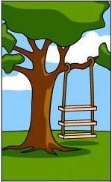
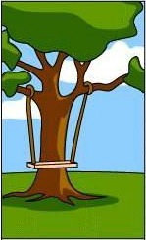





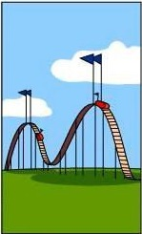
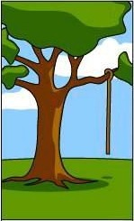
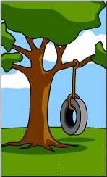
Understanding the problem
What the customer
explained
What the project leader understood
What the analyst designed
What the consultant defined
What the programmer made
How it was maintained
What was documented
What was charged
What was installed
What the client needed

Slide 10
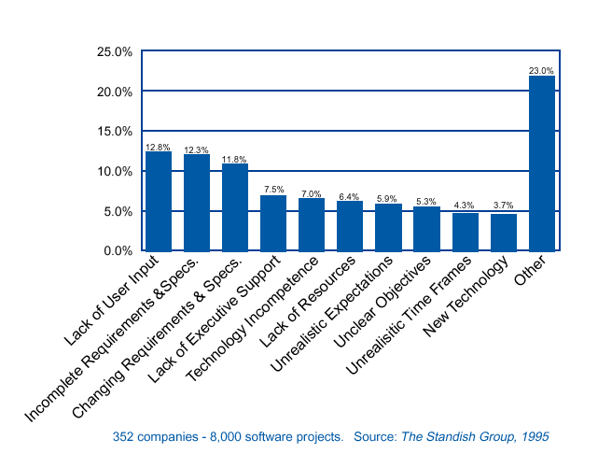
Why Software Projects Fail
Related to
Requirements
Engineering
Example of empirical research
Notes:
Example of result of empirical research

Slide 11

Why Requirements Engineering?
Scope the problem
Understand the problem
  for the client as well as the architect
Basis for design
Contract between client/user and builders
  agreement on what has to be built

Slide 12
Types of Requirements
Functional requirements
  Describe what the system should do
Extra-functional requirements (aka ‘non-functional’)
  *ilities: Availability, Security, Reliability, Timeliness, …
  Capacity
Constraints that must be adhered to during development and execution
Notes:
L&L Section 4.5

Slide 13
Functional requirements
  What inputs the system should accept
  What outputs the system should produce
  What computations the system should perform

Slide 14
Examples
The system shall allow users to search for an item by title, author, or ISBN.
Defines system functionality.
If an item is not returned within the period of load, then the person who loans the item will be fined Euro 1 per week.
Defines (causal) relations between system functions.

Slide 15
Examples XFR: Maintainability
Maintainability
The average person time required to fix a category 3 defect (including testing and documentation upgrade) shall not exceed two person days.

Slide 16
Examples of XFR: Reliability
Typically expressed in terms of
Mean Time Between Failures (MTBF)
  Number of hours that pass before a component fails
  E.g. 2 failures per million hours:
    MTBF = 10⁶ / 2 = 0,5 * 10⁶ hr
Mean Time To Failure (MTTF)
  Mean time expectec until the first failure of a system
  Is a statistical value over a long period of time
Mean Time To Repair (MTTR)
for repairable systems
For non-repairable systems
Availability

Slide 17
Constraints
  Constraints concerning the environment and technology of the system.
    Platform
    Technology to be used
  Constraints concerning the project plan and development methods
    Development process (methodology) to be used
    Cost and delivery date
      Often put in contract or project plan instead

Slide 18
Constraints
Constraint set restrictions on how the user requirements are to be implemented.
Interface Requirements.
How external interfaces with other systems must be done.
Communication Interfaces.
The networks and protocols to be used.
Hardware Interfaces.
The computer hardware the software is to execute on.
Software Interfaces.
How the software should be compatible with other software: applications, compilers, operating systems, programming languages, database management systems.
User Interfaces.
Style, format, messages

Slide 19

Requirements on Requirements (3)
S Specific
  To-the-point, precise
M Measurable
  Quantifiable and verifiable
A Acceptable (to the stakeholders)
  Accessible, understandable (for the user)
  Achievable (technically/planning/economically)
R Realistic
  Deducible to the real business drivers
T Testable

Slide 20

Quality Requirements
Identifier | Feature Description | Priority
QL-35 | The system will be capable of supporting peak user volumes up to 100 users | 10
QL-36 | The system will process and respond to login requests in less than 5 seconds 90% of the time when subjected to peak user volumes. | 10
QL-37 | The system will process and respond to general transactions in less than 5 seconds 90% of the time when subjected to peak user volumes. | 10
QL-38 | The system will process and response to process intensive transactions in less than 8 seconds 90% of the time when subjected to peak user volumes. | 10
QL-39 | The system will perform document generation in less than 30 seconds 90% of the time when subjected to peak user volumes. | 10
Performance Requirements

Slide 21
Typical exam question
Consider a system that does
  Ticket booking
  Video streaming
  …
Write a scenario for the following quality attribute
  Reliability
  Performance
  Security
  ….

Slide 22
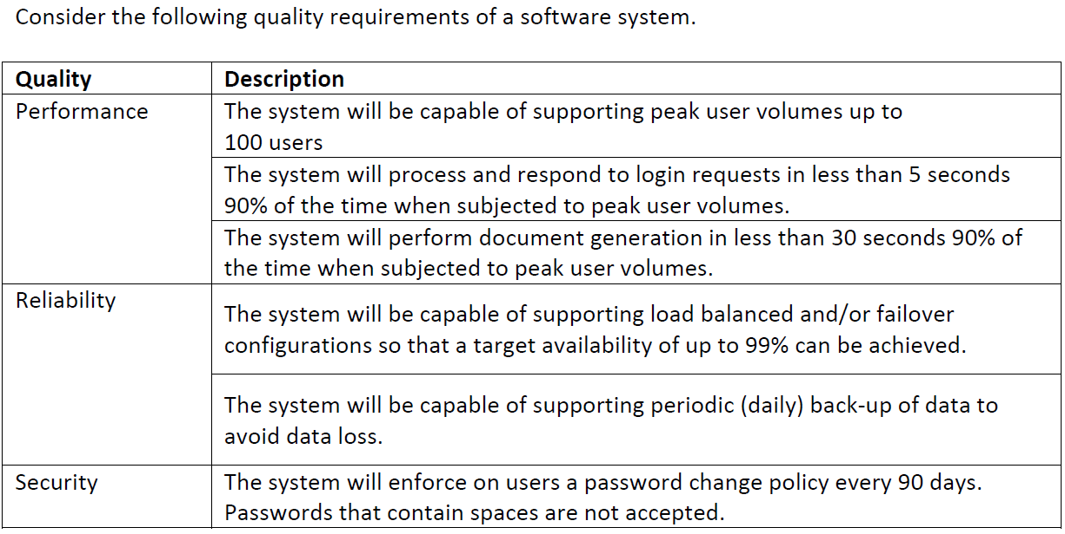
Question
Give quality attribute scenarios for above quality requirements.

Slide 23
Requirements on Requirements (1)
Each individual requirement should be
Important/necessary for the solution of the current problem
Unique (no duplicates/overlap)
Unambiguous
Logically consistent
Not over-constrain the design of the system
Atomic: not consist of multiple separate requirements
Notes:
L & L Section 4.8

Slide 24
Public Transport e-ticketing system
The system should be aware of interchanges made by the traveller
The system should be able to register a valid period card on board of the transportation
The ticket system should send a response within 5 sec when an SMS is received from a customer
The system gives a written message that the user needs to recharge his card

Slide 25
A ticket should be valid for 90 minutes after being paid
The system shall be compatible with android mobile phones
System response time shall not exceed 2 sec
The card shall have its information encrypted with AES
Every ticket is identified uniquely in all the lifetime of the system

Slide 26
Tell if these are good/what is wrong?
“All communication between client and server is secure”
“It is easy to extend”
“The system should respond quickly”
“The user should not have to wait more than a few second …”
“Determine solution within 0.3 sec”
“The system should be always available”
“The system can handle multiple concurrent users”
“The system can handle 100 concurrent users”
“The system should be state-of-the-art …”

Slide 27
Let’s consider
“All communication between client and server is secure”
“It is easy to extend”
“The system should respond quickly”
“The user should not have to wait more than a few second …”
“Determine solution within 0.3 sec”
“The system should be always available”
“The system can handle multiple concurrent users”
“The system can handle 100 concurrent users”
“The system should be state-of-the-art …”
not measurable
not measurable
not measurable
not precise
vague:to what?
attainable
doing what?
time-dependent;
means something else tomorrow
subjective

Slide 28
Eliciting Requirements
Interviewing
  Consult users
  Consult experts
Observation
  User interaction / work processes
Previous system / Existing system elsewhere
Brainstorming
Prototyping / Story-boarding

Slide 29
Requirements Prioritization

Slide 30
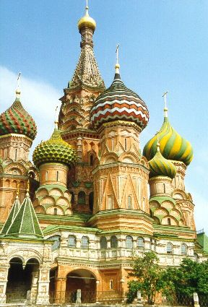
Prioritizing Requirements
MIL STD:
  Must have, will have, may have
RUP: MoSCoW
Criteria: indicate importance
Alternative criteria: volitility, cost to realize, risk, ..

Slide 31
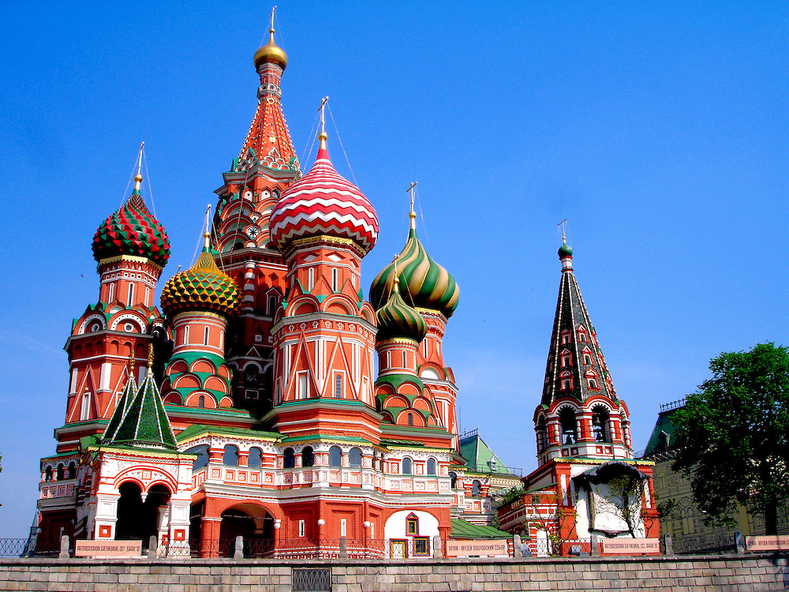
Prioritizing Requirements
MoSCoW Method:
  M - MUST: Describes a requirement that must be satisfied in the final solution for the solution to be considered a success.
  S - SHOULD: Represents a high-priority item that should be included in the solution if it is possible. This is often a critical requirement but one which can be satisfied in other ways if strictly necessary.
  C - COULD: Describes a requirement which is considered desirable but not necessary. This will be included if time and resources permit.
  W - WON'T: Represents a requirement that stakeholders have agreed will not be implemented in a given release, but may be considered for the future.

Slide 32

Question
      Are business needs typically formulated around functional features or system qualities?

Slide 33
Cost-Value Prioritization of Requirements
Motivation for Prioritization:
Focus development effort
  Allocate resources based on importance
Make trade-offs between conflicting goals, such as quality, cost and time-to-market

Slide 34
Cost-Value Prioritization of Requirements
Process:
Review requirements for clarity and completeness (by Requirements Engineers)
Assess relative value of requirements in pair wise manner (Customers and users)
Assess relative cost of realizing requirements in pair wise manner (by experienced SW Engineers)
Calculate (value, cost)-pairs
Plot requirements as (value, cost)-pairs
Prioritize

Slide 35
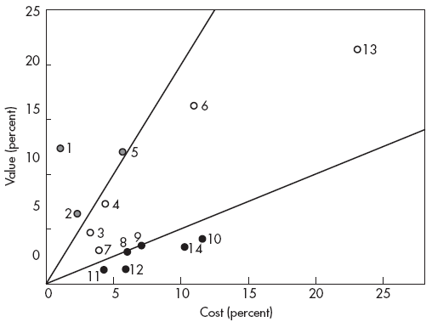
Requirements Prioritization Example
14 Requirements
Value (percentage)
high value
low cost
medium value
medium cost
low value
high cost
Cost (percentage)

Slide 36
(Recap) Forces & Drivers

Slide 37
Architectural Drivers
Architectural drivers are not all the forces that affect the design of a system, but they are those that are most influential to the architecture design decisions.
Architects pay more attention to qualities that relate to architecture design choices

Slide 38
Design of Architectures
Quality Requirements
Architecture Tactic
Performance Req.
Performance Tactic
Security Req.
Security Tactic
Usability Req.
Usability Tactic
Reliability Req.
Reliability Tactic
Availability Req.
Availability Tactic
…
…

Slide 39
Quality Attributes
A quality attribute is a measurable or testable property of a system that is used to indicate how well the system satisfies the needs of its stakeholders.*
A quality requirement is a specification of the acceptable values of a quality attribute that must be present in the system.
Quality attributes should be:
  Objective
  In sufficient detail
*Bass Clements Kazman

Slide 40
Managing Software Quality
Main issues:
Quality cannot be added as an afterthought
In order to control, we must measure /know
Product quality vs process quality

Slide 41
Quality Attributes (informally)*
Attribute | Description
Performance | How fast does it respond or execute?
Availability | Is it available when and where I need to use it?
Safety | How well does it protect against damage?
Usability | How easy it is for people to learn and use?
Interoperability | How easily does it interconnect with other systems?
Integrity | Does it protect against unauthorized access and data loss?
Installability | How easy is it to correctly install the product?
Robustness | How well does it respond to unexpected operating conditions?
Reliability | How long does it run before experiencing a failure?
Recoverability | How quickly can the user recover from a failure?
*EnfocusSolutions

Slide 42
Quality Attributes (informally)
Attribute | Description
Efficiency | How well does it utilize processor capacity, disk space, memory, bandwidth, and other resources?
Flexibility | How easily is it to modify functionality / UI?
Maintainability | How easy is it to correct defects or make changes?
Portability | How easily can it be made to work on other platforms?
Reusability | How easily can we use components in other systems?
Scalability | How easily can I add more users, servers, or other extensions?
Supportability | How easy will it be support after installation?
Testability | Can I verify that it is implemented correctly?

Slide 43
Quality Models
Quality Attributes | McCall, 1976/77 | Boehm, 1978 | FURPS, FURPS+ 1987, 1992 | ISO/IEC 9126, 1991 | Garvin, 1988
Aesthetics |  |  | Usability |  | *
Clarity |  | Understandability
Compatibility |  |  | Supportability
Conformance |  |  |  | Portability | *
Correctness | * | * |  | Maintainability
Device Efficiency | * | * | Performance | *
Documentation |  | * | Usability
Durability |  |  |  |  | *
Economy |  | *
Features |  |  |  |  | *
Flexibility | * | *
Functionality |  |  | * | *
Generality |  | *
Integrity | * | *
Interoperability | * |  |  | Functionality
Maintainability | * | * | Supportability | *
Modifiability |  | Maintainability |  | Maintainability
Modularity |  | *
Perceived Quality |  |  |  |  | *
Performance |  |  | * |  | *
Portability | * | * |  | *
Reliability | * | * | * | * | *
Resilience |  | Flexibility
Reusability | * | *
Security |  |  |  | Functionality
Serviceability |  |  | Supportability |  | *
Supportability |  |  | *
Testability | * | Maintainability | Supportability | Maintainability
Understandability |  | Maintainability |  | Usability
Usability | * | * | * | *
Validity |  | * |  | Maintainability

Slide 44
Addressing Quality Attributes
Quality attributes can be addressed through different (architectural) tactics:
  Architectural styles: for example pipes-and-filters, MVC, blackboard, publish-subscribe,…
  Architecture Tactics: Heartbeat, Retry, Concurrency, Caching, Encryption…
Quality requirements are often holistic they are a property of the system as a whole and cannot be decomposed into subsystems or components.
security
performance

Slide 45
Evaluating Quality Attributes
Quality attributes can be evaluated through:
  Scenario-based evaluation: for example change scenarios for assessing maintainability
  Simulation: for example Prototyping is a form of simulation where a part of the architecture is implemented and executed in the actual system context.
  Mathematical modeling: for example, checking for potential deadlocks, performance, reliability.
  Experience-based assessment: this is based on subjective factors like intuition and expertise of software engineers.

Slide 46
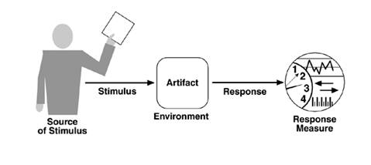
Specifying Quality Attribute Scenarios
A Quality Attribute Scenario is a format for defining a testable scenario for a system
  Source of stimulus (e.g., human, system, 1 or more actor(s).)
  Stimulus – the ‘trigger’ of the scenario
  Environment - what are the conditions when the stimulus occurs?
  Artifact – what elements of the system are stimulated.
  Response – the activity undertaken after occurrence of the stimulus.
  Response measure – when the response occurs it should be measurable so that the requirement can be tested.

Slide 47
Specifying Quality Attribute Scenarios
Reliability
Source of Stimulus | System Database Server
Stimulus | Database crashes
Environment | Runtime with average load
Artifact | Database
Response | Detect the failure, inform the sys-adm, use redundant database server
Response Measure | #seconds until recovery is at most 120

Slide 48
Availability
Availability is concerned with system failure and its associated consequences.
A system failure occurs when the system no longer delivers a service consistent with its specification.
Such a failure is observable by the system's users—either humans or other systems.

Slide 49

Availability
Availability of a system/module is the percentage of time when it is operational.
Availability of a hardware/software module can be obtained by the formula
Mean Time Between Failures (MTBF)
  Number of hours that pass before a component fails
  E.g. 2 failures per million hours: MTBF = 10⁶ / 2 = 0,5 * 10⁶ hr
Mean Time To Repair (MTTR)

Slide 50
Downtime
Availability is typically specified in nines notation.
For example 3-nines availability corresponds to 99.9% availability.
A 5-nines availability corresponds to 99.999% availability.
Downtime per year is a more intuitive way of understanding the availability.
Availability | Downtime
90% (1-nine) | 36.5 days/year
99% (2-nines) | 3.65 days/year
99.9% (3-nines) | 8.76 hours/year
99.99% (4-nines) | 52 minutes/year
99.999% (5-nines) | 5 minutes/year
99.9999% (6-nines) | 31 seconds/year !

Slide 51
Availability Tactic
Replication of computation is an availability tactic
Compute A
Input
Handling Output
Also Compute A

Slide 52
Performance
Different types of performance:
Throughput – number of items handled per second
Response time/Turn-around time/Latency
Efficiency – resources used per (trans)action
Tactics:
Resource demand
Resource management
Resource arbitration

Slide 53
Performance
Part of Scenario | Possible Values
Source | One of a number of independent sources, possibly from within system
Stimulus | Periodic events arrive; sporadic events arrive; stochastic events arrive
Artifact | System
Environment | Normal mode; overload mode
Response | Processes stimuli; changes level of service
Response Measure | Latency, deadline, throughput, jitter, miss rate, data loss

Slide 54
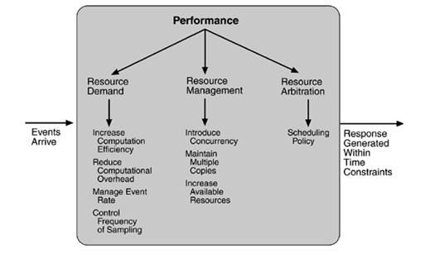
Performance Tactics

Slide 55

SECURITY
Security is a measure of the system's ability to resist unauthorized usage while still providing its services to legitimate users.

Slide 56
SECURITY
Security can be characterized as a system providing
Nonrepudiation is the property that a transaction (access to or modification of data or services) cannot be denied by any of the parties to it.
Confidentiality is the property that data or services are protected from unauthorized access.
Integrity is the property that data or services are being delivered as intended.
Assurance is the property that the parties to a transaction are who they purport to be.
Availability is the property that the system will be available for legitimate use.
Auditable is the property that the system tracks activities within it at levels sufficient to reconstruct them

Slide 57
Part of Scenario | Possible Values
Source | Individual or system that is correctly identified, identified incorrectly, of unknown identity who is internal/external, authorized/not authorized with access to limited resources, vast resources
Stimulus | Tries to display data, change/delete data, access system services, reduce availability to system services
Artifact | System services; data within system
Environment | Either online or offline, connected or disconnected, firewalled or open
Response | Authenticates user; hides identity of the user; blocks access to data and/or services; allows access to data and/or services; grants or withdraws permission to access data and/or services; records access/modifications or attempts to access/modify data/services by identity; stores data in an unreadable format; recognizes an unexplainable high demand for services, and informs a user or another system, and restricts availability of services
Response Measure | Time/effort/resources required to circumvent security measures with probability of success; probability of detecting attack; probability of identifying individual responsible for attack or access/modification of data and/or services; percentage of services still available under denial-of-services attack; restore data/services; extent to which data/services damaged and/or legitimate access denied

Slide 58

Safety
The system will not cause any harm to its environment.
Tactics:
-fail safe mode
e.g. in railway: stop all trains
in nuclear reactor: stop the reactor
not possible for all systems: airplane

Slide 59
Tactics summary
Tactics generic patterns of construction that address quality- properties of the design – mostly at run-time, but also at development-time (maintainability)
Tactics do not affect the functionality computed by the system.
Tactics often exploit freedom in deployment.

Slide 60
Component Diagrams

Slide 61
What is a subsystem/component?
Sub-system models is a logical grouping of functionality into a coherent subsystems
  Operate on the same data
  Perform functions that belong to the same responsibility

Slide 62
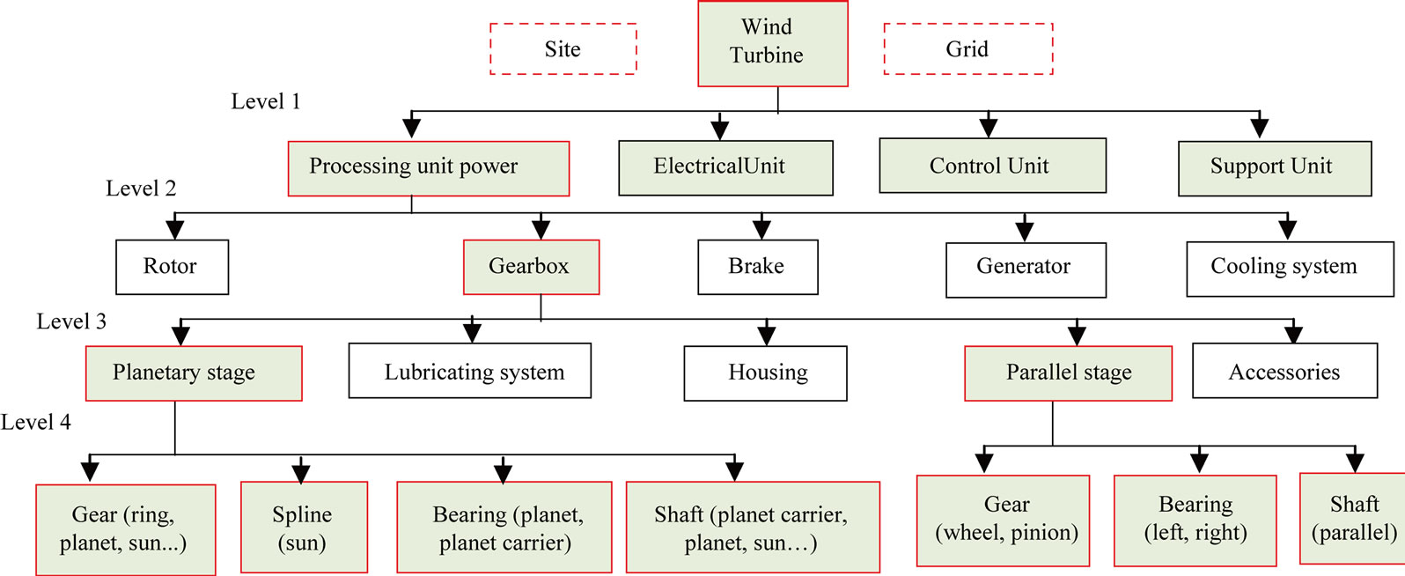
Subsystem Functions

Slide 63
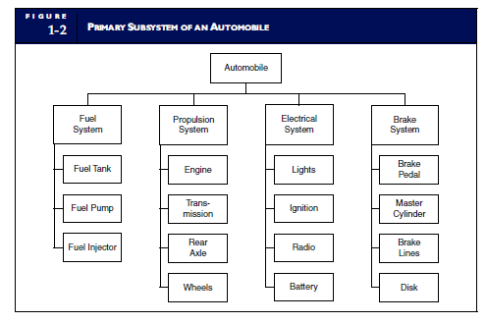
Functional Decomposition

Slide 64
Amusement Park
Providing Ticketing
Accommodation Booking
Handling Group Communication
Handling Payments
Measure Queue Lengths

Slide 65
Subsystems vs Layering
Functional
Dimension
Fuel
System
Propulsion
System
Electrical
System
Braking
System
Layer 1
Layer 2
Layer 3
Abstraction
Dimension
Again: natural language is used in imprecise manner

Slide 66
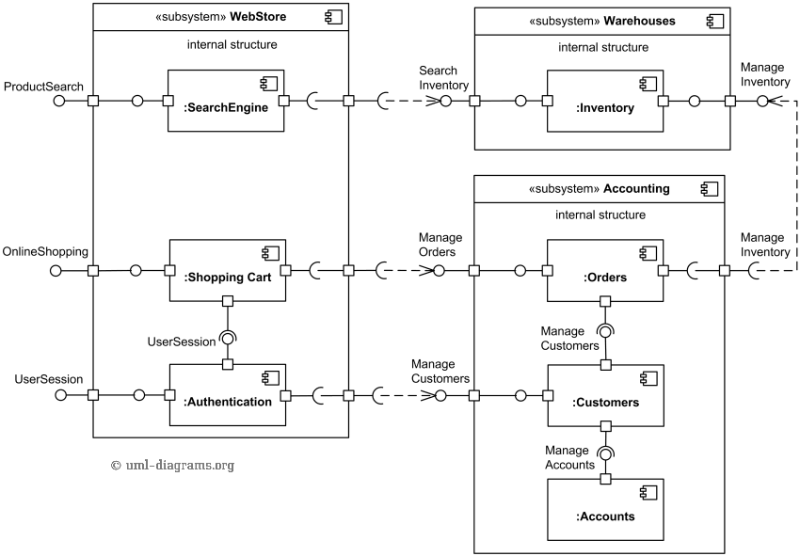
Component Diagram

Slide 67
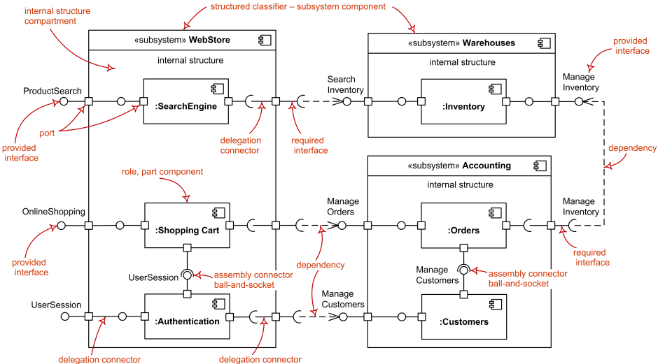
https://www.uml-diagrams.org/component-diagrams-reference.html

Slide 68
Component Diagram
Important to know (you can use)
  Component
  Subsystems
  Interfaces
    Required & provided
  Dependency
Useful to know (you can read)
  Delegation
Nice to know: there are variations of representing components diagrams graphically. Don’t Panic.

Slide 69
Amusement Park
Providing Ticketing
Accommodation Booking
Handling Group Communication
Handling Payments
Measure Queue Lengths

Slide 70
Components in Sequence Diagrams

Slide 71
Documenting Software Architecture
Also on Canvas:
https://www.cs.helsinki.fi/group/os3/HP_arch_template_vers13_withexamples.pdf

Slide 72
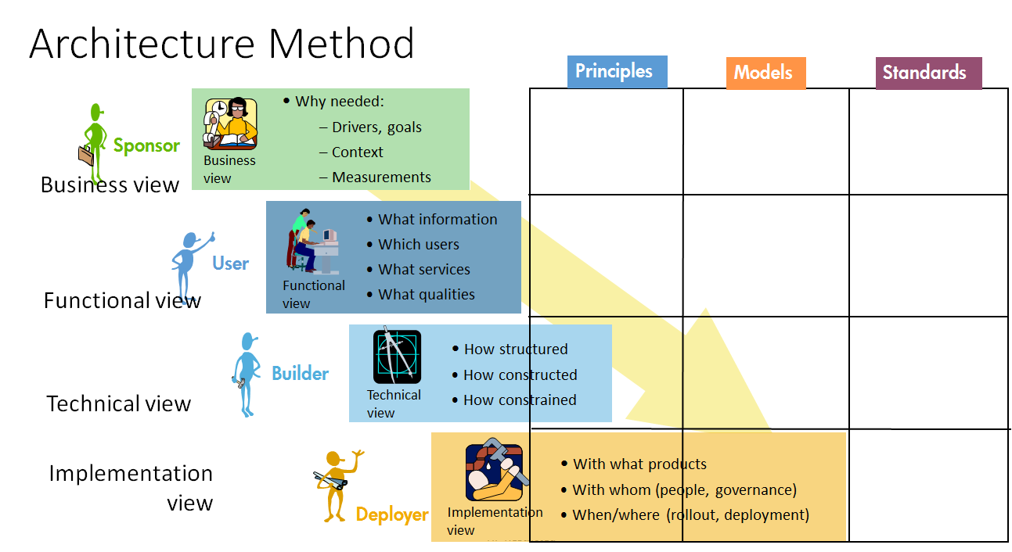
Domain
Solution Design view
Solution Construction view

Slide 73
Summary / Conclusion
Requirements
  Can write Requirements
    SMART
    QA Scenarios
Discuss Software Quality
    What is Sw Quality?
    Different perspectives on Sw Q?
Initial idea of Architectural Styles
We use the session this Friday

Slide 74
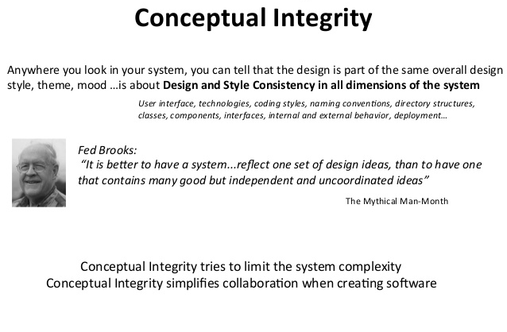

Slide 75
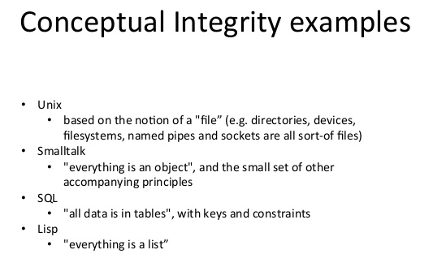

Slide 76
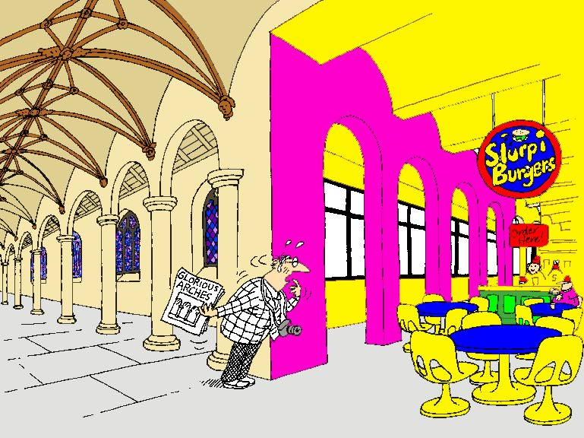
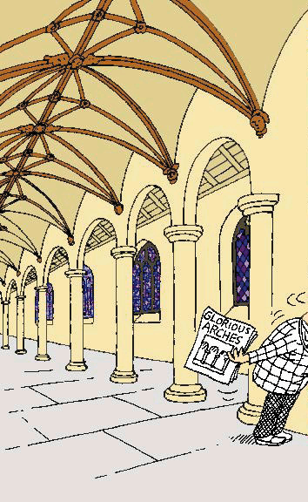
Conceptual integrity counter example!

Slide 77
Architectural Styles
Architectural Styles help in
  Achieving conceptual integrity
    They define ‘ways’/vocabulary of construction:
      Which types of components exist?
      How do data and control flow through the system
        Defaults for initiative and fault-handling.
A key task of the architect is to propose a ‘metaphor’ for the architecture – Alexander Ran (Nokia)

Slide 78
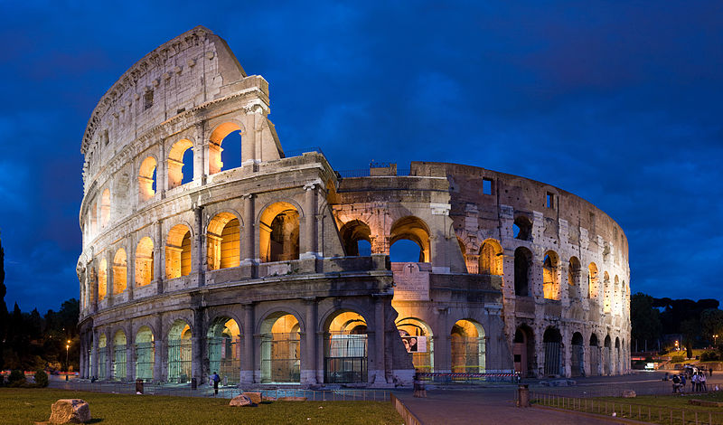
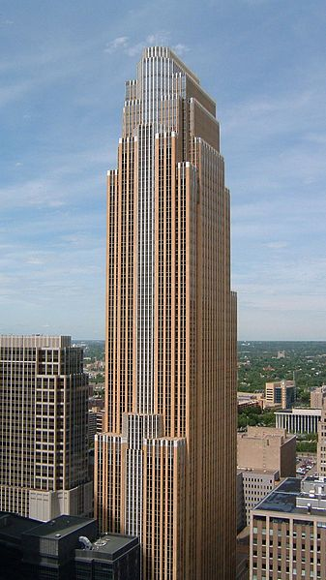
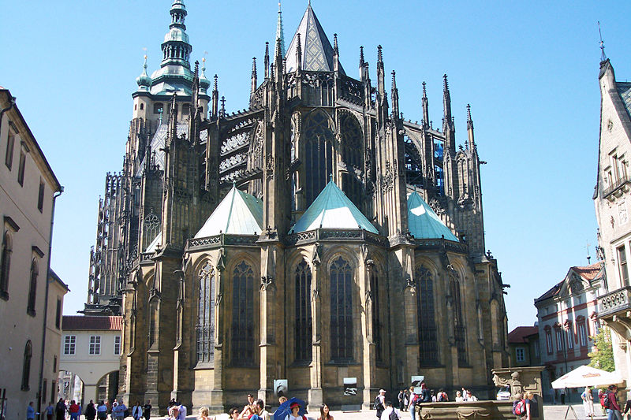
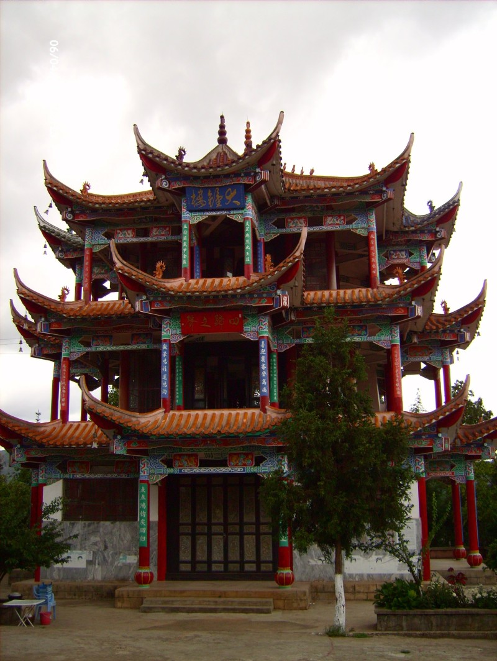
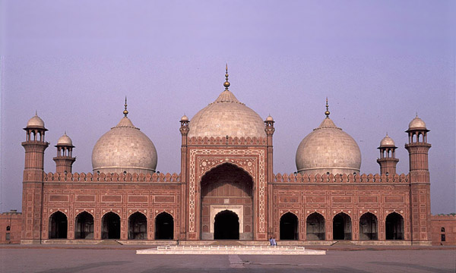
What is a Style?
Ancient Roman
Gothic
Postmodern
Islamic
Ancient Chinese

Slide 79

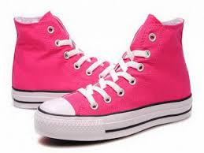
What is a Style?
Coordinated, aligned

Slide 80
What is an Architectural Style?
An architectural style is defined by:
a set of rules and constraints that prescribe
  vocabulary/metaphor: which types of components, interfaces & connectors must/may be used in a system. Possibly introducing domain-specific types
  structure: how components and connectors may be combined
  behavior: how the system behaves
  guidelines: these support the application of the style (how to achieve certain system properties)

Slide 81
What is an Architectural Style?
An architecture style defines a family of systems in terms of a pattern of structural organization.
An architectural style defines
  a vocabulary of components and connector types
  a set of constraints on how they can be combined
  one or more semantic models that specify how a system’s overall properties can be determined from the properties of its parts

Slide 82
Quality Attributes & Architectural Styles
Different architectural styles address different sets of quality attributes and to varying degrees
  Architecture decides range of quality possibilities
Not all quality attributes are addressed by the architectural design, e.g. some aspects of usability (e.g. layouts) and some aspects of performance (e.g. algorithms)
Impossible to maximize all quality attributes at once
  Tradeoff: More of this → less of that
  Performance versus security

Slide 83
What is an Architectural Style?
Architectural styles are design paradigms for
a set of design dimensions
  Some architectural styles emphasize different aspects
  such as: Subdivision of functionality, topology or
  interaction style
Styles are open-ended; new styles may emerge
An architecture can use several architectural styles
Architectural styles are not disjoint

Slide 84
Common Architectural Styles
Client-Server
Blackboard
Pipe-and-Filter
Peer-to-peer
Publish-Subscribe

Slide 85
Architectural Styles & Quality Properties
Client-Server
  Scalable, portable
Blackboard
  interoperable
Pipe-and-Filter
  composable
Peer-to-peer
  robust
Publish-Subscribe
  Reliable, dynamic

Slide 86
International Standard specifies the manner in which architecture descriptions of systems are organized and expressed.

Slide 88
Views and Viewpoints

Slide 89
System exhibit an architecture
Architecture descriptions express an architecture
An architecture description
consists of 1 or more views
Each architecture view addresses a concern
Each view is governed by a viewpoint
Viewpoints use 1 or more model-kinds
Model kinds are like a ‘language’ for describing a view (for a particular concern)

Slide 90
Examples
System: Browser
Concern: Privacy
Viewpoint: Security (Privacy)
Model-kind: UML-SEC
  UML-SEC is an extension of UML with security-annotations
Model:

Slide 91

Some viewpoints important for some systems, but not for others
  Legal?
  Sustainability?
For some views no standard model-kind (‘language’) exists
  Need to invent one yourself

Slide 92
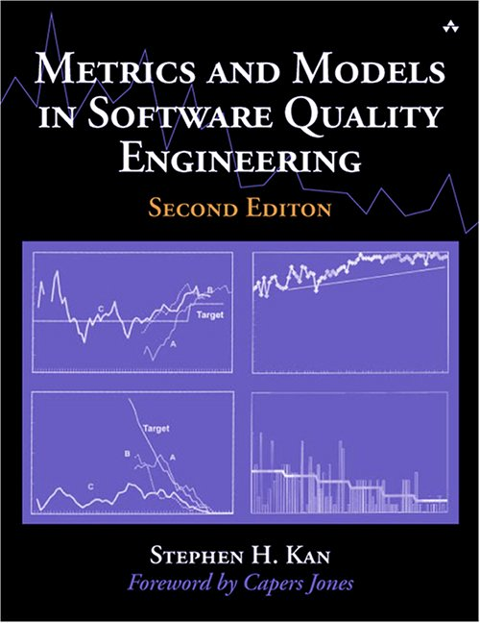
Literature on Software Quality
Metrics and Models in Software Quality Engineering (2nd edition) Stephen H. Kan
Addison Wesley, 2002

Slide 93
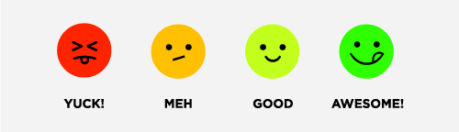
Perspectives on quality
Transcendent (“I really like this program”)

Slide 94
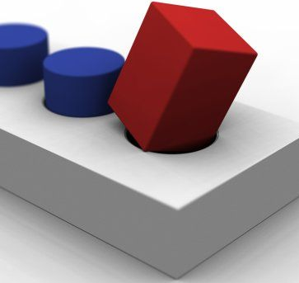
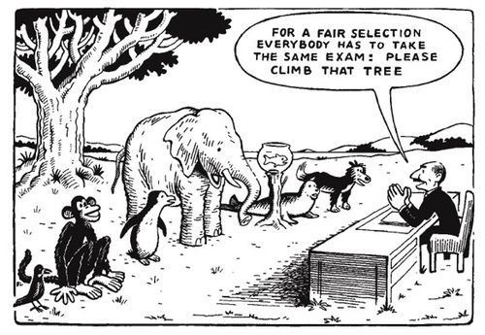
Fit for Purpose
A square peg does not fit a round hole.

Slide 95

Perspectives on quality
Product-based (based on attributes of the software)

Slide 96
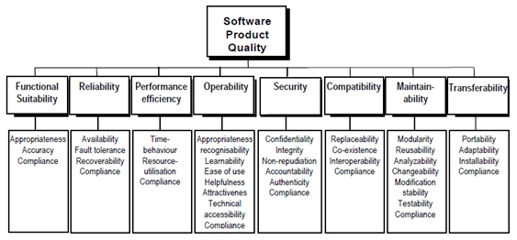
ISO 25010
ISO/IEC CD 25010 Software engineering — Software Product Quality Requirements and Evaluation (SQuaRE) — Quality model and guide, 2011.

Slide 97
What is Quality?

Slide 98
Perspectives on quality
Manufacturing-based (conformance to specs)
The product is produced according to an approved recipe
Based on the premise:
  If a proper process is followed for production:
  Good quality products are bound to follow.
This idea derives from manufacturing industries: 1 process, many products.
Software industry is different: 1 process for 1 product.
A process is necessary, but not sufficient.

Slide 99
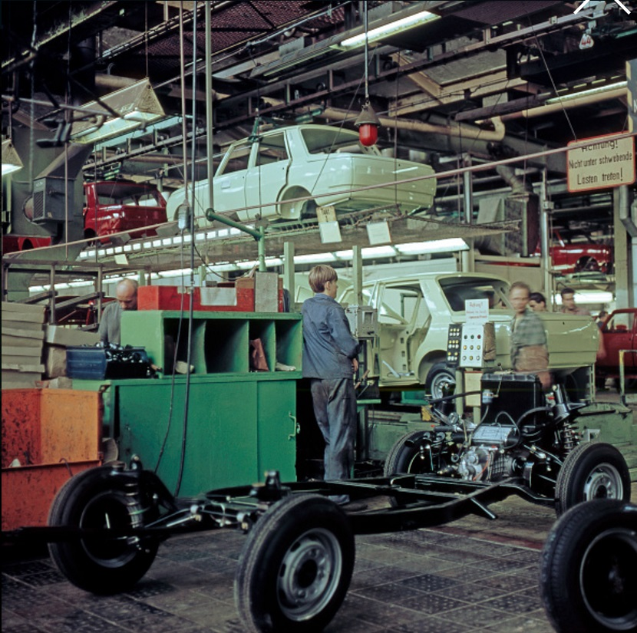

Slide 100
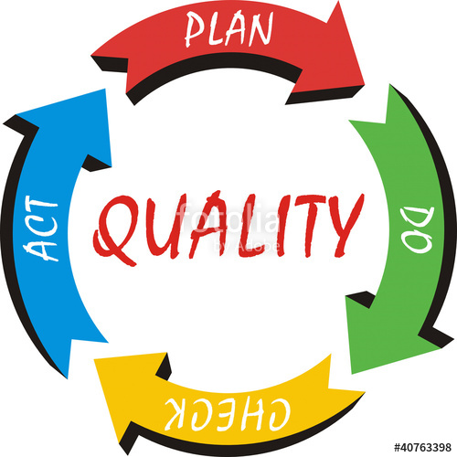
Process Improvement:
Plan Do Check Act
Plan – set objectives
Do – produce
Check – assess/test
analyse gap
Act – improve process

Slide 101
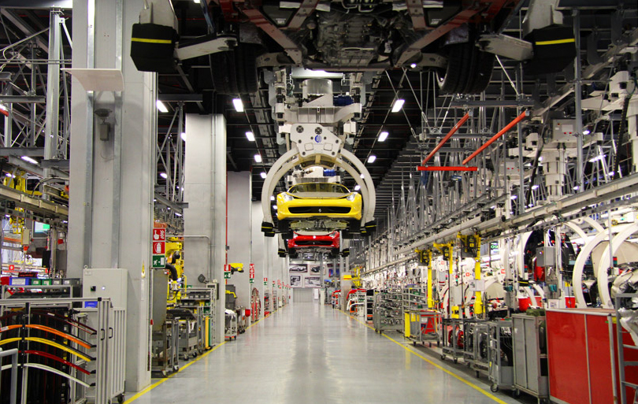
Production Process

Slide 102
Perspectives on quality
Transcendent (“I really like this program”)
User-based (“fitness for use”)
Product-based (based on attributes of the software)
Process/Manufacturing-based
Value-based (balancing time and cost vs profits)

Slide 103
Question
Given a web-based system for tax return. In this system, users will correct/change or add information related to their personal economy in order to compute how much tax they have to pay or they get refunded from the state.
  (a) Create one relevant quality attribute scenario on security for the system described above.
  (b) Create one relevant quality attribute scenario on modifiability for the system described above.
  (c) Create one relevant quality attribute scenario on performance for the system described above.
  (d) Create one relevant quality attribute scenario on interoperability for the system described above.

Slide 104
Question
How does software architecture help with the opposing tensions in the system?

Slide 105
Question
Discuss quality attribute trade-off in the case of Heartbeat as architectural tactic!

Slide 106
Question
In software architectural design, the “decomposition” technique is often used. Among the following software quality attributes, which quality attribute does the “decomposition” technique give the most support?
  Availability
  Modifiability
  Performance
  Security
  Testability
  Usability

Slide 107
Question
What is the difference between a quality attribute and a quality requirement? Illustrate your answer with an example.

Slide 108
Question
Give in detail three examples of design forces that are neither functional nor quality requirements.

Slide 109
Question
Give quality attribute scenarios for above quality requirements.

Slide 110
Question
Give an example of two conflicting quality requirements.

Slide 111
Question
What architectural aspects may affect performance?

Slide 112
ISO/IEC 25010:2011 Quality Model
Functional suitability Functional completeness Functional correctness Functional appropriateness | Compatibility Co-existence Interoperability | Reliability Maturity Availability Fault tolerance Recoverability | Maintainability Modularity Reusability Analysability Modifiability Testability
Performance efficiency Time behaviour Resource utilization Capacity | Usability Appropriateness recognizability Learnability Operability User error protection User interface aesthetics Accessibility | Security Confidentiality Integrity Non-repudiation Accountability Authenticity | Portability Adaptability Installability Replaceability

Slide 113
ISO/IEC 25010:2011 Quality in Use Characteristics
Effectiveness | Efficiency
Satisfaction Usefulness Trust Pleasure Comfort | Freedom from risk Economic risk mitigation Health and safety risk mitigation Environmental risk mitigation
Context coverage Context completeness Flexibility

