Slide 1
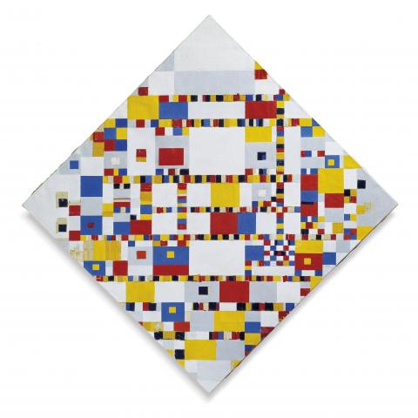
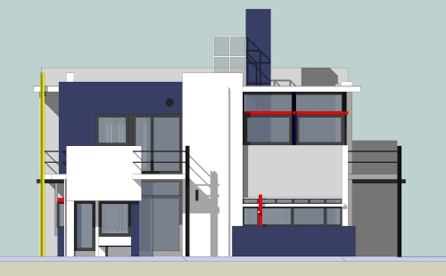
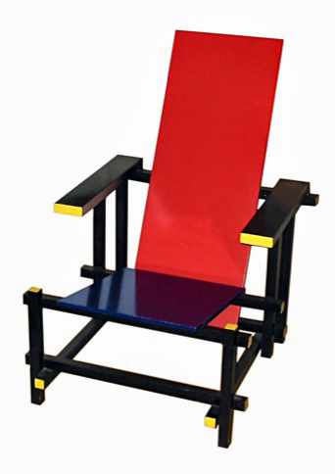
Architectural Styles
M.R.V. Chaudron
chaudron@chalmers.se | chaudron@cse.gu.se
https://en.wikipedia.org/wiki/De_Stijl

Slide 2
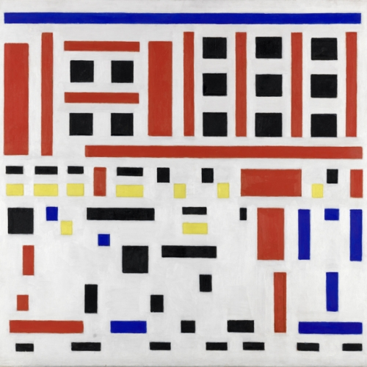
Bart van der Leck
Composition no. 4, Uitgaan van de fabriek, 1917

Slide 3
Schedule
Week |  | Date | Time | Lecture | Reading | Note
36 | L1 | 4 sept | 13:00 – 15:00 | Introduction & Organization
37 | L2 | 11 sept | 13:00 – 14:30 | Architecting Process & Views | Ch 1 & 2
37 | S1 | 12 sept | 10:15 – 12:00 | << Supervision/Assignment>>
38 | L3 | 18 sept | 13:00 - 15:00 | Requirements & Quality Attributes | Ch 3 & 4
38 | S2 | 19 sept | 13:00 – 15:00 | << Supervision/Assignment>>
38 | L4 | 20 sept | 13:15 – 15:00 | Architectural Styles 1 | Ch 13
39 | L5 | 25 sept | 13:15 – 15:00 | Architectural Styles 2 | Ch 13
39 | S3 | 26 sept | 10:15 – 12:00 | << Supervision/Assignment>>
39 | L6 | 27 sept | 13:15 – 15:00 | Roles and Responsibilities | Check Canvas
40 | L7 | 2 Oct | 13:15 – 15:00 | To be determined |  | UG
40 | S4 | 3 Oct | 10:15 – 12:00 | << Supervision/Assignment>> |  | UG
41 |  | 4 Oct | 13:00 – 15:00 | To be determined |  | UG
42 | L8 | 9 Oct | 13:15 – 15:00 | Technical Debt |  | PhD defence
41 | S5 | 10 Oct | 10:15 – 12:00 | << Supervision/Assignment>>
42 | L9 | 16 Oct | 13:15 – 15:00 | Design Principles | Ch 21
42 | S6 | 17 Oct | 10:15 – 12:00 | << Supervision/Assignment>> |  | check!
43 | L10 | 18 Oct | 13:15 – 15:00 | Architecture Evaluation | tbd
43 | L11 | 23 Oct | 13:15 – 15:00 | Reverse Engineering & Correspondence
43 | L12 | 24 Oct | 13:15 – 15:00 | To be determined (slack) | Ch 20
43 | L13 | 25 Oct | 13:00 – 15:00 | To be determined (exam practice?)

Slide 4
Learning Objectives of this lecture
The task of the architect is to come up
with a good metaphor for the system
Alexander Ran (Nokia)
Understand functional decomposition as design approach
Build vocabulary of architectural styles
a set of ‘archetypes’ that are often used
know their relative strengths and weaknesses
Today: (at least) Client-Server
Know when to apply or not to apply a particular style

Slide 5
Recap
Stakeholders have concerns
Forces influence the design of the architecture
Architectural Drivers are the forces that dominate the architecture design decisions
Drivers are a subset of forces
In assignment: explain why a force is a driver

Slide 6
Decomposition into Areas of Functionality
Notes:
Functional decomposition is helpful prior to creating functional requirements documents. If you need software for something, functional decomposition answers the question "What are the functions this software must provide". Decomposing is needed to define fine-grain functions. "I need software for energy efficiency measurement" is too general. That's why we break this into smaller pieces until the point where we clearly understand all the functions the systems need to provide. This can be later used as a checklist for completeness of a system.
A functional requirements document (FD) is basically a textual representation of functional decomposition. Coding directly from the FD may be ok for procedural languages, but it is not good enough for object-oriented solutions, because it doesn't identify objects. Neither is good for usability planning and testing.
My opinion is that you should take some time to create a FD, but not to use it too much of the time. Consult every person that knows the process you are following with your system to find all the functions needed.
I have a lot of experience in software design, development, and selling, and I use functional decomposition as the first step of development. I use it as a base for the contract, so the client knows what they will get and I know what I must provide.

Slide 7
Subsystems vs Layering
Functional Dimension
(in the ‘problem domain’)
Group Interaction
Ticketing
Payment
Queue Length
Layer 1
Layer 2
Layer 3
Decomposition in the
implementation / technology stack

Slide 8
Subsystems vs Layering
Functional
Dimension
Group Interaction
Ticketing
Payment
Queue Length
Layer 1
UI
Layer 2
Layer 3
DB
Decomposition in the
implementation / technology stack

Slide 9
Radio-Alarm Clock
Identify from subsystems the radio-alarm clock can be built.

Slide 10
Take 4 minutes to write down your ideas

Slide 11
Radio Alarm Clock (initial)
What should be the responsibility of each component?
radio
speaker
clock
buttons
timer
display

Slide 12
Radio Alarm Clock
Naming: aim for generality
audio supplier
audio rendering
music
speaker
time supplier
input handler
clock
input
output handler
timer
output
Alarm time supplier

Slide 13
Radio Alarm Clock
radio
audio supplier
CD
audio rendering
Internet-stream
music
speaker
time supplier
input handler
clock
input
output handler
timer
output
Alarm time supplier

Slide 14
Radio Alarm Clock
Is the controller a functional area or an implementation component?
music
speaker
clock
input
timer
output
controller
Notes:
Q: How about electricity? Is that a subsystem?
A: No – that is ‘implementation’ technology.

Slide 15
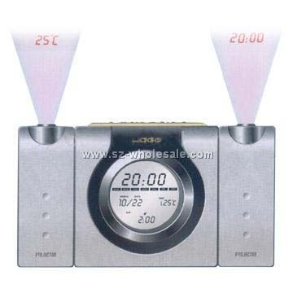
Radio Alarm Clock
Can your design easily accommodate extensions?
Alarm-time
temperature
lamp
Bat-alarm
(wireless) atomic clock
Train strike/traffic delays

Slide 16
Which Design and Why?
Buy Ticket
Book Hotel
Buy Ticket
Book Hotel
Payment
Payment
Payment

Slide 17
Factor out what is common
Buy Ticket
Book Hotel
Payment
Payment is
a common service
a clear cohesive responsibility

Slide 18
Example Design Case: Web Shop

Slide 19
Example Design Case: Web Shop
register
login
search
add item to
catalogue
add item to cart
remove item
from catalogue
customer
shop owner
remove item from cart
add to stock
pay items in cart
package & ship

Slide 20
Structure/Group Functionality
Defines subsystems of functionality
Purpose
Define decomposition into subsystems
Provide support for use-cases
Think in terms of responsibilities
Use Component diagram

Slide 21
Web Shop: Functional Areas (V0.1)
Customer
Registration
Shop Owner
Registration
Product Catalogue
Maintenance
Payment
Stock Control

Slide 22
Check Use Cases Against Functional Areas
login
Customer
Registration
Shop Owner
Registration
login
register
add item to
catalogue
search
Product Catalogue
Maintenance
remove item
from catalogue
Payment
Stock Control
pay items in cart
add to stock
?
package & ship
add item to cart
remove item from cart

Slide 23
Web Shop: Functional Areas (V0.2)
login
Customer
Registration
Shop Owner
Registration
login
register
add item to
catalogue
Product Catalogue
Maintenance
search
remove item
from catalogue
Payment
Stock Control
pay items in cart
add to stock
Excluded from example
Payment adm
Shop staff salary adm
...
add item to cart
package & ship
Customer Selection
Management
remove item from cart
Notes:
I consider as alternative name for Customer Selection Management to be Customer Session Management

Slide 24
Web Shop: Responsabilities
Customer Registration
Entry, storage & retrieval of customers
Shop Owner Registration
Entry, storage & retrieval of shop staff
Product Catalog Maint.
Entry, storage & retrieval of product data
Cust. Selection Mngmt.
Register customer product selection
Payment
Handle transaction between customer & shop
Stock Control
Register available products in stock

Slide 26
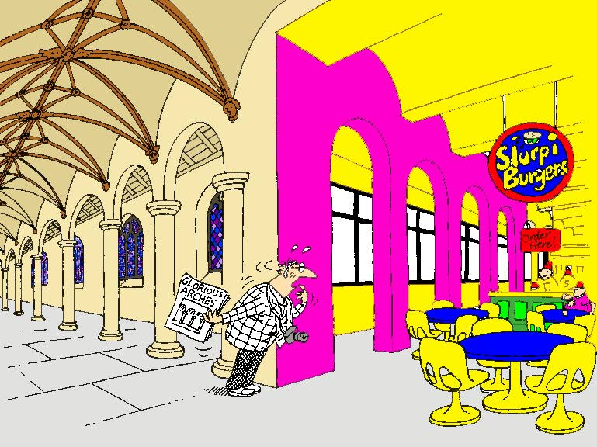
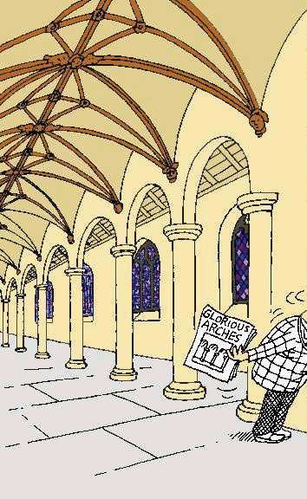
Conceptual integrity counter example!

Slide 27
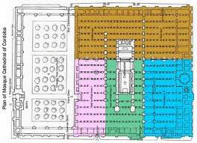
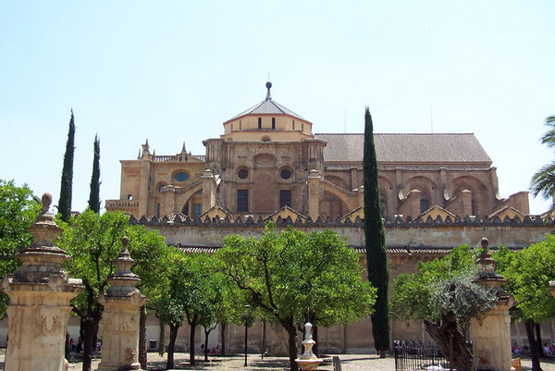
Cordoba, Spain

Slide 28
Conceptual Integrity in Software
Uniformity – where possible
Same solution-approach/tactic/design-principle applied to similar problems
For example in
Control/Data-flow patterns
Naming of variables
Structure of API’s
Layering
Exception-handling
User interface (dialogs)
Harmony

Slide 30
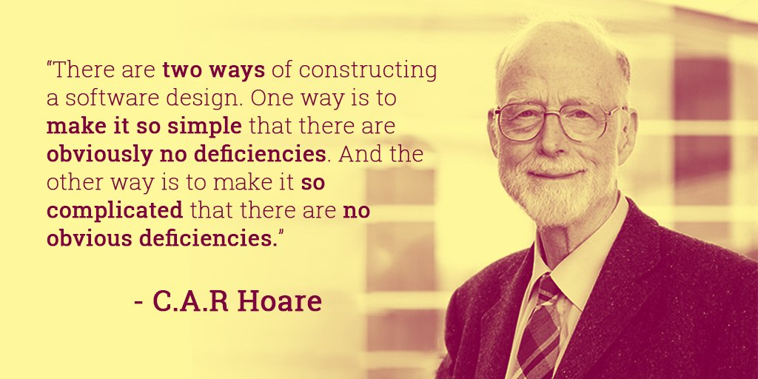

Slide 31
CONTENTS
Introduction
Architectural styles
2.1 Client/Server
2.2 Pipe and Filter style
2.3 Blackboard style
2.4 Publish Subscribe
2.5 Peer-to-Peer
2.6 Layered style
3. Interaction style
4. Conclusions

Slide 32
What is an Architectural Style?
Architectural styles are collections of design conventions for a set of design dimensions
Some architectural styles emphasize different aspects such as:
- Subdivision of functionality,
- topology
- interaction/coordination pattern between
components
An architecture can use several architectural styles
Architectural styles are not disjoint
Styles are open-ended; new styles may emerge

Slide 33
Architectural style 1/2
An architectural style is defined by:
a set of rules and constraints that prescribe
vocabulary/metaphor: which types of components, interfaces & connectors must/may be used in a system. Possibly introducing domain-specific types
structure: how components and connectors may be combined
behaviour: how the system behaves
guidelines: these support the application of the style (how to achieve certain system properties)

Slide 34
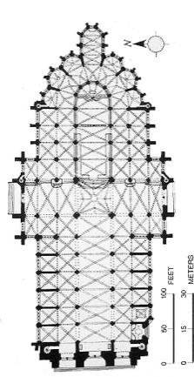
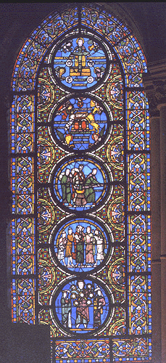
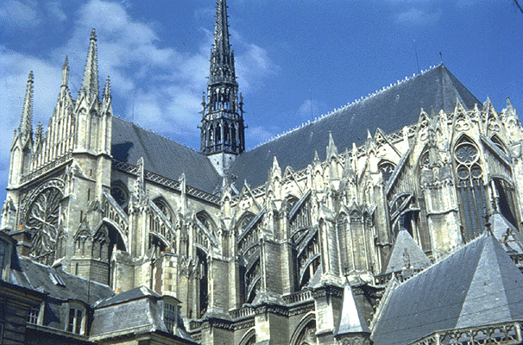
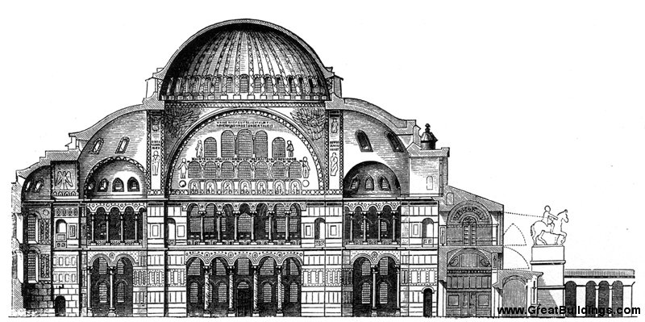
Architectural style
Nomenclature inspired by building architecture;
Buildings: Gothic, Byzantian, ….
Cathedral Amiens
Hagia Sofia, Istanbul
bridges: suspension, arc, … (check your Euro-notes)
http://en.wikipedia.org/wiki/Architectural_style
Notes:
An architectural style can be regarded as a set of constraints on the architectural components and their interaction
http://en.wikipedia.org/wiki/Architectural_style

Slide 35
Architectural style 2/2
An architecture style defines a family of systems in terms of a pattern of structural organization.
An architectural style defines
a vocabulary of components and connector types
a set of constraints on how they can be combined
one or more semantic models that specify how a system’s overall properties can be determined from the properties of its parts

Slide 36
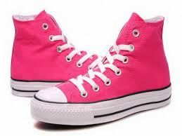
What is a Style?
Coordinated, aligned

Slide 37
Maturing Discipline
Architectural styles are the codification of
common recurring patterns of software design
Codification enables
communication, reuse, comparison
generally useful (generic)
generally easy to get right
generally as good as the alternatives

Slide 38
On Codification of Engineering Knowledge
Engineering is an art/craft, not an engineering discipline.
An engineering discipline encodes knowledge about successful solutions into rules such that ‘normal engineers’ can produce great systems.
Patrick Lardieri, Lockheed Martin MODELS 2007
(based on Shaw & Garlan)

Slide 39
CONTENTS
Introduction
Architectural styles
2.1 Client/Server
2.2 Pipe and Filter style
2.3 Blackboard style
2.4 Publish Subscribe
2.5 Peer-to-Peer
2.6 Layered style
3. Interaction style
4. Conclusions

Slide 40
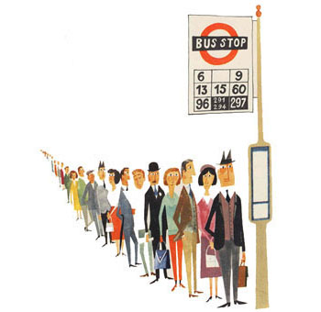
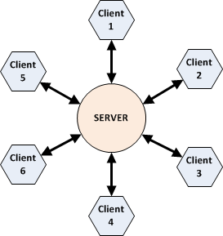
Client-Server Architectures
Nice source:
IT Architectures and Middleware:
Strategies for building Large Integrated Systems,
Chris Britton and Peter Bye, Addison Wesley, 2004

Slide 41
What is Client / Server?
Client: an application that makes requests (to the servers)
and handles input/output with the system environment
Server: an application that services requests from clients
Client/Server System:
an application that is built from clients and servers
Typical application area:
distributed multi-user (business) information systems
In real-life: client instructs/commands the server. Pitfall: keep an eye on (hidden) dependencies
Notes:
I will consider clients and servers to be applications.
It is possible that multiple applications run on a single computer.
In principle, it is possible that a single computer runs both client and server applications (although this is not the typical application).
The Client/Server paradigm is a combination of layering and request-response.

Slide 42
Why Client / Server?
±1980’s
- multiple users want to share and exchange data
- first: attempt: shared file-server
Applications
- problem:
scalability to ±10 due to contention for files and volume of data-transfer
- solution: perform processing on (file) server
files
File server
Notes:
Another force in the evolution:
- mainframe and mini-computers could not handle graphical user interfaces

Slide 43
3-tier Reference Model
presentation
logic
presentation logic ([G]UI):
anything that involves system/user interaction
e.g. dialogs (management), forms, reports
application
logic
data
management
application logic (data processing):
where the functionality of the application
resides / where the actual computation of the
system takes place
interfaces
to OS and network
data management:
storing, retrieving and updating data
Notes:
Essence of the model: separate the functionality in layers, where each layer has a
well-defined, coherent responsability

Slide 44
Client / Server Style
Concept: Separation of application in units of change
Components: presentation,
application logic,
business logic,
data management
Connector: ‘uses’ lower layer
Interaction style: request/response
presentation
logic
client
application
logic
business
logic
data
management
server
Notes:
A virtual machine architecture can empower the user
by defining a high-level language that allows him to express his ideas
in a easily understandable form
In this scenario, the ICT-specialist is not longer responsible
for the application programs
(that execute in a domain that is barely understood by him)
but only for the proper execution platform

Slide 45
Deployment of C/S Model
Rather than having the client do the processing …
Move processing power to server such that the server sends a (condensed) response to request rather than a whole file
presentation
logic
presentation
logic
presentation
logic
application
logic
shared data
application
logic
1 - tier
2 - tier
client
data
management
application
logic
data
management
data
management
server
Notes:
This slide shows various alternatives in the deployment of the layers.
A request is typically a Remote Procedure Call (RPC) or a SQL-query
The server has no user interface (for the application; does have one for maintenance).

Slide 46
C/S Example: Thin Client
Thin Client C/S:
largest part of processing at the server-side
presentation
logic
WWW Browser
application
logic
functional processing
data
management
database storage and access
Network load: low
Config. Mngmnt: simple (only server)
Security: concentrated at server
Robustness: stateless clients => easy fault recovery
Notes:
The (condensed) response of a request is passed over the network.
This incurs a lower network-load than thick-client.

Slide 47
C/S Example: Thick Client
Thick Client: significant processing
at the client-side
presentation
logic
WWW Browser
application
logic
application
(specific)
application
logic
application
(generic)
data
management
database
Network load: high
Config. Mngmnt: complex (both client & server)
Security: complex (both client & server)
Robustness: clients have state => complex fault recovery
Notes:
Here, application logic is divided over the client-platform and the server-platform

Slide 48
Client/Server in terms of Characteristics
Dependencies: client depends on the server
Topology: one or more clients may be connected to a
server there are no connections between clients
Multiplicity: 1-to-1, directed
Synchronicity: synchronous or asynchronous
Mobility: easily supports client mobiliy
Binding: from compile to invocation time
Initiative: request (by client) / response (by server)
Periodicity: typically a-periodic (periodic possible)
Security: typically controlled at server, also possible at application/business layer
Notes:
Ad multiplicity: Middleware (ORBs) are loosening the 1-to-1 directed style
Architectural Style and Interaction Style are introduced later. Briefly explain concepts.

Slide 49
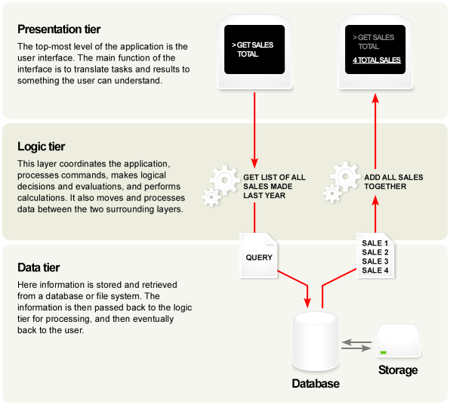
Example 3-tier System
(application)
Diagram from Wikipedia, 2007

Slide 50
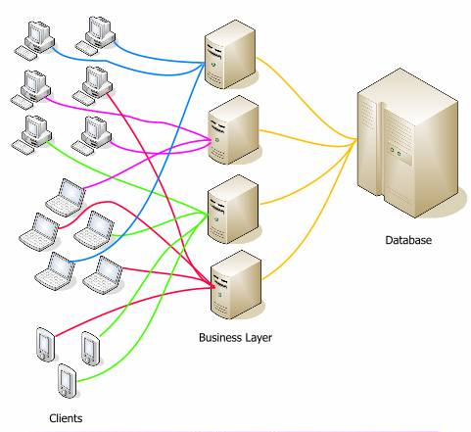
Deployment: Many physical clients and servers

Slide 51
Business Logic Layer
presentation
logic
An even broader organizational scope of sharing and exchanging data requires
coordination across multiple applications and databases
application
logic
The complexity of the middle tier ranges from
reactive with little intelligence
(e.g. resource management and interconnection services)
to active with much intelligence
(active enforcement of global constraints and coordination of
activities across applications e.g. workflow)
business
logic
data
management
Advantage of business logic-tier:
changes to business are localized
(compared to intertwining with application logic)
Notes:
Business logic is sometimes called “domain layer”

Slide 52
Types of business logic
Transaction Processing Manager/Monitor
Handling of transactions
queuing, coordination across multiple DB’s
TP Monitor decouples client-thread from server-thread
=> Increases scalability
Coordination of workflow
Message Queues
Advantages of Business Logic Layer
better scalability of application
security measures can be centrally allocated
separate maintenance of application and business logic

Slide 53
Client / Server Summary
Task are mapped on platform where they are most
efficiently handled
presentation layer on client
data management and storage on a server
possible intermediate platforms for transaction multiplexing and global coordination
With the aim of obtaining
scalability: changing number of clients
interoperability: client may use data from multiple sources

Slide 54
Emergent Interface Technologies
presentation
logic
presentation
logic
HTML, XML
application
logic
application
logic
business
logic
business
logic
ODBC
data
management
data
management
.Net, Corba, EJB
XML, SOAP, RDF
Notes:
Standardisation takes places at the interfaces of the components of the C/S reference model
SOAP: Simple Object Access Protocol
HTML : for application to presentation communication
CORBA/DCOM: standard for inter-application communication
XML : facilitates standard format for data-interchange with semantic information (self-descriptive)
ODBC : standard for database access

Slide 55
Client-Server
Advantages:
centralized data access
higher security
ease of maintenance
scalability (in clients)
interoperability (use of multiple sources)
Limitations:
single point of failure

Slide 56
WWW Sources for C/S
C/S-FAQ:
http://www.faqs.org/faqs/client-server-faq/
C/S info @ Software engineering institute Carnegie Mellon Univ.
http://www.sei.cmu.edu/str/descriptions/clientserver_body.html
Sectie over C/S bij een cursus @ TU Delft
http://www.sepa.tudelft.nl/modulemateriaal/tb141/Comms/inhoud.htm
Middleware (TP, MO-Mw, DB-Mw, Message-brokers and OBJ-brokers) http://www.sdmagazine.com/breakrm/features/s994f2.shtml

Slide 58
Summary Architectural Styles
Every Architect should have a standard set of
architectural styles in his/her repertoire
it is important to understand the essential properties
of each style: when to (not) use them
examples:
C/S, pipe and filters, blackboard, pub/sub, P2P
The choice for a style can make a big difference in
the quality properties of a system
analysis of the differences can provide rational for
choosing a style

Slide 59
CONTENTS
Introduction
Architectural styles
2.1 Client/Server
2.2 Pipe and Filter style
2.3 Blackboard style
2.4 Publish Subscribe
2.5 Peer-to-Peer
2.6 Layered style
3. Interaction style
4. Conclusions

