Slide 1
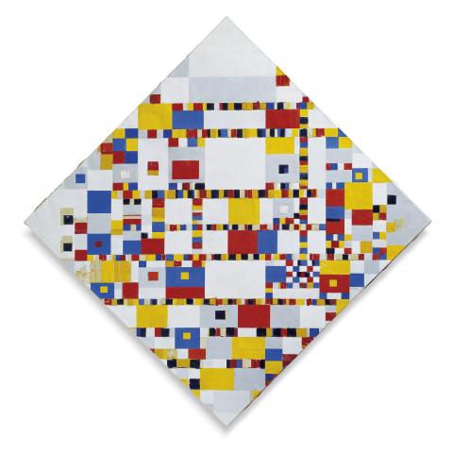
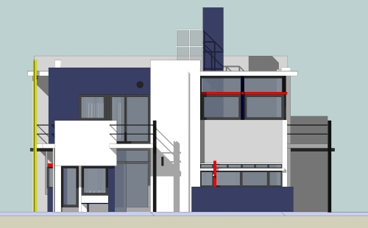
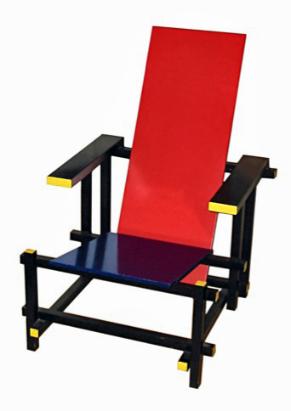
Architectural Styles - Part II
M.R.V. Chaudron
chaudron@chalmers.se | chaudron@gu.se

Slide 2
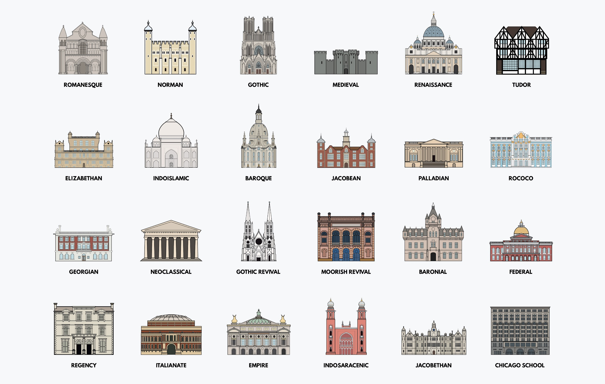

Slide 3
Schedule
Week |  | Date | Time | Lecture | Reading | Note
36 | L1 | 4 sept | 13:00 – 15:00 | Introduction & Organization
37 | L2 | 11 sept | 13:00 – 14:30 | Architecting Process & Views | Ch 1 & 2
37 | S1 | 12 sept | 10:15 – 12:00 | << Supervision/Assignment>>
38 | L3 | 18 sept | 13:00 - 15:00 | Requirements & Quality Attributes | Ch 3 & 4
38 | S2 | 19 sept | 13:00 – 15:00 | << Supervision/Assignment>>
38 | L4 | 20 sept | 13:15 – 15:00 | Architectural Styles 1 | Ch 13
39 | L5 | 25 sept | 13:15 – 15:00 | Architectural Styles 2 | Ch 13
39 | S3 | 26 sept | 10:15 – 12:00 | << Supervision/Assignment>>
39 | L6 | 27 sept | 13:15 – 15:00 | (finish) Architectural Styles & Tactics
40 | L7 | 2 Oct | 13:15 – 15:00 | The Human Factor in Software Architecturing: Cognitive and Social Aspects | Ch 18 | Rodi Jolak
40 | S4 | 3 Oct | 10:15 – 12:00 | << Supervision/Assignment>> |  | UG
41 |  | 4 Oct | 13:00 – 15:00 | skip |  | UG
42 | L8 | 9 Oct | 13:15 – 15:00 | Technical Debt (Terese Besker) |  | PhD defence
41 | S5 | 10 Oct | 10:15 – 12:00 | << Supervision/Assignment>>
42 | L9 | 16 Oct | 13:15 – 15:00 | Design Principles (Tactics) | Ch 6, 7
42 | S6 | 17 Oct | 10:15 – 12:00 | << Supervision/Assignment>> |  | check!
43 | L10 | 18 Oct | 13:15 – 15:00 | Architecture Evaluation | Ch 21
43 | L11 | 23 Oct | 13:15 – 15:00 | Reverse Engineering & Correspondence | Ch 20
43 | L12 | 24 Oct | 13:15 – 15:00 | Lindholmen Software Development Days
43 | L13 | 25 Oct | 13:00 – 15:00 | To be determined (exam practice)
Notes:
2019: other topics that could be added:
- Risk management

Slide 4
Theme/Objective of this lecture
The task of the architect is to come up
with a good metaphor for the system
Alexander Ran (Nokia)
Build vocabulary of architectural styles
  a set of ‘archetypes’ that are often used
  know their relative strengths and weaknesses
Know when to apply or not to apply a particular style

Slide 5
Architectural style 1/2
An architectural style is defined by:
a set of rules and constraints that prescribe
  vocabulary/metaphor: which types of components,
  interfaces & connectors must/may be used
  in a system.
  Possibly introducing domain-specific types
  structure: how components and connectors may be
  combined
  behaviour: how the system behaves
  guidelines: these support the application of the style
  (how to achieve certain system properties)

Slide 6
Architectural style
Architectural styles are design paradigms for
a set of design dimensions
  Some architectural styles emphasize different aspects
  such as: Subdivision of functionality, Topology or
  Interaction style
Styles are open-ended; new styles will emerge
An architecture can use several architectural styles
Architectural styles are not disjoint
Notes:
An architectural style can be regarded as a set of constraints on the architectural components and their interaction

Slide 7
Used diagrams/slides
from this book

Slide 8
Client-Server (S+B+D)
There is more than structure
to a style!
Client
1..*
1
Server
Client
Server
Client
Server

Slide 9
Client / Server Style
Concept: Separation of application in units of change
Components: presentation,
application logic,
business logic,
data management
Connector: ‘uses’ lower layer
Interaction style: request/response
presentation
logic
client
application
logic
business
logic
data
management
server
Notes:
A virtual machine architecture can empower the user
by defining a high-level language that allows him to express his ideas
in a easily understandable form
In this scenario, the ICT-specialist is not longer responsible
for the application programs
(that execute in a domain that is barely understood by him)
but only for the proper execution platform

Slide 14
Recap
Client-Server
Pipe and Filter
Conceptual Integrity

Slide 15
CONTENTS
Introduction
Architectural styles
2.1 Client/Server
2.2 Pipe and Filter style
2.3 Blackboard style
2.4 Publish Subscribe
2.5 Peer-to-Peer
2.6 Layered style
3. Interaction style
4. Conclusions

Slide 16
CONTENTS
Introduction
Architectural styles
2.1 Client/Server
2.2 Pipe and Filter style
2.3 Blackboard style
2.4 Publish Subscribe
2.5 Peer-to-Peer
2.6 Layered style
3. Interaction style
4. Conclusions

Slide 17
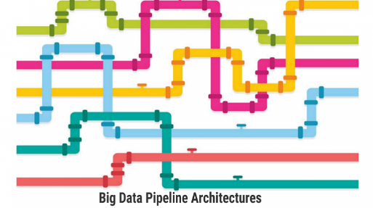
Pipe and Filter Style (1)
Concept: Series of filters / transformation
  where each component is consumer and producer
Filter 1
Filter 2
Filter 3
Filter 4
Components: filters / transformations
possibly also: sources and sinks
Connectors: pipes;
interaction style: streaming of data
Topology: linear; possible variations:
feedback-loops, splitting pipes
computational component
data flow

Slide 18
Special types of filters (?)
Pump (Producer/Source)
Produces data and puts it to an output port that is connected to the input end of a pipe.
Sink (Consumer)
Gets data from the input port that is connected to the output end of a pipe and consumes the data.

Slide 19
Pipe and Filter Style (2)
Filter 1
Filter 2
Filter 3
Filter 4
Constraints about the way filters and pipes can be joined:
Unidirectional flow
Control flow derived from data flow
Behaviour Types:
a. Batch sequential
  Run to completion per transformation
b. Continuous
  Incremental transformation
  variants: push, pull, asynchronous

Slide 20
Pipe and Filter Style (3)
Filter 1
Filter 2
Filter 3
Filter 4
Semantic Constraints
Filters are independent entities
- they do not share state
- they do not know their predecessor/successor
What are the dependencies between filters?
Compare this with Client Server?

Slide 21
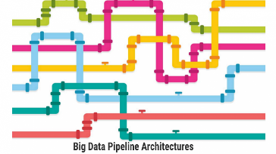
Pipe and Filter (Struct+Behaviour)
Source
Filter1
Filter2
Sink
Source
Filter1
Filter2
Sink

Slide 22
Pipe and Filter (Struct+Behaviour)
Source
Filter1
Filter2
Sink
Source
Filter1
Filter2
Sink

Slide 23
Pipe and Filter (Deployment)
Source
Filter1
Filter2
Sink

Slide 24
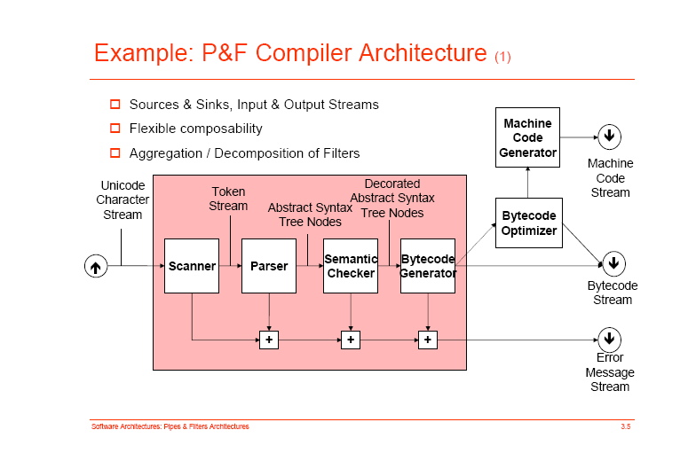

Slide 25
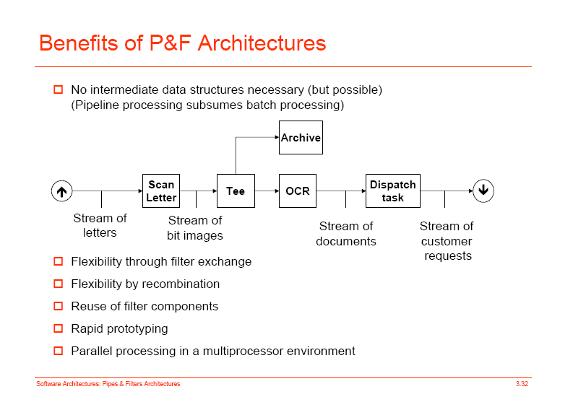
Example P&F Architecture

Slide 26
Pipe and Filter Style (4a)
Advantages:
Simplicity:
  no complex component interactions
  easy to analyze (deadlock, throughput, … )
Easy to maintain and to reuse
Filters are easy to compose (also hierarchically?)
Can be easily made parallel or distributed
Notes:
What is wrong with ASCI as data representation? There is XML in which to code semantic information.

Slide 27
Pipe and Filter Style (4b)
Disadvantages:
Interactive applications are difficult to create
Filter ordering can be difficult
Performance:
  - Enforcement of lowest common data representation,
  ASCII stream, may lead to (un)parse overhead
- If output can only be produced after all input is
received, an infinite input buffer is required
(e.g. sort filter)
If bounded buffers are used, deadlocks may occur
Notes:
What is wrong with ASCI as data representation? There is XML in which to code semantic information.

Slide 28
ls | grep ‘architecture’ | sort
  First ‘list files in directory’, then keep only files with ‘architecture’ in name, then sort this list
ls | sort ls | grep ‘architecture’
This rearrangement works because components have the same input and output: the ‘lowest common denominator’ is a stream of lines of characters.

Slide 29
Pipe and Filter Style (5)
Quality Factors
Extendibility: extends easily with new filters
Flexibility: - functionality of filters can be easily redefined,
- control can be re-routed
(both at design-time, run-time is difficult)
Robustness: ‘weakest link’ is limitation
Security: -
Performance: allows straightforward parallelisation

Slide 30
Pipe and Filter Style (6)
Application Context
Rules of thumb for choosing pipe-and-filter (o.a. from Shaw/Buschman):
if a system can be described by a regular interaction pattern of a
collection of processing units at the same level of abstraction;
e.g. a series of incremental stages
(horizontal composition of functionality);
if the computation involves the transformation of streams of data
(processes with limited fan-in/fan-out)
Hint: use a looped-pipe-and-filter if the system does continuous controlling of a physical system
Typical application domain: signal processing

Slide 31
CONTENTS
Introduction
Architectural styles
2.1 Client/Server
2.2 Pipe and Filter style
2.3 Blackboard style
2.4 Publish Subscribe
2.5 Peer-to-Peer
2.6 Layered style
3. Interaction style
4. Conclusions

Slide 32
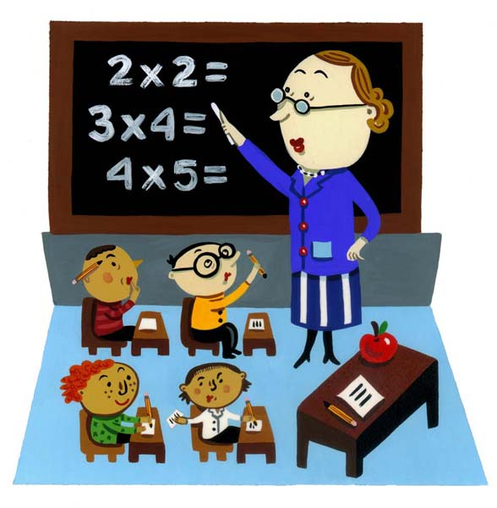
Blackboard Style (1)
Concept: Concurrent transformations on
shared data
data
Component
Component
Component
Components: processing units (typically knowledge source)
Connectors: blackboard
interaction style: asynchronous
Topology: one or more transformation-components may
be connected to a data-space,
there are typically no connections between
processing units (bus-topology)
Notes:
Overlap with Client-Server paradigm
if repository is passive and encapsulated and all clients are active
What are the connectors in the blackboard architecture?
- the links between the processing units and the dataspace?
- or the actual blackboard mechanism
(which connects all processing units together)?

Slide 33
Blackboard Style (2)
Behaviour Types:
a. Passive repository
  Accessed by a set of components; e.g. database or server
b. Active repository
  Sends notification to components when data of interest changes; e.g. blackboard or active database
data
Component
Component
Component
Constraints:
Consistency of repository: Various types of (transaction) consistency

Slide 34
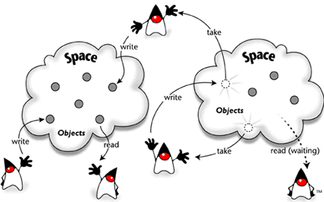
JavaSpaces – Blackboard in Java

Slide 35
Layering & Blackboard
UI
UI
UI
UI
A
B
C
A
B
C
BB
BB

Slide 36
Blackboard Style (3)
Advantages:
Allows different control heuristics
Reusable & heterogeneous knowledge sources
Support for fault tolerance and robustness
by adding redundant components
+/- Dataflow is not directly visible
Disadvantages
Distributed implementation is complex
  distribution and consistency issues

Slide 37
Blackboard Characteristics
Data may be structured (DB) or unstructured
Data may be selected based on content
Applications may insert/retrieve different data-type
per access.
This in contrast to pub-sub where data of the same type
is retrieved repeatedly

Slide 38
Blackboard and consistency
C1
C2
C3
Delete(Z)
Insert(Z)
BB
A..Z
A..Z
A..Z
Node1
Node2
Node3
Node 1, 2 and 3 are all storing a copy of the entire
dataset (A-Z). This increases reliability & availability
and improves response time *(. But ….

Slide 39
Blackboard and consistency
C1
C2
C3
Delete(Z)
Insert(Z)
BB
A..Z
A..Z
A..Z
Node1
Node2
Node3
C1 and C3 may ‘see’ a different content on the blackboard
depending on the order (and speed) of executing the delete
and insert actions.

Slide 40
Example of Blackboard Architecture
Hearsay, speech understanding
Hearsay was developed in the 1970’s by Raj Reddy et al. at Carnegie Mellon University.
Randy Davis, Speech Understanding Using Hearsay, MIT videotape, 1984.
Slides adapted from Terry Bahill, Univ. Arizona, 2007

Slide 41
Hearsay: knowledge sources
Acoustics
Spectrographs
Phonetics
Pronunciation
Coarticulation
Syntax
Semantics
Pragmatics
data
Acoustics
Spectrogr.
Phonetics
Syntax
Pronunciation
Semantics
Pragmatics
Notes:
Phoneme triples was considered but not implemented in Hearsay.

Slide 42
Hearsay: levels of abstraction*
Notes:
The Randy Davis’ slides showed interactions at only one level above and one level below (with one exception).
For the lower three levels they turned off the top-down – bottom-up structure of the blackboard and forced it to do bottom-up only until they got to the word level.

Slide 43
A blackboard architecture for countering terrorism
Rubin, S.H.; Smith, M.H.; Trajkovic, L.
Systems, Man and Cybernetics, 2003. IEEE International Conference on
Volume 2, Issue , 5-8 Oct. 2003 Page(s): 1550 - 1553 vol.2

Slide 44
L.D. Erman, F. Hayes-Roth, V.R. Lesser and D. R. Reddy, “The Hearsay-II speech understanding system: integrating knowledge to resolve uncertainty”, ACM Computing Surveys 12(2), pp213-253, 1980.
L.D. Erman, P.E. London and S. F. Fickas, “The Design and an Example Use of Hearsay-II”, Proc. IJCAI-81, pp 409-415, 1981.

Slide 45
Hearsay: control
Data driven
Asynchronous
Opportunistic
Islands of reliability
Combined top-down and bottom-up

Slide 46
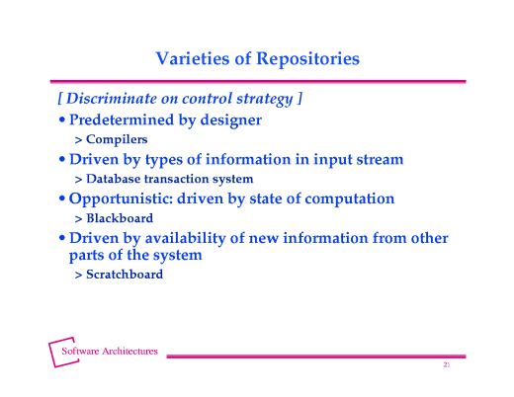
From http://www.cs.cmu.edu/afs/cs/project/tinker-arch/www/html/1997/lectures/19.Blkbd/base.020.html

Slide 47
Blackboard Style (4) Quality Factors
Extensibility: components can be easily added
Flexibility: functionality of components can be easily
changed
Robustness: + components can be replicated,
- blackboard is single point of failure
Security: - all process share the same data
+ security measures can be centralized
around blackboard
Performance: easy to execute in parallel fashion
consistency may incur synchroniz.-penalty

Slide 48
Blackboard Style (5) Application Context
Rules of thumb for choosing blackboard (o.a. from Shaw):
if representation & management of data is a central issue
if data is long-lived
if order of computation
  can not be determined a-priori
  is highly irregular
  changes dynamically
if units of different functionality (typically containing
highly specialized knowledge) concurrently act on shared
data (horizontal composition of functionality)
Example application domain: expert systems

Slide 49
CONTENTS
Introduction
Architectural styles
2.1 Client/Server
2.2 Pipe and Filter style
2.3 Blackboard style
2.4 Publish Subscribe
2.5 Peer-to-Peer
2.6 Layered style
3. Interaction style
4. Conclusions

Slide 50
Summary Architectural Styles
Every Architect should have a standard set of
architectural styles in his/her repertoire
it is important to understand the essential properties
of each style: when to (not) use them
examples:
  C/S, pipe and filters, blackboard, pub/sub, P2P
The choice for a style can make a big difference in
the quality properties of a system
analysis of the differences can provide rational for
choosing a style

Slide 51
Questions ?

