Slide 1
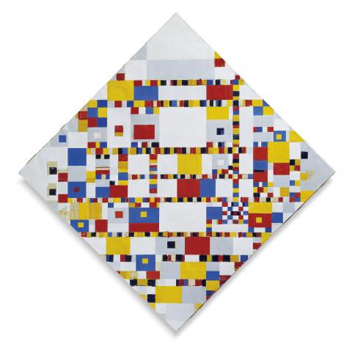
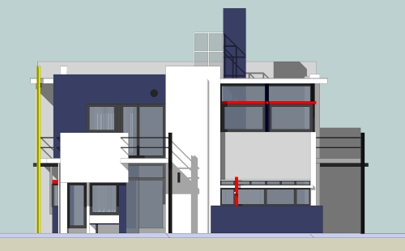
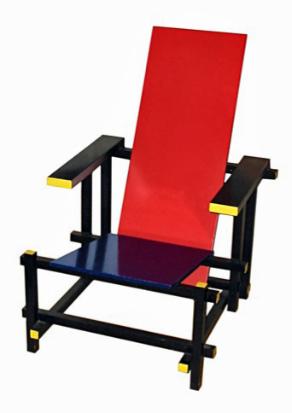
Architectural Styles - Part III
Publish-Subscribe
M.R.V. Chaudron
chaudron@chalmers.se | chaudron@gu.se

Slide 2
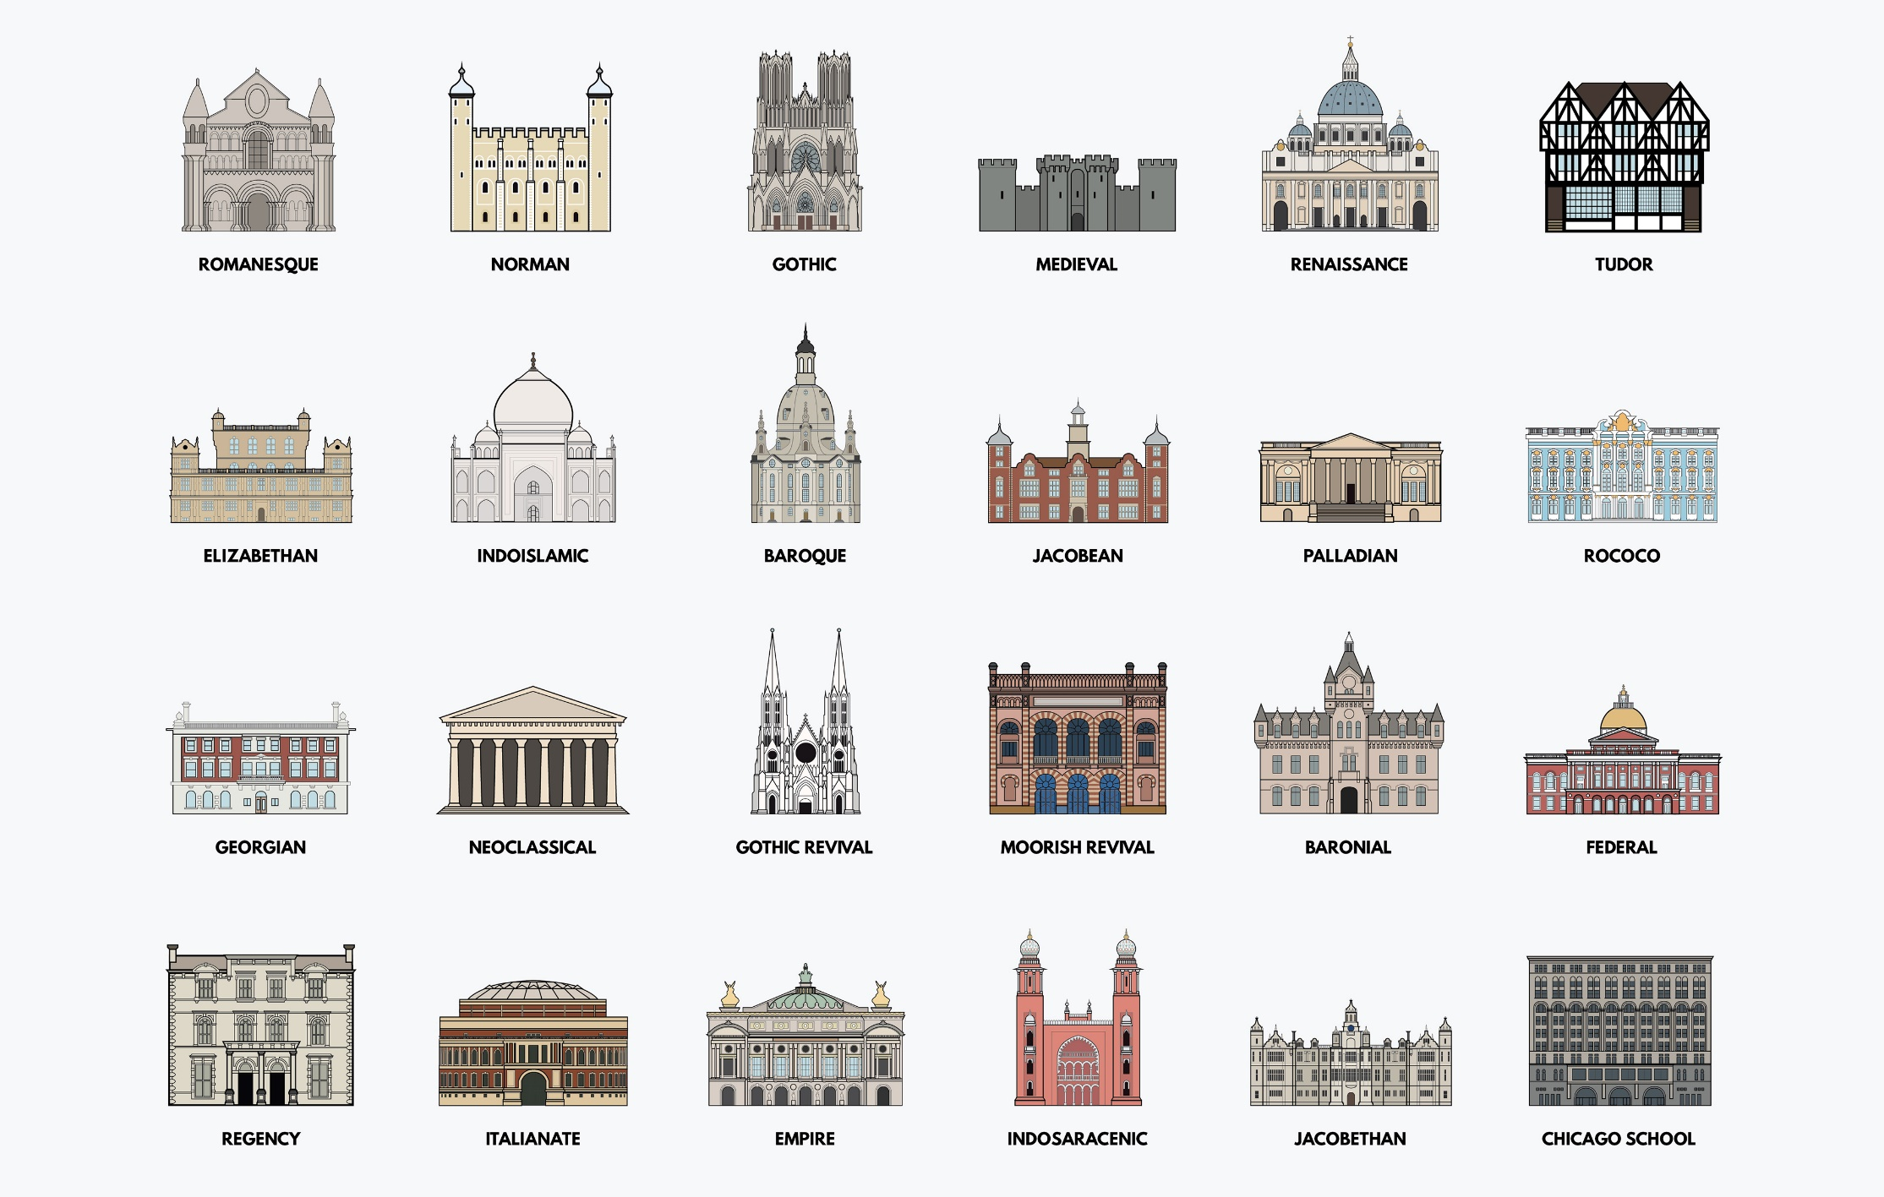

Slide 3
Schedule
Week |  | Date | Time | Lecture | Reading | Note
36 | L1 | 4 sept | 13:00 – 15:00 | Introduction & Organization
37 | L2 | 11 sept | 13:00 – 14:30 | Architecting Process & Views | Ch 1 & 2
37 | S1 | 12 sept | 10:15 – 12:00 | << Supervision/Assignment>>
38 | L3 | 18 sept | 13:00 - 15:00 | Requirements & Quality Attributes | Ch 3 & 4
38 | S2 | 19 sept | 13:00 – 15:00 | << Supervision/Assignment>>
38 | L4 | 20 sept | 13:15 – 15:00 | Architectural Styles 1 | Ch 13
39 | L5 | 25 sept | 13:15 – 15:00 | Architectural Styles 2 | Ch 13
39 | S3 | 26 sept | 10:15 – 12:00 | << Supervision/Assignment>>
39 | L6 | 27 sept | 13:15 – 15:00 | (finish) Architectural Styles & Tactics
40 | L7 | 2 Oct | 13:15 – 15:00 | The Human Factor in Software Architecturing: Cognitive and Social Aspects | Ch 18 | Rodi Jolak
40 | S4 | 3 Oct | 10:15 – 12:00 | << Supervision/Assignment>> |  | UG
41 |  | 4 Oct | 13:00 – 15:00 | skip |  | UG
42 | L8 | 9 Oct | 13:15 – 15:00 | Technical Debt (Terese Besker) |  | PhD defence
41 | S5 | 10 Oct | 10:15 – 12:00 | << Supervision/Assignment>>
42 | L9 | 16 Oct | 13:15 – 15:00 | Design Principles (Tactics) | Ch 6, 7
42 | S6 | 17 Oct | 10:15 – 12:00 | << Supervision/Assignment>> |  | check!
43 | L10 | 18 Oct | 13:15 – 15:00 | Architecture Evaluation | Ch 21
43 | L11 | 23 Oct | 13:15 – 15:00 | Reverse Engineering & Correspondence | Ch 20
43 | L12 | 24 Oct | 13:15 – 15:00 | Lindholmen Software Development Days
43 | L13 | 25 Oct | 13:00 – 15:00 | Guest lecture Volvo
Notes:
2019: other topics that could be added:
- Risk management

Slide 4
Theme/Objective of this lecture
The task of the architect is to come up
with a good metaphor for the system
Alexander Ran (Nokia)
Build vocabulary of architectural styles
  a set of ‘archetypes’ that are often used
  know their relative strengths and weaknesses
Know when to apply or not to apply a particular style

Slide 5
Architectural style 1/2
An architectural style is defined by:
a set of rules and constraints that prescribe
  vocabulary/metaphor: which types of components,
  interfaces & connectors must/may be used
  in a system.
  Possibly introducing domain-specific types
  structure: how components and connectors may be
  combined
  behaviour: how the system behaves
  guidelines: these support the application of the style
  (how to achieve certain system properties)

Slide 6
CONTENTS
Introduction
Architectural styles
2.1 Client/Server
2.2 Pipe and Filter style
2.3 Blackboard style
2.4 Publish Subscribe
2.5 Layered style
2.6 Peer-to-Peer
3. Interaction style
4. Conclusions

Slide 7
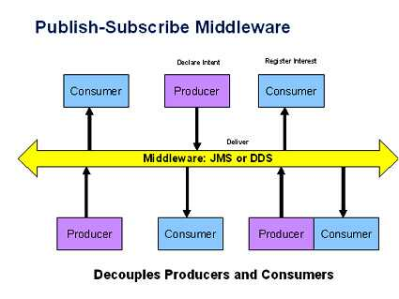
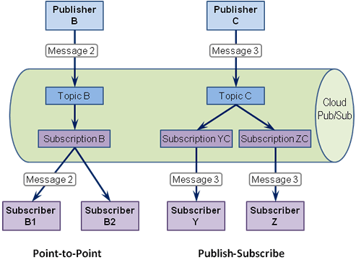
Publish-Subscribe

Slide 8
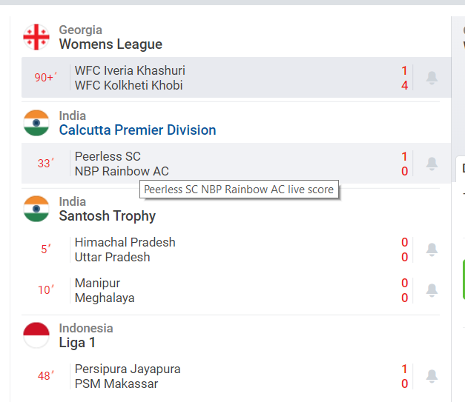

Publish-Subscribe
P/S is like: subscriptions that you know:
e.g. newspapers or live sports highlights:

Slide 9
Publish-Subscribe
Components interact via announced messages, or events.
  Components may subscribe to a set of events.
  It is the job of the publish-subscribe runtime infrastructure to make sure that each published event is delivered to all subscribers of that event.
Advantages: loose coupling, scalability, extendibility, improved security (messages sent to subscribers only)
Limitations: need to guarantee delivery, performance problems when overloaded with messages

Slide 10
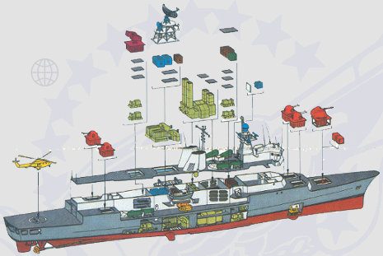
Publish-Subscribe Style
Case Study: SPLICE
Developed by Thales (formerly Hollandse Signaal App.)
Oriented towards high quality control systems:
Distributed
Fault tolerant (support
of degraded modes)
(Soft) real-time
Extensible
F124 frigate

Slide 11
Architecture Requirements
The architecture is characterized as:
real-time
distributed
data driven
fault tolerant
with some typical figures:
50 nodes containing 170 CPU’s
2200 active executables
4000 Hz. data-updates over Network
>2000 distributed data-types

Slide 12
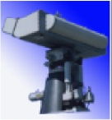
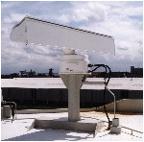


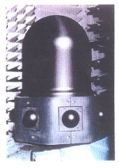
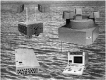
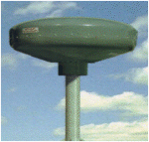
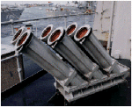
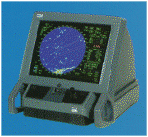
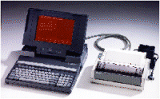
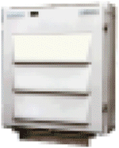

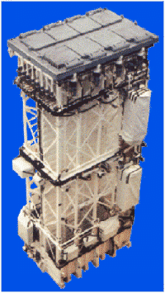

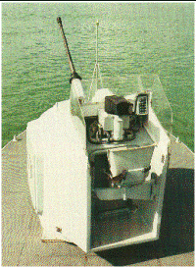
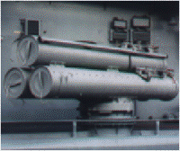
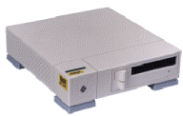
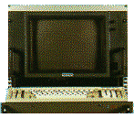


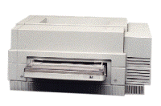
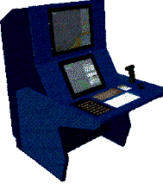
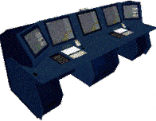
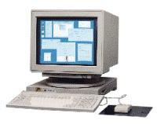
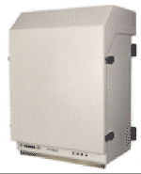
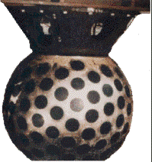
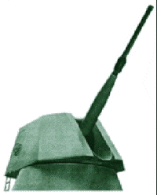
Configuration example: frigate size system
3D SURV. RADAR
MW08 & IFF
SCOUT FMCW
BRIDGEMASTER
LPI RADAR
NAVIGATION
RADAR
BRIDGEMASTER
STING BS/ CW
TRACK
RADAR
MIRADOR
E / O
TRACKER
IRSCAN
IR SEARCH /
TRACK
TARGET
DES. SIGHT
PORT & STBD
DATA
LINK 11
DR3000
SLW
ESM
SALAMANDRE
ECM
DECOY
SYSTEM
ALEX/SRBOC
MK36
ALTESSE
COM
ESM
TRANSPONDER
FMCW
TO
BRIDGE
MFC
DTS
LINK 11
INTERROGATOR
TO
BRIDGE
MFC
SENSORS
BTS
NAVRAD
BTS
NAV
BTS
TDS
BTS
LINK 11
BTS
EW
DUAL DATA DISTRIBUTION BUS
DUAL VIDEO DISTRIBUTION BUS
CMS
INTERNAL
COMMS
FOCON-32
EXTERNAL
COMMS
MESSAGE
HANDLING
PIOD/PCDU
TACTICOS with MOC-Mk3
GSS
FIBRE OPTIC BUS
WEAPONS /
SONAR /
NAV
BTS
RAM
MIC
MK41
BTS
SSM
GIC
76mm
GIC
30mm
GIC
30mm
BTS
TORP
BTS
HMS
BTS
TAS
BTS
OSD
XBT/
XSV
RAM
ASM
VLS SAM-MK41
LAUNCHING
SYSTEM
(ASROC OPTION)
SSM-LR
BOFORS
RBS15 MK3
GUN
76 MM
OSRG
GUN
30 MM
GUN
30 MM
B515
TORPEDO
SYSTEM
HULL
MOUNTED
SONAR
ACT.TOWED
ARRAY
SONAR
WIND/GPS
SHIPS REF.
SENSORS

Slide 13
Combat-Management-System Overview
SMART-L
APAR
KH/SCOUT
NAV. RADAR
HELI APPR.
RADAR
VESTA
OFF LINE
R/S
SIRIUS
TDS (2x)
POS
SYSTEM
SHIP’S REF.
IRC
sensors
APECS-3
ESM / ECM
IFF
LINK 11
SRBOC
VESTA
CATV BUS
TDLPP
VEX/
RCP
BTS
OSD
BTS
OSD
ATM NETWORK
VIDEO INTERFACE
CABINET
LARGE SCREEN
DISPLAY 1
LARGE SCREEN DISPLAY 2
VCR 1/2
Data-handling
SPARE
FL. DECK
TV CAMERA
TV CAMERA
COMBAT INFORMATION CENTER
STAFF ROOM
BRIDGE
COMMS ROOM
DEPARTMENT OFF. / OFF. QUARTERS
ETC.
WORKSTATION 01 WORKSTATION M
COTS & SIGMA TYPE PROCESSOR
PIOD /
PTSU
15
15
15
15
PRINTERS
TORPEDO
WEAPON
SYSTEM
MK32 MOD-9
(MK46)
GIC-
127
MIC-
MK41
MIC-
MK41
INTEGRATED
MACHINERY
CONTROL
SYSTEM
CCC1 CCC2
actuators
COMMS NETWORK
SPHERION
+ XBT / XSV
+ SURF. TEMP. REC.
ATAS
HARPOON
GUN 127 MM
30 MM GUNS
OFF LINE
MK41 SM2
LAUNCHER
GOALKEEPER

Slide 14
SPLICE Application Domain
Used in command and control & traffic mgm. systems
Typical process:
  Acquire input-signals through sensors
  Process input-signals
  Interpret input in terms of environment model
  Take action through effectors
  or support operators in decision making
The interpretation of input may require the
sharing of data between many different applications that act in irregular patterns
Notes:
Processing of input means filtering, noise reduction, …

Slide 15
SPLICE Pub/Sub-Model
Applications are concurrently executing processes that implement part of the overall functionality
Processes register with network agents whether they are producers or consumers of a type of data.
The network agents manage distribution of data.
process
process
process
applications
agent
agent
agent
network
Notes:
When a process declares that it wants to use certain data of a certain type (sort), then this process’ agent subscribes to that sort.
Whenever a process writes data, then this process’ agent broadcasts (or multi-casts) this data to all agents.
The agents forward data of types that the corresponding process is interested in (subscribed to).

Slide 16
SPLICE Data Sorts
Data elements are labeled records.
Each record has a system-wide unique label,
  called the data sort
A field of a sort may be declared key if it
  uniquely determines the values of the non-key fields
sort flightplan
  key flightnumber : string
  Departure : time
  Arrival : time
  Aircraft : string
sort track
  key flightnumber : string
  key index : integer
  State : string

Slide 17
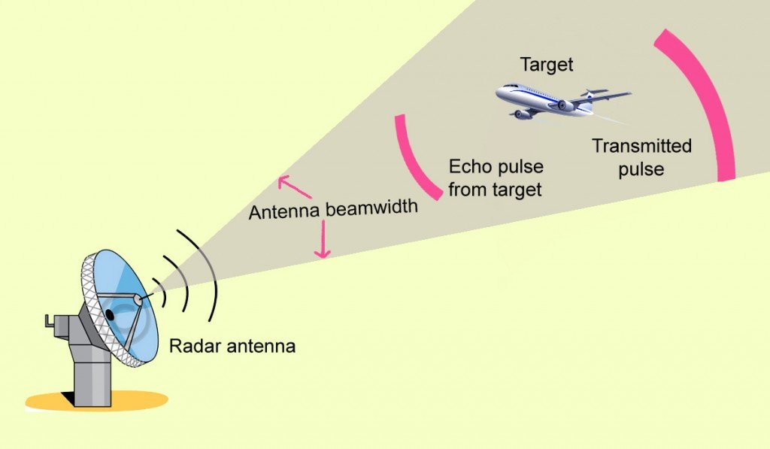
SPLICE Example (1/5)
Consider a system for tracking flying objects:
Observations are made by a radar
  (and are called plots), i.e. the acquisition sensor
Plots are correlated into tracks, that are
  interpreted in terms of a flight trajectory model
Tracks are used to control the direction of the radar
  and for taking action through effectors)

Slide 18
SPLICE Example (2/5)
Processes
  Radar: generates signals
  Detect: processes radar signals into plots
  Track: correlates plots into tracks
  Predict: predicts next coordinates of the flying object
  Control: the radar to probe the next position of the object
  UI: user interface of the system
Sorts (=data types)
  D0: radar signals
  D1: control data to the radar
  D2: plots (coordinates) from the radar
  D3: sensor characteristics
  D4: speed-vector of the object
  D5: predicted object coordinates
  D6: user commands

Slide 19
Application model using one-to-one connections
radar
detect
track
predict
control
UI
Notes:
This diagram shows the subscriptions of data sorts.

Slide 20
SPLICE Example program (4/5)
Program Detect
sort raw_data: radar_signals consumed
sort obj_pos: coordinates produced
signal: sensor_data
Forever do
signal := get(raw_data);
if valid_signal(signal)
then obj_pos:= f(signal); put(obj_pos)
else { corrective action }
End program Detect
What happens when multiple copies of
Detect are running concurrently?
Notes:
Multiple copies increase redundancy

Slide 21
SPLICE Example (5/5)
Program Predict
sort radar_attr: sensor_attr consumed
sort track_data: track consumed
sort pred_coord: coordinates produced
sort user_cmnd: command consumed
result: integer
local_track: track
get(radar_attr);
Forever do
result := get(track_data);
if valid_track(result)
then
{ local_track:=predict new coordinates};
put(obj_pos)
else
if local_track.timestamp + radar_attr.cycle_time >
time – comm_delay
then { new data too late; corrective action };
result := get(user_cmnd);
if valid_cmnd(result)
then { deal with command }
End program Predict

Slide 22
P/S Deployment
node A
node B
node C
producer
consumer
consumer
subscriptions
Type x: B,C
subscriptions
Type x: B,C
subscriptions
Type x: B,C
agent
agent
agent
network
middleware
producer
= application software component
agent
= middleware software component

Slide 23
Upgrading in the publish-subscribe style

Slide 24
Registration Phase
node A
node B
node C
producer
consumer
consumer
subscriptions
Type x: B,C
subscriptions
Type x: B,C
subscriptions
Type x: B,C
agent
agent
agent
network

Slide 25
Distribution Phase
node A
node B
node C
producer
consumer
consumer
X
X
subscriptions
Type x: B,C
subscriptions
Type x: B,C
subscriptions
Type x: B,C
agent
agent
agent
network

Slide 26
Distribution Phase
node A
node B
node C
producer
consumer
consumer
X
subscriptions
Type x: B,C
subscriptions
Type x: B,C
subscriptions
Type x: B,C
agent
agent
agent
X
X
network

Slide 27
Distribution Phase
node A
node B
node C
producer
consumer
consumer
X
subscriptions
Type x: B,C
subscriptions
Type x: B,C
subscriptions
Type x: B,C
agent
agent
agent
X
X
network

Slide 28
Insert New Consumer Component
node B’
node A
node B
node C
consumer
producer
consumer
consumer
X
X
X
agent
agent
agent
agent
network
B’ can build up state from inputs it receives.
If B and B’ both consume and produce data,
then duplicate data is generated.
B’ can monitor output of B to check convergence

Slide 29
Phase out old Consumer Component
node B’
node A
node B
node C
consumer
producer
consumer
consumer
X
X
X
agent
agent
agent
agent
network
Once B’ has converged with B, B is stopped

Slide 30
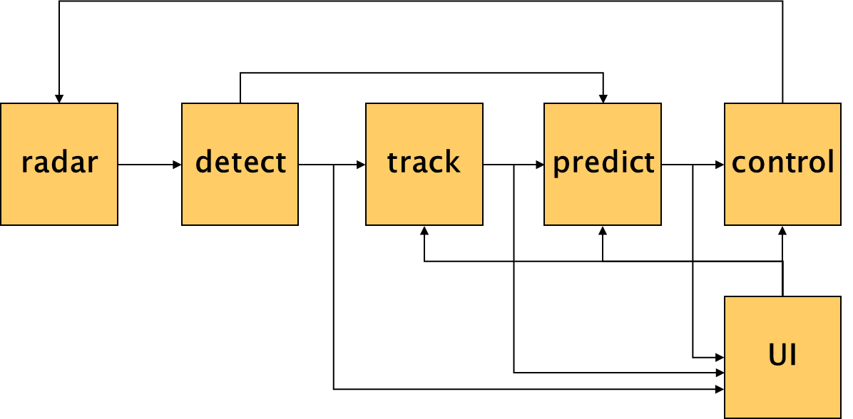
Reflection on
Architectural Style of Pub/Sub
The architectural style strongly influences
the complexity of the overall design, and
the systems’ quality attributes
radar
detect
track
predict
control
UI

Slide 31
When to use P/S
Data is short-lived
‘Frequent’ production of data
Consumers are interested in updates
Multiple consumers
Dynamically changing topology of producers and/or consumers

Slide 32
References
Control System Software, M. Boasson
IEEE Transactions on Automatic Control, Vo. 38, No. 7, July 1993
Software Architecture for Large Embedded Systems
M. Boasson and E. de Jong
http://www.cwi.nl/~marcello/SAPapers/BJ97.html

Slide 33
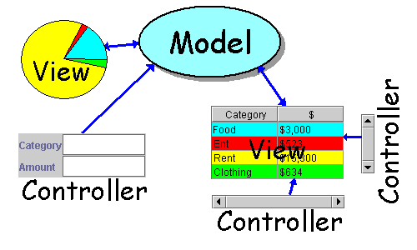
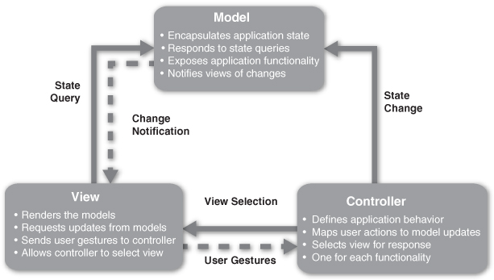
Model-View-Controller

Slide 34
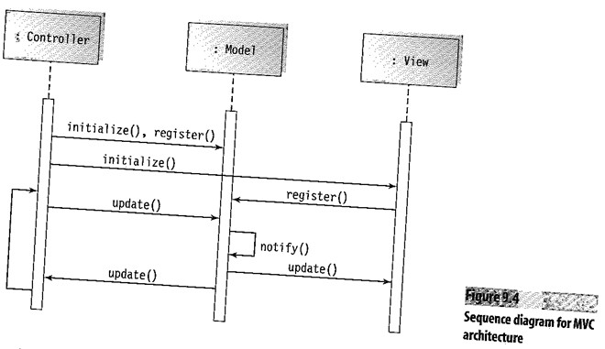
Sequence Diagram for MVC

Slide 35
Model-View-Controller
Model-View-Controller (MVC) separates application functionality into three kinds of components:
  A model, which manages the application’s data
  A view, which displays some portion of the underlying data and interacts with the user
  A controller, which mediates between the model and the view and manages the notifications of state changes
Advantages: separation of concerns, loose coupling, maintainability, reuse, extensibility, scalability
Limitations: complexity, performance
problems due to frequent updates

Slide 36
MVC objectives
Achieve loose coupling between Model and View
Encapsulate business logic into Model so that it can be exhaustively tested
Make View as ‘thin’ as possible to lessen the need to test it

Slide 38
MVC pattern can have a ‘local’ scope
Management
Dashboard
V
Planning
Truck
C
Maintenance
planning
Sensors
M
Job planning
GPS
fuel
maintenance
Map
Traffic Information
M’
Not an architectural style? More a construction pattern?

Slide 39
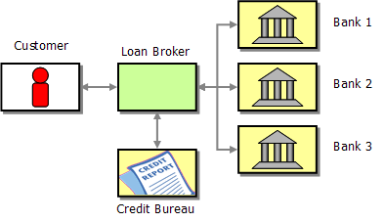
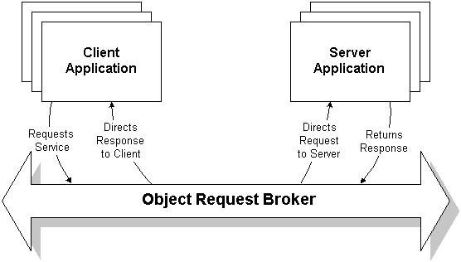
Broker
middleware

Slide 40

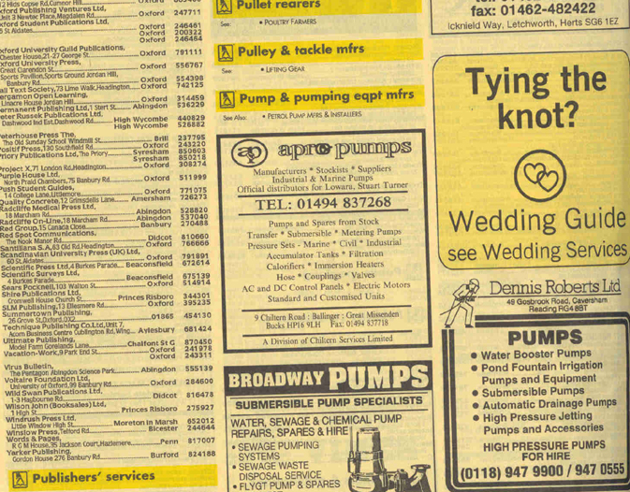
Broker
I want to find a hotel
Who want to sell their house?
  Via: Real estate broker
Where can I buy a pump?

Slide 41
Broker
Broker separates users of services from providers of services by inserting an intermediary, called a broker
  A user queries a broker via a standard interface.
  The broker forwards the user’s service request to a service-provider, who processes/answers the request.
  The service result is communicated from the service provder back to the broker, which then returns the result back to the requesting client
Advantages: isolation, interoperability, flexibility (late-binding!)
Limitations: indirection, latency, target for security attacks, a single point of failure

Slide 42
Reflection
Can publish-subscribe be seen as a broker-style ?
Brokering of ‘service’ vs
Brokering of ‘messages’?
Is any service delivered/returned?

Slide 43
CONTENTS
Introduction
Architectural styles
2.1 Client/Server
2.2 Pipe and Filter style
2.3 Blackboard style
2.4 Publish Subscribe
2.5 Layered style
2.6 Peer-to-Peer
3. Interaction style
4. Conclusions

Slide 44
Layering (1)
Goals: Separation of Concerns, Abstraction, Modularity, Portability
Partitioning in non-overlapping units that
provide a cohesive set of services at an
abstraction level
(while abstracting from their implementation)
layer n is allowed to use services of layer n-1
(and not vice versa)
alternative:
bridging layers: layer n may use layers <n
enhances efficiency but hampers portability
3
2
1
0
Notes:
A layer structure can e.g. be used to implement a functional hierarchy
Strict layering: layer n can use layer n-1
Loose layering: layer n can use layers k s.t. k<n
Loose layering reduces portability/replacebility of layers.

Slide 45
Layering (2)
Example: Communication Stack
Request
Confirm
Response
Indication
Layer 3: End-to-End
Distributed (e.g. TCP)
Protocol
Layer 2: Datalink
Distributed (e.g. IP)
Layer 1: Physical
Local (e.g. OS)
Bitpipe

Slide 46
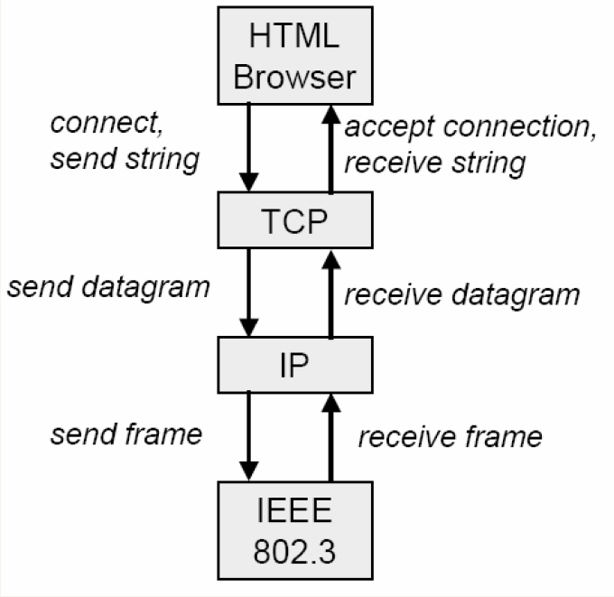
Picture from Jeremy Bradbury, Queens Univ. Canada

Slide 47
Layered architecture
Issues
- Separation of concerns
Applications& interfaces
Major processes
Domain classes
Mechanisms
Services

Slide 48
Layering (3)
Example: Virtual Machine
Concept: Separation of application lang. from execution platform
  Emulation of a higher-level language
Types: a. Language interpreters
  E.g. Java virtual machine, Unix command shell
b. Rule-based systems
  E.g. inference machine, expert system
Constraints: Defined by language
Advantages:
Easy implementation
Parts can be changed during execution
Disadvantages:
Performance overhead
Notes:
A virtual machine architecture can empower the user
by defining a high-level language that allows him to express his ideas
in a easily understandable form
In this scenario, the ICT-specialist is not longer responsible
for the application programs
(that execute in a domain that is barely understood by him)
but only for the proper execution platform

Slide 49
Layering (4) Quality Factors
Scalability: n.a.*
Flexibility: layers can be redefined
Robustness: ‘weakest layer’ is limitation
Security: security measures should be taken at every
layers’ interface
To understand a system as a whole, the number of layers
Should be limited to an intellectually manageable number: ±7
Notes:
Why is scalability not applicable to the layering-style?

Slide 50
Layering (5) Application Context
Rules of thumb for using layering:
if data processing progresses through successive levels of abstraction
(vertical composition of functionality)
Layering is a technique that helps in structuring systems
Typical examples: OS, device drivers, virtual machine (JVM), ISO,
Client/Server

Slide 51
Division of Functionality
Pipeline: - Multiple functional units operating in sequence
(units chosen as steps in process)
- Regular pattern of computation for the class of inputs
- Functional units at same level of abstraction
Blackboard: - Multiple functional units where order of operation
is irregular or not know a-priori
- Allows concurrent operation of functional units
- Functional units at same level of abstraction
(typically highly specialized processing)
Layered: - Functionality (services) which are concerned
with same level of abstraction are grouped

Slide 52
Heterogeneity of Styles
Systems are seldom built using a single style
Styles do not partition architectures into clean non-overlapping parts
Spatial heterogeneity
  Different parts of a system use different styles
Temporal heterogeneity
  At different moments in time, a system employs different styles
Hierarchical heterogeneity
  A component of one style uses sub-components of another style;
  e.g. at a lower abstraction level
Notes:
Examples:
Spatial (Locational) heterogeneity
Some branches of a main-program-and-subroutine systems
might have a shared data repository
Hierarchical heterogeneity
The layers of a layered systems
may be composed of independent components
Temporal (Simultaneous) heterogeneity
The components of a pipe-and-filter system
are implemented as independent processes

Slide 53
CONTENTS
Introduction
Architectural styles
2.1 Client/Server
2.2 Pipe and Filter style
2.3 Blackboard style
2.4 Publish Subscribe
2.5 Peer-to-Peer
2.6 Layered style
3. Interaction style
4. Conclusions

Slide 54

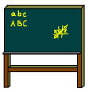
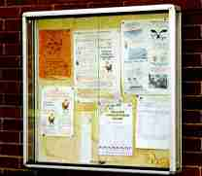



Interaction Styles and Dependencies
Broadcast
Blackboard
Radio, TV
Notice board
Referential coupling
no
yes
Connection-
oriented
Asynchronous
connection
telephone
E-mail
yes
no
Temporal coupling
Referential coupling : sender has reference to receiver name/address
Temporal coupling: sender and receiver synchronize in time
Notes:
Referential (de)coupling : sender has (no) reference to receiver
Temporal (de)coupling: sender and receiver synchronize in time
Referential coupling gaat snel in de richting van 1-1 communicatie.

Slide 55
Summary Architectural Styles
Every Architect should have a standard set of
architectural styles in his/her repertoire
it is important to understand the essential properties
of each style: when to (not) use them
examples:
  C/S, pipe and filters, blackboard, pub/sub, P2P
The choice for a style can make a big difference in
the quality properties of a system
analysis of the differences can provide rational for
choosing a style

Slide 56
Questions ?

Slide 57
Special Issues
Independent of the architectural style, attention has to be paid to the following issues:
initialization, termination
powering, start-up, shut-down/decommission
error handling / recovery
resource management
diagnostics, field-service, self-test
run-time configuration
Thanks to
Rob v. Ommering, Natlab
Notes:
Also, these issues must be considered in a component model.

Slide 58
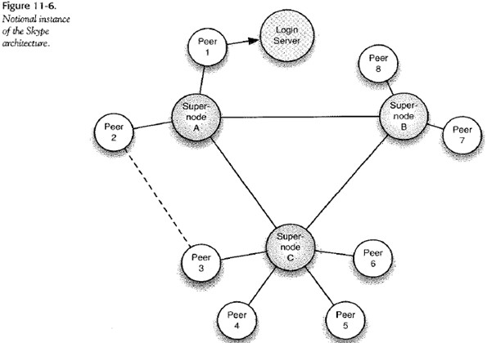

Slide 59
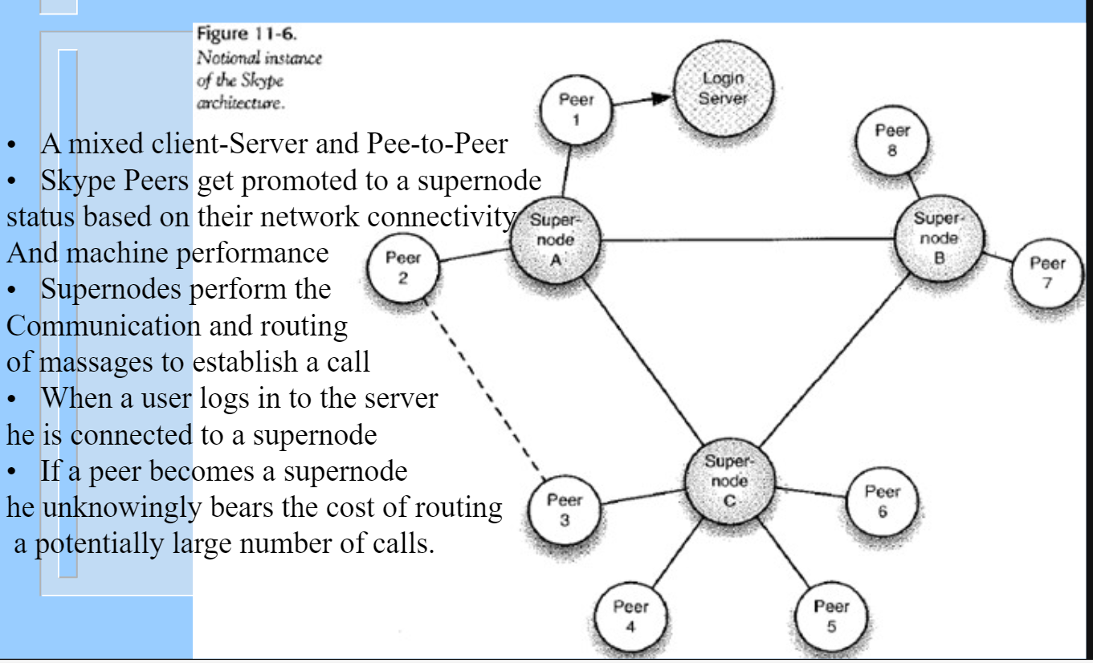

Slide 60
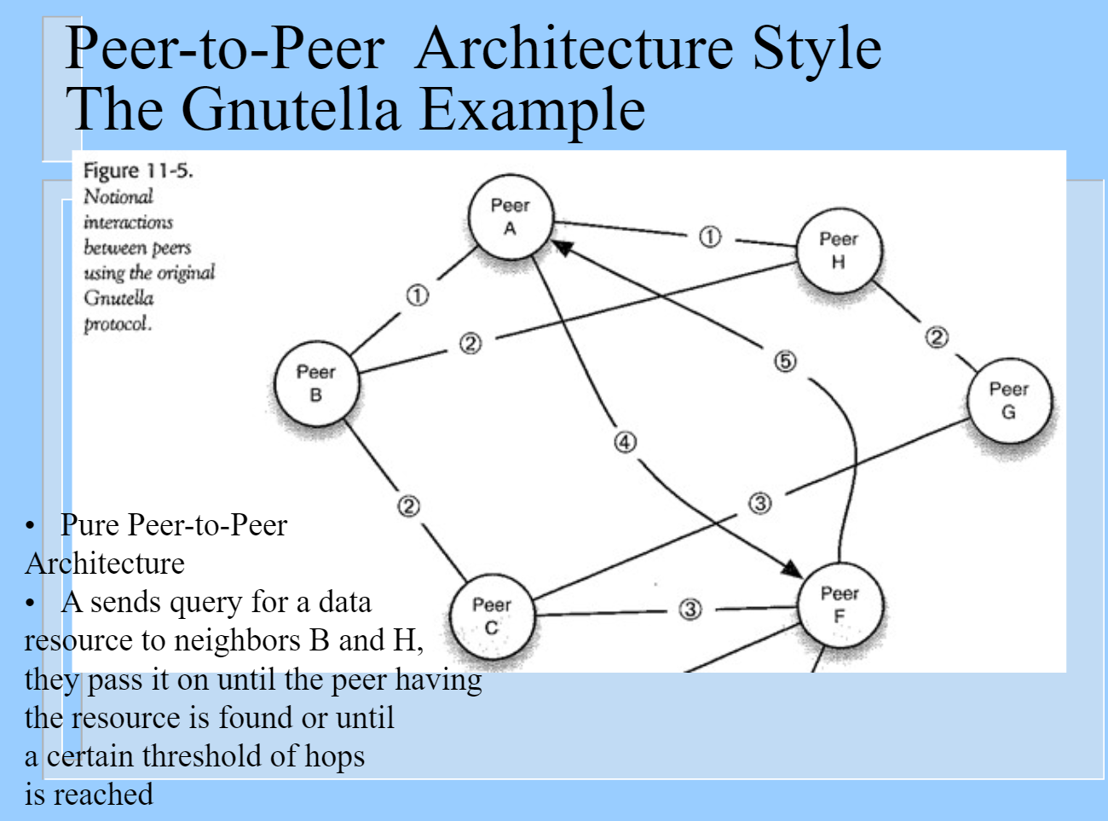

Slide 61
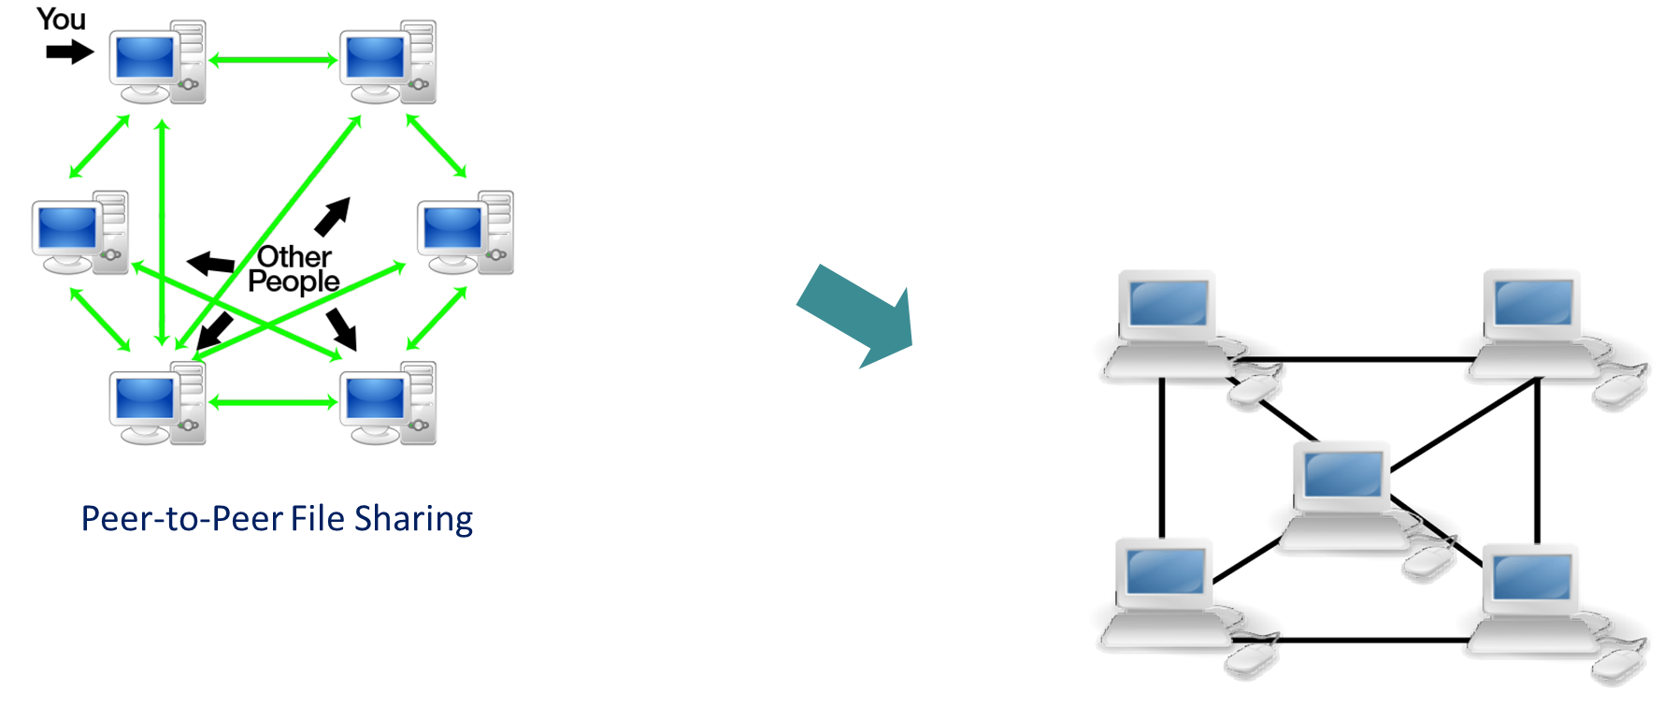
Peer-to-Peer

Slide 62
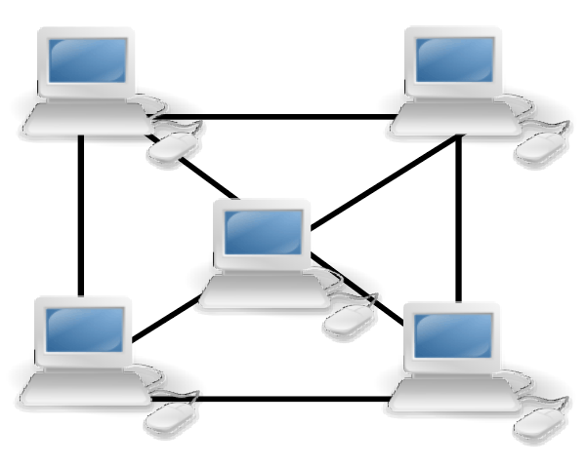
Peer-to-Peer
Components directly interact as peers
  a.k.a. Forwarder-Receiver
Special peer components can provide routing, indexing, and peer search capability.
Connector element: connect, search, and invoke
Advantages: availability, performance, scalability
Limitations: security, consistency, need for other communication for updating data

Slide 63
CONTENTS
Introduction
Architectural styles
2.1 Client/Server
2.2 Pipe and Filter style
2.3 Blackboard style
2.4 Publish Subscribe
2.5 Peer-to-Peer
2.6 Layered style
3. Interaction style
4. Conclusions

Slide 64
Peer to Peer Architectures
Peer-to-Peer Computing, D.S. Milojicic et.al.,
HP Labs Technical Report HPL-2002-57

Slide 65
Peer to Peer Style (1)
Concept: collections of autonomous ‘peers’ that share resources
to provide a service that
- can be accessed from all nodes? or
- if offered uniform across all nodes?
‘All nodes are equal’
Components: peers
Connectors: ??
Topology: fully connected graph
Notes:
A collection of nodes jointly provide a service (to/at all participants in the network) that is realised by distributing the load equally over all participants in the network.

Slide 66
Peer to Peer Style (2)
Constraints about the way peers can be joined:
Bi-directional flow of data
Peers have autonomy over:
  connection/disconnection
  local flow of control
  resources provided to peers
Typically the administrative control (‘ownership’) may differ per node

Slide 67
Peer to Peer Reference Architecture
Application
layer
tools
applications
services
Class specific
layer
scheduling
meta-data
messaging
management
Quality of service
layer
security
resource aggregation
reliability
Group mngmnt
layer
discovery
locating & routing
Communication
layer
communication

Slide 68
P2P look-up mechanism
Centralized vs Distributed

Slide 69
Peer to Peer Style (3)
Semantic Constraints
Peers are autonomous entities (not clients, not servers);
No centralized control
The effects of removing one node in a network of n nodes is limited to the decrease of service by at most 1/n .
MojoNation: the quality of service provided to a node is proportional to the resources it provides to the community.

Slide 70
Peer to Peer Style (4a)
Advantages:
nodes may use the large capacity of the whole while bringing
in only their own.
low ‘cost of ownership’ (through sharing)
‘self-organizing’ ⇒ low administrative overhead
Scalable
Resilient to failures (Fault tolerant) ⇒ graceful degradation
Supports dynamic configurations

Slide 71
Peer to Peer Style (4b)
Disadvantages:
No guarantees about quality of service
  (nodes participate voluntarily)
The utility of a system grows with the number of users
Security? (no accountability)
Notes:
What is wrong with ASCI as data representation? There is XML in which to code semantic information.

Slide 72
Peer to Peer Style (5) Quality Factors
Scalability: Service scales easily
Extendibility: System provides only one type of service
Flexibility: Not an issue in this style.
Robustness: High
Security: Each peer offers its local resources to the community in the belief it will not be misused.
Performance: scales with the number of nodes

Slide 73
Peer to Peer Style (6) Application Context
Rules of thumb for choosing peer to peer style:
if a service needs to available across all nodes in a network
if the configuration of the network is dynamic
  e.g. nodes on the internet or in mobile / wireless networks
Typical application domain:
file-sharing: Napster (not!), Gnutella, Kazaa
CPU sharing: SETI@home (not!)
Peer-to-Peer Computing, D.S. Milojicic et.al., HP Labs Technical Report HPL-2002-57

Slide 74
Other Styles?
Object Oriented
Components: Objects (encapsulation of data + operations)
Topology: Arbitrary
Connectors: Method Invocation / Message Passing
Not an architectural style, more a design paradigm

Slide 75
