Slide 1
Software Architecture
Communication and Knowledge Sharing
Rodi Jolak
www.rodijolak.com
Gothenburg, 2nd of October 2019

Slide 2
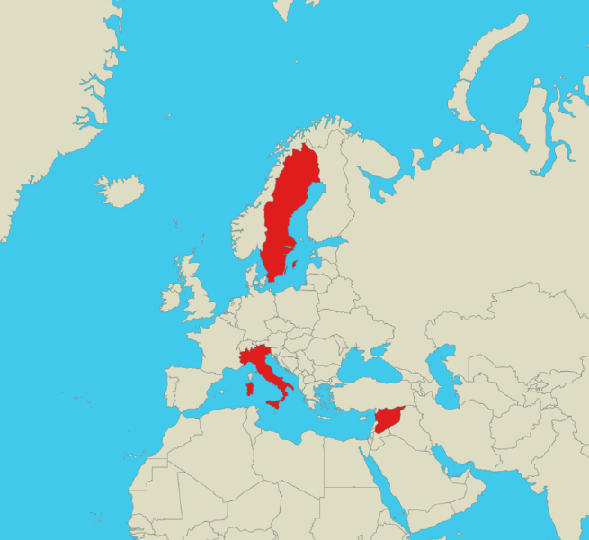




A little bit of background…
2015
2004

Slide 3


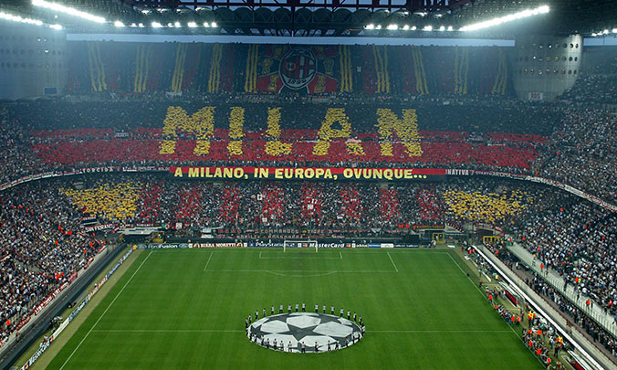
A little bit of background… (interests!)

Slide 4
Assignments
Feedback!

Slide 5
Outline
Software Architecture Documentation
Communication & Collaboration
Knowledge Sharing
Play a game
Graphical vs. Textual Design

Slide 6
Software Architecture
What is a software architecture?

Slide 7
Software Architecture

Slide 8
Documenting
Software Architecture
“If it is not written down, it does not exist”
─ Philippe Kruchten

Slide 9
4 + 1 Architectural View Model
Logical view: classes, packages, components, interfaces.
Development view:
file ownership
Config. Mngnt view
versioning policies
…
A
B
Stakeholders &
Use Cases view
C
D
Process view:
State-diagrams
Deployment view:
physical model + mapping
A
B
C
D
A
C
D
B
TCP/IP over Ethernet
bandwidth, availability

Slide 10
Uses and Audiences for Architecture Documentation
Architecture Documentation should be:
  Transparent
  Accessible
  Concrete
  Detailed - Rich of information

Slide 11



Uses and Audiences for Architecture Documentation
Architecture Documentations has three main uses:
  As means of education: introducing the system to people.
  As means for communication among stakeholders.
  As basis for system analysis and construction.

Slide 12
Architecture Documentation
Architecture Documentations can be:
  Prescriptive: represent the world as it should be.
  Descriptive: represent the world as it is.

Slide 13
Notations for
Architecture Documentation
Notations?
  Views or models that represent an architecture
There are three main categories of Notations:
  Informal: drawn using general-purpose diagramming and editing tools e.g. PowerPoint.
  Semi-formal: views that are expressed via a standardized modeling syntax without providing a complete semantic of these notations. E.g. UML.
  Formal: views that are described in a notation that has a precise semantics.
Informal
Effort
Formal
Opportunities for Analysis

Slide 14




Notations: Example
Informal Modeling
“models used as drafts”
Formal Modeling
“models used as guidelines”
Purposes:
Ideation & Exploration
Problem Understanding
Creative Thinking
Communication
Purposes:
Documentation
Communication
Instruction for Implementation
Code-Generation

Slide 15
Architecture Documentation
Purpose
Users
Notation

Slide 16

Questions?

Slide 17
Task (in groups)
Create the architecture documentation (view) of an Automatic Teller Machine (ATM) :
  State the purpose of this documentation.
  State the users of this documentation.
  What notations (informal/formal)
  do serve the purpose
  of your documentation? why?
Purpose
Users
Notation

Slide 18
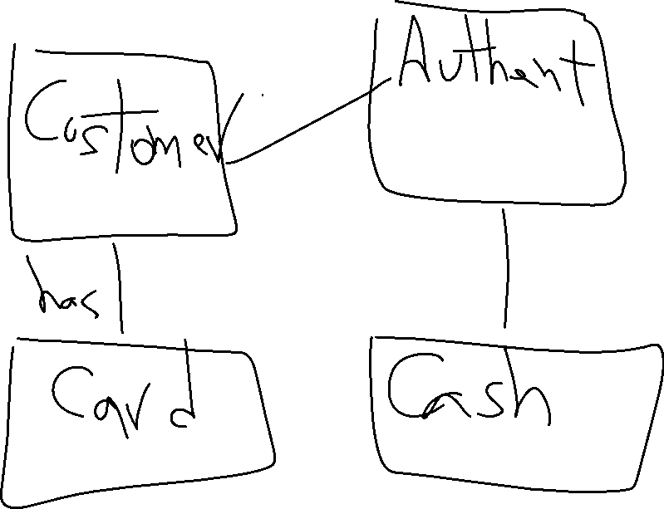

Slide 19
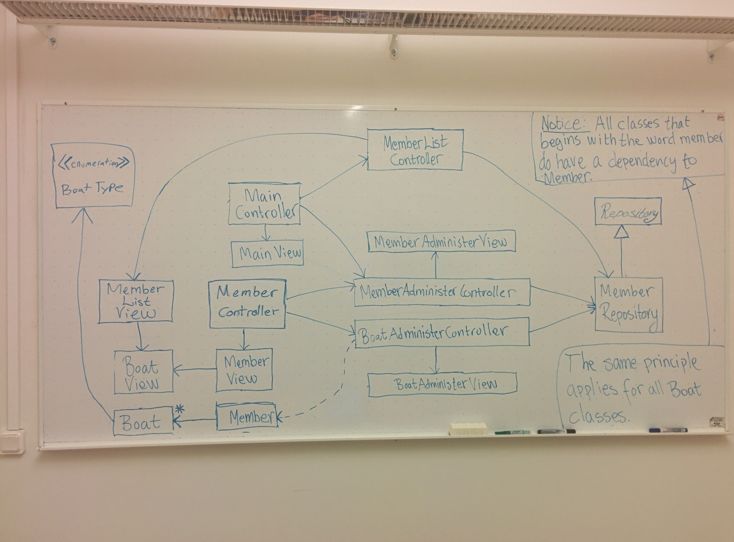
Architecture Documentation

Slide 20
Designing Software…
Framing and
Analyzing
Iterative
Alignment
Ideating and
Evaluating
Problem Space
Exploration
Solution Space
Exploration
Iterative
Alignment

Slide 21

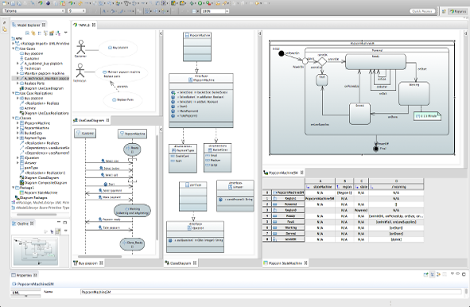
Architecture Documentation

Slide 22
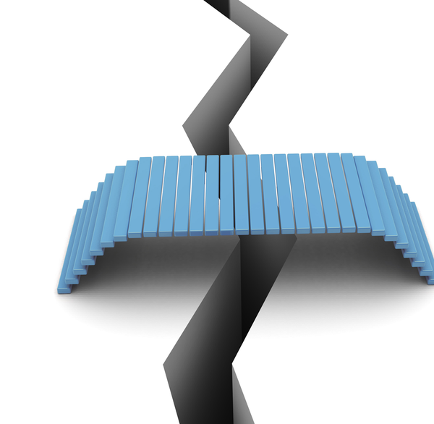

Architecture Documentation
Formalization &
Documentation
Early Design
OctoUML
Software Design Process

Slide 23
DEMO of OctoUML/OctoBubbles

Slide 24
Architecture Communication
Communication Effort!

Slide 25
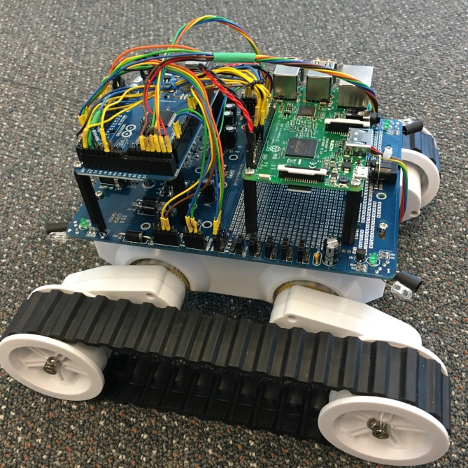

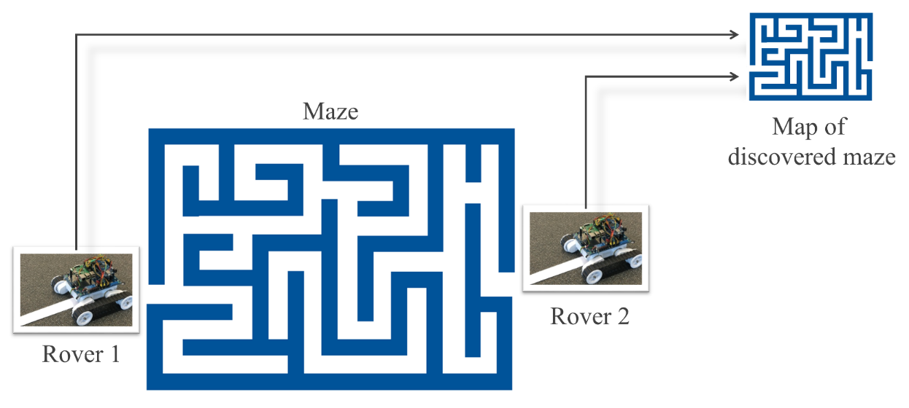
Collaborative MBE
Two Teams
Case 1: MathWorks
Matlab & Simulink
Case 2: PolarSys
Papyrus & Capella
Jolak, et al. "Model-Based Software Engineering: A Multiple-Case Study on Challenges and Development Efforts." In Proceedings of the 21th ACM/IEEE International Conference on Model Driven Engineering Languages and Systems (MoDELS), pp. 213-223. ACM, 2018.

Slide 26
Effort distribution in MBE

Slide 27
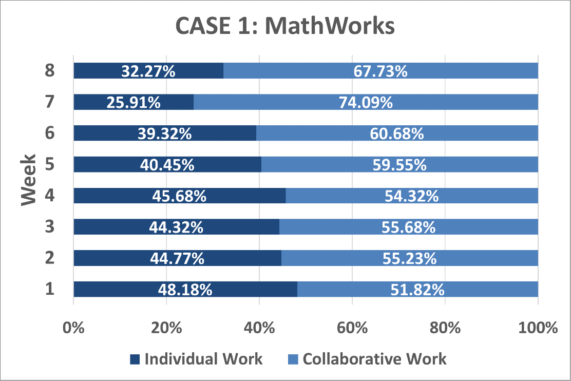
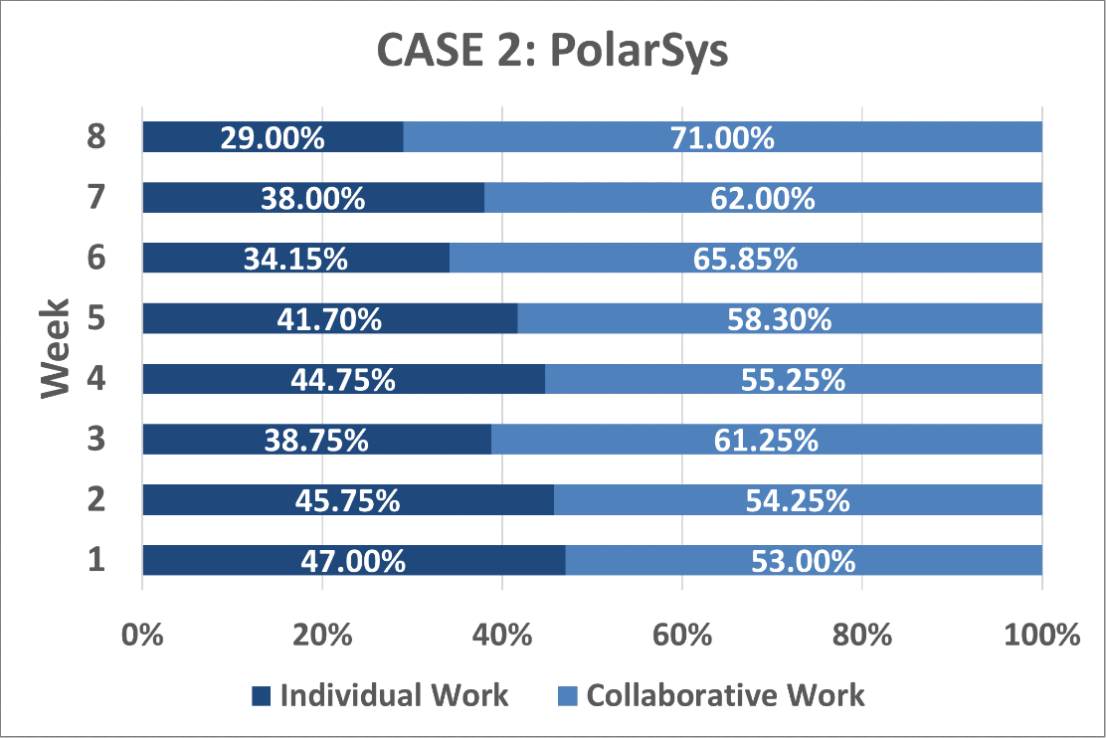
How large is the portion of collaborative work in MBE projects?

Slide 28
Questions?

Slide 29
Architecture Communication
Co-located vs. Distributed Design

Slide 30

Global Software Engineering
Software engineering is a collaborative activity.
When globalized, software modeling could become less effective.

Slide 31

Collaborative, Distributed Design
12 Professional Developers
Challenge: Create a software design of a simulator that should enable its users to investigate the effects of different signal timing on traffic flow.
Case 1: Co-location
Case 2: Distribution
Jolak, et al. "Does Distance Still Matter? Revisiting Collaborative Distributed Software Design." IEEE Software 35, no. 6, 40-47. 2018.

Slide 32




Case 1
Co-location
(6 developers: 3 teams of two people)
Can you explain this ?
Yes,
of course!
USA

Slide 33



Case 2
Distribution
(6 developers: 3 teams of two people)
Can you explain this ?
Yes,
of course!
Internet
OctoUML
OctoUML
Germany
Sweden
Geographic Distance

Slide 34
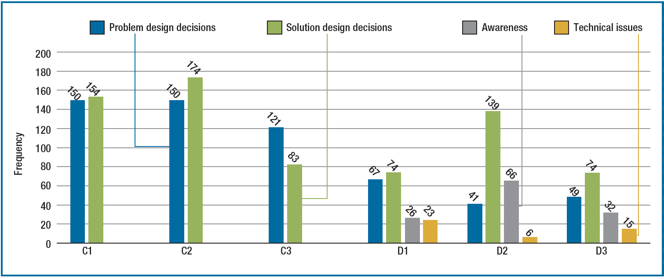
Results (1/2)
We
Figure 1. The number of design decisions, awareness, and technical issues per each
co-located team (C1–C3) and distributed team (D1–D3).

Slide 35
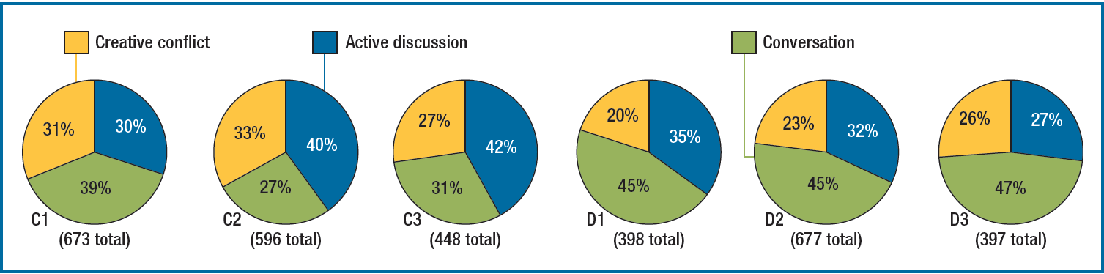
Results (2/2)
Disagree, Propose Exception, Doubt, Etc.
Figure 2. The categories of collaborative discussions (communications)
made in each design session.

Slide 36
Results (2/2)
Coordinate, Summarize Info, Etc.
Figure 2. The categories of collaborative discussions (communications)
made in each design session.

Slide 37
Questions?

Slide 38
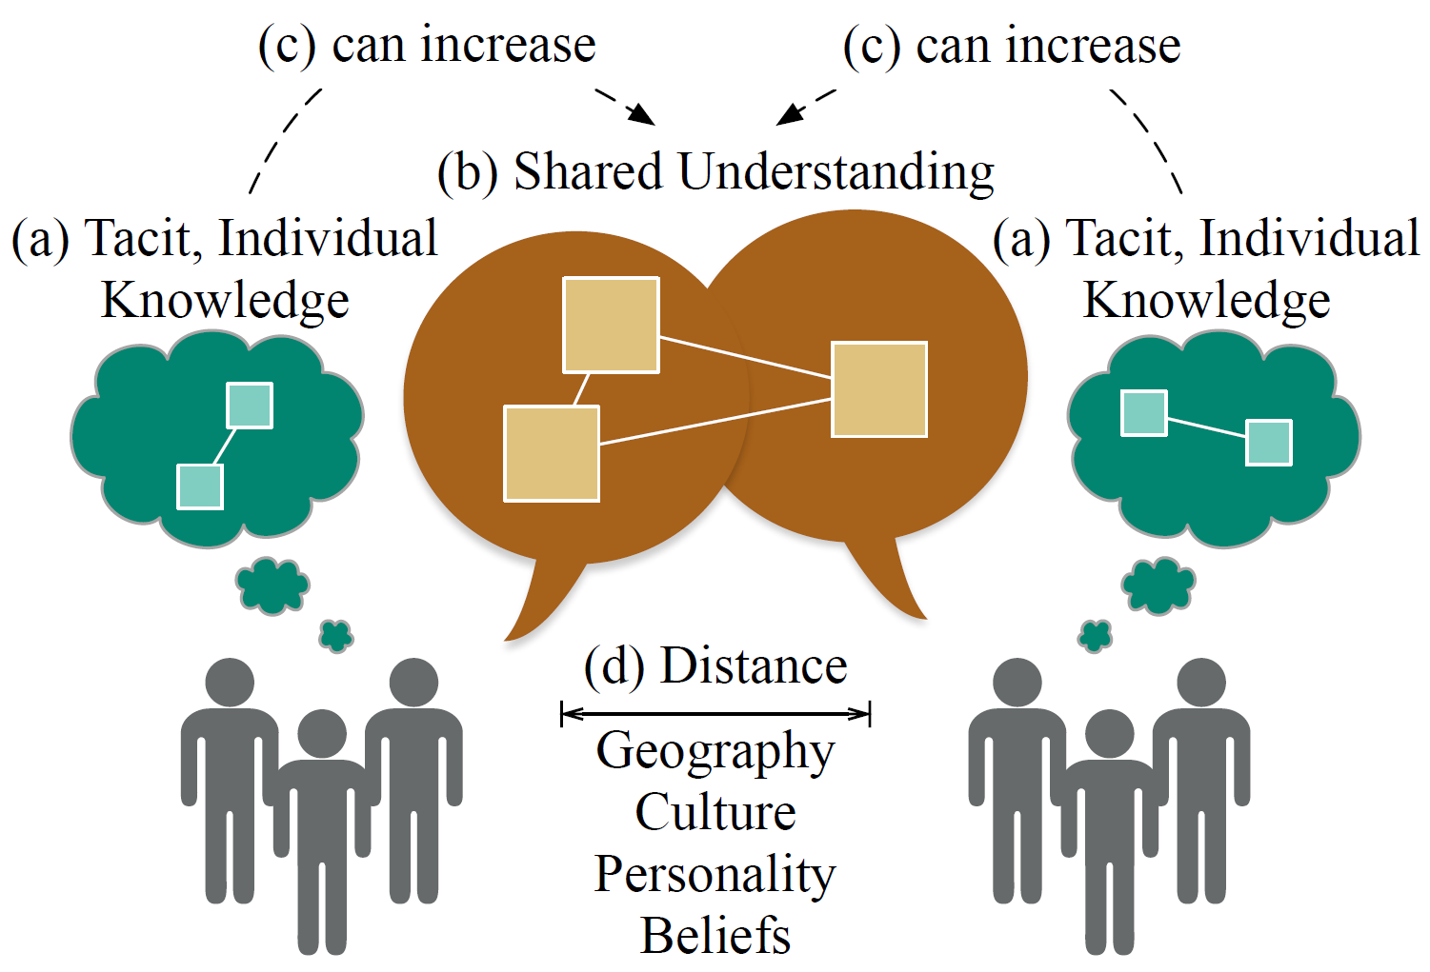
Knowledge Sharing

Slide 39


Knowledge Sharing
The effectiveness of collaborative design can be enhanced by:
  investigating why people are not able or eager to share knowledge.
  developing methods that trigger knowledge sharing.
Cognitive Factors
Motivational Factors

Slide 40




Overcoming Social Distances
The effectiveness of collaborative design can be enhanced by:
  investigating the effect of distances in geography, culture, personality, and beliefs on team behavior.
  developing methods to account for these distances.
Culture
Personality
Beliefs
G. A. Neuman et al. “The relationship between work-team personality composition and the job performance of teams,” Group & Organization Management, vol. 24, no. 1, pp. 28–45, 1999
C. Passos et al. “Analyzing the impact of beliefs in software project practices,” in International Symposium on Empirical Software Engineering and Measurement. IEEE, 2011, pp. 444–452.
N. Lehmann-Willenbrock et al. “Observing culture: Differences in us-american and german team meeting behaviors,” Group Processes & Intergroup Relations, vol. 17, no. 2, pp. 252– 271, 2014.

Slide 41
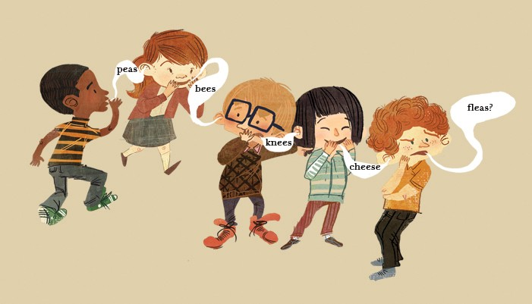
Let’s play a game!

Slide 42
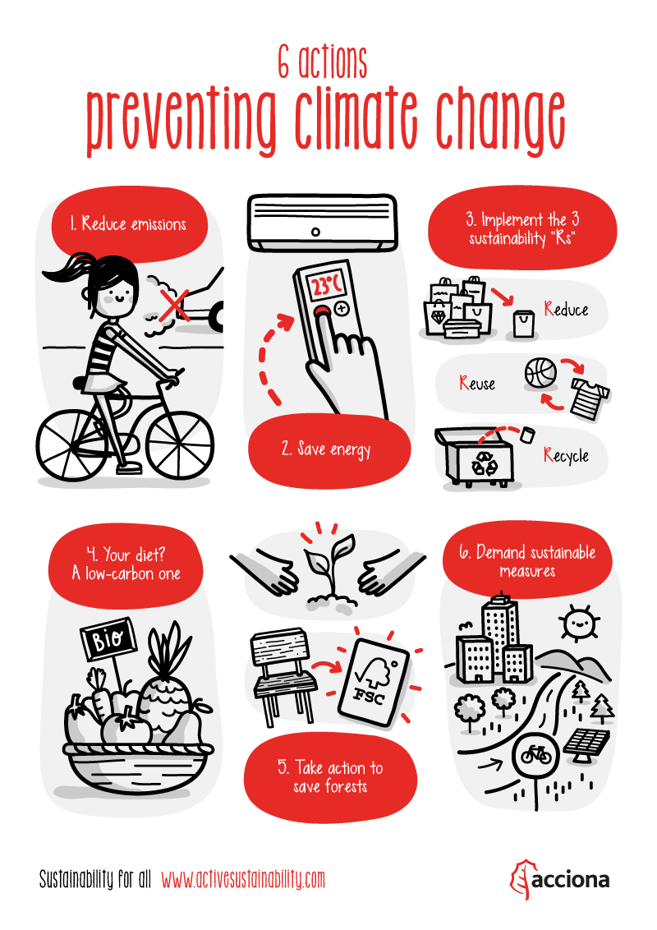
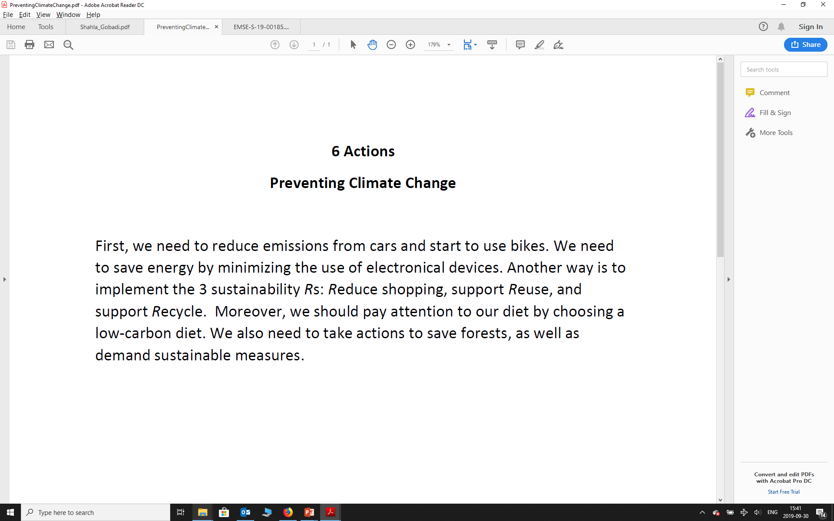
Let’s play a game!

Slide 45


Architecture Documentation
A picture is worth a thousands words.

Slide 46
Architecture Documentation
Textual vs. Graphical Design Representation.

Slide 47
Textual vs. Graphical Design Representation

Slide 48

Pre-task
Questionnaire
Pre-task
Questionnaire
Explainer
Receiver
Discussion
Text
Text/Model
OR
Model
Explainer
Explainer
Receiver
Post-task
Questionnaire
Post-task
Questionnaire
Explainer
Receiver

Slide 49


Explainer
Receiver
Discussion
Active Discussion
Understand-ability
Explaining
Re-call

Slide 50
Textual vs. Graphical Design Representation

Slide 51
Textual vs. Graphical Design Representation

Slide 52
Textual vs. Graphical Design Representation

Slide 53
Questions?

Slide 54
The End!

