Slide 1
Software Design Principles
Michel R.V. Chaudron
Software Architecture 2019
chaudron@chalmers.se | chaudron@cse.gu.se

Slide 2
Schedule
Week |  | Date | Time | Lecture | Reading | Note
36 | L1 | 4 sept | 13:00 – 15:00 | Introduction & Organization
37 | L2 | 11 sept | 13:00 – 14:30 | Architecting Process & Views | Ch 1 & 2
37 | S1 | 12 sept | 10:15 – 12:00 | << Supervision/Assignment>>
38 | L3 | 18 sept | 13:00 - 15:00 | Requirements & Quality Attributes | Ch 3 & 4
38 | S2 | 19 sept | 13:00 – 15:00 | << Supervision/Assignment>>
38 | L4 | 20 sept | 13:15 – 15:00 | Architectural Styles 1 | Ch 13
39 | L5 | 25 sept | 13:15 – 15:00 | Architectural Styles 2 | Ch 13
39 | S3 | 26 sept | 10:15 – 12:00 | << Supervision/Assignment>>
39 | L6 | 27 sept | 13:15 – 15:00 | (finish) Architectural Styles & Tactics
40 | L7 | 2 Oct | 13:15 – 15:00 | The Human Factor in Software Architecting: Cognitive and Social Aspects | Ch 18 | Rodi Jolak
40 | S4 | 3 Oct | 10:15 – 12:00 | << Supervision/Assignment>> |  | UG
41 |  | 4 Oct | 13:00 – 15:00 | skip |  | UG
42 | L8 | 9 Oct | 13:15 – 15:00 | Technical Debt (Terese Besker) |  | PhD defence
41 | S5 | 10 Oct | 10:15 – 12:00 | << Supervision/Assignment>>
42 | L9 | 16 Oct | 13:15 – 15:00 | Design Principles / Tactics | Ch 6, 7
42 | S6 | 17 Oct | 10:15 – 12:00 | << Supervision/Assignment>> |  | check!
43 | L10 | 18 Oct | 13:15 – 15:00 | Architecture Evaluation / Tactics | Ch 21
43 | L11 | 23 Oct | 13:15 – 15:00 | Reverse Engineering & Correspondence | Ch 20
43 | L12 | 24 Oct | 13:15 – 15:00 | No lecture: Lindholmen Software Development Days
43 | L13 | 25 Oct | 13:00 – 15:00 | Guest lecture Volvo Trucks
Notes:
2019: other topics that could be added:
- Risk management

Slide 3

Outline
Recap
  Architectural Styles
Design Principles
Tactics
Course representatives? Volunteers?

Slide 4
Learning Objectives
Know principles
Apply Principles
Recognize violations of design principles
Hint: try if you can think up a counter-example for each design principle

Slide 5

Advice on Design of Software
Generic Design Principles
Principles for Architectural Design
Principles for Design of Components
Principles for collaboration amongst Components
Design = trade-offs = gray area
➔ Principles are heuristics
Not today: User Interface design, protocol design

Slide 6
General Software - Design Principles 1
Information Hiding:
All information about a module should be private to
the module unless required externally
Minimize Coupling
Every module should depend on as few
others as possible
Coherence:
Keep things together that belong together
Keep behaviour together with related data
Keep information about one thing in one place

Slide 7
General Software Design Principles 2
Divide and Conquer
  Break a big problem into smaller ones
Separation of Concerns
  Divide into different parts logic
  that addresses different issues
Keep it Simple

Slide 8
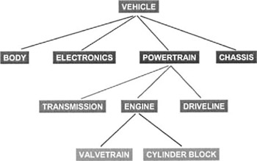
Generic Design Principles
Decomposition
  Break problem into independent smaller parts
  Independent?

Slide 9
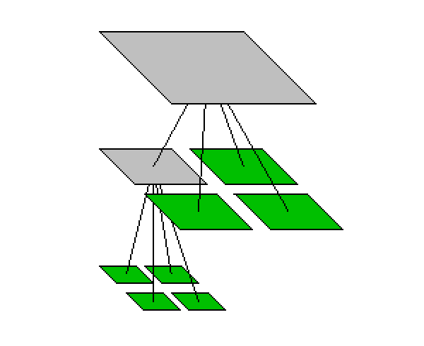
Design Principle : Divide and conquer
Trying to deal with something big all at once is harder than dealing with a set of smaller things
  Each individual component is smaller,
  and therefore easier to understand
  Parts can be replaced or changed
  without having to replace or extensively
  change other parts.
  Separate people can work on separate parts
  An individual software engineer can specialize

Slide 10
Ways of dividing a software system
A system is divided up into
  Layers & subsystems
  A subsystem can be divided
  up into one or more packages
  A package is divided up into classes
  A class is divided up into methods

Slide 11
Subsystems vs Layering
Functional
Dimension
Fuel
System
Propulsion
System
Electrical
System
Braking
System
Layer 1
Layer 2
Layer 3
Abstraction/Implementation
Dimension

Slide 12
Layering
Goals: Separation of Concerns, Abstraction, Modularity, Portability
Partitioning in non-overlapping units that
provide a cohesive set of services at an
abstraction level
(while abstracting from their implementation)
layer n is allowed to use services of layer n-1
(and not vice versa)
alternative:
bridging layers: layer n may use layers <n
enhances efficiency but hampers portability
3
2
1
0
Notes:
A layer structure can e.g. be used to implement a functional hierarchy
Strict layering: layer n can use layer n-1
Loose layering: layer n can use layers k s.t. k<n
Loose layering reduces portability/replacebility of layers.

Slide 13
Consistency in two dimensions

Slide 14
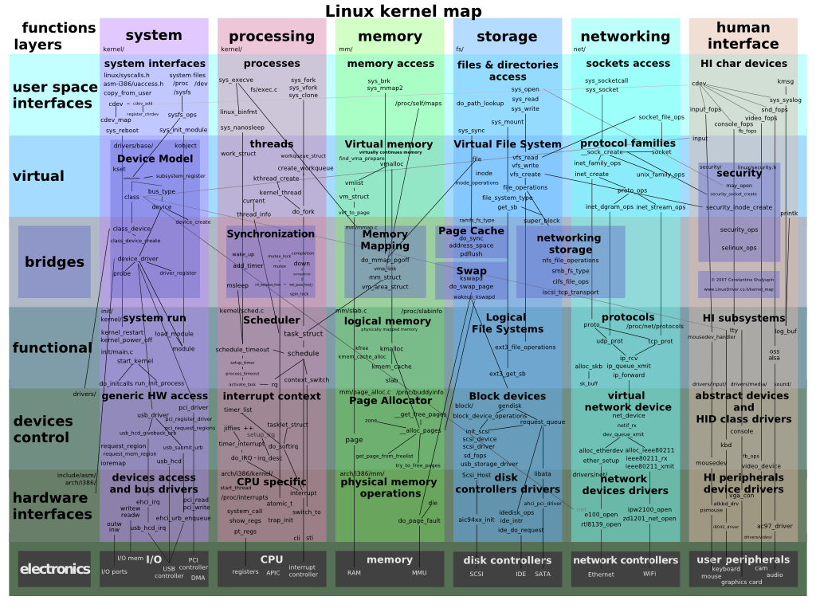
Consistency in two dimensions

Slide 15
A Component-based Reference Architecture for Computer Games
(E. Folmer, 2007)
specific
generic

Slide 16
Example
«layer»
«layer»
Presentation and Dialogue Layer
Common Elements
«subsystem»
«subsystem»
Client / Browser
Client Authentication
«subsystem»
«subsystem»
«subsystem»
«subsystem»
S
M
P
M
C
«subsystem»
«subsystem»
«subsystem»
D
F
«subsystem»
E
«layer»
Business Layer
«subsystem»
«subsystem»
«subsystem»
«subsystem»
JR
M
P
M
C
«subsystem»
«subsystem»
«subsystem»
«subsystem»
D
F
Apache
«layer»
«subsystem»
«subsystem»
Persistence Layer
RC
Data Security
«subsystem»
«subsystem»
«subsystem»
P
M
M
PL
«subsystem»
«subsystem»
«subsystem»
«subsystem»
C
D
F

Slide 17
What is a dependency?
A
A depends on B
B
Component A requires B for it to work
  Functional coupling
A change in module B requires a change in module A
  Implementation coupling
  Typically requires: re-testing A & B
Run-time
Development-time

Slide 18
Dependency/Coupling
There is coupling between two classes A and B if:
  A calls a service of an object B
  A has a method which references B
  (via return type or parameter)
  A has an attribute that refers to B
  A is of type (inherits from) B
    A is a subclass of (or implements) class B
This is not an exhaustive definition
A may depend on
some assumption on
another component B

Slide 19
Architecture Design Principles
Dependencies direct in the direction of stability
A
B is less likely to change than A
B

Slide 20




Dependency: Coupling
Coupling is the degree of interdependence
between modules
high coupling
low coupling

Slide 21
Coupling and Cohesion
Coupling is a measure of dependency between modules.
Cohesion is a measure of the coherence (‘togetherness’) of a module amongst the pieces of that module.
In a system design, one wants
high cohesion and low coupling
  within components between components

Slide 22
Cohesion
Cohesion is concerned with the relatedness
within a module
high cohesion
low cohesion
Heuristic:
Keep things together that belong together
High cohesion within a module is good

Slide 23
Cohesion
Cohesion is concerned with the relatedness
within a module
FILTER
SORT
COUNT
REVIEW
PLAY
PRINT
STORE
GAME
high cohesion
low cohesion
Heuristic:
Keep things together that belong together
High cohesion within a module is good

Slide 24
Cohesion
Cohesion is concerned with the relatedness
within a module
Provide Ride Waiting Time
Convert Q-length
to WaitTime
Count People
in Queue
GPS

Slide 25
Benefits of Low Coupling/Dependencies
Modules are easier to replace
fewer interconnections between modules reduce time needed for understanding the modules and interactions
fewer interconnections between modules reduce the chance that changes in one module cause problems in other modules, which enhances reusability
fewer interconnections between modules reduce the chance that a fault in one module will cause a failure in other modules, which enhances robustness
Page-Jones, M. 1980. The Practical Guide to Structured Systems Design. New York, Yourdon Press, 1980.

Slide 26
Inheritance = Coupling
99.9% of the time I find that it makes sense to assign all of the classes of a hierarchy, either an inheritance hierarchy or a composition hierarchy, to the same component.
Scott Ambler
Inheritance implies cohesiveness

Slide 27
Reducing Coupling: Information Hiding
Information Hiding:
  Try to localize future change
  Hide system details likely to change independently
  Separate parts that are likely to have a different rate of change
  In interfaces expose only assumptions unlikely to change
Why is information hiding a good idea?
  which types of coupling are prevented/reduced?

Slide 28
Information Hiding
Information Hiding is a means of avoiding dependencies.
Minimize the information interfaces disclose about
the inner-workings of components
  Balance with genericity
Information hiding aims at avoiding dependencies on
implementation details
Corollary:
  Components typically encapsulate volatile technologies

Slide 29

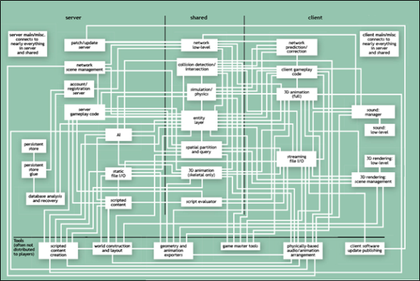
David Parnas
We propose that one begins with a list of:
  difficult design decisions, or
  design decisions which are likely to change
Each module is then designed to hide such a decision from the other modules.
David Parnas
1941-…
Goal: ISOLATE CHANGE
Means: Information hiding, minimizing dependencies
I advise students to pay more attention to the fundamental ideas rather than the latest technology.
The technology will be out-of-date before they graduate. Fundamental ideas never get out of date.
Notes:
"On the Criteria To Be Used in Decomposing Systems into Modules". http://www.cs.umd.edu/class/spring2003/cmsc838p/Design/criteria.pdf.
I would advise students to pay more attention to the fundamental ideas rather than the latest technology.
he technology will be out-of-date before they graduate. Fundamental ideas never get out of date.

Slide 30


Design Principle: Information Hiding
  what is inside, must stay inside.

Slide 31

WHAT versus HOW
‘WHAT’: think Responsibility, Declarative
Mechanisms are about ‘HOW’
WHAT: Build a house
HOW: stone, sticks, straw

Slide 32


Example: Change implementation
Build_House()
Sort()
Store()
Public
Interface
Sorter
Database
Builder
straw
Bubble
sort
stone
Quick
sort
DB
Cloud
Suports evolution and platform-independence

Slide 33
Example 1
IPrimeEncrypt(m,p)
ICeasarEncrypt(m,s)
IEncrypt(m)
Information hiding guides the design of the interface
The interface should aim to be:
generic
  We can do this by stating ‘what’, but not ‘how’
  We can do this by avoiding unnecessary parameters in the calling of the component

Slide 34
Example 2
Steer a vehicle
Interface
  Option 1: Isteer = { TurnLeft, TurnRight }
  Option 2: Isteer = { PressLeft, PressRight }
  Option 3: Isteer = { Left, Right }

Slide 35
Alternative Interfaces
Traffic Light
Level of abstraction

Slide 36
Traffic Light - Alternative Interfaces
Traffic Light1
Reset()
  Postcondition: RED
Run()
  Red→Green→
  Orange→ Red
SetIntervalDuration(t)
Traffic Light2
SetRed(On/Off):Exc
SetOrange(On/Off):Exc
SetGreen(On/Off):Exc
Blink/Disco()
GetState(…)
Traffic Light3
Halt()
Warn()
Drive()
‘Secrets’
  Actual colours
  Initial state
  Order of lights
  (easy to change)
  ‘On’ is Mutual exclusive
‘Secrets’
  Initial state
  Order of states
‘Secrets’
  Actual colours
  Initial state
  Order of states
More Generic
(lights not exclusive)
Higher Level of
abstraction
Synchronization/Timing?

Slide 37
Traffic Light - Alternative Interfaces
Traffic Light1
Reset()
  Postcondition: RED
Run()
  Red→Green→
  Orange→ Red
SetIntervalDuration(t)
Traffic Light2
SetRed(On/Off):Exc
SetOrange(On/Off):Exc
SetGreen(On/Off):Exc
Blink/Disco()
GetState(…)
Traffic Light3
Halt()
Warn()
Drive()
Traffic Light1’
SwitchNextColour(c)
Traffic Light2’
SetColour(c)
Malfunction?
‘Secrets’
  Initial state
  Order of states
  (easy to change)
‘Secrets’
  Initial state
  Order of states
‘Secrets’
  Initial state
  Order of states
Sychronisation/Timing?
More Generic
(lights not exclusive)
Higher Level of
abstraction
Notes:
This is the orginal slide.

Slide 38
What is Modularity?
We can “see it” via a
Design Structure Matrix (DSM) Map

Slide 39
Design Structure Matrix Map of a Laptop Computer

Slide 40
Design Structure Matrix Map of a Modular System

Slide 41
DSM of Mozilla before and after redesign
number
of files
2.4 dependencies per KSLOC
1.3 dependencies per KSLOC
Formerly Mozilla was the commercial Netscape Navigator, then released into open source.
From: Exploring the Structure of Complex Software Designs: An Empirical Study of Open Source and Proprietary Code, Alan MacCormack, John Rusnak, Carliss Baldwin,
Harvard Business School, draft October 1st 2005

Slide 42

Chest of drawers by Droog Design
Build from ‘modules’
But no stable architecture:
many dependencies from all
drawers on all other drawers

Slide 43
Single Responsibility
What is a responsibility?
  Depends on level of design
  Relates to Parnas Information Hiding:
    The responsibility relates to the secret
      E.g. sorting
      Viewer: way of displaying information
      Model: storing & querying information
  Alternative formulation (‘Uncle Bob’):
    A class should have only one reason to change

Slide 44
Reducing Coupling: Facade pattern

Slide 45
Reducing Coupling: Facade pattern
What is changed? Functional Coupling or Implementation Coupling?

Slide 46

Generic Design Principle: Separation of Concerns
Decomposition / Divide and Conquer
Issues that are not related should be handled in separate parts
Single responsibility:
  Assign a single responsibility to a single component/class
  Typical responsibilities: to know something, to do something
  E.g. to know an algorithm (worker)
  to coordinate workers (coordination)
  to manage student-records (information holder)
Edsger W.
Dijkstra

Slide 47

Simplicity
Simplicity is a great virtue but it requires hard work to achieve it and education to appreciate it.
And to make matters worse:
Complexity sells better.
Source: Edsger W. Dijkstra
EWD896 - On the nature of Computing Science
Turing Award (1972)

Slide 48

Edsger Wybe Dijkstra
1930-2002
Ph.D. in Physics
Leiden University, Netherlands
Contributions to:
Algorithms, Concurrency, Distributed Systems,
Program Correctness, Discipline of Design:
Structured Programming (Go To considered Harmful)
Separation of Concerns
Turing Award (1972)
O.-J. Dahl, E. W. Dijkstra, C. A. R. Hoare, Structured Programming, Academic Press, London, 1972
Notes:
O.-J. Dahl, E. W. Dijkstra, C. A. R. Hoare Structured Programming, Academic Press, London, 1972 ISBN 0-12-200550-3

Slide 49
Example Separation of Concern Principle
Telecom Domain:
  Telecom protocol:
    decode1 ; handle1 ; decode2 ; handle2 ; decode3
handle &
encode/
decode
Separate the encoding/decoding of a message from the handling of a message:
    decode1 ; decode2 ; decode3 ; handle1 ; handle2
handle
encode/
decode

Slide 50

Separation of Concerns in Interface Design
Separate What from How
The interface of a component exposes what it do, but not how it does this.
The ‘how’ is the information-hiding ‘secret’
Details of the data representation
Details of the algorithm

Slide 51
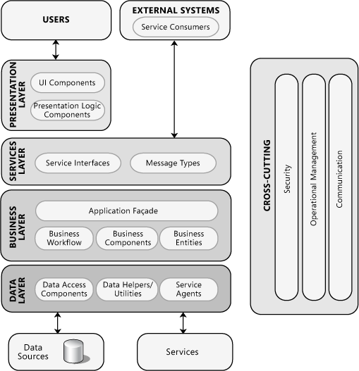
Reference Architecture
Generic (i.e. not application-specific) Design.
Generally believed for Information Systems
Not so very different for embedded systems
From: Microsoft Application Architecture Guide, 2nd Edition
http://msdn.microsoft.com/en-us/library/ff650706.aspx

Slide 52
Design Principles
Keep things that belong together at a single place
e.g. in OO: data and
the operations on that data
Don’t replicate
  functionality, storage of data

Slide 53
The Common Reuse Principle
Classes that are used together are packaged together
If you use one class of a package,
you will use all its other classes too.

Slide 54
The Common Closure Principle
Classes that change together are packaged together

Slide 55
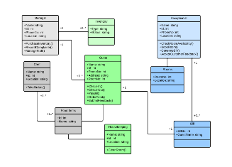
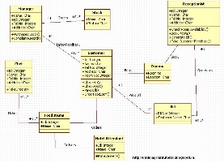
From Analysis to Initial Design
The OO paradigm has been designed such that Analysis and Design models look ‘alike’: Classes that appear in a domain model, can also appear in a design model
Descriptive Models
Prescriptive Models
Problem Space/Domain
Solution Space/Domain
Component/Class
Diagram
Components/Classes
& their behaviour
These are elements of analysis:
What is there?
These are elements of construction:
How will it work?

Slide 56
Features
According to
FODA: A prominent and user-visible aspect, quality or
characteristic of a system.
ODM: A distinguishable characteristic of a system that is
relevant to a stakeholder of the system
In mobile telephones:
- polyphonic ringtones
- SMS, MMS
- dual, tri-band,
- …
In cars:
- airco
- power-steering
- remote key-lock
- …

Slide 57
Feature models
Types of features
Mandatory: All systems must have it
  e.g. A car must have an engine
Alternative:
A system must have one out of multiple options
  e.g. Transmission may be manual or automatic
Optional: A system may have a feature
  e.g. A car may have air-conditioning

Slide 58
Feature Diagram
A hierarchical decomposition of features.
A concept higher in the tree consists of its children
car
optional
wheels
engine
steering
wheel
transmission
airco
alternative
mandatory
(default)
manual
automatic
Additional annotations that may be used in the feature diagram:
mutually exclusive features
rationale for chosing between alternatives
composition rules: airco may be used if horsepower>100

Slide 59
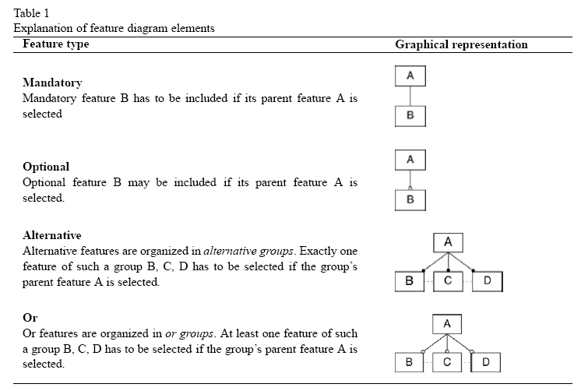

Slide 60
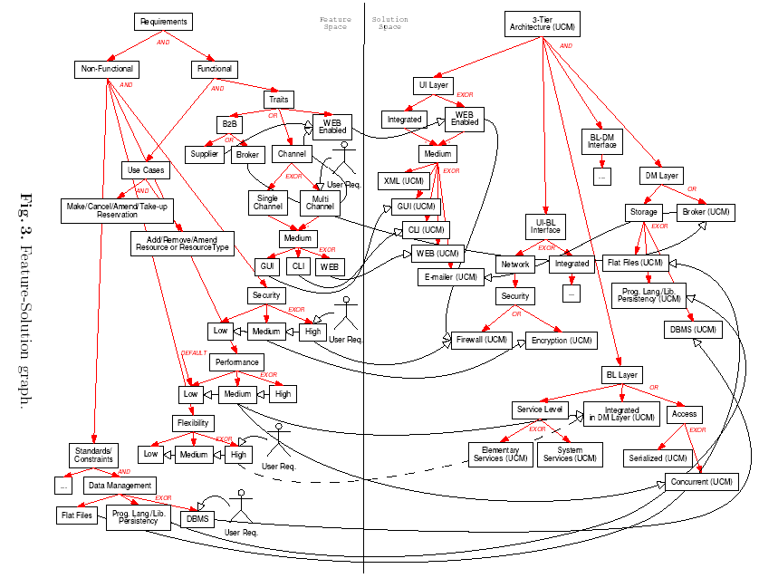
Feature Solution Diagrams
Feature
space
Solution
space
From de Bruin & Van Vliet, 2001

Slide 61
Feature-Solution Graph
Example from Hans de Bruin, Hans van Vliet

Slide 62
Summary
Information Hiding
Minimize Coupling
Divide and Conquer
Separation of Concerns
Keep it Simple
Design Principles
Design Structure Matrix
  can you read it? make it?
Know them, Apply them
Recognize violations

Slide 63
Questions?

Slide 64
Summary of key architecting practices
Understand the drivers for the project (business, politics)
Get stakeholder involvement early and often
Understand the requirements incl. quality properties
  SMART & prioritized
Develop iteratively and incrementally
Describe architecture using multiple views
  abstract, but precise, design decisions & rationale
Design for change (modularity, low coupling, inform. hiding)
Analyze in an early stage (use maths! and scenarios)
Simplify, simplify, simplify
Regularly update planning and risk analysis
Monitor that architecture is implemented
Get good people, make them happy set them loose

