Slide 1
Deployment Diagrams M.R.V. Chaudron

Slide 2
See also:
https://www.uml-diagrams.org/deployment-diagrams.html
http://aviadezra.blogspot.com/2009/09/uml-deployment-component-diagrams.html

Slide 3
Deployment Diagram
Captures the topology of a system’s hardware
Purpose
Specify the distribution of components
Identify performance bottlenecks
Developed by architects, networking engineers, and system engineers

Slide 4
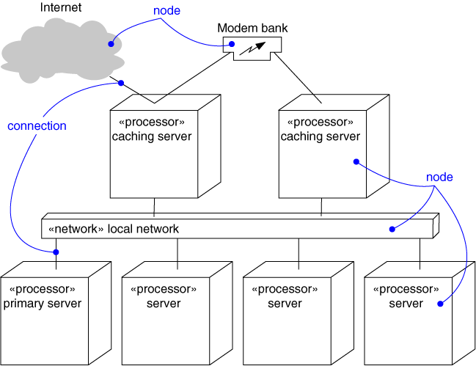
Deployment Diagram
A deployment diagram models:
The topology of a system’s physical hardware i.e. computing-devices and network
the mapping of logical (structural) view to the physical hardware
This diagram is an example of only the hardware

Slide 5
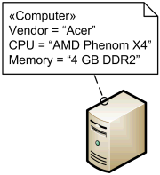
Node is a deployment target which represents computational resource upon which artifacts may be deployed for execution.
Examples of devices are:
«application server»
«client workstation»
«mobile device»
«embedded device»

Slide 6
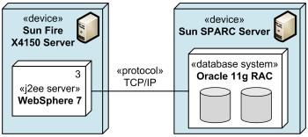
Communication Path
A communication path is an association between two deployment targets, through which they are able to exchange signals and messages.
paths are parts of the hardware/infrastructure

Slide 7
Deployment Diagram
Deployment view: physical model + mapping
...
component
A
C
D
B
physical device
TCP/IP over Ethernet
network
Basis for analyzing throughput, availability
Separation of Concerns in diagrams: the deployment diagram does not show the dependencies between components

Slide 8
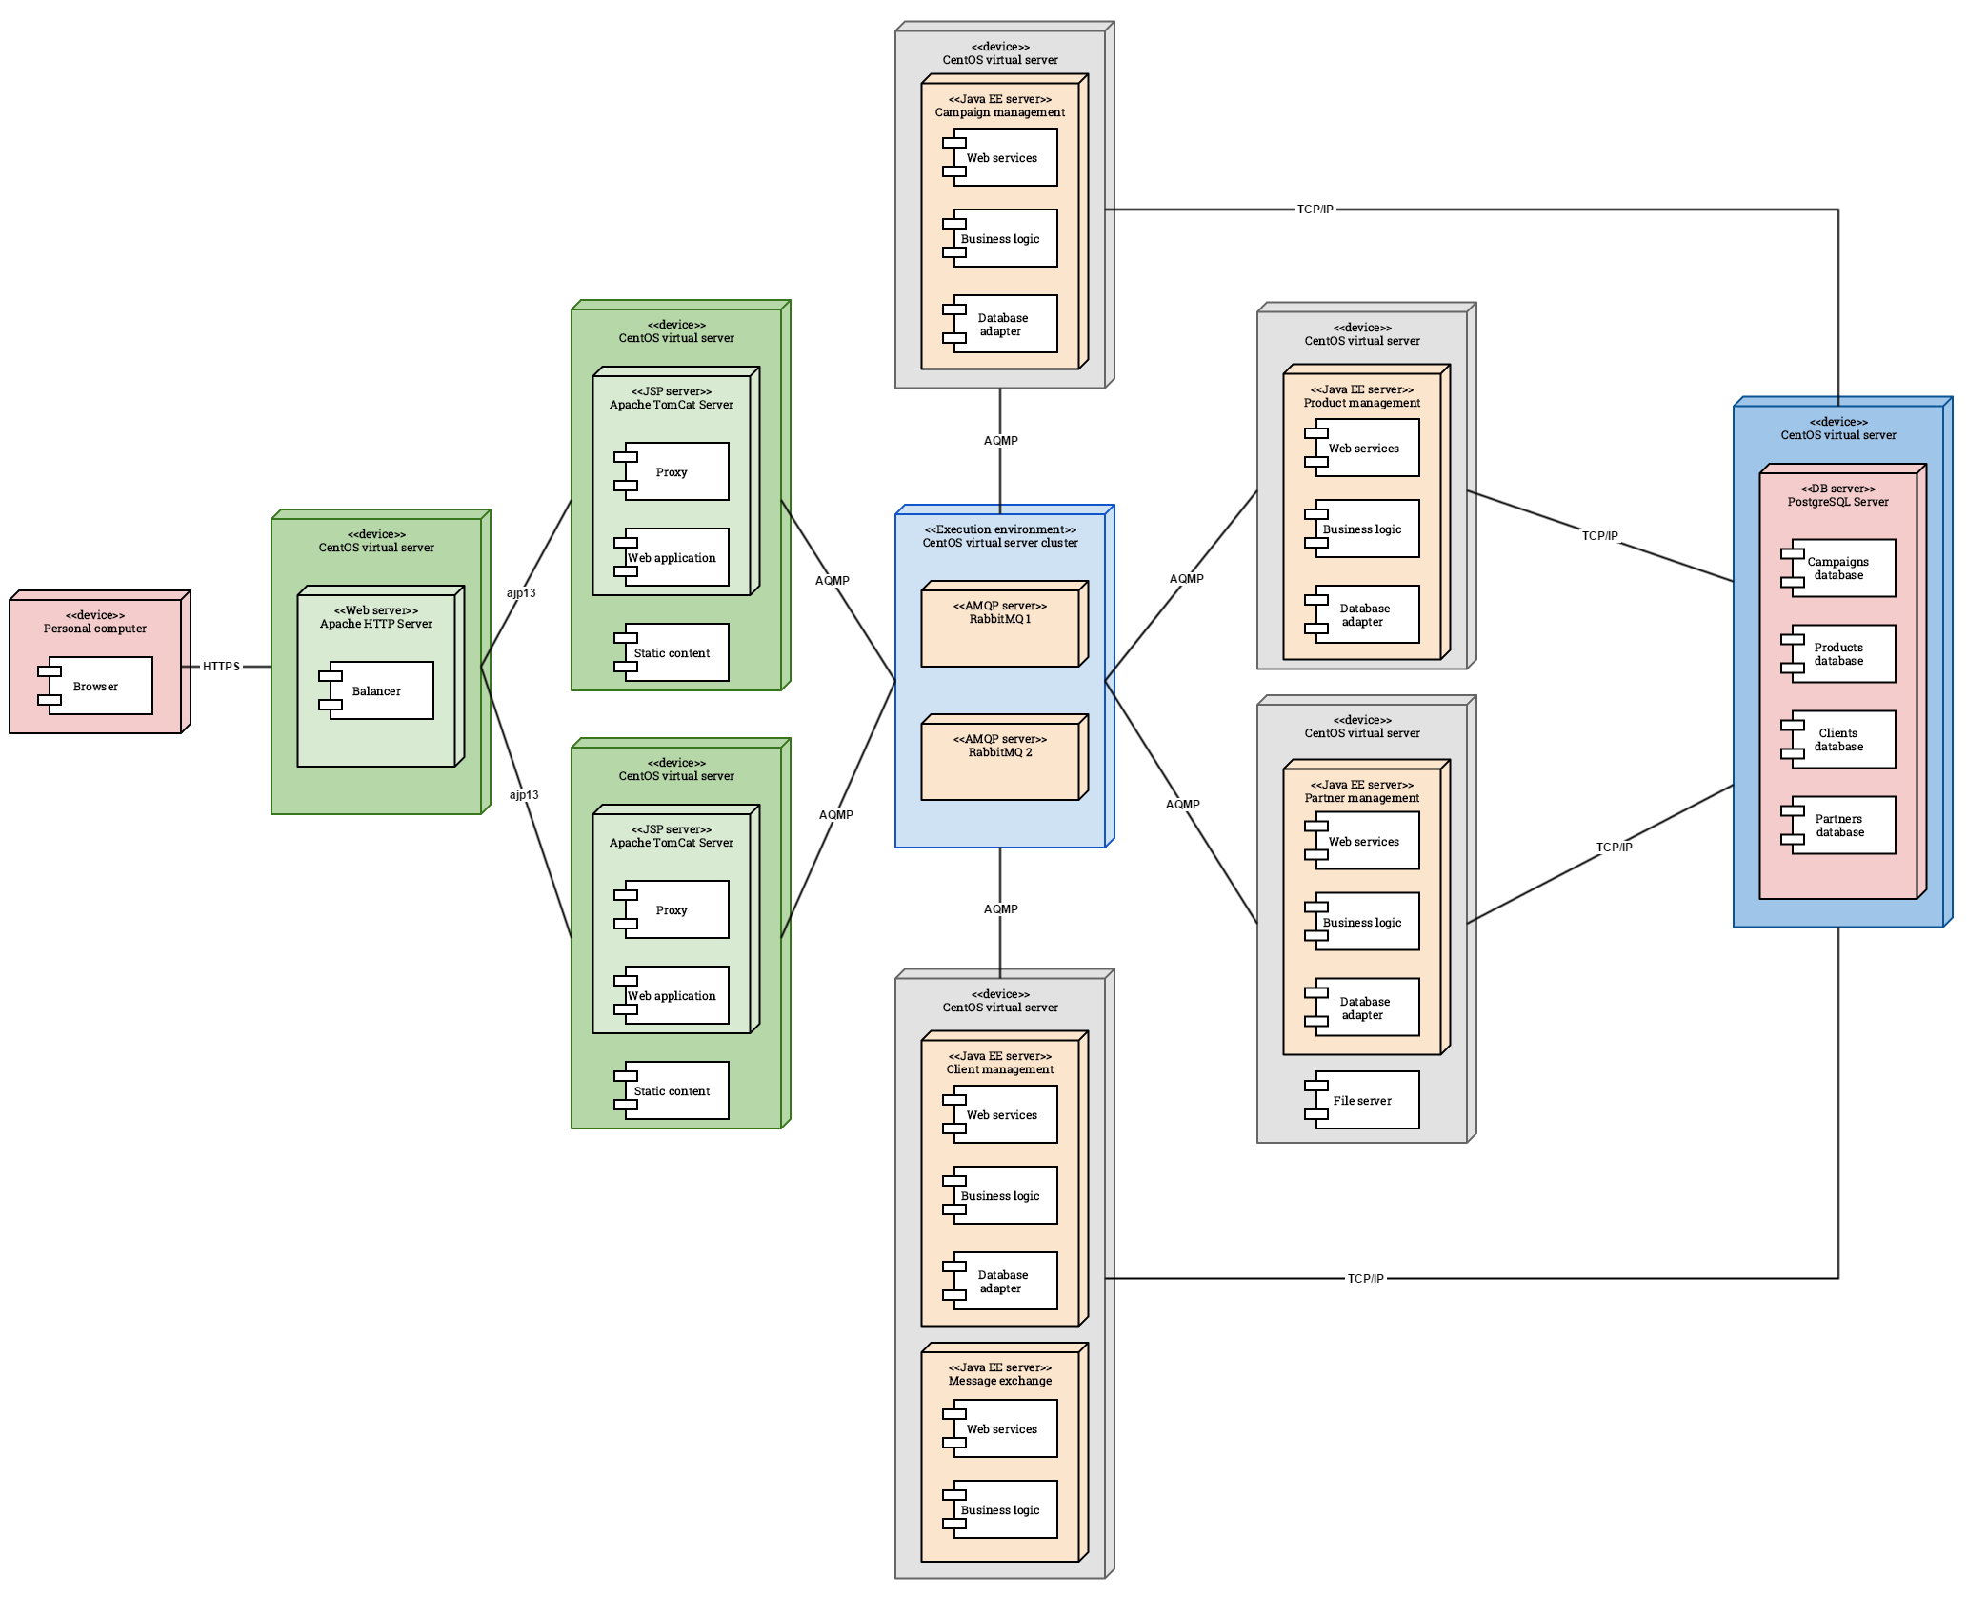

Slide 9
Web Shop Deployment Diagram
Internet Client
Shop Terminal
Shop UI
Staff Shop UI
Staff Shop
Registration
Cust. Selection
Management
Customer
Registration
Stock Control
Product
Cat. Maint.
Cart Data
Payment
Internet
Local Area Network
Gateway
Firewall
Shop Staff
Stock
Customer
DB
Product
Catalogue

Slide 10
Deployment Example
UI
UI
UI
UI
Student
Reg.Off.
Internet
Client
Library
Dorm
Internet
Local Area Network
Registration
Firewall
Database
Server
Gateway

Slide 11
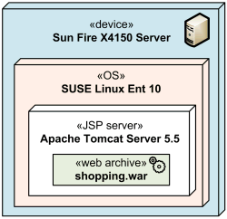
Execution Environment
Deployment Diagrams may show the
Execution environment of a general node or «device» which represents. Execution environments can be nested (e.g., a database execution environment may be nested in an operating system execution environment).

Slide 12
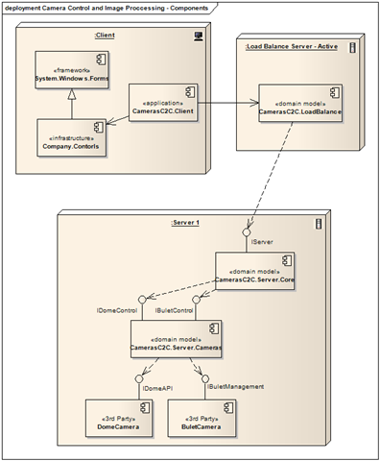
Deployment = Structural View onto Hardware/Infrastructure
Depending on your purpose you may show component-dependencies.
I prefer not to do this because these are already shown in structural view.

Slide 13
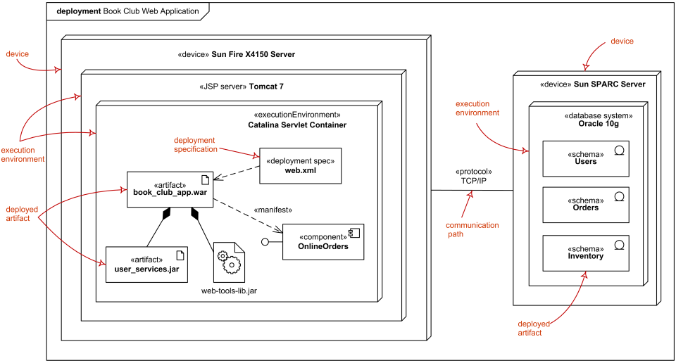
One more example

Slide 14
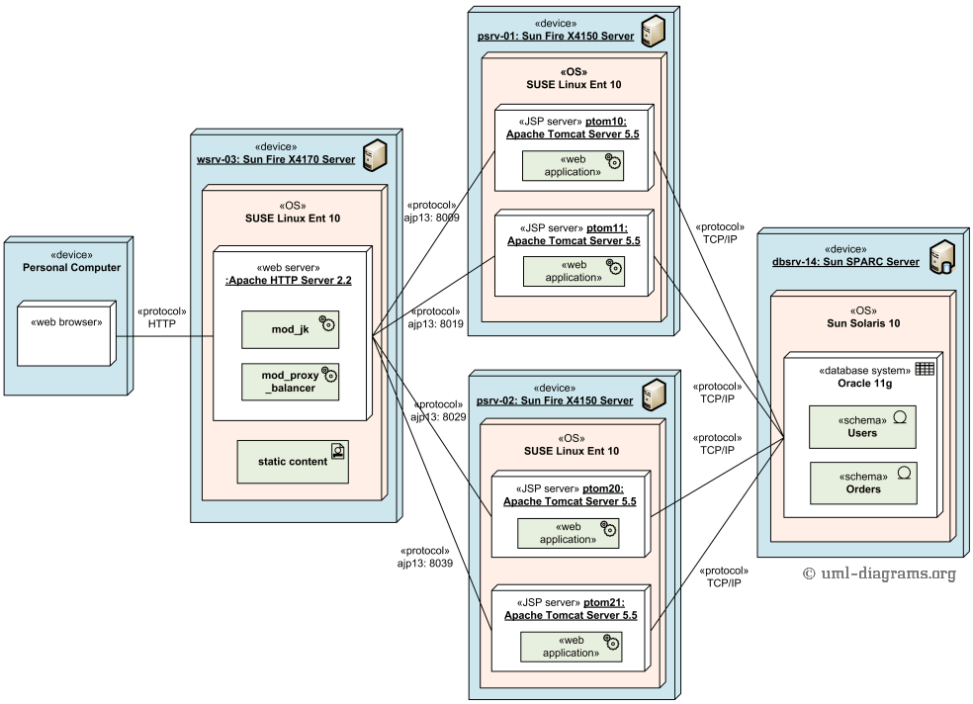
Use nice colours!

Slide 15
Case: Web shop
register
login
search
add item to
catalogue
add item to cart
remove item
from catalogue
customer
shop owner
remove item from cart
add to stock
pay items in cart
package & ship

Slide 16
Structure Diagram
Defines subsystems of functionality
Purpose
Define decomposition into subsystems
Provide support for use-cases
Use Component (or Class) diagram

Slide 17
Web Shop: Functional Areas (V0.1)
Customer
Registration
Shop Owner
Registration
Shop User Interface
Product Catalogue
Maintenance
Payment
Stock Control

Slide 18
Check Use Cases Against Functional Areas
login
Customer
Registration
Shop Owner
Registration
login
register
add item to
catalogue
search
Shop UI
Product Catalogue
Maintenance
remove item
from catalogue
Payment
Stock Control
pay items in cart
add to stock
?
package & ship
add item to cart
remove item from cart

Slide 19
Web Shop: Functional Areas (V0.2)
login
Customer
Registration
Shop Owner
Registration
login
register
add item to
catalogue
Shop UI
Product Catalogue
Maintenance
search
remove item
from catalogue
Payment
Stock Control
pay items in cart
add to stock
Excluded from example
Payment adm
Shop staff salary adm
...
add item to cart
package & ship
Customer Selection
Management
remove item from cart
Notes:
I consider as alternative name for Customer Selection Management to be Customer Session Management

Slide 20
Web Shop: Responsabilities
Customer Registration
Entry, storage & retrieval of customers
Shop Owner Registration
Entry, storage & retrieval of shop staff
Shop UI
Provide customers access to product data
Prod. Cat. Maintenance
Entry, storage & retrieval of product data
Cust. Selection Mngmt.
Register customer product selection
Payment
Handle transaction between customer & shop
Stock Control
Register available products in stock

Slide 21
Identification of Data Domains
Customer Registration
Customer data
(name+address, authentication)
Shop Staff Registration
Shop staff
(name, authentication)
Shop UI
interface
issues only
Product Catalogue
(product-id, price)
Prod. Cat. Maintenance
Cust. Selection Mngmt.
Cart
(product-id, quantity)
volatile &
derived
Payment
volatile
Stock data
(product-id, quantity)
Stock Control

Slide 22
Some Concrete Examples
http://www.nkictarchitectuur.nl/2006/index.htm
Rabobank, Belastingdienst, Ahold, FEI, Schiphol, Elsevier, …

Slide 23
Identification of Dependencies
Shop UI
Staff Shop UI
Customer
Registration
Cust. Sel.
Mngmt.
Cart-
data
Payment
Prod. Catal.
Maint.
Stock
Control
Shop Staff
Registration
Customer
data
Product
Catalogue
Stock
data
Shop
Staff
data
key
uses
Subsystem
<< subsystem>>
package
Notes:
Drawing the picture this way, makes it clear that a separate Staff Shop UI is needed

Slide 24
Identification of Active Processes
Shop UI
Staff Shop UI
Customer
Registration
Cust. Sel.
Mngmt.
Cart-
data
Payment
Prod. Catal.
Maint.
Stock
Control
Shop Staff
Registration
Customer
data
Product
Catalogue
Stock
data
Shop
Staff data
key
uses
Active
Component
Passive
Component
Notes:
Drawing the picture this way, makes it clear that a separate Staff Shop UI is needed

Slide 25
Sequence Diagram
Captures interaction between components
Purpose
Model flow of control
Identify synchronization
Illustrate typical scenarios

Slide 26
Design System Dynamics: Scenario’s
Shop UI
Product
Catalogue
Customer Selection
Management
Cart-data
Enter search
e2e deadline
1,0 sec.
Matches of search
Select item
Update selection
Store selection
Scenario’s describe the interaction between components
Notes:
Drawing the picture this way, makes it clear that a separate Staff Shop UI is needed

Slide 27
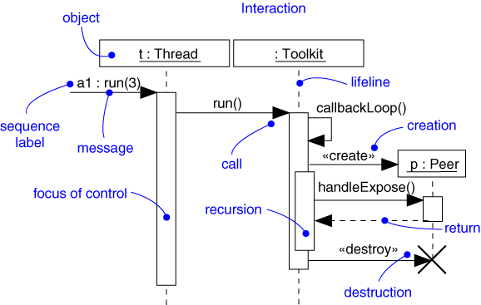
Sequence Diagram
Captures interaction between components

