Slide 1
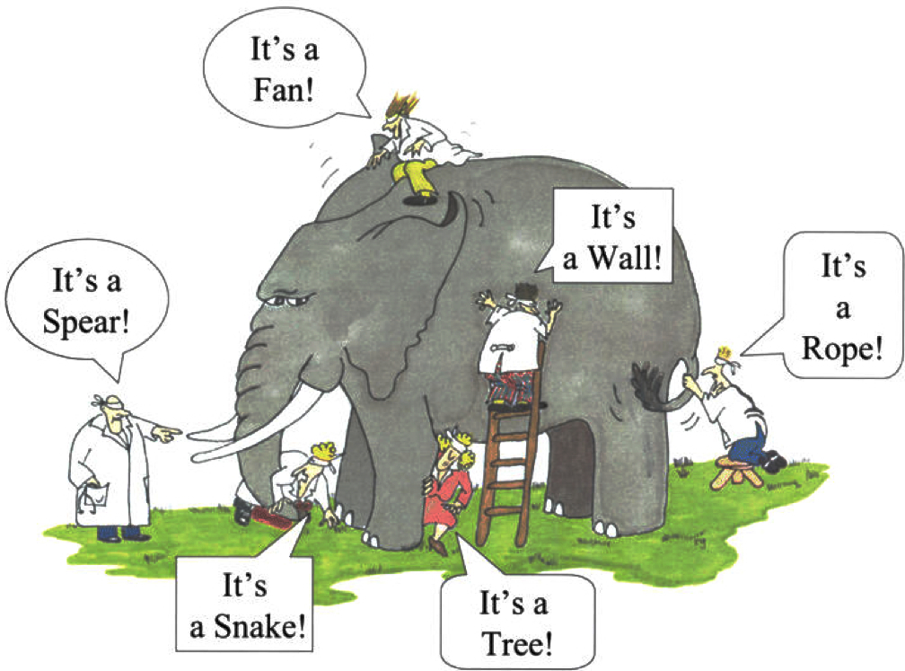
Tactics, Architecture Reconstruction &
Architecture-Implementation Correspondence
Prof. Dr. Michel R.V. Chaudron
Chalmers | Gothenburg University

Slide 2
Schedule
Week |  | Date | Time | Lecture | Reading | Note
36 | L1 | 4 sept | 13:00 – 15:00 | Introduction & Organization
37 | L2 | 11 sept | 13:00 – 14:30 | Architecting Process & Views | Ch 1 & 2
37 | S1 | 12 sept | 10:15 – 12:00 | << Supervision/Assignment>>
38 | L3 | 18 sept | 13:00 - 15:00 | Requirements & Quality Attributes | Ch 3 & 4
38 | S2 | 19 sept | 13:00 – 15:00 | << Supervision/Assignment>>
38 | L4 | 20 sept | 13:15 – 15:00 | Architectural Styles 1 | Ch 13
39 | L5 | 25 sept | 13:15 – 15:00 | Architectural Styles 2 | Ch 13
39 | S3 | 26 sept | 10:15 – 12:00 | << Supervision/Assignment>>
39 | L6 | 27 sept | 13:15 – 15:00 | (finish) Architectural Styles & Tactics
40 | L7 | 2 Oct | 13:15 – 15:00 | The Human Factor in Software Architecting: Cognitive and Social Aspects | Ch 18 | Rodi Jolak
40 | S4 | 3 Oct | 10:15 – 12:00 | << Supervision/Assignment>> |  | UG
41 |  | 4 Oct | 13:00 – 15:00 | skip |  | UG
42 | L8 | 9 Oct | 13:15 – 15:00 | Technical Debt (Terese Besker) |  | PhD defence
41 | S5 | 10 Oct | 10:15 – 12:00 | << Supervision/Assignment>>
42 | L9 | 16 Oct | 13:15 – 15:00 | Design Principles / Tactics | Ch 6, 7
42 | S6 | 17 Oct | 10:15 – 12:00 | << Supervision/Assignment>>
43 | L10 | 18 Oct | 13:15 – 15:00 | Architecture Evaluation | Ch 21
43 | L11 | 23 Oct | 13:15 – 15:00 | Tactics & Reverse Engineering & Correspondence | Ch 20
43 | L12 | 24 Oct | 13:15 – 15:00 | No lecture: Lindholmen Software Development Days
43 | L13 | 25 Oct | 13:15 – 15:00 | Guest lecture Volvo Trucks
Notes:
2019: other topics that could be added:
- Risk management

Slide 3
Outline
Tactics in UML & 4+1 views
Reverse Architecting –
based on slides by prof. Arie van Deursen, TU Delft, NL
Course Feedback Survey
Monitoring Architecture-Implementation Conformance
  includes slides by Reinder Bril, TU Eindhoven, NL

Slide 4
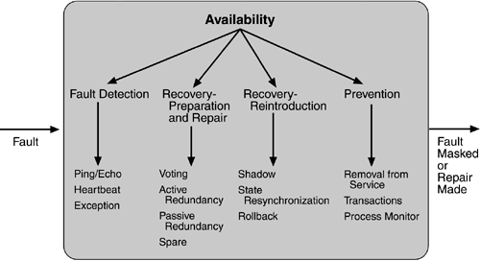
Availability tactics

Slide 5
Most Tactics fits in one of these stages
Prevent
Detect
Correct

Slide 6
Performance Tactic:
Client-Server with load balancer
Structure Diagram
Sequence Diagram
Deployment Diagram
C
LB
S
C
LB
S1
S2
check load status
C
S2
check load status
actual request
LB
S1
Many variations are possible
(Almost) the same tactic can also be used for improving availability

Slide 7

Heartbeat tactic
Structure Diagram
Sequence Diagram
Deployment Diagram
A
B
A
B
A
B
I’m alive
A monitors B
No specific constraints
on deployment.
Although: A and B typically
run as separate processes
or threads.
This is by default the case
when running on different
compute-nodes.
‘dead’ silence /
time-out
‘B’ must be dead

Slide 8
A detail on notation: Active Class
Sequence Diagram
An active class can decide to take actions by itself (autonomously);
e.g. as to initiate actions
This is needed if you have concurrency in the system.
Otherwise, by default, sequential execution is assumed.
Bold-outline indicates ‘active’ class
A
B
Sequence Diagram
Camera
Video
Repository
Image
Filter
Stream video
Extract video-
fragment

Slide 9
Heartbeat tactic (with active classes)
Structure Diagram
Sequence Diagram
Deployment Diagram
A
B
A
B
A
B
I’m alive
A monitors B
No specific constraints
on deployment.
Although: A and B typically
run as separate processes
or threads.
This is by default the case
when running on different
compute-nodes.
‘dead’ silence /
time-out
‘B’ must be dead

Slide 10
Availability: Active Redundancy
Deployment Diagram
Structure Diagram
Sequence Diagram
C
S1
C
AR
S
C
AR
S1
S2
AR
S2
S1 computes response
C sends a request
S2 also computes response
AR selects either response
S1 and S2 run as separate processes/threads.
Both S1 and S2 are active at the same time (in parallel).
Hence there is no extra waiting time if one of the servers fails
Ideally the AR-module (and hence the AR-mechanism) is transparent (‘invisible’) to the C (and S) components.
Notes:
Q: what do you imagine the sequence diagram for ‘passive’ redundancy looks like?

Slide 11
Reliability: voting
Deployment Diagram
Structure Diagram
C
S1
S3
C
V
S
V
S2
Sequence Diagram
C
V
S1
S2
S3
C sends a request
S1 computes response
S2 also computes response
S3 also computes response
V selects the ‘majority’-vote
The intent of this tactic is different from active redundancy: here the idea is to have 3 different components all compute answers to the same question – but possibly using different algorithms.
The value that comes out ‘most often’ is taken as the answer. This works for odd numbers of components

Slide 12
Layers of Defense
preventive
detective
corrective
Respond
Deter
Detect
Alarm
Delay escape
Sequence should not take too long!

Slide 13
Classes of Tactics
A system is more that only the HW/SW
physical
logical / sw
organizational
preventive
fence, guard
firewalls
training
motion
detector
detective
logging
audit
Generator-
power supply
corrective
virus checker
backup

Slide 14
Take home message
Tactics can be described using 4+1 Views and UML
Often, you need multiple views together to get the complete meaning of a tactic
Don’t forget to add explanatory text also

Slide 15
Reverse Engineering of Software Architecture

Slide 16


Reverse Architecting: Motivation
Architecture description is (often) lost or outdated
Obtain advantages of explicit architecture:
  Understanding
  Communication / Transferable abstraction
  Analysis
  Basis for further design decisions
Project wants to monitor evolution
of the system(architecture)
  - e.g. to plan maintenance effort

Slide 17
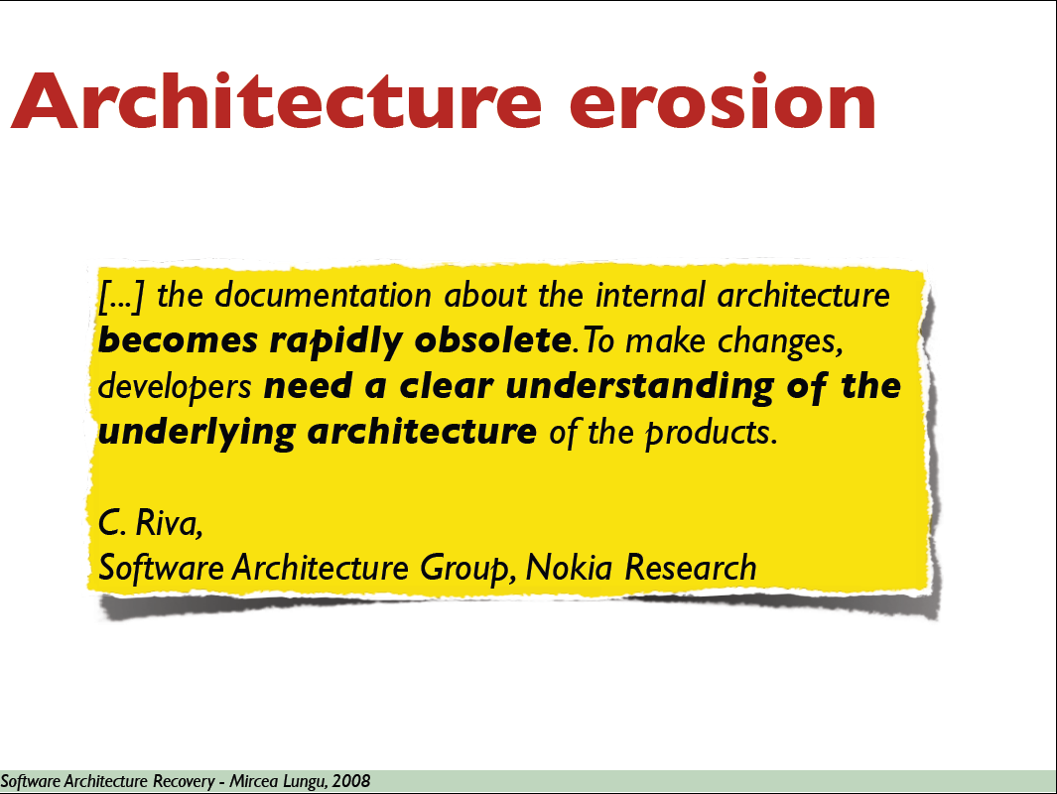
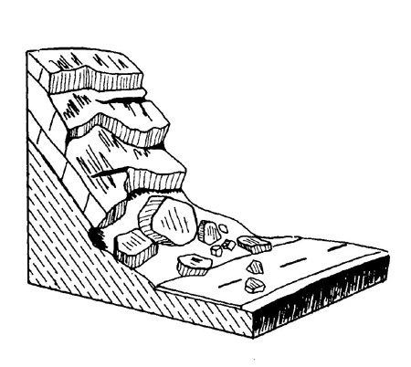

Slide 18
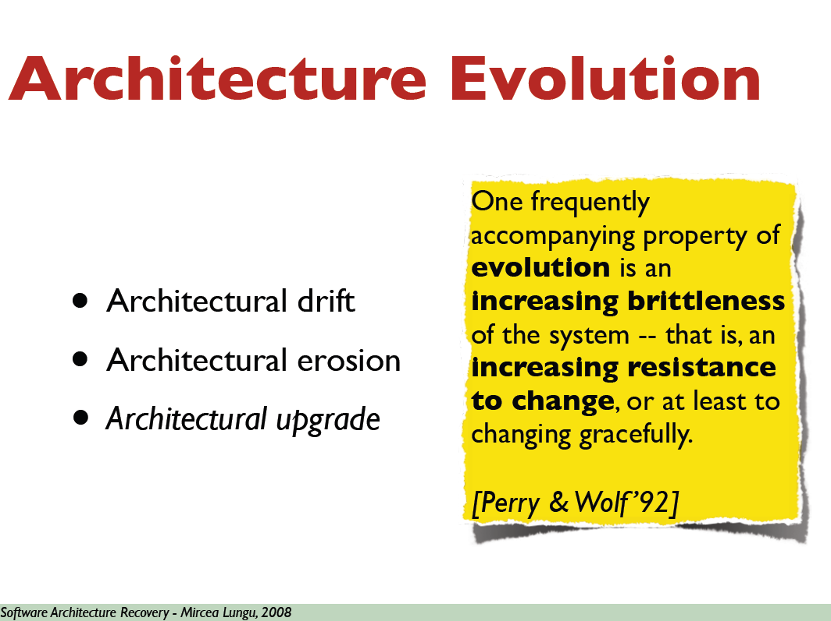

Slide 19
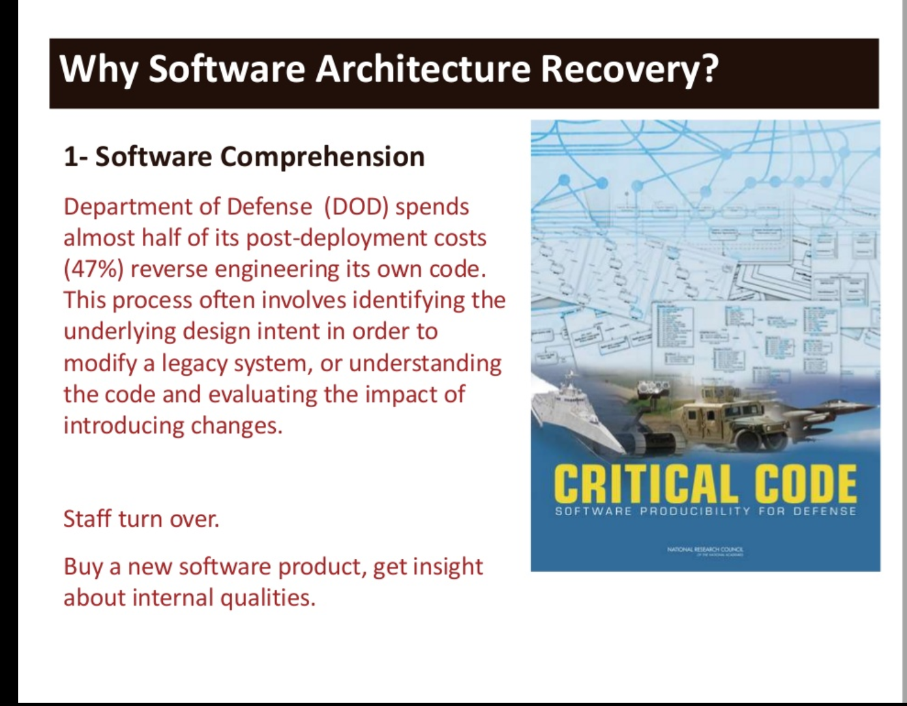
Slide by Mehdi Mirakorli

Slide 20
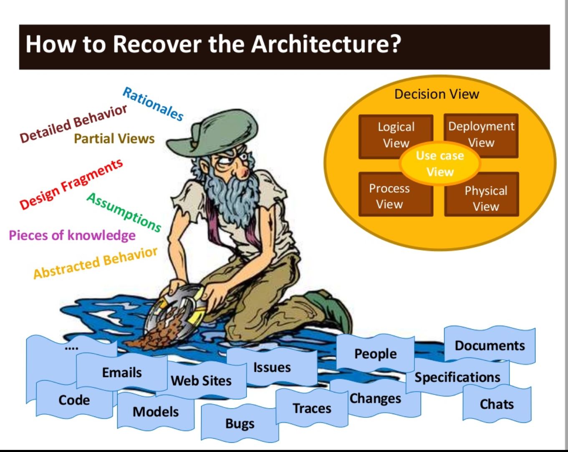
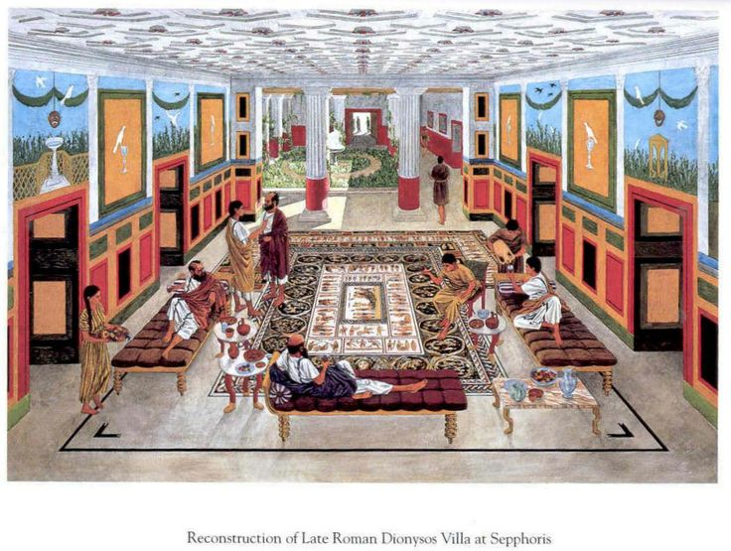
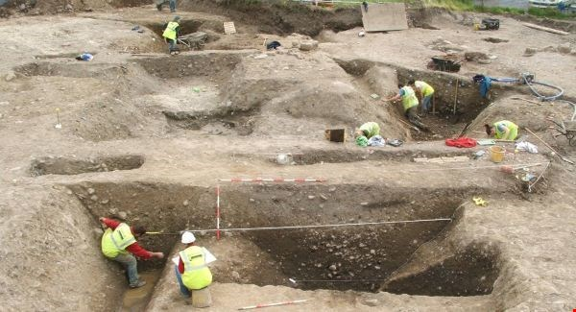
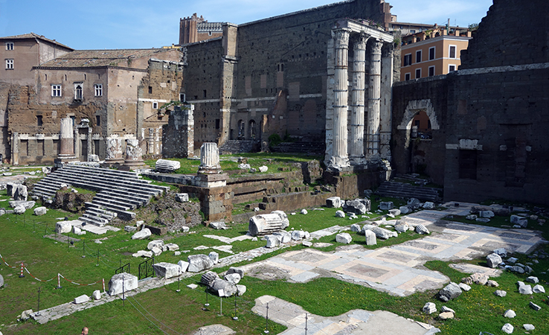
Software Archaeology

Slide 21
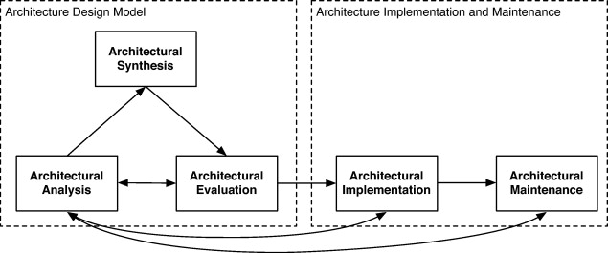
Software architecture life cycle
Fig. 1 Software architecture life cycle
Rainer Weinreich , Georg Buchgeher
Towards supporting the software architecture life cycle
Journal of Systems and Software Volume 85, Issue 3 2012 546 - 561
http://dx.doi.org/10.1016/j.jss.2011.05.036

Slide 22

Architectural Views/Structures
Which architectural views?
Which level of abstraction?
Module structure
Data model structure
Process structure
Call structure
Type structure
GUI flow
...
Notes:
Ask for structures in their systems

Slide 23
Reverse Engineering
The process of analyzing a subject system with two goals in mind:
  to identify the system's components and their interrelationships; and,
  to create representations of the system in another form or at a higher level of abstraction.

Slide 24
Reengineering
The examination and alteration of a subject system
to reconstitute it in a new form
and the subsequent implementation of that new form
Beyond analysis: aim is to actually improve.

Slide 25
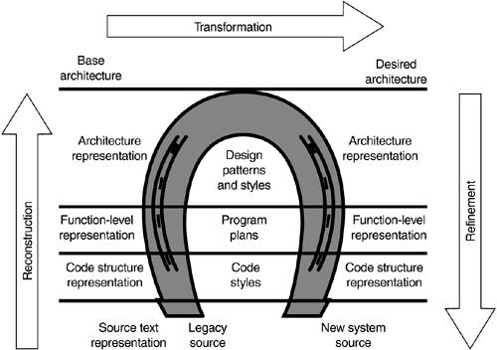
Reengineering Hors-shoe

Slide 26
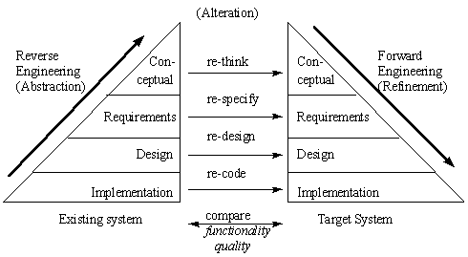
Reengineering

Slide 27
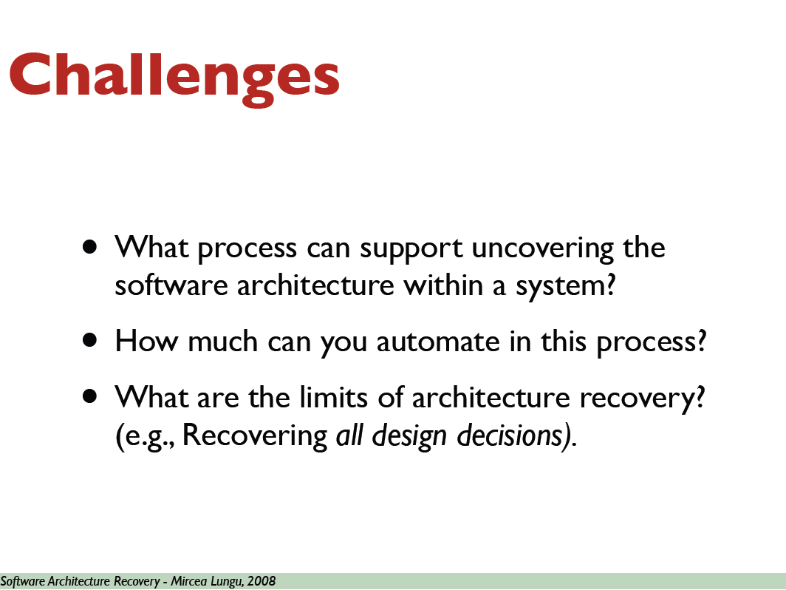

Slide 28

Program Understanding
the task of building (mental) models of an underlying software system
at various abstraction levels, ranging from
  models of the code itself to
  ones of the underlying application domain,
50% of
maintenance
effort!!
Notes:
how achieved
code reading
meaningful names
short names
no smells.
software visualization
code is written only once, but read many times.

Slide 29
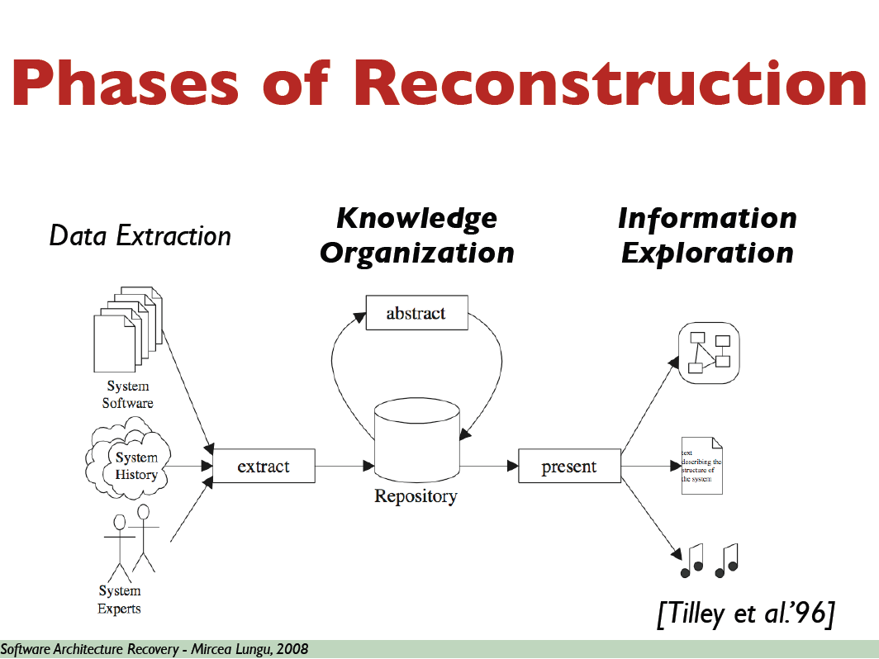

Slide 30
Architecture Exploration
artifacts
extract
repository
visualize
interpret
analysis
Extract facts from system artifacts
  src code, dir-structure, file-names, …
Analyse to infer knowledge
Visualize for understanding, interpretation

Slide 31
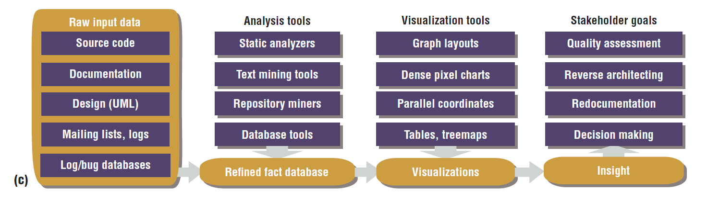

Slide 32
Extraction
artifacts
extract
repository
visualize
interpret
analysis

Slide 33
Source Model Extraction
Derive information from system artifacts
  call graphs, file dependencies, database access, …
Challenges
  Accurate & complete results
  Flexible: easy to adapt
  Robust: deal with irregularities in input,
  reuse for different systems
Another option: extract dynamic information from run-time execution

Slide 34
Analysis
artifacts
extract
repository
visualize
interpret
analysis

Slide 35
Analyse
Goals:
  infer knowledge & abstractions
  filter information
Example structures:
  Call graph
  Screen flows in UI
  Database-schema
  Performance graph
In search for
more abstraction

Slide 36
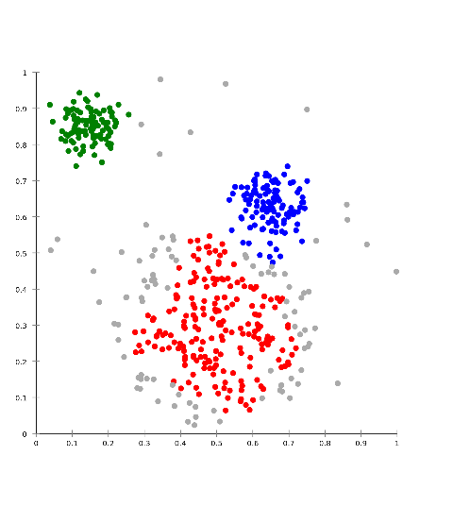
Combining Data & Functionality
Cluster analysis
  technique for finding groups in data
  Relies on metrics to compare distance
  between data items
Concept analysis
  for finding groups too
  Relies on maximal subsets of data items sharing a set of features

Slide 37
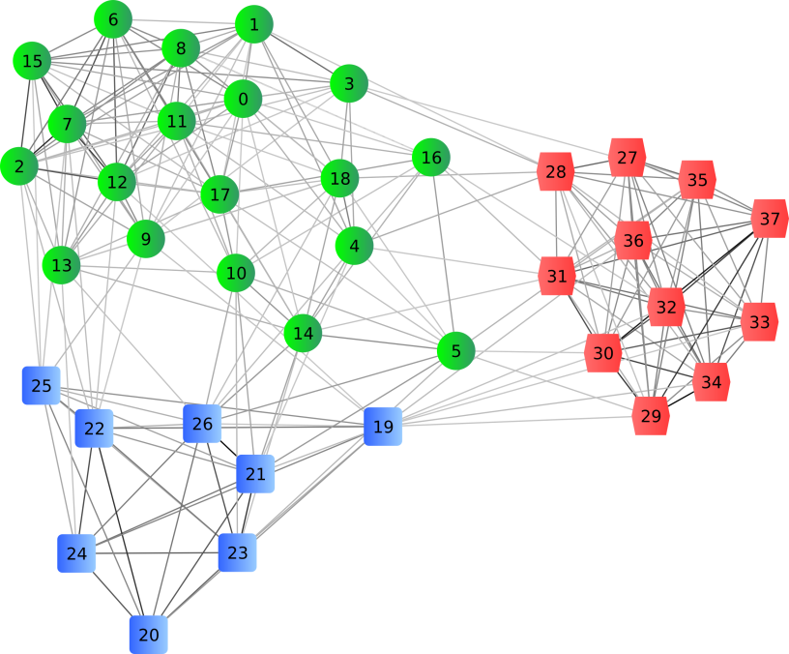
How about more abstraction?
Clustering

Slide 38
Visualisation
artifacts
extract
repository
visualize
interpret
analysis

Slide 39
Presentation Desiderata
Different stakeholders will have different needs
  Show multiple structures
  Multiple levels of abstraction
  Interaction:
    Zoom in, zoom out
    Browsing and searching
Visual as well as textual information
  Graph visualization

Slide 40
Types of navigation
Vertical browsing
  supported by hierarchical structures
  zoom into more detailed level
    system → subsystem → program → … → source
Horizontal browsing
  supported by graph-like structures
  find related on same abstraction level
    called components
    which components use data –type ‘X’?

Slide 41
Presentation Challenges
Handling abstractions not visible in code
Giving abstractions a meaningful name
  e.g., name for inferred type
Defining starting points for browsing
  lists of types, programs, copybooks, words, lits

Slide 42
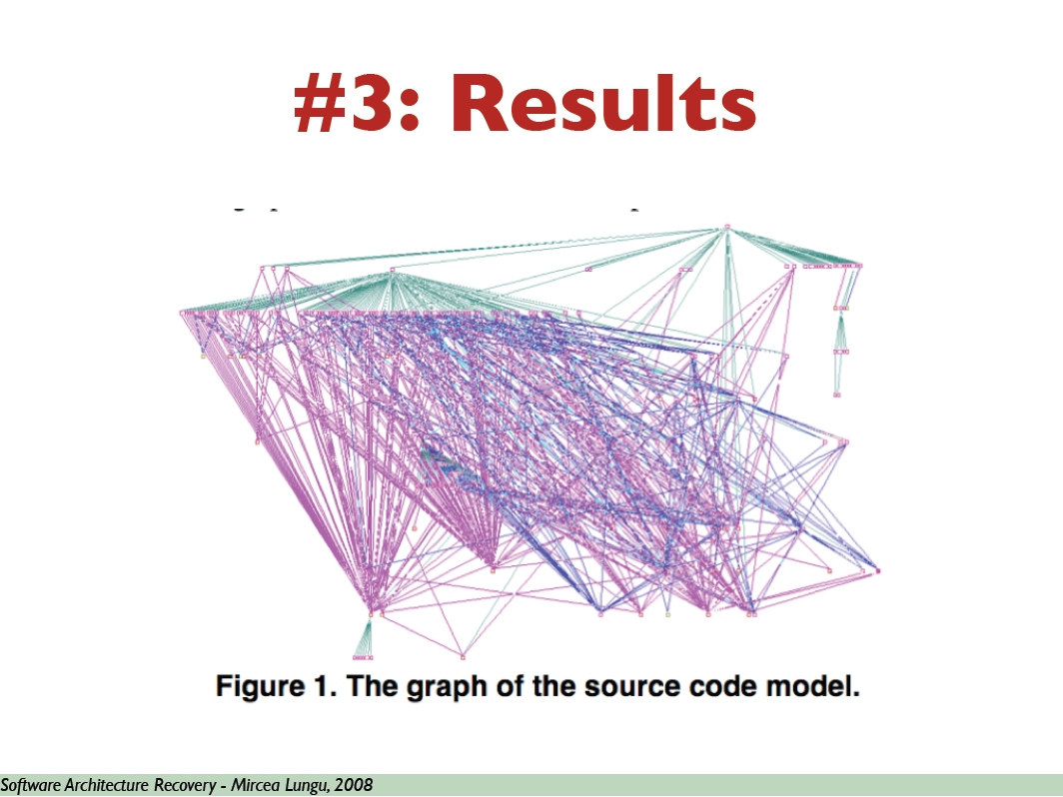
Visualizations

Slide 43
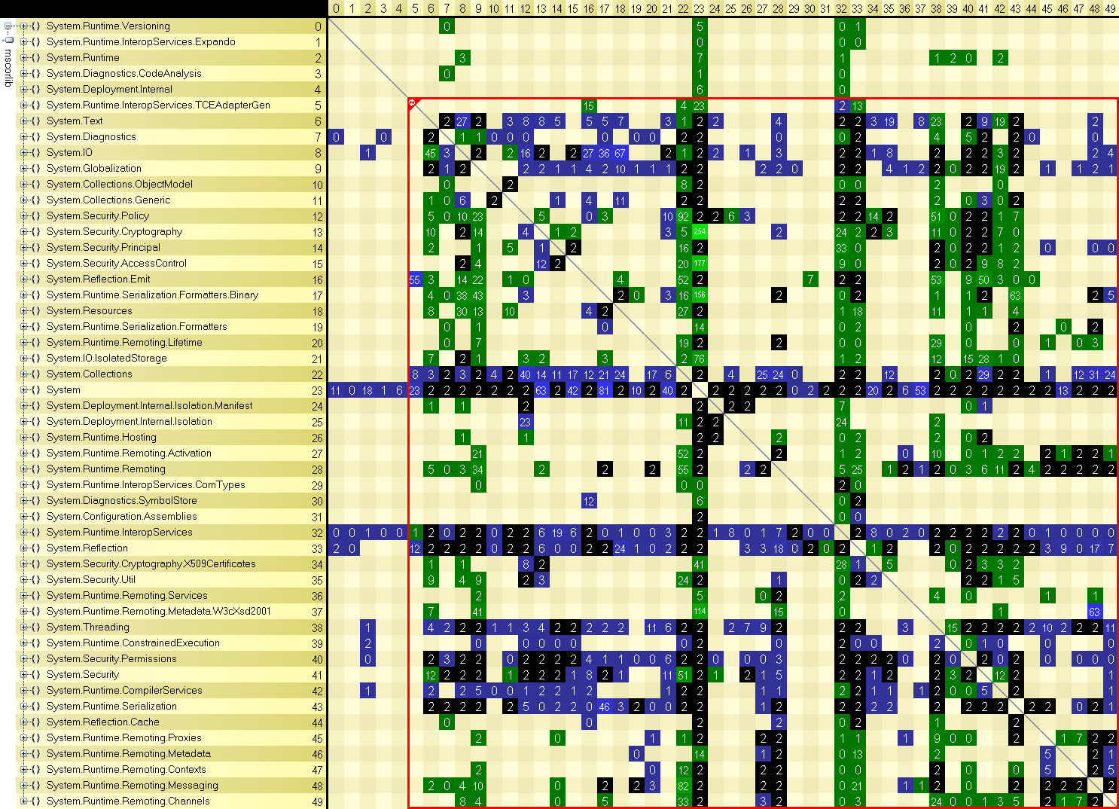
NDepend

Slide 44
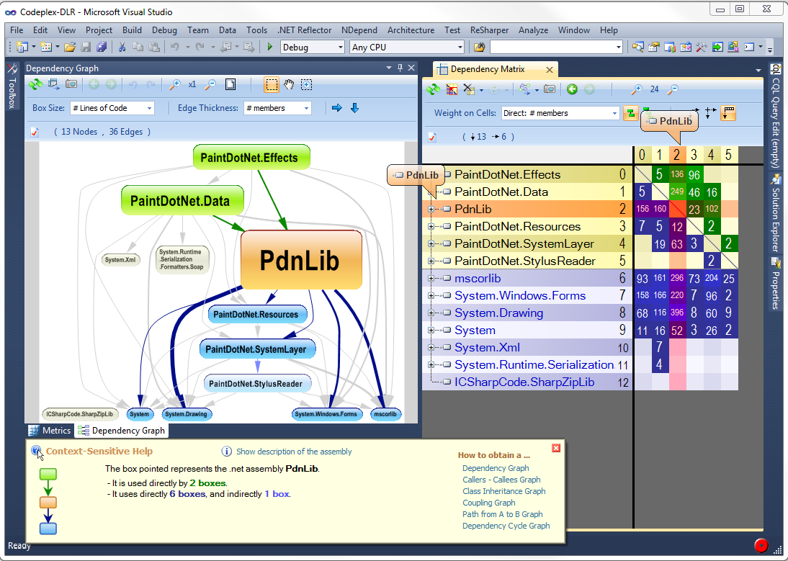
NDepend

Slide 45
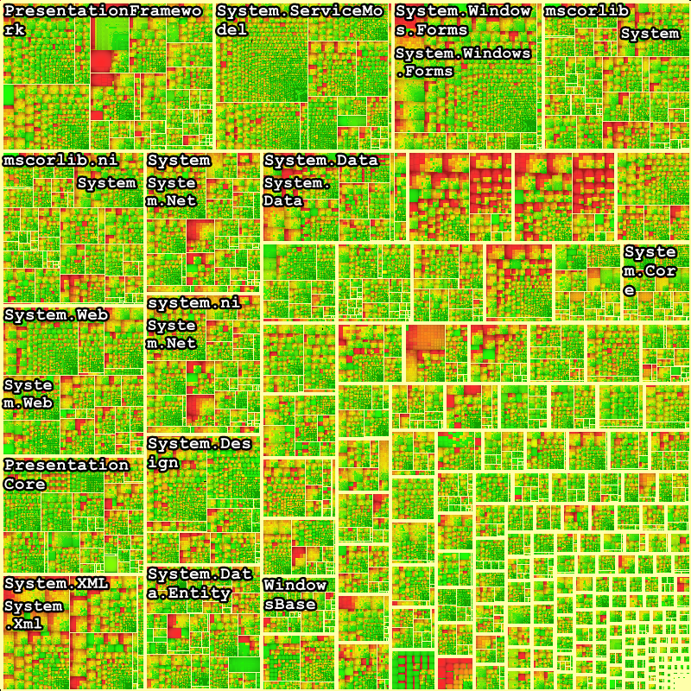
Matrix-view
Scales to very large systems

Slide 46
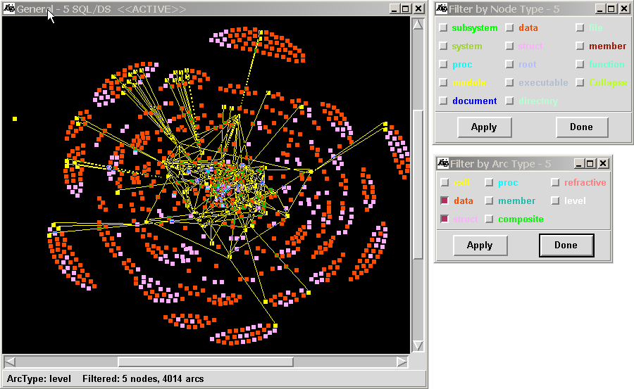
Rigi tool
http://www.svgopen.org/2002/papers/kienle_weber_mueller__rigi_reverse_engineering/

Slide 47
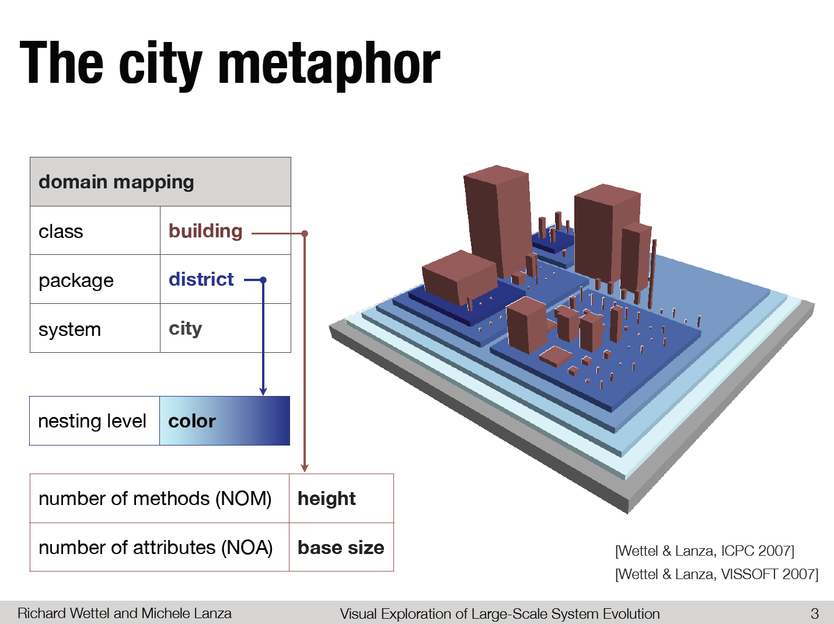

Slide 48
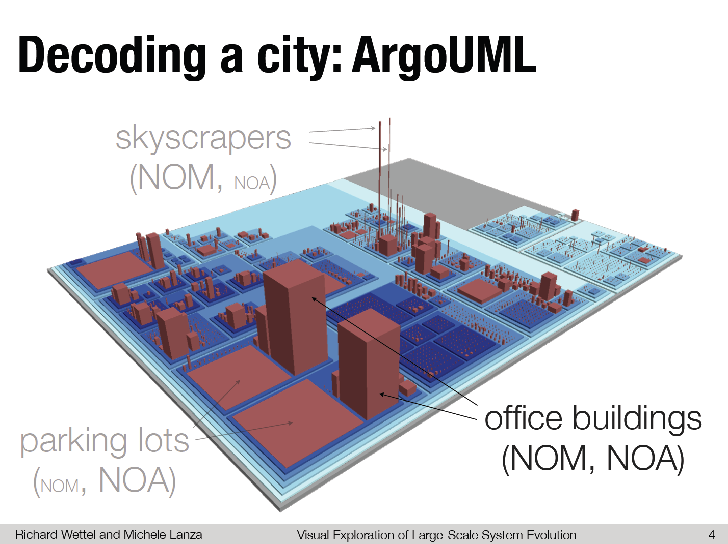

Slide 49
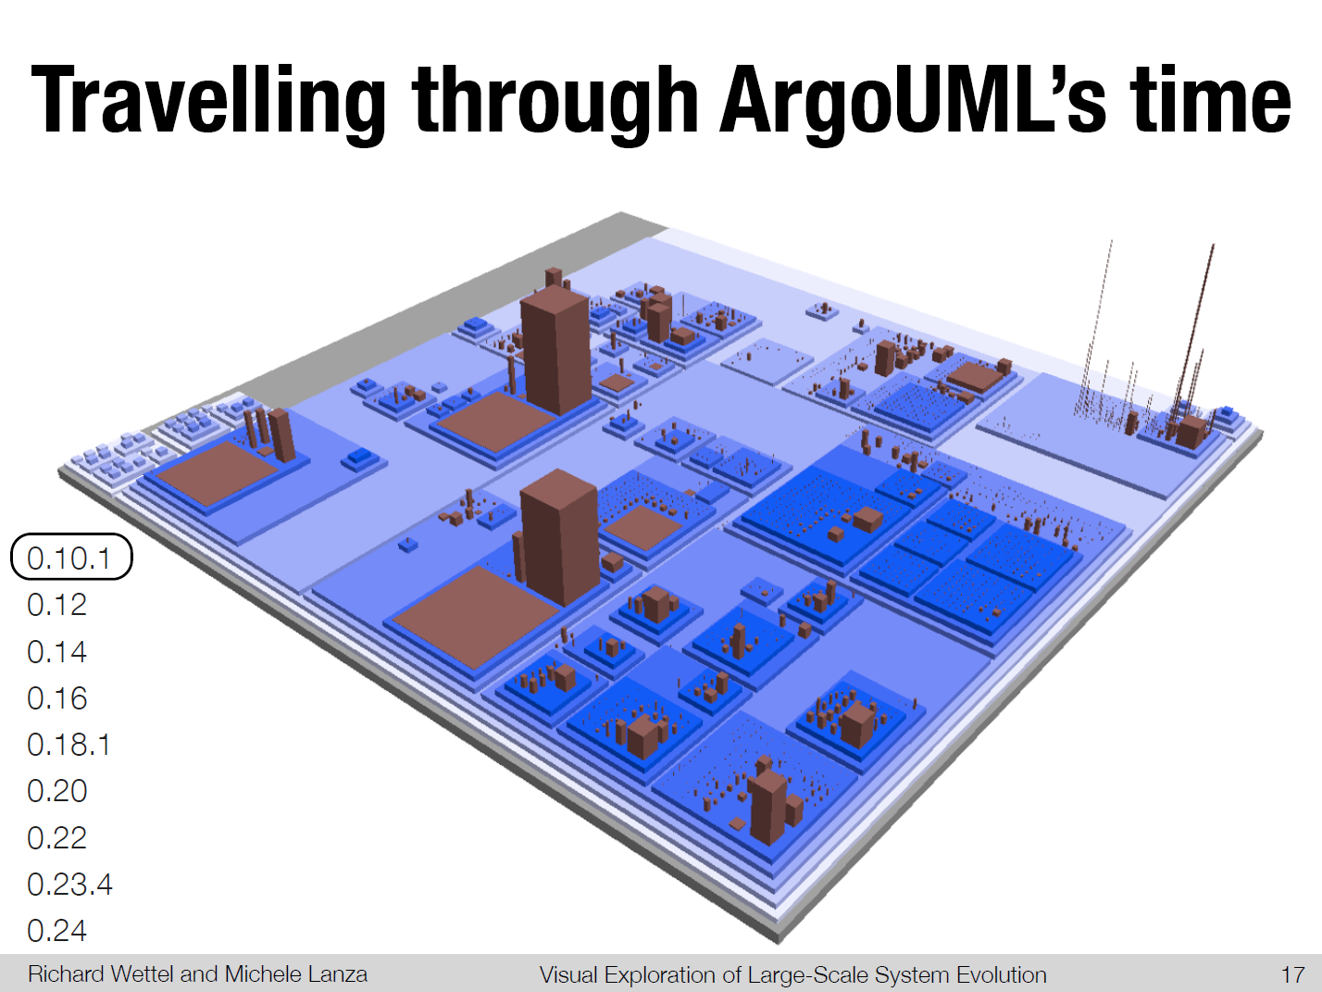

Slide 50
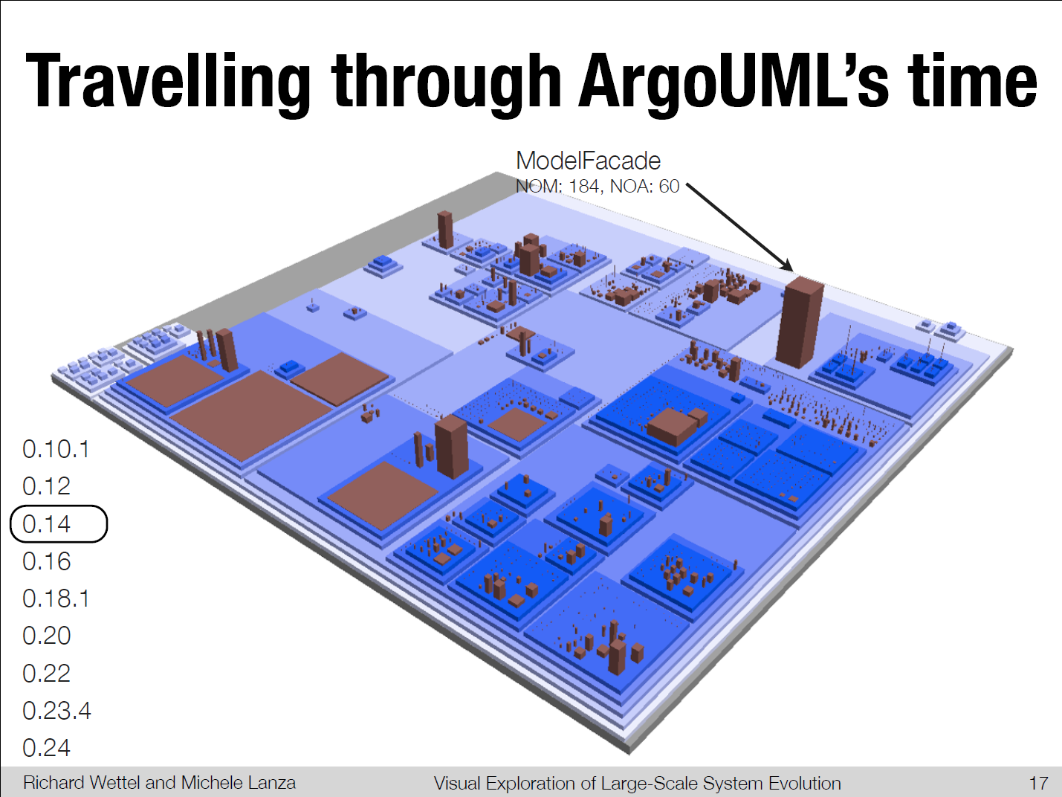

Slide 53
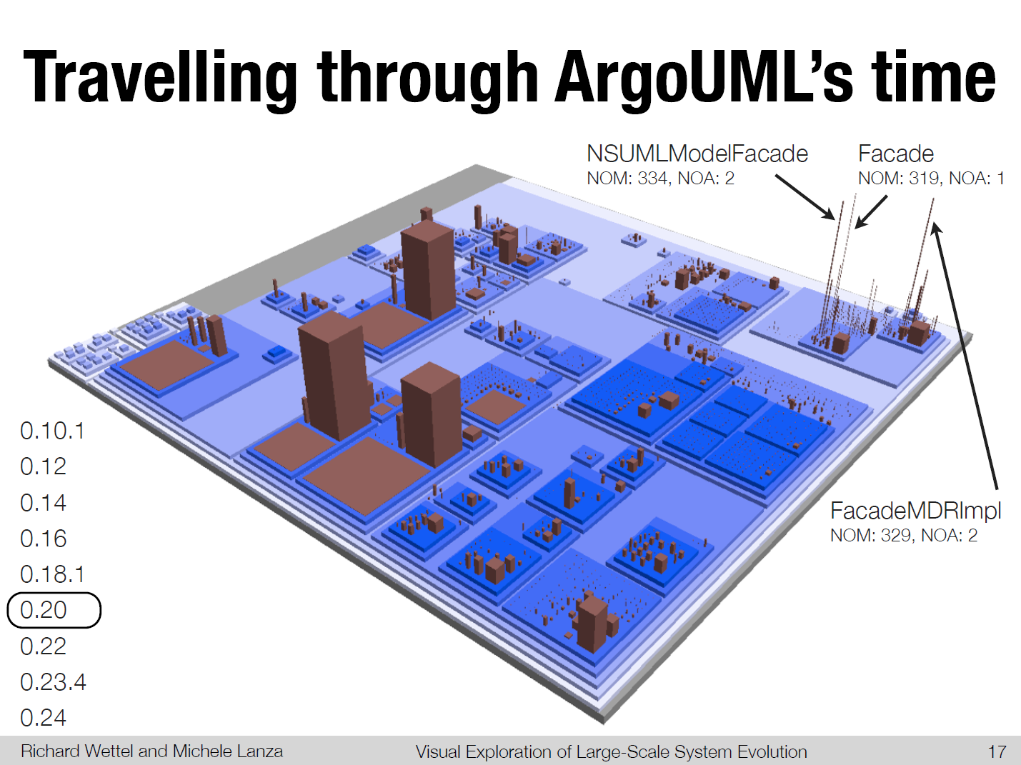

Slide 54
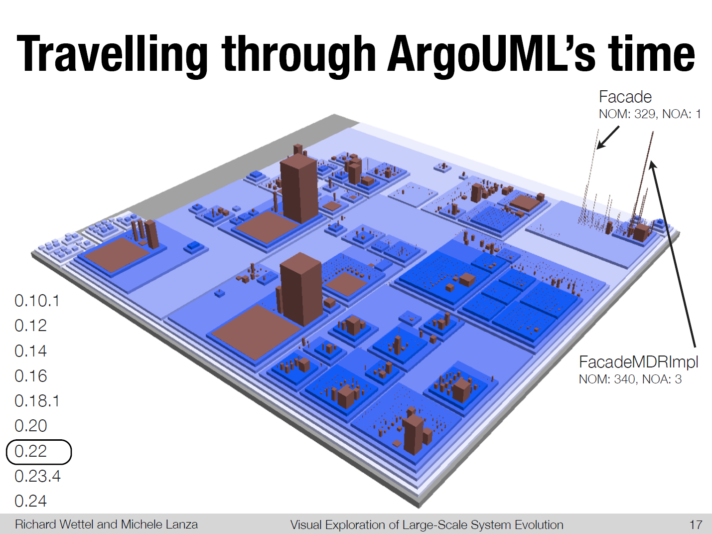

Slide 55


Slide 56
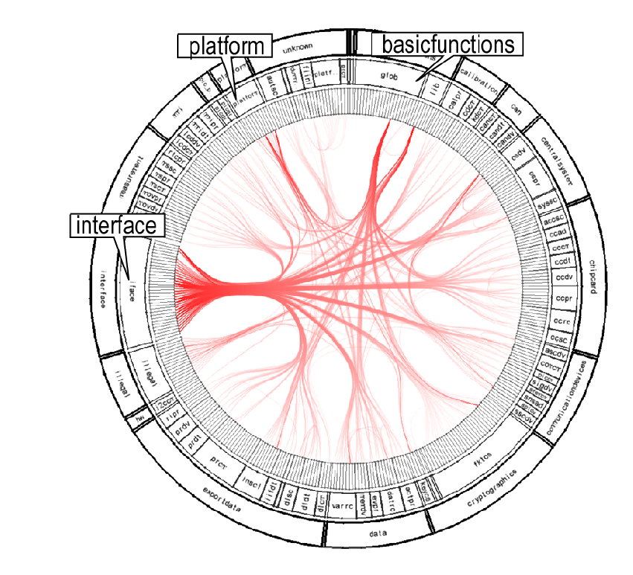
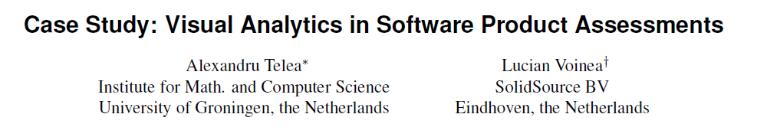

Slide 57
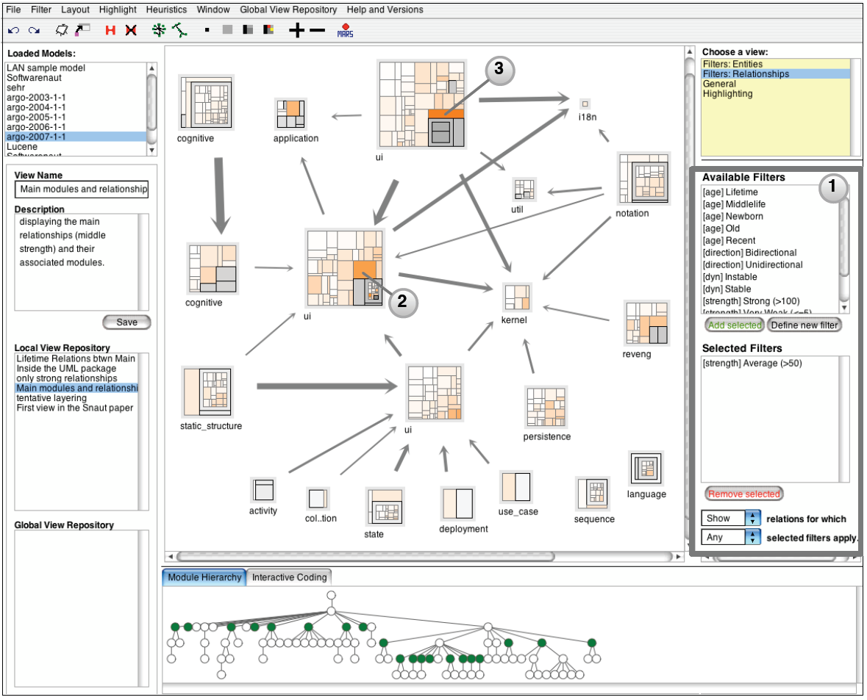
SoftwareNaut
Mircea Lungu, Michele Lanza, and Oscar Nierstrasz. Evolutionary and Collaborative Software Architecture Recovery with Softwarenaut.
Science of Computer Programming (SCP), 2012. DOI

Slide 58
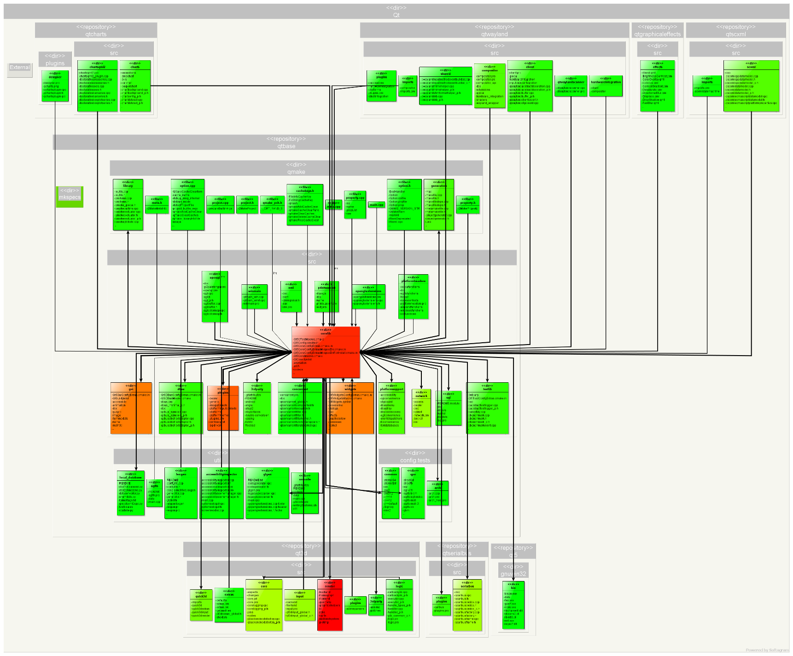
Softagram

Slide 59
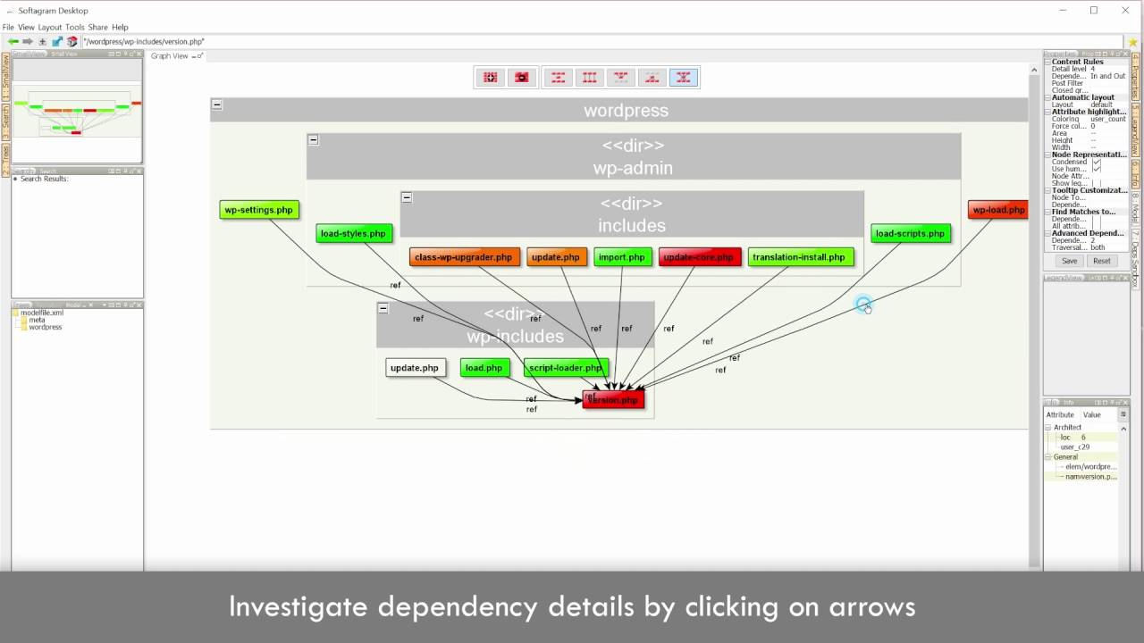
Softagram

Slide 60
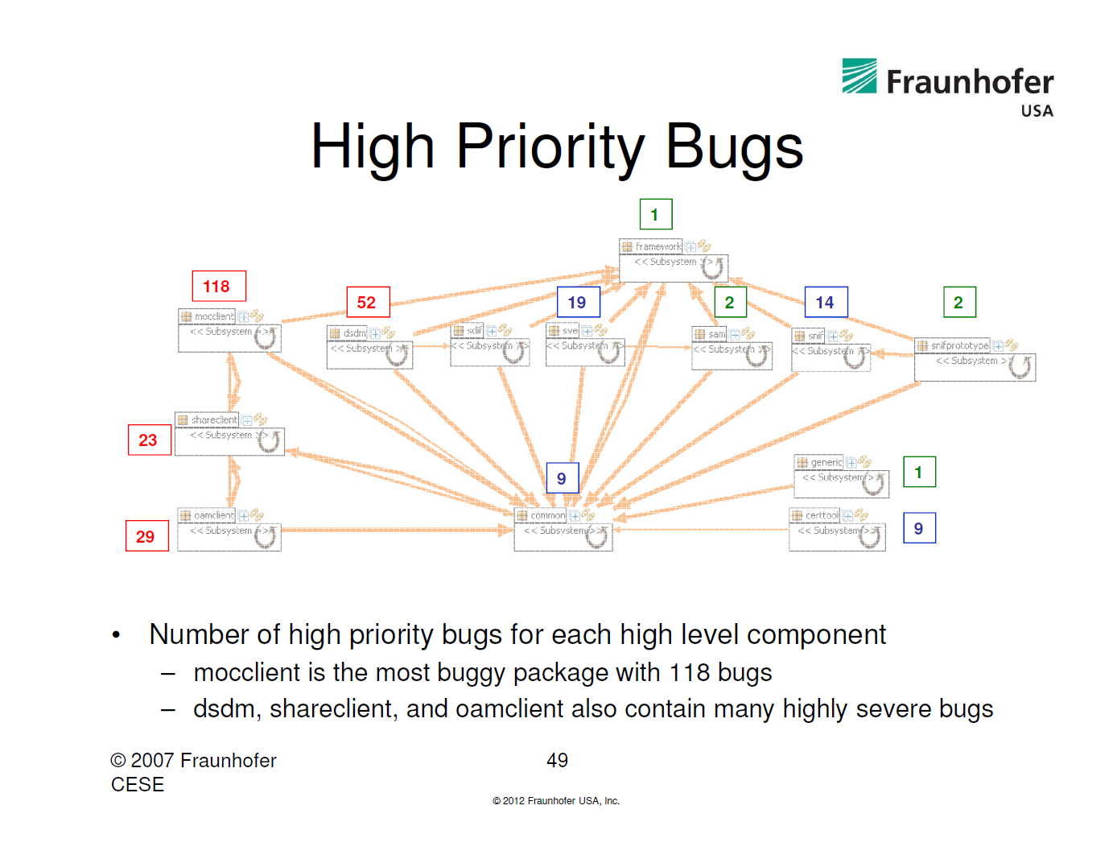
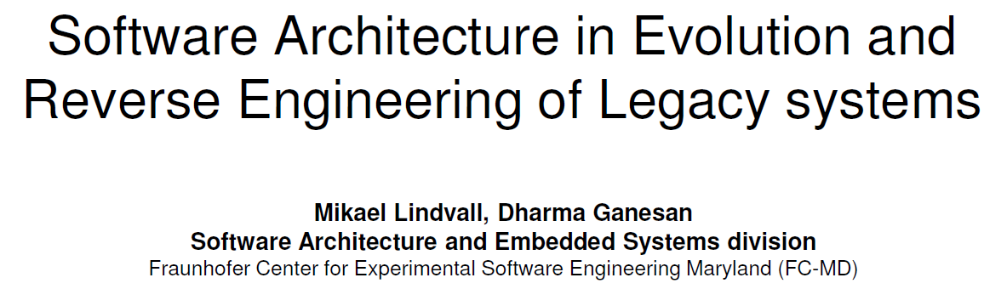
Combine Architecture with other Development metrics: High Priority Bugs

Slide 61
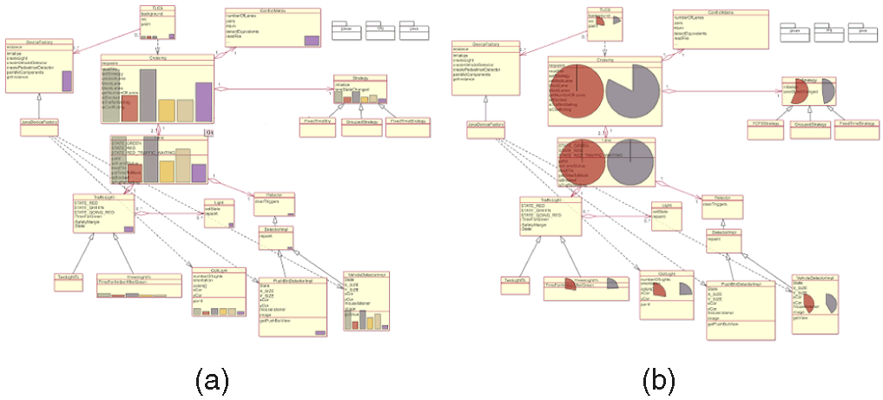
MetricView: Combine Design and Metrics information

Slide 62
Beyond structure views
How about a process/dynamics view?
  Sequence diagrams
  Maybe use run-time monitoring?
How about views of: security, performance
How is the system structured?
What can/does the system do ?
How to build / configure ?
Structure View
Development View
Functionality (Decomposition)
End-user
Use Case View
Where to install ?
What hw\nw is used?
How does the system behave?
Process View
Deployment View
System topology
Delivery, installation, maintenance
Concurrency, Communication,
Synchronization
How does the system perform ?

Slide 63
Beyond Views
How about recovery of
  Design principles
    Thin-client
    Dynamic binding
    Portable
Intent: What is this meant to do?
Rationale: Why was it designed this way?

Slide 64
Reasoning about Design Structures
Identify ‘Region’ of design related
to loading of ‘Image format’
Optical Character Recognition
`
GUI
Understand
Design Strategies
for Software Extensibility
OCR
filter
Image loader
recognize
segmentation
JPG
PNG
Principle 1: Separate Interface from Implementation
Principle 2: Minimize Coupling
Principle 3: Hide implementation details
Principle 4:…

Slide 65
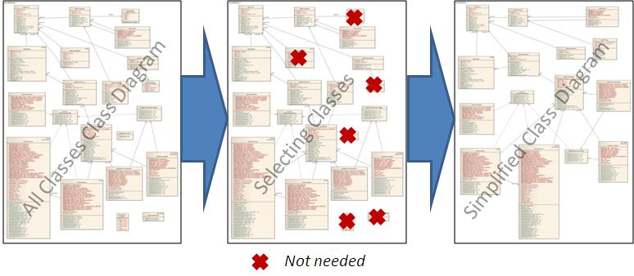
Class Diagram Simplification
Hafeez Osman
This research aims at simplifying class diagrams
Considering: - structural properties (coupling, size)
- semantic properties:
‘support’ vs ‘core functionality’
GUI / frameworks / gets&sets vs cruise control
- feature based

Slide 66
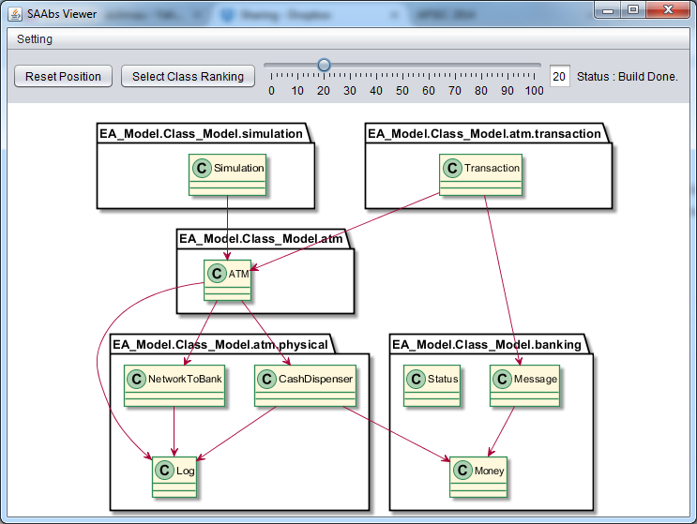
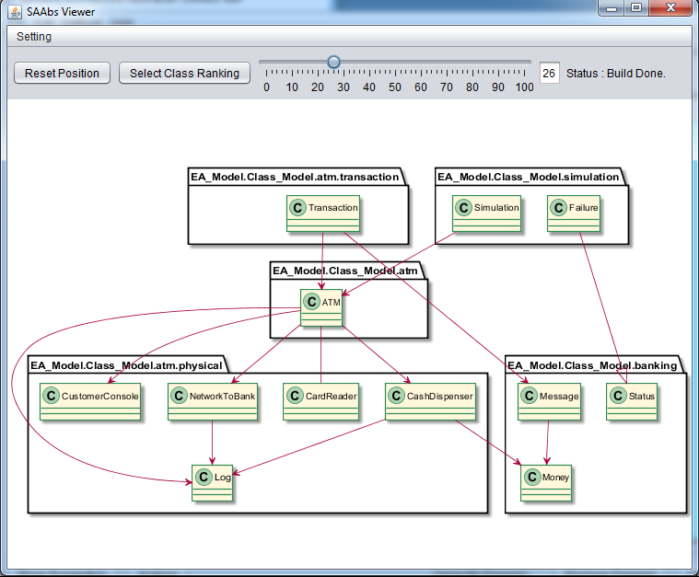
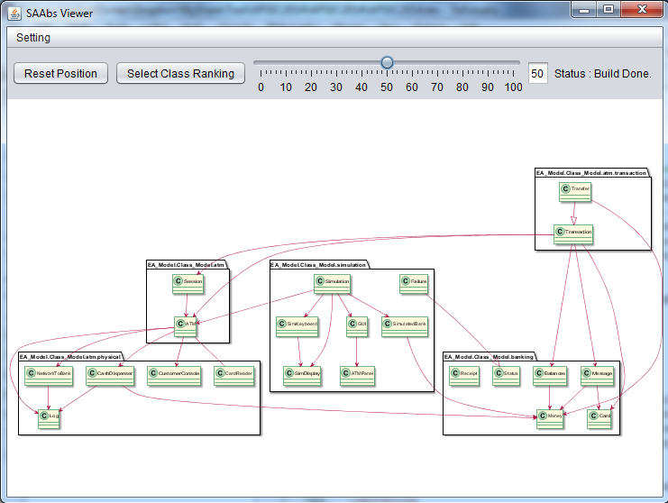
Scaling Abstraction
20%
30%
50%
Which criteria to use for abstraction?
What is the relation between design and code?

Slide 67



Reverse Engineering of K9
K-9 Mail Android App
(https://github.com/k9mail/k-9)
Inner class extraction (srcML)
& unused import removal (Checktype)
779 classes
K-9 Mail logo created by Tobias Bernard, licensed using Apache License 2.0

Slide 68
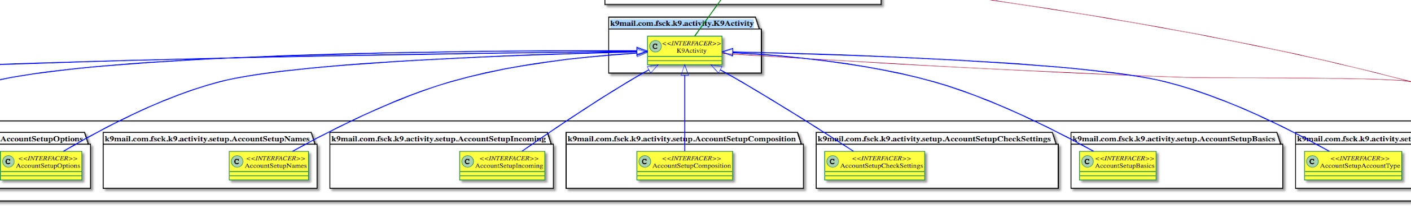
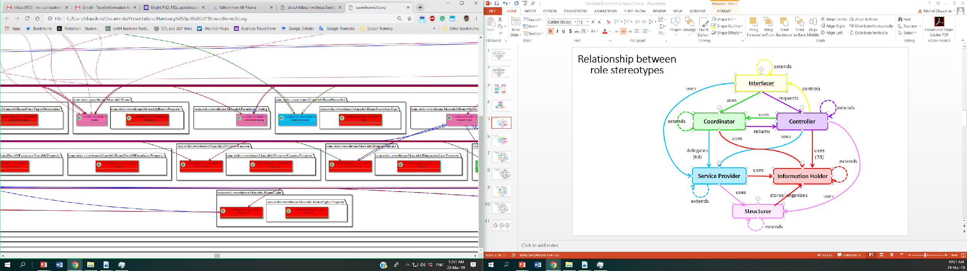
‘Raw’ Reverse Engineered: K9
This shows expansion of roles
Interfacer
Controller
Coordinator
Service Provider
Information Holder
Structurer

Slide 69
All packages
K9mail-library
k9mail
mail
mail.filter
mail.oauth
mail.store
k9
autocrypt
mailstore
mail.helper
mail.power
account
cache
mailstore.migrations
mail.internet
mail.ssl
activity
controller
mailstore.util
mail.message
mail.store
(imap, pop2, webdav)
acitivity.compose
crypto
message
acitivity.loader
fragment
message.extractors
acitivity.misc
helper
message.html
acitivity.setup
helper.jsoup
message.quote
message.signature
ui
service
notification
ui.compose
setup
power
ui.crypto
search
preferences
ui.dialog
view
provider
ui.message
widget.list
remotecontrol
ui.messageview
search

Slide 70
Presentation Layer (1.)
Service Layer (2.)
Cross-cutting (5.)
user-interface (1.1.)
user-interface-logic (1.2.)
content provider (2.1.)
intent provider (2.2.)
layout (.xml files, .kt)
activity.*
ui.*
notification
provider.*
(Attachment, DecryptedFile, Account)
com.fsck.k9.intent.action.*
fragment.*
view
widget.list
com.fsck.k9.intent.extra
Business layer (3.)
Business Façade (3.1.)
controller.MessagingController
uses
controller.MessagingControllerCommand
Business Workflow (3.2.)
Business Entity Components (3.4.)
Scheduling (3.2.1.)
mail
mailstore
preferences
AlarmManager API
service.*
message.*
account
crypto
helper
cache
autocrypt
Talk with mail-providers (3.2.2.)
MIME encoder | decoder (3.2.3.)
Other (3.2.4.)
Business Components (3.3.)
mail.transport
mail.internet
search
mail.ssl
mail.power
mail.message
mail.store
(imap, pop2, webdav)
mail.helper
mailstore.migrations
mailstore.migrations
mail.oauth
mail_providers
mail.filter
power
(IdleManager)
k9
Data Access Layer (4.)
mailstore.util
mailstore
SQLiteDB

Slide 71
K9 from:

Slide 72
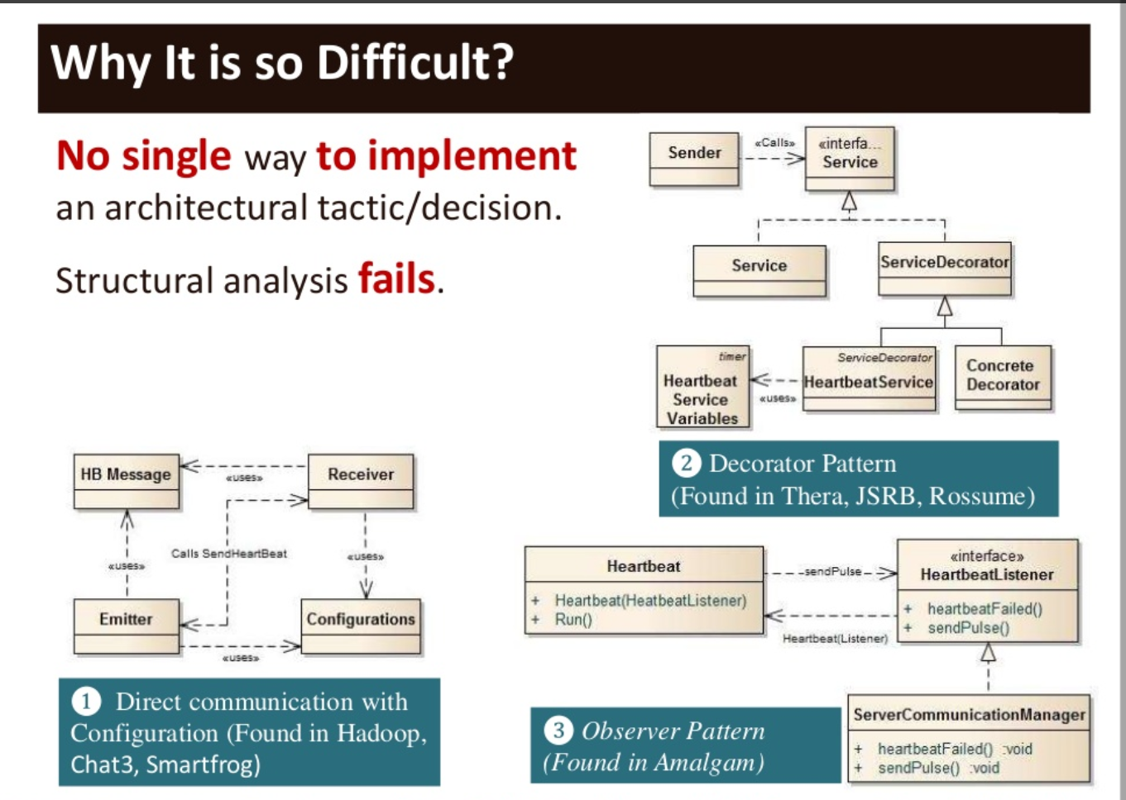
Why is it difficult to detect architectural patterns and tactics in reverse engineering?
Notes:
From Mehdi Mirakorli & Jane Cleland-Huang, ICSE 2011 Hawai’i

Slide 73


Reverse Architecting
?
Very difficult to reconstruct the intention & rationale

Slide 74
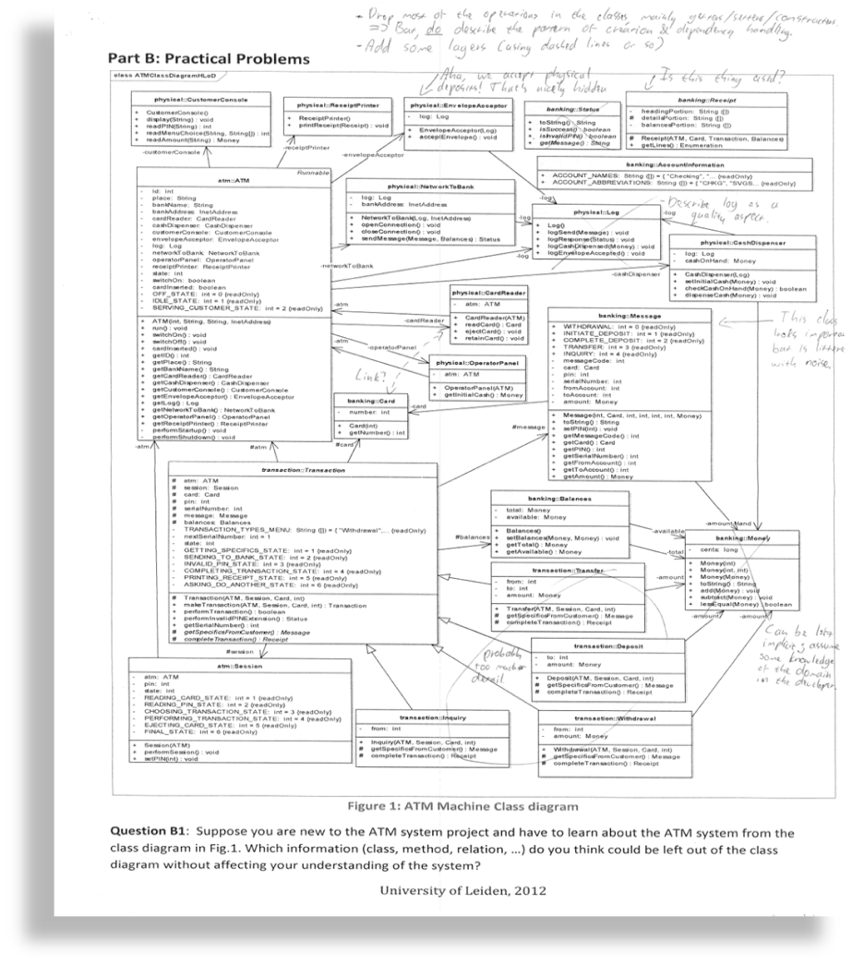

Slide 75
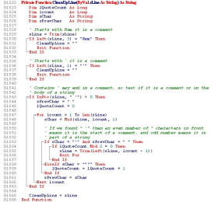

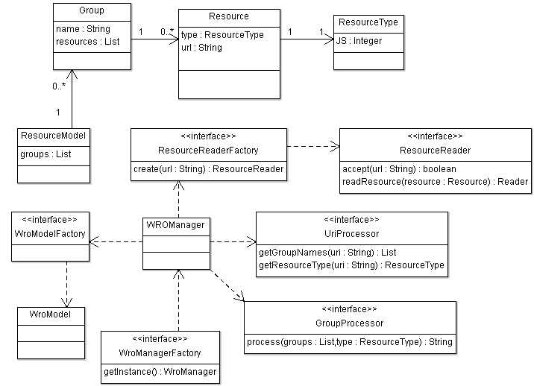
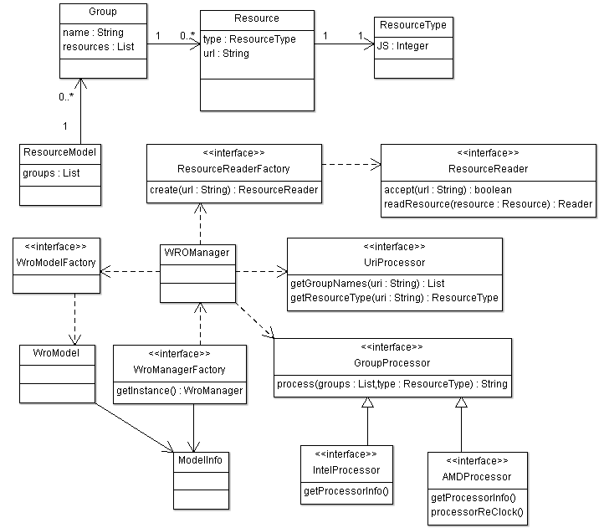
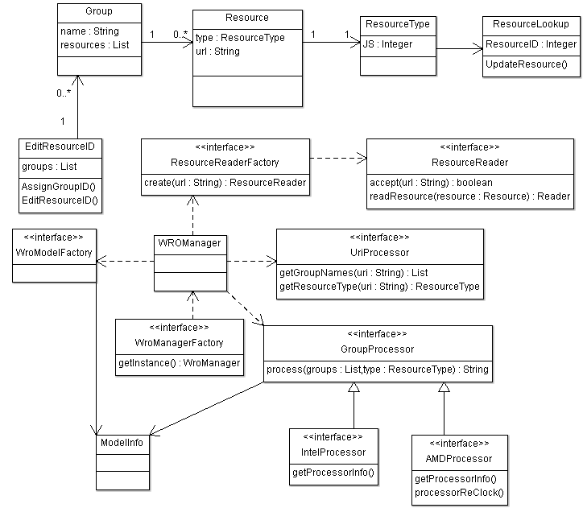
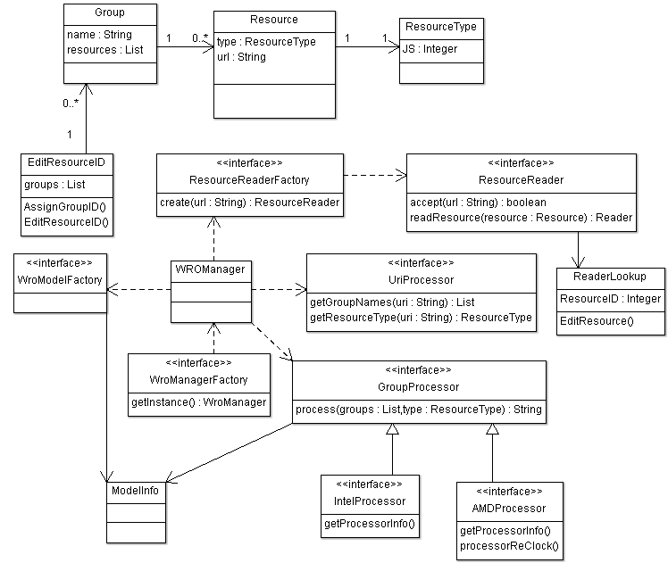
Automated Updating of Class Models
time
change δ
change δ’
change δ’’
source code
learn design
abstraction: α
update with
abstraction of change: α(δ)
α(δ’)
α(δ’’)
UML design model
A change δ can be an addition, modification, removal.

Slide 76

Managing Design – Code Correspondence

Slide 77
Architecture conformance checking
Compare
Intended architecture
with
Actual architecture

Slide 78


Slide 79

Slide by Mehdi Mirakhorli

Slide 80
Checking Design-Code Correspondence using Relational Algebra
2019 course:
For this topic I only want you to understand the ‘key idea’:
we can use the mathematical theory of relations to model the dependency-graphs in the implementation and with relational-calculus we can do some abstractions.
+ : once set up, this can be automated
: required math to set up
: produces ‘binary’ vote on violations
hence even if a deviation is small/insignificant

Slide 81
Application domain
SOPHO
CPC
SAS
POMCL
CPS
POM
GOS
LOS
SD
“Intended” module architecture
(documentation + software architects)

Slide 82
Application domain
SOPHO
CPC
SAS
POMCL
CPS
POM
GOS
LOS
SD
“Actual” module architecture
(extracted from the implementation)

Slide 83

Conceptual Integrity

Slide 84
Conformance
S
S
H
H
I
I
A
A
D
D
Intended
Extracted
Causes when “intended” and “extracted” differ:
“intended” is wrong (e.g. out-of-date): improve;
“extracted” is wrong: improve;
implementation is optimized for, e.g., speed ⇒ refinement.

Slide 85
Application domain
Ensure conformance to an architecture !
  Keep the architecture up-to-date
Approach using relation algebra (RPA):
  Represent the “intended” architecture in RPA.
  Extract the “derived” architecture from the implementation, and represent in RPA.
  Express “conformance” in RPA.
  Ensure conformance by means of verification (using RPA) and improvements (i.e. control).

Slide 86
System Representation
System S is balanced, and
the decomposition tree has 3 levels

Slide 87
Relation Algebra: Example
Set of Entities E:
E = { S, A, A₁, A₂, A₃, B, B₁, B₂}

Slide 88
Relation Algebra: Example
Part-of relation P:
P = { <B, S>, <A, S>,
<B₁, B>, <B₂, B>,
<A₁, A>, <A₂, A>,
<A₃, A> }
A part-of relation:
describes the decomposition tree;
is both: functional and a-cyclic.

Slide 89
Example: Overview of Operations on Relations
  A⁻¹ = {<y,x> ⏐<x,y> ∈ A }
  A – B = {<x,y> ⏐<x,y> ∈ A and <x,y> ∉ B }
  A ∪ B = {<x,y> ⏐ <x,y> ∈ A or <x,y> ∈ B }
  A ∩ B = {<x,y> ⏐<x,y> ∈ A and <x,y> ∈ B }
  A;B = {<x,z> ⏐ <x,y> ∈ A and <y,z> ∈ B }
  A⁺ = _{n=1} R^{n}, where R^{n} = R;R^{n-1} for n >=2
  A* = A⁺ ∪ I
  A ∅ B = {<x,y> ⏐ <x,v> ∈ A and <y,v> ∈ B }
  A ↑ B = B⁻¹ ; A ; B (lifting)
  A ↓ B = B ; A ; B⁻¹ (lowering)

Slide 90
Operators in Relational Algebra
Union I + E = {(a,b), (b,y)}
Intersection E ^ C = {(b,y)}
Difference C - E = {(r,a), (r,b), (a,v), (a,w), (a,x), (b,z)}
Inverse inv E = {(y,b)}
Composition I o E = {(a,y)}
Identity id = {(r,r), (a, a), (b,b), (w,w) … }
Transitive Cl. C+ = {(r,a), (r, b), (r,v), (r,w), (r,x), (r,y),
(r,z), (a,v), (a,w), (a,x), (b,y), (b,z)}
Reflex. T.C. C* = ID + C+

Slide 91
Example Typed Graph
r
r
C
C
a
I
b
a
b
I
z
w
E
U
U
C
C
C
E
C
C
v
x
y
v
w
x
y
z
U
U
    C = { (r,a), (r,b), (a,v), (a,w) (a,x), (b,y), (b,z) }
    I = { (a,b) }
    E = { (b,y) }
    U = { (v,w), (x,y) }

Slide 92
Lifting
→
Lift dependencies from classes to components

Slide 93
Hiding
→
Hiding the decomposition structure of both A and B

Slide 94
Example: “Class diagram – MSC”
Board
GameManager
GameManager :
Manager
HumanPlayer :
Player1
ComputerPlayer :
Player2
Display :
display
Player
Display
HumanPlayer
ComputerPlayer
There is no dependency between HumanPlayer and Display in the class diagram

Slide 95
Example: “Class diagram - MSC”
Class Diagram in RPA:
  CLASS = {GameManager, Board, Player, HumanPlayer, ComputerPlayer, Display}
  METHOD = {GameManager.play, GameManager.stop,
  Player.setToken, HumanPlayer.getNextMove,
  HumanPlayer.setToken, ComputerPlayer.getNextMove,
  ComputerPlayer.setToken, Display.printLn,
  Display.printBoard}
  IMPLEMENTS = {<GameManager.play,GameManager>,
  …. }
  INHERITANCE = {<HumanPlayer,Player>,<ComputerPlayer,Player>}
  DEPENDENCY = {<GameManager,Player>, <GameManager,Display>}
  AGGREGATION = {<GameManager,Board>}

Slide 96
Example: “Class diagram - MSC”
MSC in RPA:
  OBJECT = {Manager, Player1, Player2, display}
  TYPE = {<Manager, GameManager>, <Player1,HumanPlayer>, <Player2,ComputerPlayer>,<display,Display>}
  CALL = {c₁,c₂,c₃,c₄c₅}
  NEXT = {<c₁,c₂>,<c₂,c₃>,<c₃,c₄>,<c₄,c₅>}
  CALLER = {<Manager,c₁>,<Player1,c₂>,<Manager,c₃>,
  <Manager,c₄>,<Manager,c₅>}
  CALLEE = {<Player1,c₁>,<display,c₂>,<display,c₃>
  <Player2,c₄>,<display,c₅>}
  MESSAGE = {<HumanPlayer.getNextMove,c₁>, <Display.printLn,c₂>,
  <Display.printBoard,c₃>, <ComputerPlayer.getNextMove,c₄>,
  <Display.printBoard,c₅>}

Slide 97
Example: “Class diagram - MSC”
Board
GameManager
GameManager :
Manager
HumanPlayer :
Player1
ComputerPlayer :
Player2
Display :
display
Player
Display
HumanPlayer
ComputerPlayer
!
Rule
  (CALLER ® CALLEE) " TYPE µ (DEPENDENCY ↓ INHERITANCE*)

Slide 98
Uses of Relational Languages
Enforce architecture rules. Holt 96, Feijs 98, Knodel 08
Lift dependency edges. Holt 98, Feijs 1998
Find design pattern instances. Consens 98, Beyer 02
Find violations of patterns. Guo 99
Find anti-patterns. vanEmden 02, Feijs 98
Change impact analysis. Feijs 98
Specify extraction from syntax. Lin 08
Find source of dependency. Fahmy 01, Feijs 98
Locate uses of protocols. Wu 01
Type inference using transitive closure. vanDeursen 99

Slide 99
Time for Reflection
What are the strengths and weaknesses of the Relational Algebra Approach towards checking conformance between Architecture and Implementation?

Slide 100

Checking Correspondence through metrics
Horizontal axis:
metric from design
Vertical axis:
metric from code
Dots:
( metric(class in design),
metric(class in code) )
Here: Number of Methods Inherited
Implementation
Design

Slide 101

Tool for Correspondence Checking
X-Axis
  Metrics of Design
Y-Axis
  Metrics of Implementation
Points represent Classes
Points off the diagonal indicate (critical) outliers
Outlier
This approach illustrates the ‘magnitude’ of the deviation/mismatch between architecture and implementation (i.e. not ‘binary’ as Rel.Alg)

Slide 102

The scatter plotter (screenshot)

Slide 103
Summary Reverse Architecting
Reverse Architecting is a labour-intensive activity
  Manual (re)discovery of abstractions
  Different stakeholders have different needs
Reverse Architecting is a step in managing:
  conformance of the ‘as-is’ architecture (of the implementation) to the ‘intended’ architecture
  conceptual integrity

Slide 104

Key Architecting Practices

Slide 105
Questions

Slide 106
Risk Analysis
Apply security where needed
asset
threat
incident
impact
risk
Risk analysis helps determine security needs

Slide 107
Security Ontology
Learning objective: main concepts & their relations
Security Goal
establishes
Security
Risk
Security Policy
specifies
targets
what
Security Requirements
Threat
Security Mechanism
how
Attack
eliminates \
reduces
causes
exploits
Harm
Vulnerability
is caused to
Asset
System
exists in

Slide 108


Slide 109
Tool Sets
Rigi (Victoria)
Bauhaus (Stuttgart)
Dali (SEI)
Portable Bookshelf (Toronto)
DocGen (Amsterdam)
Extract
Query
Abstract
Present
Visualize
Browse
Search

Slide 110
Source: booking system
Trigger/Stimulus: provide Traveller booking
Artefact: CalendarInterface
Environment/Context:
Response: succesfull entry of booking-data in calendar
Measure: 99% of bookings

Slide 111



Slide by Mehdi Mirakhorli

Slide 112


Slide 113


How is Level of Detail distributed in a diagram?
Case 1
Case 2
High detail
High detail
Low detail
Low detail
Robin van den Broek B.Sc. Thesis in CS, 2009, Leiden University

Slide 114



What do developers look at anyway?

