Slide 1
Statistical modeling in logistics
MMS075
Lecture 1: Introduction & linear regression
Acknowledgement: Some of the figures in this presentation are taken from
"An Introduction to Statistical Learning, with applications in R" (Springer, 2013)
with permission from the authors: G. James, D. Witten, T. Hastie and R. Tibshirani

Slide 2
Outline
Introduction
Simple linear regression:
Motivation with advertising example
Terminology
Confidence intervals for coefficients
Feedback
Quiz checking background knowledge on:
Exponential function & logarithm
Matrices, vectors

Slide 3
Introduction
Reviewing course information

Slide 4
General course information
W4 (Jan 20-26)
Lecture 1 | Tue | Jan 21 | 13.15-15.00 | Svea216
Exercise class 1 | Wed | Jan 22 | 10.15-12.00 | Svea221
Computer lab 1 | Thu | Jan 23 | 13.15-15.00 | Jupiter024, 025
Consultation 1 | Fri | Jan 24 | 09.00-12.00 | Saga460 | By appointment
W5 (Jan 27-Feb 2)
Lecture 2 | Tue | Jan 28 | 13.15-15.00 | Svea216
Exercise class 2 | Wed | Jan 29 | 10.15-12.00 | Svea221
Computer lab 2 | Thu | Jan 30 | 08.15-10.00 | Jupiter024, 025
Consultation 2 | Thu | Jan 30 | 13.15-16.00 | Saga460 | By appointment
W6 (Feb 3-9)
Lecture 3 | Wed | Feb 5 | 08.15-10.00 | Svea216
Exercise class 3 | Wed | Feb 5 | 10.15-12.00 | Svea221
Computer lab 3 | Thu | Feb 6 | 13.15-15.00 | Jupiter309, 311
Consultation 3 | Fri | Feb 7 | 09.00-12.00 | Saga460 | By appointment
W7 (Feb 10-16)
Lecture 4 | Tue | Feb 11 | 10.15-12.00 | Svea216
Exercise class 4 | Tue | Feb 11 | 13.15-15.00 | Svea221
Computer lab 4 | Wed | Feb 12 | 10.15-12.00 | Jupiter024, 025
Consultation 4 | Fri | Feb 14 | 09.00-12.00 | Saga460 | By appointment
W8 (Feb 17-23)
Lecture 5 | Mon | Feb 17 | 10.15-12.00 | Svea216
Exercise class 5 | Tue | Feb 18 | 13.15-15.00 | Svea221
Computer lab 5 | Wed | Feb 19 | 10.15-12.00 | Jupiter309, 311
Consultation 5 | Thu | Feb 20 | 13.15-16.00 | Saga460 | By appointment
W9 (Feb 24-Mar 1)
Lecture 6 | Tue | Feb 25 | 13.15-15.00 | Svea216
Exercise class 6 | Wed | Feb 26 | 10.15-12.00 | Svea221
Computer lab 6 | Thu | Feb 27 | 13.15-15.00 | Jupiter310, 311
Consultation 6 | Fri | Feb 28 | 09.00-12.00 | Saga460 | By appointment
W10 (Mar 2-8)
Lecture 7 | Tue | Mar 3 | 13.15-15.00 | Svea216
Exercise class 7 | Wed | Mar 4 | 10.15-12.00 | Svea221
Computer lab 7 | Thu | Mar 5 | 13.15-15.00 | Jupiter310, 311
Consultation 7 | Fri | Mar 6 | 09.00-12.00 | Saga460 | By appointment
W11 (Mar 9-15)
Consultation 8 | Wed | Mar 11 | 13.15-16.00 | Saga460 | By appointment
Consultation 9 | Fri | Mar 13 | 09.00-12.00 | Saga460 | By appointment
Syllabus available on the Student Portal
Course guide (kurs-PM) is available on Canvas, see also next slides
For course dates, see TimeEdit; there is also a Word document on Canvas with all dates and locations

Slide 5
Learning objectives (After the course, students should be able to…)
Demonstrate an understanding of the key concepts and ideas in statistical modeling on larger datasets;
Describe suitable statistical methods for using on larger datasets relevant in logistics;
Choose and use appropriate statistical methods for answering a logistics related problem, and report the findings in a suitable and compelling format;
Critically evaluate statistical materials and methods and reason about their limitations;
Reflect on ethical aspects and considerations when collecting and analyzing larger datasets.

Slide 6
Prerequisites
Knowledge and skills equivalent to learning outcomes for SJO915 Applied statistics:
- Describe basic statistic concepts - Describe different ways to present data - Describe how to collect data - Apply basic probability theory - Define density and distribution functions - Analyze a normally distributed variable - Apply basic statistical analysis

Slide 7
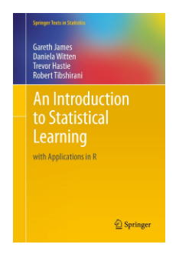
Course literature
James, G., Witten, D., Hastie, T., and Tibshirani, R. (2013) An Introduction to Statistical Learning: With Applications in R. New York: Springer Science+Business Media, LLC
Freely available online, material also covered in the free online course Statistical Learning
Parts of this book are covered in the course: mainly Chapters 2-5 and small parts in other chapters

Slide 8
Course design
The course includes:
Lectures → presenting new concepts & methods
Exercise classes → deeper understanding
Computer labs → practical implementation
Consultation times → if you want clarification or discuss the material, book a meeting during consultation times
Attendance is not mandatory, but strongly recommended

Slide 9
Assessment (mandatory elements)
3 individual homework assignments (pass/fail, 5c), need to pass all three. Assignments are specified at least one week before the deadlines:
Deadline for assignment 1: Monday, February 10, 2020
Deadline for assignment 2: Monday, March 2, 2020
Deadline for assignment 3: Thursday, March 12, 2020
Written exam: March 16, 2020, am (5/4/3/fail, 2.5c); grade on exam determines final grade
The assignment deadlines are strict. Delays must be indicated before the deadlines and motivated by good, provable reasons. Make sure to submit even if your solution is not perfect.

Slide 10
Main contacts
Examiner and course responsible (all classes):
András Bálint, andras.balint@chalmers.se
http://www.chalmers.se/en/staff/Pages/andras-balint.aspx
Student representatives:
TBD
Please give feedback! (directly or via the student representatives)

Slide 11
Recommended resources
Reading in ISL:
Introduction of Section 2.1 (the part before 2.1.1)
Introduction in Chapter 3
Section 3.1 (also Sections 3.2-3.4 as preparation for next lecture)
Sections 3.1-3.2 in the online course Statistical Learning
Recall: glossary at homepage of International Statistical Institute:
http://isi.cbs.nl/glossary/index.htm

Slide 12
Simple linear regression
Motivation with advertising example
Terminology (e.g. Slope, Intercept, RSS, TSS, RSE, R²)
Confidence intervals for coefficients

Slide 13
Company goal: optimize advertising
A company wants to sell a specific product
Advertising may increase sales – how to do this best? How much money to spend & how to spend that amount? How would you do this?
One reasonable plan:
Identify different means of advertising
Collect data on #(units sold) as a function of $ spent
Model different solutions
Choose the best available option

Slide 14
Advertising data
Source: Figure 2.1 in ISL
1000 units
1000$
Notes:
Internet is missing -> this example already feels a bit outdated.

Slide 15
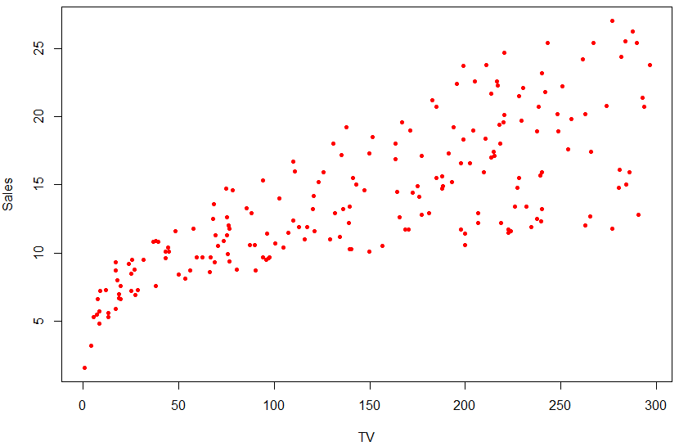
How do TV advertisments affect sales?
Figure created in R based on data downloaded from http://faculty.marshall.usc.edu/gareth-james/ISL/data.html

Slide 16
Modelling with linear regression
Can we assume linear relationship?
True relationship is almost never linear
(here: especially spendings 0-50k$ suggest non-linear dependence)
Linear modelling can still be good enough in many situations and results are easy to interpret

Slide 17
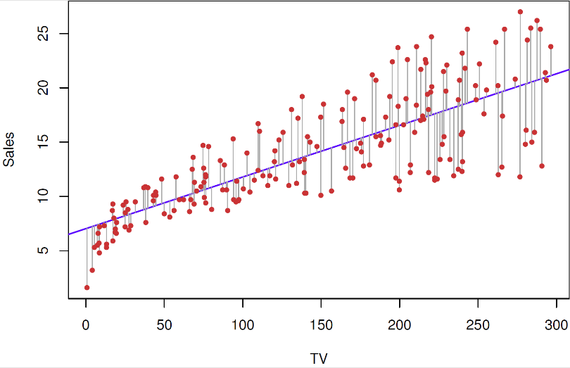
Interpretation for TV advertisment
In the best linear model,
What does ”best” mean?
Among all lines, this one fits best (i.e. is closest) to available data, with ”closeness” defined by least squares here
How do we know that these are the best parameters?
Usually from computer output (or formula (3.4) in ISL)
See next slides

Slide 18
Interpretation for TV advertisment (cont.)
In the best linear model,
What do we learn from this?
Setting TV=0 results in Sales=7.0325 → without TV advertisments, we would sell about 7000 units
If we increase ”TV” by 1, then ”sales” increases by 0.0475 → if we decided to invest 1000$ more in TV advertisments, we could expect to increase our sales by close to 50 units

Slide 19
Simple linear regression: model definition
Linear regression model: outcome linearly depends on a predictor
All the above terms are used regularly in different contexts
Response
Output variable
Dependent variable
Coefficients
Parameters
Predictor
Feature
Input variable
Independent variable
Error term

Slide 20
Regression coefficients
Linear dependence is determined by the parameters of the model:
Response
Output variable
Dependent variable
Intercept
Slope
Predictor
Feature
Input variable
Independent variable
Error term
Coefficients
Parameters

Slide 21
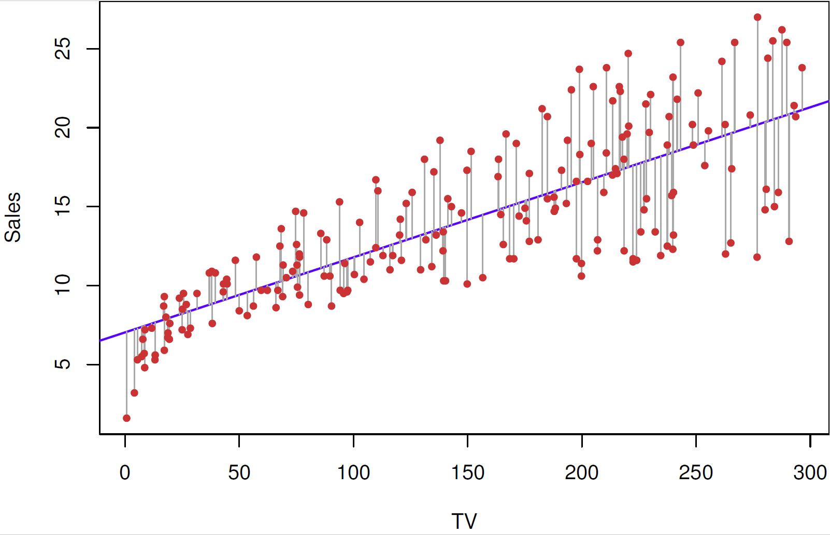
Geometrical interpretation of coefficients
Intercept: the value where the regression line crosses the y-axis
Slope: average increase in Y associated with a one-unit increase in X (also called gradient)

Slide 22
Difference of predicted & observed values
Observed data in form of (predictor, response) pairs:
For fixed and , the linear model estimates response i as
How far is the prediction from the actually observed response i?
”hat”
i-th residual

Slide 23
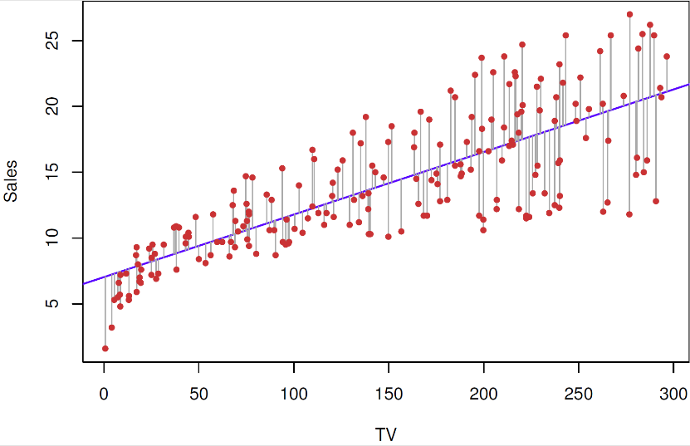
Defining ”closeness” as RSS
Negative differences are as bad as positive ones → define distance of prediction from response for data pair i as
Distance of regression line from available data is defined by the residual sum of squares (RSS):
Want: this is small

Slide 24
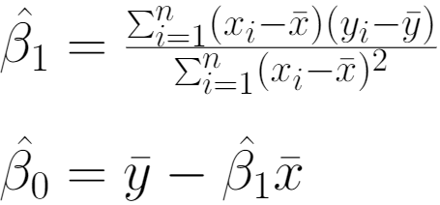
Coefficient estimates
Least squares coefficient estimates for simple linear regression: those parameter values that minimize RSS
There are formulas available to determine these values (ISL, 3.4):
with and denoting the sample means of predictors & responses in the observed data:

Slide 25
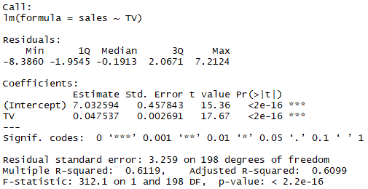
Coefficients from software output
Typically, we get coefficients from computer software
Available in different software, R output is shown
What is this? (next slides)

Slide 26
Population regression line
Recall the model equation:
The error term is random and has mean zero, representing:
Measurement error
That the true relationship may not be linear
Variation of Y caused by other variables
Assume that and give the best linear description of the true relationship between and → they are the parameters of the population regression line

Slide 27
Least squares line is sample-dependent!
Recall: for a fixed set of predictor-response observation pairs
, we could determine the least square coefficient estimates
The resulting line is the least squares line
This line depends on the observed sample and may be different for other sets of observations!

Slide 28
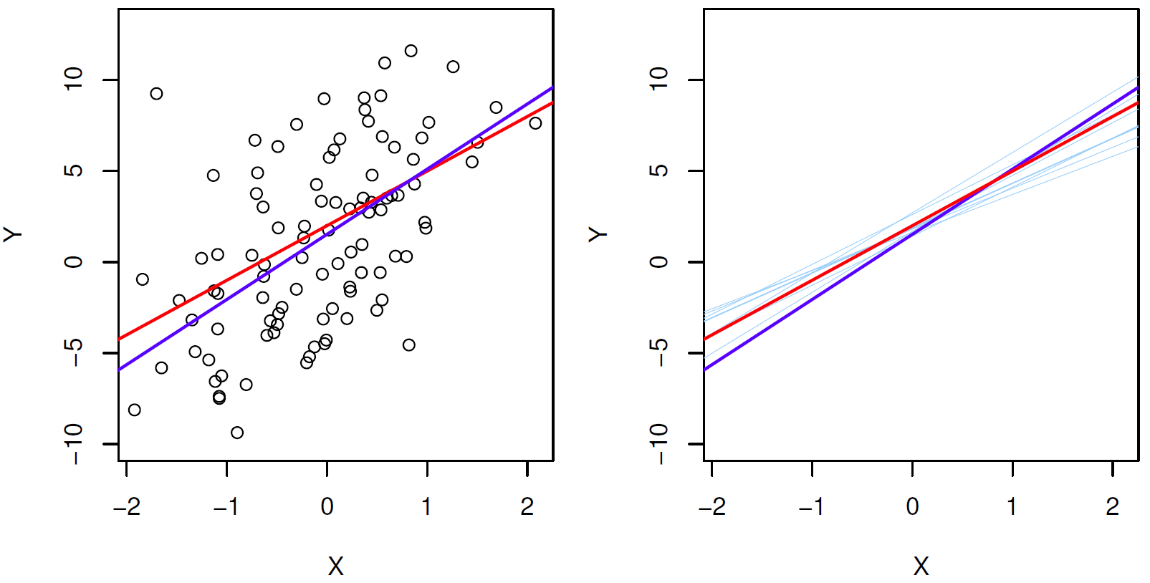
Example (Fig 3.3 in ISL)
Red: population regression line; Blue lines: least square lines for separate random samples (Black points: one such sample)

Slide 29
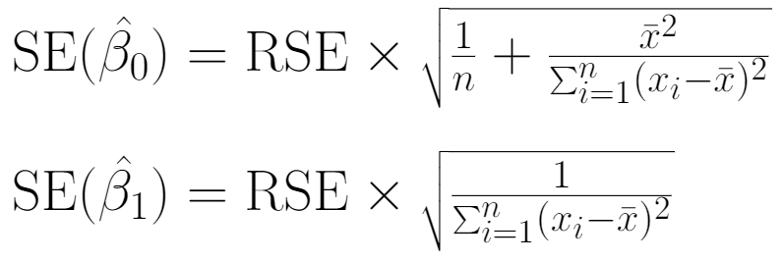
Estimating standard error of coefficients
This depends on the residual standard error:
RSE is an estimate of the standard error of . This allows determining estimates for the standard errors of coefficients:

Slide 30
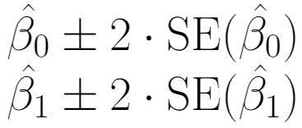
Confidence intervals for coefficients
Estimated standard errors can be used to define confidence intervals; approximately:
Typically, one gets the standard error estimates and confidence intervals from computer software (computer lab)
Other use: for hypothesis testing (next lecture)
In both formulas, 2 should be
replaced by the 97.5% quantile
of a distribution for the
precise values

Slide 31
TV advertisment: confidence intervals
The 95% confidence intervals for the coefficients:
What do we learn from this by inserting in ?
Setting TV=0 → without TV advertisments, we would expect to sell between 6130 and 7935 units
If we increase ”TV” by 1, the increase of ”sales” in the model is between 0.042 and 0.053 → if we decided to invest 1000$ more in TV advertisments, we could expect to increase our sales by 42-53 units

Slide 32
Accuracy of the model – RSE
Recall: residual standard error was defined as
This is the average amount that the response deviates from the true regression line → measures the lack of fit of the model
This is an absolute measure. For advertising example, RSE=3.26 → even if we knew the true parameter values, our prediction of sales may be off by 3260 units. Is this OK or too much?

Slide 33
Accuracy of the model – R²
Measures the proportion of variability in the response that is explained by the predictor:
where TSS is the total sum of squares and RSS is the residual sum of squares (as defined before):
Depends on:
sample
Depends on:
sample
model

Slide 34
Properties of R²
This is a proportion → its value is always between 0 and 1, larger R² indicates better fit of the model (but ”good enough” values depend on the application)
Values close to 0 may indicate:
Linear model is wrong
Inherent error is high
R² measures linear relationsip between X and Y – can it be linked to their correlation?
and/or
Yes, see next slide

Slide 35
R² and correlation
Recall the definition of the sample correlation of X and Y:
Not a coincidence that the same letter is used for both quantities; in simple linear regression setting, we indeed have that:
That is, correlation can be used to assess linear modelling

Slide 36
Feedback quiz
Feedback is essential to me so that I can improve the lectures during the course. Please take your chance to optimize your learning experience!
If you are willing to give feedback, please follow these steps:
Go to www.menti.com
Enter the code 57 25 09
Rate your experience today in slide 1
Wait until I change slide
Answer to the questions in slide 2

Slide 37
Quiz on background knowledge
It is important to know how much mathematical background you have to identify whether I can assume knowledge about some concepts or I need to introduce them in the class.
If you are willing to help learning this, please follow these steps:
Go to www.menti.com
Enter the code 51 51 25
Answer to the question in slide 1
Wait until I change slide
Answer to the question in slide 2

