Slide 1
Statistical modeling in logistics
MMS075
Lecture 2: Multiple linear regression
Acknowledgement: Some of the figures in this presentation are taken from
"An Introduction to Statistical Learning, with applications in R" (Springer, 2013)
with permission from the authors: G. James, D. Witten, T. Hastie and R. Tibshirani

Slide 2
Recommended resources
Sections 3.2-3.4 in ISL and Sections 2.3 and 3.6 for R codes
Sections 3.2-3.4 in the online course Statistical Learning
Rougier, N.P., Droetboom, M., Bourne, P.E. (2014). Ten Simple Rules for Better Figures. PLoS Comput Biol. 10(9): e1003833, https://www.ncbi.nlm.nih.gov/pmc/articles/PMC4161295/
Zook M, Barocas S, boyd d, Crawford K, Keller E, Gangadharan SP, et al. (2017) Ten simple rules for responsible big data research. PLoS Comput Biol 13(3): e1005399. https://doi.org/10.1371/journal.pcbi.1005399

Slide 3
Outline
Simple linear regression continued
Revisiting Exercise 1
Testing relationship with response
Advertisement example & ethical aspects
Multiple linear regression
Terminology
Relationship with response, variable significance
Feedback

Slide 4
Simple linear regression continued
Revisiting Exercise 1 – reviewing relevant concepts in this context
Testing relationship with response – is there sufficient evidence of a relationship?
Advertisement example & ethical aspects – rules for good figures and ethical analysis

Slide 5
Recall exercise 1 background
A (hypothetical) very large company called Maintain-IT is responsible for a project task that needs to be repeated every year. They want to determine how the number of employees assigned to the project affects the completion time. An analyst at Maintain-IT decides to use simple linear regression to model this dependence, based on the observations shown in the table to the right.
Year | Employees on project | Completion time (days)
1 | 70 | 20
2 | 30 | 60
3 | 10 | 100
4 | 90 | 20

Slide 6
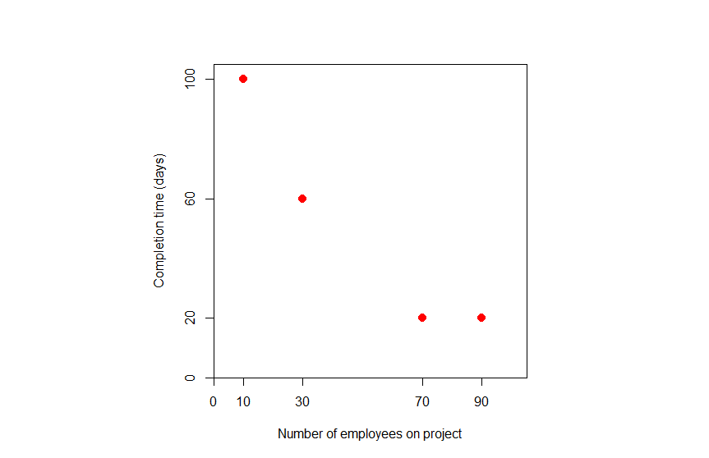
Step 1: specifying data points
Year | Employees on project | Completion time (days)
1 | 70 | 20
2 | 30 | 60
3 | 10 | 100
4 | 90 | 20
The analyst wants to explain completion time by number of employees on project
→ The response, Y, is completion time, and the predictor, X, is the number of employees on project
Data points in the sample are pairs of (number of employees, completion time) observed in years 1-4 (i.e., )

Slide 7
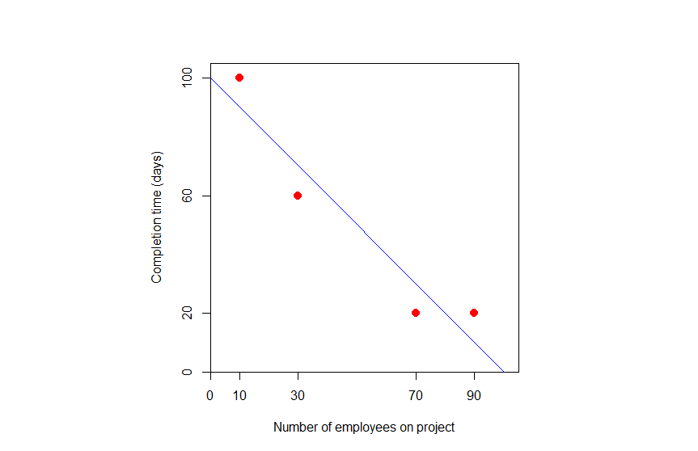
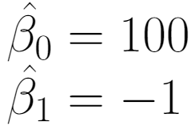
Step 2: fitting the least squares line
Use formulas/software to determine the least squares coefficients:
The least squares line is a line that crosses the y-axis at the value of , and has slope indicating the change in the y-coordinate after a one-unit step to the right on the x-axis

Slide 8
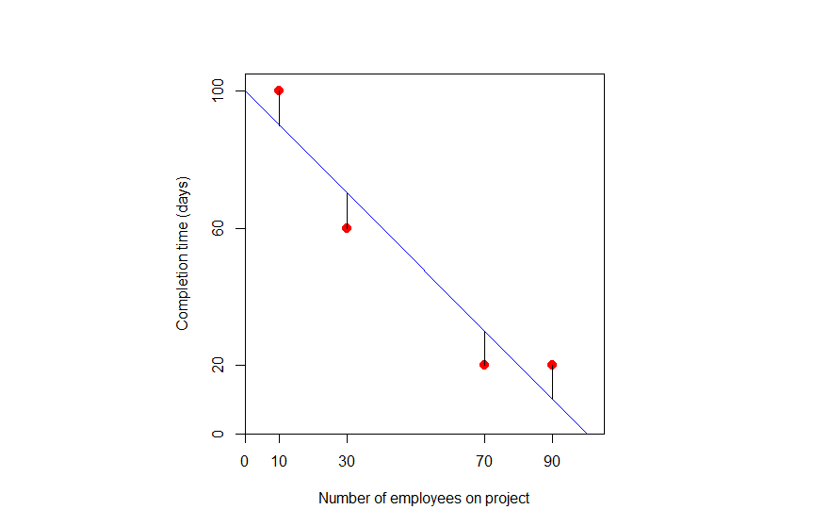
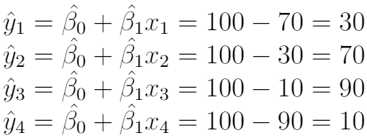
Step 3: predicted values for data points
For each data value there is a prediction determined by the y-value of the point on the regression line at the given x-coordinate
This is determined by substituting the x-values in the formula for the line:

Slide 9
Step 4: determining residuals and RSS
Differences between the observed and predicted responses are called residuals:
The sum of squared residuals is RSS:
(RSS is minimal for least squares line, i.e. sum of squared distances would be at least 400 for any other line)

Slide 10
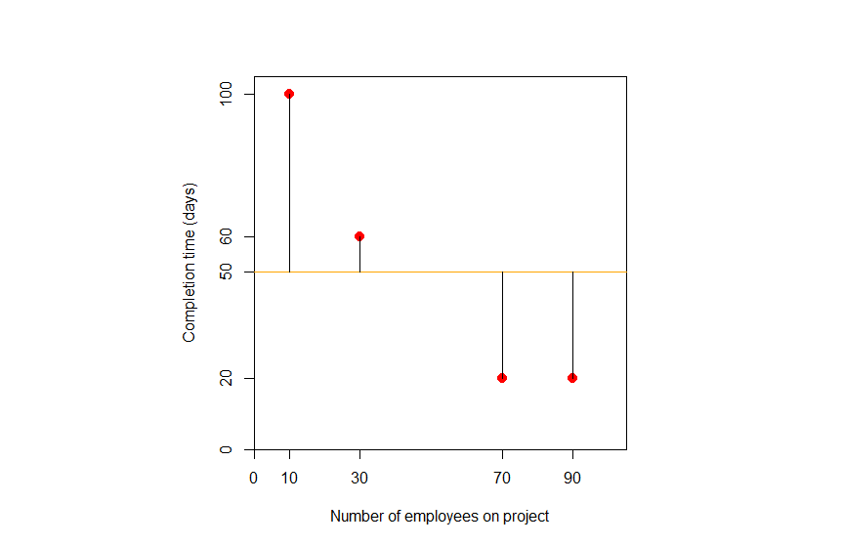
Step 5: determining TSS & computing R²
TSS measures the variation of responses compared to their average:
The sum of squared differences is TSS:
Have RSS & TSS → compute proportion of variation in completion time explained by the model:

Slide 11
Step 6: RSE & standard error of coefficients
Residual standard error quantifies the lack of fit of the model:
, i.e. 28% of
The standard errors of coefficients:

Slide 12
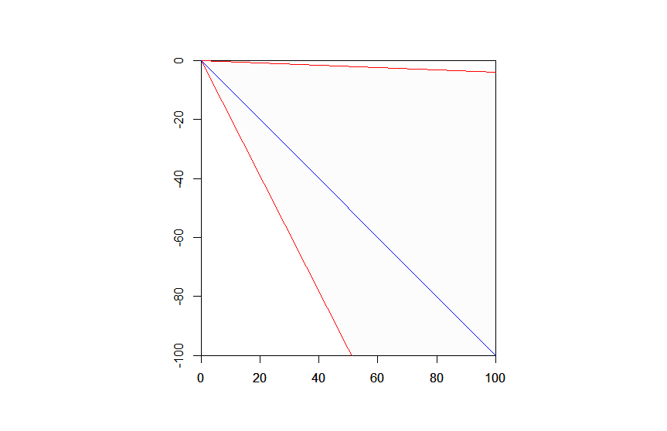
Step 7: Confidence intervals for coefficients
The 97.5% quantile of the distribution with degrees of freedom is 4.3027, so the confidence intervals are:
Why wasn’t the simple formula with 2 instead of 4.3027 good? Why are CIs so wide? Because of the small sample size ( ), see next slides
The blue line has slope -1, like the least squares
line, while the red lines have slopes corresponding
to the endpoints of the confidence intervals for
the slope, i.e. -1±0.96.

Slide 13
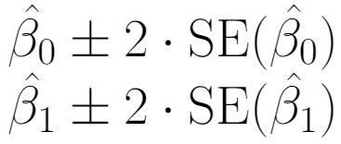
Effect of small sample size on CIs
Recall from Lecture 1 that approximate confidence intervals are defined as follows:
This is almost like a 95% confidence interval for a standard normal variable – see next slide from SJO915
We have a variable with Student’s distribution instead* with degrees of freedom – this is close to normal for large enough
* Because we do not know the standard error of but rather had to estimate it by RSE

Slide 14
Finding z_{α/2} for a 95% Confidence Level
_{α = 0.05}
Use the standard table to find a z-score of 1.96
₊
₋
z_{α/2} = 1.96

Slide 15
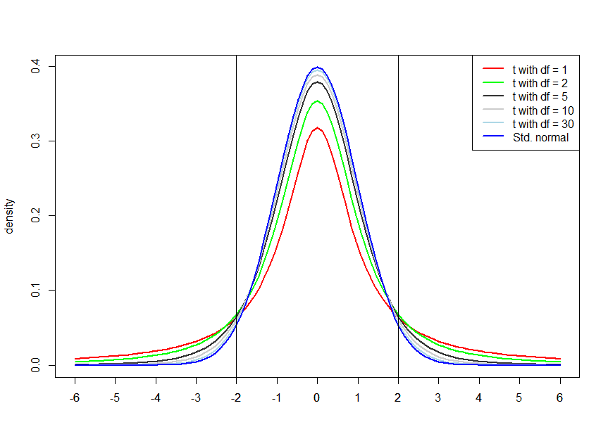
distribution is close to normal for large df
97.5% quantiles of the distribution by degree of freedom:
df | 1 | 2 | 3 | 4 | 5 | 10 | 20 | 30 | 100 | 1000 | 10000
97.5% quantile | 12.71 | 4.30 | 3.18 | 2.78 | 2.57 | 2.23 | 2.09 | 2.04 | 1.98 | 1.96 | 1.96

Slide 16
Simple linear regression continued
Revisiting Exercise 1 – reviewing relevant concepts in this context
Testing relationship with response – is there sufficient evidence of a relationship?
Advertisement example & ethical aspects – rules for good figures and ethical analysis

Slide 17
Slope CI as evidence of relationship
Recall: in Excercise 1, the confidence interval for slope was -1±0.96 → we are quite confident that adding an extra person on the project reduces the completion time on average (by at least 0.04 days and at most 1.96 days)
This is strong evidence of a relationship between the predictor and the response
Can also do hypothesis testing – recall corresponding concept from SJO915:
The blue line has slope -1, like the least squares
line, while the red lines have slopes corresponding
to the endpoints of the confidence intervals for
the slope, i.e. -1±0.96.

Slide 18
Key Concept
Individual components of a hypothesis testing:
identify the null hypothesis and alternative hypothesis from a given claim, and how to express both in symbolic form
identify the Critical Value(s), given a significance level
calculate the value of the test statistic, given a claim and sample data
identify the P-value, given a value of the test statistic
state the conclusion about a claim in simple and nontechnical terms

Slide 19
p-value and corresponding decisions
For a specific null hypothesis and test statistic, the corresponding p-value is the probability of having at least as extreme values of the test statistic as the one observed, assuming that the null hypothesis is true.
If the p-value is very small*, that’s strong evidence against the null hypothesis ➔ decision: reject the null hypothesis
If the p-value is not very small, that’s not enough evidence against the null hypothesis ➔ decision: fail to reject the null hypothesis
*Smaller than a significance level which is typically chosen as 0.1, 0.05 (this is most common) or 0.01

Slide 20
Is there a relationship between and ?
Recall the model equation:
This describes a relationship indicating how changes as a result of changing , unless the coefficient is zero
If , then the model equation reduces to , and there is indeed no relationship between and
How can we test whether this is the case?

Slide 21
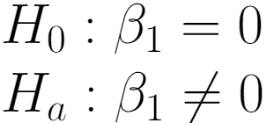
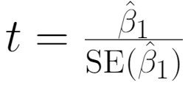
Testing relevance of in predicting
The null and alternative hypotheses:
Is the estimated slope large enough, compared to its standard error? If so, that would provide some evidence that the true slope parameter is different from 0
→ Test statistic:
No relationship is the null hypothesis – is there evidence against this?
If were true, then this statistic would have
distribution with degrees of freedom

Slide 22
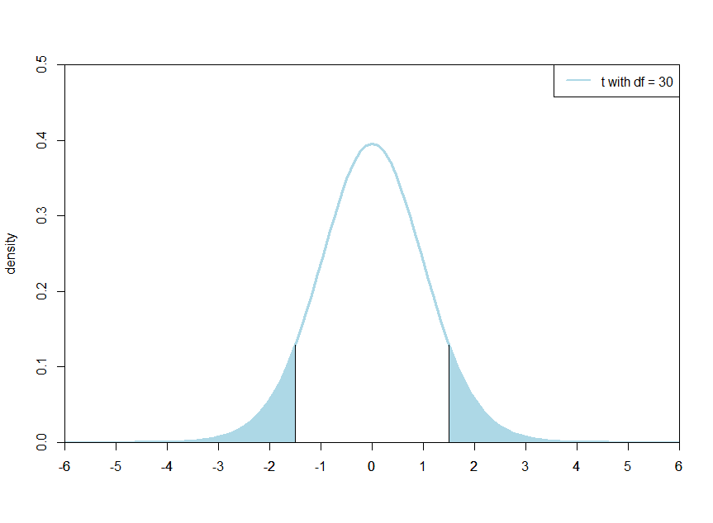
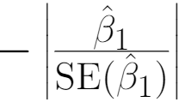
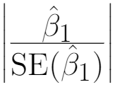
Testing relevance of in predicting (cont.)
For p-value: which values of a distribution with degrees of freedom are ”at least as extreme as the one observed”? It is those values that are at least as far from zero as the test statistic:
Example with 30 degrees of freedom (corresponding to sample size 32) and the test statistic taking value -1.5
Here the p-value is the sum of the shaded areas; here: 0.144
This is not sufficiently small to reject the null hypothesis; for df = 30, test statistic values smaller than -2.04 or greater than 2.04 would be needed for rejection of

Slide 23
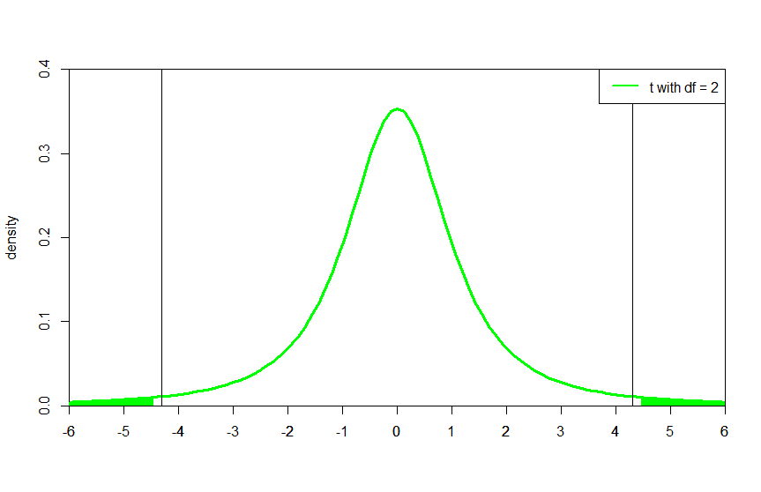
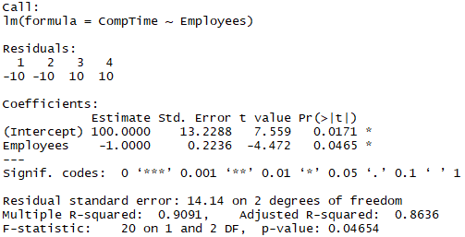
Exercise 1 example
Output from R: p-value of 0.0465 < 0.05 → decision: reject , conclude: there is a relationship between number of employees on the project and completion time
Important: p-value < 0.05 if and only if 95% confidence interval for the slope does not contain 0
t-statistic: -4.472
< -4.3027, which is the 2.5% quantile of the t distribution with df

Slide 24
Simple linear regression continued
Revisiting Exercise 1 – reviewing relevant concepts in this context
Testing relationship with response – is there sufficient evidence of a relationship?
Advertisement example & ethical aspects – rules for good figures and ethical analysis

Slide 25
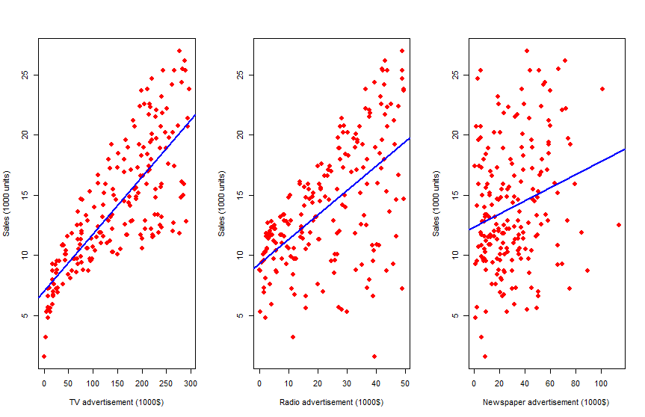
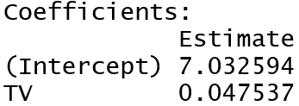
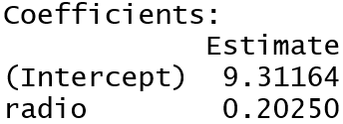
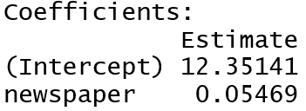
Advertising data, three separate LR models
This is the largest slope
by far – shouldn’t
regression line be
steepest for radio??
Figure similar to: Figure 2.1 in ISL; figure created in R based on data downloaded
from http://faculty.marshall.usc.edu/gareth-james/ISL/data.html
Notes:
Internet is missing -> this example already feels a bit outdated.

Slide 26
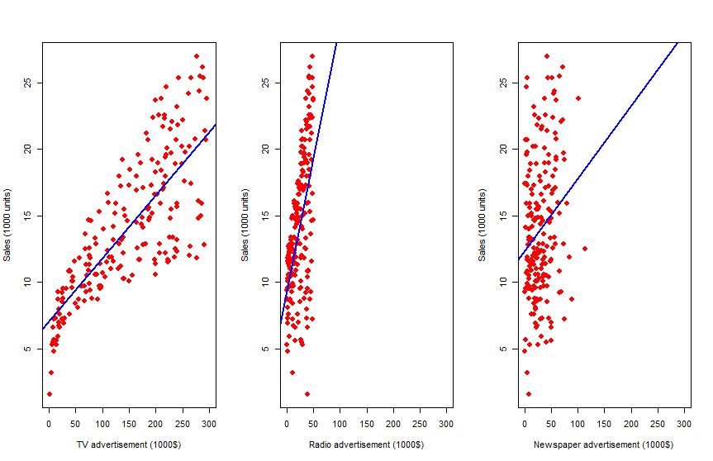
Same data, same x-axis range in all graphs
Figure created in R based on data downloaded
from http://faculty.marshall.usc.edu/gareth-james/ISL/data.html
Notes:
Internet is missing -> this example already feels a bit outdated.

Slide 27
Is the first figure misleading?
Check the 10 rules described in Rougier et al. (2014)*. Are any of these recommendations violated? Consider individual figures and the three figures side-by-side.
When is it fine to use the first figure? Why? Vote at www.menti.com (code: 49 82 50) & discuss!
Check also “Ten simple rules for responsible big data research”** for a detailed discussion of ethical aspects.
*Rougier, N.P., Droetboom, M., Bourne, P.E. (2014). Ten Simple Rules for Better Figures. PLoS Comput Biol. 10(9): e1003833, https://www.ncbi.nlm.nih.gov/pmc/articles/PMC4161295/
** Zook M, Barocas S, boyd d, Crawford K, Keller E, Gangadharan SP, et al. (2017) Ten simple rules for responsible big data research. PLoS Comput Biol 13(3): e1005399. https://doi.org/10.1371/journal.pcbi.1005399

Slide 28
Multiple linear regression
Terminology (e.g. Slope, Intercept, RSS, TSS, RSE, R²)
Relationship between predictors and response, variable significance

Slide 29
Advertising example: all media in same model
We constructed three separate models to understand the effect of each advertisement form on sales
A better approach: include all predictors in the same model!
Give each predictor a separate slope, add a common intercept:

Slide 30
Multiple linear regression: model definition
Outcome linearly depends on predictors:
All the above terms are used regularly in different contexts
Response
Output variable
Dependent variable
Coefficients
Parameters
Predictors
Features
Input variables
Independent variables
Error term

Slide 31
Multiple linear regression: model definition
Outcome linearly depends on predictors:
Intercept
Slope of
Slope of
Slope of
Coefficients
Parameters

Slide 32
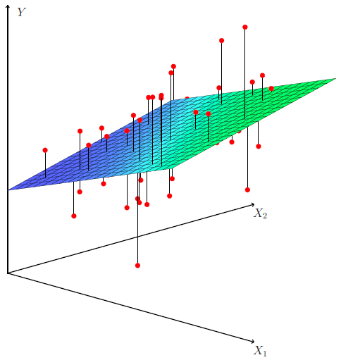
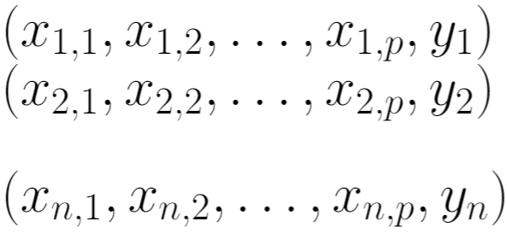
Residuals & RSS
Observed data: observations containing values for each of the predictors and the response:
For fixed coefficients, define residuals & residual sum of squares:
Source:
Figure 3.4 in ISL
Want: this is small

Slide 33
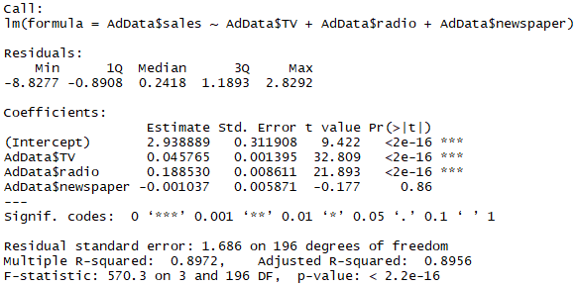
Coefficients from software output
Least squares coefficient estimates: parameter values that minimize RSS; we get them from computer software
Available in different software, R output is shown

Slide 34
Interpretation for advertisement model
In the best linear model,
What do we learn from this?
Setting all predictors to 0 results in Sales=2.939 → without any advertisements, we would sell about 3000 units
If we increase ”TV” by 1 while holding ”radio” and ”newspaper” constant, then ”sales” increases by 0.046 → if we decided to invest 1000$ more in TV advertisements and the held radio and newspaper budgets fixed, we could expect to increase our sales by about 46 units
Having TV and radio in the model, newspaper has no added value on sales

Slide 35
Accuracy of the model – RSE
Residual standard error, which is an estimate of the standard deviation of :
This is the average amount that the response deviates from the true regression line → measures the lack of fit of the model
This is an absolute measure. For advertising example, RSE=1.686 → even if we knew the true parameter values, our prediction of sales may be off by 1686 units. Is this OK or too much?

Slide 36
Accuracy of the model – R²
Measures the proportion of variability in the response that is explained by the linear model including all predictors:
where TSS is the total sum of squares and RSS is the residual sum of squares (as defined before):

Slide 37
Properties of R²
This is a proportion → its value is always between 0 and 1, larger R² indicates better fit of the model (but ”good enough” values depend on the application)
Values close to 0 may indicate:
Linear model is wrong
Inherent error is high
Link between R² and correlation in the multiple variable case:
and/or

Slide 38
Multiple linear regression
Terminology (e.g. Slope, Intercept, RSS, TSS, RSE, R²)
Relationship between predictors and response, variable significance

Slide 39
Testing relationsip between response and all predictors (model significance)
Test null hypothesis that all coefficients are zero (and hence this collection of predictors has no relationship to response):
Test statistic:
Large values of are evidence of a relationship
No relationship is the null hypothesis – is there
evidence against this?

Slide 40
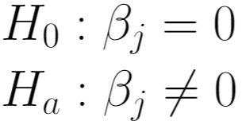
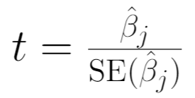
Testing relevance of in predicting in the presence of all other predictors
The null and alternative hypotheses:
Is the estimated slope large enough, compared to its standard error? If so, that would provide some evidence that the true slope parameter is different from 0
→ Test statistic:
No relationship in the presence of all other predictors is the null hypothesis – is there evidence against this?

Slide 41
Feedback

Slide 42
Feedback quiz
Feedback is essential to me so that I can improve the lectures during the course. Please take your chance to optimize your learning experience!
If you are willing to give feedback, please follow these steps:
Go to www.menti.com
Enter the code 48 61 22
Rate your experience today in slide 1
Wait until I change slide
Answer to the questions in slide 2

