Slide 1
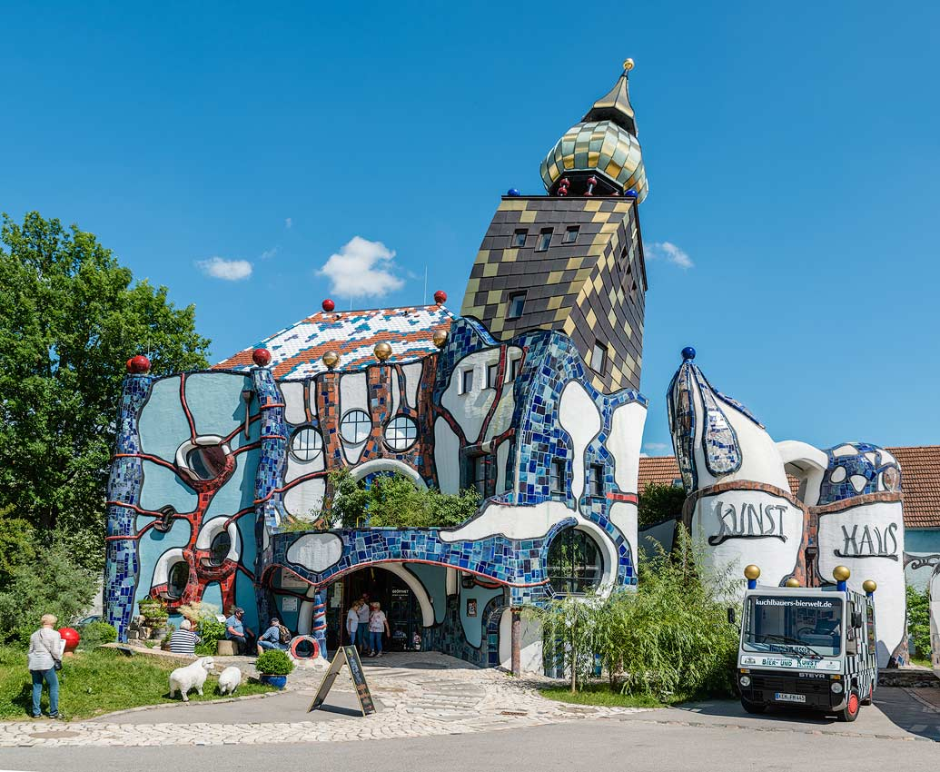
Software Architecting
Michel R.V. Chaudron chaudron@chalmers.se
Chalmers | Gothenburg University, Sweden
Notes:
(From Wikipedia dd Jan 2020)
Friedrich Stowasser (December 15, 1928 – February 19, 2000), better known by his pseudonym Friedensreich Regentag Dunkelbunt Hundertwasser, was an Austrian-born New Zealand artist^{[1]} and architect who also worked in the field of environmental protection.
Hundertwasser stood out as an opponent of "a straight line" and any standardization, expressing this concept in the field of building design. His best known work is the Hundertwasserhaus in Vienna, Austria which has become a notable place of interest in the Austrian capital, characterised by imaginative vitality and uniqueness.

Slide 2
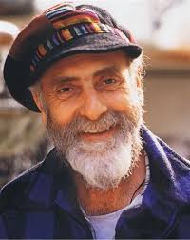
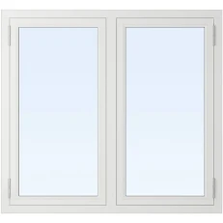
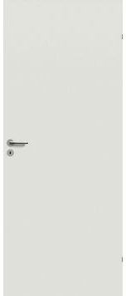
Standardization
Friedrich Stowasser (1928 – 2000)
better known by his pseudonym
Friedensreich Regentag Dunkelbunt Hundertwasser
He was an opponent of "a straight line"
“Die gerade Linie ist gottlos und unmoralisch.”
(from Hundertwassers’ manifest against Rationalism in Architecture, 1958)
What does this do to
  Reuse? Complexity?
  Patterns?
  Mass-production? Efficiency?

Slide 3
Schedule
Week |  | Date | Time | Lecture | Reading | Note
4 | L1/S1 | 22 JAN | 10:15 – 12:00 | Introduction, Objectives & Organization
4 | L2 | 23 JAN | 13:15 – 15:-00 | Architecting Process & Architecture Views | Ch 1 & 2
5 |  | 28 JAN | 10:15 – 12:00 | Skip
5 | S2 | 29 JAN | 10:15 - 12:00 | << Supervision: Launch Assignment 1>> | Ch 3 & 4
5 |  | 30 JAN | 13:00 – 15:00 | Skip
6 | L3 | 3 FEB | 13:15 – 15:00 | Architectural Styles 1 | Ch 13
6 | S3 | 5 FEB | 10:15 – 12:00 | << Supervision/Assignment>>
6 | L4 | 6 FEB | 13:15 – 15:00 | Architectural Styles 2 | Ch 13
7 | L5 | 10 FEB | 13:15 – 15:00 | Technical Debt |  | Terese
7 | S4 | 12 FEB | 10:15 – 12:00 | << Supervision/Assignment>>
7 | L6 | 13 FEB | 10:15 – 12:00 | Performance – Analysis & Tactics | Ch 8 + paper
8 | L7 | 17 FEB | 13:15 – 15:00 | Design Principles (Maintainability, Modifiability) | Ch 7
8 | S5 | 19 FEB | 10:15 – 12:00 | << Supervision/Assignment>>
8 | L8 | 20 FEB | 10:15 – 12:00 | Reliability, Availability, Fault Tolerance | Ch 5, 14 + paper
9 | L9 | 24 FEB | 13:15 – 15:00 | Guest Lecture 1
9 | S6 | 26 FEB | 10:15 – 12:00 | << Supervision/Assignment>>
9 | L10 | 27 FEB | 13:15 – 15:00 | Architecture Evaluation | Ch 21
10 | L11 | 2 MAR | 13:15 – 15:00 | Reverse Engineering & Correspondence | Ch 20
10 | S7 | 4 MAR | 10:15 – 12:00 | << Supervision/Assignment>>
10 | L12 | 5 MAR | 13:15 – 15:00 | Guest Lecture 2

Slide 4
Assignment Schedule
Week |  | Date | Lecture | Assignment1 | Assignment2
4 | L1/S1 | 22 JAN | Introduction, Objectives & Organization | Form groups & read Ass 1
4 | L2 | 23 JAN | Architecting Process & Architecture Views
5 |  | 28 JAN | Skip
5 | S2 | 29 JAN | << Supervision: Launch Assignment 1>> | Work & TA feedback
5 |  | 30 JAN | Skip
6 | L3 | 3 FEB | Architectural Styles 1
6 | S3 | 5 FEB | << Supervision/Assignment>> | Hand-in draft of Ass 1
6 | L4 | 6 FEB | Architectural Styles 2 | (perform peer review)
7 | L5 | 10 FEB | Technical Debt | Deadline peer review Ass 1
7 | S4 | 12 FEB | << Supervision/Assignment>> |  | Start Assignment 2
7 | L6 | 13 FEB | Performance – Analysis & Tactics
8 | L7 | 17 FEB | Design Principles (Maintainability, Modifiability)
8 | S5 | 19 FEB | << Supervision/Assignment>> | Work & TA feedback | Work & TA feedback
8 | L8 | 20 FEB | Reliability, Availability, Fault Tolerance
8 |  | 21 FEB |  |  | Hand-in Ass 2
9 | L9 | 24 FEB | Guest Lecture 1 |  | Deadline peer review Ass 2
9 | S6 | 26 FEB | << Supervision/Assignment>> | Work & TA feedback | Revise Ass 2
9 | L10 | 27 FEB | Architecture Evaluation
10 | L11 | 2 MAR | Reverse Engineering & Correspondence |  | Deadline Ass 2
10 | S7 | 4 MAR | << Supervision/Assignment>> | Deadline Ass 1
10 | L12 | 5 MAR | Guest Lecture 2

Slide 5
Proposal/Question: Use Data from Assignment for Scientific Study
Global topic of study: How well do teaching methods in software architecture work?
Data handled anonymously & confidentially
No extra work for you & will not affect your grade
No effect on learning opportunity
Either, you state you wish to ‘opt out’, or you fill a consent form: https://www.tcd.ie/swsp/assets/pdf/Participant%20consent%20form%20template.pdf

Slide 6
Outline
Organization of the lectures
Importance and use of architecture
What is Software Architecture?
Stakeholders
How to do Software Architecting?
4+1 Views
Concluding Remarks & References

Slide 7
The Importance of Architecture
“A correct architecture has the largest single impact
on cost and quality of the product.”
Maranzano, ATT, 1995

Slide 8
The Importance of Architecture
10% of the lifecycle determines
90% of the costs and risks
≥ 100x
Requirements & Architecting
Design
Implementation
Testing
Deployment
Operation
SW fault repair costs
1x
Notes:
The costs of repairing a fault increases exponentially with the delay of its detection

Slide 9
Two levels of benefits
Business benefits
Cost
Time / Efficiency
Quality
Mangement
Engineering benefits
Maintainability

Slide 10


Business Objectives of Sw. Arch.
Reduce time-to-market
‘Earliest to have feature on the market’
Through enabling reuse and gradual evolution
Manage Risk and Cost cost of development and maintenance
Project estimation, planning & organization
Earlier assessment of design alternatives and
assessment of system risks
Through improved communication between developers
Through incorporation of foreseeable changes
Improve product quality
Increase fitness for use through stakeholder involvement;
reduce errors through enforcement of conceptual integrity

Slide 11
Development Objectives of Software Architecture
Management of complexity
  Define a model of a system that is intellectually manageable
  incorporation of foreseeable changes
Answering of what-if questions
  Allows stakeholders to evaluate different architectural solutions and their consequences (e.g. on satisfying requirements)
Feasibility study & risk analysis
  Analysis of various (non-)functional features of the future product;
  Identification of possible problems during development, production & operation

Slide 12
Multiple Purposes of Architecture
Understanding + Analyzing
+ Communicating + Constructing
Understanding
Describing
Guiding
Why
What
How
Why is the system needed? What constraints apply?
Understanding the requirements
What are the important design decisions
What functions does the system provide?
What properties does the design have?
How can the system be built?
Figure from Gerrit Muller, How to Create a Manageable Platform Architecture

Slide 13
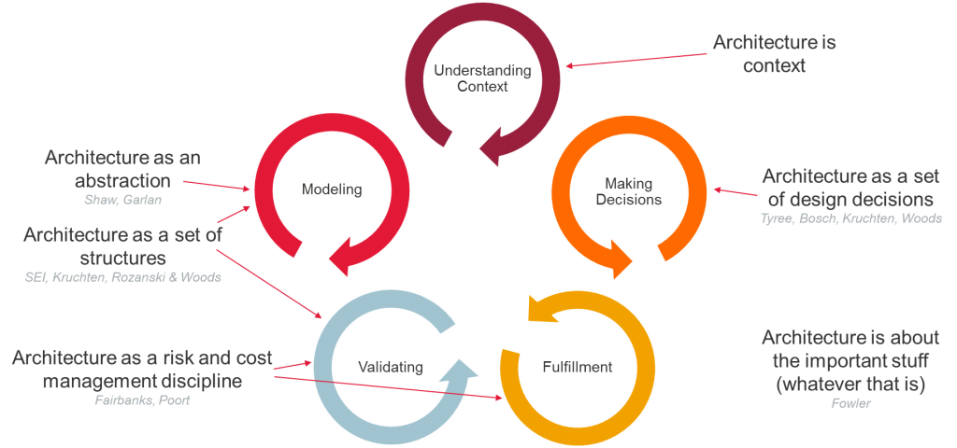
Multiple Purposes of Architecture
Picture from Eltjo Poort’s Architecture Blog - https://eltjopoort.nl/

Slide 14
Multiple Purposes of Architecture
analyse domain
communicate
(by defining) the design
analyse system
guide design
monitor implementation
guide implementation
monitor progress, cost, risk
Picture from Eltjo Poort’s Architecture Blog (2019) - https://eltjopoort.nl/

Slide 15
Focus of this course
analyse domain
communicate
(by defining) the design
analyse system
guide design
monitor implementation
guide implementation
monitor progress, cost, risk
Picture from Eltjo Poort’s Architecture Blog (2019) - https://eltjopoort.nl/

Slide 16
Outline
Organization of the lectures
Importance and use of architecture
What is Software Architecture?
Concluding Remarks & References

Slide 17
Let’s Look at some Examples

Slide 18
Semi-autonomous lawn mowing system

Slide 19
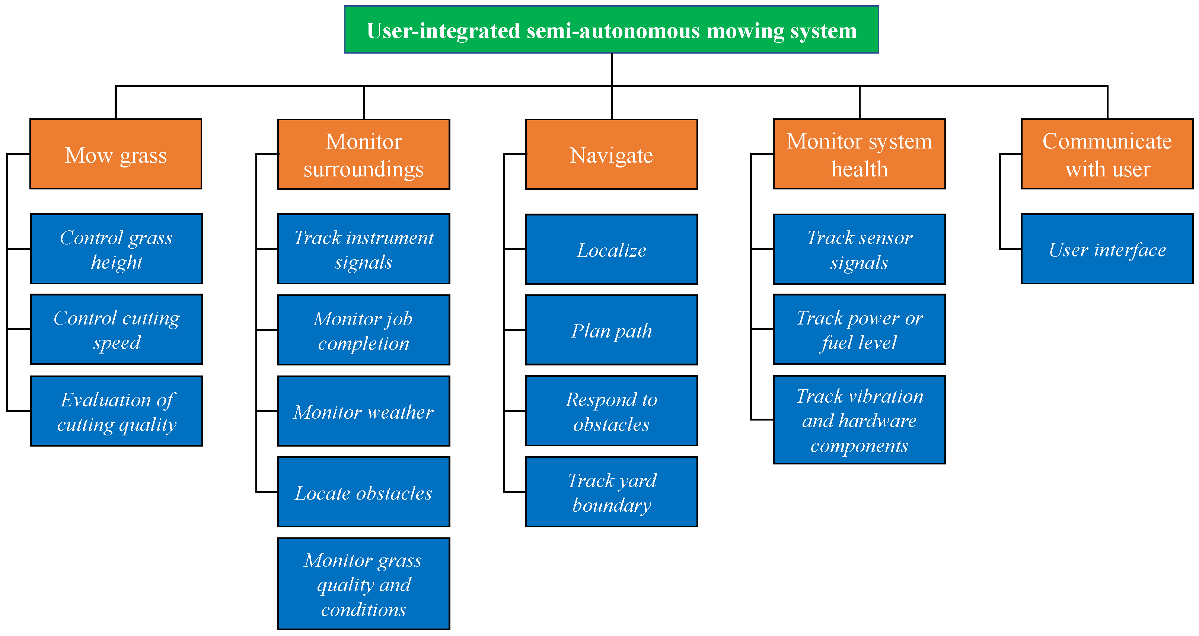
Shows:
Decomposition into main functions of the system
Does not show:
How components relate to/interact with each other
How components are implemented
IT does not show ‘power’ or ‘memory’!
Alt: responsibilities / tasks
Not at this ‘perspective’/abstraction
AgriEngineering 2019, 1(3), 453-474; https://doi.org/10.3390/agriengineering1030033
Development of User-Integrated Semi-Autonomous Lawn Mowing Systems: A Systems Engineering Perspective and Proposed Architecture by Albert E. Patterson,Yang Yuan and William R. Norris

Slide 20
Shows:
Sub-functions
AgriEngineering 2019, 1(3), 453-474; https://doi.org/10.3390/agriengineering1030033
Development of User-Integrated Semi-Autonomous Lawn Mowing Systems: A Systems Engineering Perspective and Proposed Architecture by Albert E. Patterson,Yang Yuan and William R. Norris

Slide 21
eCommerce Architecture Blueprint
VK
Par.
Trw
RD
AD
NRC
DtRG
Ad.g.
Ad.k.
Graf.
Meul.
DocA
DocR
MRe
Losv
Distr
Ab.A
Ab.R
Extranet
Internet
Intranet
Journ.
Auteurs
Nieuws-
dnsten
Advert.
(PR-bur)
Losse
verk.pt.
Vervoer-
ders
Distrib.,
bezorg.
Busin.
partners
Bedrijv.
Instell.
Advert.
(part.)
Abon-
nees
Bezoe-
kers
PCM
medewr.
Integration Platform (Message Broker)
Multi-channel Platform
Tel/CC
Brief/fax
Email
Website
Mobiel
ITV
...
Commerce Platform
Merkgebonden producten en diensten
Content
mgmt.
Content
publish.
Relatie
Onderh.
Advert.
aanbod
Advert.
Activ.
Merk
regels
Understanding
Describing
Guiding
Why
Gemeenschappelijke services
Search
&config.
Relatie
Profiles
Product
prijzen
What
How
PCM
regels
Work
flow
Security
ePaym’t
Content
DB
Relation
profile
DB
Bedrijfs
Regels
DB
Beveili-
gings
DB
Legacy Platform
ATEX
MedS
CCI
SII
Quark
VIP
Nova
Oman
Meul.
Lovr
Opls
ADS
TDS
NPD
Ami1
Ami2

Slide 22
From: CMU/SEI-2005-TN-027
From: Using the SEI Architecture Tradeoff Analysis Method to Evaluate WIN-T: A Case Study
Technical Note CMU/SEI-2005-TN-027
Notes:
Using the SEI Architecture Tradeoff Analysis Method to Evaluate WIN-T: A Case Study
Paul Clements, Software Engineering Institute
John Bergey, Software Engineering Institute
Dave Mason, U.S. Army’s Communications and Electronics Command (CECOM)
September 2005
Technical Note CMU/SEI-2005-TN-027

Slide 24
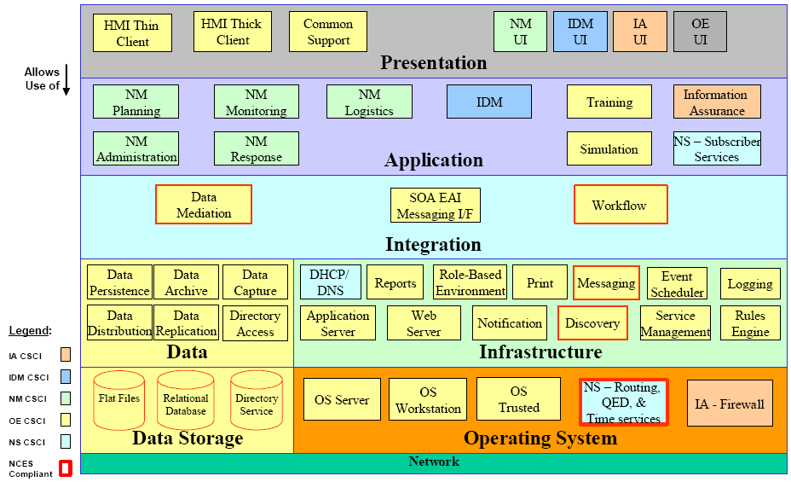

Refinement of previous slide
From: Using the SEI Architecture Tradeoff Analysis Method to Evaluate WIN-T: A Case Study
Technical Note CMU/SEI-2005-TN-027
Notes:
A legend is really important!

Slide 25
Complementary view of previous
From: Using the SEI Architecture Tradeoff Analysis Method to Evaluate WIN-T: A Case Study
Technical Note CMU/SEI-2005-TN-027

Slide 26
Software Architecture of
K9 e-mail app (on Android )

Slide 27
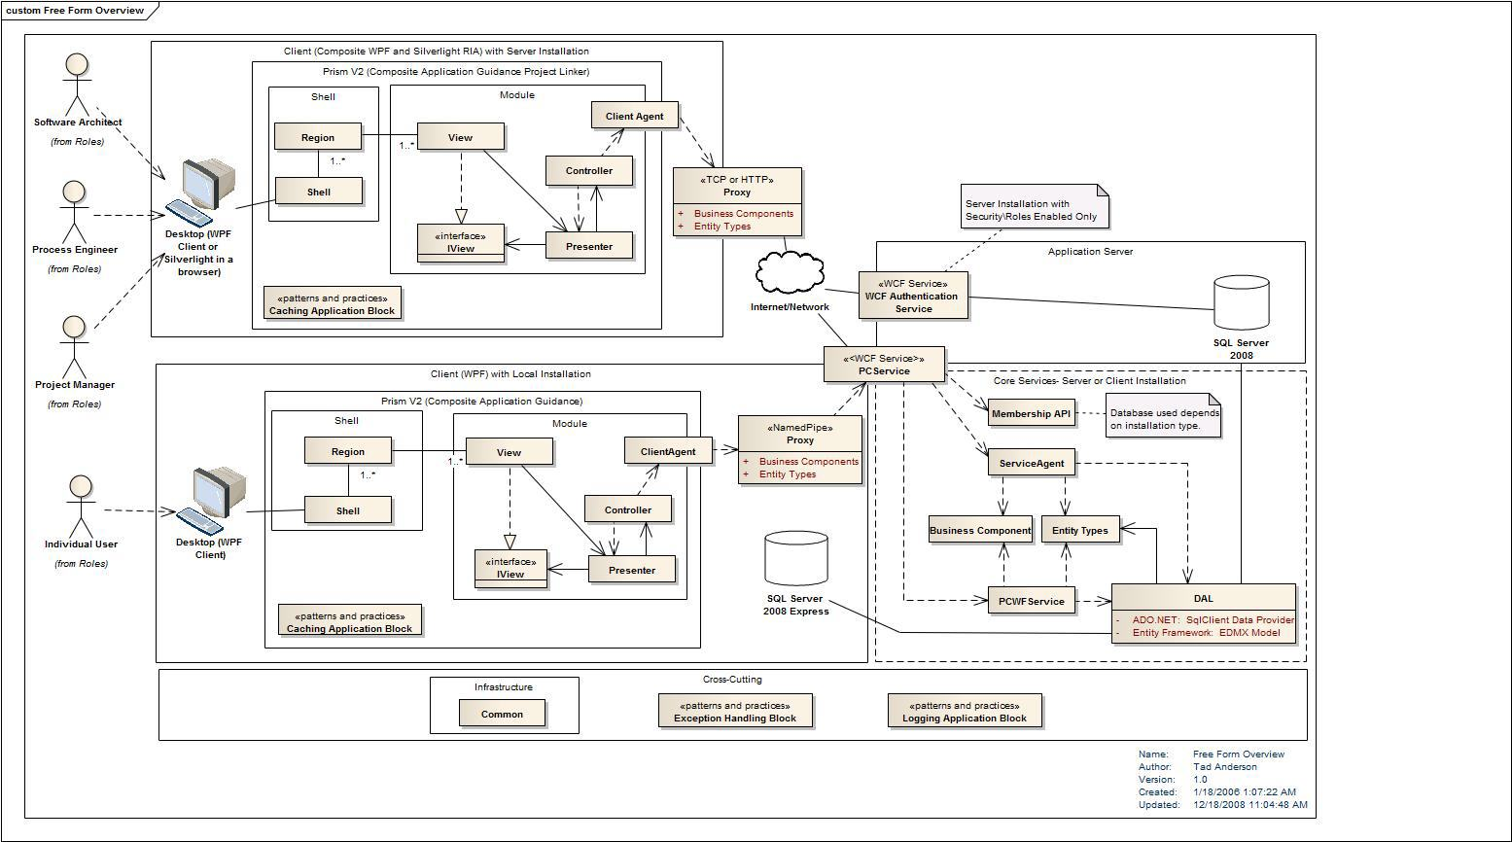
Decomposition
! Pretty nice UML use: systematic, nice layout

Slide 28
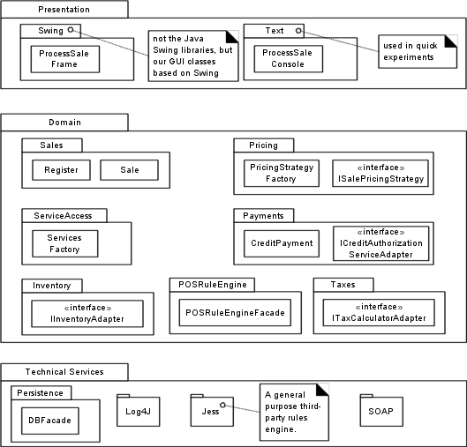
Decomposition in Layers
Decomposition in layers is often
Implementation decomposition, and not functional decomposition

Slide 29
Decomposition in Layers
Lawnmower-case
Decomposition in layers is often Implementation decomposition, and not functional decomposition

Slide 30
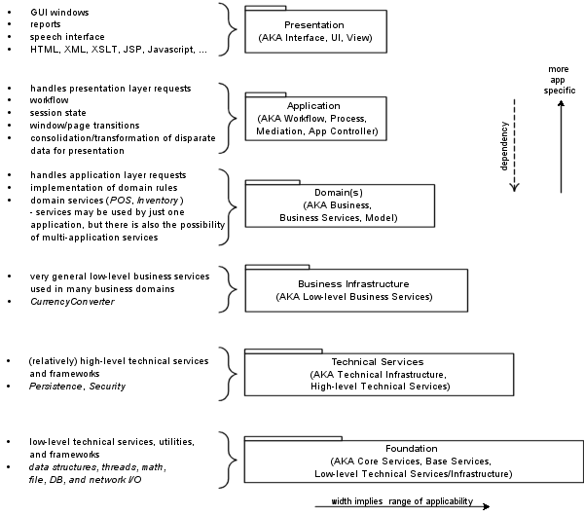
Reference Architectures

Slide 31
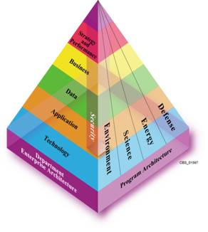
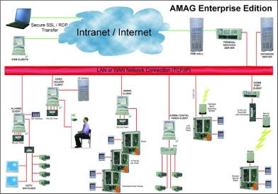
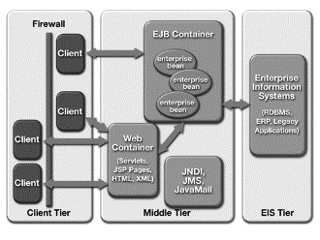
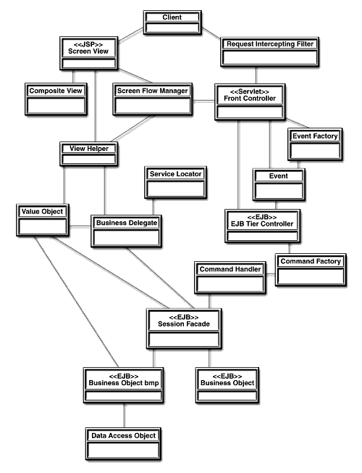
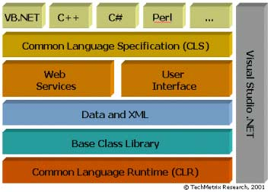
Levels of architecture*
Enterprise architecture
System architecture
Subsystem
Application architecture
Application
Macro-architecture
Frameworks
Micro-architecture
Subject
Observer
attach(Observer)
detach(Observer)
notify()
forall o in observers
o.update()
update()
Design patterns
ConcreteSubject
ConcreteObserver
* Mowbray and Malveau
getState()
update()
Notes:
Thomas J. Mowbray and Raphael C. Malveau. CORBA Design Patterns. John Wiley & Sons, 1997

Slide 32
Types of Architectures
• Single product
  Future-proof with respect to a particular product
• Product family – e.g. TVs / Telephones
  Instantiation of many related products
  Stable with respect to a restricted set of Quality
  attributes
  Future-proof with respect to a product type
Time/Product Scope

Slide 33
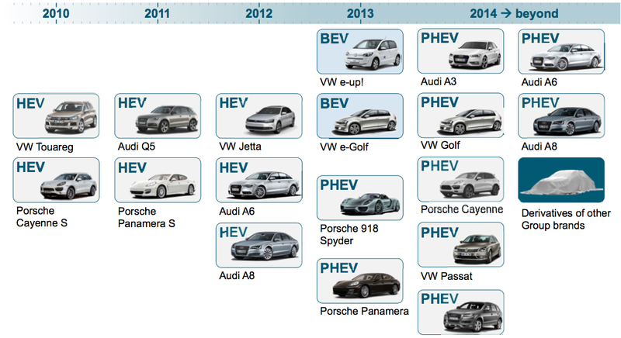
Automotive Product Line

Slide 34
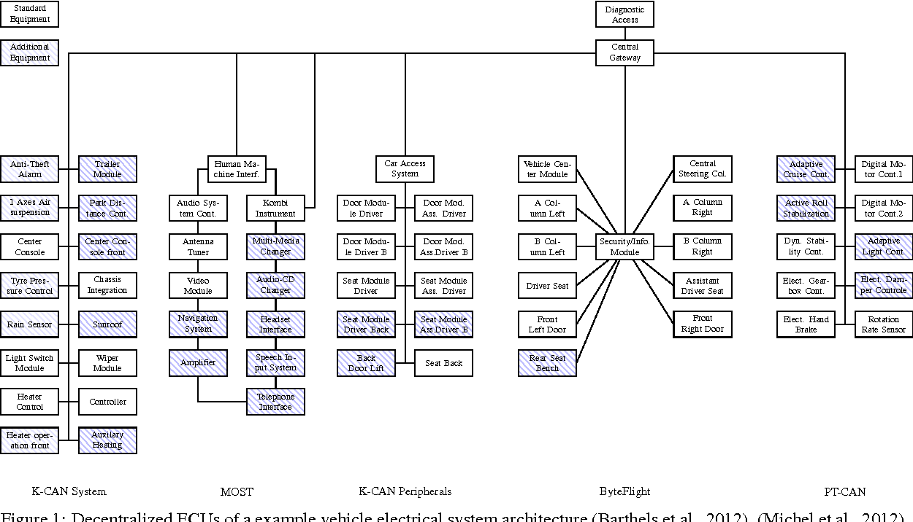
In-Car network of ECU’s

Slide 35
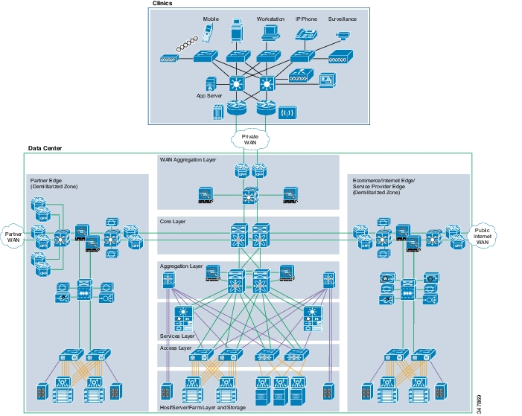
= Network
topology

Slide 36
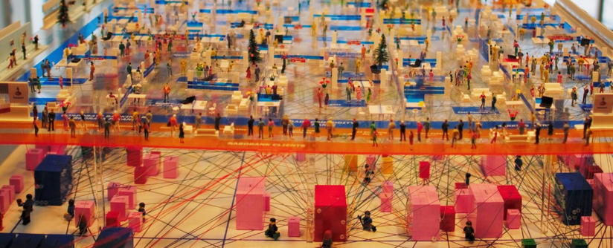
Banking Architecture
(Physical 3D model)
Rabobank's 3D model (Image source: Hans Tesselaar, BIAN)

Slide 37
What is Software Architecture?
Classic Definitions 1
An architecture is the set of significant decisions about
the organization of a software system,
the selection of the structural elements and their interfaces by which
the system is composed, together with their behaviour as specified in
the collaborations among those elements,
the composition of these structural and behavioural elements into
progressively larger subsystems,
the architectural style that guides this organization
The UML Modeling Language User Guide, Addison-Wesley, 1999
Booch, Rumbaugh, and Jacobson

Slide 38
What is Software Architecture?
Definition 2
The fundamental organization of a system embodied by its components, their relationships to each other and to the environment and the principles guiding its design and evolution
IEEE Standard P1471 Recommended Practice for
Architectural Description of Software-Intensive Systems

Slide 39
What is Software Architecture?
Definition 3
IT-Architecture is the collection of principles, guidelines and modelling standards that are used to guide the development, maintenance and use of IT-resources
within the entire organization.
M. Sikkema (banking industry)
Translation by M.R.V. Chaudron
Ontwikkelen Onder Architectuur, Informatie, juni 2000
Oriented towards enterprise systems.

Slide 40
Software Architecture & Quality
The notion of quality is central in software architecting:
a software architecture is devised to gain insight in the qualities of a system at the earliest possible stage.
Some qualities are observable via execution: performance, security, availability, functionality, usability
And some are not observable via execution, but in the development process: modifiability, portability, reusability, integrability, testability

Slide 41
Architecting = Balancing Objectives
Functional dimensions
Structure
Functionality
Component interfaces
Component configurations
Local/Global Behavior
Control modes
Activities/Transactions
C&S protocols
Dependability
Performance
Timeliness
Reliability
Availability
Safety
Security
Robustness
General
Scalability
Flexibility
Maintainability
Reusability
Openness
User-Friendliness
Costprize
•••
Composability
Interoperability
Reusability
Extra-Functional dimensions
Notes:
All relevant system dimensions must be described by an architecture

Slide 42
Outline
Recap : What is Software Architecture?
Stakeholders
How to do Software Architecting?
4+1 Views
Concluding Remarks

Slide 43
All of the above are valid!
Add your own definition:
  http://www.sei.cmu.edu/architecture/start/glossary/community.cfm

Slide 44
Why, When and for Whom?
Why architecting?
When architecting?
For whom?

Slide 45

Developing a shared vision
Requirements emerge from a process of
co-operative learning in which they are explored, prioritized, negotiated, evaluated, and documented.
Notes:
slides from Paul Gruenbacher

Slide 46
Software Architecture & Quality
The notion of quality is central in software architecting:
a software architecture is devised to gain insight in the qualities of a system at the earliest possible stage.
Some qualities are observable via execution: performance, security, availability, functionality, usability
And some are not observable via execution, but in the development process: modifiability, portability, reusability, integrability, testability

Slide 47
Architecting = Balancing Objectives
Functional dimensions
Structure
Functionality
Component interfaces
Component configurations
Local/Global Behavior
Control modes
Activities/Transactions
C&S protocols
Dependability
Performance
Timeliness
Reliability
Availability
Safety
Security
Robustness
General
Scalability
Flexibility
Maintainability
Reusability
Openness
User-Friendliness
Costprize
•••
Composability
Interoperability
Reusability
Extra-Functional dimensions
Notes:
All relevant system dimensions must be described by an architecture

Slide 48
Some more examples of *ilities
Accessibility, Understandability, Usability, Generality, Operability, Simplicity, Mobility, Nomadicity, Portability, Accuracy, Efficiency, Footprint, Responsiveness, Scalability, Schedulability, Timeliness, CPU utilization, Latency, Throughput, Concurrency, Flexibility, Changeability, Evolvability, Extensibility, Modifiability, Tailorability, Upgradeability, Expandability, Consistency, Adaptability, Composability, Interoperability, Openness, Integrability, Accountability, Completeness, Conciseness, Correctness, Testability, Traceability, Coherence, Analyzability, Modularity, Reusability, Configurability, Distributeability, Availability, Confidentiality, Integrity, Maintainability, Reliability, Safety, Security, Affordability, Serviceablility, …

Slide 49
Extra Functional Properties
Performance
Scalability
Reliability
System
Maintainability
Efficiency
CPU, Memory Use
Timeliness
Schedulability
Essential system engineering problem:
a plurality of contradictory goals
a plurality of means (technology, process)
each of which provides a varying degree of help or hindrance in achieving a given goal
Notes:
B. Boehm, Software Engineering Economics

Slide 50
How to architect?
The most important software engineering skills we
must learn are:
the skill involved in dealing with a plurality of goals which may be at odds with each other,
the skill of coordinating the application of a plurality of means, each of which provides a varying degree of help or hindrance in achieving a given goal, depending on the situation.
B. Boehm, Software Engineering Economics

Slide 51
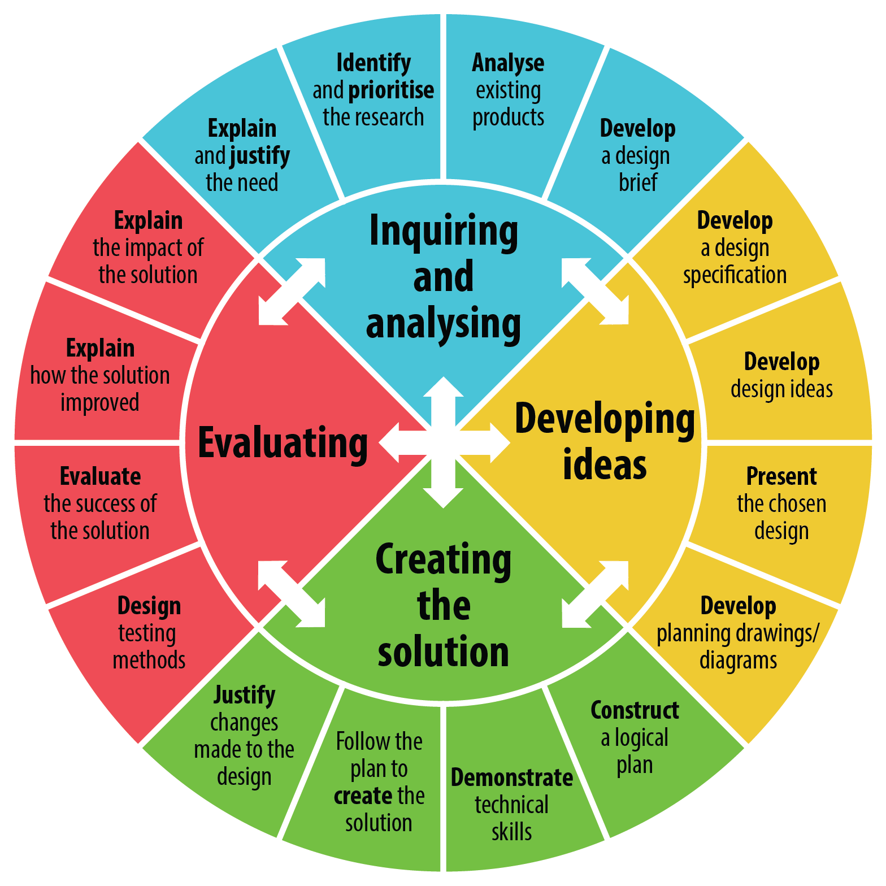
Software Architecting = Designing
Respond to change:
Iterative
Feedback
Evolve

Slide 52

Architectural Drivers
Architectural drivers are the design forces that will influence the early design decisions the architects make
Architectural drivers are not all of the requirements for a system, but they are an early attempt to identify and capture those requirements, that are most influential to the architect making early design decisions.
  → architecturally significant requirements
      Architects pay more attention to qualities that arrise from architecture choices

Slide 53

Architectural Information Increases
Architecture is everything that a (group of)
person(s) needs to let a large team successfully
develop a (family of) products
Rob van Ommering, Philips Natlab
- : ‘Everything’? Clearly too broad.
+ : point towards: “Knowledge Management”
Everything that everyone in the team should know

Slide 54
Positioning Architecture
The question:
The answer:
Implementation:
Deployment:
Require-
ments
Architecture
Source code
Executable
  • Features
  • Use cases
  • Dependability
  Timing
  Reliability
  Security
  • Quality
  • Standards
  • Etc.
  • HL-Design
  Components
  Interfaces
  Interactions
  Styles
  • Constraints
  • Guidelines
  • Reuse
  • Etc.
  • Decomposition
  • Algorithms
  • Data structures
  • Distribution
  • Scheduling
  • Recovery
  Language
  • Encryption
  • Etc.
  • Memory
  allocation
  • Dynamic
  Instantiation
  • Call stacks
  • Garbage
  collection
  • Machine code
  • Etc.

Slide 55
The Role of the Architect
Notes:
In a sense, the two elements on the lower left are new: the elements labeled appearance/behaviour, and the one labelled architectural design

Slide 56
Outline
What is Software Architecture?
Stakeholders
How to do Software Architecting?
4+1 Views
Concluding Remarks

Slide 57
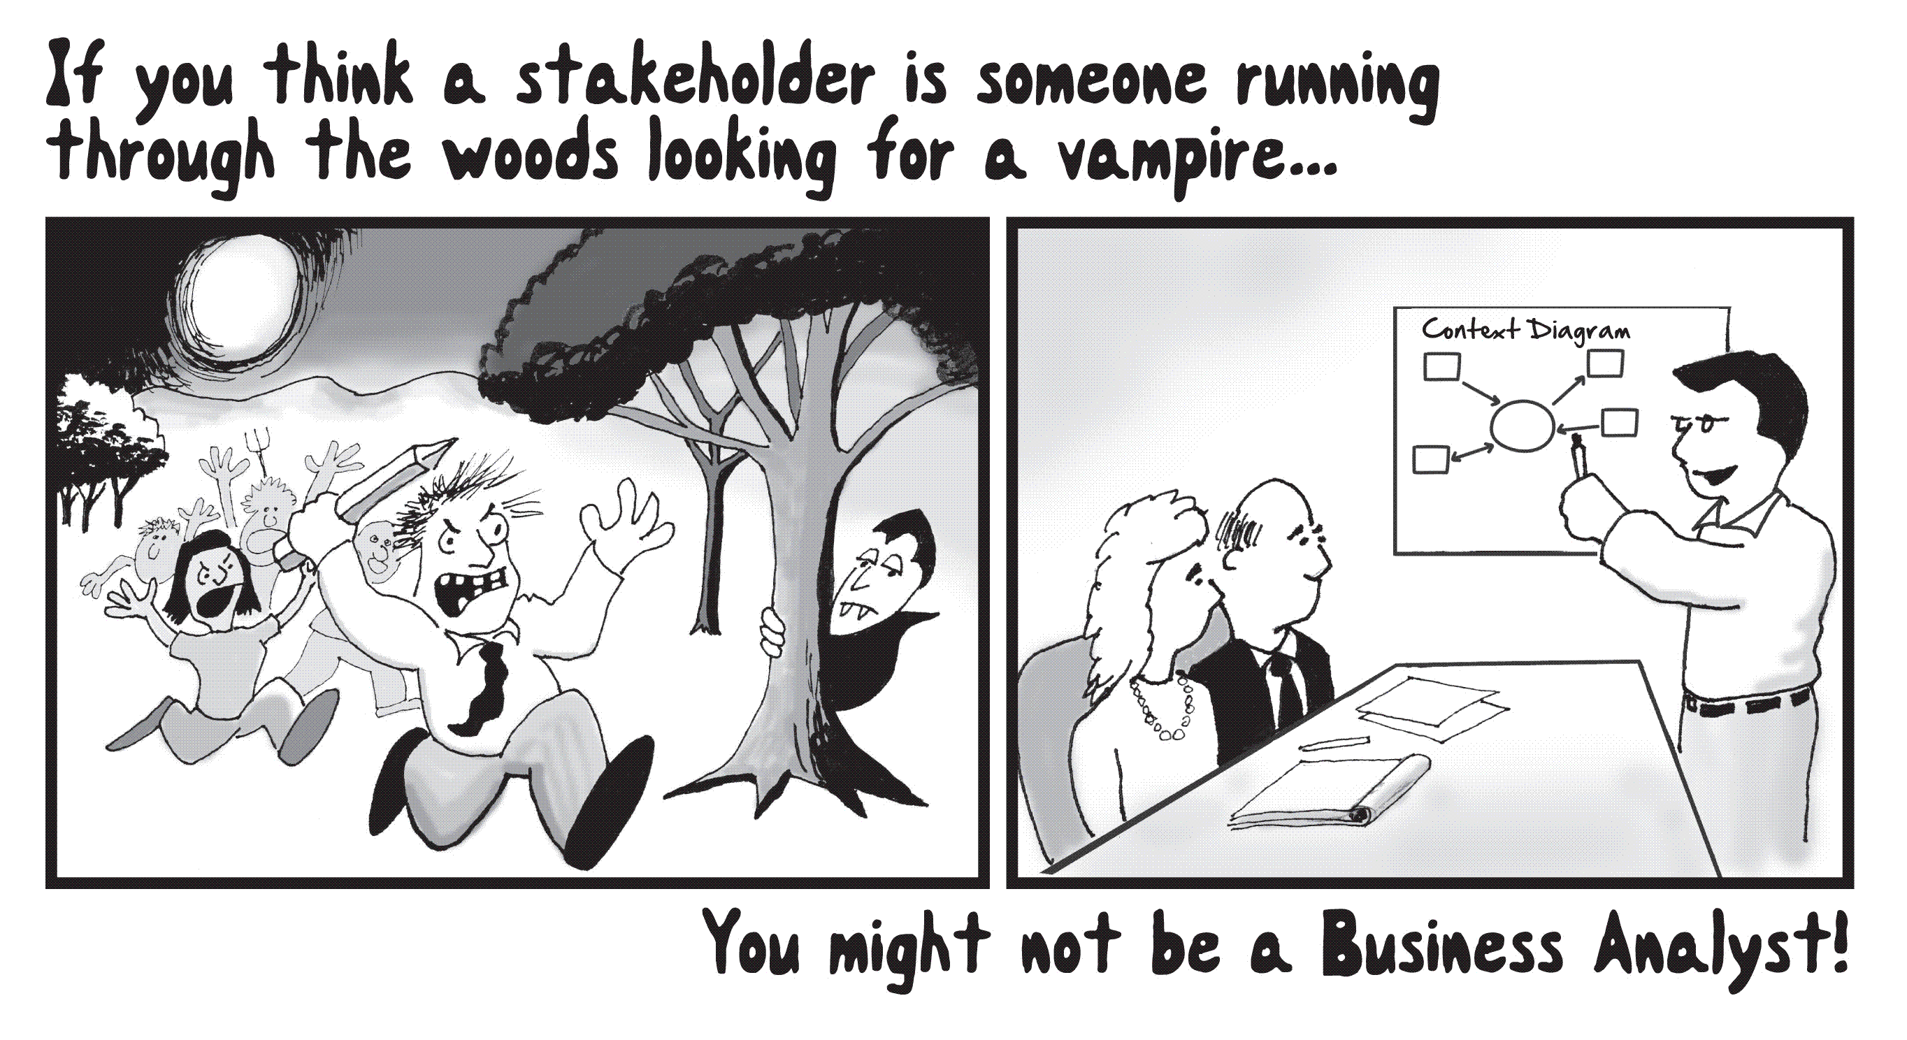
Stakeholder?

Slide 58
For Whom?
An architecture is a (common) means of understanding of a system
  Customers, Users, Domain Experts
  Engineers:
    Analysts
    Architects
    Programmers: maintenance, development, testing
    New members of the development team
  Marketing
  Sales
  Management

Slide 59
Stakeholders
‘‘4.16 Stakeholder: An interested party having a right, share or claim in the system or in its possession of qualities that meet their needs.’’
Draft Standard ISO/IEC 15288 (ISO/IEC 1999)
Customer:
solves problems at
User:
an acceptable cost in
easy to learn;
terms of money paid and
efficient to use;
resources used
helps get work done
Software
System
Development manager:
Developer:
sells more and
easy to design;
pleases customers
easy to maintain;
while costing less
easy to reuse its parts
to develop and maintain
Figure from: Lethbridge and Laganiere

Slide 60
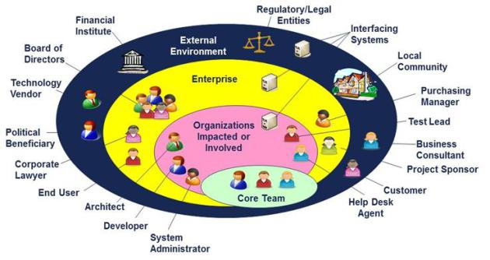
Stakeholders

Slide 61
Stakeholders & their Concerns 1/2
Stakeholder Concern (Examples)
Customer Business goals
  Schedule & budget estimation
  Feasibility and risk assessment
  Requirements traceability & progress tracking
  Product-line compatibility
User Consistency with requirements & use cases
  Future requirements growth accommodation
  Support of dependability & other X-abilities
Service manager Reliability, availability and maintainability
Notes:
Customer: The architecture should be strongly coupled with the requirements, indicating whether it can meet them or not
Users: The architecture should show the impact of the system structure on the system attribute requirements like quality, performance, usability and other X-abilities
Service manager: Maintenance accounts for about 80% of the total lifecycle costs

Slide 62
Stakeholders & their Concerns 2/2
Stakeholders Concern (Examples)
System engineer Requirements traceability
  Support of tradeoff analyses
  Completeness of architecture
  Consistency of architecture with requirements
Developer Sufficient detail for design and development
  Workable framework for system construction,
  e.g. selection/assembly of components & technologies
  Resolution of development risks
Maintainer Guidance on software modification
  Guidance on architecture evolution
  Interoperability with existent systems
Notes:
Architects and system engineers: Consistency of/mapping between requirements and architecture
Developers: The architectural definition should be detailed enough to build a system that satisfies the customer requirements but not so constraining as to preclude different technical approaches
The stakeholders win-win approach allows the definition of much more
thorough evaluation criteria for the initial project milestones

Slide 63
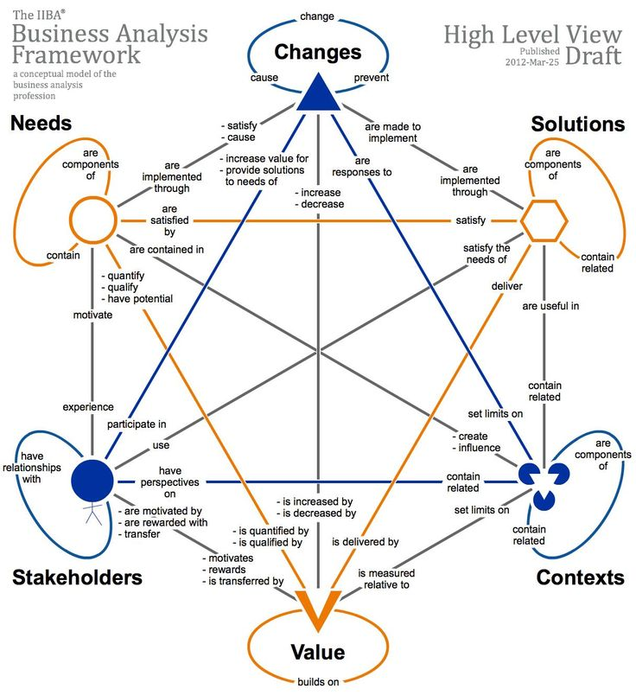

Slide 64
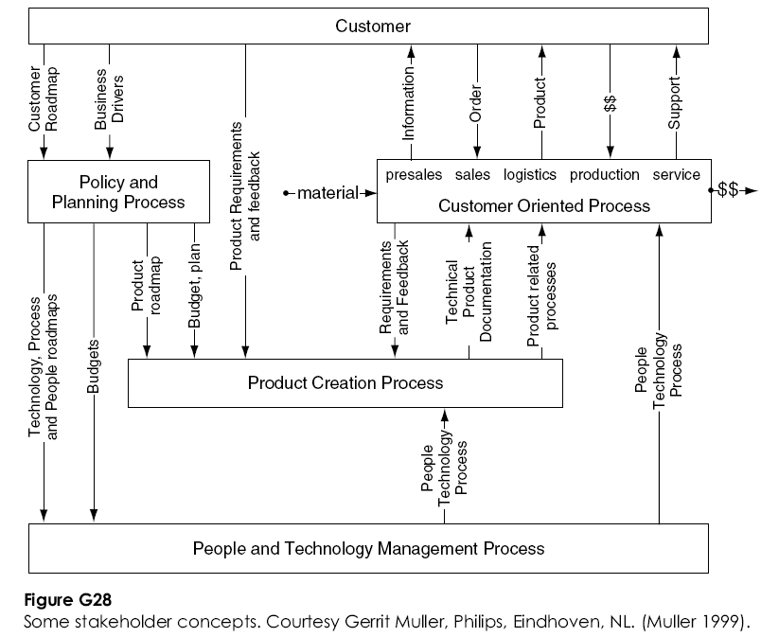
Relations between stakeholders

Slide 65
When Architecting?
When developing a new system
When changing a system
  if an architecture description is not available, or insufficient, as a basis for change
  adapt the architecture documentation to changes
When integrating existing systems
For special communication needs to provide a common ground for understanding

Slide 66

Disclaimer
No matter how good your architecture, it can always be ruined by bad implementation!
Is this a reason for not doing architecture?
Guide & Monitor
Implementation !

Slide 67
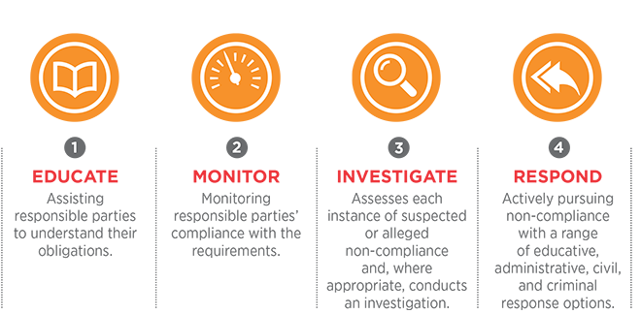
Manage Compliance

Slide 68
Outline
What is Software Architecture?
Stakeholders
How Software Architecting?
4+1 Views
Concluding Remarks & References

Slide 69


Slide 70

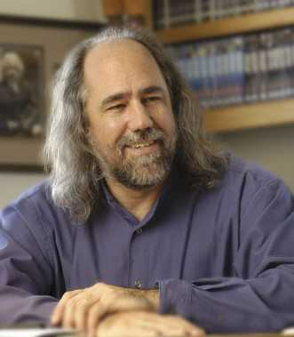
Architecture is making decisions
The life of a software architect
is a long (and sometimes painful) succession of suboptimal decisions made partly in the dark.
Grady Booch
You will not have all information available
You will make mistakes, but you should learn from them
There is no absolute measure for ‘goodness’
Notes:
Experience is a hard teacher because she gives the test first, the lesson afterwards

Slide 71

No ideal solution
Discovery may
be exploratory
There is no ideal system to be discovered.
Notes:
slides from Paul Gruenbacher

Slide 72
Process: Working Together
WHAT?
Requirements
Stakeholders
HOW?
Implementation
Quality
System
Architect
Business
Drivers
Costs
HW
SW
Close and effective interaction between these actors is essential!
Make process transparent: Get/Give feedback early and often
Notes:
The requirements of a (software) system is a description of its external properties
as seen by the various stakeholders (black box model)
RE often involves BPR and requires thus that also the BPR- and organization consultants are considered as stakeholders
The architecture of a (software) system is the structures of the system,
which comprises the (software) components,
the externally visible (static and dynamic) properties
of those components
and the relationships among them
(glass box model)
These two activities are not sequential but intermingled!
The result is the shared responsibility of the architect and the stakeholders!

Slide 73
How to Bridge the Gap?
WHAT?
Requirements
HOW?
Implementation
?

Slide 74
Traditional Answer
WHAT?
Requirements
HOW?
Implementation
Miracle
happens
Ad-hoc - not repeatable, not predictable
Requires Magic (Wizards/Gurus)
Costly

Slide 75
Architecting
WHAT?
Requirements
HOW!
Implementation
Architecting
Gross decomposition of a system in components and their interrelations, taking into account
  non-functional dimensions
  rationale of design and future change
Notes:
The requirements of a (software) system is a description of its external properties
as seen by the various stakeholders (black box model)
RE often involves BPR and requires thus that also the BPR- and organization consultants are considered as stakeholders
The architecture of a (software) system is the structures of the system,
which comprises the (software) components,
the externally visible (static and dynamic) properties
of those components
and the relationships among them
(glass box model)
These two activities are not sequential but intermingled!
The result is the shared responsibility of the architect and the stake holders!

Slide 76
Software Architecture Design Process
Requirements
Domain
Requirements
User
Requirements
Functional
Requirements
Extra-Functional
Requirements
Design approach for
realizing extra-functional quality properties
Group Functionality
in subsystems
Select
Architectural Style
Reference Architecture
Architecture Tactics
Synthesize
refine
Guide & Monitor
Implementation
Analyze

Slide 77
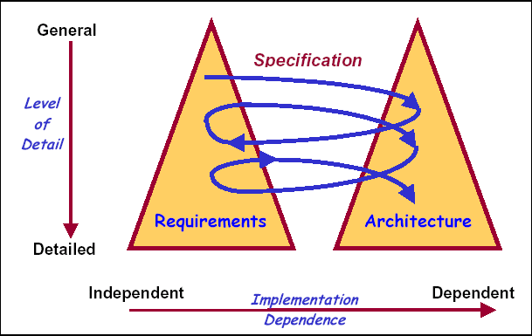
Twin Peaks Process
Separate but concurrent development of
requirements & architecture
WHAT:
problem
structuring
HOW:
solution
structuring
Progressing understanding of architecture & design provides a basis for discovering further problem space & requirements and vice versa.
There is interaction between available solutions and requirements
Notes:
For instance the structure of a hierarchy of requirements document follows the hierarchical structure of a system.
COTS influence what ultimate solution looks like.
Interaction allows to rapidly narrow down choices and accomodate COTS solutions.

Slide 78
Focus over time
Discovery
‘Understanding’
Invention
‘Ideation’
Implementation
Focus
Time
From : Bran Selic
Notes:
Grady

Slide 79
Paris Avgeriou Keynote at SEAA 2017
Architecting is not only about the solution space, but also about the problem space: identifying, scoping, understanding the problem space.

Slide 80
Architecture is not only IT/technology
Technical and non-techical issues and options are intertwined
  Architects deciding on the type of database
  versus
  Management deciding on new strategic partnership
  or
  Management deciding on budget
Notes:
A similar depedency exists between tech and non-tech options.
Here we have an example

Slide 81
Why is documenting design decisions important?
Explains why this is a good architecture
Prevents repeating (expensive) past steps
Provides context and background

Slide 82
Outline
What is Software Architecture?
Stakeholders
How Software Architecting?
4+1 Views
Concluding Remarks & References

Slide 83
Overview (According to IEEE 1471)
has
1..*
system
stakeholder
has
has
1..*
concern
architecture
is covered by
1..*
viewpoint
described by
1
conforms to
is organised by
establishes
methods for
architectural
description
view
consists of
1..*
model
Notes:
Models may be part of multiple views

Slide 84
ISO/IEC/IEEE 42010:2011 Conceptual Framework

Slide 85
Outline
What is Software Architecture?
Stakeholders
How Software Architecting?
4+1 Views
Summary

Slide 86
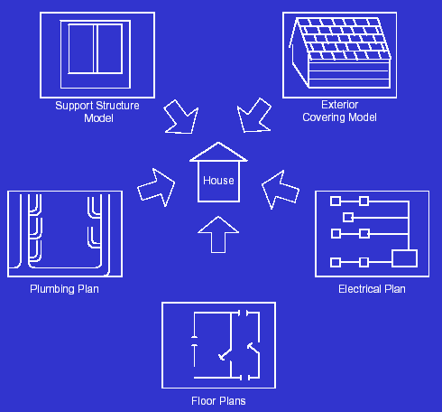
Viewpoints & views
view
view
point

Slide 87
View: Definition (from IEEE 1471)
3.4 Architectural Description (AD): A collection of products to document an architecture.
3.9 View: A representation of a whole system from the perspective of a related set of concerns.
A view may consist of one or more architectural models
Each such architectural model is developed using the methods established by its associated architectural viewpoint.
An architectural model may participate in more than one view.

Slide 88
Architectural view
An architectural view is a simplified description (an abstraction) of a system from a particular perspective/view point, covering particular concerns, and omitting entities that are not relevant to this perspective

Slide 89

Overview - example
Traffic light
has
1..*
Driver
system
stakeholder
has
has
Timeliness
1..*
Safety
concern
Traffic Light
Architecture
architecture
is covered by
Timing-
viewpoint
1..*
viewpoint
described by
1
conforms to
TLA
Description
is organised by
Timing-
diagrams
establishes
methods for
architectural
description
view
consists of
1..*
model
Notes:
Models may be part of multiple views

Slide 90
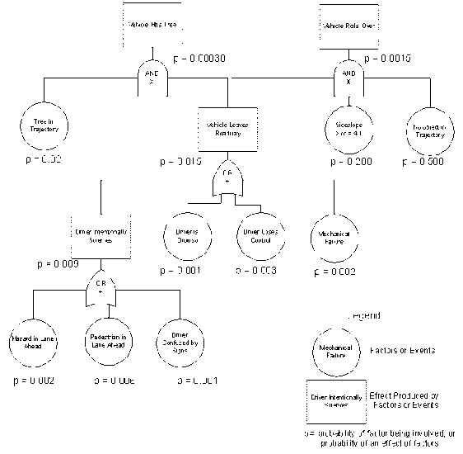
Example (According to IEEE 1471)
has
1..*
Railway safety
Passenger
has
has
1..*
safety
architecture
is covered by
1..*
safety-viewpoint
described by
1
conforms to
Method:
Fault trees
architectural
description
is organised
by
behaviour
structure
deployment
…
consists of
1..*
models
Notes:
Models may be part of multiple views

Slide 91
4+1 Views Model
Borrowed from Grady Booch on architecting
www.rational.com
Approach inspired by 4+1 views model by Kruchten

Slide 92
The 4 + 1 View Model (Kruchten95)
Structure: Component diagrams
Config. Mngnt policies
Structure
view
Development
view
Use case
view
Process
view
Deployment
view
Use case
models
Deployment diagrams
  structure of infrastructure
  rules for mapping of design
  and process view onto infra
Statechart diagrams (intra)
Interaction diagrams (inter)

Slide 93
4+1 Views Representation of System Architecture
What can/does the system do ?
How is the system structured?
How to build / configure ?
Structure View
Development View
System Architect
End-user
Programmers
Configuration management
Functionality (Decomposition)
Use Case View
How does the system behave?
Where to install ?
What hw\nw is used?
Process View
Deployment View
System Architect
System engineering
System topology
Delivery, installation, maintenance
Performance, Scalability, Throughput
Concurrency, Communication,
Synchronization
How does the system perform ?

Slide 94
Example 4+1 Views model
Structure view: components, packages, interfaces
Development view
file ownership
Config. Mngnt view
versioning policies
…
A
B
Stakeholders &
Use cases view
C
D
Behaviour view:
MSC, state-diagrams
Deployment view:
physical model + mapping
A
B
C
D
A
C
D
B
TCP/IP over Ethernet
BC/WC e2e-response times, freq.
bandwidth, availability

Slide 95
What is a subsystem/component?
Sub-system models is a logical grouping of functionality into a coherent subsystems
  Operate on the same data
  Perform functions that belong to the same responsibility

Slide 96
Multiple diagram types per View
4+1 View Model
(Philippe Kruchten)
Logical View
Process View
Deployment View
Development View
Scenario View
Unified Modeling Language
UML is de-facto industry standard
Component, Class diagram
Use Case diagram
Object diagram
State-chart diagram
Sequence diagram
Collaboration diagram
Activity diagram
Deployment diagram
Multiple diagram types may be used in one view

Slide 97
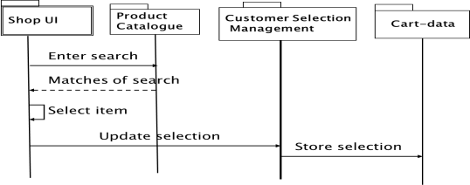
Relation Between Models
UI
S
DBA
DBB
1: register
DB
2:search
UI
T
DBA
DBB
customer
S
UI
S
DBB
DBA
3:pay items
in cart
UI
UI
S
T
DBA
DBB

Slide 98
Show example

Slide 99
4 + 1: Logical Viewpoint
The logical viewpoint supports the functional requirements, i.e., the services the system should provide to its end users.
Typically, it shows the key abstractions (e.g., classes and interactions amongst them).
Notes:
The logical view primarily supports the functional requirements; the services the system should provide to its end users.It depicts the major design elements and their interaction.
Designers decompose the system into a set of key abstractions, taken mainly from the problem domain. These abstractions are objects or object classes that exploit the principles of abstraction, encapsulation, and inheritance. In addition to aiding functional analysis, decomposition identifies mechanisms and design elements that are common across the system.
Components are related by “shares data with”
In termen van het boek is dit een module view

Slide 100
4 + 1: Process Viewpoint
Addresses concurrent aspects at runtime (tasks, threads, processes and their interactions)
It takes into account some nonfunctional requirements, such as performance, system availability, concurrency and distribution, system integrity, and fault-tolerance.
Notes:
The process view takes into account some nonfunctional requirements, such as performance and system availability. It addresses concurrency and distribution, system integrity, and fault-tolerance. The process view also specifies which thread of control executes each operation of each class identified in the logical view.
So the process view describes the mapping of functions to runtime elements. It concenrs the dynamics of the system. A process is a group of tasks which form a logical unit. A process can be started, stopped, resumed, etc., and there is communication between processes.
Components are related by “synchronizes with”
In termen van het boek: een C&C view

Slide 101
4 + 1: Deployment Viewpoint
The deployment viewpoint defines how the various elements identified in the logical, process, and implementation viewpoints-networks, processes, tasks, and objects-must be mapped onto the various nodes.
It takes into account the system's nonfunctional requirements such as system availability, reliability (fault-tolerance), performance (throughput), and scalability.
Notes:
The physical view takes into account the system's nonfunctional requirements such as system availability, reliability (fault-tolerance), performance (throughput), and scalability. The software executes on a network of computers (the processing nodes). The various elements identified in the logical, process, and development views-networks, processes, tasks, and objects-must be mapped onto the various nodes. Several different physical configurations will be used-some for development and testing, others for system deployment at various sites or for different customers. The mapping of the software to the nodes must therefore be highly flexible and have a minimal impact on the source code itself.
Components are related by “communicates with”
In termen van het boek: een allocation view

Slide 102
4 + 1: Implementation Viewpoint
The imlementation viewpoint focuses on the organization of the actual software modules in the software-development environment.
The software is packaged in small chunks-program libraries or subsystems-that can be developed by one or more developers.
Notes:
The development view focuses on the organization of the actual software modules in the software-development environment. The software is packaged in small chunks-program libraries or subsystems-that can be developed by one or more developers. The subsystems are organized in a hierarchy of layers, each layer providing a narrow and well-defined interface to the layers above it.
Components are related by “is submodule of”.
In termen van het boek: een allocation view

Slide 103
4 + 1: Scenario Viewpoint
The scenario viewpoint consists of a small subset of important scenarios (e.g., use cases) to show that the elements of the four viewpoints work together seamlessly.
This viewpoint is redundant with the other ones (hence the "+1"), but it plays two critical roles:
  it acts as a driver to help designers discover architectural elements during the architecture design;
  it validates and illustrates the architecture design, both on paper and as the starting point for the tests of an architectural prototype.
Notes:
The scenario view consists of a small subset of important scenarios-instances of use cases-to show that the elements of the four views work together seamlessly. For each scenario, we describe the corresponding scripts (sequences of interactions between objects and between processes). This view is redundant with the other ones (hence the "+1"), but it plays two critical roles:
it acts as a driver to help designers discover architectural elements during the architecture design;
it validates and illustrates the architecture design, both on paper and as the starting point for the tests of an architectural prototype.
The scenario view is important for stakeholder communication.

Slide 104
Discussion
Why should we use different diagrams?
Why should we use different views?

Slide 105
Summary - 1
Software architecture:
  enables and encourages communication among stakeholders
  captures early design decisions
  acts as a transferable abstraction of a system
  defines constraints on implementation
  drives a system’s quality attributes
  is analyzable and a vehicle for predicting system qualities
  makes it easier to reason about and manage change
  helps in prototyping
  dictates organizational structure
  enables more accurate cost and schedule estimates

Slide 106
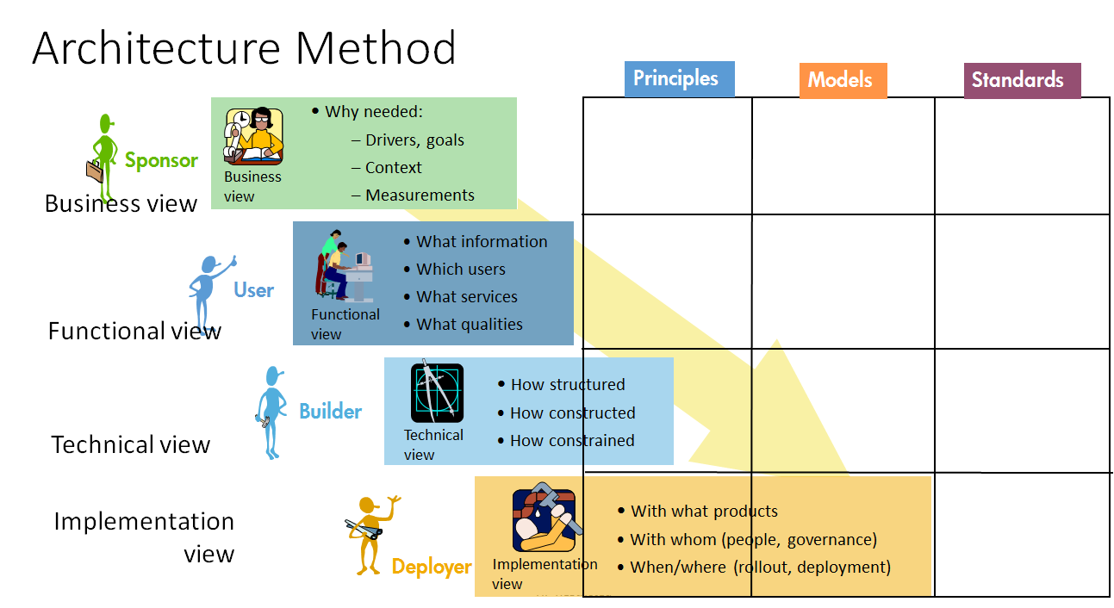
Domain
Solution Design view
Solution Construction view

Slide 107
Summary
Architecture Design process
  Iterative
  Feedback early and often
Architecture Description
  Multiple concerns => multiple views (e.g. 4 + 1)
  Include Design Rationale
Notes:
Additional problems:
Common definitions and terminology
What architectural descriptions need the various stakeholders?
What are suitable orthogonal design dimension?
Derivation of these descriptions from a common framework?
Criteria for the assessment of the quality and performance of IT-Architectures?
To what extent are object-orientation and formal methods useful?
When does a project requires a major architecting effort
and what is a suitable architecting process?
How to deal with the product-process interdependence?
How to manage the architecting function in an organization?

Slide 108
Summary
Experience is the hardest kind of teacher.
It gives the test first and the lesson afterward.
Susan Ruth, 1993
Software Architecture is a critical aspect in the design and development of software
We discussed definitions and objectives of Sw.Arch.
Good architectural design requires human creativity, hard work, and a critical attitude.
Notes:
Additional problems:
Common definitions and terminology
What architectural descriptions need the various stakeholders?
What are suitable orthogonal design dimension?
Derivation of these descriptions from a common framework?
Criteria for the assessment of the quality and performance of IT-Architectures?
To what extent are object-orientation and formal methods useful?
When does a project requires a major architecting effort
and what is a suitable architecting process?
How to deal with the product-process interdependence?
How to manage the architecting function in an organization?

Slide 109
Monitor the Implementation

Slide 110
AgriEngineering 2019, 1(3), 453-474; https://doi.org/10.3390/agriengineering1030033
Development of User-Integrated Semi-Autonomous Lawn Mowing Systems: A Systems Engineering Perspective and Proposed Architecture by Albert E. Patterson,Yang Yuan and William R. Norris

