Slide 1
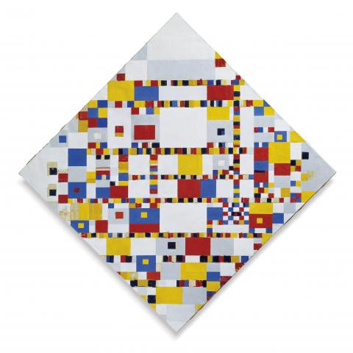
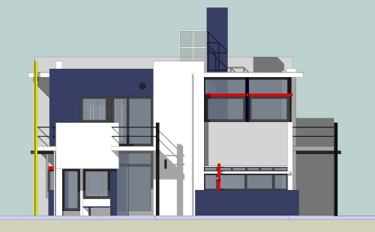
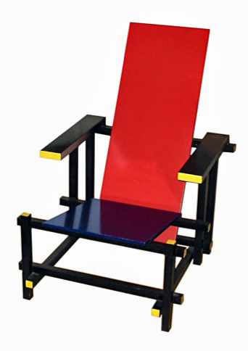
Architectural Styles
M.R.V. Chaudron
https://en.wikipedia.org/wiki/De_Stijl

Slide 2
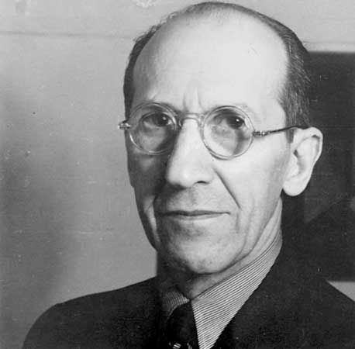
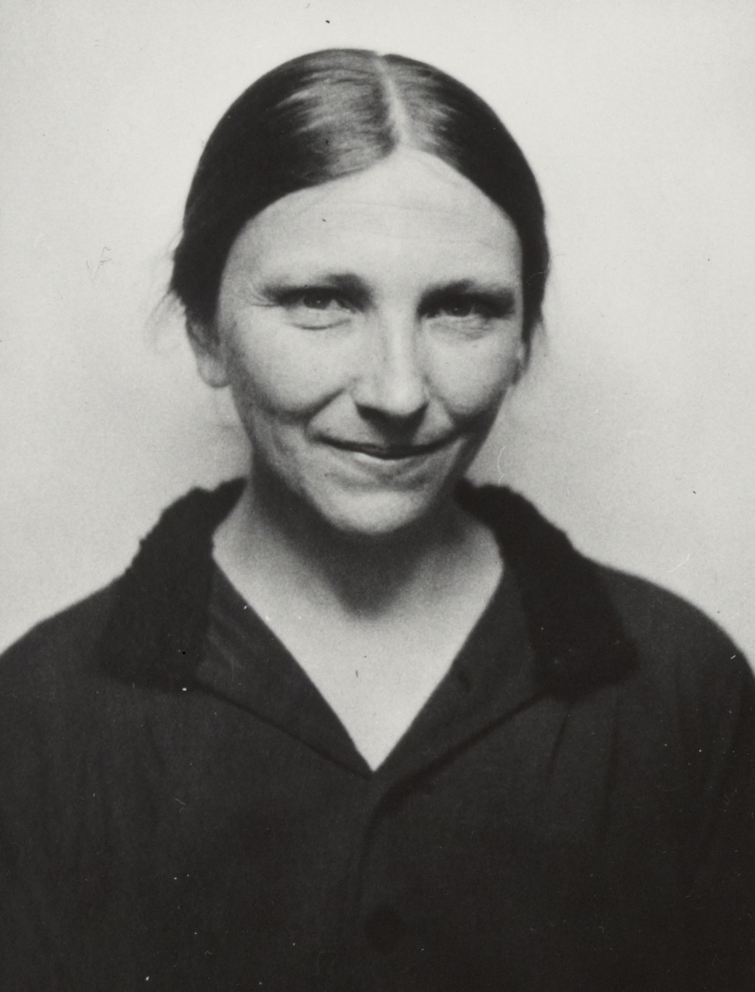
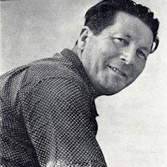
Architectural Styles
M.R.V. Chaudron
Piet Mondriaan
Truus Schröder-Schräder
Gerrit Rietveld
Notes:
Gerrit Rietveld (1888 – 1964)
For Truus Schröder, the Rietveld Schröder House was a declaration of how an independent modern woman intended to live her life.^{[2][}

Slide 3
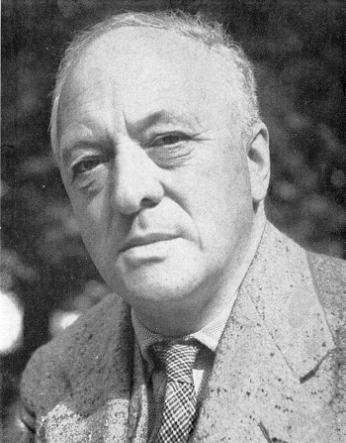
Bart van der Leck
(1876 – 1958)
Composition no. 4, Uitgaan van de fabriek, 1917

Slide 4
Which ‘Rules’ Define this style?
Notes:
Shape: must be rectangular
Colour: must be either white, black or (primary) red, yellow or blue.
Orientation: horizontal or vertically aligned

Slide 5
Schedule
Week |  | Date | Time | Lecture | Reading | Note
4 | L1/S1 | 22 JAN | 10:15 – 12:00 | Introduction, Objectives & Organization
4 | L2 | 23 JAN | 13:15 – 15:-00 | Architecting Process & Architecture Views | Ch 1 & 2
5 |  | 28 JAN | 10:15 – 12:00 | Skip
5 | S2 | 29 JAN | 10:15 - 12:00 | << Supervision: Launch Assignment 1>> | Ch 3 & 4
5 |  | 30 JAN | 13:00 – 15:00 | Skip
6 | L3 | 3 FEB | 13:15 – 15:00 | Design Principles (Maintainability, Modifiability) | Ch 7
6 | S3 | 5 FEB | 10:15 – 12:00 | << Supervision/Assignment>>
6 | L4 | 6 FEB | 13:15 – 15:00 | Architectural Styles 1 | Ch 13
7 | L5 | 10 FEB | 13:15 – 15:00 | Technical Debt |  | Terese
7 | S4 | 12 FEB | 10:15 – 12:00 | << Supervision/Assignment>>
7 | L6 | 13 FEB | 10:15 – 12:00 | Architectural Styles 2 | Ch 13
8 | L7 | 17 FEB | 13:15 – 15:00 | Performance – Analysis & Tactics | Ch 8 + paper
8 | S5 | 19 FEB | 10:15 – 12:00 | << Supervision/Assignment>>
8 | L8 | 20 FEB | 10:15 – 12:00 | Reliability, Availability, Fault Tolerance | Ch 5, 14 + paper
9 | L9 | 24 FEB | 13:15 – 15:00 | Anders Alminger - Volvo
9 | S6 | 26 FEB | 10:15 – 12:00 | << Supervision/Assignment>>
9 | L10 | 27 FEB | 13:15 – 15:00 | Architecture Evaluation | Ch 21 | Rodi PhD
10 | L11 | 2 MAR | 13:15 – 15:00 | Reverse Engineering & Correspondence | Ch 20
10 | S7 | 4 MAR | 10:15 – 12:00 | << Supervision/Assignment>>
10 | L12 | 5 MAR | 13:15 – 15:00 | Guest Lecture 2

Slide 6
Assignment Schedule
Week |  | Date | Lecture | Assignment1 | Assignment2
4 | L1/S1 | 22 JAN | Introduction, Objectives & Organization | Form groups & read Ass 1
4 | L2 | 23 JAN | Architecting Process & Architecture Views
5 |  | 28 JAN | Skip
5 | S2 | 29 JAN | << Supervision: Launch Assignment 1>> | Work & TA feedback
5 |  | 30 JAN | Skip
6 | L3 | 3 FEB | Architectural Styles 1
6 | S3 | 5 FEB | << Supervision/Assignment>> | Hand-in draft of Ass 1
6 | L4 | 6 FEB | Architectural Styles 2 | (perform peer review)
7 | L5 | 10 FEB | Technical Debt
7 | S4 | 12 FEB | << Supervision/Assignment>> | Deadline peer review Ass 1 | Start Assignment 2
7 | L6 | 13 FEB | Performance – Analysis & Tactics
8 | L7 | 17 FEB | Design Principles (Maintainability, Modifiability)
8 | S5 | 19 FEB | << Supervision/Assignment>> | Work & TA feedback | Work & TA feedback
8 | L8 | 20 FEB | Reliability, Availability, Fault Tolerance
8 |  | 21 FEB |  |  | Hand-in Ass 2
9 | L9 | 24 FEB | Guest Lecture 1 |  | Deadline peer review Ass 2
9 | S6 | 26 FEB | << Supervision/Assignment>> | Work & TA feedback | Revise Ass 2
9 | L10 | 27 FEB | Architecture Evaluation
10 | L11 | 2 MAR | Reverse Engineering & Correspondence |  | Deadline Ass 2
10 | S7 | 4 MAR | << Supervision/Assignment>> | Deadline Ass 1
10 | L12 | 5 MAR | Guest Lecture 2

Slide 7
To Do:
Add slides on risk (management)

Slide 8
Learning Objectives of this lecture
The task of the architect is to come up
with a good metaphor for the system
Alexander Ran (Nokia)
Understand functional decomposition as design approach
Build vocabulary of architectural styles
a set of ‘archetypes’ that are often used
know their relative strengths and weaknesses
Today: (at least) Client-Server
Know when to apply or not to apply a particular style

Slide 9
Recap
Forces influence the design of the architecture
Architectural drivers are the forces that dominate the architecture design decisions
Design Principles (KISS, SoC, IH, C&C, Modularity)

Slide 10
Decomposition of Functionality
Notes:
Functional decomposition is helpful prior to creating functional requirements documents. If you need software for something, functional decomposition answers the question "What are the functions this software must provide". Decomposing is needed to define fine-grain functions. "I need software for energy efficiency measurement" is too general. That's why we break this into smaller pieces until the point where we clearly understand all the functions the systems need to provide. This can be later used as a checklist for completeness of a system.
A functional requirements document (FD) is basically a textual representation of functional decomposition. Coding directly from the FD may be ok for procedural languages, but it is not good enough for object-oriented solutions, because it doesn't identify objects. Neither is good for usability planning and testing.
My opinion is that you should take some time to create a FD, but not to use it too much of the time. Consult every person that knows the process you are following with your system to find all the functions needed.
I have a lot of experience in software design, development, and selling, and I use functional decomposition as the first step of development. I use it as a base for the contract, so the client knows what they will get and I know what I must provide.

Slide 11
Subsystems vs Layering
Functional Dimension
(in the ‘problem domain’)
Group Interaction
Ticketing
Payment
Queue Length
Layer 1
Layer 2
Layer 3
Decomposition in the
implementation / technology stack

Slide 12
Subsystems vs Layering
Functional
Dimension
Group Interaction
Ticketing
Payment
Queue Length
Layer 1
UI
Layer 2
Layer 3
DB
Decomposition in the
implementation / technology stack

Slide 13
Radio-Alarm Clock
Identify from subsystems the radio-alarm clock can be built.

Slide 14
Take 4 minutes to write down your ideas

Slide 15
Radio Alarm Clock (initial)
What should be the responsibility of each component?
radio
speaker
clock
buttons
timer
display

Slide 16
Radio Alarm Clock
Naming: aim for generality
audio supplier
audio renderer
music
speaker
time supplier
input handler
clock
input
output handler
timer
output
Alarm time supplier

Slide 17
Radio Alarm Clock
radio
audio supplier
CD
audio renderer
Internet-stream
music
speaker
time supplier
input handler
clock
input
output handler
timer
output
Alarm time supplier

Slide 18
Radio Alarm Clock
A ‘controller’ is an ‘integrator’ of all functionalities
music
speaker
clock
input
timer
output
controller
Notes:
Q: How about electricity? Is that a subsystem?
A: No – that is ‘implementation’ technology.

Slide 19
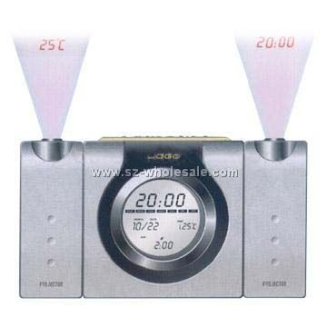
Radio Alarm Clock
Can your design easily accommodate extensions?
Alarm-time
temperature
lamp
Bat-alarm
(wireless) atomic clock
Train strike/traffic delays

Slide 20
Which Design and Why?
Buy Ticket
Book Hotel
Buy Ticket
Book Hotel
Payment
Payment
Payment

Slide 21
Factor out what is common
Buy Ticket
Book Hotel
Payment
Payment-functionality is
a common, generic service
a clear cohesive responsibility
a unit of change

Slide 22
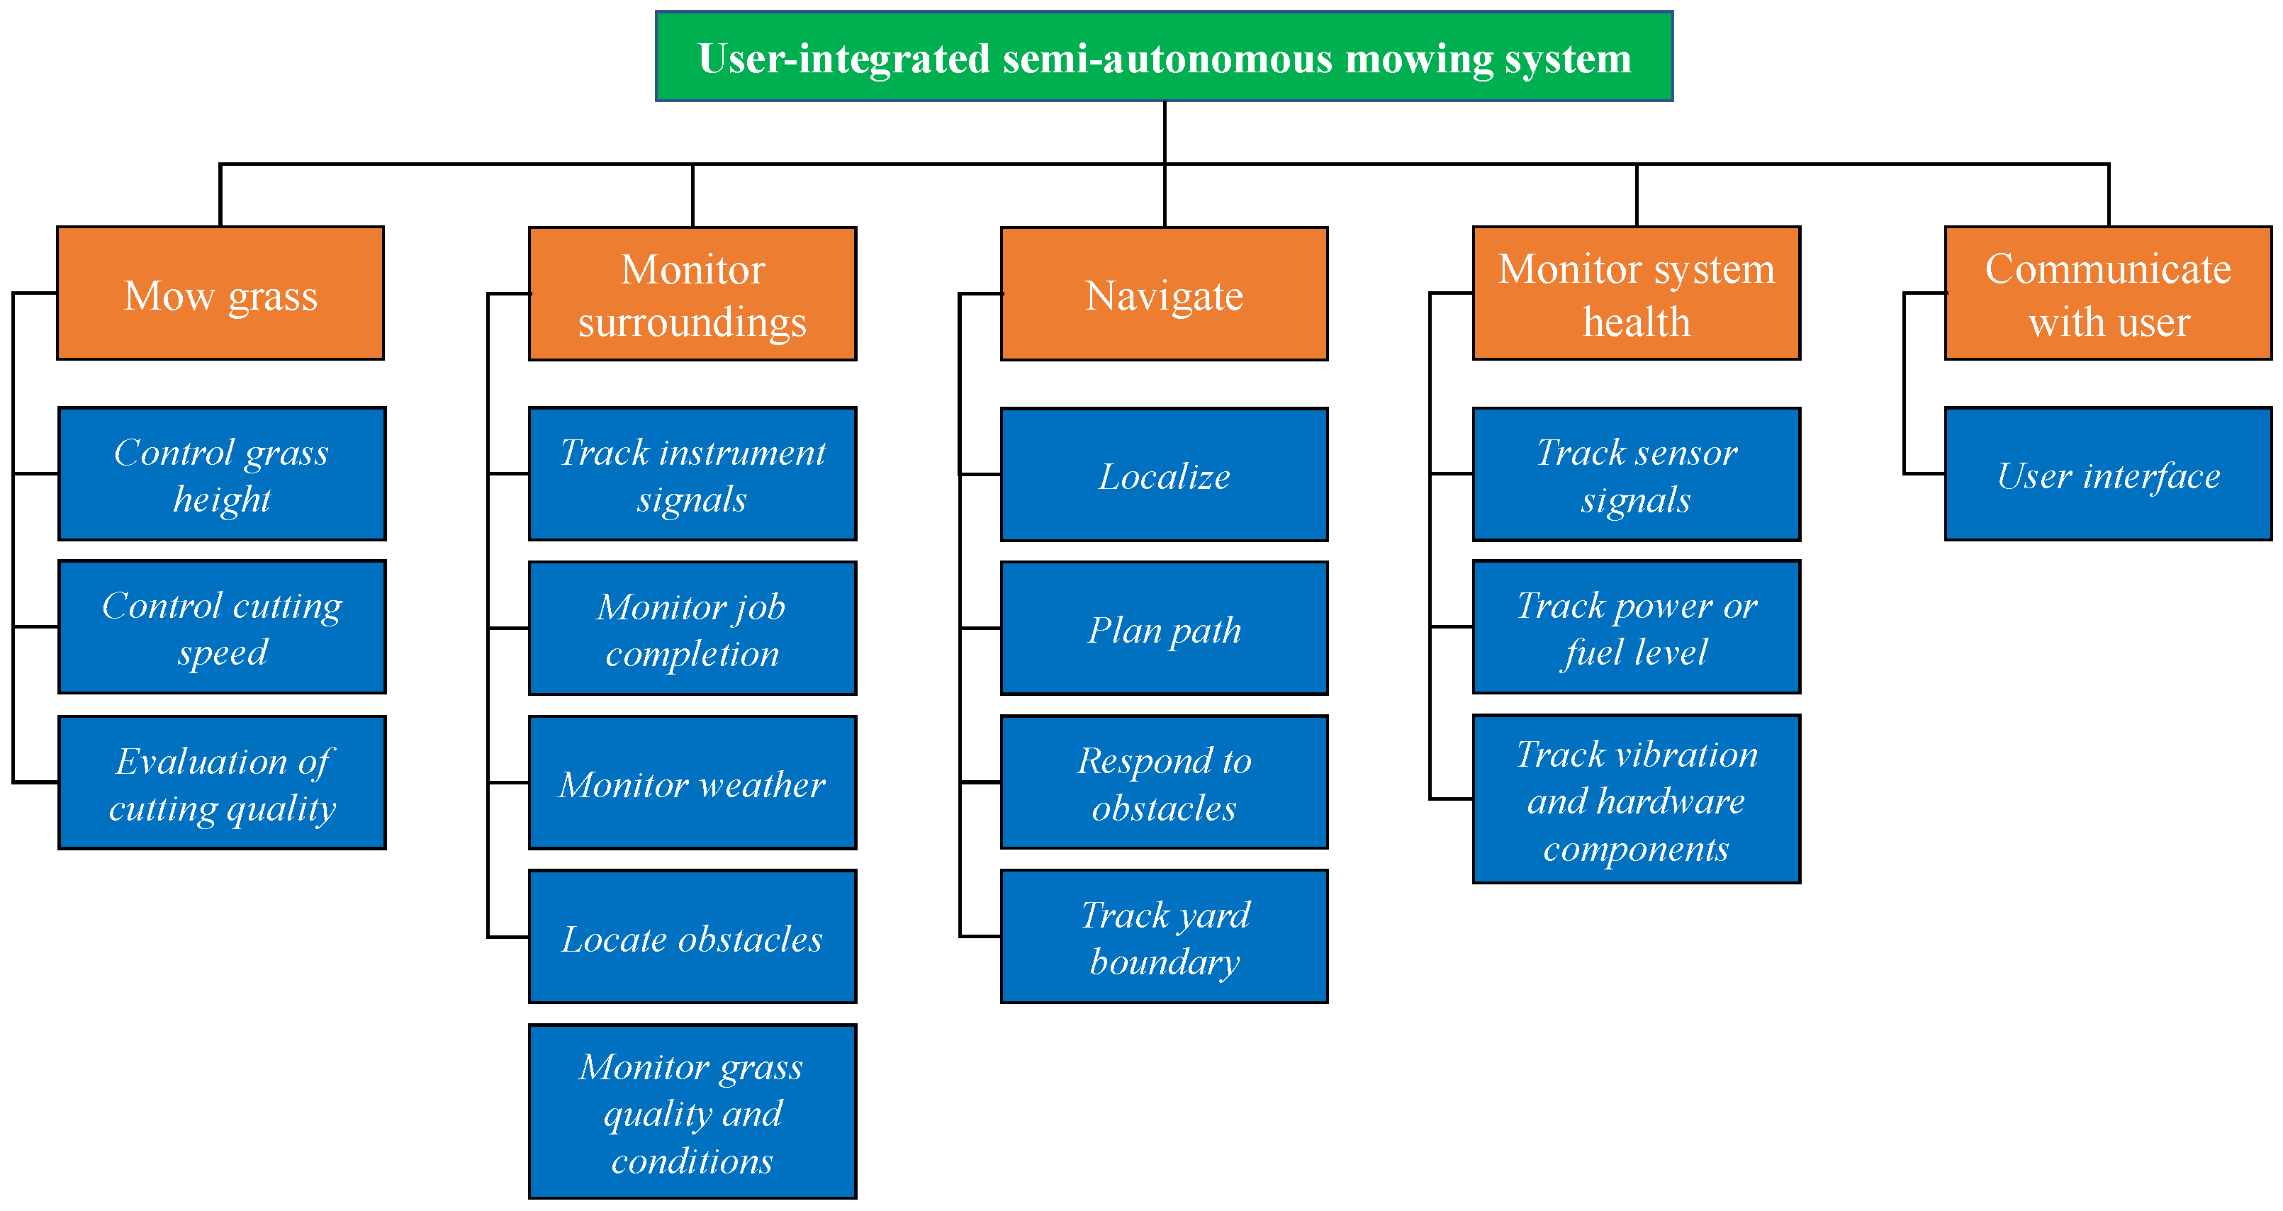
Shows:
Decomposition into main functions of the system
Does not show:
How components are implemented
IT does not show ‘power’ or ‘memory’!
Alt: responsibilities / tasks
Not at this ‘perspective’/abstraction
AgriEngineering 2019, 1(3), 453-474; https://doi.org/10.3390/agriengineering1030033
Development of User-Integrated Semi-Autonomous Lawn Mowing Systems: A Systems Engineering Perspective and Proposed Architecture by Albert E. Patterson,Yang Yuan and William R. Norris

Slide 23
Autonomous Grass Mower Subsystem decomposition
Communicate with User
Driver
Surroundings Monitor
Grass Mower
Health Monitor

Slide 24
Shows:
Sub-functions
AgriEngineering 2019, 1(3), 453-474; https://doi.org/10.3390/agriengineering1030033
Development of User-Integrated Semi-Autonomous Lawn Mowing Systems: A Systems Engineering Perspective and Proposed Architecture by Albert E. Patterson,Yang Yuan and William R. Norris

Slide 25
Autonomous Grass Mower Sub-subsystem decomposition
Communicate with User
Driver
Surroundings Monitor
Localiser
Planner
Grass Mower
Health Monitor

Slide 26
Subsystems vs Layering
Functional Dimension
(in the ‘problem domain’)
Communicate with User
Driver
Surroundings Monitor
Localiser
Planner
Grass Mower
Health Monitor
Layer 1
Layer 2
Layer 3
Decomposition in the
implementation / technology stack

Slide 27
Example Design Case: Web Shop

Slide 28
Example Design Case: Web Shop
register
login
search
add item to
catalogue
add item to cart
remove item
from catalogue
customer
shop owner
remove item from cart
add to stock
pay items in cart
package & ship

Slide 29
Structure/Group Functionality
Defines subsystems of functionality
Purpose
Define decomposition into subsystems
Provide support for use-cases
Think in terms of responsibilities
Use Component diagram

Slide 30
Web Shop: Functional Areas (V0.1)
Customer
Registration
Shop Owner
Registration
Product Catalogue
Maintenance
Payment
Stock Control

Slide 31
Check Use Cases Against Functional Areas
login
Customer
Registration
Shop Owner
Registration
login
register
add item to
catalogue
search
Product Catalogue
Maintenance
remove item
from catalogue
Payment
Stock Control
pay items in cart
add to stock
?
package & ship
add item to cart
remove item from cart

Slide 32
Web Shop: Functional Areas (V0.2)
login
Customer
Registration
Shop Owner
Registration
login
register
add item to
catalogue
Product Catalogue
Maintenance
search
remove item
from catalogue
Payment
Stock Control
pay items in cart
add to stock
Excluded from example
Payment adm
Shop staff salary adm
...
add item to cart
package & ship
Customer Selection
Management
remove item from cart
Notes:
I consider as alternative name for Customer Selection Management to be Customer Session Management

Slide 33
Web Shop: Responsabilities
Customer Registration
Maintain customer accounts
Shop Owner Registration
Maintain staff accounts
Product Catalog Maint.
Maintain product data
Cust. Selection Mngmt.
Maintain customer product selection
Payment
Handle payment between customer, shop & bank
Stock Control
Maintain availability of products in stock

Slide 34
Another Example: Automated Plagiarism Checking System
University can have subscriptions
University-faculty can make accounts
Faculty can send in documents for checking
Documents are turned into a standard internal format
The document is segmented (chapters, section, sentences, …)
Document is compared on a sentence by sentence basis.
A plagiarism score is produced
A report is sent to the person that sent in the document
The system keeps records of use for producing yearly accounting reports
Notes:
Question 4 (2 + 4 + 6 + 6 + 2 = 22 pts) Architectural design
Read the case description below and make and answer the questions below the case description. Motivate for your answers and state your assumptions, and provide explanatory text with your diagrams.
The case study we consider in this question is an automated plagiarism checking tool (APC) for student-assignments. This is a system that teachers of higher level education (universities, polytechnics …) can use to check for plagiarism in the electronic documents that are handed in by students. To this end, universities can have subscriptions to the APC-service. Teaching staff of such universities can then create an account (by registering their e-mail address) with the APC. Teaching staff can use the APC by sending an email with an attachment of a student hand-in to an assignment as attachment. The APC has conversion functionality which it uses to convert a variety of document formats (of the attachments) such as Word (.doc and .docx) as well as open document format (.odf) into pdf-format. The pdf is then ‘segmented’: the segmentation functionality produces a XML-document that contains the main structures of the document (such as title, table of contents, section-header, figure, table, section-text, sentence). Next, the APC system performs an analysis to find out if there are parts of the hand-in that match any parts of any other document that it knows. For this, the APC system has a large repository of previous assignments and published scientific papers and books. This repository is updated automatically with new papers from scientific databases (such as IEEE Explore). For comparing a new hand-in, a reduced version of the XML document of the hand-in is made that only contains significant keywords (thereby omitting non-significant words such as ‘the’ and ‘a’). This step is called ‘pre-processing’. Then, in the actual comparison, each sentence of the reduced hand-in is compared to all sentences of all papers in the repository. Each comparison produces a similarity score. The scores of larger sections of a hand-in are obtained by summing up the scores of the sentences of which it consists. Ultimately, this leads to a plagiarism score for the entire hand-in. The analysis of a hand-in produces a report. This report shows which sentences of the hand-in have a significant ‘plagiarism’-score with which specific documents from the repository. This report is sent by e-mail to the staff member that has submitted the request for analysis. At the end of each month, the APC system sends a management-overview report to the universities that are subscribed. This report describes basis statistics about the number of hand-in’s that have been analysed and from which department and staff-member the hand-in’s were submitted.
Mention 2 architectural drivers for the system (but not cost, schedule or maintainability)
Create a use case diagram for the system that lists the 3 most important use cases for the system
Create a structural view for the architecture of the APC system. In your structural design, you have to infer which subsystems/components are needed in the system. For each component in your architecture, briefly explain its responsibility (aim for 1 sentence).
Create a behavioural view for the system. This view should describe at least the following:
Send a report in response to the request to analyse a hand-in (model the entire scenario starting from the request).
Send a management overview report
Give one example in your architecture design where you used ‘Information Hiding’. Explain your answer.

Slide 35
Decomposition into Subsystems
Report Generator
Comparator
Account Registration
Submission Loader
External Paper Loader
Paper Repository

Slide 36
Where do these sub-subsystems go?
Paper Reporter
Report Generator
Comparator
Account Registration
University Reporting
Compute Score
Submission Loader
Comparator
File Segmenter
External Paper Loader
Paper Repository
File Converter

Slide 37
Report Generator
Comparator
Account Registration
Paper Reporter
Compute Score
University Reporting
Comparator
Submission Loader
File Segmenter
External Paper Loader
Paper Repository
File Converter

Slide 38
Subsystems vs Layering
Functional
Dimension
Report Generator
Comparator
Account Registration
Ppr Reporter
Comp.Score
Univ. Reprting
Comparator
Submission Loader
File Segmenter
External Paper Loader
Paper Repository
File Converter
Layer 1
Layer 2
Layer 3
Abstraction/Implementation
Dimension

Slide 40
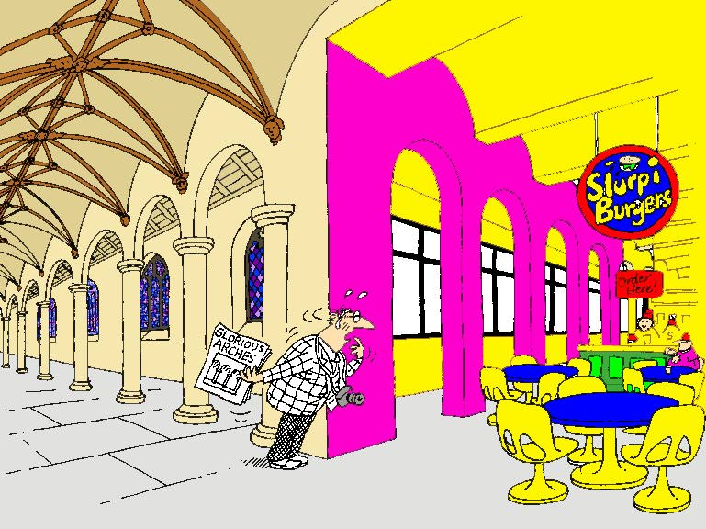
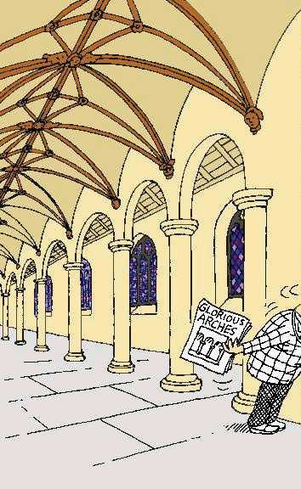
Conceptual integrity counter example!

Slide 41
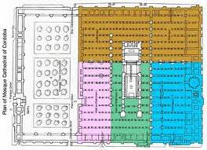
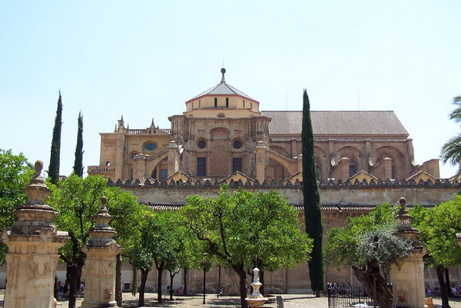
Cordoba, Spain

Slide 42
Conceptual Integrity in Software
Uniformity – where possible
Same solution-approach/tactic/design-principle applied to similar problems
For example in
patterns of communication & control/data-flow
Naming of methods, parameters, variables
Structure of API’s
Layering
Exception-handling
User interface (dialogs)
Harmony
Uniformity

Slide 44
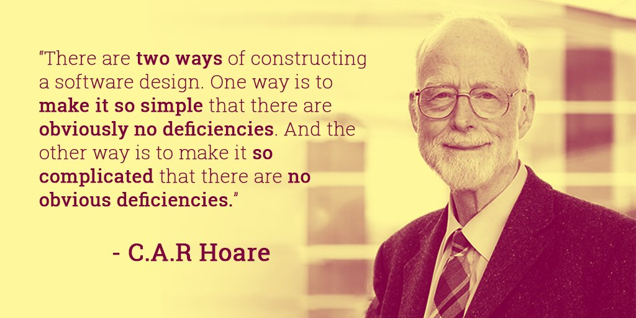

Slide 45
CONTENTS
Introduction
Architectural styles
2.1 Client/Server
2.2 Pipe and Filter style
2.3 Blackboard style
2.4 Publish Subscribe
2.5 Peer-to-Peer
2.6 Layered style
3. Interaction style
4. Conclusions

Slide 46
What is an Architectural Style?
Architectural styles are collections of design conventions for a set of design dimensions
Some architectural styles emphasize different aspects such as:
- Subdivision of functionality,
- topology
- interaction/coordination pattern between
components
An architecture can use several architectural styles
Architectural styles are not disjoint
Styles are open-ended; new styles may emerge

Slide 47
Architectural style 1/2
An architectural style is defined by:
a set of rules and constraints that prescribe
vocabulary/metaphor: which types of components, interfaces & connectors must/may be used in a system. Possibly introducing domain-specific types
structure: how components and connectors may be combined
behaviour: how the system behaves
guidelines: these support the application of the style (how to achieve certain system properties)

Slide 48
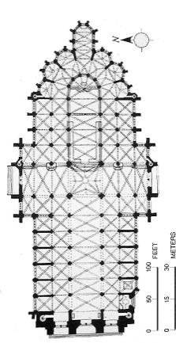
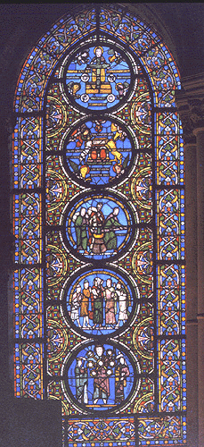
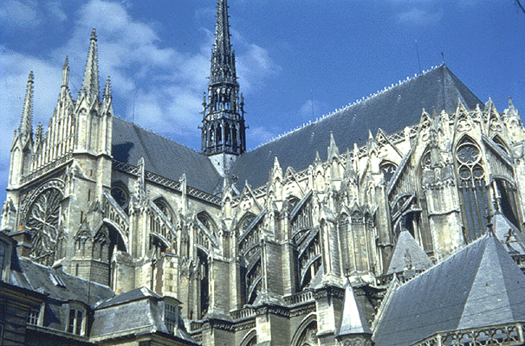
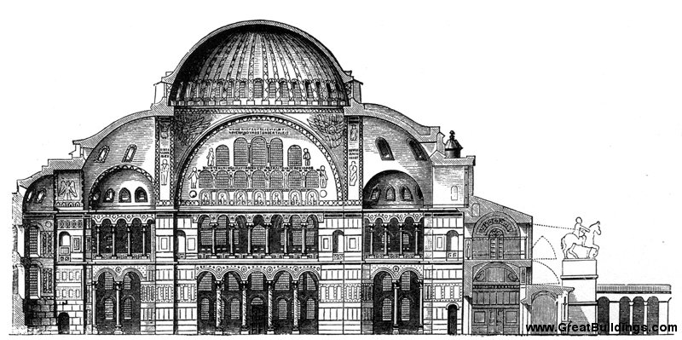
Architectural style
Nomenclature inspired by building architecture;
Buildings: Gothic, Byzantian, ….
Cathedral Amiens
Hagia Sofia, Istanbul
bridges: suspension, arc, … (check your Euro-notes)
http://en.wikipedia.org/wiki/Architectural_style
Notes:
An architectural style can be regarded as a set of constraints on the architectural components and their interaction
http://en.wikipedia.org/wiki/Architectural_style

Slide 49
Architectural style 2/2
An architecture style defines a family of systems in terms of a pattern of structural organization.
An architectural style defines
a vocabulary of components and connector types
a set of constraints on how they can be combined
one or more semantic models that specify how a system’s overall properties can be determined from the properties of its parts

Slide 50
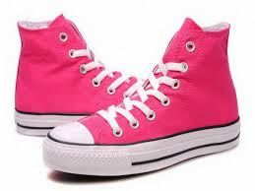
What is a Style?
Coordinated, aligned

Slide 51
Maturing Discipline
Architectural styles are the codification of
common recurring patterns of software design
Codification enables
communication, reuse, comparison
generally useful (generic)
generally easy to get right
generally as good as the alternatives

Slide 52
On Codification of Engineering Knowledge
Engineering is an art/craft, not an engineering discipline.
An engineering discipline encodes knowledge about successful solutions into rules such that ‘normal engineers’ can produce great systems.
Patrick Lardieri, Lockheed Martin MODELS 2007
(based on Shaw & Garlan)

Slide 53
CONTENTS
Introduction
Architectural styles
2.1 Client/Server
2.2 Pipe and Filter style
2.3 Blackboard style
2.4 Publish Subscribe
2.5 Peer-to-Peer
2.6 Layered style
3. Interaction style
4. Conclusions

Slide 54
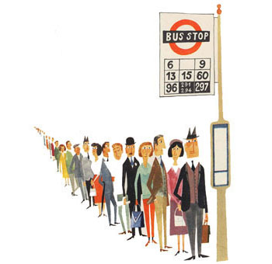
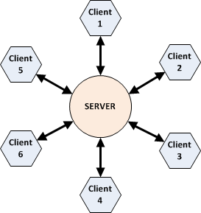
Client-Server Architectures
Nice source:
IT Architectures and Middleware:
Strategies for building Large Integrated Systems,
Chris Britton and Peter Bye, Addison Wesley, 2004

Slide 55
What is Client / Server?
Client: an application that makes requests (to the servers)
and handles input/output with the system environment
Server: an application that services requests from clients
Client/Server System:
an application that is built from clients and servers
Typical application area:
distributed multi-user (business) information systems
In real-life: client instructs/commands the server. Pitfall: keep an eye on (hidden) dependencies
Notes:
I will consider clients and servers to be applications.
It is possible that multiple applications run on a single computer.
In principle, it is possible that a single computer runs both client and server applications (although this is not the typical application).
The Client/Server paradigm is a combination of layering and request-response.

Slide 56
Why Client / Server?
±1980’s
- multiple users want to share and exchange data
- first: attempt: shared file-server
Applications
- problem:
scalability to ±10 due to contention for files and volume of data-transfer
- solution: perform processing on (file) server
files
File server
Notes:
Another force in the evolution:
- mainframe and mini-computers could not handle graphical user interfaces

Slide 57
3-tier Reference Model
presentation
logic
presentation logic ([G]UI):
anything that involves system/user interaction
e.g. dialogs (management), forms, reports
application
logic
data
management
application logic (data processing):
where the functionality of the application
resides / where the actual computation of the
system takes place
interfaces
to OS and network
data management:
storing, retrieving and updating data
Notes:
Essence of the model: separate the functionality in layers, where each layer has a
well-defined, coherent responsability

Slide 58
Client / Server Style
Concept: Separation of application in units of change
Components: presentation,
application logic,
business logic,
data management
Connector: ‘uses’ lower layer
Interaction style: request/response
presentation
logic
client
application
logic
business
logic
data
management
server
Notes:
A virtual machine architecture can empower the user
by defining a high-level language that allows him to express his ideas
in a easily understandable form
In this scenario, the ICT-specialist is not longer responsible
for the application programs
(that execute in a domain that is barely understood by him)
but only for the proper execution platform

Slide 59
Deployment of C/S Model
Rather than having the client do the processing …
Move processing power to server such that the server sends a (condensed) response to request rather than a whole file
presentation
logic
presentation
logic
presentation
logic
application
logic
shared data
application
logic
1 - tier
2 - tier
client
data
management
application
logic
data
management
data
management
server
Notes:
This slide shows various alternatives in the deployment of the layers.
A request is typically a Remote Procedure Call (RPC) or a SQL-query
The server has no user interface (for the application; does have one for maintenance).

Slide 60
C/S Example: Thin Client
Thin Client C/S:
largest part of processing at the server-side
presentation
logic
WWW Browser
application
logic
functional processing
data
management
database storage and access
Network load: low
Config. Mngmnt: simple (only server)
Security: concentrated at server
Robustness: stateless clients => easy fault recovery
Notes:
The (condensed) response of a request is passed over the network.
This incurs a lower network-load than thick-client.

Slide 61
C/S Example: Thick Client
Thick Client: significant processing
at the client-side
presentation
logic
WWW Browser
application
logic
application
(specific)
application
logic
application
(generic)
data
management
database
Network load: high
Config. Mngmnt: complex (both client & server)
Security: complex (both client & server)
Robustness: clients have state => complex fault recovery
Notes:
Here, application logic is divided over the client-platform and the server-platform

Slide 62
Client/Server in terms of Characteristics
Dependencies: client depends on the server
Topology: one or more clients may be connected to a
server there are no connections between clients
Multiplicity: 1-to-1, directed
Synchronicity: synchronous or asynchronous
Mobility: easily supports client mobiliy
Binding: from compile to invocation time
Initiative: request (by client) / response (by server)
Periodicity: typically a-periodic (periodic possible)
Security: typically controlled at server, also possible at application/business layer
Notes:
Ad multiplicity: Middleware (ORBs) are loosening the 1-to-1 directed style
Architectural Style and Interaction Style are introduced later. Briefly explain concepts.

Slide 63
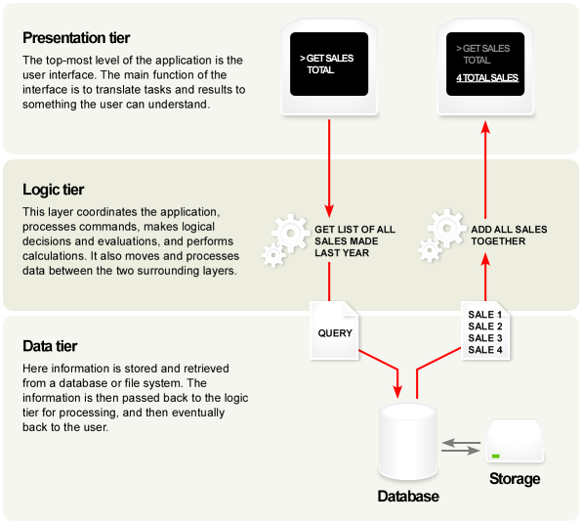
Example 3-tier System
(application)
Diagram from Wikipedia, 2007

Slide 64
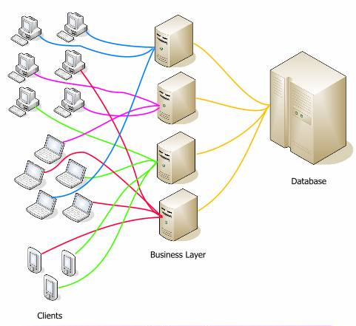
Deployment: Many physical clients and servers

Slide 65
Business Logic Layer
presentation
logic
An even broader organizational scope of sharing and exchanging data requires
coordination across multiple applications and databases
application
logic
The complexity of the middle tier ranges from
reactive with little intelligence
(e.g. resource management and interconnection services)
to active with much intelligence
(active enforcement of global constraints and coordination of
activities across applications e.g. workflow)
business
logic
data
management
Advantage of business logic-tier:
changes to business are localized
(compared to intertwining with application logic)
Notes:
Business logic is sometimes called “domain layer”

Slide 66
Types of business logic
Transaction Processing Manager/Monitor
Handling of transactions
queuing, coordination across multiple DB’s
TP Monitor decouples client-thread from server-thread
=> Increases scalability
Coordination of workflow
Message Queues
Advantages of Business Logic Layer
better scalability of application
security measures can be centrally allocated
separate maintenance of application and business logic

Slide 67
Client / Server Summary
Task are mapped on platform where they are most
efficiently handled
presentation layer on client
data management and storage on a server
possible intermediate platforms for transaction multiplexing and global coordination
With the aim of obtaining
scalability: changing number of clients
interoperability: client may use data from multiple sources

Slide 68
Emergent Interface Technologies
presentation
logic
presentation
logic
HTML, XML
application
logic
application
logic
business
logic
business
logic
ODBC
data
management
data
management
.Net, Corba, EJB
XML, SOAP, RDF
Notes:
Standardisation takes places at the interfaces of the components of the C/S reference model
SOAP: Simple Object Access Protocol
HTML : for application to presentation communication
CORBA/DCOM: standard for inter-application communication
XML : facilitates standard format for data-interchange with semantic information (self-descriptive)
ODBC : standard for database access

Slide 69
Client-Server
Advantages:
centralized data access
higher security
ease of maintenance
scalability (in clients)
interoperability (use of multiple sources)
Limitations:
single point of failure

Slide 70
WWW Sources for C/S
C/S-FAQ:
http://www.faqs.org/faqs/client-server-faq/
C/S info @ Software engineering institute Carnegie Mellon Univ.
http://www.sei.cmu.edu/str/descriptions/clientserver_body.html
Sectie over C/S bij een cursus @ TU Delft
http://www.sepa.tudelft.nl/modulemateriaal/tb141/Comms/inhoud.htm
Middleware (TP, MO-Mw, DB-Mw, Message-brokers and OBJ-brokers) http://www.sdmagazine.com/breakrm/features/s994f2.shtml

Slide 72
Summary Architectural Styles
Every Architect should have a standard set of
architectural styles in his/her repertoire
it is important to understand the essential properties
of each style: when to (not) use them
examples:
C/S, pipe and filters, blackboard, pub/sub, P2P
The choice for a style can make a big difference in
the quality properties of a system
analysis of the differences can provide rational for
choosing a style

Slide 73
CONTENTS
Introduction
Architectural styles
2.1 Client/Server
2.2 Pipe and Filter style
2.3 Blackboard style
2.4 Publish Subscribe
2.5 Peer-to-Peer
2.6 Layered style
3. Interaction style
4. Conclusions

