Slide 1

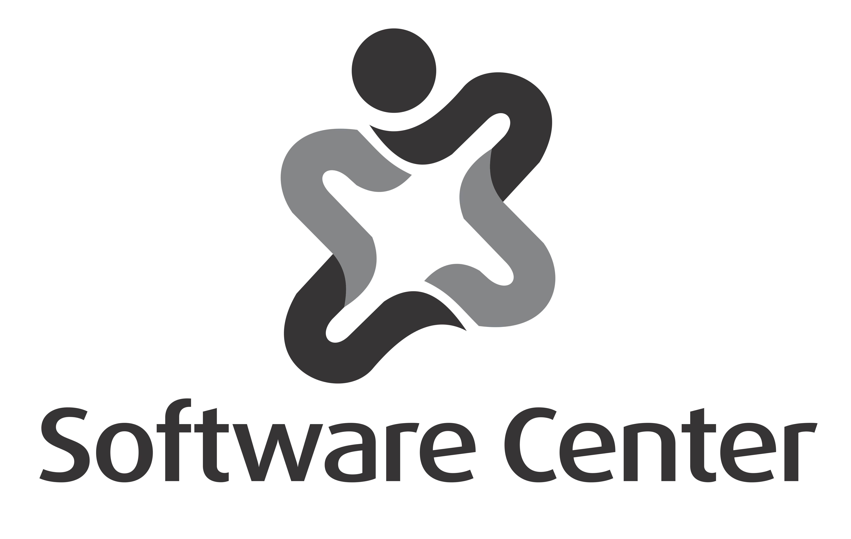
Architectural Technical Debt
Terese Besker
Software Center
Chalmers University of Technology
Gothenburg, Sweden.
www.software-center.se

Slide 2

Today’s excursion
Cleaning in general
Who am I?
What is debt?
What is Technical Debt?
Solutions
Prioritization
Prevention mechanisms
Regulations
The costly Bill of Technical Debt
Architectural Technical Debt
Always a bad thing?
A balancing act

Slide 3


Have you ever…..?

Slide 4

Have you ever deliberately introduced a sub-optimal solution (“quick and dirty” or “cutting some corners”) in order to finish early?

Slide 5

….or maybe you have introduced a sub-optimal solution unconsciously at some point?
Because you didn’t know any better way of doing it or…
it was the most optimal solution at that specific time
Notes:
Work-around solutions
Further, our result also shows that practitioners often develop work-a-round solutions to avoid TD refactoring activities and
thereby to avoid the associated consequences and the need for the additional activities and costs.

Slide 6
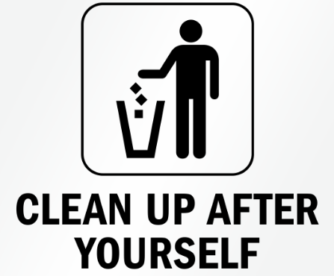
The final question:
Did you ever go back and fixed it?

Slide 7
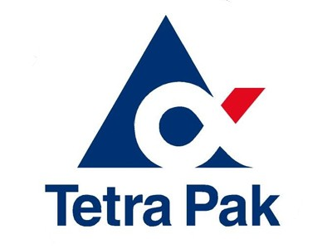

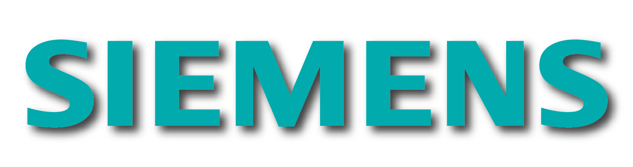
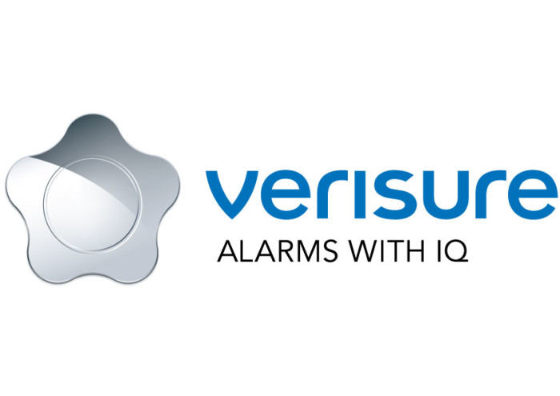









Software Center
Mission: Improve the software engineering capability of the Nordic Software-Intensive industry with an order of magnitude
Theme: Fast, continuous deployment of customer value
Success: Academic excellence
Success: Industrial impact

Slide 8



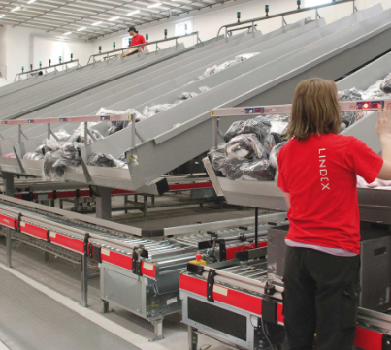
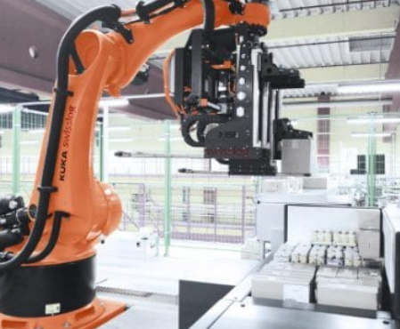
Traceability
Human – Computer
Interaction
Safety and validation
Integration between
different sub systems
Signal processing
Notes:
Embedded software, real time systems
Data management is Important!

Slide 9

A Debt Background
Financial debt:
  Loan
  Debt
  Interest

Slide 10
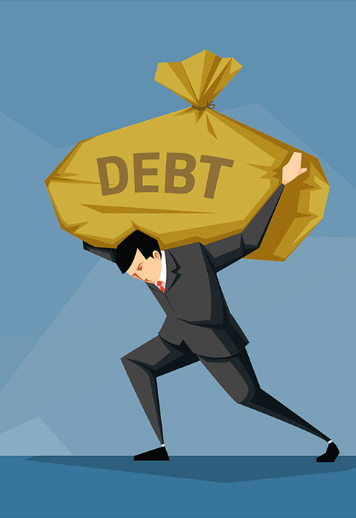
Basically a Debt is….
Borrowing against our capacity of tomorrow to make more progress today

Slide 11
What is
Technical Debt?

Slide 12
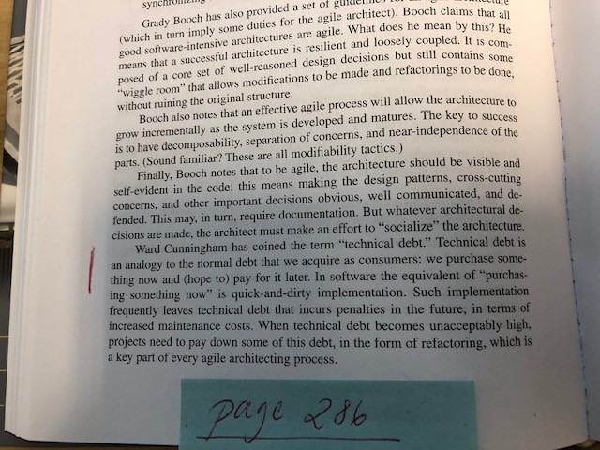

Technical Debt Background

Slide 13
A ordinary day at the software development office
Software Companies need to do:
Customer value
Software companies need to deliver customer value continuously, both from a short- and long-term perspective
Tradeoffs
Software companies need to consider the tradeoffs between the overall quality of the software, and the costs of the software development process in terms of the required time and resources
Efficiency
Software companies need to balance the quality of the software with the ambition of increasing the efficiency and decreasing the costs in each lifecycle phase

Slide 14
And what do we do?
A ordinary day at the software development office:
What Software Companies need to do:
Implement sub-optimal solutions
Deliberately
Deliberately implement sub-optimal solutions in order to shorten the time-to-market or when resources are limited in practice, by implementing “quick fixes” or “cutting corners” during the software development process
Postponed refactoring tasks
Even if the best intention is to go back and refactor the sub-optimal solution immediately afterward, there is a tendency that these refactoring tasks will be postponed since, commonly, there are other important deadlines in the near future, where these refactoring tasks are often down-prioritized
Implement sub-optimal solutions
Unintentionally
There is also the scenario where sub-optimal solutions are implemented unintentionally, due to a lack of knowledge, guidelines or best practices.

Slide 15

Eavesdropping at the office
Let’s finish the testing in the next release*
Let’s just copy and paste this part*
We don’t have time to reconcile these two databases right now, lets use some glue code and we can fix it later
Lets do a quick and dirty solution now, and we can have a look at this in next sprint(s)
* R. K. Gupta, P. Manikreddy, S. Naik, and K. Arya, “Pragmatic Approach for Managing Technical Debt in Legacy Software Project,” in Proceedings of the 9th India Software Engineering Conference, Goa, India, 2016, pp. 170-176.

Slide 16

"Shipping first time code is like going into debt”
“A little debt speeds development so long as it is paid back promptly with a rewrite…”
“Every minute spent on not-quite-right code counts as interest on that debt”
Ward Cunningham
Notes:
How it all started – the history behind the concept
Same guy who evented Wikipedia as well.

Slide 17
Why the Technical Debt metaphor?
Helps business staff to understand and make technical decisions
Helps technical staff to understand financial consequences of technical decisions, and argue for e.g. the need for refactoring

Slide 18
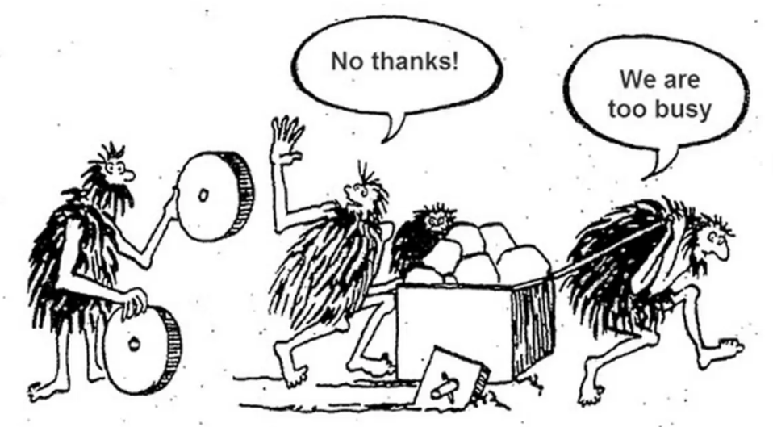
Technical Debt is sub-optimal solutions, not bugs, and not yet implemented features
Notes:
What is a sub-optimal solution and what is it NOT

Slide 19
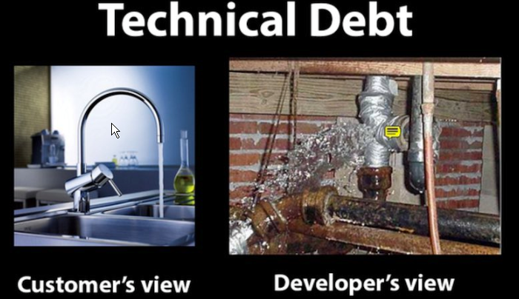

Slide 20
Technical Debt, Features, Defects, etc.
Visible
Invisible
New Features
Added Functionality
Architectural, Structural Features
Positive Value
Defects
Technical Debt
Negative Value
P. Kruchten, R. L. Nord, and I. Ozkaya, “Technical Debt: From Metaphor to Theory and Practice,” IEEE Software
Notes:
To better understand what TD is, lets look at the quadrants or software ingredients

Slide 21
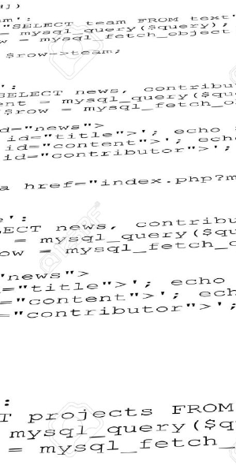
Examples of
Technical Debt
Poor code quality
Poor or inappropriate Architecture of the software
Lack of following guidelines
Lack of documentation
Lack of testing
… and so on

Slide 22


The Bill: Software related Interest
- it is not technical debt if you don’t pay any interest
Working around or fixing existing errors
Extra effort spent on understanding complex code
Baby-sitting tasks that could be automated

Slide 23

Worst case scenarios
Impede innovation and expansion of your software systems
Stifle an whole organization’s ability to innovate
Negative effect on available resources to implement new technology
Time consuming maintenance
Lower the productivity
Lower the morale
In the long run, it can lead to a system crisis
Notes:
What happens when you allow TD to grow in the system?

Slide 24
Examples of Vicious circles
Lower the software developer productivity
Less time for implementing new features and do refactorings
Running late and behind schedule
Take on Technical Debt, both deliberate or undeliberate
Postpone refactoring = still having Technical Debt in the software
Notes:
Here is an example illustrating how TD can grow in the software and what can happen…

Slide 25

Suddenly, you reach a point when you have to take a step back and reflect on where you are going

Slide 26

Solutions…
Refactoring – to optimize (and clean) the software without impacting the user experience or functionality
Continuous process of refactoring initiatives
Refactoring is crucial to prevent spiraling technical debt
Notes:
Do everybody know what refactoring is?

Slide 27

Remediation of
Technical Debt
The only significantly effective way of reducing TD, is to refactor it
Refactoring activities of the identified TD items needs to be prioritized
Competing with for example implementation of new features
Besker, T., et al. (2019). Technical debt triage in backlog management. Proceedings of the Second International Conference on Technical Debt. Montreal, Quebec, Canada, IEEE Press: 13-22.
Notes:
When TD is present in the software, the only significantly effective way of reducing it is to refactor it.
However, to be refactored, the refactoring activities of the identified TD items needs to be prioritized in competition with, for example, implementation of new features.
The goal of this study is to explore how the prioritization of technical debt is carried out by practitioners within today’s software industry.

Slide 28
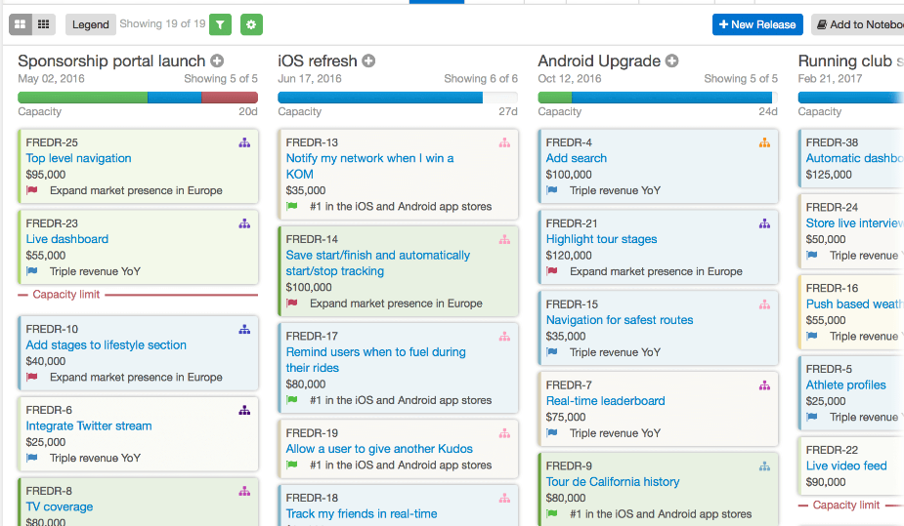
The Agile Backlog

Slide 29
The presence of Technical Debt items in backlogs?
Does the Prioritization process of the backlog also include the prioritization of Technical Debt?
Technical Debt issues – not in same Backlog as Features and Bug fixes
Technical Debt issues – in a “shadow “ backlog
Fixed amount of time in each sprint allocated for improvement, which includes TD, however no follow-up on time spent
Besker, T., et al. (2019). Technical debt triage in backlog management. Proceedings of the Second International Conference on Technical Debt. Montreal, Quebec, Canada, IEEE Press: 13-22.
Notes:
a starting point of our findings shows that TD items commonly are not present in the main sprint backlog; they are often documented in quite ad-hoc managed shadow backlogs.
unofficial “shadow” - This shadow backlog was described as “A shadow outside as one tries to catch up and drive aside.” Reason for having these shadows was mainly because the companies did not support an official representation of TD in the backlogs.
Allocation of refactoring was done as setting aside a full or partial sprint only focusing on improvements from the backlog allocating 15% of the time in each sprint for improvement work where the developers are specifically encouraged to refactor items from their shadow backlogs. BUT : that there is no obligation to spend the time.

Slide 30
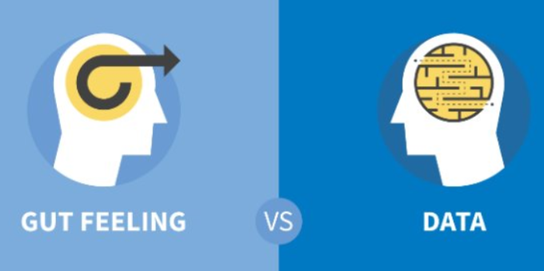
Supporting frameworks or Gut Feelings?
Company commonly does not use any guiding Decision Making Frameworks
Gut feeling is not an add-hoc approach:
Prior experience
Acquired knowledge
Instinct or emotion
Roadmap of future features
……
“In my experience, it’s usually the most experienced guy that has the biggest impact [when prioritizing TD]. We don’t actually need a big consensus among the participants.”
Notes:
Citations show that The prioritization process was described to be heavily influenced by the different participants’ roles and their empowerment to make decisions during these meetings.
Our result shows that the decisions based on gut feeling are far from being taken on an ad hoc basis without any firm strategy.

Slide 31
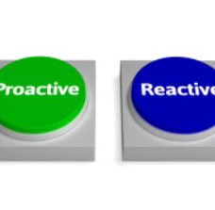
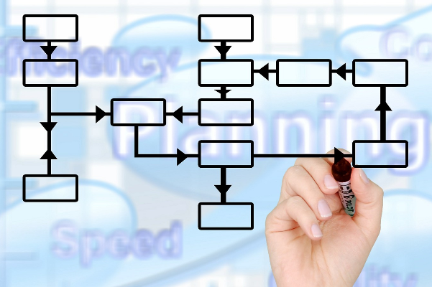
A reactive or proactive approach
The prioritization of TD in the backlog is much more of a reactive then a proactive approach
Estimating the value of doing refactoring of Technical Debt, is considered to be difficult
92 % states that the Technical Debt’s negative effects could be reduced, if they did the prioritization of their Backlog differently
Besker, T., et al. (2019). Technical debt triage in backlog management. Proceedings of the Second International Conference on Technical Debt. Montreal, Quebec, Canada, IEEE Press: 13-22.

Slide 32
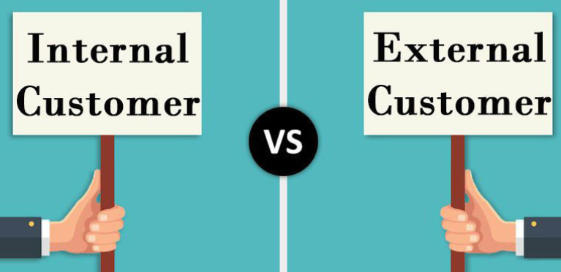
TD refactoring competition with customer requirements
92 % states that the Technical Debt’s negative effects could be reduced, if they did the prioritization of their Backlog differently
Besker, T., et al. (2019). Technical debt triage in backlog management. Proceedings of the Second International Conference on Technical Debt. Montreal, Quebec, Canada, IEEE Press: 13-22.
Notes:
Pressure of delivering customer value and meeting delivery deadlines forces the software teams to down-prioritize TD refactorings continuously in favor of implementing new features rapidly.
this pressure depends largely on whether the user of the software is an internal or external customer. : If the user is an internal customer, the pressure is much lower than if the user is an
external customer.

Slide 33


Refactoring contra
Prevention
Besides continuously refactoring activities we also need to prevent introducing Technical Debt from the very beginning
Notes:
So far we have mainly focused on removing TD when we have it…but…

Slide 34

TD prevention……prevents potential TD from being incurred, in the first place
Commonly TD Prevention is "cheaper" than TD repayment
There is no tool for TD prevention - > Development Process Improvement
Notes:
It is better and cheaper for the development team to invest in debt prevention early rather than incur debt and pay it off later.
There is no tool for TD prevention. The potential reason is that TD prevention can be supported mainly by software development process improvement.

Slide 35
TD prevention – from a Change Management perspective
TD Prevention
1
2
3
4
5
6
7
8
Identification
Set the Targets
Communication
Revise
Explanation
Provide Resources
Change in mindset
Celebrate Success
Notes:
This is a quite classical change management process describing how a company can implenet a new culture with a focus on preventing taking on TD in the first place

Slide 36
TD prevention (1/2)
Identify what need to be improved
coding standards
code reviews
definition of done
architectural structure (e.g. Monolithic or Micro Services)
Explain the cost and nature of debt to developers architect, PO, PM etc.
Debt awareness is best among the methods of debt prevention
Harmfulness today and in future (predicting growth of interest costs)
Productivity increase
Feel more confident (developers pride) and attract the “best” developers
Set the Targets (clear steps with measurable targets e.g. wasted time)
Provide Resources (tools such as AnaConDebt, SonarQube, Arcan, education etc. )

Slide 37
TD prevention (2/2)
Communication
Change in mindset
Manage resistance and cultivate a culture
Celebrate Success
Recognizing milestone achievements
Encouragement
Review, Revise and Continuously Improve

Slide 38

Can regulations stop us from introducing TD in the first place?
The relationship between safety-critical software (SCS)
regulations and the management of TD
Notes:
Just for fun: what happens with TD when we have for instance SCS? Is regulation the way forward?

Slide 39
Examples of regulatory certification processes
SCS are heavily regulated
SCS require certiﬁcation against industry standards
Recertified to ensure compliance with the present safety standards.
E.g. after a refactoring activity of software:
retested
revalidated
reverified
Cost and time-consuming – risk of being down-prioritized or avoided -> more TD
Besker, T., et al. (2018). How Regulations of Safety-Critical Software Affect Technical Debt. 2019, SEAA
Notes:
This means that these software applications are required to pass a regulatory certification process prior to being placed on the market.
This recertification process requires several extra activities compared to non-SCS, and this process is
commonly a very cost- and time-consuming practice. Thus there is a significant potential risk of TD refactoring
initiatives being down-prioritized or even proactively avoided with the negative consequence of an increasing and
alarming amount of TD in the SCS.

Slide 40

Consequences and Effects of SCS Regulations when Conducting or Planning for TD Refactoring Activities
TD refactoring activities are commonly deliberately avoided
Besker, T., et al. (2018). How Regulations of Safety-Critical Software Affect Technical Debt. 2019, SEAA
Notes:
Yet another consequence is the Avoidance of refactoring activities
As a result of the mentioned consequences of performing TD refactoring, we see that due to extra activities, TD refactoring activities are commonly deliberately avoided with the result of an increasing amount of TD in the software.

Slide 41
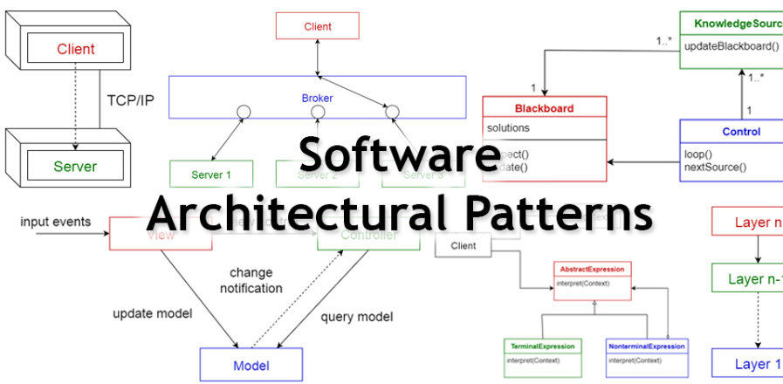
Software Architectural Structures
Contributing to TD Refactoring
Components can have different levels of safety regulations, which defines the refactoring scope
The importance of a software architecture that facilitates refactoring with as little effort and cost as possible
Examples of different architectural structures; component-based, pipes and filters, monolithic, and layered structures
Besker, T., et al. (2018). How Regulations of Safety-Critical Software Affect Technical Debt. 2019, SEAA
Notes:
Work-around solutions
Further, our result also shows that practitioners often develop work-a-round solutions to avoid TD refactoring activities and
thereby to avoid the associated consequences and the need for the additional activities and costs.

Slide 42

Software Architectural Structures
Contributing to TD Refactoring
Monolithic architecture = major hindrance for TD refactoring tasks in SCS
Modular SCS architecture (component-based or loosely coupled units or
layer-based structures) = increase likelihood of TD Refactoring tasks
“Our middle layer
in the architecture would have looked different [if it was not
SCS] since the intention of the decision level is actually to
abstract and isolate different ASIL levels because it would be
quite hard and expensive to maintain these dependencies
otherwise.”
Notes:
In the last part of ths study we focused on the software archiceture.
Further, in SCS systems, different components can have
different levels of safety regulations, which defines the
recertification scope. This means that even if the refactoring
changed only a modest part of the software, the recertification cost and effort can, nevertheless, be
substantial if the scope of the concerned component is large
[5]. A key solution to alleviate this issue is to design a sound
architecture and validate it against the criticality of the
software [6]. These settings stress the importance of a
software architecture that facilitates refactoring with as little
effort and cost as possible.
We know since before that There are different architectural structures such as component-based, pipes and filters, monolithic, and layered
structures [16].
Our analysis shows that specifically the architectural structure of SCS has a huge impact on the
possibility and probability of performing TD refactoring activities.
SCS based on monolithic architecture components is characterized by interconnected and interdependent components and were described as a major hindrance for TD refactoring tasks in SCS due to the interwoven nature of different components or resources.
huge scope of the software to be recertified or requalified

Slide 43

Consequences and Effects of SCS Regulations when Conducting or Planning for TD Refactoring Activities
Work-around solutions to avoid the additional activities and costs
Besker, T., et al. (2018). How Regulations of Safety-Critical Software Affect Technical Debt. 2019, SEAA
Notes:
Work-around solutions
Further, our result also shows that practitioners often develop work-a-round solutions to avoid TD refactoring activities and
thereby to avoid the associated consequences and the need for the additional activities and costs.

Slide 44
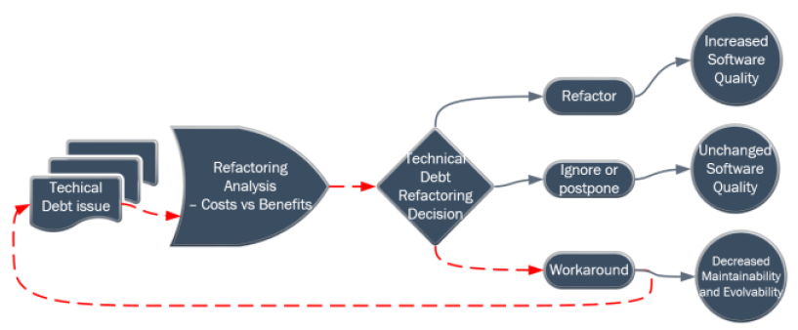
The Counterproductiveness of the SCS Regulations
Even if the SCS regulations have the best intention to produce a high-quality software product, the findings
demonstrate that these heavy regulations are conceivably counterproductive since they potentially can constrain
the possibility of performing optimal TD refactoring activities efficiently
Opposite effect : the regulations contribute to the further introduction of TD and thereby
potentially decrease both the maintainability and evolvability of the software.
Besker, T., et al. (2018). How Regulations of Safety-Critical Software Affect Technical Debt. 2019, SEAA
Notes:
Taken together:
However, even if these regulations have the best intention
to produce a high-quality software product, the findings in
this study demonstrate that these heavy regulations are
conceivably counterproductive for the achievement of this
goal since they potentially can constrain the possibility of
performing optimal TD refactoring activities efficiently
in several cases, the opposite effect of what was
intended and desired; instead of promoting refactoring
activities to raise the software quality, the regulations
contribute to the further introduction of TD and thereby
potentially decrease both the maintainability and evolvability
of the software.

Slide 45


How expensive is Technical Debt? – from a productivity perspective
Technical Debt cause developers to waste working time, since they have to perform extra activities due to the present Technical Debt.
How much time?
Notes:
We move on to the price of having TD – the negative effects of TD
Why should we care?

Slide 46

Technical Debt contra Productivity
24 % of all development time is wasted by developers, due to Technical Debt
Besker, T., et al. (2019). "Software developer productivity loss due to technical debt—A replication and extension study examining developers’ development work." Journal of Systems and Software 156: 41-61.
Notes:
Work-around solutions
Further, our result also shows that practitioners often develop work-a-round solutions to avoid TD refactoring activities and
thereby to avoid the associated consequences and the need for the additional activities and costs.

Slide 47
Technical Debt contra Productivity
In a quarter of all occasions of encountering TD, developers were forced to introduce additional TD due to already existing TD
Additional activities:
performing additional testing
additional source code analysis
performing additional refactoring
Besker, T., et al. (2019). "Software developer productivity loss due to technical debt—A replication and extension study examining developers’ development work." Journal of Systems and Software 156: 41-61.
Notes:
Work-around solutions
Further, our result also shows that practitioners often develop work-a-round solutions to avoid TD refactoring activities and
thereby to avoid the associated consequences and the need for the additional activities and costs.

Slide 48

Technical Debt and Morale
TD can reduce developers’ morale; the presence of TD hinders developers from performing their tasks and achieving their goals
A proper management of TD increases developers’ morale
Ghanbari, H., et al. (2017). Looking for Peace of Mind? Manage your (Technical) Debt - An Exploratory Field Study. 11th International Symposium On Empirical Engineering and Measurement (ESEM), Toronto, Canada.
Notes:
Work-around solutions
Further, our result also shows that practitioners often develop work-a-round solutions to avoid TD refactoring activities and
thereby to avoid the associated consequences and the need for the additional activities and costs.

Slide 49

What about the Software Quality due to having Technical Debt?

Slide 50
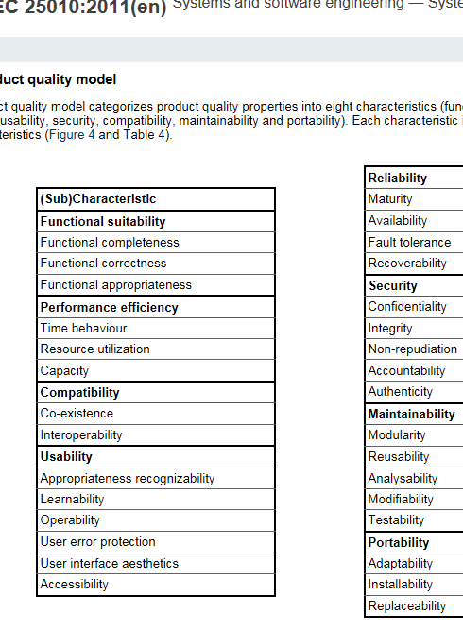
Compromised quality attributes due to Technical Debt
Maintainability
Reliability
Performance
Reusability
Ability to add new features
Besker, T., et al. (2017). Time to Pay Up - Technical Debt from a Software Quality Perspective. proceedings of the 20th Ibero American Conference on Software Engineering (CibSE) @ ICSE17, Buenos Aires, Argentina, CibSE.

Slide 51
Different types of Technical Debt*
Architectural Technical Debt
Documentation Technical Debt
Requirements Technical Debt
Design Technical Debt
Code Technical Debt
Test Technical Debt
Build Technical Debt
Infrastructure Technical Debt
Versioning Technical Debt
Defect Technical Debt
* E. Tom, A. Aurum, and R. Vidgen, “An exploration of technical debt,” Journal of Systems and Software, vol. 86, no. 6, 2013, pp. 1498-1516.

Slide 52
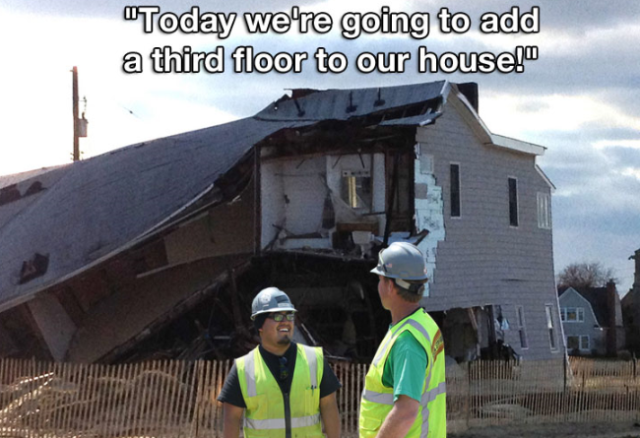

Slide 53

Architectural Technical Debt –
ATD
Notes:
Even if we have the best of intention, things can go wrong …and even become worse over time

Slide 54

The importance of ATD
ATD is the most commonly encountered instances of TD and are caused by architectural inadequacies
Architectural decisions are the most important source of TD
ATD has a huge impact and leverage within the overall development lifecycle
“Architecture plays a signiﬁcant role in the development of large systems, together with other development activities, such as documentation and testing (which are often lacking). These activities can add signiﬁcantly to the debt and thus are part of the technical debt landscape”. **
** Kruchten, P. , Nord, R.L. , Ozkaya, I. , 2012. Technical debt: from metaphor to theory and practice. Software, IEEE 29, 18–21 .

Slide 55
Categories related to ATD
Dependencies violations, including module dependencies, external dependencies, and external team dependencies
Non-uniformity of patterns and policies where, for example, a violation of naming conventions and non-uniform design or architectural patterns are implemented
Code-related issues such as code duplication and overly complex code
Non-uniform management of integration with subsystems and resources
Conﬂicting QA synergies
Besker, T., et al. (2018). "Managing architectural technical debt: A unified model and systematic literature review." Journal of Systems and Software 135(Supplement C): 1-16.

Slide 56

Challenges
related to ATD
Detection, no available tools supporting the detection of ATD
ATD seldom yield observable behaviors to end users
ATD evolves over time
Notes:
Different from other TD types

Slide 57

Negative effects
caused by ATD
Reduced flexibility –
need for a proactive thinking
Maintenance complications and penalties
Stiﬂing the organization's ability to introduce new features
Imped innovation and system growth (evolvability, extendability)
Understandability, testability, extensibility, reusability performance and reliability

Slide 58
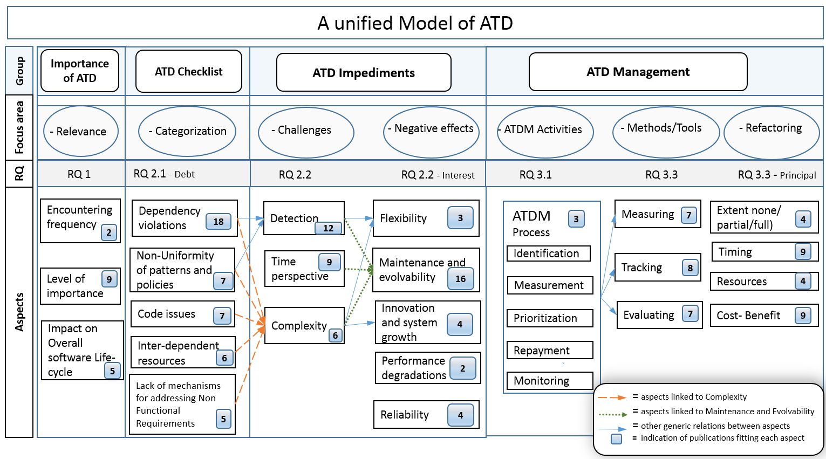
Architectural Technical Debt
[T. Besker, A. Martini, and J. Bosch, “Managing architectural technical debt: A unified model and systematic literature review,” Journal of Systems and Software, vol. 135, no. Supplement C, pp. 1-16, 2018/01/01/, 2018.

Slide 59



Technical Debt:
always negative?

Slide 60
Technical Debt – so far
Technical Debt
Negative impact
Software Quality,
Maintainability,
Evolvability etc.
Developer productivity
Developer Morale

Slide 61

Any suggestions when taking on TD can be beneficial?

Slide 62

Is it always a bad thing to take on Technical Debt?
It’s about making informed decisions and be aware of the consequences
Depends on the amount of the interest cost
Depends on the variance on the interest (growing or stable)
Possible spending the money and time on new features that can generate even more value to the company instead of paying back the debt (called refactoring)

Slide 63
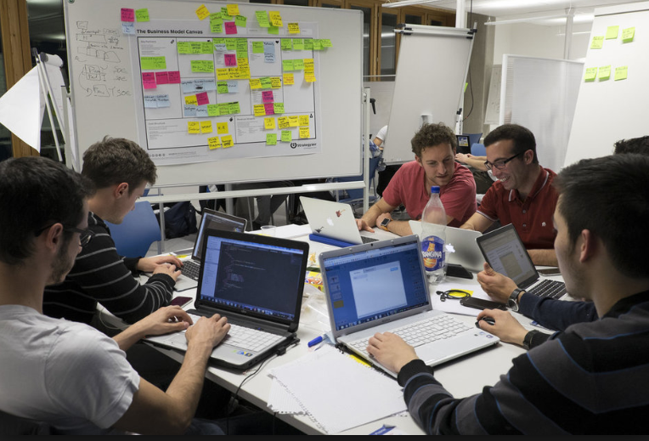
Software Startups

Slide 64
Startups contra
Mature Software companies
Startup Companies
Software development in Startups:
Freshly created company, no history
Main goal is to grow their business
Extreme pressure to get to the market quickly
Limited resources and limited budget
High uncertainty
Need early feedback from customers
Mature Software developing companies
Software development in Mature companies:
Less pressure to get to the market quickly
More resources
Less uncertainty
Besker, T., et al. (2018). Embracing Technical Debt, from a Startup Company Perspective. 2018 IEEE International Conference on Software Maintenance and Evolution (ICSME).

Slide 65

Startups and Technical Debt
Taking on Technical Debt can be beneficial for Startups:
Speed up time-to-market
Allowing them to release their product to end-users faster
Get feedback
Evolve the software
Preserve capital
Besker, T., et al. (2018). Embracing Technical Debt, from a Startup Company Perspective. 2018 IEEE International Conference on Software Maintenance and Evolution (ICSME).

Slide 66

Technical Debt must
be managed
Unmanaged TD can have negative consequences, such as the death of the startup itself!
Besker, T., et al. (2018). Embracing Technical Debt, from a Startup Company Perspective. 2018 IEEE International Conference on Software Maintenance and Evolution (ICSME).
Notes:
One Key take-away

Slide 67
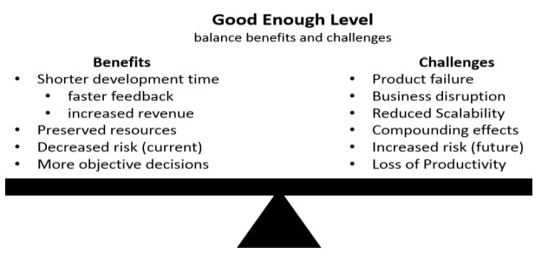
A balance between
Benefits and Challenges
Besker, T., et al. (2018). Embracing Technical Debt, from a Startup Company Perspective. 2018 IEEE International Conference on Software Maintenance and Evolution (ICSME).

Slide 68

Terese Besker
besker@chalmers.se

