Slide 1

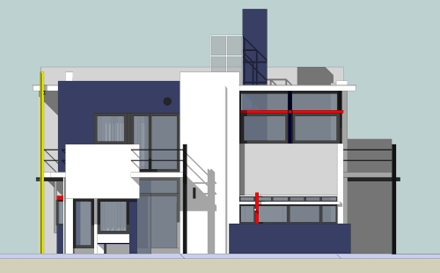
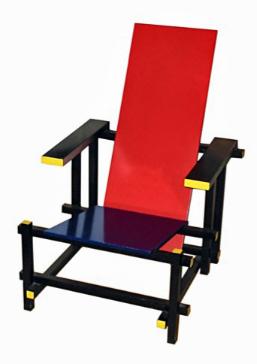
Architectural Styles - Part II
M.R.V. Chaudron
chaudron@chalmers.se | chaudron@gu.se

Slide 2
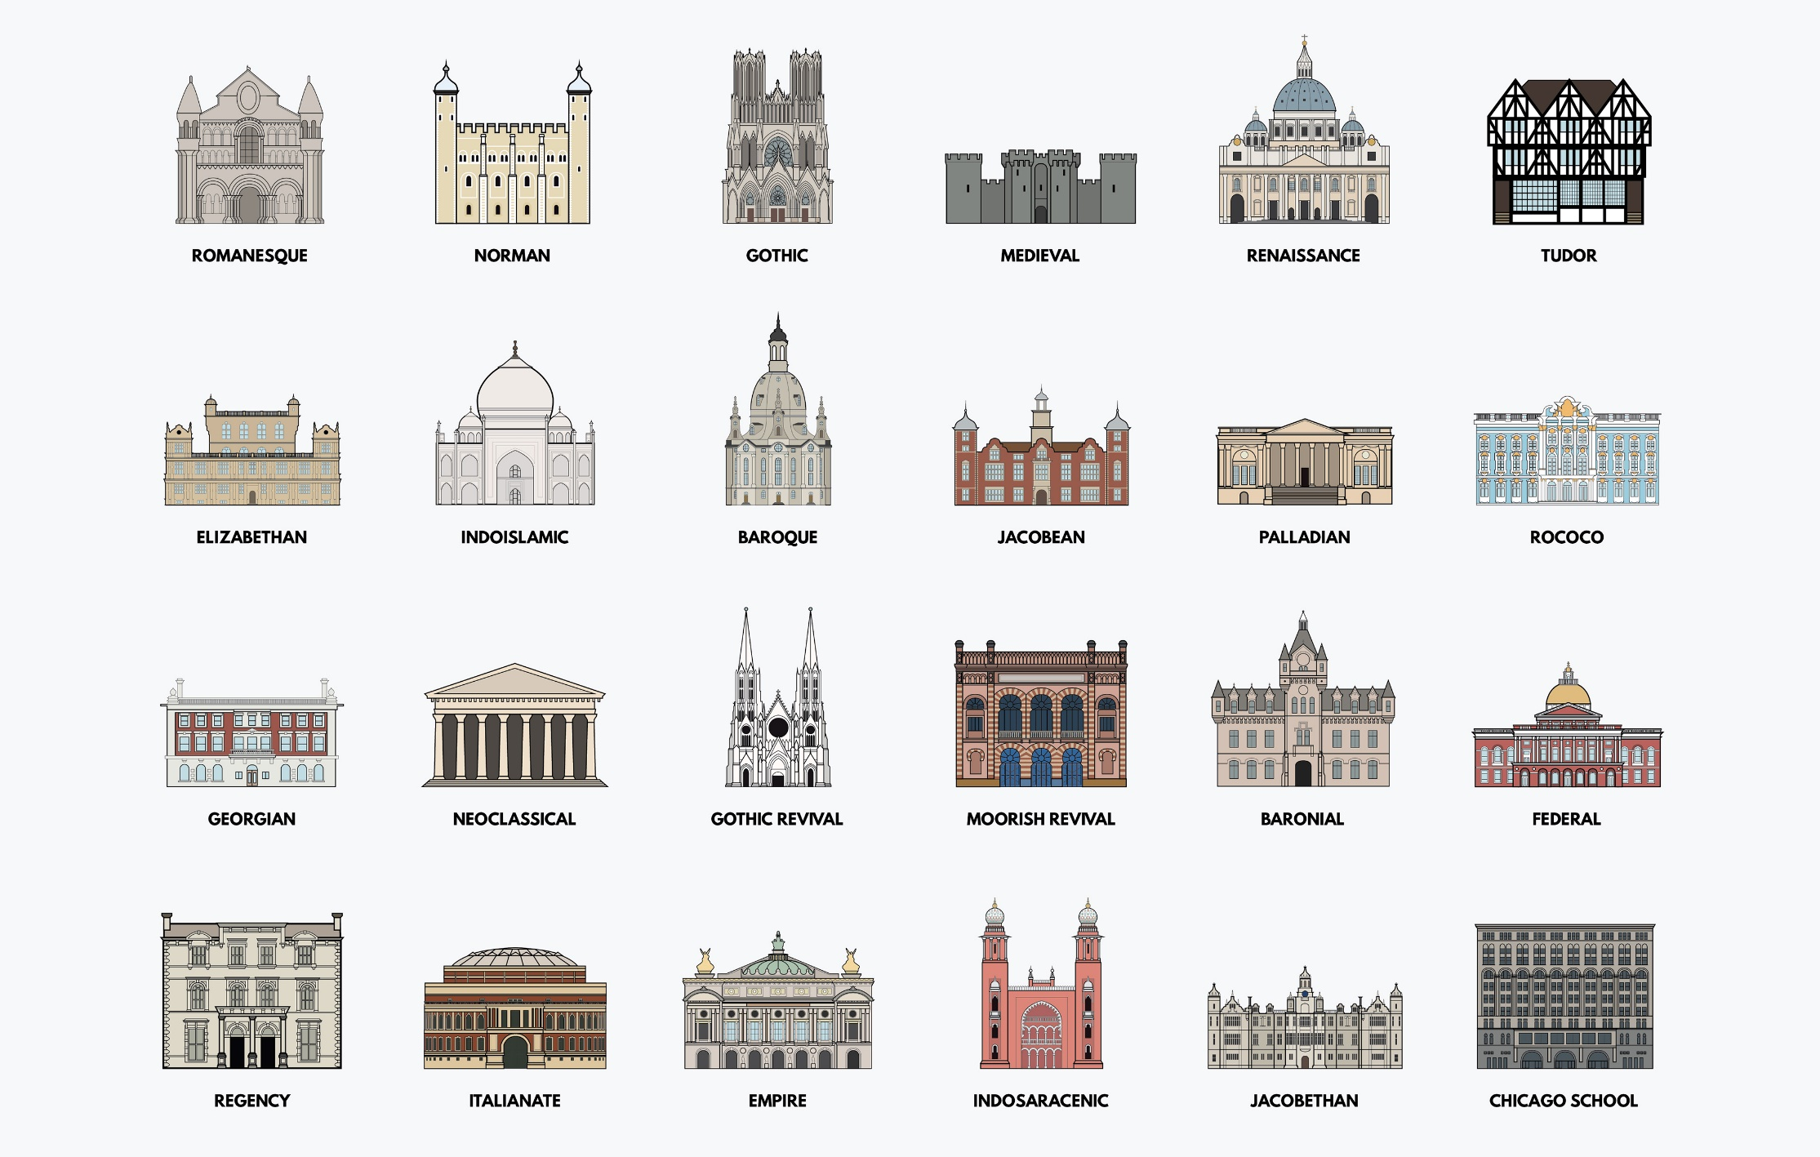

Slide 3
Outline of Topics for Today’s Lecture
Domain Space vs Solution Space
Architectural Styles
  Pipe and Filter
  Publish-Subscribe
  (Blackboard)

Slide 4
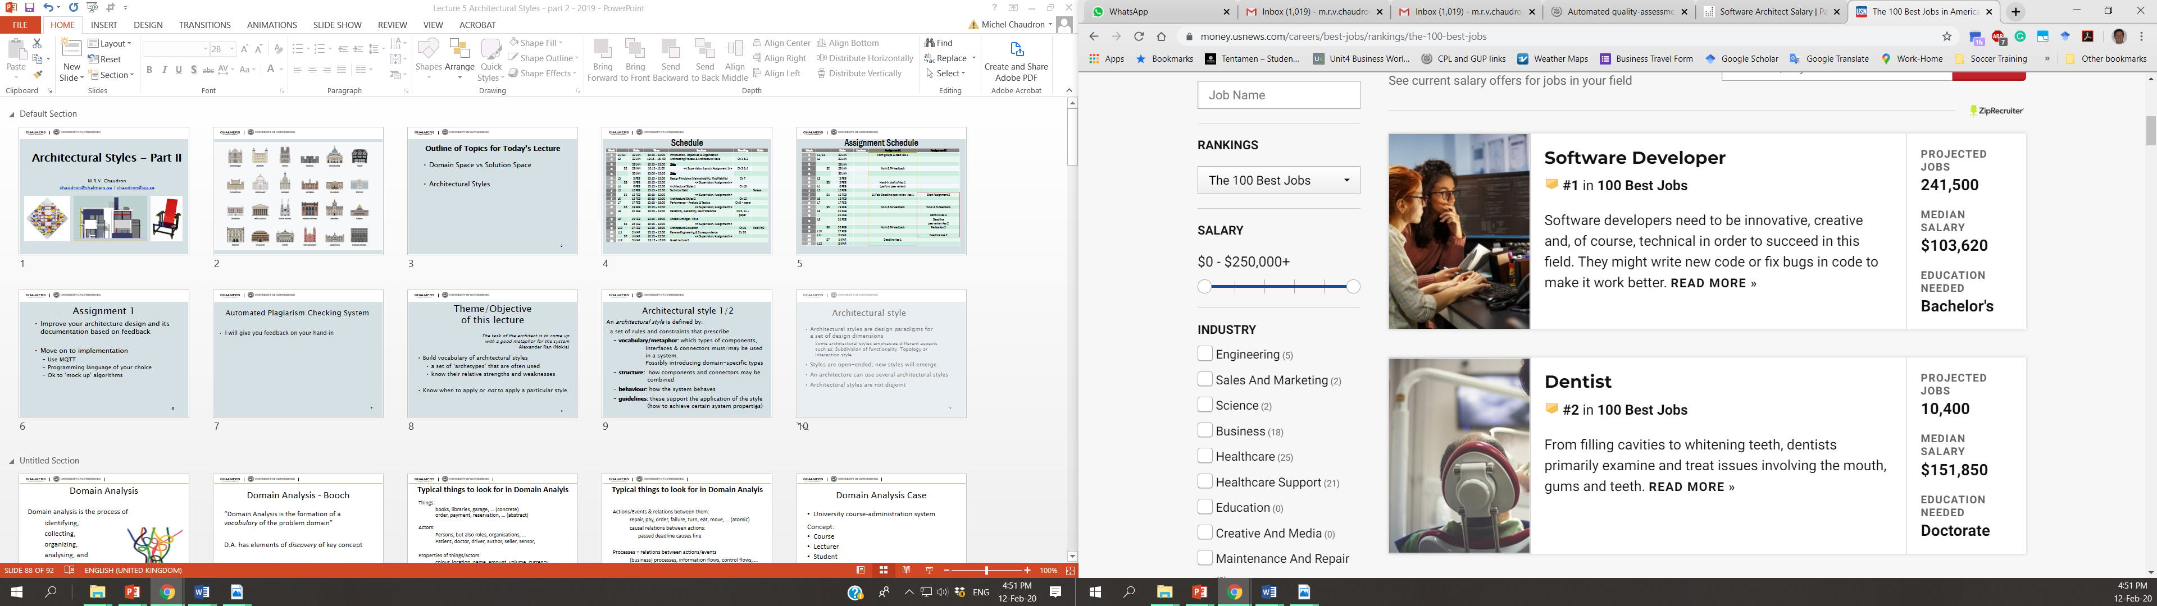

Slide 5
Schedule
Week |  | Date | Time | Lecture | Reading | Note
4 | L1/S1 | 22 JAN | 10:15 – 12:00 | Introduction, Objectives & Organization
4 | L2 | 23 JAN | 13:15 – 15:-00 | Architecting Process & Architecture Views | Ch 1 & 2
5 |  | 28 JAN | 10:15 – 12:00 | Skip
5 | S2 | 29 JAN | 10:15 - 12:00 | << Supervision: Launch Assignment 1>> | Ch 3 & 4
5 |  | 30 JAN | 13:00 – 15:00 | Skip
6 | L3 | 3 FEB | 13:15 – 15:00 | Design Principles (Maintainability, Modifiability) | Ch 7
6 | S3 | 5 FEB | 10:15 – 12:00 | << Supervision/Assignment>>
6 | L4 | 6 FEB | 13:15 – 15:00 | Architectural Styles 1 | Ch 13
7 | L5 | 10 FEB | 13:15 – 15:00 | Technical Debt |  | Terese
7 | S4 | 12 FEB | 10:15 – 12:00 | << Supervision/Assignment>>
7 | L6 | 13 FEB | 10:15 – 12:00 | Architectural Styles 2 | Ch 13
8 | L7 | 17 FEB | 13:15 – 15:00 | Performance – Analysis & Tactics | Ch 8 + paper
8 | S5 | 19 FEB | 10:15 – 12:00 | << Supervision/Assignment>>
8 | L8 | 20 FEB | 10:15 – 12:00 | Reliability, Availability, Fault Tolerance | Ch 5, 14 + paper
9 | L9 | 24 FEB | 13:15 – 15:00 | Anders Alminger - Volvo
9 | S6 | 26 FEB | 10:15 – 12:00 | << Supervision/Assignment>>
9 | L10 | 27 FEB | 13:15 – 15:00 | Architecture Evaluation | Ch 21 | Rodi PhD
10 | L11 | 2 MAR | 13:15 – 15:00 | Reverse Engineering & Correspondence | Ch 20
10 | S7 | 4 MAR | 10:15 – 12:00 | << Supervision/Assignment>>
10 | L12 | 5 MAR | 13:15 – 15:00 | Guest Lecture 2

Slide 6
Assignment Schedule
Week |  | Date | Lecture | Assignment1 | Assignment2
4 | L1/S1 | 22 JAN |  | Form groups & read Ass 1
4 | L2 | 23 JAN
5 |  | 28 JAN
5 | S2 | 29 JAN |  | Work & TA feedback
5 |  | 30 JAN
6 | L3 | 3 FEB
6 | S3 | 5 FEB |  | Hand-in draft of Ass 1
6 | L4 | 6 FEB |  | (perform peer review)
7 | L5 | 10 FEB
7 | S4 | 12 FEB |  | 11 Feb: Deadline peer review Ass 1 | Start Assignment 2
7 | L6 | 13 FEB
8 | L7 | 17 FEB
8 | S5 | 19 FEB |  | Work & TA feedback | Work & TA feedback
8 | L8 | 20 FEB
8 |  | 21 FEB |  |  | Hand-in Ass 2
9 | L9 | 24 FEB |  |  | Deadline peer review Ass 2
9 | S6 | 26 FEB |  | Work & TA feedback | Revise Ass 2
9 | L10 | 27 FEB
10 | L11 | 2 MAR |  |  | Deadline Ass 2
10 | S7 | 4 MAR |  | Deadline Ass 1
10 | L12 | 5 MAR

Slide 7
Assignment 1
Improve your architecture design and its documentation based on feedback
Move on to implementation
  Use MQTT
  Programming language of your choice
  Ok to ‘mock up’ algorithms

Slide 8
Automated Plagiarism Checking System
I will give you feedback on your hand-in
Notes:
Question 4 (2 + 4 + 6 + 6 + 2 = 22 pts) Architectural design
Read the case description below and make and answer the questions below the case description. Motivate for your answers and state your assumptions, and provide explanatory text with your diagrams.
The case study we consider in this question is an automated plagiarism checking tool (APC) for student-assignments. This is a system that teachers of higher level education (universities, polytechnics …) can use to check for plagiarism in the electronic documents that are handed in by students. To this end, universities can have subscriptions to the APC-service. Teaching staff of such universities can then create an account (by registering their e-mail address) with the APC. Teaching staff can use the APC by sending an email with an attachment of a student hand-in to an assignment as attachment. The APC has conversion functionality which it uses to convert a variety of document formats (of the attachments) such as Word (.doc and .docx) as well as open document format (.odf) into pdf-format. The pdf is then ‘segmented’: the segmentation functionality produces a XML-document that contains the main structures of the document (such as title, table of contents, section-header, figure, table, section-text, sentence). Next, the APC system performs an analysis to find out if there are parts of the hand-in that match any parts of any other document that it knows. For this, the APC system has a large repository of previous assignments and published scientific papers and books. This repository is updated automatically with new papers from scientific databases (such as IEEE Explore). For comparing a new hand-in, a reduced version of the XML document of the hand-in is made that only contains significant keywords (thereby omitting non-significant words such as ‘the’ and ‘a’). This step is called ‘pre-processing’. Then, in the actual comparison, each sentence of the reduced hand-in is compared to all sentences of all papers in the repository. Each comparison produces a similarity score. The scores of larger sections of a hand-in are obtained by summing up the scores of the sentences of which it consists. Ultimately, this leads to a plagiarism score for the entire hand-in. The analysis of a hand-in produces a report. This report shows which sentences of the hand-in have a significant ‘plagiarism’-score with which specific documents from the repository. This report is sent by e-mail to the staff member that has submitted the request for analysis. At the end of each month, the APC system sends a management-overview report to the universities that are subscribed. This report describes basis statistics about the number of hand-in’s that have been analysed and from which department and staff-member the hand-in’s were submitted.
Mention 2 architectural drivers for the system (but not cost, schedule or maintainability)
Create a use case diagram for the system that lists the 3 most important use cases for the system
Create a structural view for the architecture of the APC system.
In your structural design, you have to infer which subsystems/components are needed in the system. For each component in your architecture, briefly explain its responsibility (aim for 1 sentence).
Create a behavioural view for the system. This view should describe at least the following:
Send a report in response to the request to analyse a hand-in (model the entire scenario starting from the request).
Send a management overview report
Give one example in your architecture design where you used ‘Information Hiding’. Explain your answer.

Slide 9

Domain Analysis
Domain analysis is the process of
identifying,
collecting,
organizing,
analysing, and
representing
a domain model

Slide 10
Domain Analysis - Booch
“Domain Analysis is the formation of a vocabulary of the problem domain”
D.A. has elements of discovery of key concept
D.A. has elements of organizing/grouping

Slide 11
Typical things to look for in Domain Analyis
Things:
books, libraries, garage, … (concrete)
order, payment, reservation, … (abstract)
Actors:
Persons, but also roles, organisations, …
Patient, doctor, driver, author, seller, sensor,
Properties of things/actors:
colour, location, name, amount, volume, currency, …
Relations between things:
is a, part of

Slide 12
Typical things to look for in Domain Analyis
Actions/Events & relations between them:
repair, pay, order, failure, turn, eat, move, … (atomic)
causal relations between actions:
passed deadline causes fine
Processes = relations between actions/events
(business) processes, information flows, control flows, …

Slide 13
Domain Analysis Case
University course-administration system
Concept:
Course
Lecturer
Student
Book
Exam
Schedule

Slide 14
Domain Analysis Case
University course-administration system
Student
Book
Course
Lecturer
Exercise
Exam
Lecture
Schedule

Slide 15
Domain Analysis Case
University course-administration system
registers
Student
has
has
Book
Course
Lecturer
has
mentions
is_part_of
is_part_of
is_part_of
Exercise
Exam
Lecture
Schedule

Slide 16
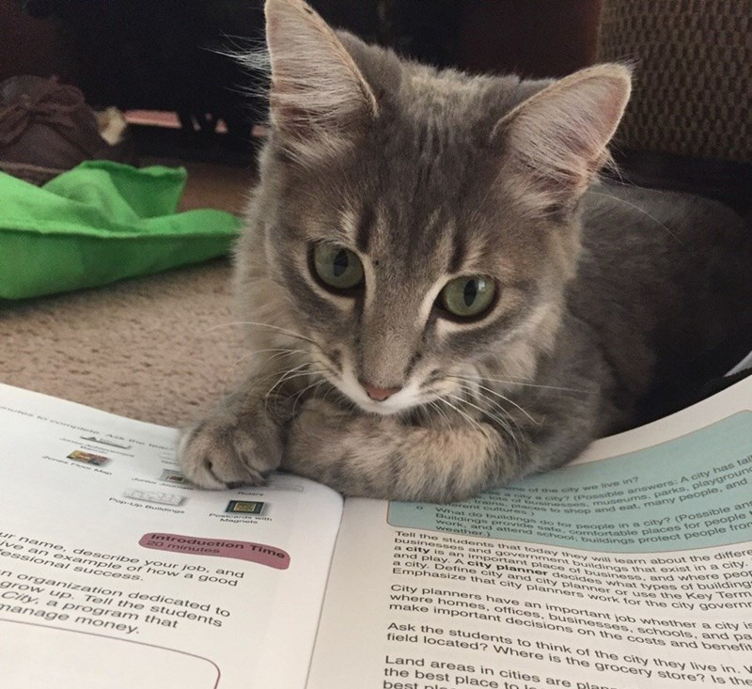
Domain Analysis Case
University course-administration system:
How about:
group?
grade?
students address? age? pet cat?

Slide 17
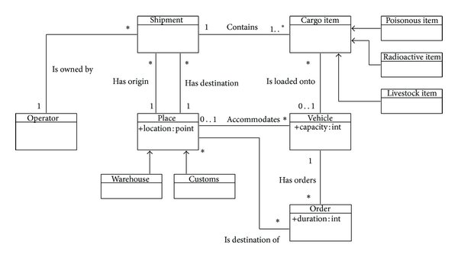
Domain Model Example

Slide 18
Domain Analysis Case
Also behaviour exists in domain – as illustration ….
:Student
:Course
:Lecture
:Exercise
:Exam
enroll
attend
makes
attend
writes
Other modeling languages can be used for
describing the behaviour(e.g. activity diagrams)

Slide 19

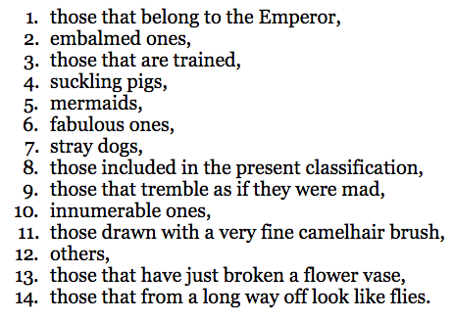
From: Jorge Luis Borges
"El idioma analitico de John Wilkins"
“A certain Chinese encyclopaedia," likely fictitious, but attributed to Franz Kuhn, called the
Celestial Emporium of Benevolent Knowledge
said to divide animals into “

Slide 20
What makes a good analysis?
Correct Scope
Complete
Consistent
Systematic
Typically performed by an expert in the domain.
Domain analysist in finance/banking are not automatically good domain analysis in automotive.

Slide 21
Domain Analysis Example

Slide 22
Exercise
It is Tuesday-afternoon and Sarah walks into the office of the SuperFly Travel Company on Avenyn in Gothenburg. She opens the door and draws a ticket. Sara is 24 years also and would like to visit her grandmother Ana who is 77 years old and lives in Rotterdam. Sara is interested in booking a flight from Gothenburg to Amsterdam. When driving by road, the distance from Gothenburg to Amsterdam is about 1096 kilometers. From Amsterdam she will take the train to Rotterdam. Sara is known amongst her friends for being very flexible. However, she has a preference for pink airplanes.
Assignment: Create a domain model

Slide 23
Exercise
It is Tuesday-afternoon and Sarah walks into the office of the SuperFly Travel Company on Avenyn in Gothenburg.
company
has
office
has
customer
customer
is abstraction
of Sara
location
name
Notation:
‘thing’
properties
capabilities
Notes:
NB it is our interpretation/domain knowledge that tells us that Sara is a customer

Slide 24
“She opens the door and draws a ticket”
Maybe ‘ticket’?

Slide 25
“Sara is 24 years also and would like to visit her grandmother Ana who is 77 years old and lives in Rotterdam.”
Sara => Customers have a name (property) and age (property).
Grandmother and age and her location are not essential for travelling

Slide 26
“Sara is interested in booking a flight from Gothenburg to Amsterdam”
customer
has
booking
origin
destination

Slide 27

“Sara is interested in booking a flight from Gothenburg to Amsterdam”
customer
has
booking
has
trip
has
*
leg
origin
destination
Notation: * means 0 or more
(note: no plurals in ‘thing’ names)
transportation -type

Slide 28
“Sara is interested in booking a trip from Gothenburg to Rotterdam”, flying from Got to AMS and taking the train from AMS to Rotterdam.
trip
has
*
leg
instance
origin
leg 1
leg 2
destination
Gothenburg
Amsterdam
transportation -type
Amsterdam
Rotterdam
flight
train

Slide 29
“When driving by road, the distance from Gothenburg to Amsterdam is about 1096 kilometers.”
This is not so relevant (yet), maybe could be input to pricing.
This data can be derived from existing data => maybe no need to include in our system.

Slide 30
“Sara is known amongst her friends for being very flexible. However, she has a preference for pink airplanes.”
customer
name
preference
Notation:
‘thing’
properties
capabilities

Slide 31
Putting Everything Together
has
company
office
*
location
has
*
customer
has
booking
has
trip
*
name
birthday
preference
has
*
leg
origin
destination
transportation -type

Slide 32
So far so good
Anything missing from the analysis?
Dynamics/behaviour
Business logic

Slide 33
Responsibility
The state or fact of having a duty to deal with something or of having control over someone.
Synonyms: authority, control, power, leadership, management, influence; duty
2. The state or fact of being accountable or to blame for something.
Synonyms: blame, fault, guilt, culpability, blameworthiness,
liability
A moral obligation to behave correctly towards or in respect of.
"individuals have a responsibility to control their behaviour"

Slide 34
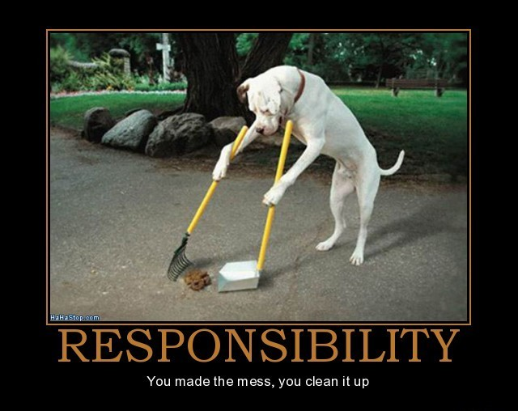
Responsibility
The opportunity or ability to act independently and take
decisions without authorization.
A thing which one is required to do as part of a job, role, or
legal obligation.
Synonyms: duty, task, function, job, role, place, charge, business, onus, burden, liability, accountability, answerability, province

Slide 35
Responsibility
To Know something
To Do something
  Act
  Control
  Decide

Slide 36
Challenge: Uncovering the hidden structure of designs
Rebecca WB: Software designs are
built from building blocks that have
stereotypical roles
Information holder
Service Provider
Interfacer
Structurer
Controller
Coordinator
Notes:
■Information holder: an object designed to know certain information and provide that
information to other objects.
■ Structurer: an object that maintains relationships between objects and information about
those relationships. Complex structurers might pool, collect, and maintain groups of
many objects; simpler structurers maintain relationships between a few objects. An example
of a generic structurer is a Java HashMap, which relates keys to values.
■ Service provider: an object that performs specific work and offers services to others
on demand.
■ Controller: an object designed to make decisions and control a complex task.
■ Coordinator: an object that doesn’t make many decisions but, in a rote or mechanical
way, delegates work to other objects. The Mediator pattern is one example.
■ Interfacer: an object that transforms information or requests between distinct parts of a
system. The edges of an application contain user-interfacer objects that interact with the
user and external interfacer objects, which communicate with external systems. Interfacers
also exist between subsystems. The Façade pattern is an example of a class designed
to simplify interactions and limit clients’ visibility of objects within a subsystem.

Slide 37
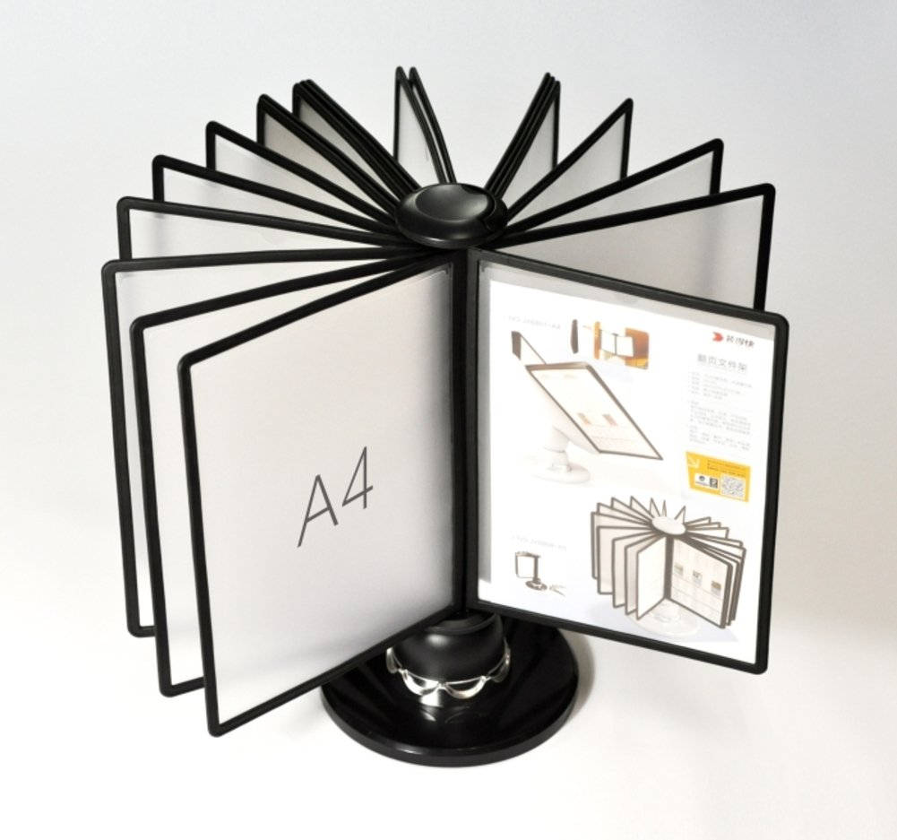
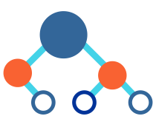

■Information holder: an object designed to know certain information and provide that information to other objects.
■ Structurer: an object that maintains relationships between objects and information about those relationships.
Complex structurers might pool, collect, and maintain groups of many objects; simpler structurers maintain relationships between a few objects. An example of a generic structurer is a Java HashMap, which relates keys to values.
■ Service provider: an object that performs specific work and offers services to others on demand.

Slide 38

■ Controller: an object designed to make decisions and control a complex task.
■ Coordinator: an object that doesn’t make many decisions but, in a rote or mechanical way, delegates work to other objects.
■ Interfacer: an object that transforms information or requests between distinct parts of a system. The edges of an application contain user-interfacer objects that interact with the user and external interfacer objects, which communicate with external systems. Interfacers
also exist between subsystems. The Façade pattern is an example of a class designed
to simplify interactions and limit clients’ visibility of objects within a subsystem.

Slide 39
Analysis & Design
In this course
Analysis is for: understanding & describing the domain
describes what : main concept & their relations
Design is for: synthesis of executable solution
describes how a construction of a solution should work

Slide 40
From Analysis to Design
Problem Space/Domain
Actors
Actions
Use Case
Diagram
Processes
Sequence / Activity
Diagram
Responsibilities
Data
Class Diagram
These are elements of analysis:
What is there?
Notes:
Michel maakt nieuw plaatje over hoe diagrammen gebruikt worden en overgaan van analyse naar design

Slide 41
From Analysis to Design
Problem Space/Domain
Solution Space/Domain
Actors
- User Interface Design
- Features
- Test cases
Use Case
Diagram
Actions
Processes
Sequence / Activity
Diagram
Business Processes /
Workflows
Responsibilities
Data
Class Diagram
Classes (Components)
& their behaviour
State Machine
Diagram
Data Collections
Behaviour
Following our terminology, these are MODELS!
These are elements of construction!
Notes:
Michel maakt nieuw plaatje over hoe diagrammen gebruikt worden en overgaan van analyse naar design

Slide 42
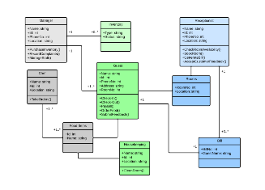
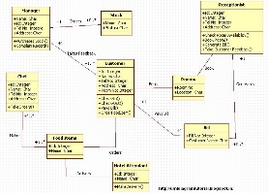
From Analysis to Initial Design
The OO paradigm has been designed such that Analysis and Design models look ‘alike’:
Classes that appear in a domain model, can also appear in a design model
Descriptive Models
Prescriptive Models
Problem Space/Domain
Solution Space/Domain
Component/Class
Diagram
Components/Classes
& their behaviour
These are elements of analysis:
What is there?
These are elements of construction:
How will it work?

Slide 43
From Analysis to Design
Descriptive Models
Prescriptive Models
S
S
Sensor
Class handles input
(e.g. UI-layer)
P
P
Process
(e.g. ordering)
Class handles process
(e.g. business layer)
D
D
Data-collection
Table in data-base
These are elements of analysis:
What is there?
These are elements of construction:
How will it work?

Slide 44
Architectural style 1/2
An architectural style is defined by:
a set of rules, principles and constraints that prescribe
  vocabulary/metaphor: which types of components,
  interfaces & connectors must/may be used
  in a system.
  Possibly introducing domain-specific types
  structure: how components and connectors may be
  combined
  behaviour: how the system behaves
  guidelines: these support the application of the style
  (how to achieve certain system properties)

Slide 45
Architectural style
Architectural styles are design paradigms for
a set of design dimensions
  Some architectural styles emphasize different aspects
  such as: Subdivision of functionality, Topology or
  Interaction style
Styles are open-ended; new styles will emerge
An architecture can use several architectural styles
Architectural styles are not disjoint
Notes:
An architectural style can be regarded as a set of constraints on the architectural components and their interaction

Slide 46
Used diagrams/slides
from this book

Slide 47
Client-Server (S+B+D)
There is more than structure
to a style!
Client
1..*
1
Server
Client
Server
Client
Server

Slide 48
Client / Server Style
Concept: Separation of application in units of change
Components: presentation,
application logic,
business logic,
data management
Connector: ‘uses’ lower layer
Interaction style: request/response
presentation
logic
client
application
logic
business
logic
data
management
server
Notes:
A virtual machine architecture can empower the user
by defining a high-level language that allows him to express his ideas
in a easily understandable form
In this scenario, the ICT-specialist is not longer responsible
for the application programs
(that execute in a domain that is barely understood by him)
but only for the proper execution platform

Slide 53
Recap
Client-Server
Pipe and Filter
Conceptual Integrity

Slide 54
CONTENTS
Introduction
Architectural styles
2.1 Client/Server
2.2 Pipe and Filter style
2.3 Blackboard style
2.4 Publish Subscribe
2.5 Peer-to-Peer
2.6 Layered style
3. Interaction style
4. Conclusions

Slide 55
CONTENTS
Introduction
Architectural styles
2.1 Client/Server
2.2 Pipe and Filter style
2.3 Blackboard style
2.4 Publish Subscribe
2.5 Peer-to-Peer
2.6 Layered style
3. Interaction style
4. Conclusions

Slide 56
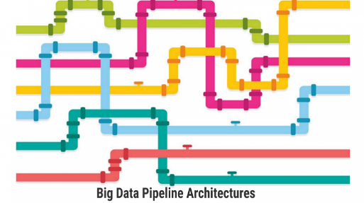
Pipe and Filter Style (1)
Concept: Series of filters / transformation
  where each component is consumer and producer
Filter 1
Filter 2
Filter 3
Filter 4
Components: filters / transformations
possibly also: sources and sinks
Connectors: pipes;
interaction style: streaming of data
Topology: linear; possible variations:
feedback-loops, splitting pipes
computational component
data flow

Slide 57
Special types of filters (?)
Pump (Producer/Source)
Produces data and puts it to an output port that is connected to the input end of a pipe.
Sink (Consumer)
Gets data from the input port that is connected to the output end of a pipe and consumes the data.

Slide 58
Pipe and Filter Style (2)
Filter 1
Filter 2
Filter 3
Filter 4
Constraints about the way filters and pipes can be joined:
Unidirectional flow
Control flow derived from data flow
Behaviour Types:
a. Batch sequential
  Run to completion per transformation
b. Continuous
  Incremental transformation
  variants: push, pull, asynchronous

Slide 59
Pipe and Filter Style (3)
Filter 1
Filter 2
Filter 3
Filter 4
Semantic Constraints
Filters are independent entities
- they do not share state
- they do not know their predecessor/successor
What are the dependencies between filters?
Compare this with Client Server?

Slide 60
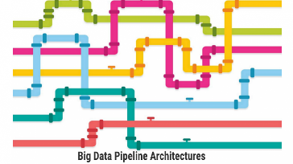
Pipe and Filter (Struct+Behaviour)
Source
Filter1
Filter2
Sink
Source
Filter1
Filter2
Sink

Slide 61
Pipe and Filter (Struct+Behaviour)
Source
Filter1
Filter2
Sink
Source
Filter1
Filter2
Sink

Slide 62
Pipe and Filter (Deployment)
Source
Filter1
Filter2
Sink

Slide 63
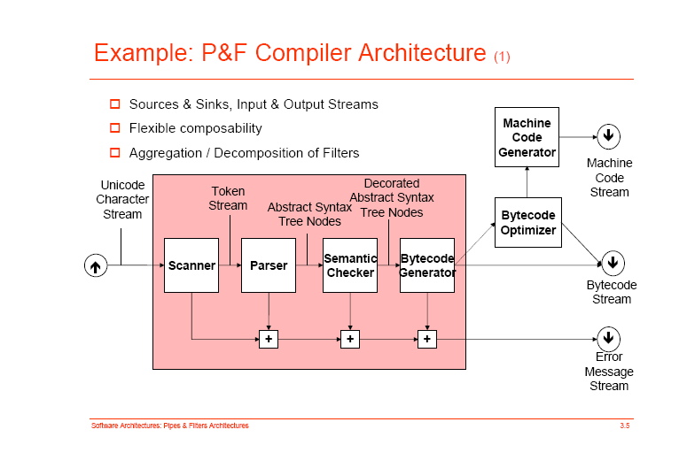

Slide 64
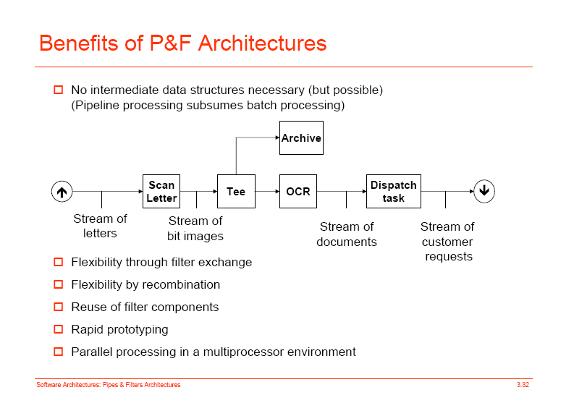
Example P&F Architecture

Slide 65
Pipe and Filter Style (4a)
Advantages:
Simplicity:
  no complex component interactions
  easy to analyze (deadlock, throughput, … )
Easy to maintain and to reuse
Filters are easy to compose (also hierarchically?)
Can be easily made parallel or distributed
Notes:
What is wrong with ASCI as data representation? There is XML in which to code semantic information.

Slide 66
Pipe and Filter Style (4b)
Disadvantages:
Interactive applications are difficult to create
Filter ordering can be difficult
Performance:
  - Enforcement of lowest common data representation,
  ASCII stream, may lead to (un)parse overhead
- If output can only be produced after all input is
received, an infinite input buffer is required
(e.g. sort filter)
If bounded buffers are used, deadlocks may occur
Notes:
What is wrong with ASCI as data representation? There is XML in which to code semantic information.

Slide 67
ls | grep ‘architecture’ | sort
  First ‘list files in directory’, then keep only files with ‘architecture’ in name, then sort this list
ls | sort ls | grep ‘architecture’
This rearrangement works because components have the same input and output: the ‘lowest common denominator’ is a stream of lines of characters.

Slide 68
Pipe and Filter Style (5)
Quality Factors
Extendibility: extends easily with new filters
Flexibility: - functionality of filters can be easily redefined,
- control can be re-routed
(both at design-time, run-time is difficult)
Robustness: ‘weakest link’ is limitation
Security: -
Performance: allows straightforward parallelisation

Slide 69
Pipe and Filter Style (6)
Application Context
Rules of thumb for choosing pipe-and-filter (o.a. from Shaw/Buschman):
if a system can be described by a regular interaction pattern of a
collection of processing units at the same level of abstraction;
e.g. a series of incremental stages
(horizontal composition of functionality);
if the computation involves the transformation of streams of data
(processes with limited fan-in/fan-out)
Hint: use a looped-pipe-and-filter if the system does continuous controlling of a physical system
Typical application domain: signal processing

Slide 70
CONTENTS
Introduction
Architectural styles
2.1 Client/Server
2.2 Pipe and Filter style
2.3 Blackboard style
2.4 Publish Subscribe
2.5 Layered style
2.6 Peer-to-Peer
3. Interaction style
4. Conclusions

Slide 71
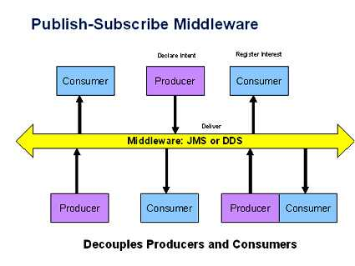
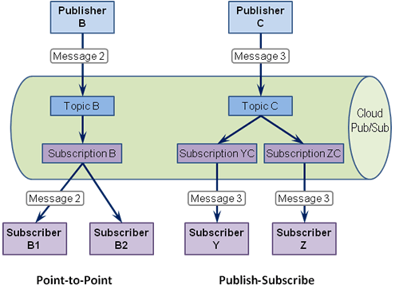
Publish-Subscribe

Slide 72
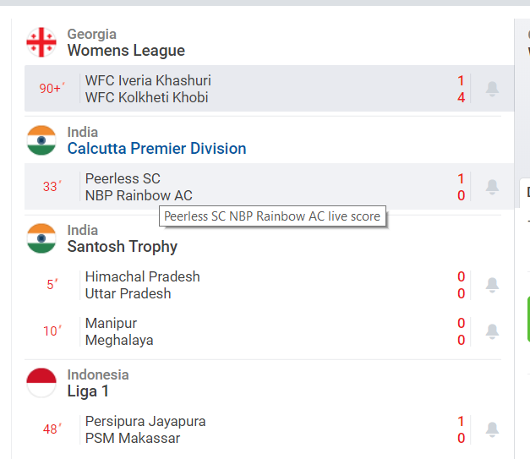

Publish-Subscribe
P/S is like: subscriptions that you know:
e.g. newspapers or live sports highlights:

Slide 73
Publish-Subscribe
Components interact via announced messages, or events.
  Components may subscribe to a set of events.
  It is the job of the publish-subscribe runtime infrastructure to make sure that each published event is delivered to all subscribers of that event.
Advantages: loose coupling, scalability, extendibility, improved security (messages sent to subscribers only)
Limitations: need to guarantee delivery, performance problems when overloaded with messages

Slide 74
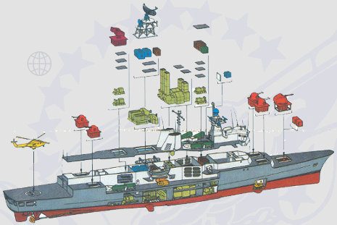
Publish-Subscribe Style
Case Study: SPLICE
Developed by Thales (formerly Hollandse Signaal App.)
Oriented towards high quality control systems:
Distributed
Fault tolerant (support
of degraded modes)
(Soft) real-time
Extensible
F124 frigate

Slide 75
Architecture Requirements
The architecture is characterized as:
real-time
distributed
data driven
fault tolerant
with some typical figures:
50 nodes containing 170 CPU’s
2200 active executables
4000 Hz. data-updates over Network
>2000 distributed data-types

Slide 76
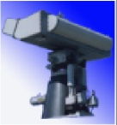
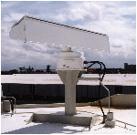

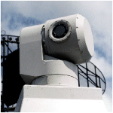
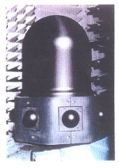
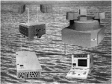
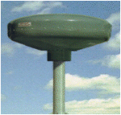
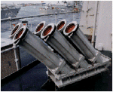
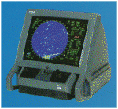
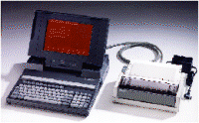
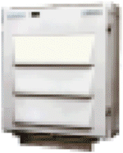
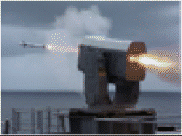
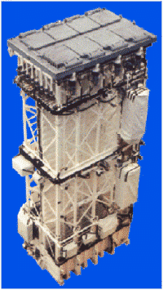
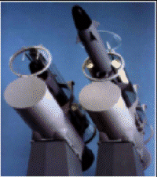
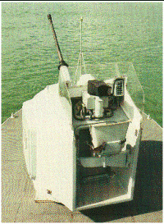
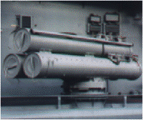
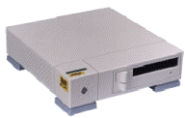
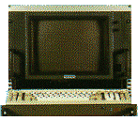
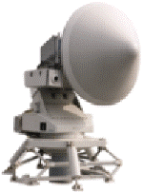

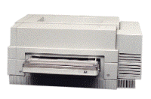
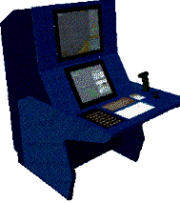

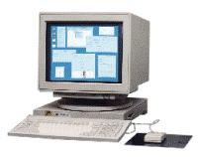
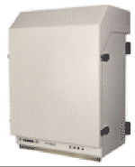
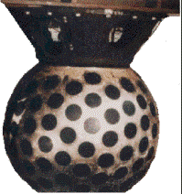
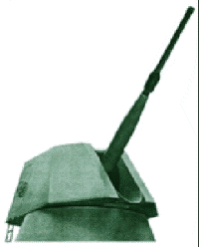
Configuration example: frigate size system
3D SURV. RADAR
MW08 & IFF
SCOUT FMCW
BRIDGEMASTER
LPI RADAR
NAVIGATION
RADAR
BRIDGEMASTER
STING BS/ CW
TRACK
RADAR
MIRADOR
E / O
TRACKER
IRSCAN
IR SEARCH /
TRACK
TARGET
DES. SIGHT
PORT & STBD
DATA
LINK 11
DR3000
SLW
ESM
SALAMANDRE
ECM
DECOY
SYSTEM
ALEX/SRBOC
MK36
ALTESSE
COM
ESM
TRANSPONDER
FMCW
TO
BRIDGE
MFC
DTS
LINK 11
INTERROGATOR
TO
BRIDGE
MFC
SENSORS
BTS
NAVRAD
BTS
NAV
BTS
TDS
BTS
LINK 11
BTS
EW
DUAL DATA DISTRIBUTION BUS
DUAL VIDEO DISTRIBUTION BUS
CMS
INTERNAL
COMMS
FOCON-32
EXTERNAL
COMMS
MESSAGE
HANDLING
PIOD/PCDU
TACTICOS with MOC-Mk3
GSS
FIBRE OPTIC BUS
WEAPONS /
SONAR /
NAV
BTS
RAM
MIC
MK41
BTS
SSM
GIC
76mm
GIC
30mm
GIC
30mm
BTS
TORP
BTS
HMS
BTS
TAS
BTS
OSD
XBT/
XSV
RAM
ASM
VLS SAM-MK41
LAUNCHING
SYSTEM
(ASROC OPTION)
SSM-LR
BOFORS
RBS15 MK3
GUN
76 MM
OSRG
GUN
30 MM
GUN
30 MM
B515
TORPEDO
SYSTEM
HULL
MOUNTED
SONAR
ACT.TOWED
ARRAY
SONAR
WIND/GPS
SHIPS REF.
SENSORS

Slide 77
Combat-Management-System Overview
SMART-L
APAR
KH/SCOUT
NAV. RADAR
HELI APPR.
RADAR
VESTA
OFF LINE
R/S
SIRIUS
TDS (2x)
POS
SYSTEM
SHIP’S REF.
IRC
sensors
APECS-3
ESM / ECM
IFF
LINK 11
SRBOC
VESTA
CATV BUS
TDLPP
VEX/
RCP
BTS
OSD
BTS
OSD
ATM NETWORK
VIDEO INTERFACE
CABINET
LARGE SCREEN
DISPLAY 1
LARGE SCREEN DISPLAY 2
VCR 1/2
Data-handling
SPARE
FL. DECK
TV CAMERA
TV CAMERA
COMBAT INFORMATION CENTER
STAFF ROOM
BRIDGE
COMMS ROOM
DEPARTMENT OFF. / OFF. QUARTERS
ETC.
WORKSTATION 01 WORKSTATION M
COTS & SIGMA TYPE PROCESSOR
PIOD /
PTSU
15
15
15
15
PRINTERS
TORPEDO
WEAPON
SYSTEM
MK32 MOD-9
(MK46)
GIC-
127
MIC-
MK41
MIC-
MK41
INTEGRATED
MACHINERY
CONTROL
SYSTEM
CCC1 CCC2
actuators
COMMS NETWORK
SPHERION
+ XBT / XSV
+ SURF. TEMP. REC.
ATAS
HARPOON
GUN 127 MM
30 MM GUNS
OFF LINE
MK41 SM2
LAUNCHER
GOALKEEPER

Slide 78
SPLICE Application Domain
Used in command and control & traffic mgm. systems
Typical process:
  Acquire input-signals through sensors
  Process input-signals
  Interpret input in terms of environment model
  Take action through effectors
  or support operators in decision making
The interpretation of input may require the
sharing of data between many different applications that act in irregular patterns
Notes:
Processing of input means filtering, noise reduction, …

Slide 79
SPLICE Pub/Sub-Model
Applications are concurrently executing processes that implement part of the overall functionality
Processes register with network agents whether they are producers or consumers of a type of data.
The network agents manage distribution of data.
process
process
process
applications
agent
agent
agent
network
Notes:
When a process declares that it wants to use certain data of a certain type (sort), then this process’ agent subscribes to that sort.
Whenever a process writes data, then this process’ agent broadcasts (or multi-casts) this data to all agents.
The agents forward data of types that the corresponding process is interested in (subscribed to).

Slide 80
SPLICE Data Sorts
Data elements are labeled records.
Each record has a system-wide unique label,
  called the data sort
A field of a sort may be declared key if it
  uniquely determines the values of the non-key fields
sort flightplan
  key flightnumber : string
  Departure : time
  Arrival : time
  Aircraft : string
sort track
  key flightnumber : string
  key index : integer
  State : string

Slide 81
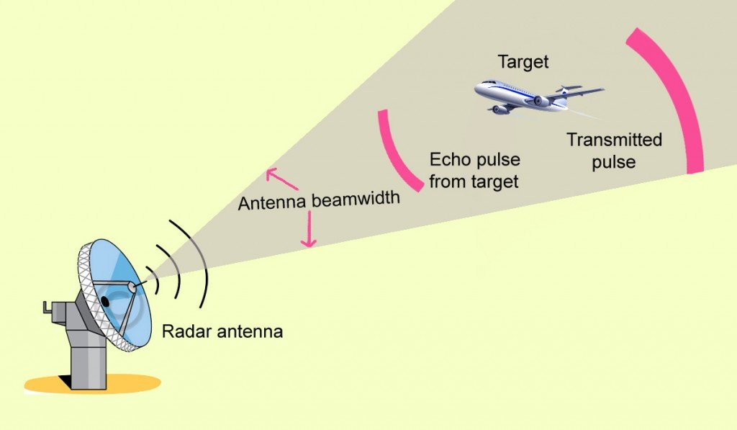
SPLICE Example (1/5)
Consider a system for tracking flying objects:
Observations are made by a radar
  (and are called plots), i.e. the acquisition sensor
Plots are correlated into tracks, that are
  interpreted in terms of a flight trajectory model
Tracks are used to control the direction of the radar
  and for taking action through effectors)

Slide 82
SPLICE Example (2/5)
Processes
  Radar: generates signals
  Detect: processes radar signals into plots
  Track: correlates plots into tracks
  Predict: predicts next coordinates of the flying object
  Control: the radar to probe the next position of the object
  UI: user interface of the system
Sorts (=data types)
  D0: radar signals
  D1: control data to the radar
  D2: plots (coordinates) from the radar
  D3: sensor characteristics
  D4: speed-vector of the object
  D5: predicted object coordinates
  D6: user commands

Slide 83
Application model using one-to-one connections
radar
detect
track
predict
control
UI
Notes:
This diagram shows the subscriptions of data sorts.

Slide 84
SPLICE Example program (4/5)
Program Detect
sort raw_data: radar_signals consumed
sort obj_pos: coordinates produced
signal: sensor_data
Forever do
signal := get(raw_data);
if valid_signal(signal)
then obj_pos:= f(signal); put(obj_pos)
else { corrective action }
End program Detect
What happens when multiple copies of
Detect are running concurrently?
Notes:
Multiple copies increase redundancy

Slide 85
SPLICE Example (5/5)
Program Predict
sort radar_attr: sensor_attr consumed
sort track_data: track consumed
sort pred_coord: coordinates produced
sort user_cmnd: command consumed
result: integer
local_track: track
get(radar_attr);
Forever do
result := get(track_data);
if valid_track(result)
then
{ local_track:=predict new coordinates};
put(obj_pos)
else
if local_track.timestamp + radar_attr.cycle_time >
time – comm_delay
then { new data too late; corrective action };
result := get(user_cmnd);
if valid_cmnd(result)
then { deal with command }
End program Predict

Slide 86
P/S Deployment
node A
node B
node C
producer
consumer
consumer
subscriptions
Type x: B,C
subscriptions
Type x: B,C
subscriptions
Type x: B,C
agent
agent
agent
network
middleware
producer
= application software component
agent
= middleware software component

Slide 87
Upgrading in the publish-subscribe style

Slide 88
Registration Phase
node A
node B
node C
producer
consumer
consumer
subscriptions
Type x: B,C
subscriptions
Type x: B,C
subscriptions
Type x: B,C
agent
agent
agent
network

Slide 89
Distribution Phase
node A
node B
node C
producer
consumer
consumer
X
X
subscriptions
Type x: B,C
subscriptions
Type x: B,C
subscriptions
Type x: B,C
agent
agent
agent
network

Slide 90
Distribution Phase
node A
node B
node C
producer
consumer
consumer
X
subscriptions
Type x: B,C
subscriptions
Type x: B,C
subscriptions
Type x: B,C
agent
agent
agent
X
X
network

Slide 91
Distribution Phase
node A
node B
node C
producer
consumer
consumer
X
subscriptions
Type x: B,C
subscriptions
Type x: B,C
subscriptions
Type x: B,C
agent
agent
agent
X
X
network

Slide 92
Insert New Consumer Component
node B’
node A
node B
node C
consumer
producer
consumer
consumer
X
X
X
agent
agent
agent
agent
network
B’ can build up state from inputs it receives.
If B and B’ both consume and produce data,
then duplicate data is generated.
B’ can monitor output of B to check convergence

Slide 93
Phase out old Consumer Component
node B’
node A
node B
node C
consumer
producer
consumer
consumer
X
X
X
agent
agent
agent
agent
network
Once B’ has converged with B, B is stopped

Slide 94
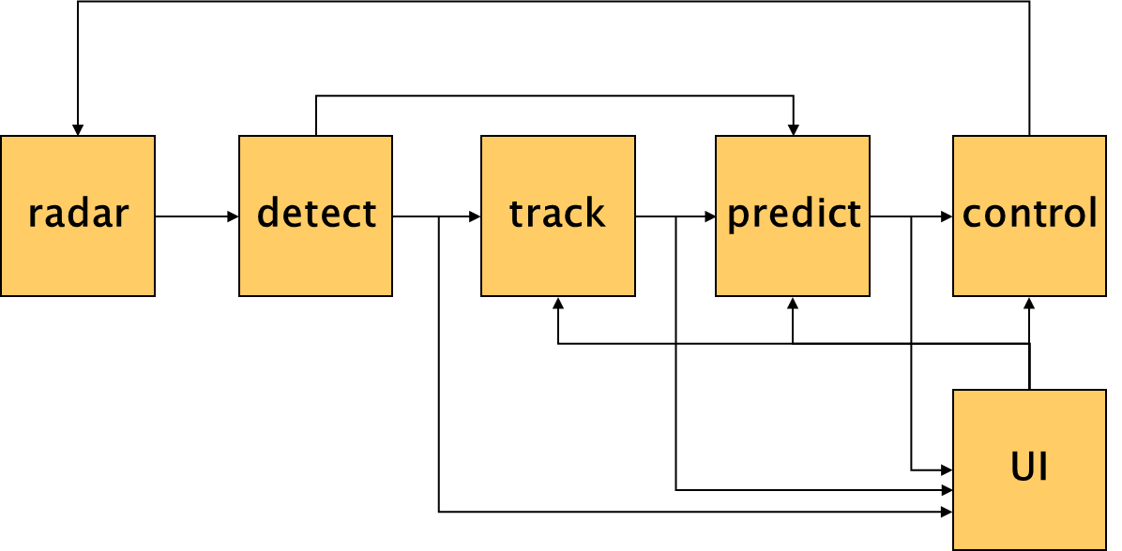
Reflection on
Architectural Style of Pub/Sub
The architectural style strongly influences
the complexity of the overall design, and
the systems’ quality attributes
radar
detect
track
predict
control
UI

Slide 95
When to use P/S
Data is short-lived
‘Frequent’ production of data
Consumers are interested in updates
Multiple consumers
Dynamically changing topology of producers and/or consumers

Slide 96
References
Control System Software, M. Boasson
IEEE Transactions on Automatic Control, Vo. 38, No. 7, July 1993
Software Architecture for Large Embedded Systems
M. Boasson and E. de Jong
http://www.cwi.nl/~marcello/SAPapers/BJ97.html

Slide 97
CONTENTS
Introduction
Architectural styles
2.1 Client/Server
2.2 Pipe and Filter style
2.3 Blackboard style
2.4 Publish Subscribe
2.5 Peer-to-Peer
2.6 Layered style
3. Interaction style
4. Conclusions

Slide 98
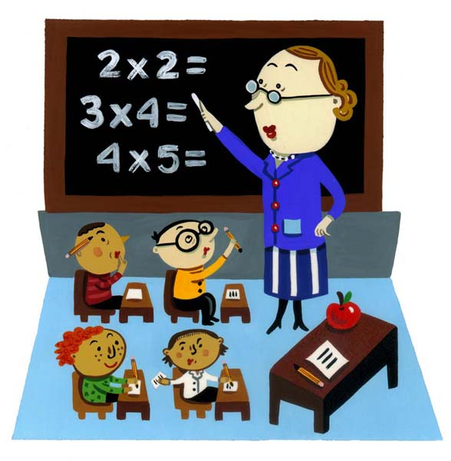
Blackboard Style (1)
Concept: Concurrent transformations on
shared data
data
Component
Component
Component
Components: processing units (typically knowledge source)
Connectors: blackboard
interaction style: asynchronous
Topology: one or more transformation-components may
be connected to a data-space,
there are typically no connections between
processing units (bus-topology)
Notes:
Overlap with Client-Server paradigm
if repository is passive and encapsulated and all clients are active
What are the connectors in the blackboard architecture?
- the links between the processing units and the dataspace?
- or the actual blackboard mechanism
(which connects all processing units together)?

Slide 99
Blackboard Style (2)
Behaviour Types:
a. Passive repository
  Accessed by a set of components; e.g. database or server
b. Active repository
  Sends notification to components when data of interest changes; e.g. blackboard or active database
data
Component
Component
Component
Constraints:
Consistency of repository: Various types of (transaction) consistency

Slide 100
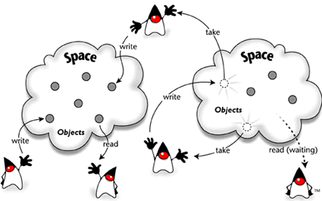
JavaSpaces – Blackboard in Java

Slide 101
Layering & Blackboard
UI
UI
UI
UI
A
B
C
A
B
C
BB
BB

Slide 102
Blackboard Style (3)
Advantages:
Allows different control heuristics
Reusable & heterogeneous knowledge sources
Support for fault tolerance and robustness
by adding redundant components
+/- Dataflow is not directly visible
Disadvantages
Distributed implementation is complex
  distribution and consistency issues

Slide 103
Blackboard Characteristics
Data may be structured (DB) or unstructured
Data may be selected based on content
Applications may insert/retrieve different data-type
per access.
This in contrast to pub-sub where data of the same type
is retrieved repeatedly

Slide 104
Blackboard and consistency
C1
C2
C3
Delete(Z)
Insert(Z)
BB
A..Z
A..Z
A..Z
Node1
Node2
Node3
Node 1, 2 and 3 are all storing a copy of the entire
dataset (A-Z). This increases reliability & availability
and improves response time *(. But ….

Slide 105
Blackboard and consistency
C1
C2
C3
Delete(Z)
Insert(Z)
BB
A..Z
A..Z
A..Z
Node1
Node2
Node3
C1 and C3 may ‘see’ a different content on the blackboard
depending on the order (and speed) of executing the delete
and insert actions.

Slide 106
Example of Blackboard Architecture
Hearsay, speech understanding
Hearsay was developed in the 1970’s by Raj Reddy et al. at Carnegie Mellon University.
Randy Davis, Speech Understanding Using Hearsay, MIT videotape, 1984.
Slides adapted from Terry Bahill, Univ. Arizona, 2007

Slide 107
Hearsay: knowledge sources
Acoustics
Spectrographs
Phonetics
Pronunciation
Coarticulation
Syntax
Semantics
Pragmatics
data
Acoustics
Spectrogr.
Phonetics
Syntax
Pronunciation
Semantics
Pragmatics
Notes:
Phoneme triples was considered but not implemented in Hearsay.

Slide 108
Hearsay: levels of abstraction*
Notes:
The Randy Davis’ slides showed interactions at only one level above and one level below (with one exception).
For the lower three levels they turned off the top-down – bottom-up structure of the blackboard and forced it to do bottom-up only until they got to the word level.

Slide 109
A blackboard architecture for countering terrorism
Rubin, S.H.; Smith, M.H.; Trajkovic, L.
Systems, Man and Cybernetics, 2003. IEEE International Conference on
Volume 2, Issue , 5-8 Oct. 2003 Page(s): 1550 - 1553 vol.2

Slide 110
L.D. Erman, F. Hayes-Roth, V.R. Lesser and D. R. Reddy, “The Hearsay-II speech understanding system: integrating knowledge to resolve uncertainty”, ACM Computing Surveys 12(2), pp213-253, 1980.
L.D. Erman, P.E. London and S. F. Fickas, “The Design and an Example Use of Hearsay-II”, Proc. IJCAI-81, pp 409-415, 1981.

Slide 111
Hearsay: control
Data driven
Asynchronous
Opportunistic
Islands of reliability
Combined top-down and bottom-up

Slide 112
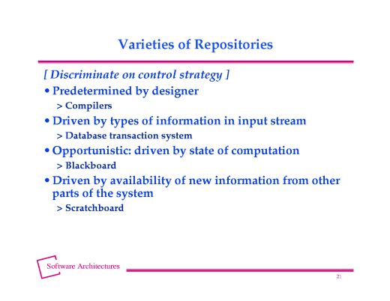
From http://www.cs.cmu.edu/afs/cs/project/tinker-arch/www/html/1997/lectures/19.Blkbd/base.020.html

Slide 113
Blackboard Style (4) Quality Factors
Extensibility: components can be easily added
Flexibility: functionality of components can be easily
changed
Robustness: + components can be replicated,
- blackboard is single point of failure
Security: - all process share the same data
+ security measures can be centralized
around blackboard
Performance: easy to execute in parallel fashion
consistency may incur synchroniz.-penalty

Slide 114
Blackboard Style (5) Application Context
Rules of thumb for choosing blackboard (o.a. from Shaw):
if representation & management of data is a central issue
if data is long-lived
if order of computation
  can not be determined a-priori
  is highly irregular
  changes dynamically
if units of different functionality (typically containing
highly specialized knowledge) concurrently act on shared
data (horizontal composition of functionality)
Example application domain: expert systems

Slide 115

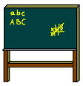




Interaction Styles and Dependencies
Broadcast
Blackboard
Radio, TV
Notice board
Referential coupling
no
yes
Connection-
oriented
Asynchronous
connection
telephone
E-mail
yes
no
Temporal coupling
Referential coupling : sender has reference to receiver name/address
Temporal coupling: sender and receiver synchronize in time
Notes:
Referential (de)coupling : sender has (no) reference to receiver
Temporal (de)coupling: sender and receiver synchronize in time
Referential coupling gaat snel in de richting van 1-1 communicatie.

Slide 116
Summary Architectural Styles
Every Architect should have a standard set of
architectural styles in his/her repertoire
it is important to understand the essential properties
of each style: when to (not) use them
examples:
  C/S, pipe and filters, blackboard, pub/sub, P2P
The choice for a style can make a big difference in
the quality properties of a system
analysis of the differences can provide rational for
choosing a style

Slide 117
Questions ?

Slide 118

The Single Responsibility Principle (SRP)
Classes should not have more than one responsibility.
Anti pattern: GOD class, or Swiss Army Knife

Slide 119
Domino-Effect of Changes
UI
Application
Domain
Infrastructure

