Slide 1

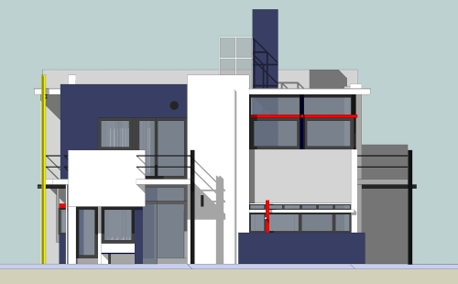
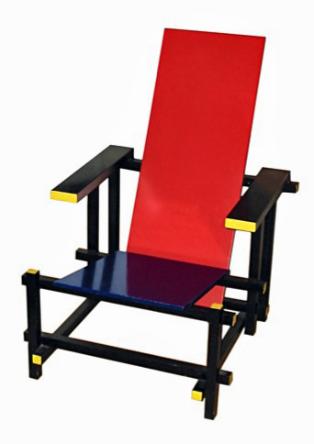
Architectural Styles - Part III
M.R.V. Chaudron
chaudron@chalmers.se | chaudron@gu.se

Slide 2
Schedule
Week |  | Date | Time | Lecture | Reading | Note
4 | L1/S1 | 22 JAN | 10:15 – 12:00 | Introduction, Objectives & Organization
4 | L2 | 23 JAN | 13:15 – 15:-00 | Architecting Process & Architecture Views | Ch 1 & 2
5 |  | 28 JAN | 10:15 – 12:00 | Skip
5 | S2 | 29 JAN | 10:15 - 12:00 | << Supervision: Launch Assignment 1>> | Ch 3 & 4
5 |  | 30 JAN | 13:00 – 15:00 | Skip
6 | L3 | 3 FEB | 13:15 – 15:00 | Design Principles (Maintainability, Modifiability) | Ch 7
6 | S3 | 5 FEB | 10:15 – 12:00 | << Supervision/Assignment>>
6 | L4 | 6 FEB | 13:15 – 15:00 | Architectural Styles 1: Client-Server | Ch 13
7 | L5 | 10 FEB | 13:15 – 15:00 | Technical Debt |  | Terese
7 | S4 | 12 FEB | 10:15 – 12:00 | << Supervision/Assignment>>
7 | L6 | 13 FEB | 10:15 – 12:00 | Architectural Styles 2: Pipe&Filter and Publ-Subscr | Ch 13
8 | L7 | 17 FEB | 13:15 – 15:00 | Architectural Styles 3: Blackboard & Performance – Analysis & Tactics | Ch 8 + paper
8 | S5 | 19 FEB | 10:15 – 12:00 | << Supervision/Assignment>>
8 | L8 | 20 FEB | 10:15 – 12:00 | Reliability, Availability, Fault Tolerance | Ch 5, 14 + paper
9 | L9 | 24 FEB | 13:15 – 15:00 | Anders Alminger - Volvo
9 | S6 | 26 FEB | 10:15 – 12:00 | << Supervision/Assignment>>
9 | L10 | 27 FEB | 13:15 – 15:00 | Architecture Evaluation | Ch 21 | Rodi PhD
10 | L11 | 2 MAR | 13:15 – 15:00 | Reverse Engineering & Correspondence | Ch 20
10 | S7 | 4 MAR | 10:15 – 12:00 | << Supervision/Assignment>>
10 | L12 | 5 MAR | 13:15 – 15:00 | Guest Lecture 2

Slide 3
Outline of Topics for Today’s Lecture
Recap
  Architectural Styles
    Client – Server, Pipe and Filter, Publish-Subscribe
Blackboard
Tactics
  Esp. performance

Slide 4
Assignment Schedule
Week |  | Date | Lecture | Assignment1 | Assignment2
4 | L1/S1 | 22 JAN |  | Form groups & read Ass 1
4 | L2 | 23 JAN
5 |  | 28 JAN
5 | S2 | 29 JAN |  | Work & TA feedback
5 |  | 30 JAN
6 | L3 | 3 FEB
6 | S3 | 5 FEB |  | Hand-in draft of Ass 1
6 | L4 | 6 FEB |  | (perform peer review)
7 | L5 | 10 FEB
7 | S4 | 12 FEB |  | 11 Feb: Deadline peer review Ass 1 | Start Assignment 2
7 | L6 | 13 FEB
8 | L7 | 17 FEB
8 | S5 | 19 FEB |  | Work & TA feedback | Work & TA feedback
8 | L8 | 20 FEB
8 |  | 21 FEB |  |  | Hand-in Ass 2
9 | L9 | 24 FEB |  |  | Deadline peer review Ass 2
9 | S6 | 26 FEB |  | Work & TA feedback | Revise Ass 2
9 | L10 | 27 FEB
10 | L11 | 2 MAR |  |  | Deadline Ass 2
10 | S7 | 4 MAR |  | Deadline Ass 1
10 | L12 | 5 MAR

Slide 5
Assignment 1
Improve your architecture design and its documentation based on feedback
Move on to implementation
  Use MQTT
  Programming language of your choice
  Ok to ‘mock up’ algorithms

Slide 6
Architectural style 1/2
An architectural style is defined by:
a set of rules, principles and constraints that prescribe
  vocabulary/metaphor: which types of components,
  interfaces & connectors must/may be used
  in a system.
  Possibly introducing domain-specific types
  structure: how components and connectors may be
  combined
  behaviour: how the system behaves
  guidelines: these support the application of the style
  (how to achieve certain system properties)

Slide 7
Architectural style
Architectural styles are design paradigms for
a set of design dimensions
  Some architectural styles emphasize different aspects
  such as: Subdivision of functionality, Topology or
  Interaction style
Styles are open-ended; new styles will emerge
An architecture can use several architectural styles
Architectural styles are not disjoint
Notes:
An architectural style can be regarded as a set of constraints on the architectural components and their interaction

Slide 8
Used diagrams/slides
from this book

Slide 9
Client-Server (S+B+D)
There is more than structure
to a style!
Client
1..*
1
Server
Client
Server
Client
Server

Slide 10
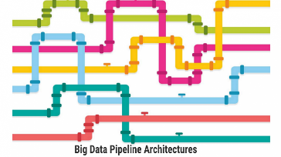
Pipe and Filter (Struct+Behaviour)
Source
Filter1
Filter2
Sink
Source
Filter1
Filter2
Sink

Slide 11

Publish-Subscribe
1..*
1..*
Publisher
Subscriber
1
1
P/S-Middleware
Pub1
P/S-M’ware
Subscr1
Subscr2
Subscr:D1
Pub:D1
Subscr:D1
v:D1
v
w:D1
v
w
w

Slide 12
Publish-Subscribe
1..*
1..*
Publisher
Subscriber
1
1
P/S-Middleware
Pub1
P/S-M’ware
Subscr1
Subscr2
Subscr:D1
Register as subscriber
of type D1
Register as producer of type D1
Pub:D1
Subscr:D1
Register as subscriber
of type D1
v:D1
Produce values: v, w
v
Deliver v
w:D1
v
w
w
Deliver w

Slide 13
Publ/Subscribe Deployment
Publ
Subscr
P/S-Middleware
P/S Agent
P/S Agent

Slide 14
Publ/Subscribe Deployment
1..*
1..*
1..*
1..*
Publ
Subscr
Publ
Subscr
P/S-Middleware
P/S Agent
P/S Agent
P/S Agent
There can be multiple publishers and subscribers
deployed on a single computation node

Slide 15
CONTENTS
Introduction
Architectural styles
2.1 Client/Server
2.2 Pipe and Filter style
2.3 Blackboard style
2.4 Publish Subscribe
2.5 Peer-to-Peer
2.6 Layered style
3. Interaction style
4. Conclusions

Slide 16

Blackboard Style (1)
Concept: Concurrent transformations on
shared data
Component
Component
Component
data
Components: processing units (typically knowledge source)
Connectors: blackboard
interaction style: asynchronous
Topology: one or more transformation-components may
be connected to a data-space,
there are typically no connections between
processing units (bus-topology)
Notes:
Overlap with Client-Server paradigm
if repository is passive and encapsulated and all clients are active
What are the connectors in the blackboard architecture?
- the links between the processing units and the dataspace?
- or the actual blackboard mechanism
(which connects all processing units together)?

Slide 17
Blackboard Style (1)
Concept: Concurrent transformations on
shared data
Component
Component
Component
Component
Component
Shared Data Storage
Components: processing units (typically knowledge source)
Connectors: blackboard
interaction style: asynchronous
Topology: one or more transformation-components may
be connected to a data-space,
there are typically no connections between
processing units (bus-topology)
Notes:
Overlap with Client-Server paradigm
if repository is passive and encapsulated and all clients are active
What are the connectors in the blackboard architecture?
- the links between the processing units and the dataspace?
- or the actual blackboard mechanism
(which connects all processing units together)?

Slide 18
Blackboard
Component
1..*
1
BB-Middleware
Comp1
BB-M’ware
Comp2
Comp3
Put:p:D1
Get:D1
Put:q:D2
p
Put:r:D2
Get:D2
q
Get:D2
r

Slide 19
Blackboard
Component
1..*
1
BB-Middleware
Comp1
BB-M’ware
Comp2
Comp3
Put:p:D1
Get:x:D1 where Pred(x)
Ask for a data-item of type D1 that satisfies some condition Pred
p

Slide 20
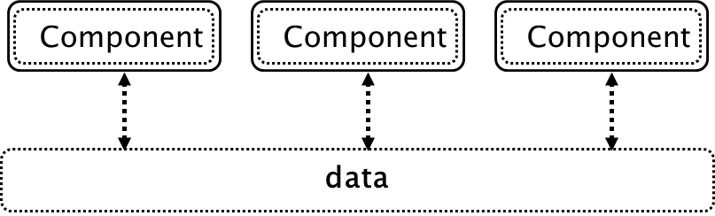
Blackboard Style (2)
Behaviour Types:
a. Passive repository
  Accessed by a set of components; e.g. database or server
b. Active repository
  Sends notification to components when data of interest changes; e.g. blackboard or active database
Component
Component
Component
Componen
Component
Shared Data Storage
Constraints:
Consistency of repository: Various types of (transaction) consistency

Slide 21
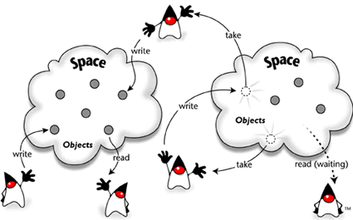
JavaSpaces – Blackboard in Java

Slide 22
Layering & Blackboard
UI
UI
UI
UI
A
B
C
A
B
C
BB
BB

Slide 23
Blackboard Style (3)
Advantages:
Allows different control heuristics
Reusable & heterogeneous knowledge sources
Support for fault tolerance and robustness
by adding redundant components
+/- Dataflow is not directly visible
Disadvantages
Distributed implementation is complex
  distribution and consistency issues

Slide 24
Blackboard Characteristics
Data may be structured (like in a DB)
or unstructured
Data may be selected based on content
Applications may insert/retrieve different data-type
per access.
This in contrast to pub-sub where data of the same type
is retrieved repeatedly

Slide 25
Blackboard Deployment
1..*
1..*
1..*
1..*
Comp1
Comp2
Comp3
Comp4
BB-Middleware
BB-
Agent
BB Agent
BB Agent
There can be multiple components
deployed on a single computation node

Slide 26
Blackboard and consistency
C1
C2
C3
Delete(Z)
Insert(Z)
BB
A..Z
A..Z
A..Z
Node1
Node2
Node3
Node 1, 2 and 3 are all storing a copy of the entire
dataset (A-Z). This increases reliability & availability
and improves response time *(. But ….

Slide 27
Blackboard and consistency
C1
C2
C3
Delete(Z)
Insert(Z)
BB
A..Z
A..Z
A..Z
Node1
Node2
Node3
C1 and C3 may ‘see’ a different content on the blackboard
depending on the order (and speed) of executing the delete
and insert actions.

Slide 28
Example of Blackboard Architecture
Hearsay, speech understanding
Hearsay was developed in the 1970’s by Raj Reddy et al. at Carnegie Mellon University.
Randy Davis, Speech Understanding Using Hearsay, MIT videotape, 1984.
Slides adapted from Terry Bahill, Univ. Arizona, 2007

Slide 29
Hearsay: knowledge sources
Acoustics
Spectrographs
Phonetics
Pronunciation
Coarticulation
Syntax
Semantics
Pragmatics
Acoustics
Spectrogr.
Phonetics
Pragmatics
Pronunciation
Semantics
Syntax
data
Notes:
Phoneme triples was considered but not implemented in Hearsay.

Slide 30
Hearsay: levels of abstraction*
Notes:
The Randy Davis’ slides showed interactions at only one level above and one level below (with one exception).
For the lower three levels they turned off the top-down – bottom-up structure of the blackboard and forced it to do bottom-up only until they got to the word level.

Slide 31
A blackboard architecture for countering terrorism
Rubin, S.H.; Smith, M.H.; Trajkovic, L.
Systems, Man and Cybernetics, 2003. IEEE International Conference on
Volume 2, Issue , 5-8 Oct. 2003 Page(s): 1550 - 1553 vol.2

Slide 32
L.D. Erman, F. Hayes-Roth, V.R. Lesser and D. R. Reddy, “The Hearsay-II speech understanding system: integrating knowledge to resolve uncertainty”, ACM Computing Surveys 12(2), pp213-253, 1980.
L.D. Erman, P.E. London and S. F. Fickas, “The Design and an Example Use of Hearsay-II”, Proc. IJCAI-81, pp 409-415, 1981.

Slide 33
Hearsay: control
Data driven
Asynchronous
Opportunistic
Islands of reliability
Combined top-down and bottom-up

Slide 34
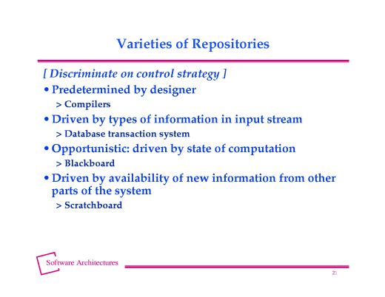
From http://www.cs.cmu.edu/afs/cs/project/tinker-arch/www/html/1997/lectures/19.Blkbd/base.020.html

Slide 35
Blackboard Style (4) Quality Factors
Extensibility: components can be easily added
Flexibility: functionality of components can be easily
changed
Robustness: + components can be replicated,
- blackboard is single point of failure
Security: - all process share the same data
+ security measures can be centralized
around blackboard
Performance: easy to execute in parallel fashion
consistency may incur synchroniz.-penalty

Slide 36
Blackboard Style (5) Application Context
Rules of thumb for choosing blackboard (o.a. from Shaw):
if representation & management of data is a central issue
if data is long-lived
if order of computation
  can not be determined a-priori
  is highly irregular
  changes dynamically
if units of different functionality (typically containing
highly specialized knowledge) concurrently act on shared
data (horizontal composition of functionality)
Example application domain: expert systems

Slide 37

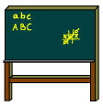
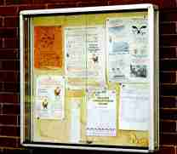



Interaction Styles and Dependencies
Broadcast
Blackboard
Radio, TV
Notice board
Referential coupling
no
yes
Connection-
oriented
Asynchronous
connection
telephone
E-mail
yes
no
Temporal coupling
Referential coupling : sender has reference to receiver name/address
Temporal coupling: sender and receiver synchronize in time
Notes:
Referential (de)coupling : sender has (no) reference to receiver
Temporal (de)coupling: sender and receiver synchronize in time
Referential coupling gaat snel in de richting van 1-1 communicatie.

Slide 38
Summary Architectural Styles
Every Architect should have a standard set of
architectural styles in his/her repertoire
it is important to understand the essential properties
of each style: when to (not) use them
examples:
  C/S, pipe and filters, blackboard, pub/sub, P2P
The choice for a style can make a big difference in
the quality properties of a system
analysis of the differences can provide rational for
choosing a style

Slide 39
Part II:
Architectural Tactics
Truong Ho Quang (truongh@chalmers.se)

Slide 40
Objectives
In this lecture you will learn:
  What is an architectural tactic
  How to address quality requirements through tactics
  A catalogue of tactics

Slide 41
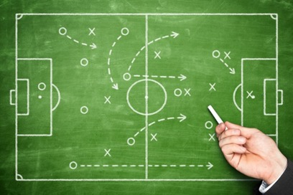
Tactics
A tactic is a design decision that influences the achievement of a quality attribute response
  Different tactics for each quality attribute
  The same tactic could be relevant to many quality attributes
  No consideration of tradeoffs
  Building blocks of archiectural styles

Slide 42





Example Quality Attributes
Availability
Interoperability
Performance
Modifiability
Security

Slide 43
Performance
Different types of performance:
Throughput – number of items handled per second
Response time/Turn-around time/Latency
Efficiency – resources used per (trans)action
Tactics:
Resource demand
Resource management
Resource arbitration

Slide 44
Resource Demand
input
processing
‘load’
output
resources
CPU, memory,
disk, network
Reduce load
Manage event rate
(e.g. drop requests, queue requests)
Control frequency of sampling
Prioritize events
Increase computational efficiency
Reduce computational overhead
Reduce computation
(e.g. scale quality of output)
Bound execution times
Bound queue sizes
Increase Resources
Replicate server (=CPU’s)

Slide 45
Load Balancer
Regular Client-Server
C
S
C
S
C
S
Client-Server with load balancer
1..*
1..*
C
LB
S1
S2
C
LB
S
check load status
C
S2
check load status
LB
S1
actual request

Slide 46
Client-Server with load balancer
C
LB
S1
S2
C
LB
S
check load status
C
S2
check load status
LB
S1
actual request
Many variations are possible
(Almost) the same tactic can also be used for improving
availability

Slide 47

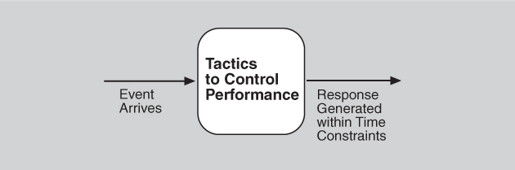
Performance
Definition:
  Performance is about time and the software system’s ability to meet timing requirements.

Slide 48
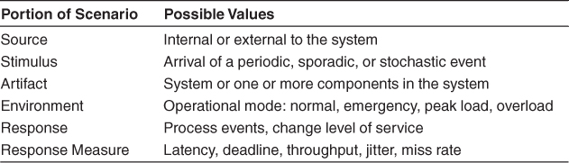
Performance General Scenario

Slide 49
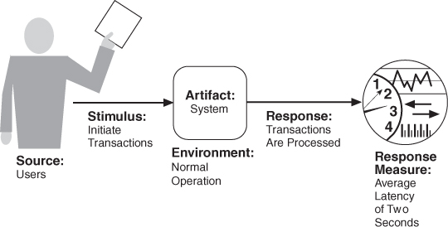
Performance Concrete Scenario

Slide 50
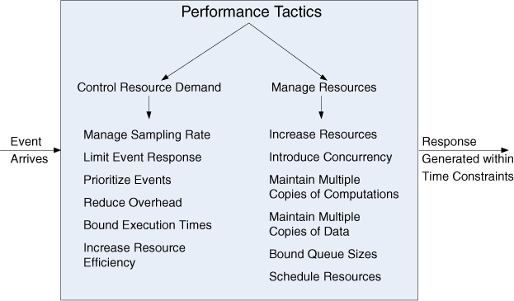
Performance Tactics

Slide 51

Question
      As developer, how would you ‘increase resource efficiency’?

Slide 52
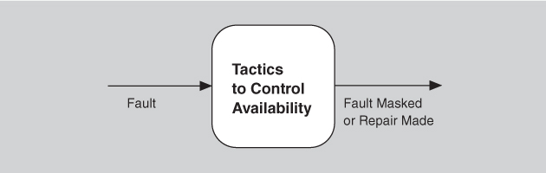
Availability
Definition:
  The ability of a system to mask or repair faults such as the cumulative service outage period does not exceed a required value over a specified time interval.

Slide 53
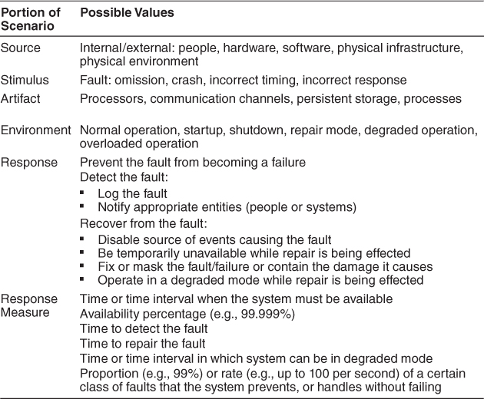
Availability General Scenario

Slide 54
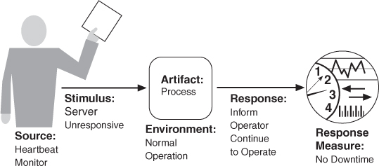
Availability Concrete Scenario
Notes:
This shows a concrete availability scenario:
The heartbeat monitor determine if the server is unresponsive during normal operation.
The system inform operator and continue to operate with no downtime.

Slide 55
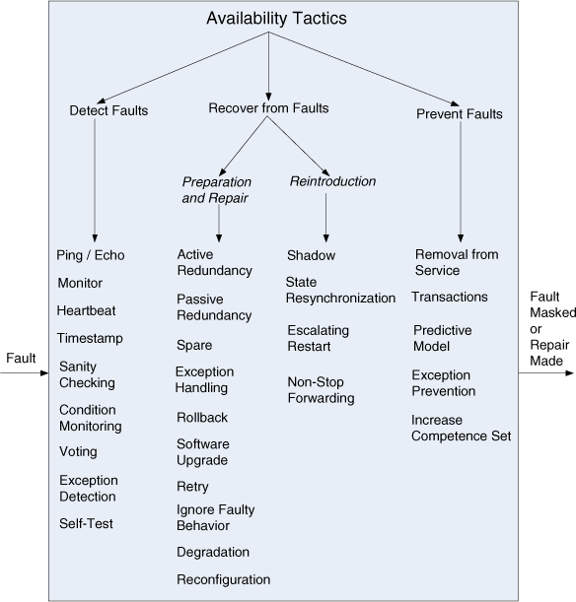
Availability Tactics

Slide 56
Question
      Considering availability tactics, what are the performance implications of using these tactics?
Notes:
Low frequency: might not detect all the time
High frequency: Consume resources…

Slide 57
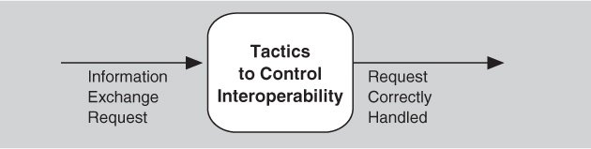
Interoperability
Definition:
  The degree to which two or more systems can usefully exchange meaningful information via interfaces in a particular context.

Slide 58
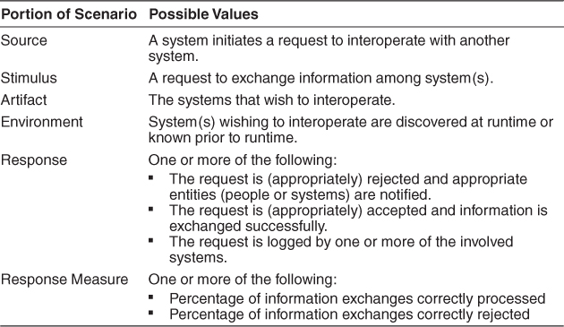
Interoperability General Scenario

Slide 59
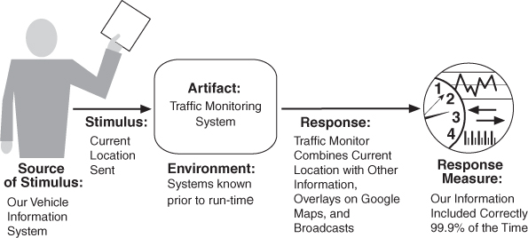
Interoperability Concrete Scenario

Slide 60
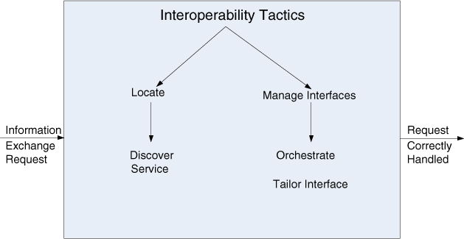
Interoperability Tactics

Slide 61
Question
      How do competing technology vendors achieve interoperability?
Notes:
Standard
Talking with each other

Slide 62
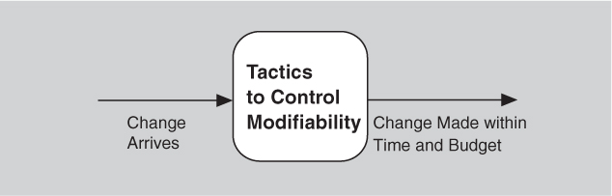
Modifiability
Definition:
  Modifiability is about change, and our interest in it centers on the cost and risk of making changes.

Slide 63
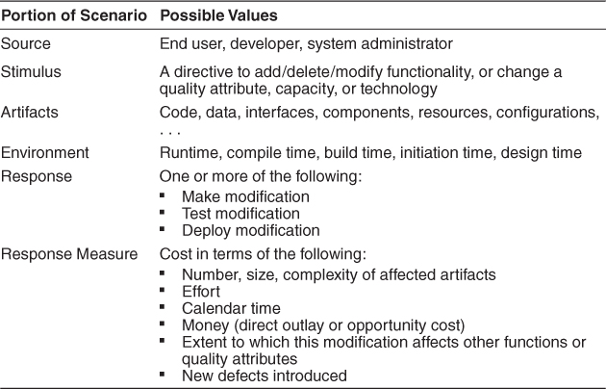
Modifiability General Scenario

Slide 64
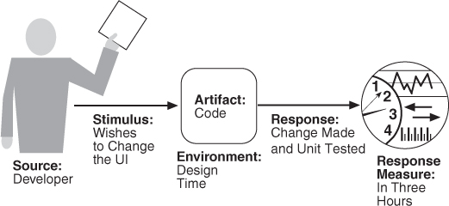
Modifiability Concrete Scenario

Slide 65
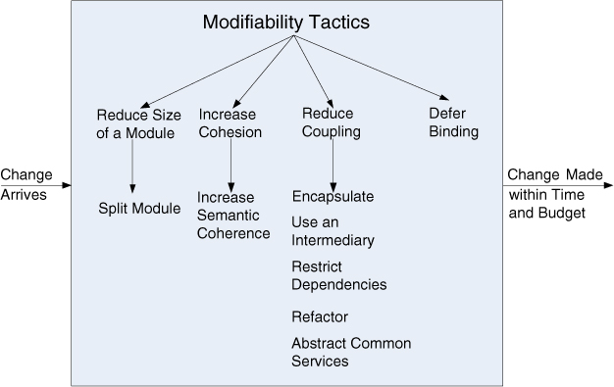
Modifiability Tactics

Slide 66
Question
      What could be a disadvantage of ‘split module’ and ‘defer binding’ as tactics?

Slide 67
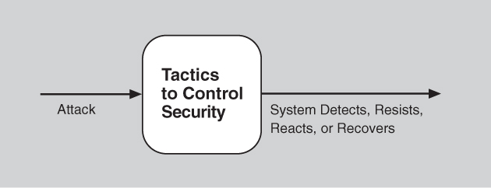
Security
Definition:
  Security is a measure of the system’s ability to protect data and information from unauthorized access while still providing access to people and systems that are authorized.

Slide 68
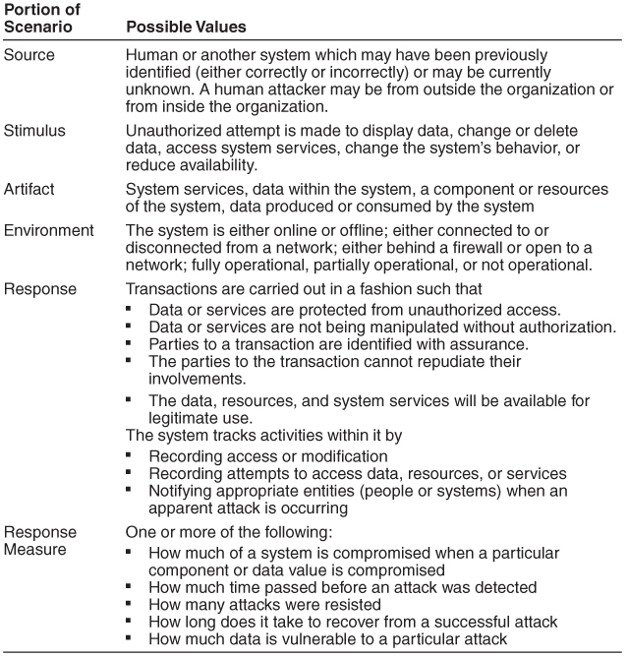
Security General Scenario

Slide 69
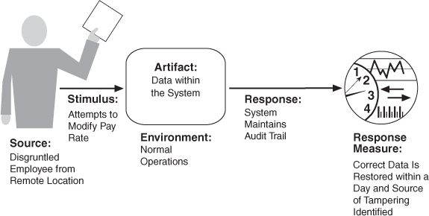
Security Concrete Scenario

Slide 70
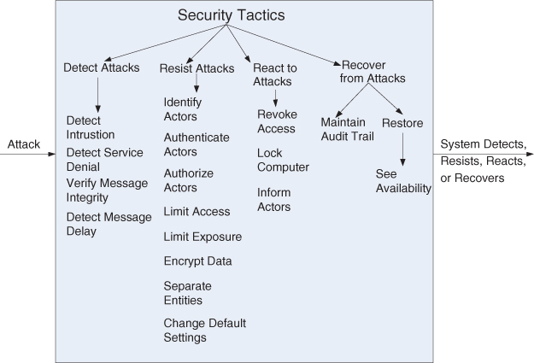
Security Tactics

Slide 71
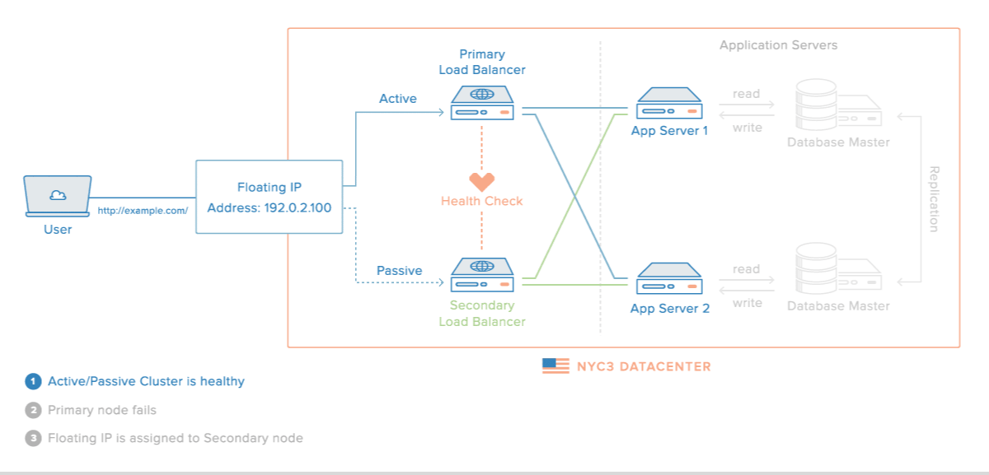
Example Architectural Tactics
[https://www.digitalocean.com]

Slide 72
Questions ?

Slide 73
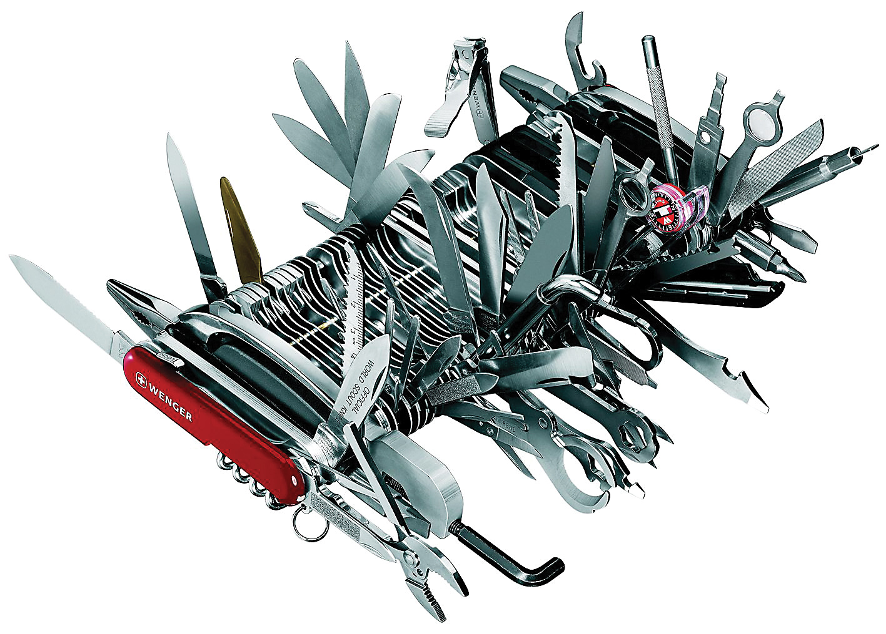
The Single Responsibility Principle (SRP)
Classes should not have more than one responsibility.
Anti pattern: GOD class, or Swiss Army Knife

Slide 74
Domino-Effect of Changes
UI
Application
Domain
Infrastructure

