Slide 1
Quantitative Analysis of Extra-Functional Quality Properties of Software Architectures
Michel R.V. Chaudron
Professor in Software Engineering
michel.chaudron(@)gu.se
chaudron(@)chalmers.se

Slide 2
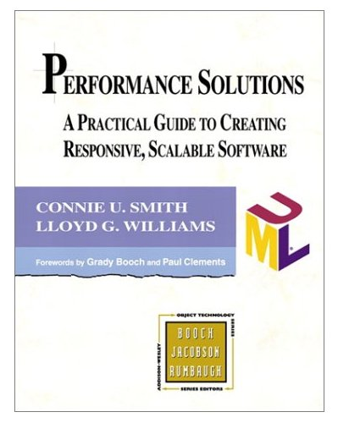
Software Performance Engineering
Connie U. Smith & Lloyd G. Williams
Performance Solutions: A Practical Guide to creating response, scalable software, Addison-Wesley, 2002

Slide 3
Extra Functional Properties
Performance
Scalability
Reliability
System
Maintainability
Efficiency
CPU, Memory Use
Timeliness
Schedulability
Essential system engineering problem:
a plurality of contradictory goals
a plurality of means (technology, process)
each of which provides a varying degree of help or hindrance in achieving a given goal
Notes:
B. Boehm, Software Engineering Economics

Slide 4
Some more examples of *ilities
Accessibility, Understandability, Usability, Generality, Operability, Simplicity, Mobility, Nomadicity, Portability, Accuracy, Efficiency, Footprint, Responsiveness, Scalability, Schedulability, Timeliness, CPU utilization, Latency, Throughput, Concurrency, Flexibility, Changeability, Evolvability, Extensibility, Modifiability, Tailorability, Upgradeability, Expandability, Consistency, Adaptability, Composability, Interoperability, Openness, Integrability, Accountability, Completeness, Conciseness, Correctness, Testability, Traceability, Coherence, Analyzability, Modularity, Reusability, Configurability, Distributeability, Availability, Confidentiality, Integrity, Maintainability, Reliability, Safety, Security, Affordability, Serviceablility, …

Slide 5
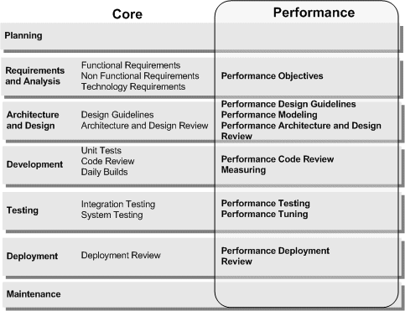
Performance throughout lifecycle

Slide 6
Performance in Requirements Engineering
It is difficult to understand requirements in terms of application domain;
E.g. In digital video: good picture quality?
In airbag: should be safe?
we don’t know how to quantify?
Resource needs are often underestimated when requirements are vague
Requirements are volatile:
the architecture should cater for changes

Slide 7
Performance Myths
It is not possible to do anything about performance until you have something to measure
Performance models are complex and expensive to construct.
Architecture determines performance properties
Simple models (‘back of the envelope’) can identify performance problems.

Slide 8
Performance Analysis
Performance is the ability of a system to meet its objectives for timeliness
How well can this system handle the anticipated demand?
What will the average response time be?
Given a max. accept. response time, what is the highest load the system can handle?
Which component is the bottleneck?
Client
Client
Client
Server
Database

Slide 9
Performance Engineering
Important performance characteristics:
Response Time
The time it takes the system to react to an impulse/trigger
Throughput
The rate at which jobs are completed
Capacity
Typically: storage, processing, bandwidth
Performance Engineering is also known as: Capacity Planning

Slide 10
Scalability (definition)
Scalability = the ability of a system to continue to meet its performance objectives under increasing demand
Scalability is limited by available resources
Thrashing is caused by contention for CPU, disk, netw.
resource
system saturation
throughput
response time
system saturation
thrashing
load
load

Slide 11
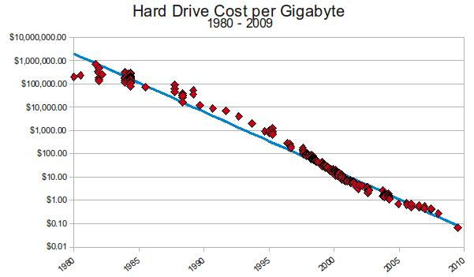
Source: A History of Storage Cost by Matthew Komorowski

Slide 12
Zen of Performance: Balance
resource capacity
demand
workload
Architect’s goal: to establish the (minimum) amount of hardware that will allow the system to meet its performance goals.
Architect’s aim: to understand the trade-off between resources and performance

Slide 13
Software Performance Engineering Process
Quantitative objectives the system has to meet
performance objectives
assess performance risk
Threats for realizing performance
identify critical use cases
Critical actions important to responsiveness as seen by the user
performance scenarios
Which scenarios are executed? And how often?
How much resources does each scenario require?
adapt
architecture
resource requirements
workload model
not ok
performance model
evaluate
capacity model
ok
design hardware infrastructure
manage implementation

Slide 14
Determining workload - Exercise
How many requests does the university library system receive per hour (during office hours)?
How many requests does a bank receive per hour for processing transactions / ATM withdrawal requests?
How many requests does an airline booking system receive for checking availability of seats on flights?
How many telephone calls go through a base station per hour?

Slide 15
Software Performance Engineering Process
performance objectives
from stakeholders
1
assess performance risk
architect (use brain)
2
identify critical use cases
architect: from use case diagrams
3
performance scenarios
architect: from scenario diagrams
4
architect: (historic) estimates / measurement
5
resource requirements
workload model
performance model
capacity model
design hardware infrastructure
architect: from deployment view
6

Slide 16
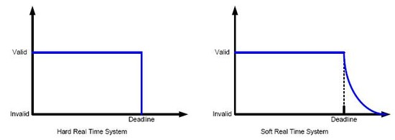
Determine Performance Objectives
1
Deduce performance objectives from business objectives
What makes the system
Acceptable (minimum)
Attractive
Future-proof
What is the cost of missing deadlines?
Hard-RT
Soft-RT

Slide 17
Guidelines performance risk scenario’s
2
Top-down (by requirements)
Assumptions on environment/load
Boundary cases: Peak load
Combinations of events
Mode-changes
Bottom-up (from solution / technology)
High utilization
Interrupts, caching
Dynamic allocation
Complex interactions
(unexpected) interactions between subsystems e.g. between CPU and memory-management or between different layers (e.g. software and hardware)

Slide 18
Identify Critical Use Cases
3
register
login
search
add item to
catalogue
add item to cart
remove item
from catalogue
customer
shop owner
remove item from cart
add to stock
pay items in cart
package & ship

Slide 19
Identify Critical Use Cases
3
register
register
login
search
add item to
catalogue
add item to cart
remove item
from catalogue
customer
shop owner
remove item from cart
add to stock
pay items in cart
package & ship

Slide 20
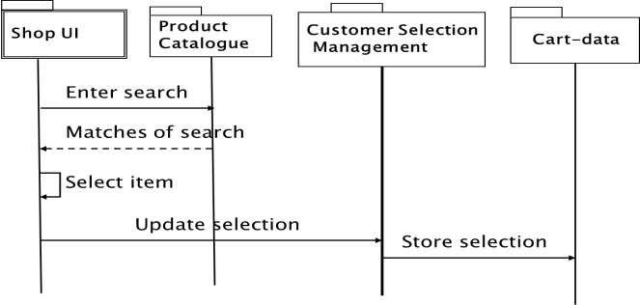
Identify Performance Scenario’s
4
1: register
2:search
customer
3:pay items in cart
Worst case Scenario: 1000*(2:search) || 100*(3: pay) / sec

Slide 21
Determine Software Resource Requirements
5
Understand the types of software resource requirements – at the level of the run-time architecture
Method Calls
Database queries
Data Loading:
How many files/tables? What is their size?
Caching
Discuss this with:
the software engineer that did the implementation
the project’s performance expert

Slide 22
Derive Load from Sequence Diagrams
A
B
Method(arg)
Processing load:
- DB / cache / processor
Return(arg)
transactions / sec
Network load
MB’s / sec

Slide 23
Software Resource Requirements
5
1: register
DB
2:search
Σ
customer
S
3:pay items in cart
UI
Σ
Compute / simulate, or use a performance-analysis tool!

Slide 24
References on Queueing Networks
E.D. Lazowska et.al., Quantitative System performance: computer system analysis using queueing networks, Prentice Hall, 1984
C.H. Sauer and K.M. Chandy, Computer systems performance modeling, Prentice Hall, 1981
Quantitative System Performance: Computer System Analysis Using Queueing Network Models, Edward D. Lazowska, John Zahorjan, G. Scott Graham, Kenneth C. Sevcik, available at: http://www.cs.washington.edu/homes/lazowska/qsp/

Slide 25
Classic paper
Architecture-based performance analysis, 1998
Spitznagel, Bridget, and David Garlan http://repository.cmu.edu/cgi/viewcontent.cgi?article=1702&context=compsci

Slide 26
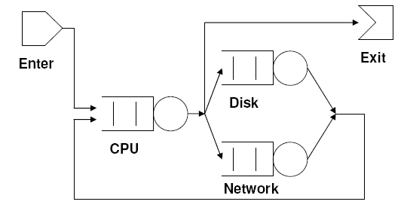
Queuing Networks
A queuing network processes jobs
The elements of the network are service centers, each of which has a queue
Jobs require service from a set of service centers and wait in a queue when a desired service center is busy.
Each job exists in only one device or queue at a time
In this Sw. Arch. class: be able to apply the formulas.

Slide 27
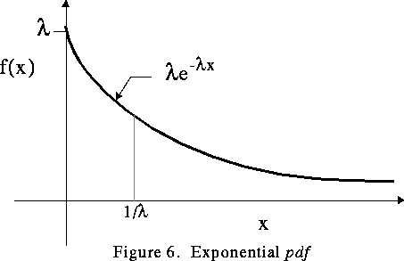
Service Centers
For example: bank teller, post office, database, …
Service Center characteristics:
service time: average time needed for processing a job
arrival rate: average rate at which jobs arrive
Usually service time and arrival rate are assumed to have an exponential distribution:
for an expected value of 1/λ,
F(t) = λ· e ^{- λ ·} ^{t}
example
Notes:
Note that the exponential distribution is memoryless: the expected time is independent of any previous activity

Slide 28
Architectural Styles and QN
Assumptions of QN seem to fit well with the following architectural styles:
pipe and filter
client/server
We assume messages are processed in FIFO order

Slide 29
QN Example
A job enters the system at the Client and is then serviced by the Client, the Server and the Database. After that it leaves the system.
Assume
An arrival rate of R jobs/second (at the Client)
Service times S_{C} , S_{S} and S_{D} respectively
Client
Server
Database
Utilization of component i: u_{i} = R · S_{i}
Avg. component queue length: q_{i} = u_{i}² / ( 1 – u_{i} )
Avg. component response time: S_{i} / ( 1 – u_{i} )
Avg. component population: p_{i} = u_{i} / ( 1 – u_{i} )
System population: P = Σ p_{i}
System response time: S = P/R
Notes:
Population = jobs in queue & jobs being processed

Slide 30
QN Example
For example if
arrival rate
R = 9.5 jobs/second
service times
S_{C} = 65 ms,
S_{S} = 20 ms, and
S_{D} = 103 ms
Client
Server
Database
Then component utilization will be
DB u_{DB} = 9.5 * 0.103 = 98%
Server u_{S} = 9.5 * 0.020 = 19%
Client u_{C} = 9.5 * 0.065 = 62%
Notes:
Population = jobs in queue & jobs being processed

Slide 31
QN Example
Utilization ( u_{i} = R · S_{i} )
Client u_{C} = 9.5 * 0.065 = 62%
Server u_{S} = 9.5 * 0.020 = 19%
DB u_{DB} = 9.5 * 0.103 = 98%
Avg. component response time ( S_{i} / ( 1 – u_{i} ) ):
Client t_{C} = 0.065/(1-0.62) = 0.17 s
Server t_{S} = 0.020/(1-0.19) = 0.025 s
DB t_{DB} = 0.103/(1-0.98) = 5.15 s
Avg. component population ( p_{i} = u_{i} / ( 1 – u_{i} ) ):
Client p_{C} = 0.62/0.38 = 1.6
Server p_{S} = 0.19/0.81 = 0.23
DB p_{DB} = 0.98/0.02 = 49
System population: P = Σ p_{i} = 50.8
System response time: S = P/R = 50.8/9.5 = 5.4 s
close to overload
bottleneck in
response time
Notes:
Population = jobs in queue & jobs being processed

Slide 32
QN Example
Avg. component queue length: q_{i} = u_{i}2 / ( 1 – u_{i} )
Client q_{C} = 0.38/0.38 = 1.0
Server q_{S} = 0.19/0.81 = 0.044
DB q_{DB} = 0.98/0.02 = 48
long queue length
If arrival rate or service time estimates are a little bit off,
we’re in big trouble.
Options: increase DB performance
replicate DB
reduce demand (arrival rate)
Which option to take?
It depends .... on other non-functional goals,
such as cost, scalability, reliability, ..
Notes:
Population = jobs in queue & jobs being processed

Slide 33
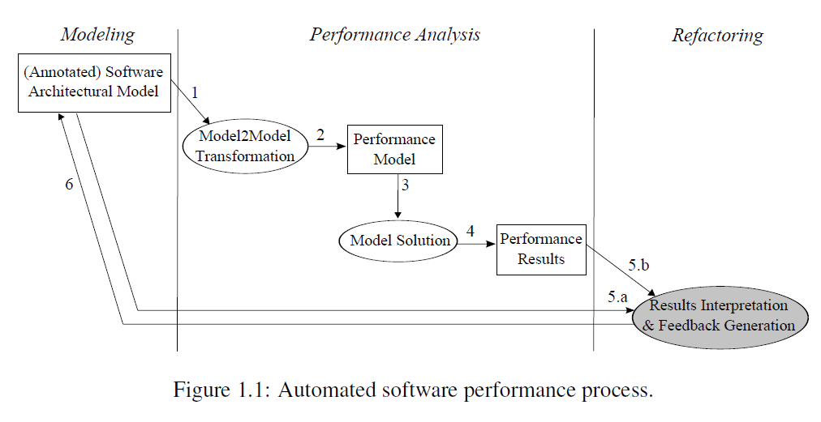
Automated Software Performance Analysis
analysis
From Catania Trubiani, Ph.D. thesis, 2011

Slide 34
1-slide Summary of Best Architecting Practices
Get stakeholder involvement & feedback early and frequently
Understand the drivers for the project (business, politics)
Understand the requirements incl. quality properties
SMART & prioritized
Develop iteratively and incrementally
Describe architecture using multiple views
abstract, but precise, design decisions & rationale
Monitor that architecture is implemented
Design for change (modularity, low coupling, inform. hiding)
Simplify, simplify, simplify
Analyze in an early stage (use maths! and scenarios)
Regularly update planning and risk analysis
Get good people, make them happy, set them loose

Slide 35
Summary
If you haven’t analyzed it, don’t build it.
Use analytical methods to support architectural decision making
Performance → Queuing networks
Many analyses are of ‘back of the envelope’ size.
little effort, lots of value
even if your model is not perfect (which they never are)

Slide 36
Reliability Block Diagrams Analysis and Tactics
No model is correct, but some are useful
– Albert Einstein
M.R.V. Chaudron

Slide 37
Reliability
Reliability is a measure of the continuous delivery of correct service
(Laprie)

Slide 38
What is Reliability?
Reliability is defined as the probability that an item will perform its intended function for a specified interval under stated conditions.
Reliability is a property over time,
= ‘a probability that something will work when you want it to.’

Slide 39
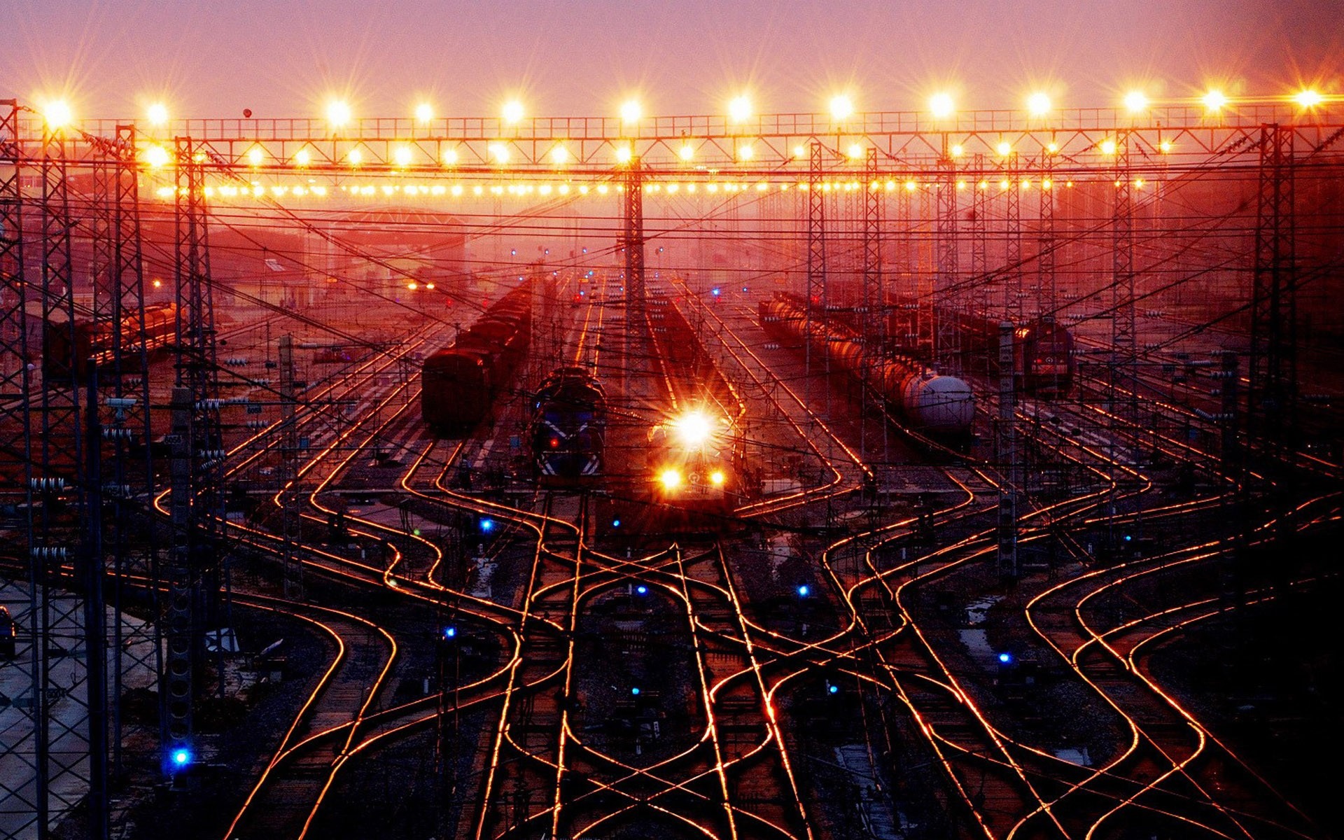
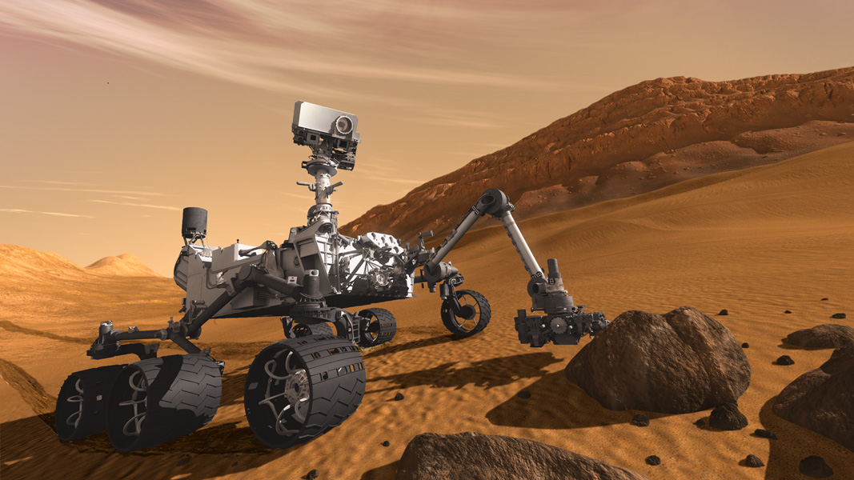
Reliability Figures of Merit
MTBF - Mean Time Between Failures
Typically used for: repairable systems
Train control system
MTTF - Mean Time to Failure
is the expected Time to Failure
Typically used: non-repairable systems
Mars rover

Slide 40
Reliability Block Diagrams (RBD)
A RBD is a graphical depiction of the system’s
components and connectors which can be used to
determine the overall system reliability
90%
97%
93%
80%
If any path through the system is successful, then
the system succeeds, otherwise it fails.

Slide 41
RBD 2: Assumptions
Lines have reliability 1
Failures of blocks are statistically independent
Blocks are bi-modal:
either their operate correctly or they fail and do nothing

Slide 42
MTBF
The MTBF is widely used as the measurement of equipment's reliability and performance. This value is often calculated by dividing the total operating time of the units by the total number of failures encountered. This metric is valid only when the data is exponentially distributed. This is a poor assumption which implies that the failure rate is constant if it is used as the sole measure of equipment's reliability.

Slide 43
Non-Constant Failure Rate Curve: The “Bathtub” Curve
1
3
Failure Rate
2
Early Life
Region
Wear-Out
Region
Constant Failure Rate Region
0
Time t

Slide 44
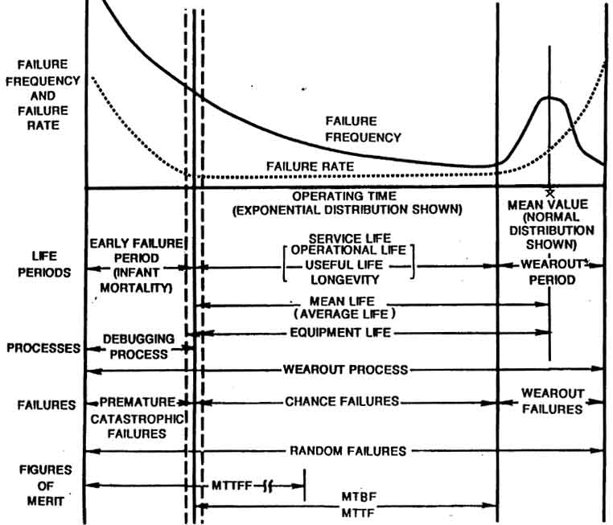
Reliability “Bathtub Curve”

Slide 45
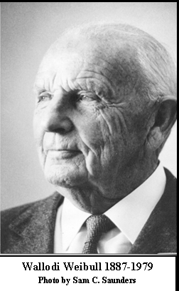
Waloddi Weibull, a Swedish inventor and engineer invented the Weibull distribution in 1937.
The Weibull distribution is much used in the statistics of reliability.

Slide 46
RBD 3: How to express reliability?
Assuming a homogeneous failure rate,
a failure rate of λ (per unit of time t )
constitutes a reliability over a period T of
R = e ^{- λ⋅T/t}
If a component has a failure rate of 10 failures per 1000 hours, then its reliability over a 24 hour period is app. 79%.

Slide 47
Common RBD Patterns: Chain of Components
R
R₁
R₂
R₃
For example
0.95
0.99
0.89
R = 0.95*0.99*0.89
= 0.84

Slide 48
Common RBD Patterns: Alternative (Parallel) Components
R
R₁
R₂
R_{n}

Slide 49
Example Parallel Components
0.95
0.99
R = 1 – (1-0.95)*(1-0.99)*(1-0.89)
= 1 – 0.05*0.01*0.11
= 1 – 5.5*10⁻⁵
= 0.99
0.89

Slide 50
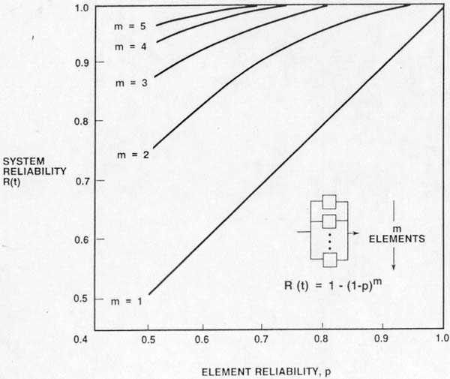
Parallel Reliability Configuration
s

Slide 51
Example Reliability: Structural View
component-diagram
with uses-relations
typical flow of control
for procedure-call style
C
C
S
S
K
L
M
K
L
M
All components are needed
reliability block diagram ?
C
S
K
L
M

Slide 52
Example Reliability: Structural View
component-diagram
with uses-relations
typical flow of control
for procedure-call style
C
C
S
S
K₁
K₂
K₃
K₁
K₂
K₃
components are alternatives
reliability block diagram ?
K₁
C
S
K₂
Don’t forget the outgoing arrow
K₃

Slide 53
Example Reliability: Deployment View
component-diagram
with uses-relations
typical flow of control
for procedure-call style
C
C
S
S
K
L
M
K
L
M
deployment diagram
DB K
DB L
DB M
Server
Client

Slide 54
Example Reliability: Deployment View
processor X
processor Y
P
Q
DB A
DB B
DB C
Server
Client
Assume Server, DB’s are in constant use and share CPU equally.
λ_{P} = ( λ_{DB A} + λ_{DB B} + λ_{DB C} + λ_{S} ) / 4
λ_{Q} = λ_{Client}
λ_{P+Q} = λ_{P} + λ_{Q}
If number of clients grows to n, then λ_{P+Q} = λ_{P} + n ·λ_{Q}
Notes:
This assumes that the client is a critical component of the system.
This is not the case for all client-server architectures.
Typically a client is allowed to fail and restart.
This depends for instance on whether the client has any data stored locally that might get lost if the client fails.

Slide 55
RBD Application Heuristics
Not all systems can be reduced to series/parallel graphs. Hence, you may need to simplify the design.
For instance by
consider only the critical paths through the system
Consider fragment of time spent per component
There are tools available that help you compute
reliability of RBD’s

Slide 56
Paper
Extending reliability block diagrams to software architectures
Ahmed Abd-Allah, 1997

Slide 57
Anti-pattern: Single Point of Failure
Client
Client
Client
Server
Database

Slide 58
Research Question
How can we determine the reliability of a piece of software?
Not all defects threaten reliability

Slide 59
Safety Analysis: Safety Cases

Slide 60
Strict Quality Requirements
Response Time
Cost
System Architecture
Power Consumption
Utilization
Security
Safety
- Time-consuming and error-prone manual work
- Limited insight in design space, because of starting from previous solutions, and not revolutionary!

Slide 61
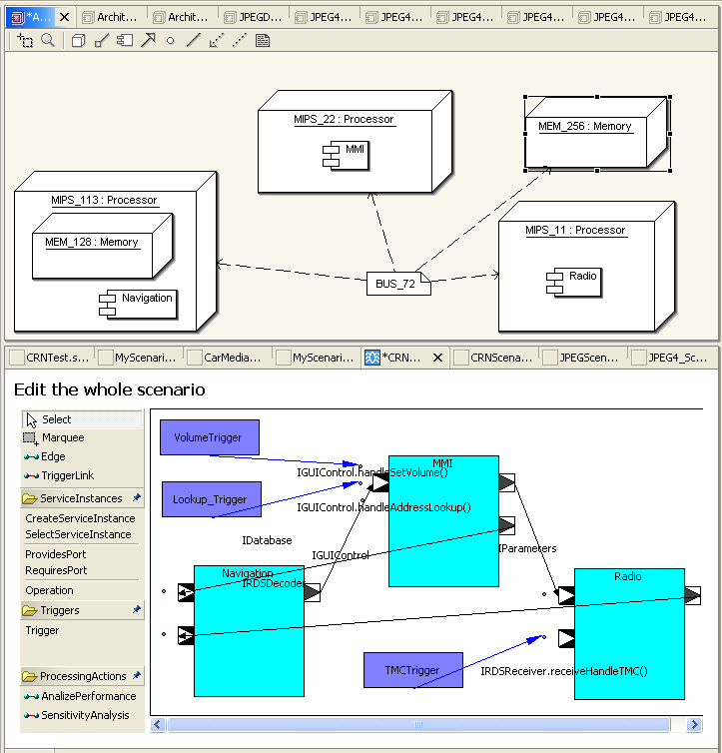
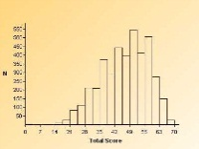
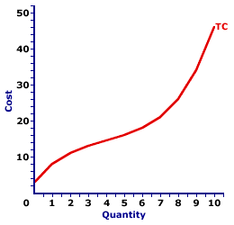
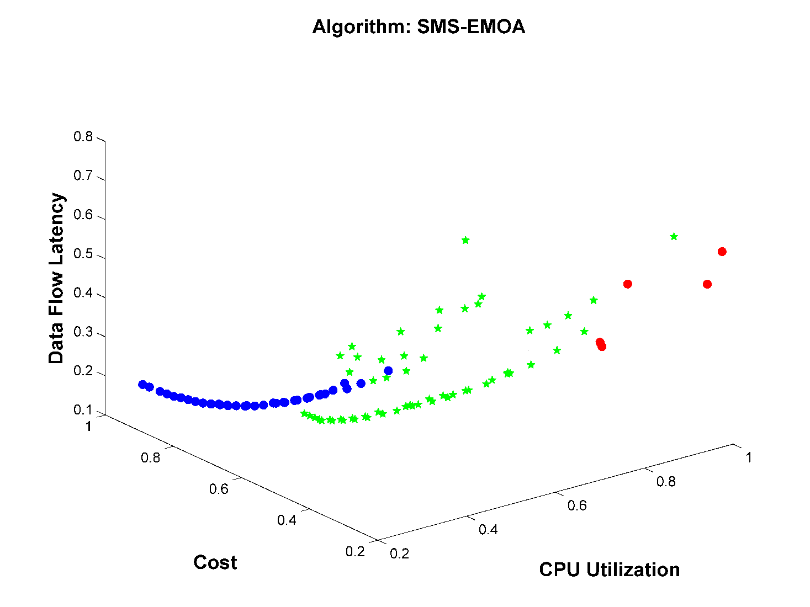
AQOSA Overview
Architecture Model
Performance
Safety
Cost
automatically
Analysis
Analysis
Analysis
generates
compare alternatives
HW & SW-components
automated
automatically
After repeating enough time
generate new alternative
architectures
Optimal SolutionS

Slide 62
Research Question
How to assess maintainability?
M = 4.5?
Portability, Extensibility, ….

Slide 63
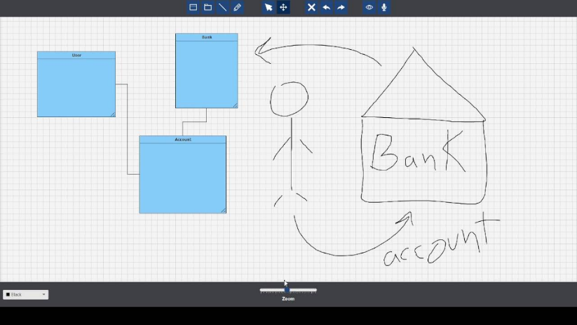
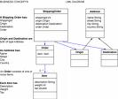
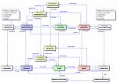
Ongoing research projects
Big Data for Software Design
http://www.models-db.com/
Smart whiteboard
Supports: touch & voice
Mix sketch & formal UML
Opportunities for thesis projects:
Animate for understanding
e.g. control- & data-flow
Collection of close to 100.000 UML diagrams from open source (GitHub)
Opportunities for thesis projects:
Learn patterns from examples
Study impact of design on project
Match up design with source code
Related:
- Develop formal reasoning about maintainability of designs

Slide 64
Summary
If you haven’t analyzed it, don’t build it.
Use analytical methods to support architectural decision making
Performance → Queuing networks
Reliability → Reliability Block Diagrams
Timeliness → Rate Monotonic Analysis
Many analyses are of ‘back of the envelope’ size.
little effort, lots of value
even if your model is not perfect (which they never are)

Slide 65
Thank you for your attention
Questions

Slide 66
References Reliability & RBD
J.-C. Laprie. Dependable Computing and Fault Tolerance: Concepts and Terminology. In Proceedings of the 15th International Symposium on Fault-Tolerant Computing (FTCS-15), pages 2–11, 1985.
Abd-Allah, A., "Extending Reliability Block Diagrams to Software Architectures," USC Technical Report USC-CSE-97-501, Center for Software Engineering, University of Southern California, March 1997.

Slide 67
BoE Performance Analysis
Sum claims per resource (processor)
number of users
frequency of occurence
resource claims per use scenario
resource management policies/mechanisms
A
B
C
D
Annotate computation with claim for
CPU cycles, memory
8/sec
D
F
C
E
G
B
F
D
1/sec
G
F
G
D
25/sec
Annotate messages with claim for
network bandwidth
H
I
J
K
F
Sum claims per resource (network)

Slide 68
Performance parameters and measures
Performance parameters (inputs to a performance evaluation) describe:
software behaviour
resource usage (measured or estimated)
workload
Performance measures (outputs - indices of a performance evaluation):
describe response time, throughput, utilization, percentage of lost packets, etc.
may be performance predictions - performance evaluation results
By Vittorio Cortellessa

Slide 69
Quality-Driven Architecture Design Tool
Architecture Model
Performance
Safety
Cost
automatically
Analysis
Analysis
Analysis
generates
compare alternatives
automated
HW & SW-components
generate new alternative
architectures
Support for the architect
automatically

Slide 70
Exponential Failure Law
Reliability of a system is often modeled as:
R(t) = exp(-λt)
where λ is the failure rate expressed as percentage failures per 1000 hours or as failures per hour.
When the product “λt” is small,
R(t) = 1 - λt

Slide 71
A simple example
A system has 4000 components with a failure rate of 0.02% per 1000 hours. Calculate λ and MTBF.
λ = (0.02 / 100) * (1 / 1000) * 4000 = 8 * 10⁻⁴ failures/hour
MTBF = 1 / (8 * 10⁻⁴ ) = 1250 hours

Slide 72
Relation between MTBF and the Failure rate
MTBF is the average time a system will run between failures and is given by:
MTBF = ∫₀ R(t) dt = ∫₀ exp(-λt) dt = 1 / λ
In other words, the MTBF of a system is the reciprocal of the failure rate.
If “λ” is the number of failures per hour, the MTBF is expressed in hours.
∞
∞

