Slide 1
Advanced Software Architecture Reliability, Availability Tactics
M.R.V. Chaudron
Feb 2020

Slide 2
Schedule
Week |  | Date | Time | Lecture | Reading | Note
4 | L1/S1 | 22 JAN | 10:15 – 12:00 | Introduction, Objectives & Organization
4 | L2 | 23 JAN | 13:15 – 15:-00 | Architecting Process & Architecture Views | Ch 1 & 2
5 |  | 28 JAN | 10:15 – 12:00 | Skip
5 | S2 | 29 JAN | 10:15 - 12:00 | << Supervision: Launch Assignment 1>> | Ch 3 & 4
5 |  | 30 JAN | 13:00 – 15:00 | Skip
6 | L3 | 3 FEB | 13:15 – 15:00 | Design Principles (Maintainability, Modifiability) | Ch 7
6 | S3 | 5 FEB | 10:15 – 12:00 | << Supervision/Assignment>>
6 | L4 | 6 FEB | 13:15 – 15:00 | Architectural Styles 1: Client-Server | Ch 13
7 | L5 | 10 FEB | 13:15 – 15:00 | Technical Debt |  | Terese
7 | S4 | 12 FEB | 10:15 – 12:00 | << Supervision/Assignment>>
7 | L6 | 13 FEB | 10:15 – 12:00 | Architectural Styles 2: Pipe&Filter and Publ-Subscr | Ch 13
8 | L7 | 17 FEB | 13:15 – 15:00 | Architectural Styles 3: Blackboard & Performance – Analysis & Tactics | Ch 8 + paper
8 | S5 | 19 FEB | 10:15 – 12:00 | << Supervision/Assignment>>
8 | L8 | 20 FEB | 10:15 – 12:00 | Reliability, Availability, Fault Tolerance | Ch 5, 14 + paper
9 | L9 | 24 FEB | 13:15 – 15:00 | Anders Alminger - Volvo
9 | S6 | 26 FEB | 10:15 – 12:00 | << Supervision/Assignment>>
9 | L10 | 27 FEB | 13:15 – 15:00 | Architecture Evaluation / Security | Ch 21
10 | L11 | 2 MAR | 13:15 – 15:00 | Session with TA’s or Skip |  | Rodi PhD
10 | S7 | 4 MAR | 10:15 – 12:00 | << Supervision/Assignment>>
10 | L12 | 5 MAR | 13:15 – 15:00 | Reverse Engineering & Correspondence | Ch 20

Slide 3
Assignment Schedule
Week |  | Date | Lecture | Assignment1 | Assignment2
4 | L1/S1 | 22 JAN |  | Form groups & read Ass 1
4 | L2 | 23 JAN
5 |  | 28 JAN
5 | S2 | 29 JAN |  | Work & TA feedback
5 |  | 30 JAN
6 | L3 | 3 FEB
6 | S3 | 5 FEB |  | Hand-in draft of Ass 1
6 | L4 | 6 FEB |  | (perform peer review)
7 | L5 | 10 FEB
7 | S4 | 12 FEB |  | 11 Feb: Deadline peer review Ass 1 | Start Assignment 2
7 | L6 | 13 FEB
8 | L7 | 17 FEB
8 | S5 | 19 FEB |  | Work & TA feedback | Work & TA feedback
8 | L8 | 20 FEB
8 |  | 21 FEB |  |  | Hand-in Ass 2
9 | L9 | 24 FEB
9 | S6 | 26 FEB |  | Work & TA feedback | Deadline peer review Ass 2
9 | L10 | 27 FEB
10 | L11 | 2 MAR |  |  | Deadline Ass 2
10 | S7 | 4 MAR |  | Deadline Ass 1
10 | L12 | 5 MAR

Slide 4
Outline / Contents
SMART
Reliability, Availability, Fault Tolerance
Tactics
Architecture Scenario’s

Slide 5
Requirements on Requirements
S Specific
To-the-point, precise
M Measurable
Quantifiable and verifiable
A Acceptable (to the stakeholders)
Accessible, understandable (for the user)
Achievable (technically/planning/economically)
R Realistic
Deducible to the real business drivers
T Testable

Slide 6
SMART
You can find lots more explanations of SMART online!

Slide 7
Let’s consider
“All communication between client and server is secure”
“It is easy to extend”
“The system should respond quickly”
“The user should not have to wait more than a few second …”
“Determine a solution within 0.3 sec”
“The system should be always available”
“The system can handle multiple concurrent users”
“The system can handle 100 concurrent users”
“The system should be state-of-the-art …”

Slide 8
Let’s consider
not precise
not measurable
“All communication between client and server is secure”
“It is easy to extend”
“The system should respond quickly”
“The user should not have to wait more than a few second …”
“Determine a solution within 0.3 sec”
“The system should be always available”
“The system can handle multiple concurrent users”
“The system can handle 100 concurrent users”
“The system should be state-of-the-art …”
not measurable
not specific
vague:to what?
not attainable
doing what?
subjective
time-dependent;
means something else tomorrow

Slide 9
Examples XFR: Maintainability
Maintainability
The average person time required to fix a category 3 defect (including testing and documentation upgrade) shall not exceed two person days.

Slide 10
Reliability Block Diagrams Analysis and Tactics
No model is correct, but some are useful
– Albert Einstein

Slide 11
What is Reliability?
Reliability is a measure of the continuous delivery of correct service (Laprie)
Reliability is defined as the probability that an item will perform its intended function for a specified interval under stated conditions.
Reliability is a property over time:
‘a probability that something will work when you want it to.’

Slide 12
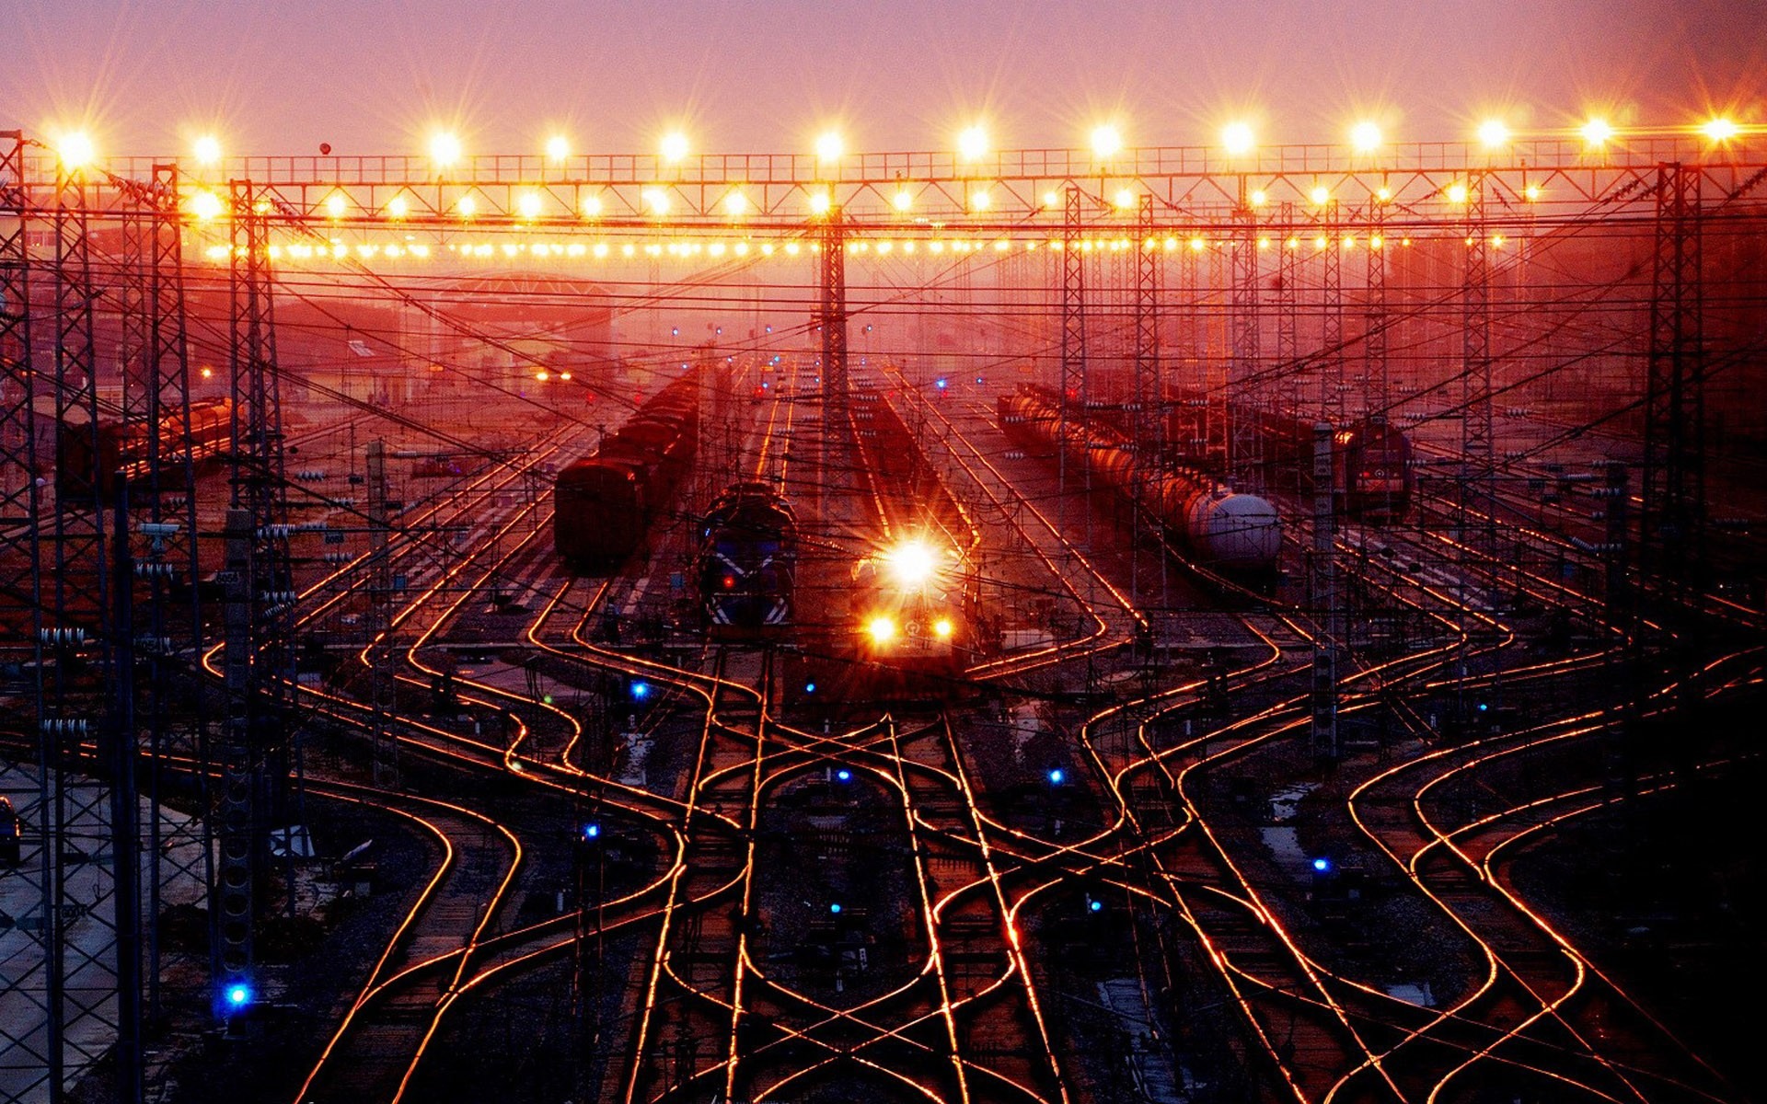
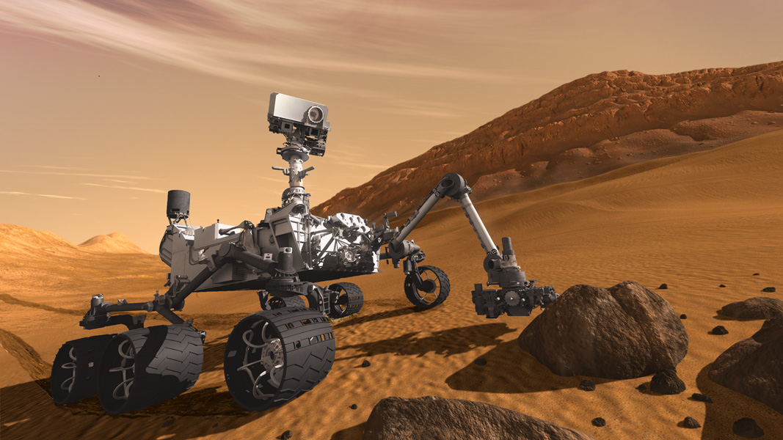
Expressing Reliability Quantitatively
MTBF - Mean Time Between Failures
is the expected Time between Failures
Typically used for: repairable systems
Train control system
MTTF - Mean Time to Failure
is the expected Time to Failure
Typically used: non-repairable systems
Mars rover
MTTR - Mean Time to Repair
is the expected Time to Repair/Recover Failure

Slide 13
Examples of XFR: Reliability
Typically expressed in terms of
Mean Time Between Failures (MTBF)
Number of hours that pass before a component fails
E.g. 2 failures per million hours:
MTBF = 10⁶ / 2 = 0,5 * 10⁶ hr
Mean Time To Failure (MTTF)
Mean time expectec until the first failure of a system
Is a statistical value over a long period of time
Mean Time To Repair (MTTR)
for repairable systems
For non-repairable systems
Availability

Slide 14
MTBF
The MTBF is widely used as the measurement of equipment's reliability and performance. This value is often calculated by dividing the total operating time of the units by the total number of failures encountered. This metric is valid only when the data is exponentially distributed. This is a poor assumption which implies that the failure rate is constant if it is used as the sole measure of equipment's reliability.

Slide 15
Reliability Block Diagrams (RBD)
A RBD is a graphical depiction of the system’s
components and connectors which can be used to
determine the overall system reliability
90%
97%
93%
80%
Numbers indicate probability of successfully passing through the box
If any path through the system is successful, then
the system succeeds, otherwise it fails.

Slide 16
RBD 2: Assumptions
Lines have reliability 1
Failures of blocks are statistically independent
Blocks are bi-modal:
either their operate correctly or they fail and do nothing

Slide 17
Non-Constant Failure Rate Curve: The “Bathtub” Curve
1
3
Failure Rate
2
Early Life
Region
Wear-Out
Region
Constant Failure Rate Region
0
Time t

Slide 18
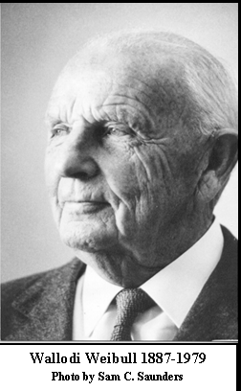
Waloddi Weibull, a Swedish inventor and engineer invented the Weibull distribution in 1937.
The Weibull distribution is much used in the statistics of reliability.

Slide 19
RBD 3: How to express reliability?
Assuming a homogeneous failure rate,
a failure rate of λ (per unit of time t )
constitutes a reliability over a period T of
R = e ^{- λ⋅T/t}
If a component has a failure rate of 10 failures per 1000 hours, then its reliability over a 24 hour period is (approx.). 79%.

Slide 20
Relation between MTBF and the Failure rate
MTBF is the average time a system will run between failures and is given by:
MTBF = ∫₀ R(t) dt = ∫₀ exp(-λt) dt = 1 / λ
In other words, the MTBF of a system is the reciprocal of the failure rate.
If “λ” is the number of failures per hour, the MTBF is expressed in hours.
∞
∞

Slide 21
A simple example
A system has 4000 components with a failure rate of 0.02% per 1000 hours. Calculate λ and MTBF.
λ = (0.02 / 100) * (1 / 1000) * 4000 = 8 * 10⁻⁴ failures/hour
MTBF = 1 / (8 * 10⁻⁴ ) = 1250 hours

Slide 22
Common RBD Patterns: Chain of Components
R
R₁
R₂
R₃
For example
0.95
0.99
0.89
R = 0.95*0.99*0.89
= 0.84
‘AND’
‘AND’

Slide 23
Common RBD Patterns: Alternative (Parallel) Components
R
R₁
‘OR’
R₂
‘OR’
R_{n}
R fails only if all component fail
Prob of fail = 1- success

Slide 24
Example Parallel Components
0.95
0.99
R = 1 – (1-0.95)*(1-0.99)*(1-0.89)
= 1 – 0.05*0.01*0.11
= 1 – 5.5*10⁻⁵
= 0.99
0.89
Reliability of system is higher than that of its parts!

Slide 25
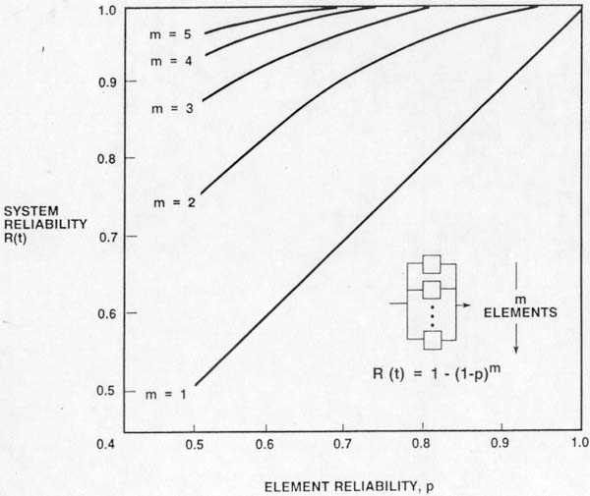
Parallel Reliability Configuration
s

Slide 26
Example Reliability: Structural View
component-diagram
with uses-relations
typical flow of control
for procedure-call style
C
C
S
S
K
L
M
K
L
M
All components are needed
reliability block diagram ?
C
S
K
L
M

Slide 27
Example Reliability: Structural View
component-diagram
with uses-relations
typical flow of control
for procedure-call style
C
C
S
S
K₁
K₂
K₃
K₁
K₂
K₃
components are alternatives
reliability block diagram ?
K₁
C
S
K₂
Don’t forget the outgoing arrow
K₃

Slide 28
Example Reliability: Deployment View
component-diagram
with uses-relations
typical flow of control
for procedure-call style
C
C
S
S
K
L
M
K
L
M
deployment diagram
DB K
DB L
DB M
Server
Client

Slide 29
Example Reliability: Deployment View
processor X
processor Y
P
Q
DB A
DB B
DB C
Server
Client
Assume Server, DB’s are in constant use and share CPU equally.
λ_{P} = ( λ_{DB A} + λ_{DB B} + λ_{DB C} + λ_{S} ) / 4
λ_{Q} = λ_{Client}
λ_{P+Q} = λ_{P} + λ_{Q}
If number of clients grows to n, then λ_{P+Q} = λ_{P} + n ·λ_{Q}
Notes:
This assumes that the client is a critical component of the system.
This is not the case for all client-server architectures.
Typically a client is allowed to fail and restart.
This depends for instance on whether the client has any data stored locally that might get lost if the client fails.

Slide 30
RBD Application Heuristics
Not all systems can be reduced to series/parallel graphs. Hence, you may need to simplify the design.
For instance by
consider only the critical paths through the system
Consider fragment of time spent per component
There are tools available that help you compute
reliability of RBD’s

Slide 31
Anti-pattern: Single Point of Failure
Client
Client
Client
Server
Database

Slide 32
Research Question
How can we determine the reliability of a piece of software?
analytically?
empirically?
observe a system? Prototype?
Not all defects threaten reliability

Slide 33
Exponential Failure Law
Reliability of a system is often modeled as:
R(t) = exp(-λt)
where λ is the failure rate expressed as percentage failures per 1000 hours or as failures per hour.
When the product “λt” is small,
R(t) = 1 - λt

Slide 34
References Reliability & RBD
J.-C. Laprie. Dependable Computing and Fault Tolerance: Concepts and Terminology. In Proceedings of the 15th International Symposium on Fault-Tolerant Computing (FTCS-15), pages 2–11, 1985.
Abd-Allah, A., "Extending Reliability Block Diagrams to Software Architectures," USC Technical Report USC-CSE-97-501, Center for Software Engineering, University of Southern California, March 1997.

Slide 35
Summary
If you haven’t analyzed it, don’t build it.
Use analytical methods to support architectural decision making
Performance → Queuing networks
Reliability → Reliability Block Diagrams
Timeliness → Rate Monotonic Analysis
Many analyses are of ‘back of the envelope’ size.
little effort, lots of value
even if your model is not perfect (which they never are)

Slide 36
Availability
Availability = the probability that a system is operational at a given time
i.e. the amount of time a device is actually operating as the percentage of total time it should be operating.
High-availability systems may report availability in terms of minutes or hours of downtime per year.
Availability = uptime / (uptime + downtime)
Availability =
/ ( + )

Slide 37
Availability = MTBF / (MTBF + MTTR)

Slide 38
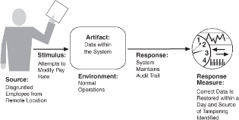
Quality Attribute Scenario
A Quality Attribute Scenario is a quality attribute specific requirement Source of stimulus (e.g., human, computer system, etc.)
Stimulus – a condition that needs to be considered
Environment - what are the conditions when the stimulus occurs?
Artifact – what elements of the system are stimulated.
Response – the activity undertaken in response to the stimulus.
Response measure – when the response occurs it should be measurable so that the requirement can be tested.
QAS are an aid in formulating your requirements in a SMART-way

Slide 39
Performance General Scenario

Slide 40
Quality Attribute Scenario
Artifact
System services
Data within the system
Component/resource of the system
Source
Identified user
Stimulus
Action performed by the identified user
Environment
Normal mode
Overload mode
Peak mode
Response
…
Measure
Latency
Deadline
Throughput
…

Slide 41
Example Quality Scenario for Security
Artifact
System services
Data within the system
Component/resource of the system
Data produced/consumed by the system
Source
Identified user
Unknown user
Hacker from outside the organisation
Hacker from inside the organisation
Stimulus
Attempt to display data
Attempt to modify data
Attempt to delete data
Access system services
Change system’s behaviour
Reduce availability
Environment
Normal mode
Overload mode
Reduced capacity mode
Emergency mode
Peak mode
Response
Lock Computer
Maintain Audit trail
Measure
Latency
Deadline
Throughput
Jitter
Miss rate
Data loss

Slide 42
Architectural Tactics

Slide 43
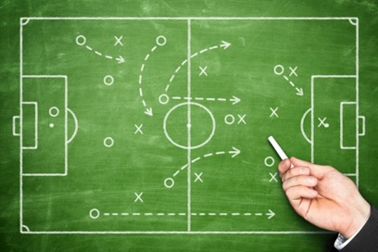
Tactics
A tactic is a construction pattern that influences the achievement of a quality attribute response
Different tactics for each quality attribute
The same tactic could be relevant to many quality attributes
Could be seen as an ’add-on’/refinement of architectural styles
Tactics do not change the functionality of the system hence they exist in the ’implementation-refinement’-layers of describing a system.

Slide 44
Example Quality Attributes
Availability
Interoperability
Performance
Modifiability
Security

Slide 45
Performance QA-Scenario

Slide 46
Resource Demand
input
processing
‘load’
output
resources
CPU, memory,
disk, network
Reduce load
Manage event rate (e.g. drop requests, queue requests)
Control frequency of sampling
Prioritize events
Increase computational efficiency
Reduce computational overhead
Reduce computation (e.g. scale quality of output)
Bound execution times
Bound queue sizes
Increase Resources
Replicate server (=CPU’s)

Slide 47
Performance Tactics

Slide 48
Client-Server with load balancer
1..*
1..*
C
LB
S1
S2
C
LB
S
check load status
check load status
actual request
C
S2
LB
S1

Slide 49
Client-Server with load balancer
1..*
1..*
C
LB
S1
S2
C
LB
S
check load status
check load status
actual request
C
S2
LB
S1

Slide 50
Availability QA-Scenario

Slide 51
Concrete Availability Scenario
Notes:
This shows a concrete availability scenario:
The heartbeat monitor determine if the server is unresponsive during normal operation.
The system inform operator and continue to operate with no downtime.

Slide 52
Availability Tactics

Slide 53
Client-Server Passive Redundancy
1..*
1..*
C
PR
S
C
PR
S1
S2
C
PR
S1
S2
C
PR
S1
S2
u
u
u
S2 is updated in the same way as S1
If S1 fails, then S2 is activated to take over from S1

Slide 54
Client-Server Passive Redundancy
1..*
1..*
C
PR
S
C
PR
S1
S2
C
PR
S1
S2
C
PR
S1
S2
S2 is updated only after every X updates from S1
If S1 fails, then S2 is activated to take over from S1

Slide 55
Voting
1..*
1..*
C
V
S
C
V
S0
S1
S2
C
V
S0
S1
S2
V computes the majority vote from the answers of S0, S1 and S2

Slide 56
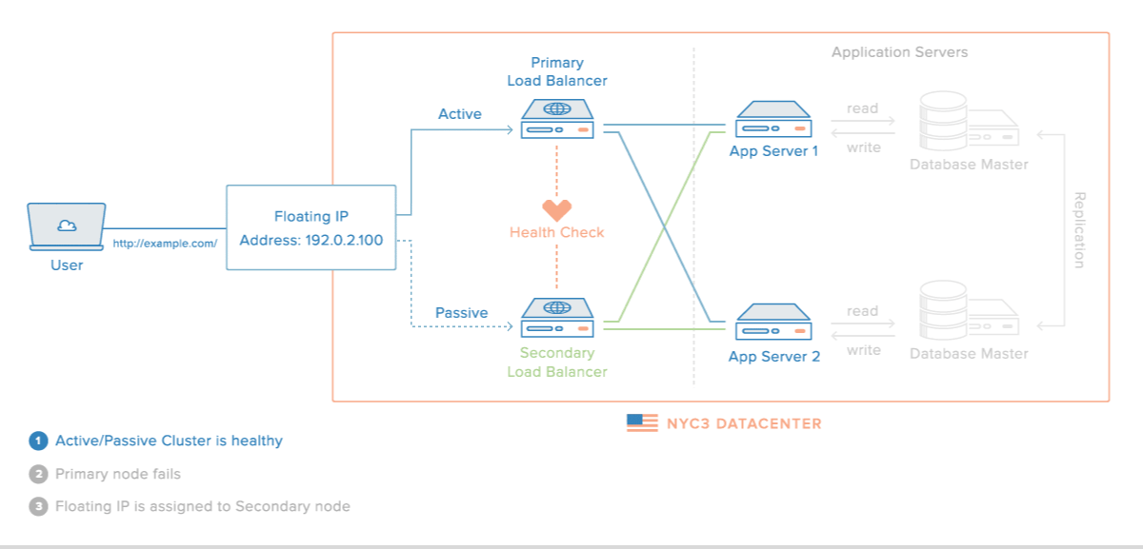
Example Availability Tactic
[https://www.digitalocean.com]

Slide 57
Interoperability
Definition:
The degree to which two or more systems can usefully exchange meaningful information via interfaces in a particular context.

Slide 58
Interoperability Scenario

Slide 59
Concrete Interoperability Scenario

Slide 60
Interoperability Tactics

Slide 61
In which view(s) could we see interoperability tactics?

Slide 62
Modifiability
Definition:
Modifiability is about change, and our interest in it centers on the cost and risk of making changes.

Slide 63
Modifiability General Scenario

Slide 64
Concrete Modifiability Scenario
time

Slide 65
Modifiability Tactics

Slide 66
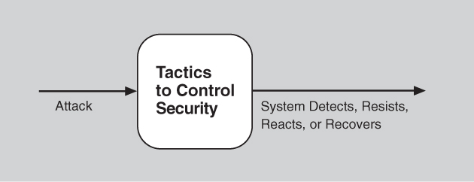
Security
Definition:
Security is a measure of the system’s ability to protect data and information from unauthorized access while still providing access to people and systems that are authorized.

Slide 67
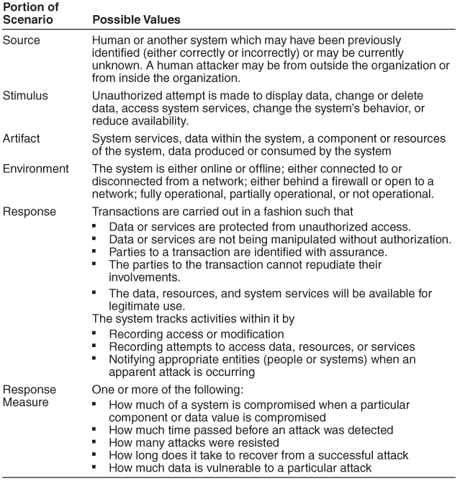
Security General Scenario

Slide 68
Concrete Security Scenario

Slide 69
Security Tactics

Slide 70
Summary & Conclusion
SMART
Be able to write SMART requirements
Reliability Block Diagrams
Be able to make simple analyses for small-sized system
Be able to model tactics with UML views

Slide 71
Backup slides next

Slide 72
Exponential Failure Law
Reliability of a system is often modeled as:
R(t) = exp(-λt)
where λ is the failure rate expressed as percentage failures per 1000 hours or as failures per hour.
When the product “λt” is small,
R(t) = 1 - λt

Slide 73
A simple example
A system has 4000 components with a failure rate of 0.02% per 1000 hours. Calculate λ and MTBF.
λ = (0.02 / 100) * (1 / 1000) * 4000 = 8 * 10⁻⁴ failures/hour
MTBF = 1 / (8 * 10⁻⁴ ) = 1250 hours

Slide 74
Relation between MTBF and the Failure rate
MTBF is the average time a system will run between failures and is given by:
MTBF = ∫₀ R(t) dt = ∫₀ exp(-λt) dt = 1 / λ
In other words, the MTBF of a system is the reciprocal of the failure rate.
If “λ” is the number of failures per hour, the MTBF is expressed in hours.
∞
∞

Slide 75
Feature-Solution Graph
Example from Hans de Bruin, Hans van Vliet

Slide 76
Safety Analysis: Safety Cases

Slide 77
Performance parameters and measures
Performance parameters (inputs to a performance evaluation) describe:
software behaviour
resource usage (measured or estimated)
workload
Performance measures (outputs - indices of a performance evaluation):
describe response time, throughput, utilization, percentage of lost packets, etc.
may be performance predictions - performance evaluation results
By Vittorio Cortellessa

Slide 78
Strict Quality Requirements
Response Time
Cost
System Architecture
Power Consumption
Utilization
Security
Safety
- Time-consuming and error-prone manual work
- Limited insight in design space, because of starting from previous solutions, and not revolutionary!

Slide 79
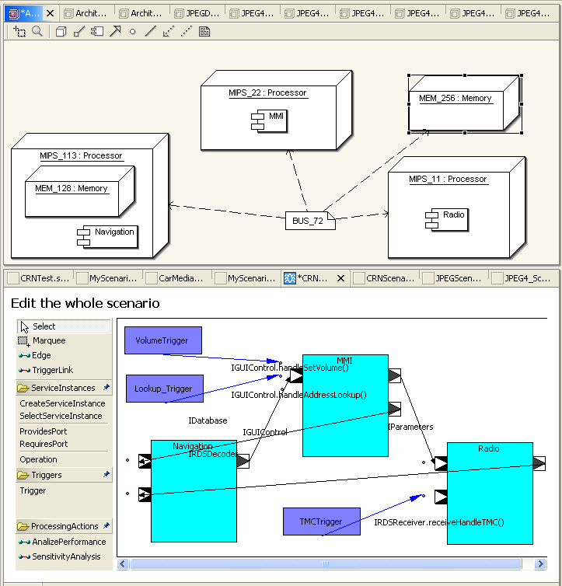
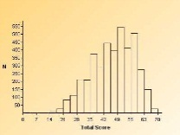
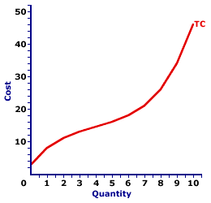
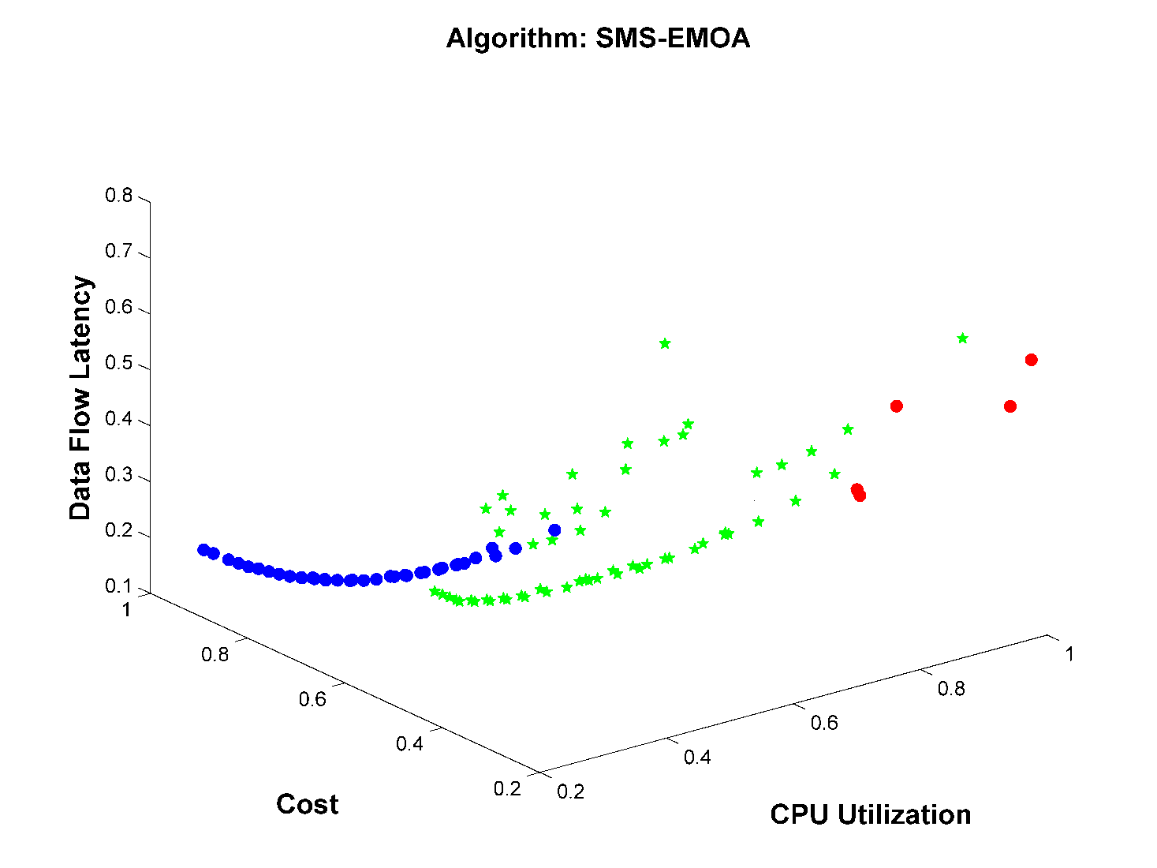
Quality-Driven Architecture Design Tool
Architecture Model
Performance
Safety
Cost
automatically
Analysis
Analysis
Analysis
generates
compare alternatives
automated
HW & SW-components
generate new alternative
architectures
Support for the architect
automatically

Slide 80
Zen of Performance: Balance
resource capacity
demand
workload
Architect’s goal: to establish the (minimum) amount of hardware that will allow the system to meet its performance goals.
Architect’s aim: to understand the trade-off between resources and performance

Slide 81
Resource Demand
input
processing
‘load’
output
resources
CPU, memory,
disk, network
Reduce load
Manage event rate (e.g. drop requests, queue requests)
Control frequency of sampling
Prioritize events
Increase computational efficiency
Reduce computational overhead
Reduce computation (e.g. scale quality of output)
Bound execution times
Bound queue sizes
Increase Resources
Replicate server (=CPU’s)

Slide 82
Performance
Definition:
Performance is about time and the software system’s ability to meet timing requirements.

