Slide 1
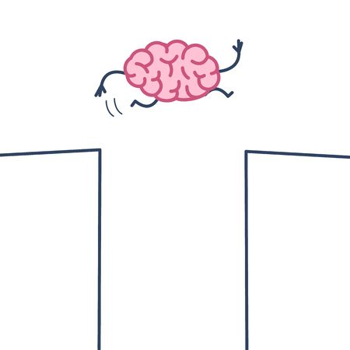
Software Architecture Evaluation
by Imed Hammouda, Michel Chaudron

Slide 2
Feedback on assignment
No textual explanation with diagram

Slide 3
Feedback on assignment
Feedback on assignment
  I have seen:
    Lack of consistency:
      Between structural view and sequence diagram and deployment diagram.
    Too abstract/coarse grained components
    If someone reads the architecture (documents), but not the requirements, they must be able to understand what the system does.

Slide 4
Nice answers from your assignments
Link your answer to the actual case

Slide 5
Nice answers from your assignments
Link your answer to the actual case:
health-data is sensitive information

Slide 6
Not Consistent:
Structure Diagram
Sequence Diagram
Deployment Diagram
A
B
UI
Server
X
Y
C
UI
DB
DB is not in the Structure diagram
Also, naming too general!

Slide 7

Goals
In this lecture you will learn:
  What is architecture evaluation!
  Evaluation approaches!
  Benefits and limits of architecture evaluation!
  ATAM as evaluation method!
    Architecture Tradeoff Analysis Method
  Example Evaluation

Slide 8


      What is Software Architecture Evaluation?

Slide 9
What is Architecture Evaluation?
Architecture Evaluation is the process of determining how well the current design or a portion of it satisfies the requirements derived during analysis.
Key questions:
  How can you be sure whether the architecture chosen for your software is a right one?
  How can you be sure that it won’t lead to calamity but instead will pave the way through a smooth development and successful product?

Slide 10
      What to evaluate in Software Architecture?

Slide 11
What to Evaluate?
"fundamental concepts or properties of a system in its environment embodied in its elements, relationships, and in the principles of its design and evolution."
ISO/IEC/IEEE 42010
"The software architecture of a program or computing system is the structure or structures of the system, which comprise software components, the externally visible properties of those components, and the relationships among them.."
Len Bass

Slide 12
What to Evaluate?
      Architects pay more attention to qualities that arise from architecture choices.
If architectural decisions determine a system’s quality attributes, then it is possible to evaluate architectural decisions with respect to their impact on those attributes.
Architectures allow or preclude nearly all of the system’s quality attributes.

Slide 13

What to Evaluate?
“… the evaluator is able to conclude that a quality goal is sensitive to certain properties of the architecture. A goal of any architecture evaluation is to make this reasoning explicit and to record it for posterity.” *
* Clements et al.

Slide 14
      How to evaluate Software Architecture?

Slide 15
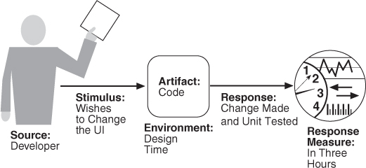
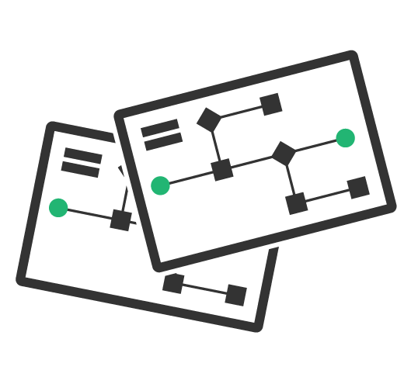
Evaluating Quality Attributes
Quality attributes can be evaluated through:
  Scenario-based evaluation: for example change scenarios for assessing maintainability

Slide 16
Slide by
Ivano Malavolta

Slide 18
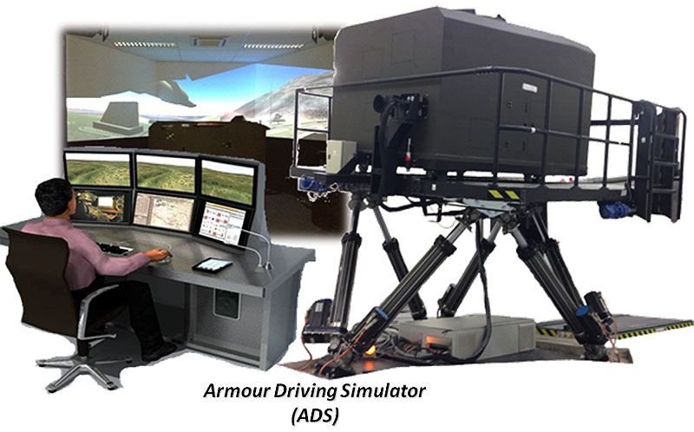
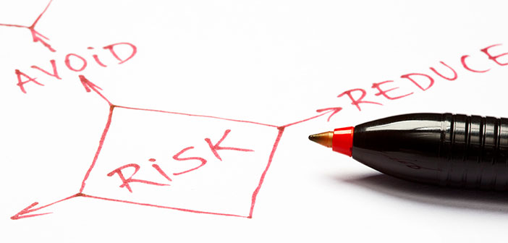
Evaluating Quality Attributes
Quality attributes can be evaluated through:
  Simulation: for example Prototyping is a form of simulation where a part of the architecture is implemented and executed in the actual system context
E.g. Usability

Slide 19
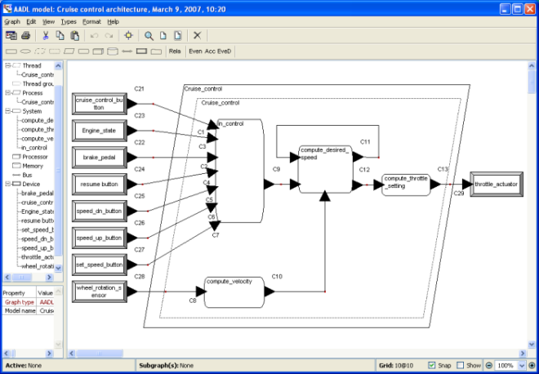
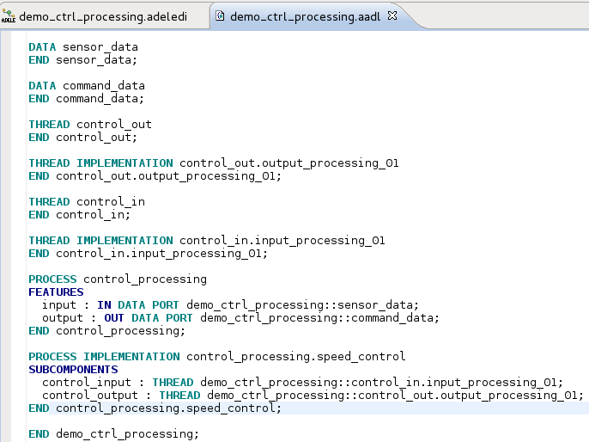
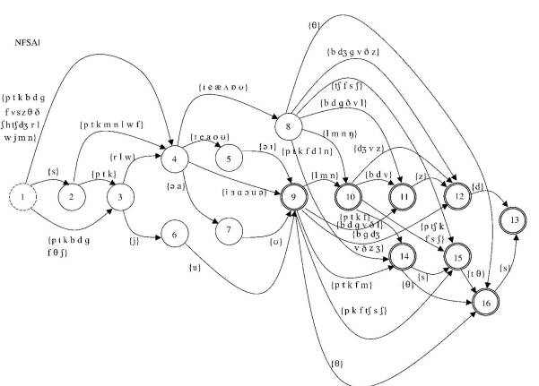
Evaluating Quality Attributes
Quality attributes can be evaluated through:
  Mathematical modeling: for example, checking for potential deadlocks
Performance
e.g. Queueing Networks
Safety
e.g. Fault-Tree Analysis
Architecture Description Languages

Slide 20

Evaluating Quality Attributes
Quality attributes can be evaluated through:
  Experience-based assessment:
    this is based on subjective factors like intuition, experience and expertise of software engineers

Slide 21
      Who should carry out architecture evaluation?

Slide 22

Who!
Evaluation by the designer
  Every time a key design decision or a design milestone is completed.
Advantages:
  Familiarity with the system
  Minimal overhead
Limitations:
  Personal bias
  Dominant architect perspective

Slide 23

Who!
Peer review
  Peer = experienced colleague on the project, but not the architect
  At any point of the design process where a candidate architecture exists.
Advantages:
  Familiarity with the system
  Multiple perspectives
Limitations:
  Organization bias
  Limited availability

Slide 24

Who!
Analysis by outsiders
  Architecture-specialists and experts.
Advantages:
  Minimal bias
  Expert recommendations
Limitations:
  Start-up time / getting up to speed
  High expenses
  Confidentiality issues

Slide 25
      When to carry out software architecture evaluation?

Slide 26
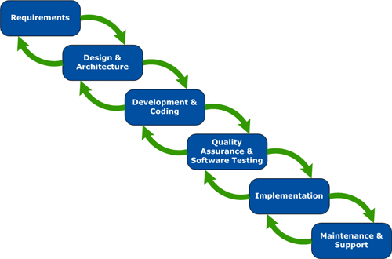

When?
Early: Examine those architectural decisions already made and choose among architectural options that are pending.

Slide 27


When?
Late: The implementation is complete (e.g. using a legacy system).
Open Source Software

Slide 28
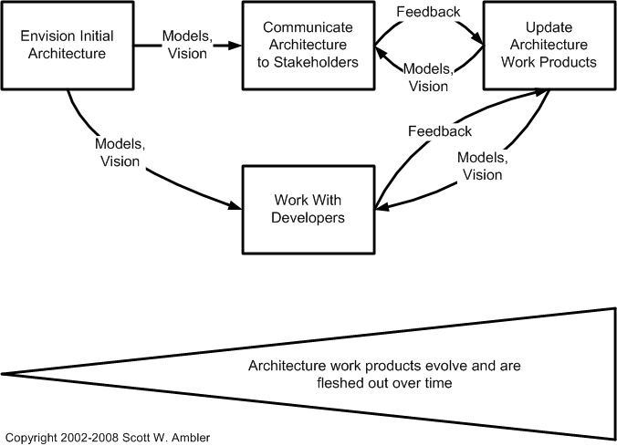

When?
Continuous: Evaluation at each development iteration.

Slide 29



When commissioning/buying a system
Which of the offered systems fits best in my
system-landscape?
buyer
sellers

Slide 30
      What are the benefits of architecture evaluation?

Slide 31
Results of Software Evaluation
Is this architecture suitable for the system for which it was designed?
Which among several competing architectures is the most suitable one for the system at hand?
  System will meet its quality goals
  System will provide the required behavioural function
  System will be developed according to its design constraints
  System can be built using the resources at hand
An architecture evaluation doesn’t tell you
“yes” or “no,” “good” or “bad,” or “6.75 out of 10.”
It tells you where you are at risk.
* Clements et al.

Slide 32


Benefits of Architecture Evaluation
Puts stakeholders in the same room
Forces an articulation of specific quality goals
Results in the prioritization of conflicting goals
Forces a clear explication of the architecture
Improves the quality of architectural documentation
Uncovers opportunities for cross-project reuse
Results in improved architecture practices

Slide 33
      What are the limits of architecture evaluation?

Slide 34

Evaluation Challenges
What artefacts are available?
What resources are available?
Who sees the results?
Who performs the evaluation?
Which stakeholders will participate?
What are the business goals?
What tools are available?

Slide 35
      What is ATAM?

Slide 36
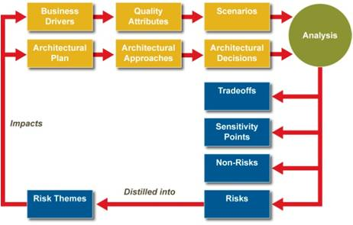
Architecture Trade-off Analysis Method - ATAM
ATAM: Architecture Trade-off Analysis Method
  A scenario-based architecture method for assessing quality attributes such as: modifiability, availability, and security.
Evaluators need not be familiar with the architecture or its business goals
System need not yet be constructed
A large number of stakeholders are involved

Slide 37
      What is a Quality Attribute Scenario?

Slide 38
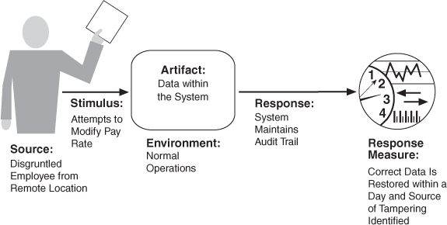
ATAM: Quality Attribute Scenario
A Quality Attribute Scenario is a quality attribute specific requirement.
  Source of stimulus (e.g., human, computer system, etc.)
  Stimulus – a condition that needs to be considered
  Environment - what are the conditions when the stimulus occurs?
  Artifact – what elements of the system are stimulated.
  Response – the activity undertaken after arrival of the stimulus.
  Response measure – when the response occurs it should be measurable so that the requirement can be tested.

Slide 39





Example Quality Scenario for Security
Artifact
System services
Data within the system
Component/resource of the system
Data produced/consumed by the system
Source
Identified user
Unknown user
Hacker from outside the organisation
Hacker from inside the organisation
Stimulus
Attempt to display data
Attempt to modify data
Attempt to delete data
Access system services
Change system’s behaviour
Reduce availability
Environment
Normal mode
Overload mode
Reduced capacity mode
Emergency mode
Peak mode
Response
Lock Computer
Maintain Audit trail
Measure
Latency
Deadline
Throughput
Jitter
Miss rate
Data loss
Should be SMART!
Examples in book are often not SMART

Slide 40
      But how to elicit and identify Quality Attribute Scenarios?

Slide 41
Utility Tree
Business value
Architectural impact value
(L,M)
storage latency on customer DB < 200ms.
Data latency
Performance
(M,M)
Deliver video in real time (50 frames/sec)
Transaction throughput
(H,H)
Add CORBA middleware in < 20 person-months
Change COTS
Modifiability
(H,L)
Change we user interface in < 4 person-weeks
New products
Utility
(H,H)
Power outage at site1 should redirect traffic to site 2 in < 3 seconds
H/W failure
(H,H)
Availability
Network failure detected and recovers in < 1.5 seconds
COTS S/W failures
(H,M)
Credit card transactions are secure 99.999% of the time
Data confidentiality
Security
(H,L)
Customer DB authorisation works 99.999% of the time
Data integrity

Slide 42
      What are the activities involved in ATAM?

Slide 43
ATAM Activities
1
Activity IV
Evaluation results
Activity I
Requirements
& scenarios
gathering
Identify
risks
non-risks
Requirements
gathering
Identify
trade-offs sensitivities
Quality
scenarios
Architectural decisions
Scenario
realization
Architectural views
Activity III
Analysis
Activity II
Architectural decisions & views

Slide 44
ATAM Conceptual Flow
Business drivers
Quality attributes
Scenarios
Analysis
Architectural plan
Architectural tactics
Architectural decisions
Trade-offs
Impacts
Sensitivity points
Non-risks
Distilled into
Risk themes
Risks

Slide 45
ATAM Output
Item | Description
Sensitivity point | A property of one or more components (and/or component relationships) that is critical for achieving a particular quality attribute response
Tradeoff point | An architectural decision that affects more than one quality attribute (possibly in opposite ways)
Risk | Architectural decision that may lead to undesirable consequences
Non risk | Architectural decision that is deemed safe
Risk theme | A general concern of a group of interrelated risks in a design, assigned its own risk value

Slide 46
ATAM Output
Item | Description
Sensitivity point | A property of one or more components (and/or component relationships) that is critical for achieving a particular quality attribute response
Tradeoff point | An architectural decision that affects more than one quality attribute (possibly in opposite ways)
Risk | Architectural decision that may lead to undesirable consequences
Non risk | Architectural decision that is deemed safe
Risk theme | A general concern of a group of interrelated risks in a design, assigned its own risk value

Slide 47
ATAM Output
Item | Description
Sensitivity point | A property of one or more components (and/or component relationships) that is critical for achieving a particular quality attribute response
Tradeoff point | An architectural decision that affects more than one quality attribute (possibly in opposite ways)
Risk | Architectural decision that may lead to undesirable consequences
Non risk | Architectural decision that is deemed safe
Risk theme | A general concern of a group of interrelated risks in a design, assigned its own risk value

Slide 48
ATAM Output
Item | Description
Sensitivity point | A property of one or more components (and/or component relationships) that is critical for achieving a particular quality attribute response
Tradeoff point | An architectural decision that affects more than one quality attribute (possibly in opposite ways)
Risk | Architectural decision that may lead to undesirable consequences
Non risk | Architectural decision that is deemed safe
Risk theme | A general concern of a group of interrelated risks in a design, assigned its own risk value

Slide 49
ATAM Output
Item | Description
Sensitivity point | A property of one or more components (and/or component relationships) that is critical for achieving a particular quality attribute response
Tradeoff point | An architectural decision that affects more than one quality attribute (possibly in opposite ways)
Risk | Architectural decision that may lead to undesirable consequences
Non risk | Architectural decision that is deemed safe
Risk theme | A general concern of a group of interrelated risks in a design, assigned its own risk value

Slide 50
Sensitivity Point
Sensitivity point is a parameter of the architecture to which some quality attribute is highly related.
A system requires
high performance
Subsystem 1
Subsystem 2
Suppose throughput depends on one channel
increase channel
speed
increase
performance
→

Slide 51
Trade-off point
A trade-off point is a parameter of the architecture that affects multiple quality attributes in opposite directions.
A system requires
high performance,
high reliability
high security
Subsystem 1
Subsystem 2
increase
performance
decrease
reliability
increase channel speed
→
&
increase
security
decrease
performance
increase encryption
→
&

Slide 52
Sensitivity Points
Trade-off Points

Slide 53
      How is ATAM planned and implemented?

Slide 54

ATAM Phases
Evaluation client
Evaluation team
Project decision makers
Stakeholders

Slide 55
ATAM Phases
Evaluation client
Evaluation team
Project decision makers
Stakeholders
Phase 0
Partnership and preparation
Proceeds informally as required, perhaps over a few weeks

Slide 56
ATAM Phases
Evaluation client
Evaluation team
Project decision makers
Stakeholders
1. Present ATAM
2. Present business drivers
3. Present the architecture
4. Identify architectural approaches
5. Generate quality attribute utility tree
6. Analyse architectural approaches
Phase 0
Partnership and preparation
Phase 1
Initial evaluation
Proceeds informally as required, perhaps over a few weeks
1-2 days followed by hiatus of 1-3 weeks

Slide 57
ATAM Phases
Evaluation client
Evaluation team
Project decision makers
Stakeholders
1. Brainstorm and prioritize scenarios
2. Analyse architectural approaches
3. Present results: provide all
documentation to the stakeholders
Phase 0
Partnership and preparation
Phase 1
Initial evaluation
Phase 2
Evaluation (continued)
Proceeds informally as required, perhaps over a few weeks
1-2 days followed by hiatus of 1-3 weeks
2 days

Slide 58
ATAM Phases
Evaluation client
Evaluation team
Project decision makers
Stakeholders
Phase 0
Partnership and preparation
Phase 1
Initial evaluation
Phase 2
Evaluation (continued)
Phase 3
Follow-up
Proceeds informally as required, perhaps over a few weeks
1-2 days followed by hiatus of 1-3 weeks
2 days
1 week

Slide 59
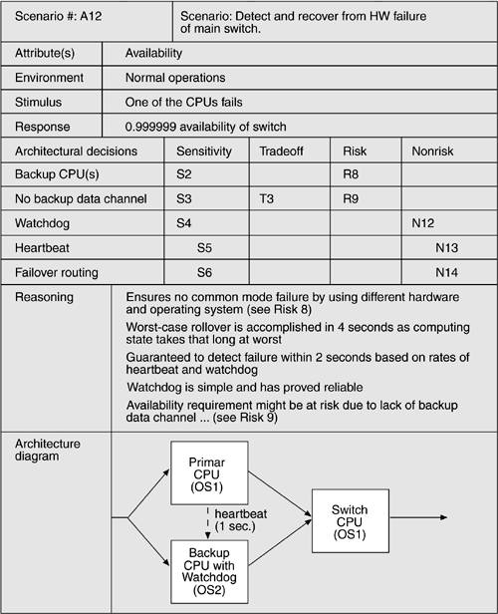
ATAM Example Analysis

Slide 60
Example
Automotive Software Architecture

Slide 61
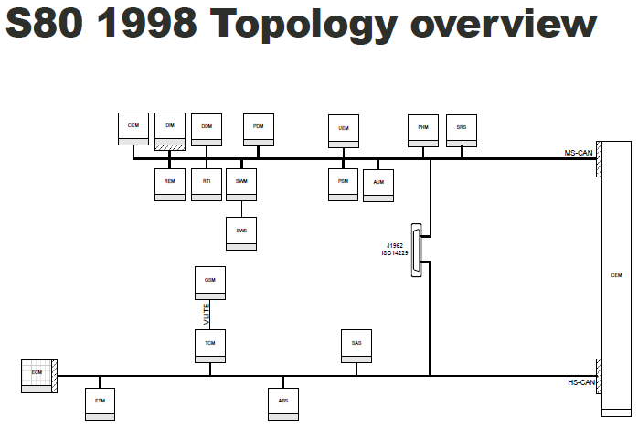
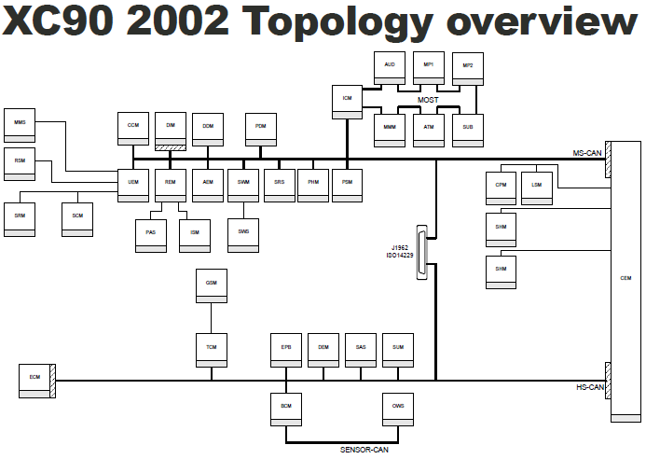
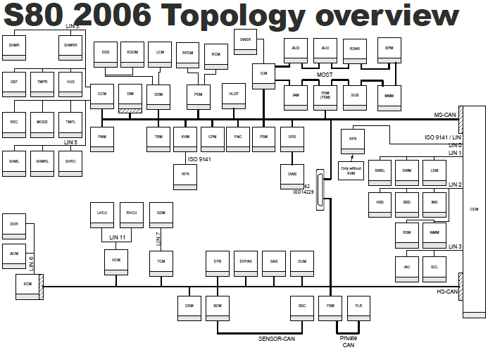
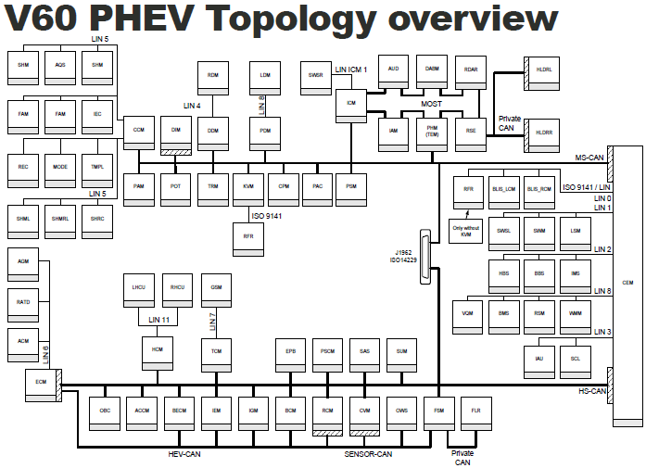
Increasing amount of software in systems

Slide 62

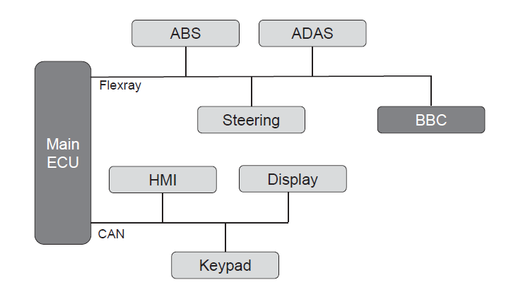


Example Quality Scenario for Safety

Slide 63




Example Quality Scenario for Safety
Artifact
Main ECU, BBC ECU, Flexray bus
Source
Rear-camera
Stimulus
Camera feed
Environment
Car in reverse driving
Response
Process video data and show it on the display
Measure
Video displayed in real-time and no loss of safety signals from parking sensors

Slide 64
Utility Tree
Business value
Architectural impact value
(H,H)
Capture video during the reverse driving of the car from the rear-camera and show it on the main display.
Car safety
Safety
(M,H)
…
Driver safety
(H,H)
…
Change ECUs
Modifiability
(H,L)
…
New ECUs
Utility
(H,M)
…
H/W failure
(H,H)
Availability
…
S/W failures
(H,M)
…
Data confidentiality
Security
(H,L)
…
Data integrity

Slide 65
ATAM Conceptual Flow
Business drivers
Quality attributes
Scenarios
The car’s electrical system should support the advanced mechanisms of active safety and should assure that none of the mechanisms interferes with another one, jeopardizing the safety.
Safety
Capture video during the reverse driving of the car from the rear-camera and show it on the main display.

Slide 66
ATAM Conceptual Flow
Placing the processing of the video feed on BBC
Business drivers
Quality attributes
Scenarios
Main ECU
BBC
RearView
Controller
CameraHW
Controller
Architectural plan
Architectural approaches
Architectural decisions
Video
Processor
Multi-tiered deployment of processing components over multiple ECUs.
Placing the processing of the video feed on the Main ECU
Main ECU
BBC
Video
Processor
CameraHW
Controller
RearView
Controller

Slide 67
ATAM Conceptual Flow
Main ECU
BBC
Video
Processor
CameraHW
Controller
RearView
Controller
Business drivers
Quality attributes
Scenarios
Analysis
Architectural plan
Architectural approaches
Architectural decisions
Def: An architectural decision that affects more than one quality attribute (possibly in opposite ways).
Example: Cost vs Safety
Cost of the car might be decreased if only Main ECU is of high processing power. Other ECUs don’t need be. However, centralized processing on Main ECU may cause congestion on the bus when reverse driving and overloading of Main ECU, thus compromising safety.
Tradeoffs
Sensitivity points
Risks
Non-risks

Slide 68
ATAM Conceptual Flow
Main ECU
BBC
Video
Processor
CameraHW
Controller
RearView
Controller
Business drivers
Quality attributes
Scenarios
Analysis
Architectural plan
Architectural approaches
Architectural decisions
Tradeoffs
Def: A property of one or more components (and/or component relationships) that is critical for achieving a particular quality attribute response.
Example:
High processing power of Main ECU allows for processing of video feed.
Sensitivity points
Risks
Non-risks

Slide 69
ATAM Conceptual Flow
Main ECU
BBC
Video
Processor
CameraHW
Controller
RearView
Controller
Business drivers
Quality attributes
Scenarios
Analysis
Architectural plan
Architectural approaches
Architectural decisions
Tradeoffs
Def: Architectural decision that may lead to undesirable consequences.
Example:
Safety requirement might be at risk due to heavy processing on Main ECU.
→ Impact: health of the passengers.
Sensitivity points
Risks
Non-risks

Slide 70
ATAM Conceptual Flow
Main ECU
BBC
Video
Processor
CameraHW
Controller
RearView
Controller
Business drivers
Quality attributes
Scenarios
Analysis
Architectural plan
Architectural approaches
Architectural decisions
Tradeoffs
Sensitivity points
Def: Architectural decision that is deemed safe.
Example:
High processing power of Main ECU guarantees high quality of video feed.
Risks
Non-risks

Slide 71
ATAM Conceptual Flow
Main ECU
BBC
Video
Processor
CameraHW
Controller
RearView
Controller
Business drivers
Quality attributes
Scenarios
Analysis
Architectural plan
Architectural approaches
Architectural decisions
Def: A general concern of a group of interrelated risks in a design, assigned its own risk value.
Example:
Safety risks.
Tradeoffs
Sensitivity points
Distilled into
Risk themes
Risks
Non-risks

Slide 72
ATAM Conceptual Flow
Main ECU
BBC
Video
Processor
CameraHW
Controller
RearView
Controller
Business drivers
Quality attributes
Scenarios
Analysis
Architectural plan
Architectural approaches
Architectural decisions
Trade-offs
Impacts
Sensitivity points
Distilled into
Risk themes
Risks
Non-risks

Slide 73
Effort of Architecture Evaluation

Slide 75
What’s Next

Slide 81
Where does Evaluation differ from Design?
Business Case
Business drivers
feasibility, value, risk
S.M.A.R.T.
MoSCoW
traceable
Manage
changes
User
Requirements
Domain
Requirements
Identify stakeholders
Functional
Requirements
Extra-Functional
Requirements
S.M.A.R.T.
Scenario’s
Design approach
for realizing extra-functional quality properties
Select
Architectural Style
Reference Architecture
Architecture Tactics
Group Functionality
in subsystems
Design Principles
Design Metrics
Identify
Trade-offs
Sensitivity points
Synthesize
RBD, QN,
ATAM, prototype
Analyze
refine

Slide 82
Summary
We have learned:
  What is software architecture evaluation!
  How to plan software architecture assessment!
  What are the results and benefits of architecture evaluation
  ATAM - Architecture Tradeoff Analysis Method

Slide 83
Summary
ATAM:
  is a scenario-based scenario-based architecture evaluation method that focuses on a system's quality goals
  is a qualitative evaluation approach
  does not include actual system testing
  is works with possible areas of risks

Slide 84
Summary
Lectures on Software Architecture on Youtube
  https://www.youtube.com/playlist?list=PLgQ2RT-ktJq6UgQDUIZXhuuiXh9T9qLJ-

Slide 85
Regular Client-Server
Structure Diagram
Component/Package/Class
Sequence Diagram
Deployment Diagram
C
S
C
S
C
S

Slide 86
Regular Client-Server
You can use packages as a unit of communication and deployment
Structure Diagram
Sequence Diagram
Deployment Diagram
P
Q
P
Q
C
S
D
T
P
Q

Slide 87
Client-Server with load balancer
Structure Diagram
Sequence Diagram
Deployment Diagram
C
LB
S1
S2
C
LB
S
check load status
C
S2
check load status
actual request
LB
S1
Many variations are possible
(Almost) the same tactic can also be used for improving availability

Slide 88



