Slide 1
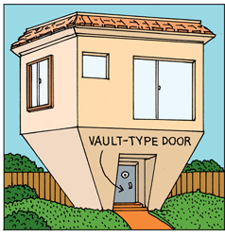

Architectural Tactics
Security
M.R.V. Chaudron
chaudron@chalmers.se
Software Engineering Division
Chalmers | Gothenburg University
neatorama.com

Slide 2
Schedule
Week |  | Date | Time | Lecture | Reading | Note
4 | L1/S1 | 22 JAN | 10:15 – 12:00 | Introduction, Objectives & Organization
4 | L2 | 23 JAN | 13:15 – 15:-00 | Architecting Process & Architecture Views | Ch 1 & 2
5 |  | 28 JAN | 10:15 – 12:00 | Skip
5 | S2 | 29 JAN | 10:15 - 12:00 | << Supervision: Launch Assignment 1>> | Ch 3 & 4
5 |  | 30 JAN | 13:00 – 15:00 | Skip
6 | L3 | 3 FEB | 13:15 – 15:00 | Design Principles (Maintainability, Modifiability) | Ch 7
6 | S3 | 5 FEB | 10:15 – 12:00 | << Supervision/Assignment>>
6 | L4 | 6 FEB | 13:15 – 15:00 | Architectural Styles 1: Client-Server | Ch 13
7 | L5 | 10 FEB | 13:15 – 15:00 | Technical Debt |  | Terese
7 | S4 | 12 FEB | 10:15 – 12:00 | << Supervision/Assignment>>
7 | L6 | 13 FEB | 10:15 – 12:00 | Architectural Styles 2: Pipe&Filter and Publ-Subscr | Ch 13
8 | L7 | 17 FEB | 13:15 – 15:00 | Architectural Styles 3: Blackboard & Performance – Analysis & Tactics | Ch 8 + paper
8 | S5 | 19 FEB | 10:15 – 12:00 | << Supervision/Assignment>>
8 | L8 | 20 FEB | 10:15 – 12:00 | Reliability, Availability, Fault Tolerance | Ch 5, 14 + paper
9 | L9 | 24 FEB | 13:15 – 15:00 | Anders Alminger - Volvo
9 | S6 | 26 FEB | 10:15 – 12:00 | << Supervision/Assignment>>
9 | L10 | 27 FEB | 13:15 – 15:00 | Security & Architecture Evaluation | Ch 21
10 | L11 | 2 MAR | 13:15 – 15:00 | Skip |  | Rodi PhD
10 | S7 | 4 MAR | 10:15 – 12:00 | << Supervision/Assignment>>
10 | L12 | 5 MAR | 13:15 – 15:00 | Reverse Eng’ing, Visualisation & Arch-Impl Correspondence | Ch 20

Slide 3
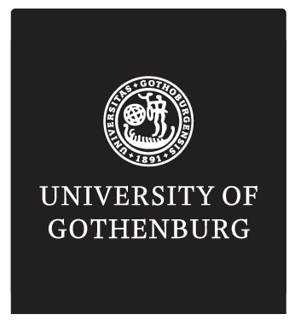
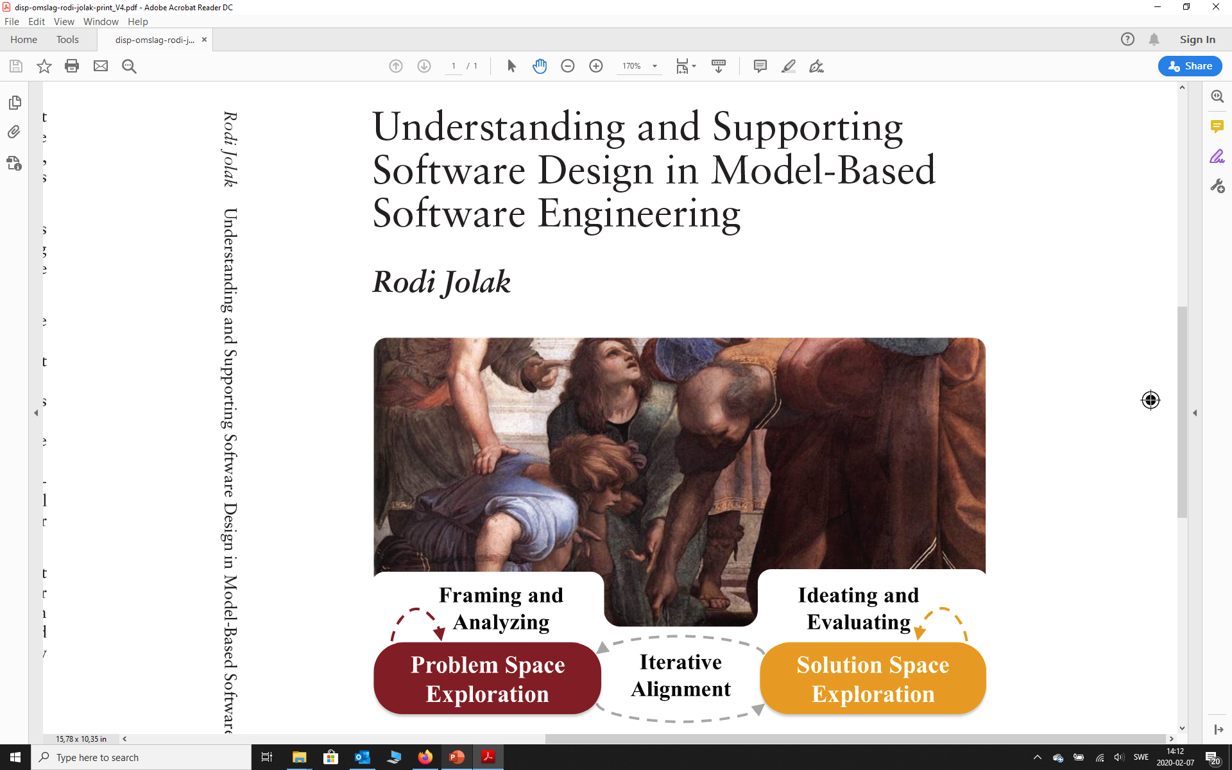
Gothenburg, 2nd of March 2020

Slide 4
Abstract
Model-Based Software Engineering (MBSE) is a software development approach in which models can serve a multitude of purposes. On the one hand, models can be used for ideation, to stimulate creative thinking, and facilitate communication. On the other hand, models can be used as guidelines for documentation, implementation, and code-generation. There is a discrepancy between empirical findings and developers' beliefs about MBSE. In this research, we address this discrepancy by contributing to the empirical understanding of software design. Moreover, we explore how to better support software design in MBSE. Our endeavor to understand design activities in MBSE resulted in the following: - Creating models while designing prompts significant thinking about the design. - Developers that work on different locations have fewer discussions about design decisions than co-located developers. - In MBSE projects, coordinating and knowledge sharing take more effort than technical engineering activities. - Graphical software design representations (GSD) promote more active discussion of design decisions between developers than textual software design representations (TSD). Also, developers have better recall of design details when using GSD than TSD. In our experience, usability and learning-effort of tools are the most encountered challenges in MBSE. Therefore, we research how to better support the design activities in MBSE by creating two software design environments: OctoUML and OctoBubbles. These tools implement new ways of transitioning from informal- to formal design representations, and novel ways to navigate between implementation-level and design-level in order to ease understanding of systems. Evaluations show enhanced efficiency of the design activities and positive perception of the usability of these environments.
Faculty Opponent
Prof. André van der Hoek, Department of Informatics, University of California, Irvine, USA.
https://gup.ub.gu.se/publication/290235
Category Thesis defence
Location: Jupiter 243, lecture room, Hörselgången 5, Jupiter
Starts: 02 March, 2020, 13:00

Slide 5
Software Design and Modeling
Design Process
Modeling Process
Problem Space Exploration
fosters
Choosing what to represent and how to represent it
Framing & Analyzing
uses
initiates
is aligned with
Drawing
Solution Space Exploration
organizes
Ideating & Evaluating
Layout
produces
produces
Design Decisions
represent
Models
5

Slide 6
Assignment Schedule
Week |  | Date | Lecture | Assignment1 | Assignment2
4 | L1/S1 | 22 JAN |  | Form groups & read Ass 1
4 | L2 | 23 JAN
5 |  | 28 JAN
5 | S2 | 29 JAN |  | Work & TA feedback
5 |  | 30 JAN
6 | L3 | 3 FEB
6 | S3 | 5 FEB |  | Hand-in draft of Ass 1
6 | L4 | 6 FEB |  | (perform peer review)
7 | L5 | 10 FEB
7 | S4 | 12 FEB |  | 11 Feb: Deadline peer review Ass 1 | Start Assignment 2
7 | L6 | 13 FEB
8 | L7 | 17 FEB
8 | S5 | 19 FEB |  | Work & TA feedback | Work & TA feedback
8 | L8 | 20 FEB
8 |  | 21 FEB |  |  | Hand-in Ass 2
9 | L9 | 24 FEB
9 | S6 | 26 FEB |  | Work & TA feedback | Deadline peer review Ass 2
9 | L10 | 27 FEB
10 | L11 | 2 MAR |  |  | Deadline Ass 2
10 | S7 | 4 MAR |  | Working & Deadline Ass 1
10 | L12 | 5 MAR
11 |  | 6 MAR | 10:30-14:00 | Demonstrate Your Implementation

Slide 7
Course Summary
Business Case
Business drivers
feasibility, value, risk
S.M.A.R.T.
MoSCoW
traceable
Manage
changes
User
Requirements
Domain
Requirements
Identify stakeholders
Functional
Requirements
Extra-Functional
Requirements
S.M.A.R.T.
Scenario’s
Design approach
for realizing extra-functional quality properties
Select
Architectural Style
Reference Architecture
Architecture Tactics
Group Functionality
in subsystems
Design Principles
Design Metrics
Identify
Trade-offs
Sensitivity points
Synthesize
RBD, QN,
ATAM, prototype
Analyze
refine

Slide 8
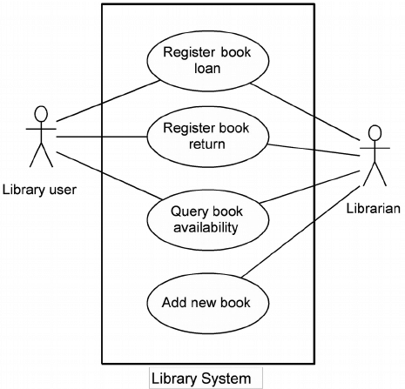
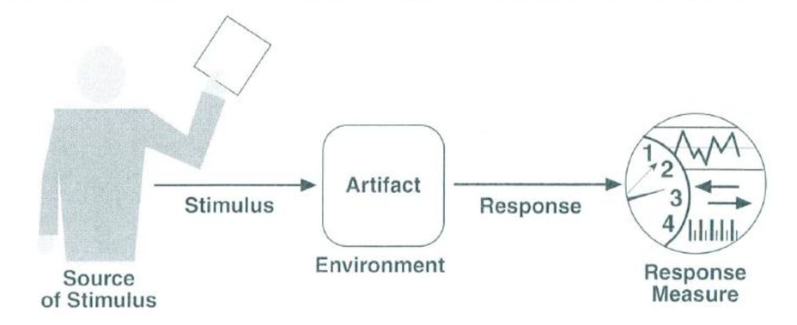
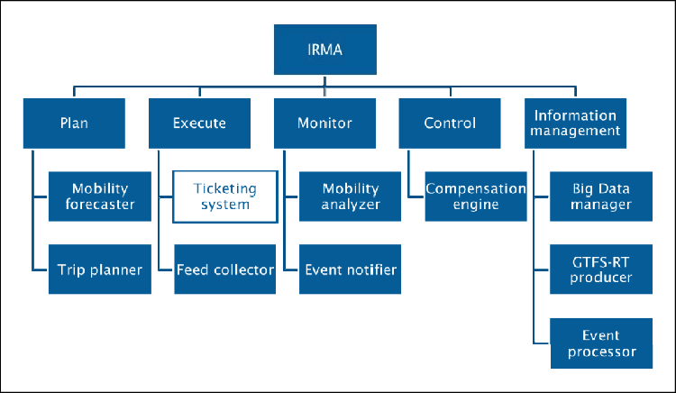
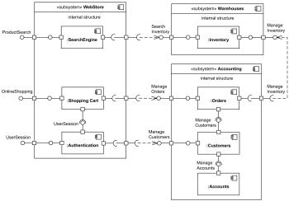
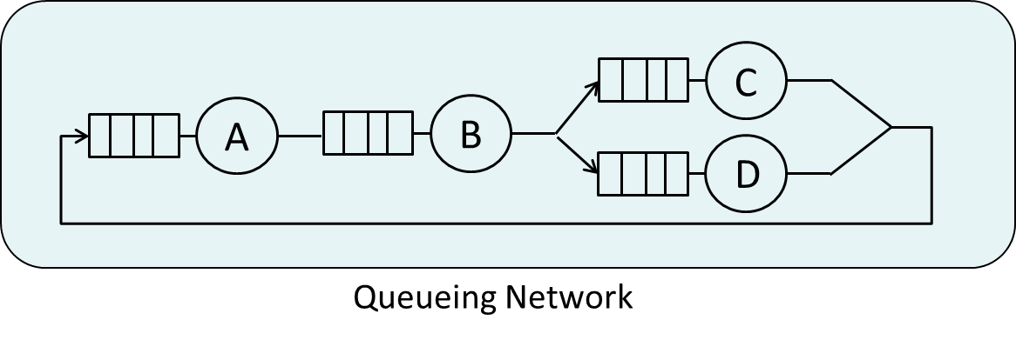
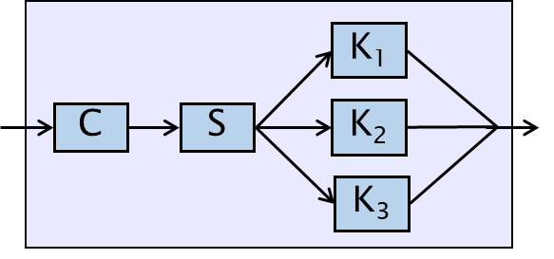
Course Summary
Business Case
Business drivers
feasibility, value, risk
User
Requirements
Domain
Requirements
Identify stakeholders
S.M.A.R.T., Scenario’s
Functional
Requirements
Extra-Functional
Requirements
Design approach
for realizing extra-functional quality properties
Select
Architectural Style
Architecture Tactics
Group Functionality
in subsystems
Design Principles
Synthesize
RBD, QN,
ATAM, prototype
refine
Analyze
Identify
Trade-offs
Sensitivity points

Slide 9
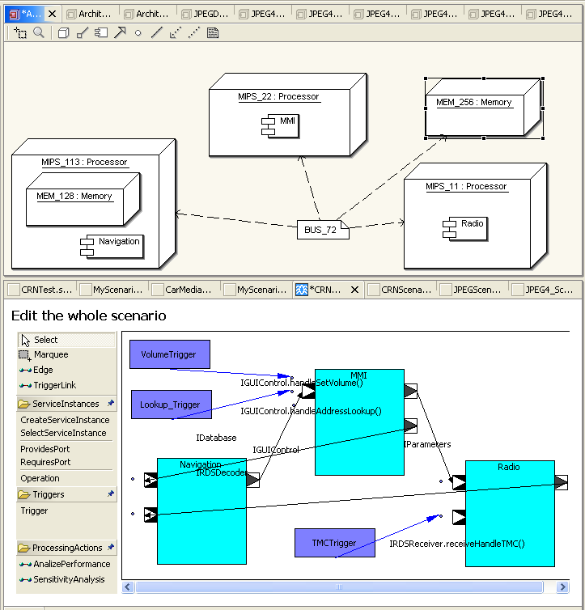
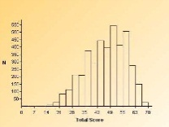
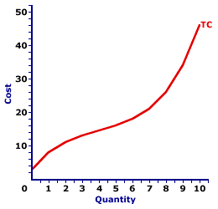
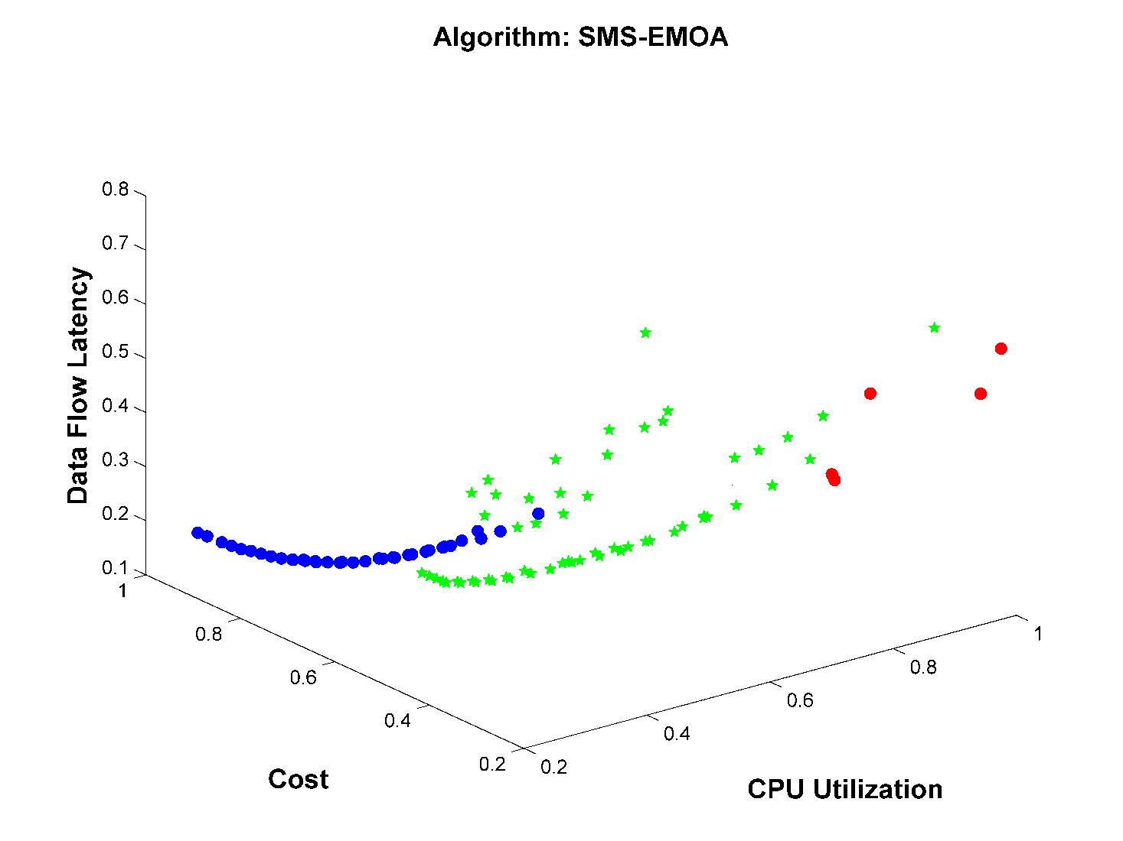




Quality-Driven Architecture Design Tool
Architecture Model
Performance
Safety
Cost
automatically
Analysis
Analysis
Analysis
generates
compare
alternatives
automated
HW & SW-components
generate new
alternative
architectures
Support for the architect
automatically

Slide 10

Security
Sources:
  Common Concepts Underlying Safety, Security, and
  Survivability Engineering
  Donald G. Firesmith, December 2003
  Technical Note CMU/SEI-2003-TN-033
  M. van Steen, Distributed Systems
Notes:
— Communications security is the degree to which communications are protected from attack.
— Data security is the degree to which stored and manipulated data are protected from attack.
— Emissions security is the degree to which systems do not emit radiation that is subject to attack.
— Personal security is the degree to which personnel are protected from attack.
— Physical security is the degree to which systems are protected from physical attack.

Slide 11
Sources: Orange Book
The Orange Book is a summary of the US Department of Defense Trusted Computer System Evaluation Criteria.
Although originally written for military systems, the security classifications are now broadly used within the computer industry.

Slide 12
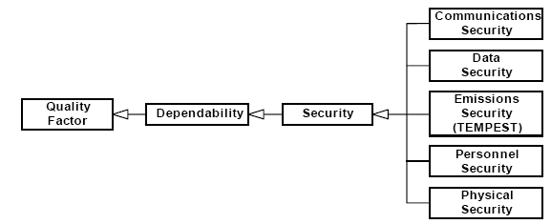
Security
Security is not a technical/systems issue only.
Systems operate in some physical and organizational context.
All these issues need to be considered in an integral manner.
Notes:
— Communications security is the degree to which communications are protected from attack.
— Data security is the degree to which stored and manipulated data are protected from attack.
— Emissions security is the degree to which systems do not emit radiation that is subject to attack.
— Personal security is the degree to which personnel are protected from attack.
— Physical security is the degree to which systems are protected from physical attack.

Slide 13


Security
Confidentiality: information is disclosed
(Secrecy) only to authorized parties
Integrity: alterations to system assets can
only be made in authorized ways
Availability: the probability that a system is
operating correctly at any given
moment
Notes:
Possibly also: authenticity

Slide 14
Assets and Threats
Asset
Threat
Asset
Item of value
Subject to CIA properties
E.g. money, password, reputation, …
Types of threats
Interception/Disclosure
Interruption
Modification
Fabrication
A password is an asset because it gives access to other assets

Slide 15
Interception
Unauthorized party gains access to a service or data
e.g. communication is overheard (‘eavesdropping’)
data is illegally copied
service is illegally used
logging the activities of a user
Notes:
Eavesdropping is a particular concern in wireless distributed systems

Slide 16
Interruption
Service or data become unavailable
e.g. denial of service attack

Slide 17
Modification
Unautorized changing of data/services such that they
no longer adhere to their original specification
e.g. changing grades/bank-account
redirecting web-requests to another page
changing beneficiary of a transaction

Slide 18
Fabrication
Data or activity are generated that would normally
not exist

Slide 19
Types of Attacks
Passive attack
does not alter the
behaviour of the
system
Active attack
alters the
behaviour of the
system
interception
interruption
modification
fabrication

Slide 20
Passive Attacks: Eaves Dropping
Eavesdropping
obtain confidential information
replay
wireless car key
Any suggestions for improvement?
Notes:
Improvement: use a different frequency (e.g. in a cyclical manner) which the car recognizes.

Slide 21
Passive Attacks: Traffic Analysis
source of messages
topology of interaction
frequency & length

Slide 22
Active Attacks: Modification
transfer 100 Euro
from account 615243 Chalmers
to account 948765 Svensson
transfer 100 Euro
from account 615243 Chalmers
to account 435263 Chaudron
Modification can also be delay in time, reordered, …

Slide 23
Active Attacks: Denial of Service
Overload a computer by sending lots
of messages (requests).
This turns the computer incapable of
providing its level of service.
During a DoS attack on a security service,
an attacker may take over the identity of another
computer in the system

Slide 24
Assets and Threats
Asset
Threat
contained in
may materialize by
System
element
applies to
Attack

Slide 25
Assets and Threats - Example
password for internet
bank account
disclosure
Asset
subject to
Threat
contained in
may materialize by
*
*
System
element
applies to
Attack
log-in
process
guessing
phising

Slide 26

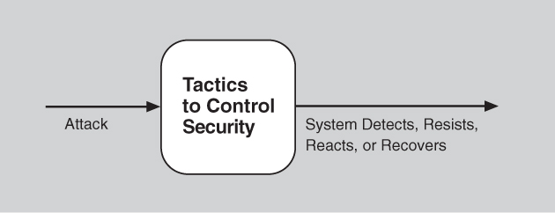
Security
Definition:
  Security is a measure of the system’s ability to protect data and information from unauthorized access while still providing access to people and systems that are authorized.

Slide 27
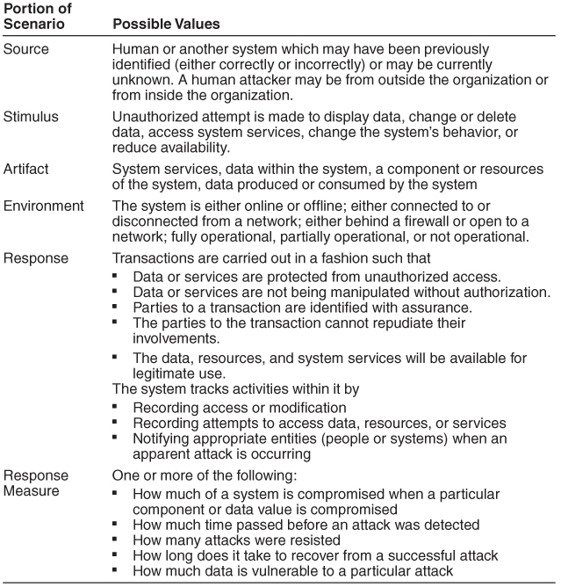
Security General Scenario

Slide 28
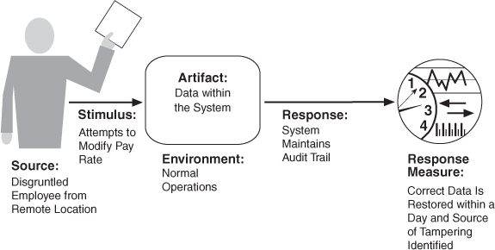
Concrete Security Scenario

Slide 29
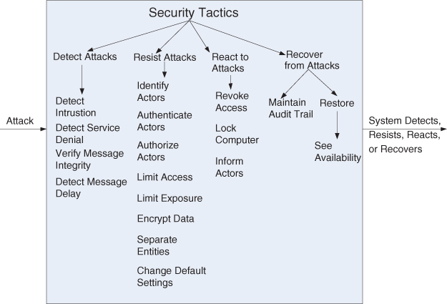
Security Tactics

Slide 30
Security Tactics
Resisting attacks
Detecting attacks
Recovering from an attack

Slide 31
Layers of Defence
preventive
detective
Corrective/recovery
Respond
Deter
Detect
Alarm
Delay escape
Sequence should not take too long!

Slide 32
Security Mechanisms
Encryption
Authentication
Authorization
Auditing / Accountability

Slide 33
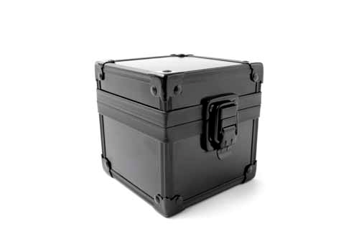

Encryption
Transform data into something an attacker
cannot understand
Encryption mechanism may support
both encryption and integrity
Password
KFJIPQSZ

Slide 34
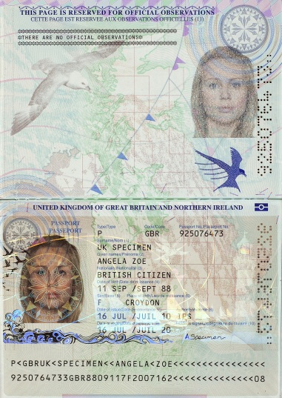


Authentication
Authentication is used to verify the claimed
identity of a user or application
e.g. using passwords or (other) challenges
Are you who you say you are?

Slide 35
Authorization
Authorization is the verification of whether
a party is allowed to access data/service
I believe you are X, but are you allowed to use this ?

Slide 36

Auditing
Auditing is the tracing of who accessed what,
when, where and in which way.
Auditing is not protective or preventive,
but corrective.
Auditing is helpful in detecting security breaches
and taking subsequent measures.

Slide 37
Detecting and Recovering
Intrusion detection system - anomalous patterns
Restoration - see availability tactics
Identification - maintain audit trail

Slide 38
Classes of Measures
physical
logical / sw
organizational
preventive
fence, guard
firewalls
training
detective
motion
detector
logging
audit
corrective
UPS
virus checker
backup

Slide 39
How much security? Risk Analysis
Apply security where needed
asset
threat
incident
impact
risk
Risk analysis helps determine security needs

Slide 40
Summary Security
Security is a dependability property
  related to availability
  formulate a SMART manner
“100% security” does not exists – security is defined relative to a threat/attack model
Security should not be addressed using technology only – but also through organizational measures

Slide 41
Summary of key architecting practices
Get stakeholder involvement early and often
Understand the drivers for the project (business, politics)
Understand the requirements incl. quality properties
  SMART & prioritized
Develop iteratively and incrementally
Describe architecture using multiple views
  abstract, but precise, design decisions & rationale
Design for change (modularity, low coupling, inform. hiding)
  keep your options open
Analyze in an early stage (use maths! and scenarios)
Simplify, simplify, simplify
Regularly update planning and risk analysis
Monitor that architecture is implemented
Get good people, make them happy, set them loose

Slide 42
Recommendations for Architecture Description
Describe the system goals & the assumptions on the environment
Describe the design principles, decisions, guidelines
  and their rationale
Describe several views that can be combined in a consistent model
at least the following views should be given:
  functional/structural (decomposition) view
    include a description of the interfaces between (sub)systems
  process/dynamical view
  deployment view
Prevent mixing of views
Address non-functional (*ilities) aspects
Use a well-defined notation and include its key/legend
    this aids systematic use of notation/avoids inconsistent use
    improves common understanding
    prevents mixing of different levels of abstraction
Add explanation in natural language
Notes:
Documenting design decisions including dismissed alternatives should be integral part of a design process.
Hence also for design of architectures.

Slide 43
Summary Architecture Evaluation
If you haven’t analyzed it, don’t build it.
Use Scenario-based evaluation for what-if questions
  Identify sensitivity- & trade-off points, and risks
Use analytical methods to support architectural decision making
  Reliability → Reliability Block Diagrams
  Throughput → Queuing networks
Use metrics to manage
  Modularity (coupling, cohesion)
  conformance of implementation to design
Many analyses are of ‘back of the envelope’ size.
  little effort, lots of value
  even if your model is not perfect (which they never are)

Slide 44
Documentation Guidelines 1
Documentation should be written from the perspective
of the reader
  organize for ease of reading / reference
  mark ‘to be determined’
Avoid Repetition
  much easier to maintain (avoid inconsistency)
Avoid unintentional ambiguity
  use legend/key with diagrams
Use a standard organization of the document
  in organizations with many projects

Slide 45
Documentation Guidelines 2
Record Rationale
  these form part of guidelines for evolution
Keep it current
Review for fitness of purpose
  have (future) users ‘test’ the documentation
Documentation is expensive (to make and maintain)
=> go for quality not quantity

Slide 46
Project Team’s Bill of Rights
To know the project objectives and to clarify priorities
To know the product details and to clarify this if necessary
To have ready access to the person(s) responsible for deciding about the systems functionality
To work in each phase of the project in a technically responsible way – e.g. use necessary tooling
To approve effort and schedule estimates for work that a team will perform; this includes to take time to make reasonable estimates and to revise estimates when requirements change
To have project’s status reported accurately to customers and management
To work in an environment free from frequent interruptions and distractions – especially during critical parts of the project.
From: Steve McConnell: Software Project Survival Guide, MicroSoft Press, 1998

Slide 47
Tactics and Pitfalls (Rozansky and Woods)
Tactics
- apply recognized security
principles
- authenticate the principals
- authorize access
- ensure information secrecy
- ensure information integrity
- ensure accountability
- protect availability
- integrate security technologies
- provide security administration
- use third-party security
infrastructure
Pitfalls
- complex security policies
- unproven security technologies
- system not designed for failure
- lack of administration facilities
- technology-driven approach
- failure to consider time sources
- overreliance on technology
- no clear requirements or models
- security as an afterthought
- security embedded in the
application code
- piecemeal security
- ad hoc security technology

Slide 48
Software Mechanisms
Encryption
Authentication
Authorization
Auditing

Slide 49
Separating Policy & Mechanism
Policy: describe which actions are allowed/prohibited
Mechanism: means to enforce policy
Allows changing (upgrading) mechanisms for
realizing a policy

Slide 50
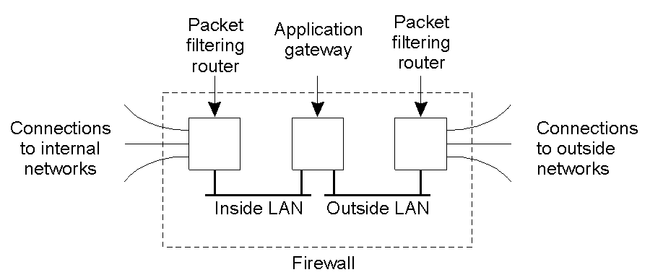
Firewalls
A common implementation of a firewall.
Adapted from: M. van Steen, Distributed Systems

Slide 51
Firewalls
A firewall disconnects a system from the outside world
packet
filtering
router
packet
filtering
router
application
gateway
connections
connections
to internal
to external
networks
networks
inside LAN
outside LAN
Firewall

Slide 52
Firewalls (2)
Incoming & outgoing messages are inspected by a special computer before they are forwarded.
E.g. discard request for an intra-net page from a computer outside a company.
Messages can be
packet-level : inspects only the header
application-level : inspects the contents
    discards virus-infected e-mails
    discards oversized e-mails

Slide 53
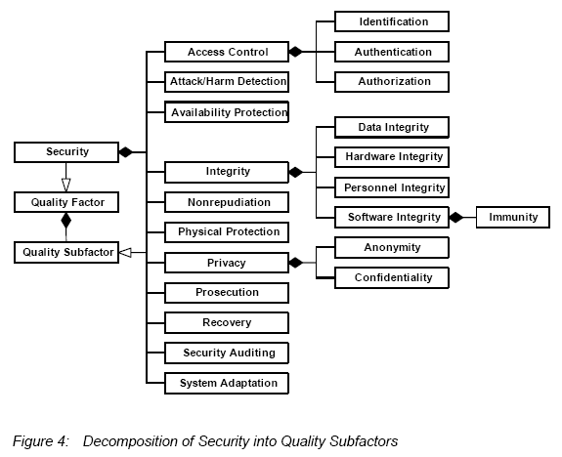

Slide 54
References
Distributed Systems: Principles and Paradigms
Tanenbaum & Van Steen, Prentice Hall, 2002
See Chapter 8 for an introduction
Cryptography and Network Security: Principles
and Practice (2nd ed), William Stallings,
Prentice Hall, 1999
Security Engineering: A guide to dependable
distributed systems, Ross Anderson, Wiley & Sons,
2001

Slide 55
Safety
The system will not cause any harm to its environment if a failure occurs.
Tactics:
-fail safe mode
e.g. in railway: stop all trains
in nuclear reactor: stop the reactor
not possible for all systems: airplane

Slide 56
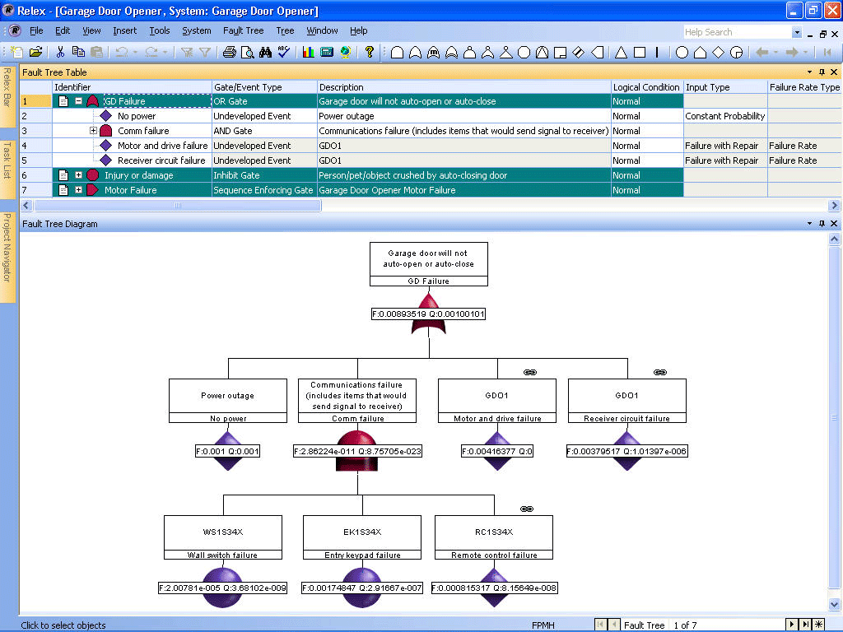
Fault-Trees
Fault-Trees

Slide 57
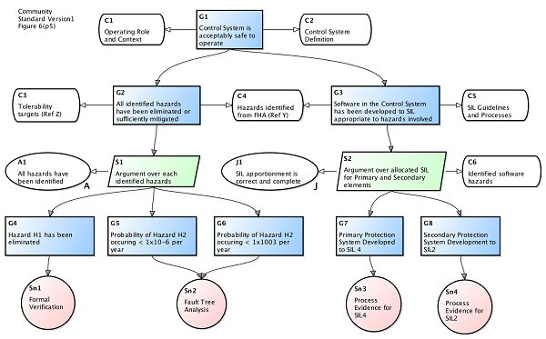
Safety Analysis: Safety Cases

