Slide 1

Reverse Architecting and
Design-Code Conformance
Michel Chaudron

Slide 2
Schedule
Week |  | Date | Time | Lecture | Reading | Note
4 | L1/S1 | 22 JAN | 10:15 – 12:00 | Introduction, Objectives & Organization
4 | L2 | 23 JAN | 13:15 – 15:-00 | Architecting Process & Architecture Views | Ch 1 & 2
5 |  | 28 JAN | 10:15 – 12:00 | Skip
5 | S2 | 29 JAN | 10:15 - 12:00 | << Supervision: Launch Assignment 1>> | Ch 3 & 4
5 |  | 30 JAN | 13:00 – 15:00 | Skip
6 | L3 | 3 FEB | 13:15 – 15:00 | Design Principles (Maintainability, Modifiability) | Ch 7
6 | S3 | 5 FEB | 10:15 – 12:00 | << Supervision/Assignment>>
6 | L4 | 6 FEB | 13:15 – 15:00 | Architectural Styles 1: Client-Server | Ch 13
7 | L5 | 10 FEB | 13:15 – 15:00 | Technical Debt |  | Terese
7 | S4 | 12 FEB | 10:15 – 12:00 | << Supervision/Assignment>>
7 | L6 | 13 FEB | 10:15 – 12:00 | Architectural Styles 2: Pipe&Filter and Publ-Subscr | Ch 13
8 | L7 | 17 FEB | 13:15 – 15:00 | Architectural Styles 3: Blackboard & Performance – Analysis & Tactics | Ch 8 + paper
8 | S5 | 19 FEB | 10:15 – 12:00 | << Supervision/Assignment>>
8 | L8 | 20 FEB | 10:15 – 12:00 | Reliability, Availability, Fault Tolerance | Ch 5, 14 + paper
9 | L9 | 24 FEB | 13:15 – 15:00 | Anders Alminger - Volvo
9 | S6 | 26 FEB | 10:15 – 12:00 | << Supervision/Assignment>>
9 | L10 | 27 FEB | 13:15 – 15:00 | Security & Architecture Evaluation | Ch 21
10 | L11 | 2 MAR | 13:15 – 15:00 | Skip |  | Rodi PhD
10 | S7 | 4 MAR | 10:15 – 12:00 | << Supervision/Assignment>>
10 | L12 | 5 MAR | 13:15 – 15:00 | Reverse Engineering & Correspondence | Ch 20

Slide 3
Assignment Schedule
Week |  | Date | Lecture | Assignment1 | Assignment2
4 | L1/S1 | 22 JAN |  | Form groups & read Ass 1
4 | L2 | 23 JAN
5 |  | 28 JAN
5 | S2 | 29 JAN |  | Work & TA feedback
5 |  | 30 JAN
6 | L3 | 3 FEB
6 | S3 | 5 FEB |  | Hand-in draft of Ass 1
6 | L4 | 6 FEB |  | (perform peer review)
7 | L5 | 10 FEB
7 | S4 | 12 FEB |  | 11 Feb: Deadline peer review Ass 1 | Start Assignment 2
7 | L6 | 13 FEB
8 | L7 | 17 FEB
8 | S5 | 19 FEB |  | Work & TA feedback | Work & TA feedback
8 | L8 | 20 FEB
8 |  | 21 FEB |  |  | Hand-in Ass 2
9 | L9 | 24 FEB
9 | S6 | 26 FEB |  | Work & TA feedback | Deadline peer review Ass 2
9 | L10 | 27 FEB
10 | L11 | 2 MAR |  |  | Deadline Ass 2
10 | S7 | 4 MAR |  | Deadline Ass 1
10 | L12 | 5 MAR
11 |  | 6 MAR | AM or PM | Demonstrate Your Implementation | Svea-219

Slide 4
Demo Schedule March 6th – SVEA 219
10:30 - 10:45 | Group 7
10:45 - 11:00 | Group 1
11:00 - 11:15 | <group_no>
11:15 - 11:30 | Group 5
11:30 - 11:45 | Group 4
11:45 - 12:00 | Group 9
12:00 - 13:00 break
13:00 - 13:15 | Group 3
13:15 - 13:30 | Group 6
13:30 - 13:45 | Group 2
13:45 - 14:00 | Group 8

Slide 5
Written Exam
19th of March in the AM/Morning

Slide 6
Outline
Reverse Architecting –
based on slides by prof. Arie van Deursen, TU Delft, Netherlands
Monitoring Implementation-Design conformance
  includes slides by Reinder Bril,
  TU Eindhoven, Netherlands

Slide 7
Reverse Architecting: Motivation
Architecture description lost or outdated
Obtain advantages of explicit architecture:
  Shared representation of system
  Stakeholder communication
  Explicit design decisions
Architecture conformance checking
Quality attribute analysis

Slide 8
Program Understanding
the task of building mental models of an underlying software system
at various abstraction levels, ranging from
  models of the code itself to
  ones of the underlying application domain,
for software maintenance, evolution, and reengineering purposes
~50% of
maintenance
effort!!
Notes:
how achieved
code reading
meaningful names
short names
no smells.
software visualization
code is written only once, but read many times.

Slide 9
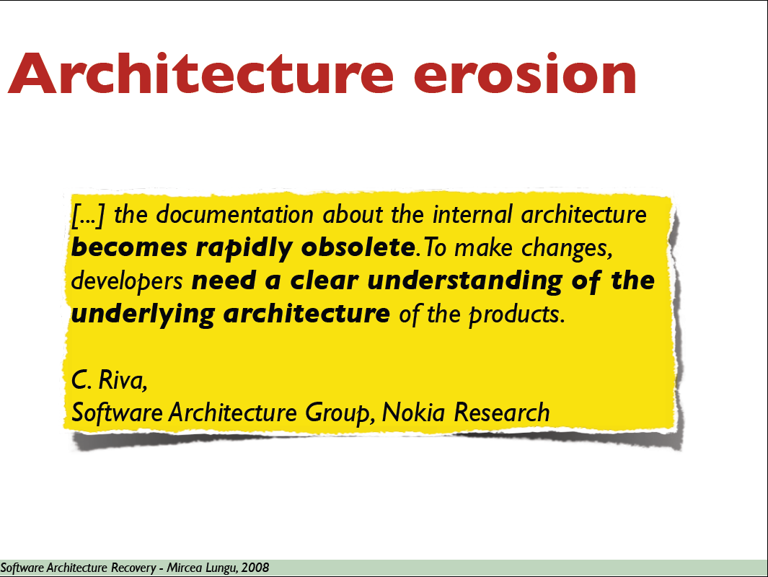

Slide 10
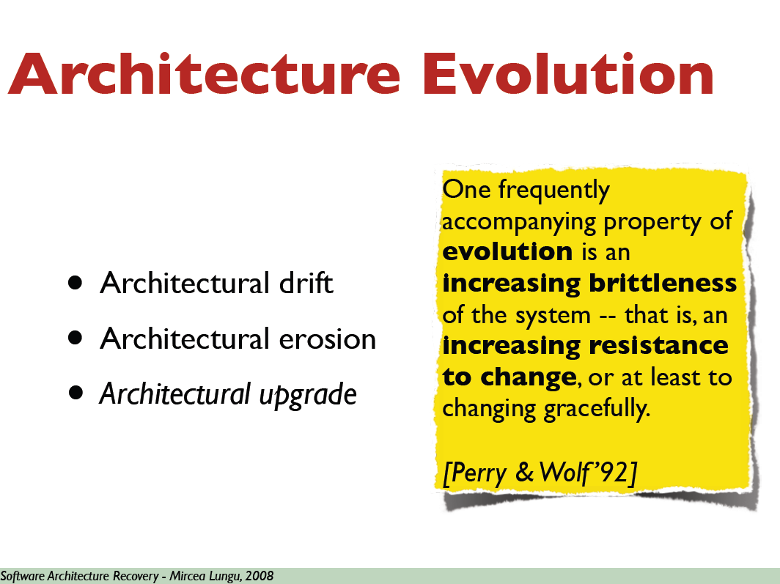

Slide 11
Architecture
Plan vs Reality (‘as-is’)
User interface

Slide 12
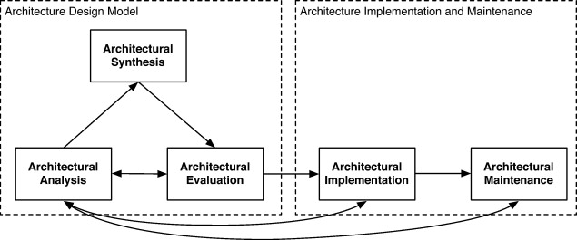
Fig. 1 Software architecture life cycle Tang et al., 2009
Rainer Weinreich , Georg Buchgeher
Towards supporting the software architecture life cycle
Journal of Systems and Software Volume 85, Issue 3 2012 546 - 561
http://dx.doi.org/10.1016/j.jss.2011.05.036

Slide 13


Problems with
Engineering Documentation
Difficult to:
find information
due to: - large size & complexity
- scattering of information
Keep (check) ‘up-to-date’
To cater for multiple audiences
tasks, experience, ….
www.webshop.com
How can a developer get the latest information he needs for his current task?
Notes:
Adding product-families and versioning makes this problem even more difficult

Slide 14
Reverse Engineering
The process of analyzing a subject system with two goals in mind:
  to identify the system's components and their interrelationships; and,
  to create representations of the system in another form or at a higher level of abstraction.

Slide 15


Reverse Engineering (analogy)

Slide 16
Re-engineering
The examination and alteration of a subject system
to reconstitute it in a new form
and the subsequent implementation of that new form
Beyond analysis -- actually improve.

Slide 17
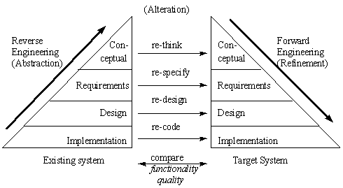
Reengineering

Slide 18
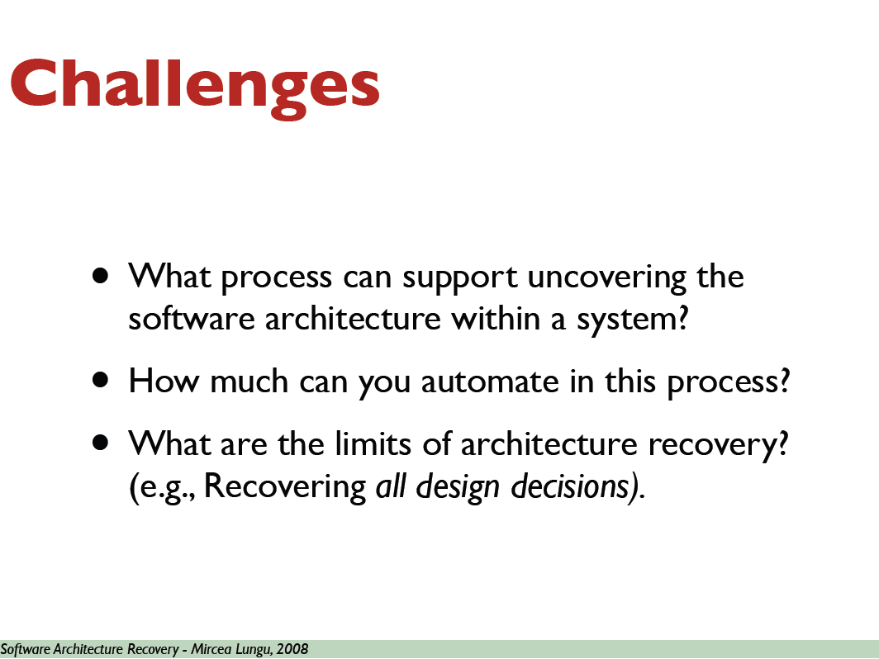

Slide 19
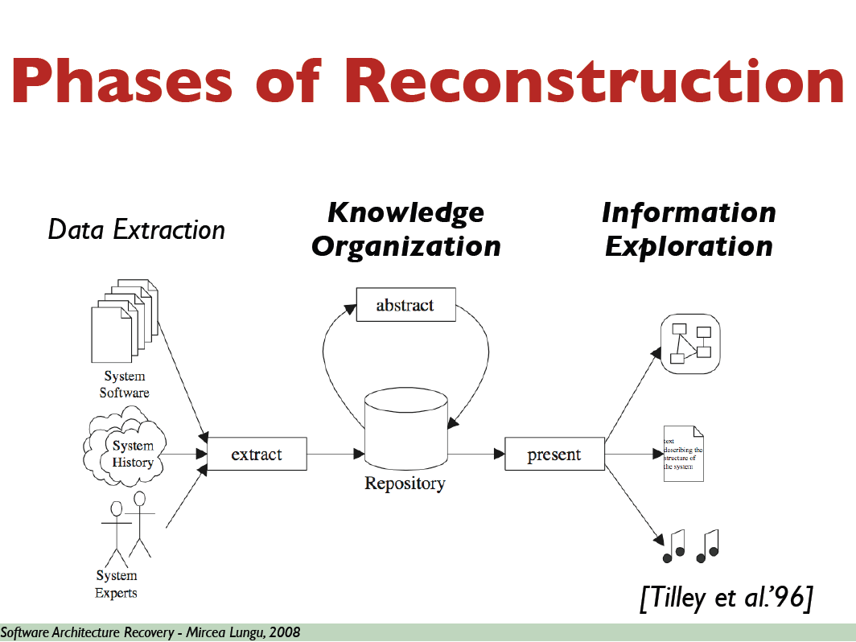

Slide 20
Reverse Engineering: Exploration
artifacts
extract
repository
view
results
query
Extract src models from system artifacts
Query/manipulate to infer new knowledge
Present different views on results

Slide 21
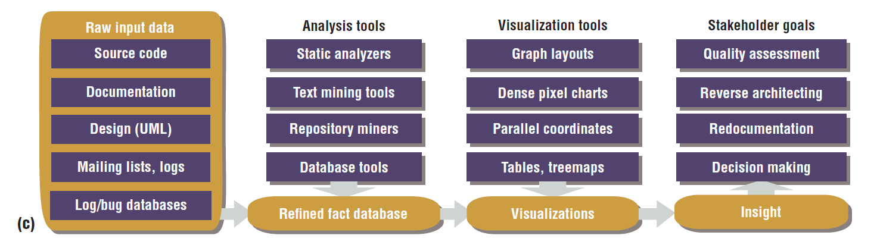

Slide 22
Source Model Extraction
artifacts
extract
repository
view
results
query

Slide 23
Source Model Extraction
Derive information from system artifacts
  variable usage, call graphs, file dependencies, database access, …
Challenges
  Accurate & complete results
  Flexible: easy to write and adapt
  Robust: deal with irregularities in input

Slide 24
Query and Manipulate
artifacts
extract
repository
view
results
query

Slide 25
Query and Manipulate
Goals:
  infer (new) knowledge & abstractions
  filter information
Example structures:
  Perform graph
  Call graph (OI, PVL)
  Screen flow
  Batch job
  Subsystem dbs
In search for
more abstraction

Slide 26
Combining Data & Functionality
Cluster analysis
  technique for finding groups in data
  Relies on metrics to compare distance between data items
Concept analysis
  for finding groups too
  Relies on maximal subsets of data items sharing a set of features

Slide 27
Presentation of Results
artifacts
extract
repository
view
results
query

Slide 28
Presentation Desiderata
Browsing and searching
Multiple levels of abstraction
  Zoom in, zoom out
Visual as well as textual information
  Graph visualization
Show multiple structures
  E.g. Package hierarchy + control-flow

Slide 29
Types of navigation
Vertical browsing
  supported by hierarchical structures
  zoom into more detailed level
    system → subsystem → program → … → source
Horizontal browsing
  supported by graph-like structures
  find related on same abstraction level
    called programs, variables of same type, etc

Slide 30
Presentation Challenges
Handling abstractions not visible in code
Giving abstractions a meaningful name
  e.g., name for inferred type
Defining starting points for browsing
  lists of types, programs, copybooks, words, lits
  add cross-cutting hyperlinks on all levels

Slide 31
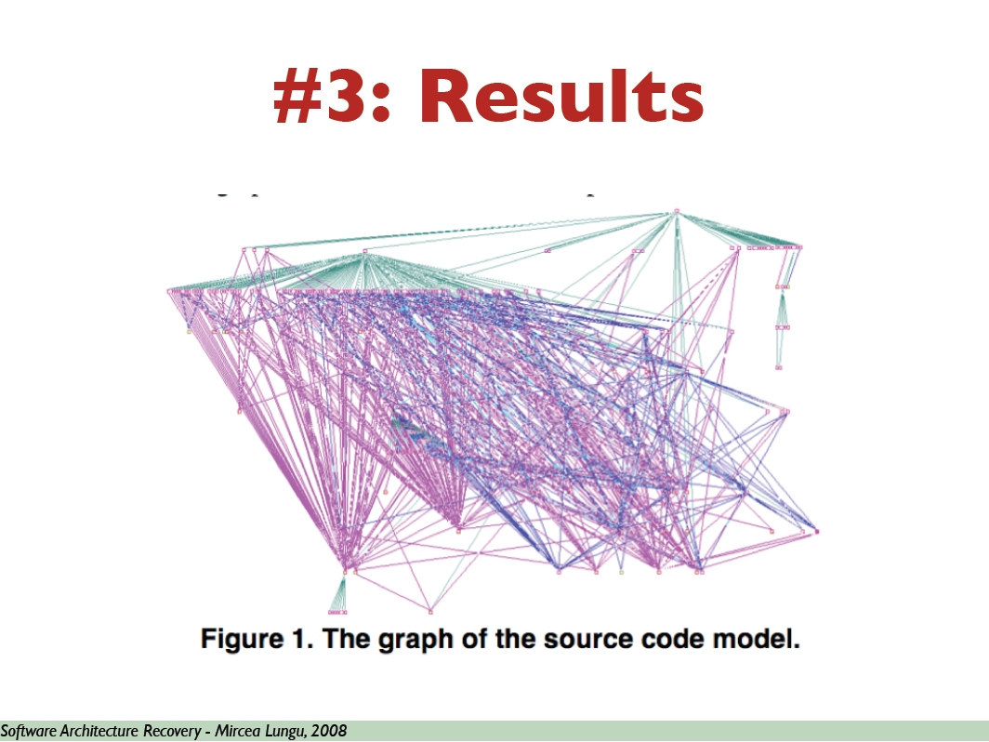

Slide 32
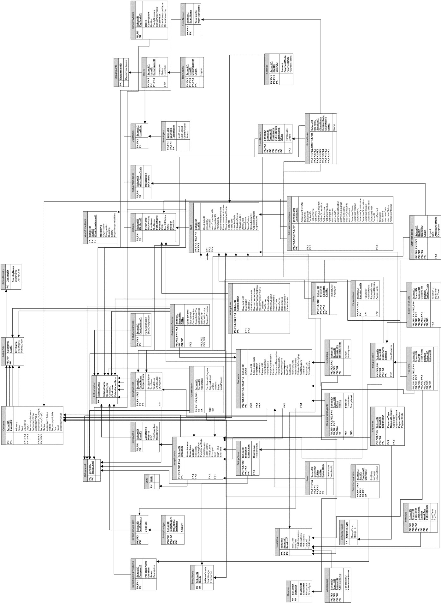
Reverse Engineering of a small system
Clearly different from forward designed UML designs
(o.a. in size, layout, detail, naming, ….)

Slide 33
Recall: 4+1 Views Representation of Systems
What can/does the system do ?
How is the system structured?
How to build / configure ?
Structure View
Development View
System Architect
End-user
Programmers
Configuration management
Functionality (Decomposition)
Use Case View
How does the system behave?
Where to install ?
What hw\nw is used?
Process View
Deployment View
System Architect
System engineering
System topology
Delivery, installation, maintenance
Performance, Scalability, Throughput
Concurrency, Communication,
Synchronization
How does the system perform ?

Slide 34
Idea 1
source code
classes
views
A
B
C
D
A
B
C
D
A
B
C
D

Slide 35
Interesting Structures of Software System
Module structure
  Modules & dependencies
  Layering
  Hierarchy
Data model structure
  Type structure
Notes:
Ask for structures in their systems

Slide 36
Behaviour is also Interesting!
Call structure
Process structure
GUI flow
...
Notes:
Ask for structures in their systems

Slide 37
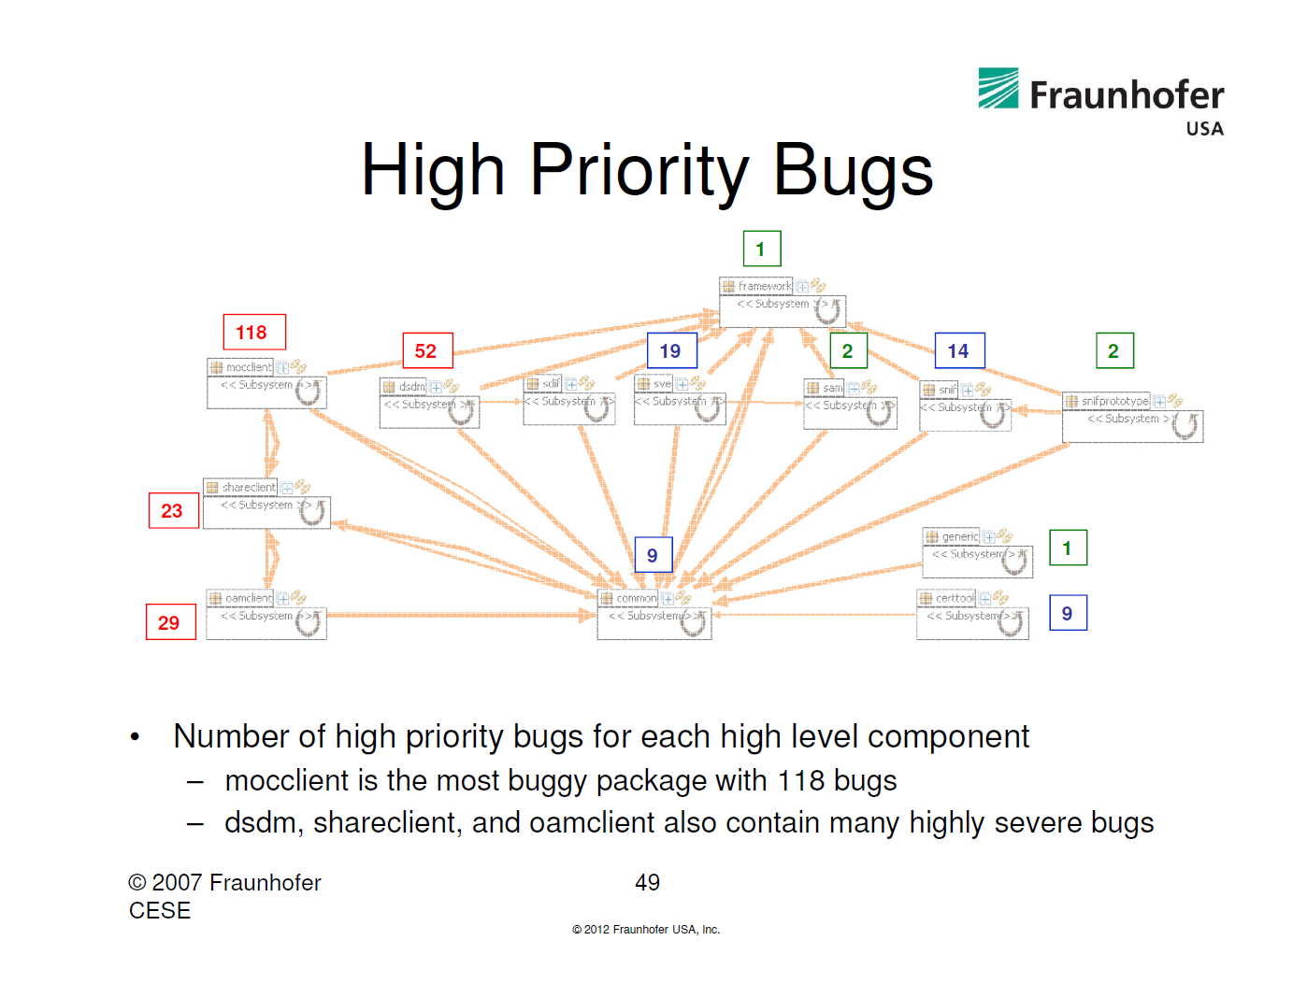
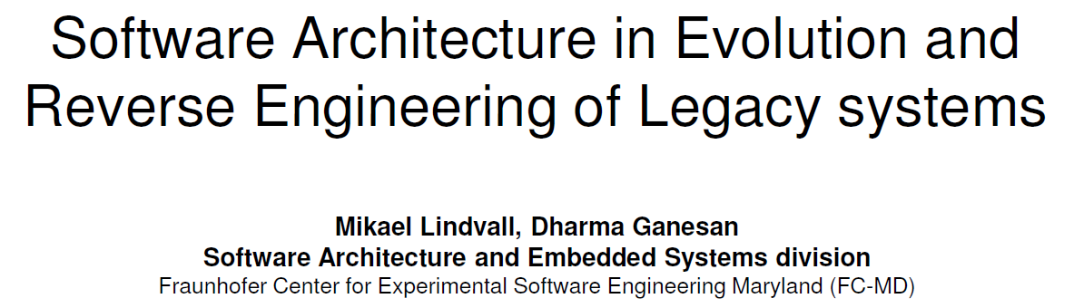
Combine Architecture with other Development metrics: High Priority Bugs

Slide 38
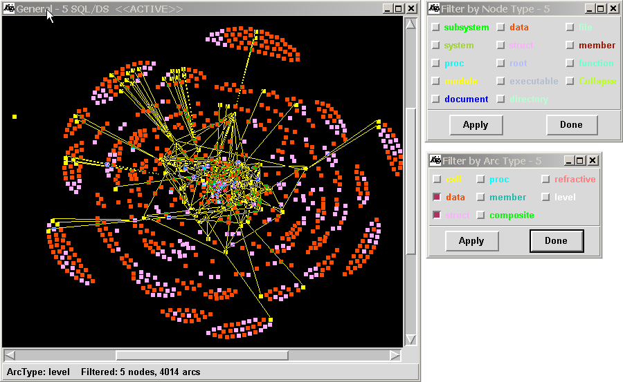
Rigi tool
http://www.svgopen.org/2002/papers/kienle_weber_mueller__rigi_reverse_engineering/

Slide 39
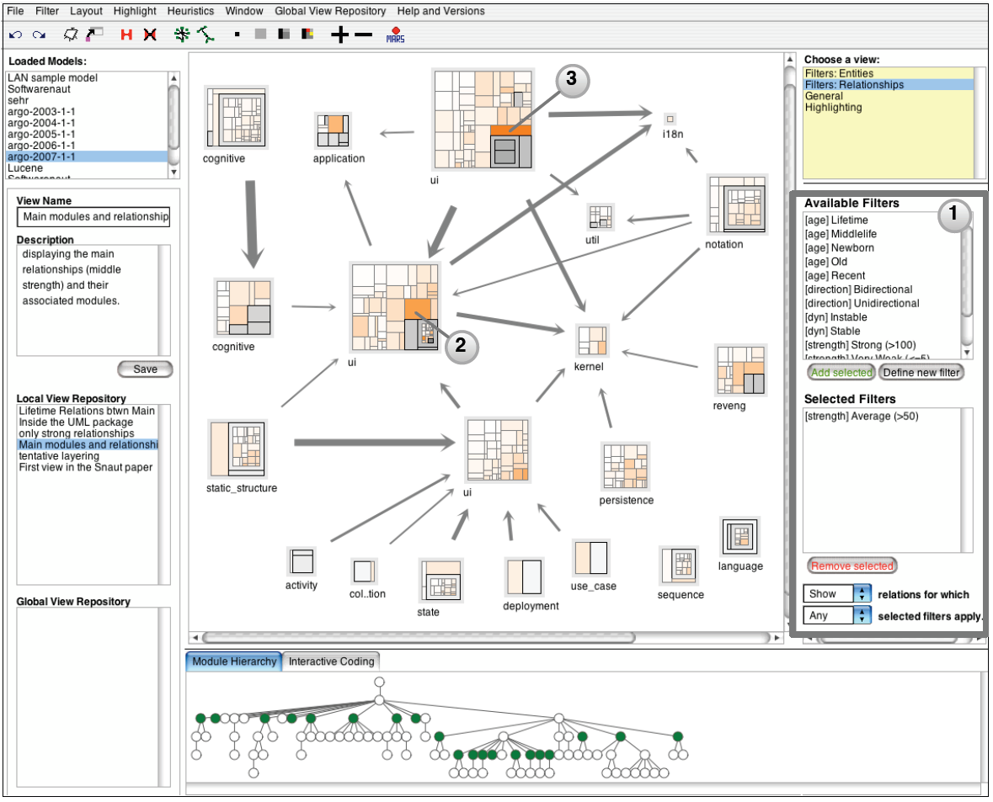
SoftwareNaut
Mircea Lungu, Michele Lanza, and Oscar Nierstrasz. Evolutionary and Collaborative Software Architecture Recovery with Softwarenaut. In Science of Computer Programming (SCP), 2012. DOI

Slide 40
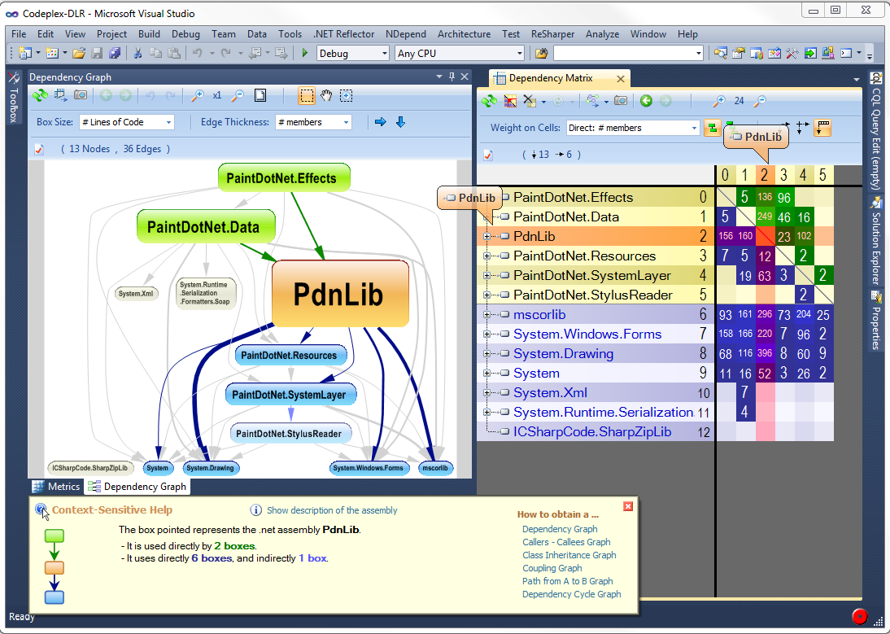
NDepend

Slide 41
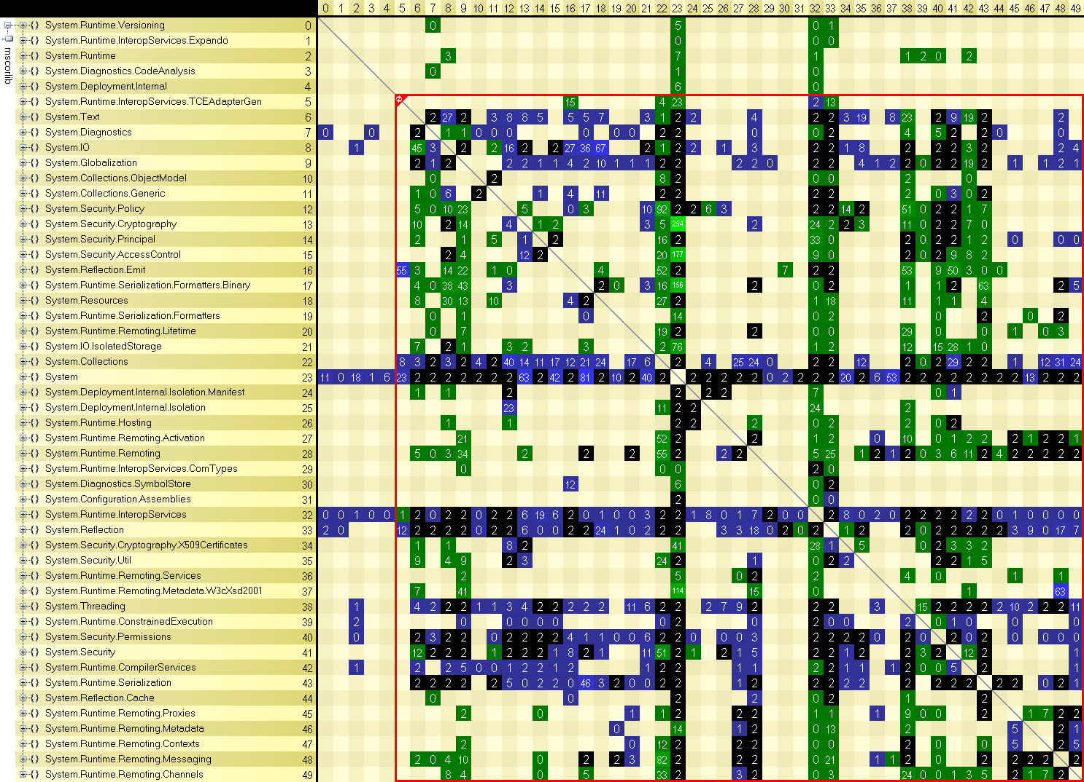
NDepend

Slide 42
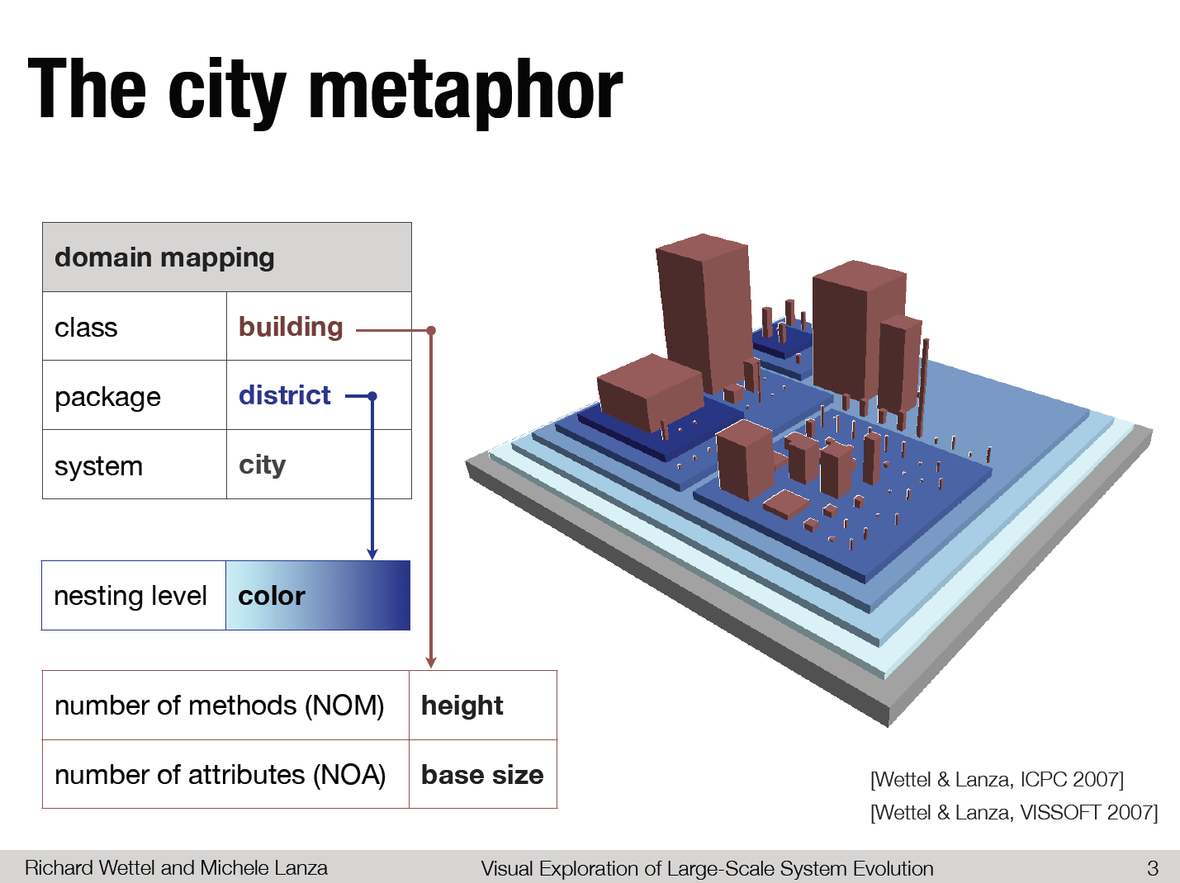

Slide 43
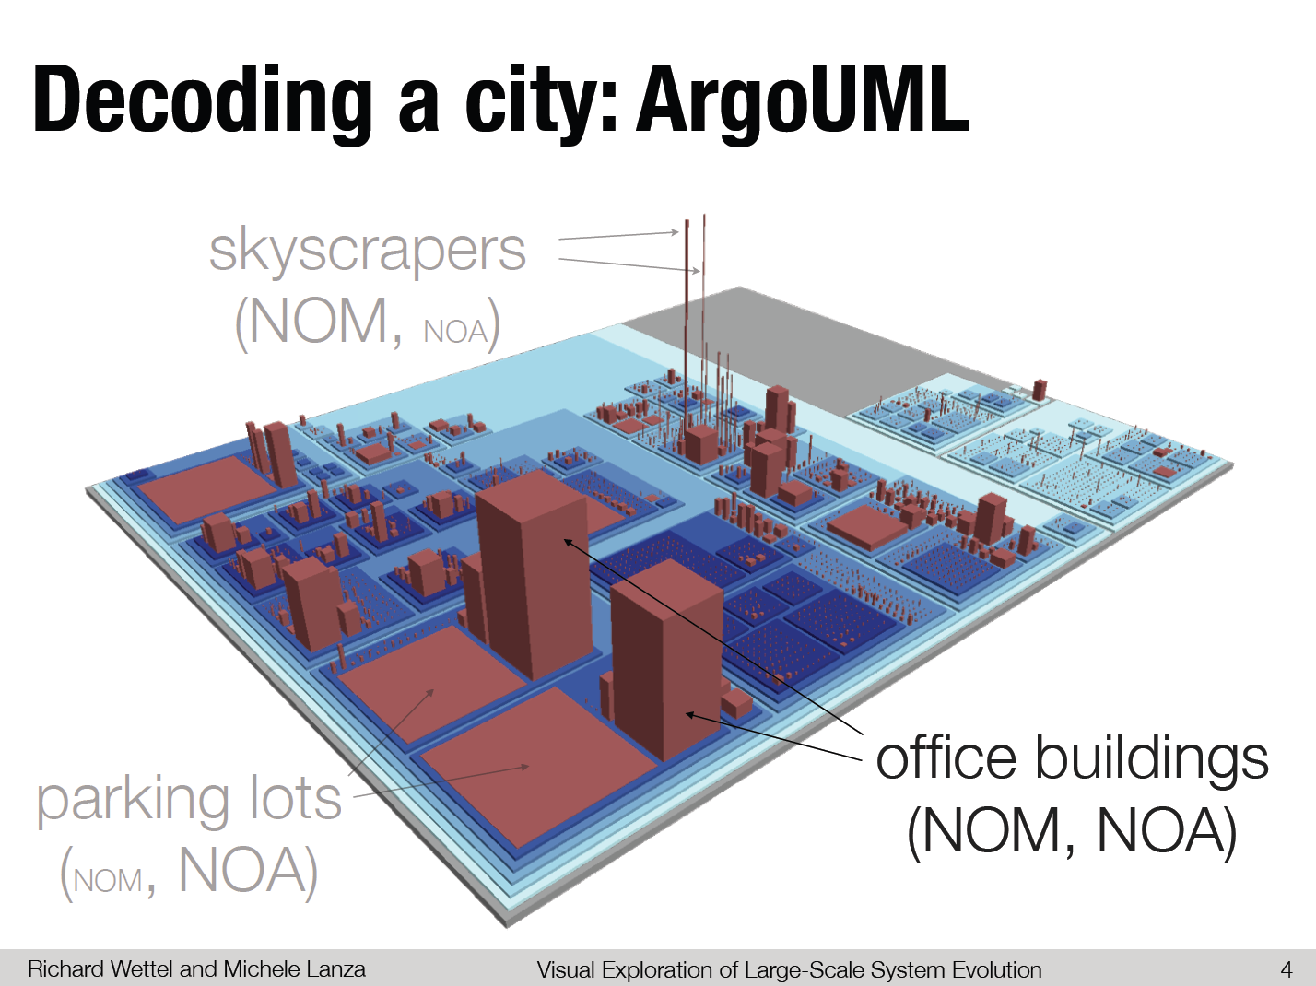

Slide 44
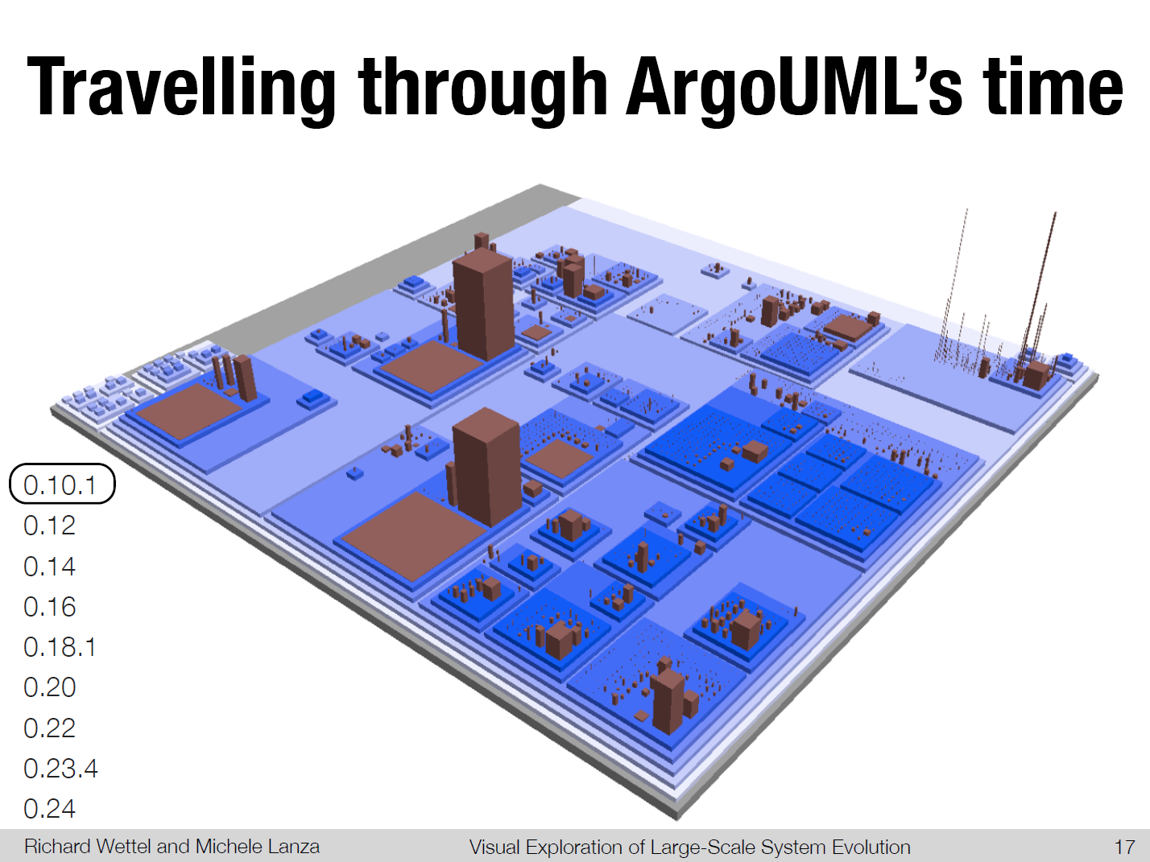

Slide 45
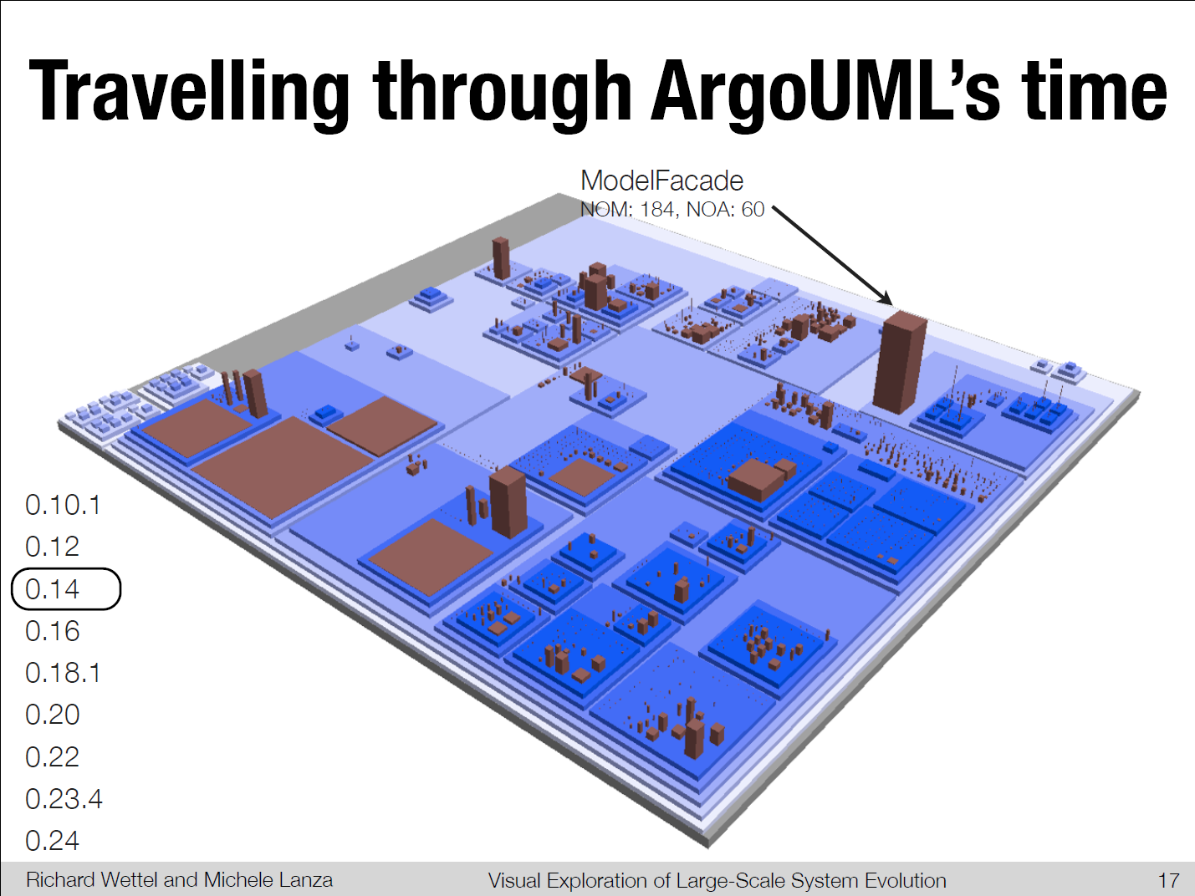

Slide 48
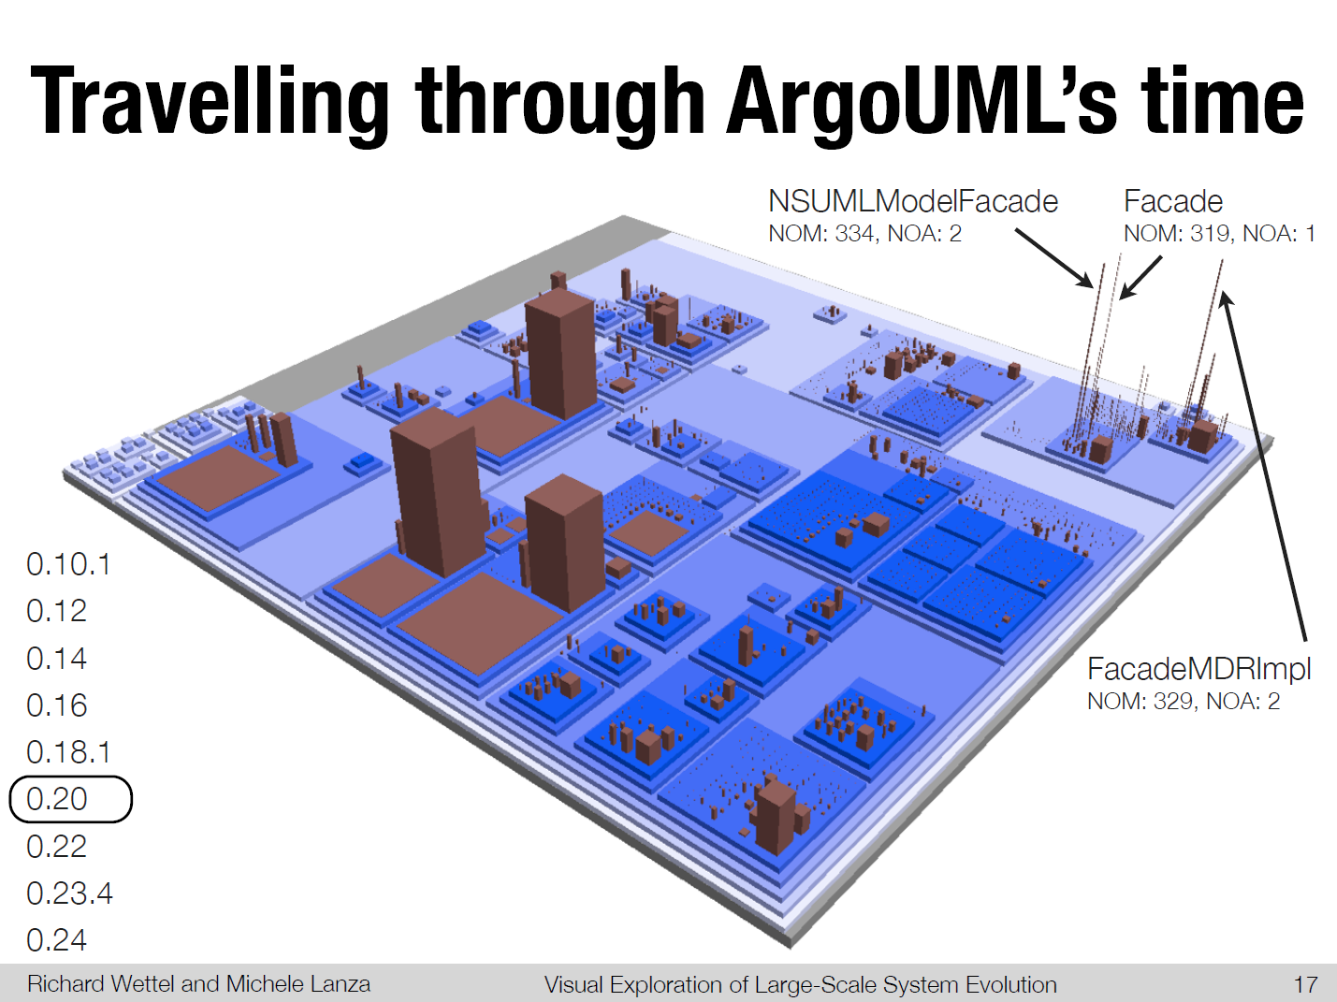

Slide 49
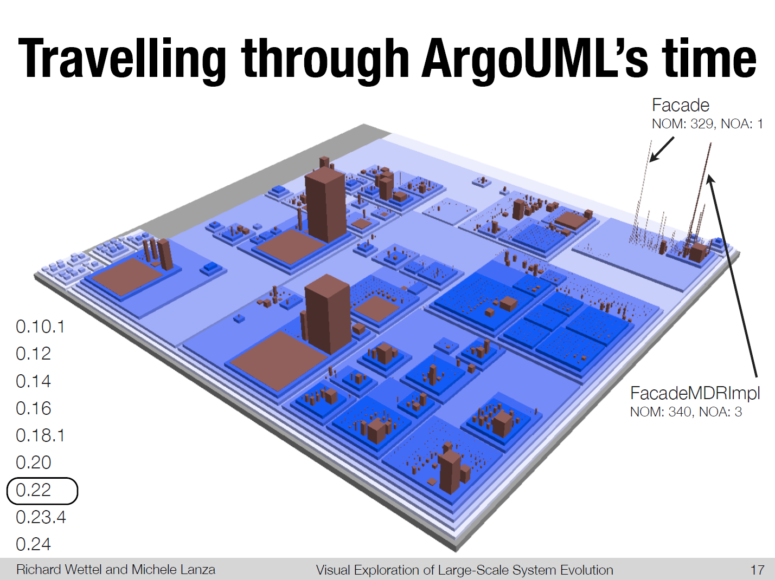

Slide 50


Slide 51
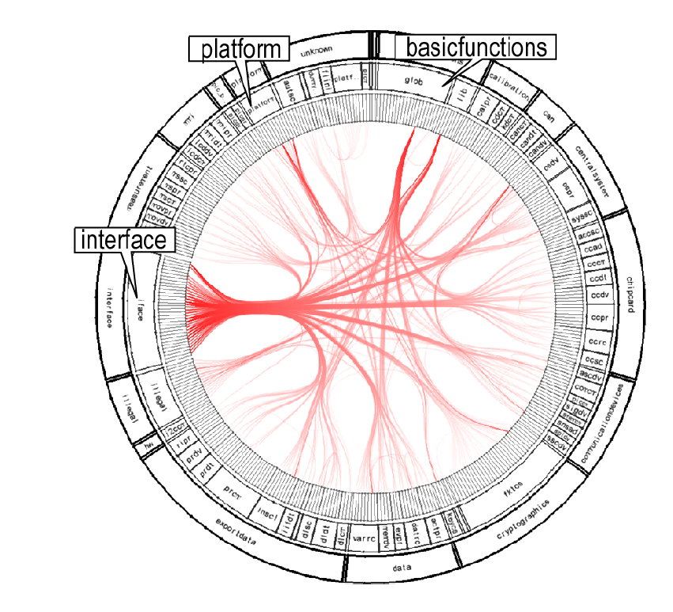
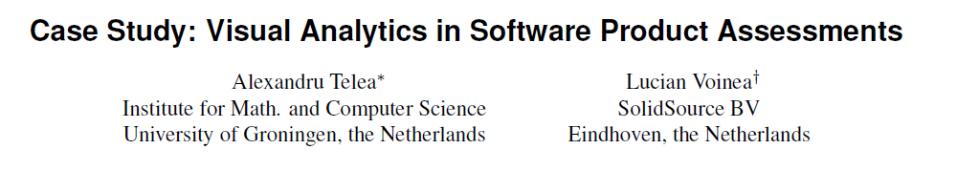

Slide 52
Advanced Documentation Generation
DocGen
  Provide technical documentation
  Used for all ABN AMRO Cobol sources
  Customizable product line
TypeExplorer
  Include inferred types as navigation structure
  Advance level of abstraction

Slide 53
Tool Sets
Extract
Query
Abstract
Present
Visualize
Browse
Search
Rigi (Victoria)
Bauhaus (Stuttgart)
Dali (SEI)
Portable Bookshelf (Toronto)
DocGen (Amsterdam)

Slide 54

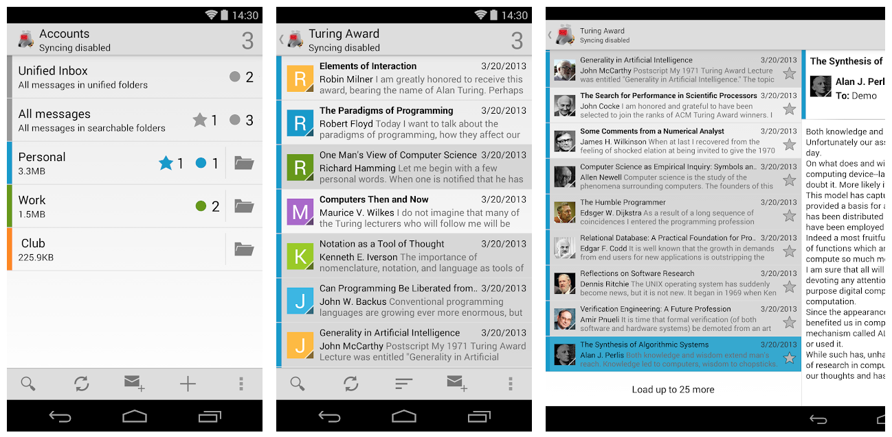
K-9 email
Android open source
10 million downloads from Google Play Store
210 contributors
https://github.com/k9mail/k-9

Slide 55
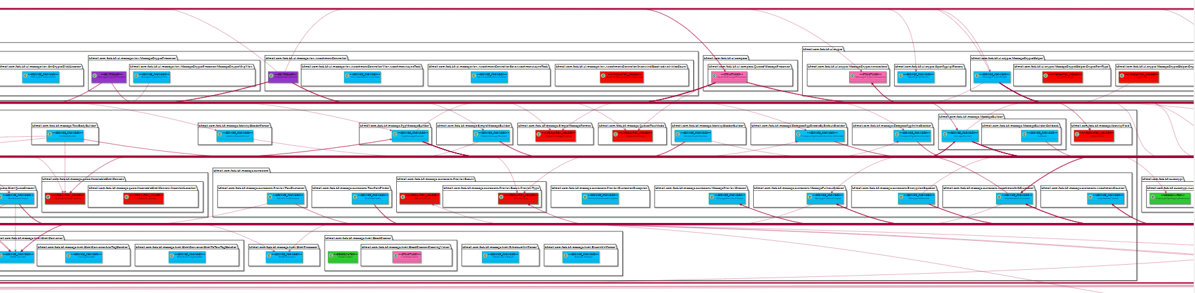
A Fragment of the 800 classes of K9
Automated layouting requires better algorithms

Slide 56
All packages
K9mail-library
k9mail
mail
mail.filter
mail.oauth
mail.store
k9
autocrypt
mailstore
mail.helper
mail.power
account
cache
mailstore.migrations
mail.internet
mail.ssl
activity
controller
mailstore.util
mail.message
mail.store
(imap, pop2, webdav)
acitivity.compose
crypto
message
acitivity.loader
fragment
message.extractors
acitivity.misc
helper
message.html
acitivity.setup
helper.jsoup
message.quote
message.signature
ui
service
notification
ui.compose
setup
power
ui.crypto
search
preferences
ui.dialog
view
provider
ui.message
widget.list
remotecontrol
ui.messageview
search

Slide 57
Presentation Layer (1.)
Service Layer (2.)
Cross-cutting (5.)
user-interface (1.1.)
user-interface-logic (1.2.)
content provider (2.1.)
intent provider (2.2.)
layout (.xml files, .kt)
activity.*
ui.*
notification
provider.*
(Attachment, DecryptedFile, Account)
com.fsck.k9.intent.action.*
fragment.*
view
widget.list
com.fsck.k9.intent.extra
Business layer (3.)
Business Façade (3.1.)
controller.MessagingController
uses
controller.MessagingControllerCommand
Business Workflow (3.2.)
Business Entity Components (3.4.)
Scheduling (3.2.1.)
mail
mailstore
preferences
AlarmManager API
service.*
message.*
account
crypto
helper
cache
autocrypt
Talk with mail-providers (3.2.2.)
MIME encoder | decoder (3.2.3.)
Other (3.2.4.)
Business Components (3.3.)
mail.transport
mail.internet
search
mail.ssl
mail.power
mail.message
mail.store
(imap, pop2, webdav)
mail.helper
mailstore.migrations
mailstore.migrations
mail.oauth
mail_providers
mail.filter
power
(IdleManager)
k9
Data Access Layer (4.)
mailstore.util
mailstore
SQLiteDB

Slide 58
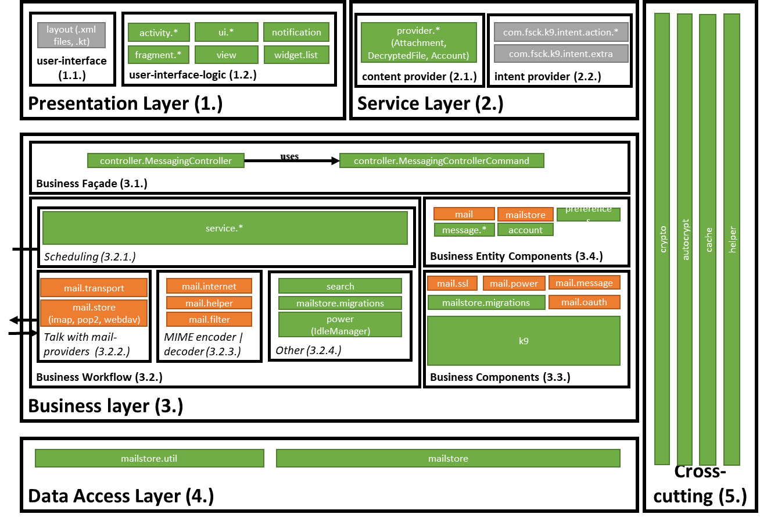

Slide 59
K9 from:

Slide 60
Functional
Dimension
Layer 1
Layer 2
Layer 3
Implementation
Dimension

Slide 61
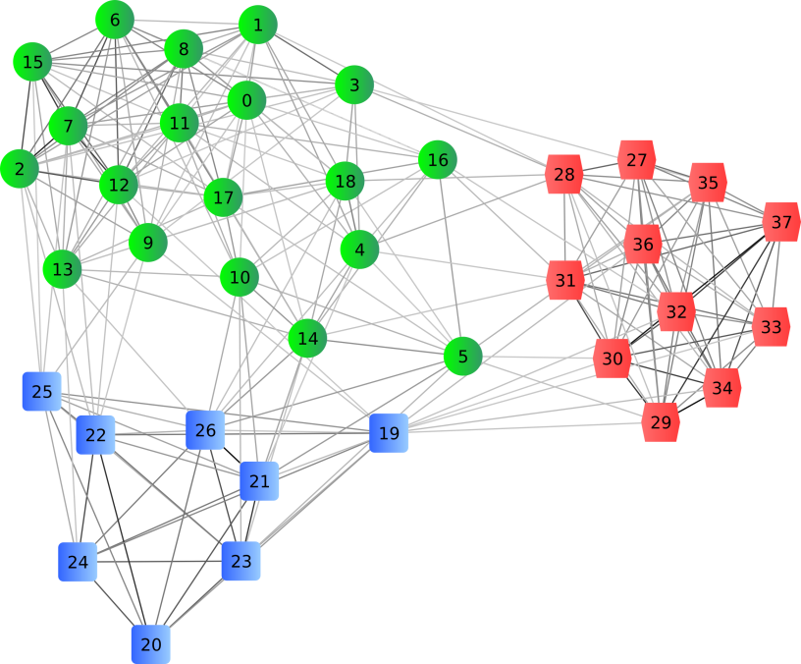
How about more abstraction?
Clustering

Slide 62
Economy of Modeling
% of system covered by model
Size of the system

Slide 63
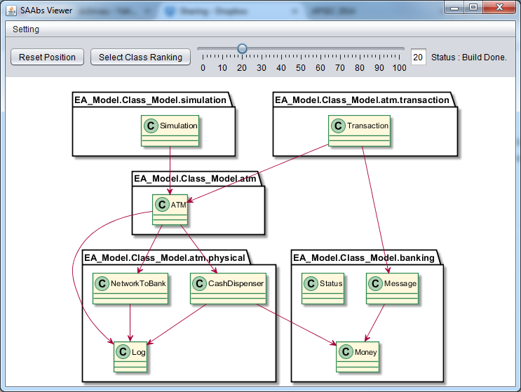
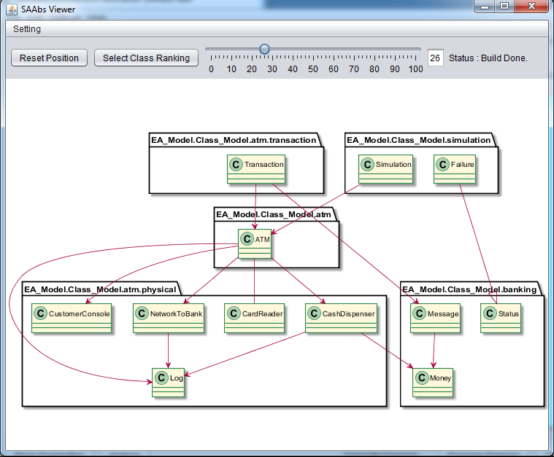
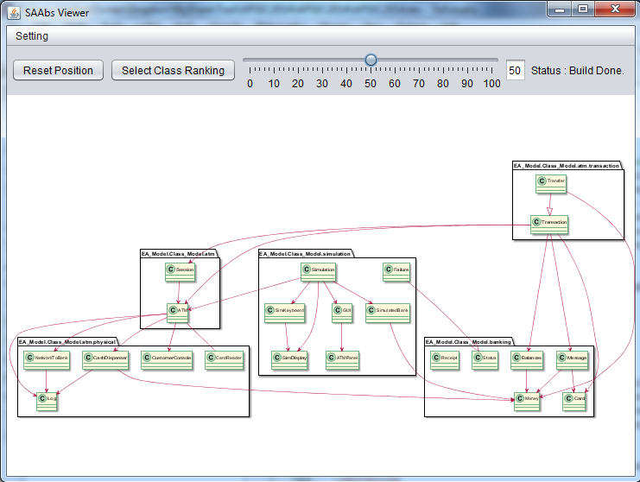
Scaling Abstraction
20%
30%
50%
Which criteria to use for abstraction?
What is the relation between design and code?
Different tasks require different parts/slices/views

Slide 64
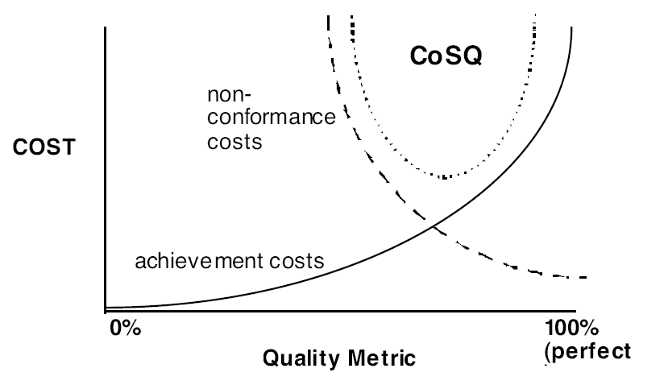
Economic Model for Cost of Quality
Imagine this is ‘cost of modeling’
From: H. Krasner, Cost of Quality, 1998
Cost of SQ = Achievement Cost + Non-conformance Cost

Slide 65
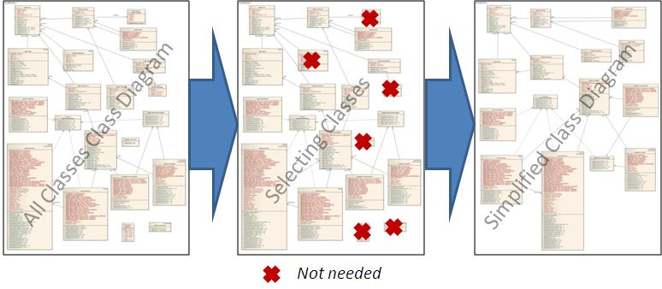
Class Diagram Simplification
Hafeez Osman
This research aims at simplifying class diagrams
Considering: - structural properties (coupling, size)
- semantic properties:
‘support’ vs ‘core functionality’
GUI / frameworks / gets&sets vs cruise control
- feature based

Slide 66
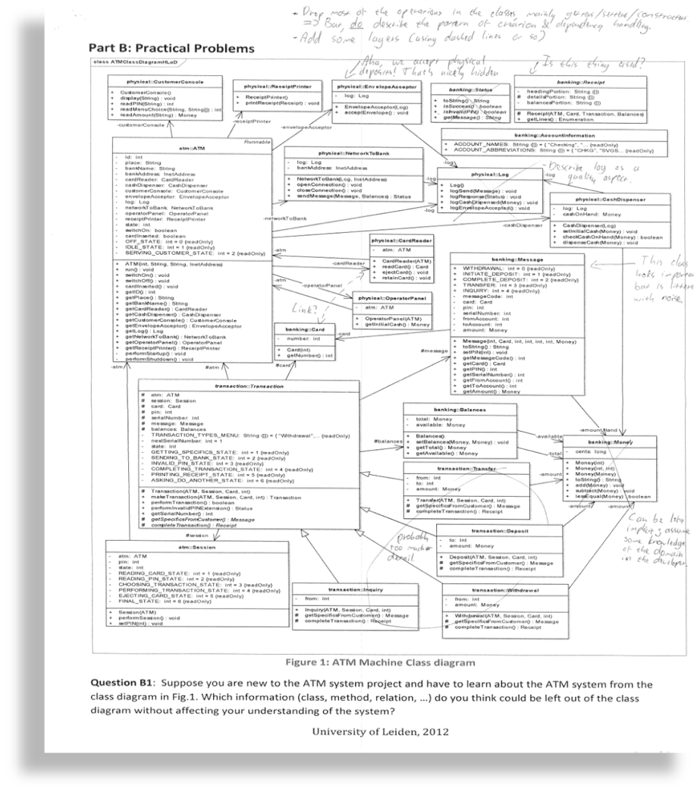

Slide 67
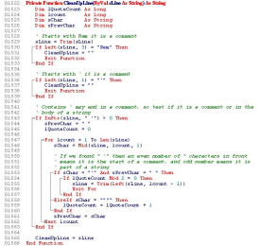

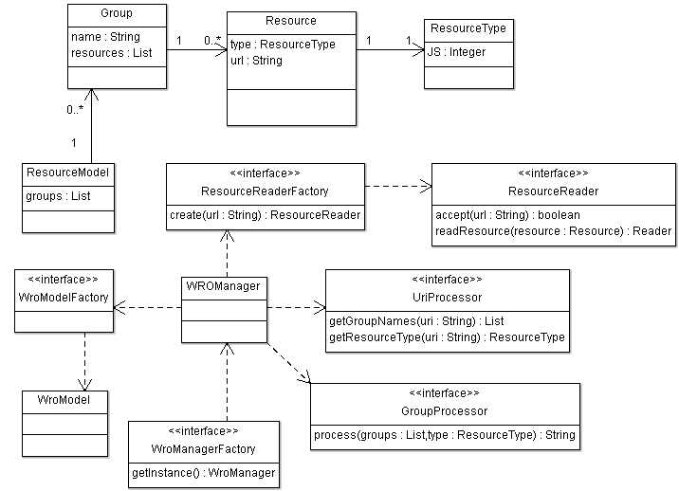
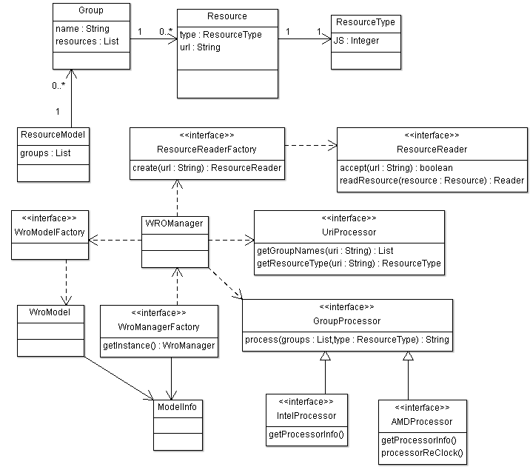
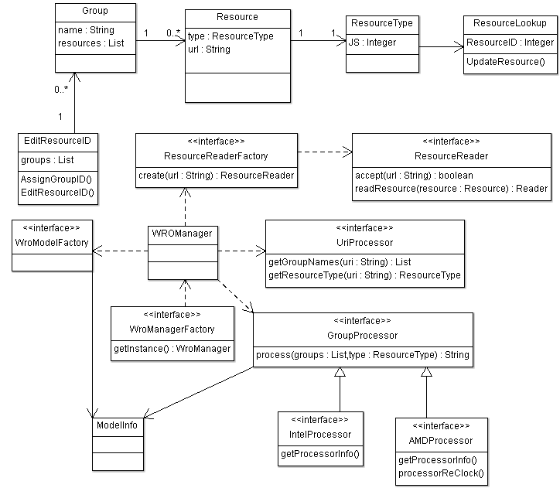
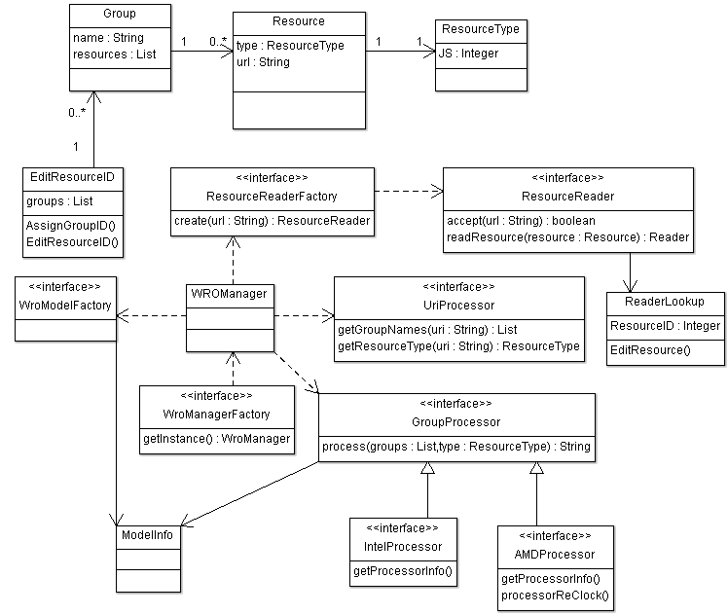
Automated Updating of Class Models
time
change δ
change δ’
change δ’’
source code
learn design
abstraction: α
update with
abstraction of change: α(δ)
α(δ’)
α(δ’’)
UML design model
A change δ can be an addition, modification, removal.

Slide 69

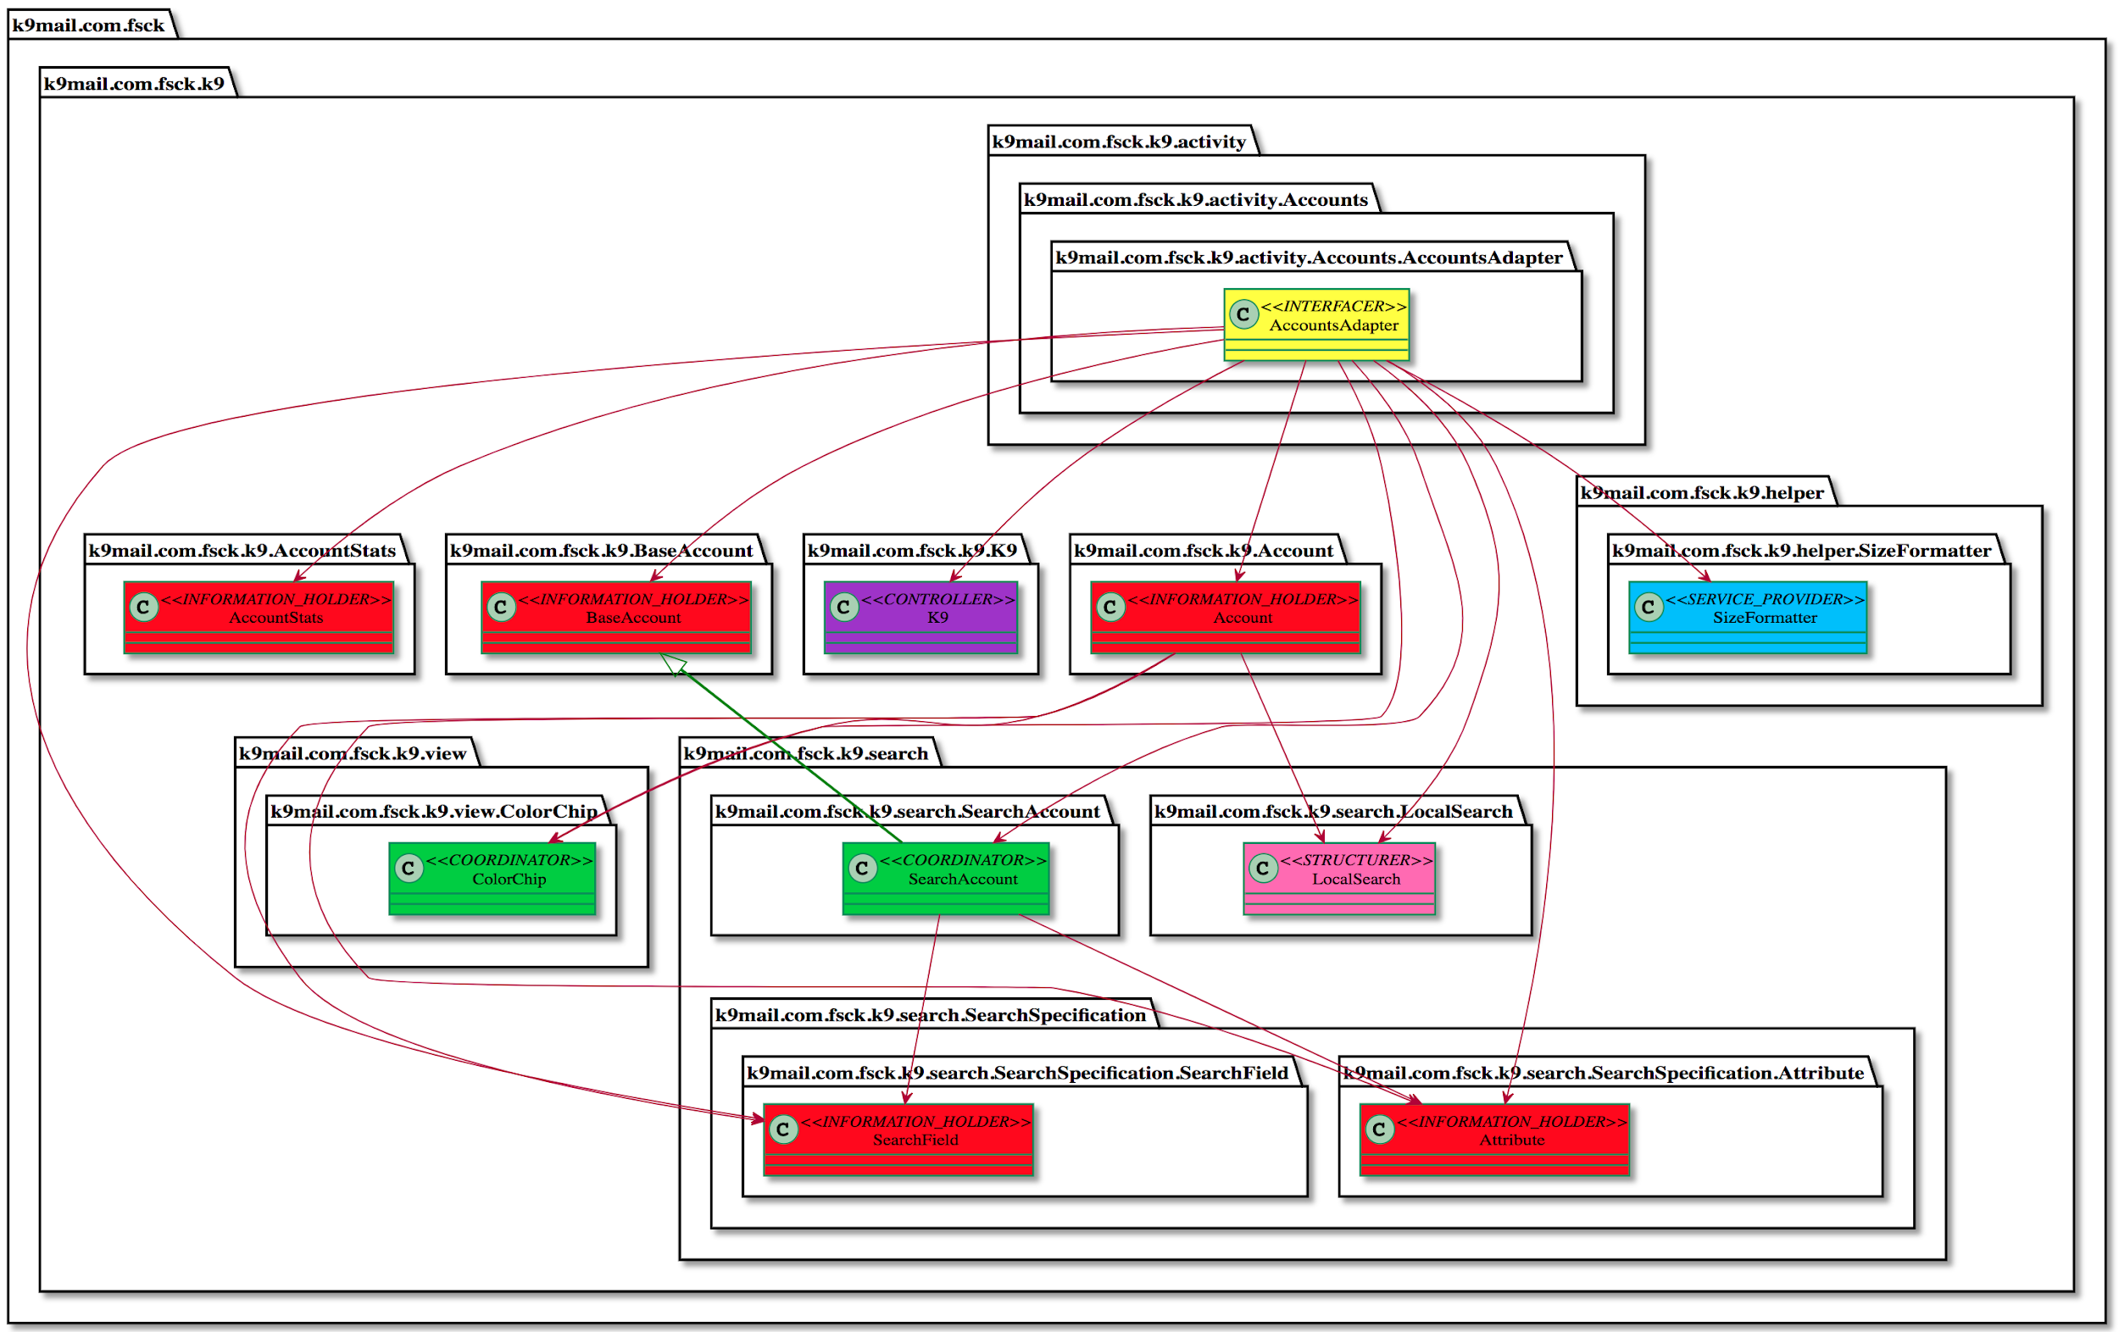
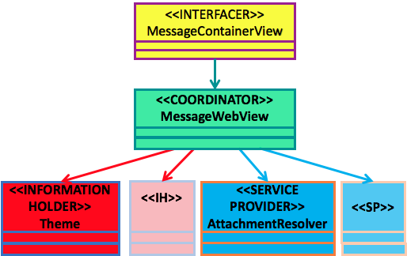
Collaboration Pattern between Stereotypes
Through labelling of roles, we find recurring patterns in the design
These patterns represent typical collaborations between responsibility-stereotypes

Slide 70
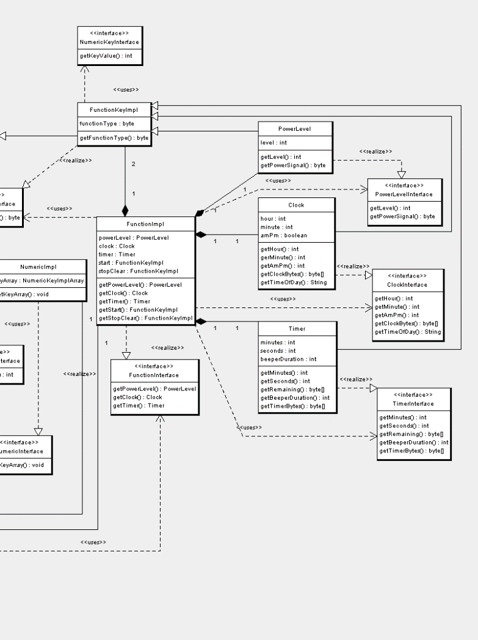
Common graph-patterns in Software Designs
Through labelling of roles, we find recurring patterns in the design
Interfacer
Coordinator
Service Provider
Service Provider
Service Provider
These patterns represent typical collaborations between role-stereotypes.
These patterns can be used for e.g.
checking designs (allowed dependencies; metric thresholds)
synthesizing a design
generating visualizations
design summarization

Slide 71
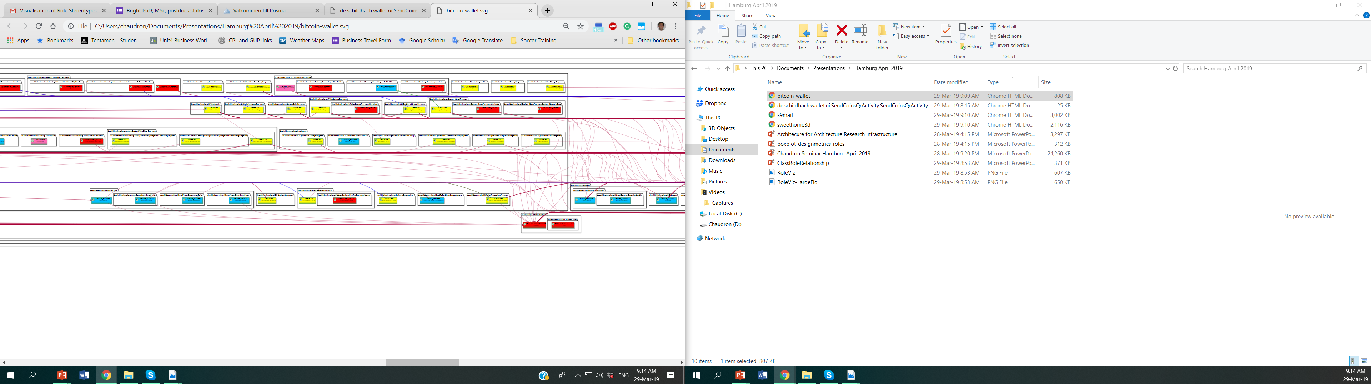
Role-stereotypes in software design
Interfacer
Controller
Coordinator
Service Provider
Information Holder
Structurer

Slide 72
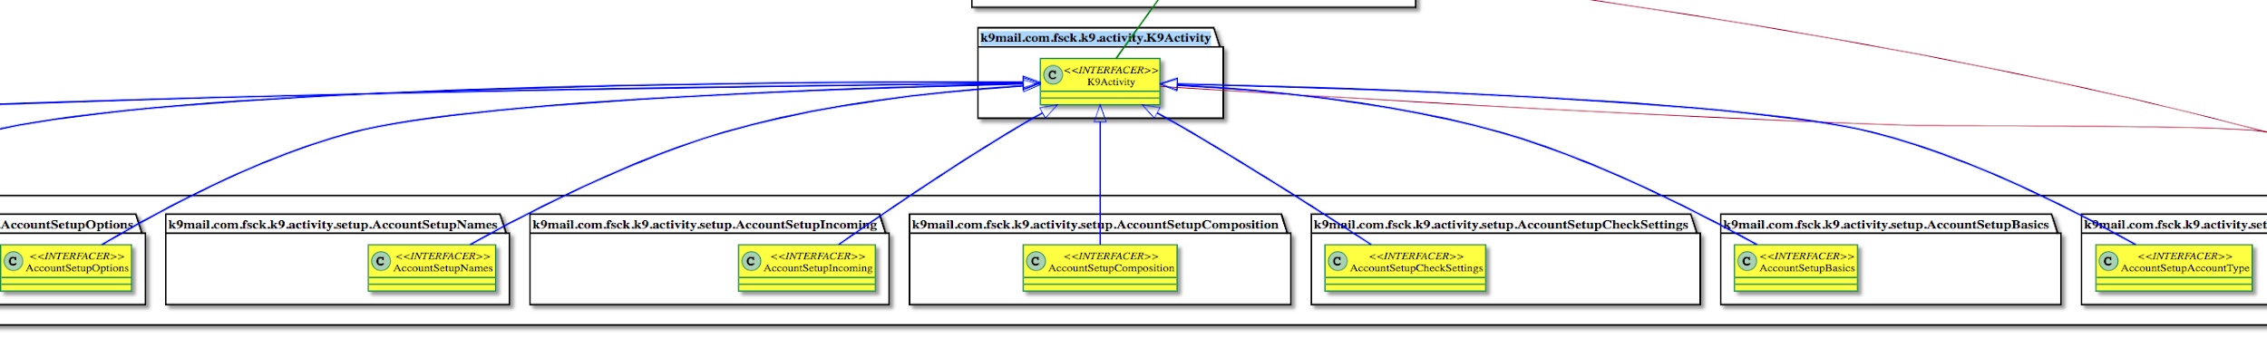
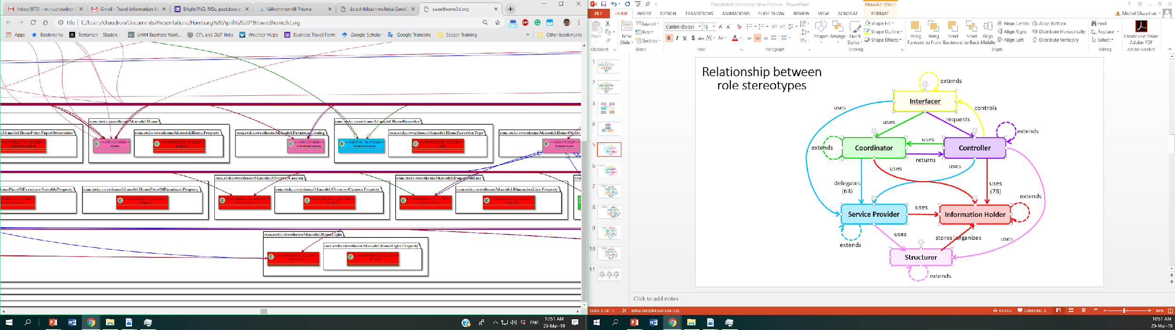
Collaboration Patterns between Stereotypes
This shows expansion of roles
Interfacer
Controller
Coordinator
Service Provider
Information Holder
Structurer

Slide 73
Checking Design-Code Correspondence using Relational Algebra

Slide 74
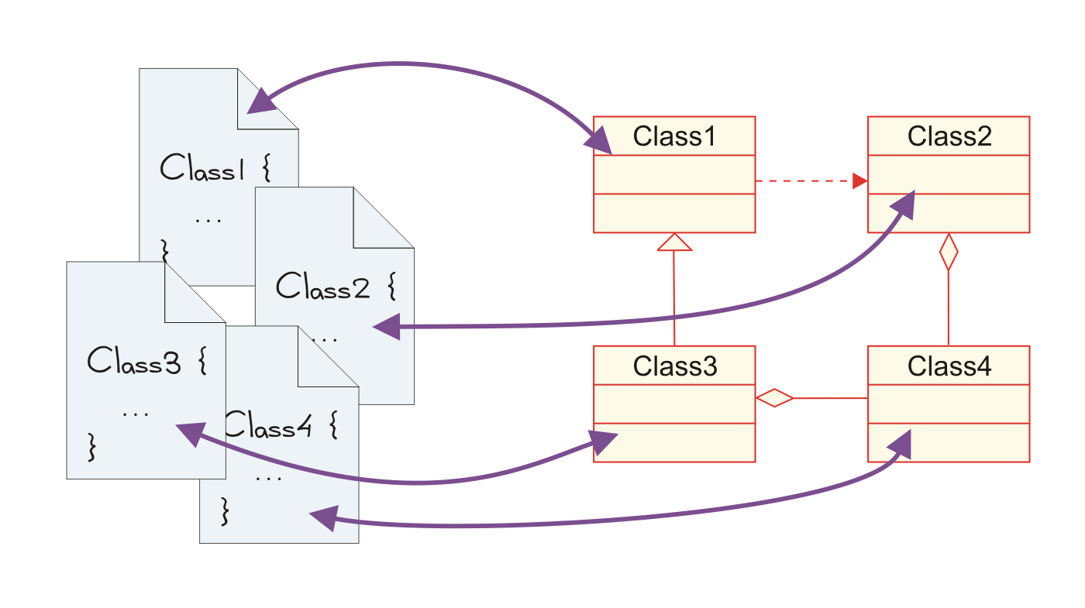
Managing Design – Code Correspondence

Slide 75
Application domain
SOPHO
CPC
SAS
POMCL
CPS
POM
GOS
LOS
SD
“Intended” module architecture
(documentation + software architects)

Slide 76
Application domain
SOPHO
CPC
SAS
POMCL
CPS
POM
GOS
LOS
SD
“Actual” module architecture
(extracted from the implementation)

Slide 77
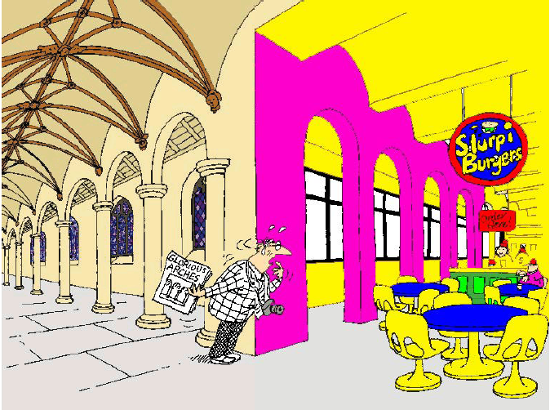
Conceptual Integrity

Slide 78
Conformance
S
S
H
H
I
I
A
A
D
D
Intended
Extracted
Causes when “intended” and “extracted” differ:
“intended” is wrong (e.g. out-of-date): improve;
“extracted” is wrong: improve;
implementation is optimized for, e.g., speed ⇒ refinement.

Slide 79
Application domain
Ensure conformance to an architecture !
  Keep the architecture up-to-date
Approach using relation algebra (RPA):
  Represent the “intended” architecture in RPA.
  Extract the “derived” architecture from the implementation, and represent in RPA.
  Express “conformance” in RPA.
  Ensure conformance by means of verification (using RPA) and improvements (i.e. control).

Slide 80
System Representation
System S is balanced, and
the decomposition tree has 3 levels

Slide 81
Relation Algebra: Example
Set of Entities E:
E = { S, A, A₁, A₂, A₃, B, B₁, B₂}

Slide 82
Relation Algebra: Example
Part-of relation P:
P = { <B, S>, <A, S>,
, <B₁, B>, <B₂, B>
, <A₁, A>, <A₂, A>,
<A₃, A> }
A part-of relation:
describes the decomposition tree;
is both: functional and a-cyclic.

Slide 83
Example: Overview of Operations on Relations
  A⁻¹ = {<y,x> ⏐<x,y> ∈ A }
  A – B = {<x,y> ⏐<x,y> ∈ A and <x,y> ∉ B }
  A ∪ B = {<x,y> ⏐ <x,y> ∈ A or <x,y> ∈ B }
  A ∩ B = {<x,y> ⏐<x,y> ∈ A and <x,y> ∈ B }
  A;B = {<x,z> ⏐ <x,y> ∈ A and <y,z> ∈ B }
  A⁺ = _{n=1} R^{n}, where R^{n} = R;R^{n-1} for n >=2
  A* = A⁺ ∪ I
  A ∅ B = {<x,y> ⏐ <x,v> ∈ A and <y,v> ∈ B }
  A ↑ B = B⁻¹ ; A ; B (lifting)
  A ↓ B = B ; A ; B⁻¹ (lowering)

Slide 84
Operators in Relational Algebra
Union I + E = {(a,b), (b,y)}
Intersection E ^ C = {(b,y)}
Difference C - E = {(r,a), (r,b), (a,v), (a,w), (a,x), (b,z)}
Inverse inv E = {(y,b)}
Composition I o E = {(a,y)}
Identity id = {(r,r), (a, a), (b,b), (w,w) … }
Transitive Cl. C+ = {(r,a), (r, b), (r,v), (r,w), (r,x), (r,y),
(r,z), (a,v), (a,w), (a,x), (b,y), (b,z)}
Reflex. T.C. C* = ID + C+

Slide 85
Example Typed Graph
r
r
C
C
a
I
b
a
b
I
z
w
E
U
U
C
C
C
E
C
C
v
x
y
v
w
x
y
z
U
U
    C = { (r,a), (r,b), (a,v), (a,w) (a,x), (b,y), (b,z) }
    I = { (a,b) }
    E = { (b,y) }
    U = { (v,w), (x,y) }

Slide 86
Lifting (2)
→

Slide 87
Hiding
→
Hiding the decomposition structure of both A and B

Slide 88
Example: “Class diagram – MSC”
Board
GameManager
GameManager :
Manager
HumanPlayer :
Player1
ComputerPlayer :
Player2
Display :
display
Player
Display
HumanPlayer
ComputerPlayer
There is no dependency between HumanPlayer and Display in the class diagram

Slide 89
Example: “Class diagram - MSC”
Class Diagram in RPA:
  CLASS = {GameManager, Board, Player, HumanPlayer, ComputerPlayer, Display}
  METHOD = {GameManager.play, GameManager.stop,
  Player.setToken, HumanPlayer.getNextMove,
  HumanPlayer.setToken, ComputerPlayer.getNextMove,
  ComputerPlayer.setToken, Display.printLn,
  Display.printBoard}
  IMPLEMENTS = {<GameManager.play,GameManager>,
  …. }
  INHERITANCE = {<HumanPlayer,Player>,<ComputerPlayer,Player>}
  DEPENDENCY = {<GameManager,Player>, <GameManager,Display>}
  AGGREGATION = {<GameManager,Board>}

Slide 90
Example: “Class diagram - MSC”
MSC in RPA:
  OBJECT = {Manager, Player1, Player2, display}
  TYPE = {<Manager, GameManager>, <Player1,HumanPlayer>, <Player2,ComputerPlayer>,<display,Display>}
  CALL = {c₁,c₂,c₃,c₄c₅}
  NEXT = {<c₁,c₂>,<c₂,c₃>,<c₃,c₄>,<c₄,c₅>}
  CALLER = {<Manager,c₁>,<Player1,c₂>,<Manager,c₃>,
  <Manager,c₄>,<Manager,c₅>}
  CALLEE = {<Player1,c₁>,<display,c₂>,<display,c₃>
  <Player2,c₄>,<display,c₅>}
  MESSAGE = {<HumanPlayer.getNextMove,c₁>, <Display.printLn,c₂>,
  <Display.printBoard,c₃>, <ComputerPlayer.getNextMove,c₄>,
  <Display.printBoard,c₅>}

Slide 91
Example: “Class diagram - MSC”
Board
GameManager
GameManager :
Manager
HumanPlayer :
Player1
ComputerPlayer :
Player2
Display :
display
Player
Display
HumanPlayer
ComputerPlayer
!
Rule
  (CALLER ® CALLEE) " TYPE µ (DEPENDENCY ↓ INHERITANCE*)

Slide 92
Uses of Relational Languages
Enforce architecture rules. Holt 96, Feijs 98, Knodel 08
Lift dependency edges. Holt 98, Feijs 1998
Find design pattern instances. Consens 98, Beyer 02
Find violations of patterns. Guo 99
Find anti-patterns. vanEmden 02, Feijs 98
Change impact analysis. Feijs 98
Specify extraction from syntax. Lin 08
Find source of dependency. Fahmy 01, Feijs 98
Locate uses of protocols. Wu 01
Type inference using transitive closure. vanDeursen 99

Slide 93
Time for Reflection
What are the strengths and weaknesses of the Relational Algebra Approach towards checking conformance between Architecture and Implementation?

Slide 94
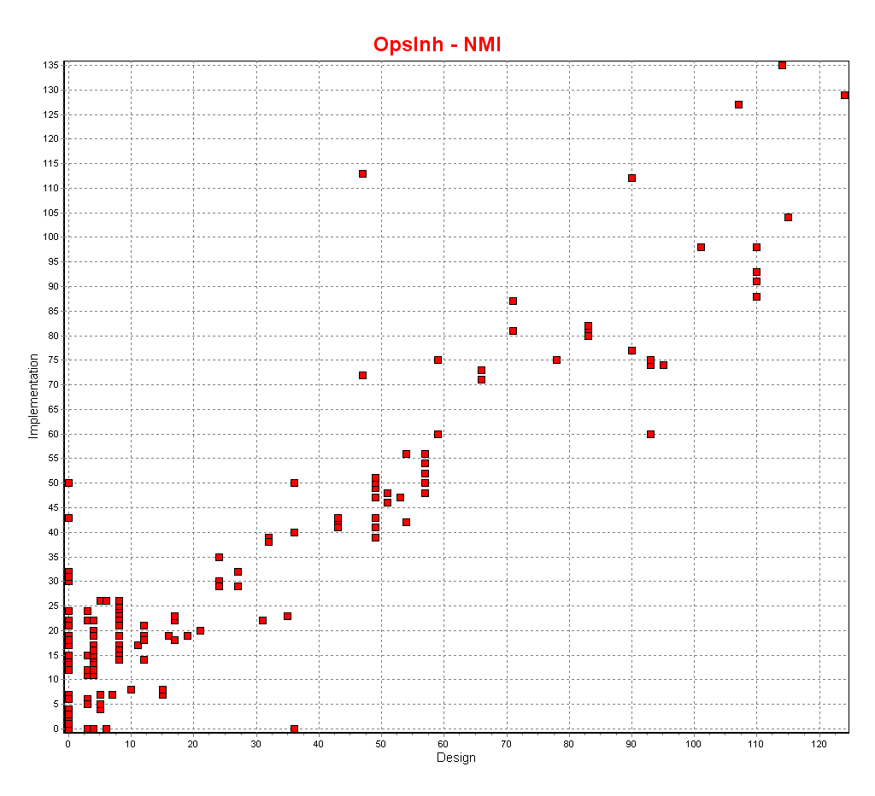
Checking Correspondence through metrics
Horizontal axis:
metric from design
Vertical axis:
metric from code
Dots:
( metric(class in design),
metric(class in code) )
Here: Number of Methods Inherited
Implementation
Design

Slide 95
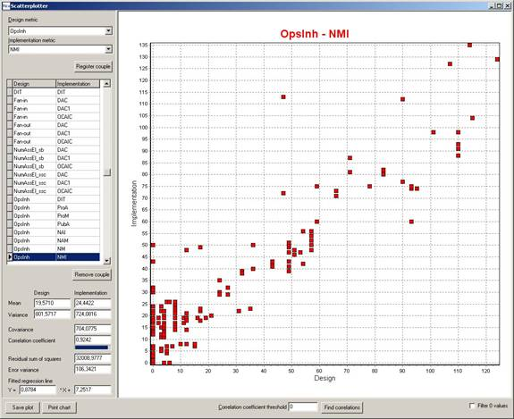
Tool for Correspondence Checking
X-Axis
  Metrics of Design
Y-Axis
  Metrics of Implementation
Points represent Classes
Points off the diagonal indicate (critical) outliers
Outlier

Slide 96
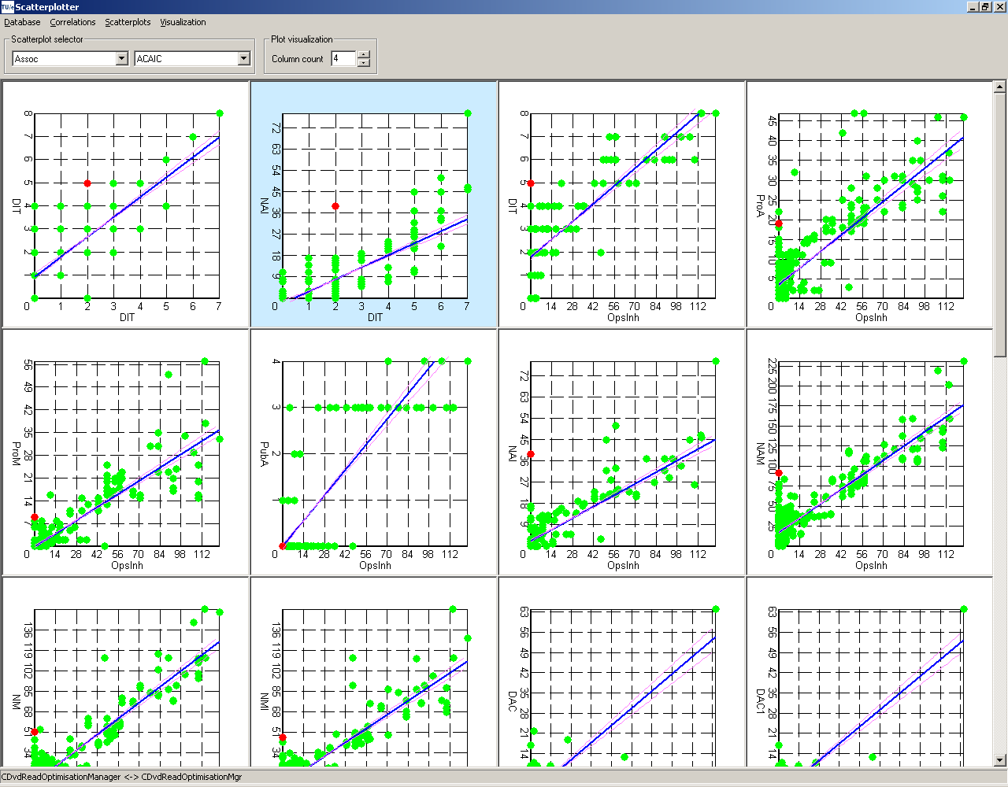
The scatter plotter (screenshot)

Slide 97
Akerman & Tyree
Architecture decisions are the primary representation of architecture
Architecture results from effective decision making, not from architectural view construction*
Architecting is primarily concerned with:
- architecture assets
- the business-driven decisions that transform these assets
- the roadmap that implements these decisions
*J. Tyree and A. Akerman, "Architecture Decisions: Demystifying Architecture," IEEE Software, vol. 22, pp. 19-27, March. 2005

Slide 98
Akerman & Tyree:
Problems with current architecture development & descriptions methods
Lack of Focus on What’s Important
Lack of Precision and Clarity
Lack of Repository Support
Lack of Support for Impact Analysis
(Decisions to Concerns, Decisions to Decisions, and Decisions to Architecture Assets)
Difficulty in Linking with the Views
Lack of Support for Temporal Mapping

Slide 99
Akerman & Tyree: Solution
Architecture meta-model
Focus on “information about architecture that an organization cares about” instead of diagrams and views. Architecture is captured as an ontology.
Tool support to enable effective decision making and “on-demand” view creation

Slide 100
Beyond structure views
How about a views for?
security
safety
- performance?

Slide 101
Beyond Views
How about recovery of
  Design principles
  Design rationale

Slide 102
Architecture Meta-Model (Details)
Concerns
Decisions
Roadmap
Assets
Notes:
background/problem slide - ideally give examples of current LACK of integration and consistency

Slide 103
Problems with
Engineering Documentation
Difficult to:
find information
due to: - large size & complexity
- scattering of information
Keep (check) ‘up-to-date’
To cater for multiple audiences
tasks, experience, ….
www.webshop.com
How can a developer get the latest information he needs for his current task?
Notes:
Adding product-families and versioning makes this problem even more difficult

Slide 104




Engineering Information Sources
Documented
Undocumented
Req’s
Design
Code
Tests
text
models
code
bugs

Slide 105





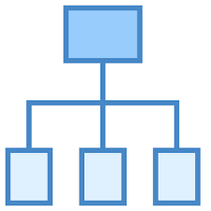



Documented
Tailor to User, Task & Project
Req’s
Design
Code
Tests
NLP
Knowledge
Base
Machine Learning
text
models
code
bugs
Internet / External Datasources
StackOverflow
GitHub
Wikipedia
…
…

Slide 106
Documentation Process & Actors
Project manager
Plan
Progress report
Go-live report
Project Initiation Document
Financial report
Final report
Impact & feasibility study
Risk log
Environmental test report
Service manual document
Use cases
Requirements
Deployed app
Functional document
Instructions for development
Technical design
Change of code
Test classes
+
Test strategy
Automated/manual tests
IT Global Design
(
(
Change of documentation
Use story
Design story
Business stakeholder
Analyst
Information analyst
Architect
Technical lead
Developer
Test lead
Tester
Deployer
Notes:
Diagram from Ana Fernandez’s Ph.D study at airline company

Slide 107





Knowledge Management
tacit
Modelling is part of Knowledge Management
codified
documented
apply
modeled
tasks

Slide 108





Vision: Automated Generation of Views to support your engineering task
Where is this feature implemented?
Which security mechanisms are used?
software
engineer
security
engineer
View Generator
Identify
Extract
Combine
Summarize
Present
StackOverflow
Req’s
Design
Code
Tests

Slide 109



Elements needed for Solution
Problem | Proposed Mechanism(s)
Finding Information | Automating the identification of relevant information
Scattering | Automating the linking of information
Out-of-date | Automating the generation of views on information
Multiple Audiences | Tailoring the presentation to task/role

Slide 110
Summary Reverse Architecting
Rev. Arch. is a labour intensive activity
  Manual (re)discovery of abstractions
  Have a purpose in mind
Rev. Arch. is a step in managing:
  conformance of the implem. to the architecture
  conceptual integrity
Need a method for focussing on what is important

Slide 111

1-slide Summary of Best Architecting Practices
Get stakeholder involvement & feedback early and frequently
Understand the drivers for the project (business, politics)
Understand the requirements incl. quality properties
  SMART & prioritized
Develop iteratively and incrementally
Describe architecture using multiple views
  abstract, but precise, design decisions & rationale
Design for change (modularity, low coupling, information hiding, separation of concerns)
Monitor that architecture is implemented
Simplify, simplify, simplify
Analyze in an early stage (use maths! and scenarios)
Regularly update planning and risk analysis
Get good people, make them happy, set them loose

Slide 112
Questions

Slide 113
Example:
Automated Plagiarism Checking System
University can have subscriptions
University-faculty can make accounts
Faculty can send in documents for checking
  Documents are turned into a standard internal format
  The document is segmented (chapters, section, sentences, …)
  Document is compared on a sentence by sentence basis.
  A plagiarism score is produced
  A report is sent to the person that sent in the document
The system keeps records of use for producing yearly accounting reports
Notes:
Question 4 (2 + 4 + 6 + 6 + 2 = 22 pts) Architectural design
Read the case description below and make and answer the questions below the case description. Motivate for your answers and state your assumptions, and provide explanatory text with your diagrams.
The case study we consider in this question is an automated plagiarism checking tool (APC) for student-assignments. This is a system that teachers of higher level education (universities, polytechnics …) can use to check for plagiarism in the electronic documents that are handed in by students. To this end, universities can have subscriptions to the APC-service. Teaching staff of such universities can then create an account (by registering their e-mail address) with the APC. Teaching staff can use the APC by sending an email with an attachment of a student hand-in to an assignment as attachment. The APC has conversion functionality which it uses to convert a variety of document formats (of the attachments) such as Word (.doc and .docx) as well as open document format (.odf) into pdf-format. The pdf is then ‘segmented’: the segmentation functionality produces a XML-document that contains the main structures of the document (such as title, table of contents, section-header, figure, table, section-text, sentence). Next, the APC system performs an analysis to find out if there are parts of the hand-in that match any parts of any other document that it knows. For this, the APC system has a large repository of previous assignments and published scientific papers and books. This repository is updated automatically with new papers from scientific databases (such as IEEE Explore). For comparing a new hand-in, a reduced version of the XML document of the hand-in is made that only contains significant keywords (thereby omitting non-significant words such as ‘the’ and ‘a’). This step is called ‘pre-processing’. Then, in the actual comparison, each sentence of the reduced hand-in is compared to all sentences of all papers in the repository. Each comparison produces a similarity score. The scores of larger sections of a hand-in are obtained by summing up the scores of the sentences of which it consists. Ultimately, this leads to a plagiarism score for the entire hand-in. The analysis of a hand-in produces a report. This report shows which sentences of the hand-in have a significant ‘plagiarism’-score with which specific documents from the repository. This report is sent by e-mail to the staff member that has submitted the request for analysis. At the end of each month, the APC system sends a management-overview report to the universities that are subscribed. This report describes basis statistics about the number of hand-in’s that have been analysed and from which department and staff-member the hand-in’s were submitted.
Mention 2 architectural drivers for the system (but not cost, schedule or maintainability)
Create a use case diagram for the system that lists the 3 most important use cases for the system
Create a structural view for the architecture of the APC system.
In your structural design, you have to infer which subsystems/components are needed in the system. For each component in your architecture, briefly explain its responsibility (aim for 1 sentence).
Create a behavioural view for the system. This view should describe at least the following:
Send a report in response to the request to analyse a hand-in (model the entire scenario starting from the request).
Send a management overview report
Give one example in your architecture design where you used ‘Information Hiding’. Explain your answer.

Slide 114
Registration
API
Report Generator
Comparator
Account
Registration
Paper Reporter
Scorer Compiler
University Accounting
Comparator
Submission Loader
File Segmenter
File
Upload
API
External
Paper Loader
Paper
Repository
File Converter

Slide 115
Subsystems vs Layering
Functional
Dimension
Report Generator
Comparator
Account
Registration
Paper Reporter
Score-Compilr
Accounting
Comparator
Submission Loader
File Segmenter
Ext. Paper Loader
Paper Repo’
File Converter
Layer 1
Layer 2
Layer 3
Implementation
Dimension

Slide 116


Slide 117


Comparing Reverse and Forward UML
Reverse Engineered Design
Forward Class Design
False Positive
False Negative

Slide 119


How is Level of Detail distributed in a diagram?
Case 1
Case 2
High detail
High detail
Low detail
Low detail
Robin van den Broek B.Sc. Thesis in CS, 2009, Leiden University

Slide 120



What do developers look at anyway?

Slide 121
Example 4+1 Views model
A
B
C
D
A
B
C
D
A
C
D
B

